Slide 1
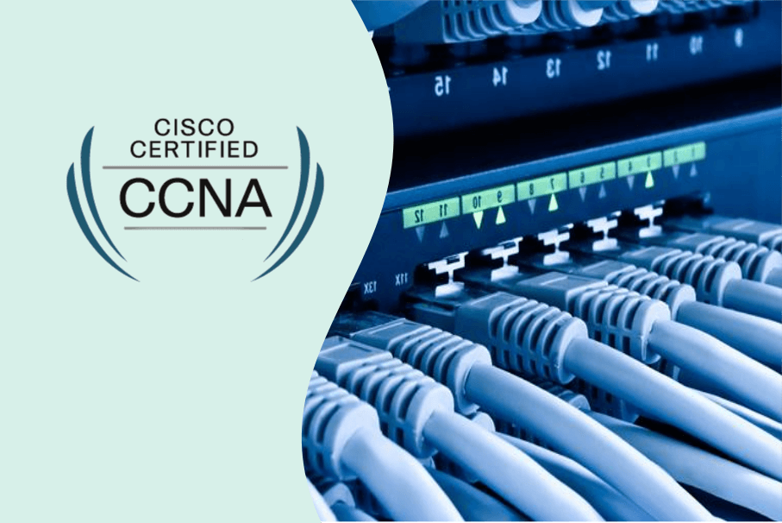

Slide 2
INTRODUCTION (Cisco Certified Network Associate)
Cisco Systems is an American multinational digital communications technology conglomerate corporation headquartered in San Jose, California.
Cisco Systems was founded in December 1984 by Leonard Bosack and Sandy Lerner, two Stanford University computer scientists who had been instrumental in connecting computers at Stanford.

Slide 3
CCNA (Cisco Certified Network Associate)
Exam fees - 300 USD
Languages - English, Japanish
Job offers
Technical Support Engineers
Systems Engineers (Fresher)
Network Administrator
Information Technology (IT) Manager
Senior Network Engineer
Network Security Specialist

Slide 4

What is Network?
Networking refers to interconnected computing devices that can exchange data and share resources with each other.

Slide 5
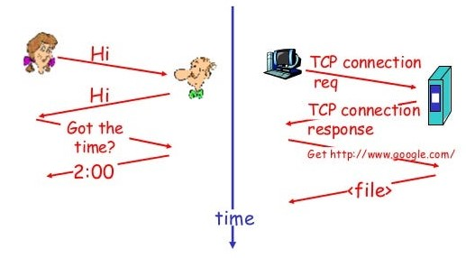
PROTOCOL
A protocol is a standardized set of rules for formatting and processing data. Protocols enable computers to communicate with one another. Eg: HTTP, SMTP, FTP

Slide 6
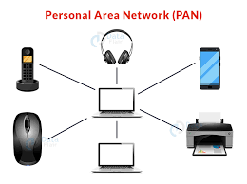
PERSONAL AREA NETWORK
1.PAN connect electronic device within a user
in mediate area=>5 to 10 m
2.Ex:bluetooth ,WiFi ,mouse etc...
3.Range few centimeter to few meter
4.Can be ether wired or wireless
5.Can be connect to LAN or internet

Slide 7
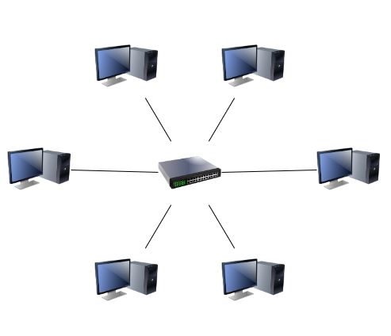
LOCAL AREA NETWORK
1.Within a smaller geographic area
2.Ex:school office ,home wifi network and small buiness
network
3.Home lans offten use a single router ,while lan in larger
space may additionally use network switches for more
efficicently packet delivery.

Slide 8
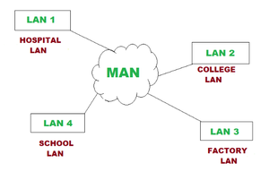
METROPOLITAN AREA NETWORK
1.Man is made up interconnect lans
2.Bigger than lans and smaller than wan
3.Ex:cities,large area with multiple buidings, town

Slide 9
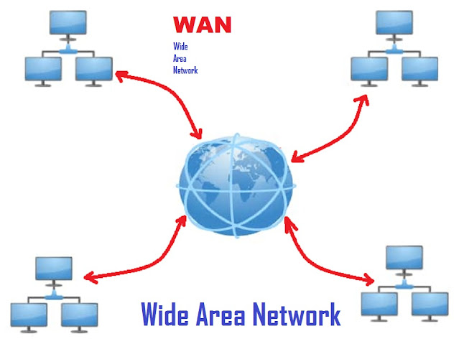
WIDE AREA NETWORK
1.Wan connect lans and man
2.Provide network connectivity over lager distance
3.Can connect devices from mulitple location and across a globle
4.Eg;internet large, business

Slide 10
Network components or devices
Media
HUBS
Bridge
Repeater
Modem
Switch
Router
Firewall and IPS
End points
server

Slide 11
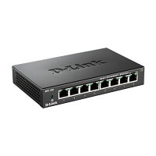
Media:
Network media is refers communication channel used to interconnection nodes on a computer network.
Example: Copper coaxial cable, Twisted pair cable, optical fiber cable used in wired network and radio waves used in wireless data connections networks.
HUBS:
Its most basic networking devices connects multiple computer or other network devices
Less security
No MAC address(physical address-unqiue-12 digit)
Oldest models

Slide 12
HUBS:
Its most basic networking devices connects multiple computer or other network devices
Less security
No MAC address learn(physical address-unqiue-12 digit)
Oldest models
No data Provide
Physical Layer

Slide 13
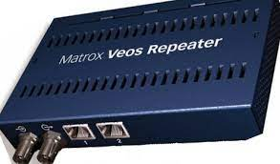
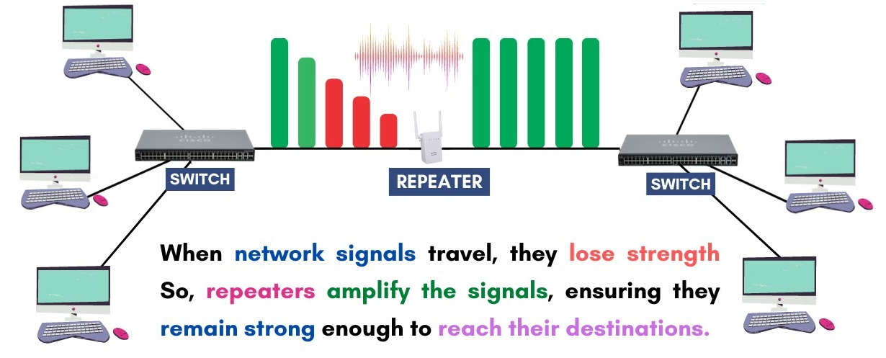
Repeater:
A repeater is a powerful network hardware device that regenerates an incoming signal from the sender before retransmitting it to the receivers

Slide 14
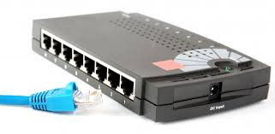
Bridge:
A network bridge is a device that connects two or more Local Area Networks (LANs) or network segments to create a single, larger network
Mostly comes with one in and out port
data link layer (Layer 2)
bridge maintains a Forwarding Table of MAC addresses

Slide 15
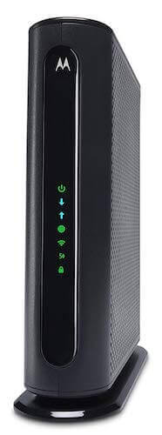
Modem:
A modem is a network device that both modulates and demodulates analog carrier signals (called sine waves) for encoding and decoding digital information for processing.

Slide 16
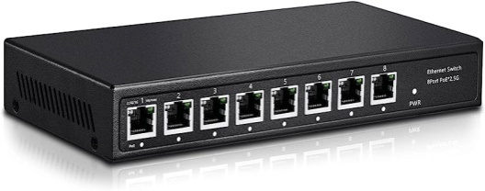
Switch:
Operate at layer2(data link layer) in network or OSI model
Efficient than HUB
Send data according to the IP MAC address
MAC Flooding
MAC Learning
MAC Table
MAC Aging
MAC Table date delete after 300 Sec (5 Min) if they not communicate.

Slide 17
Switch:
Secure
MAC learn
Data Provide
Datalink Layer

Slide 18
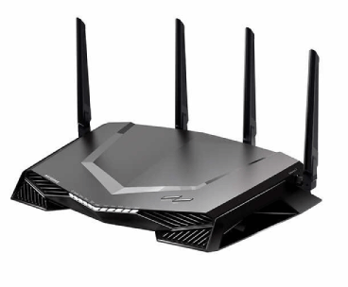
Routers:
Connects 2 or more packet switched networks /subnetworks
Manages traffic on network
allows multiple devices to use the same internet connection
Distribute packet over network
Layer 3(network layer)
NAT-Network Address Translation
(To see the changes Public IP to Private IP & Private IP to Public IP)

Slide 19
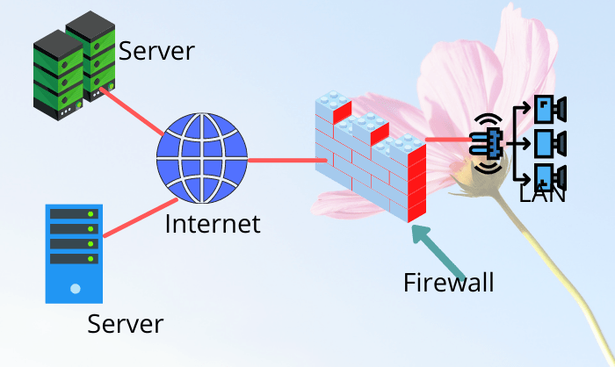
Firewalls and IPS:
A next generation firewalls (NGFW) is a deep filtering firewalls integrated with an Intrusion Detection system(IDS) & Intrusion Protection system(IPS) and able to controls and block traffic at the application level.
Monitor, Control & Traffic Clear
Eg : Request Check, Analyse and Allow

Slide 20
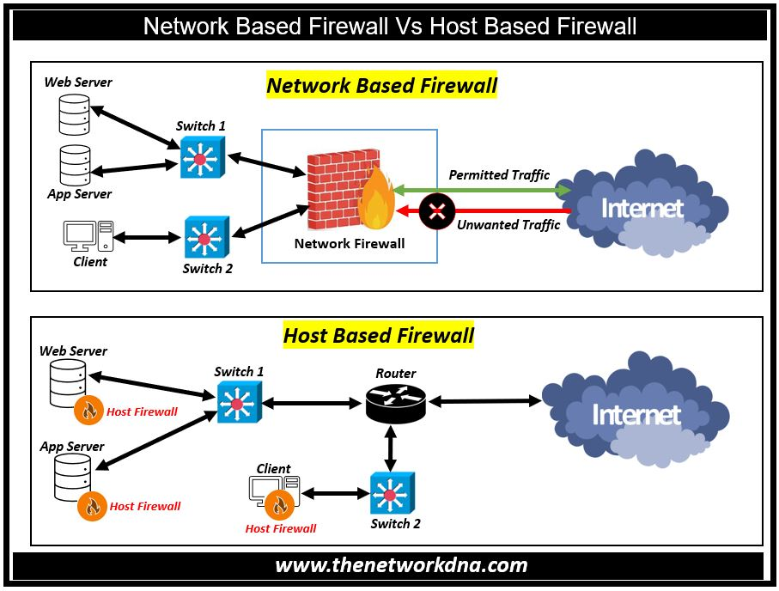

Slide 21
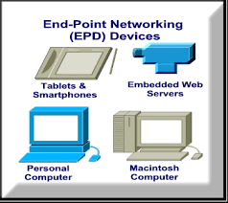
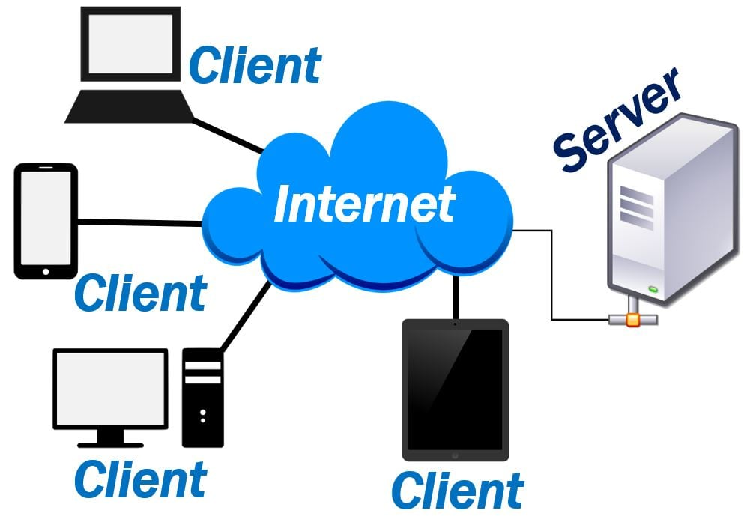
Endpoints:
End points are physical devices that connect to and exchange information with a computer networks
Eg: Servers ,mobile devices, desktop computer, Virtual machines, embedded devices.
Servers:
A servers is a software or hardware devices that accepts and responds to request made over a network. The devices that made the request and receive a response from the server is called client

Slide 22
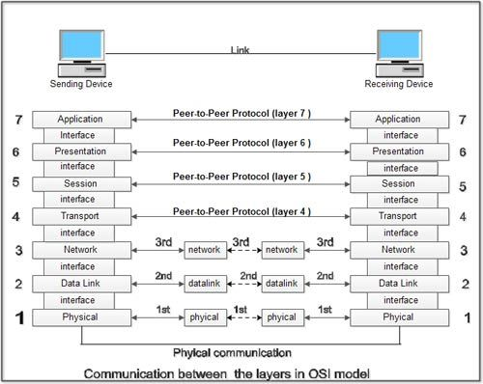
OSI(Open System Interconnection)
OSI model is a conceptual model created by the international organization of standardization , the OSI provides a standard for differents computer system to be able to communicate with each other.

Slide 23
Physical layer:
Define physical characteristics of the medium used to transfer data between devices.
Eg: voltage level, maximum transmission distance, physics connector, cables specification, etc….
Send from the devices through cable to another .
Data Link layer:
Provide node to node connectivity and data transfer.
Define low data is formatted for transmission over a physical medium (copper UTP cables)
Switches operates at layer 2

Slide 24
Network layer:
Provides connection between hosts to differents network.
Provides logical addressing (IP) path selection {source destination (outside of the LANs)}
Router operate at Layer 3
Transport layer:
Segment & reassemble data for communication end hosts
Provide host-to-host communication(end to end)
2 Protocols
Transmission control protocol(TCP)
User datagram protocol(UDP)

Slide 25
Session layer:
Control dialogue (session) between communication host
Establish,manages,terminate connection between local apps … eg:web browser & remote app(youtube)
Presentation layer:
Translate between application and network formats
Encripts the data to send & decrypt the data when received
Also translate between different application layer format.

Slide 26
Application layer:
Closeset to the users
Interacts with the software application
HTTP or HTTPS are layer 7 protocols
Identifies communication partners
Synchronizing communication
Example:Web browser

Slide 27
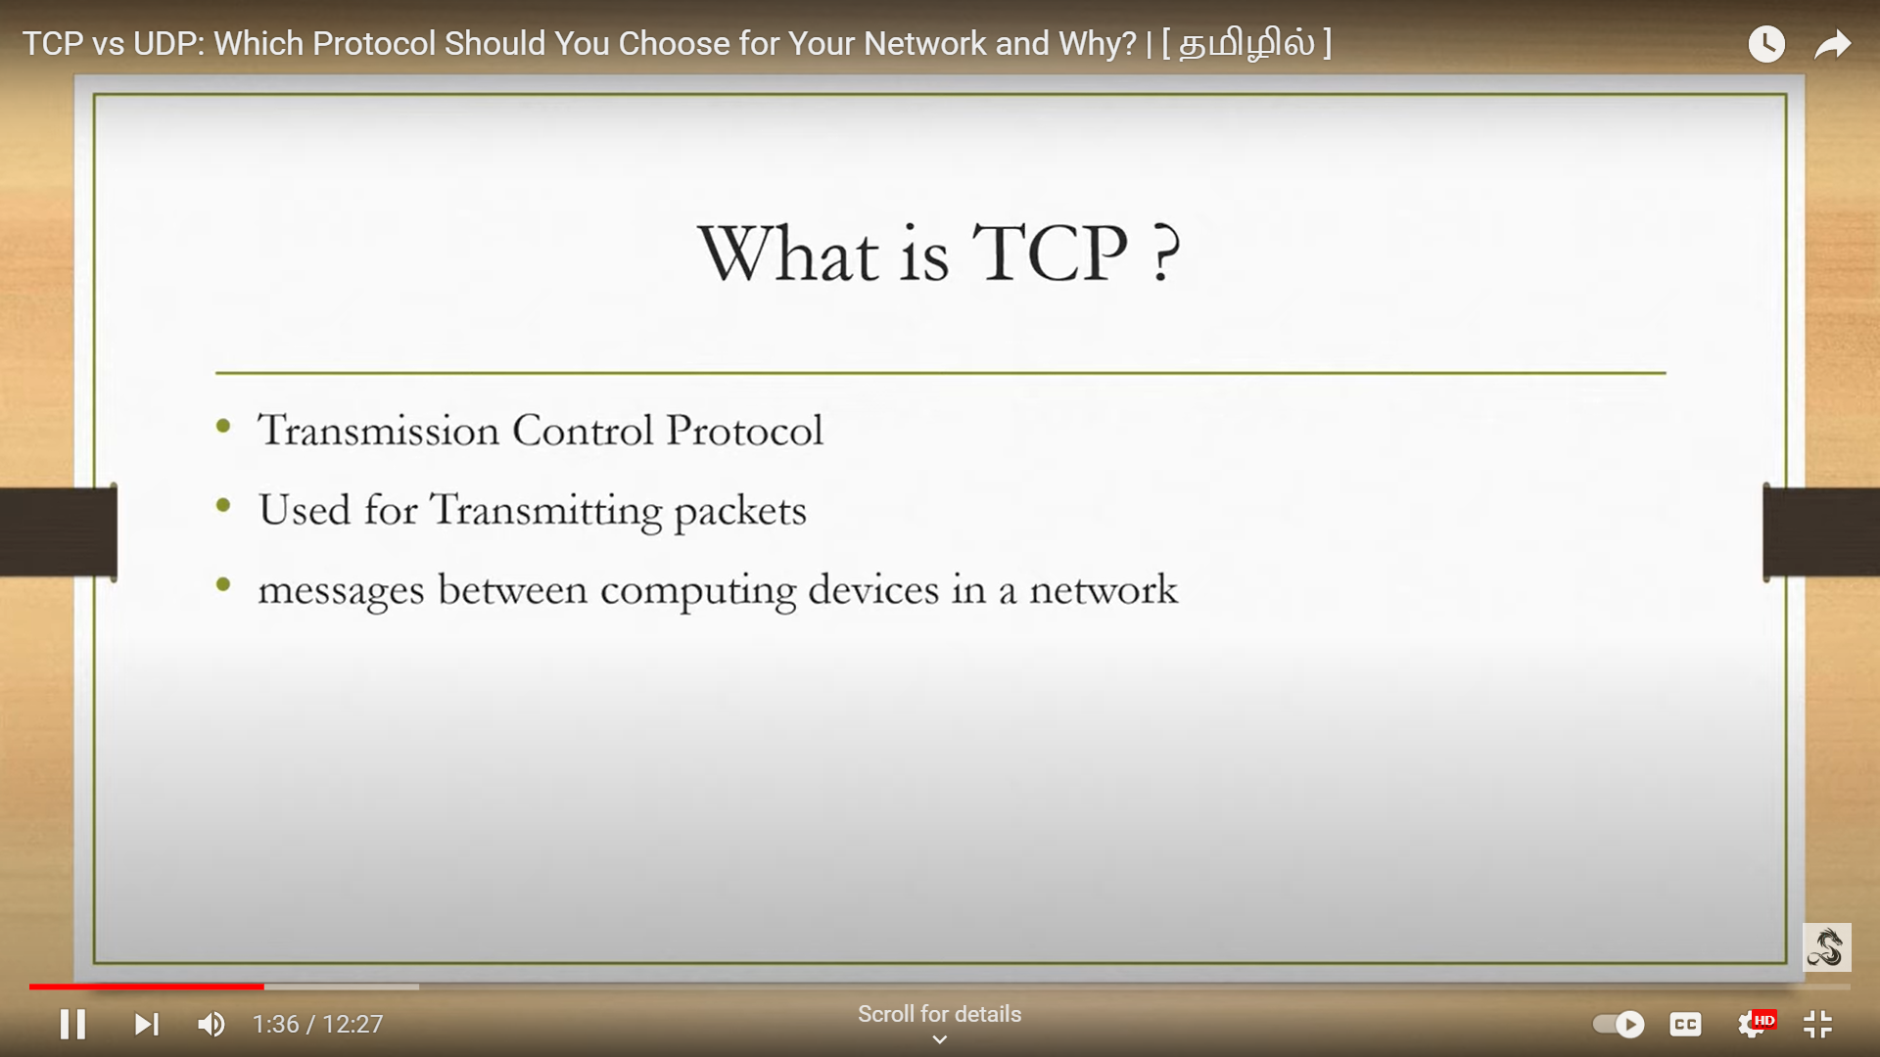

Slide 28
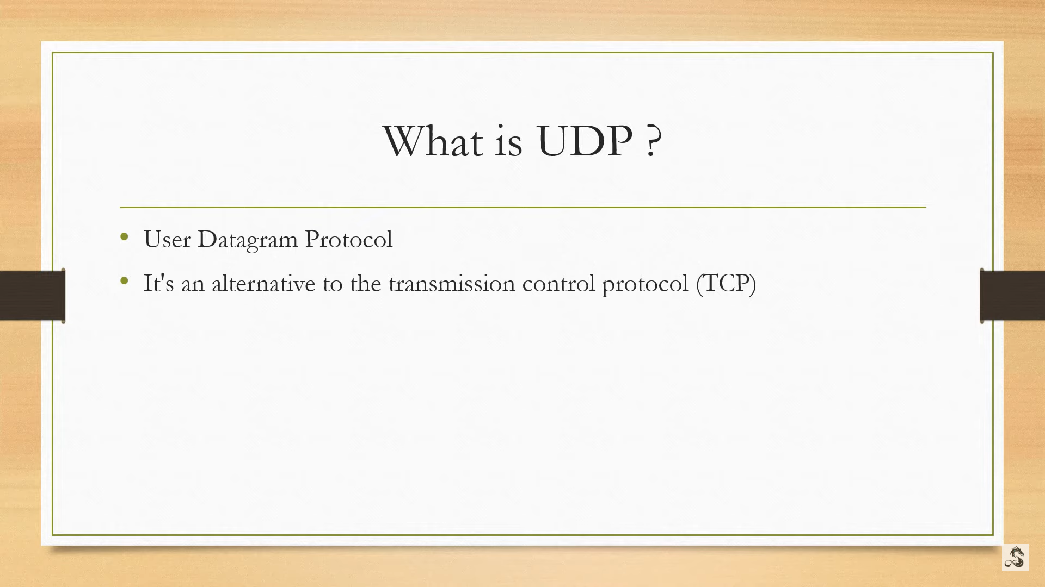

Slide 29
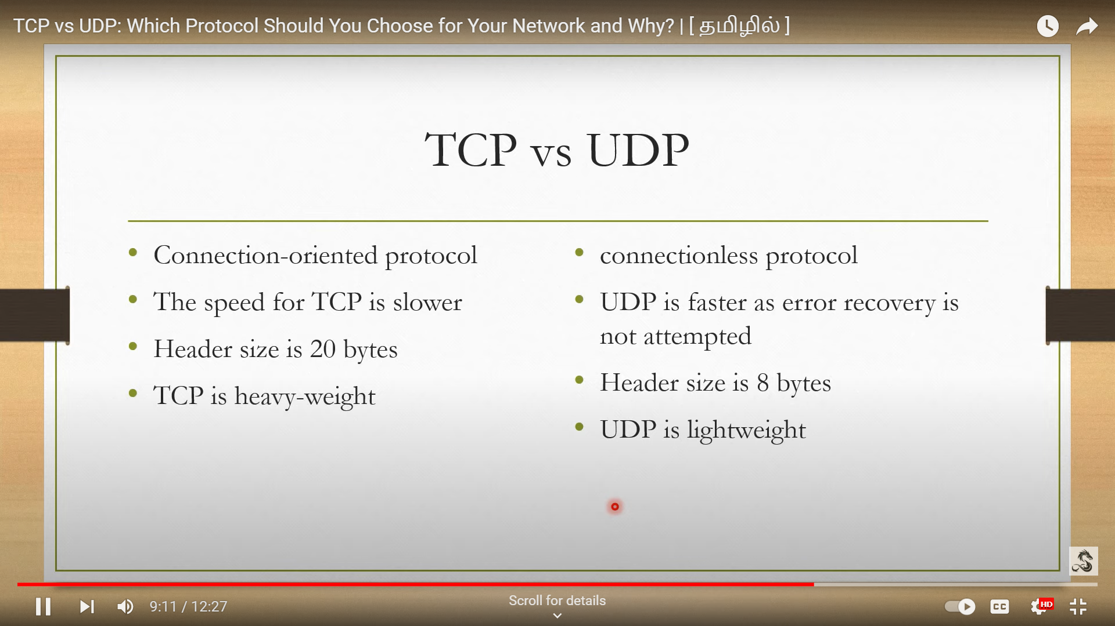

Slide 30
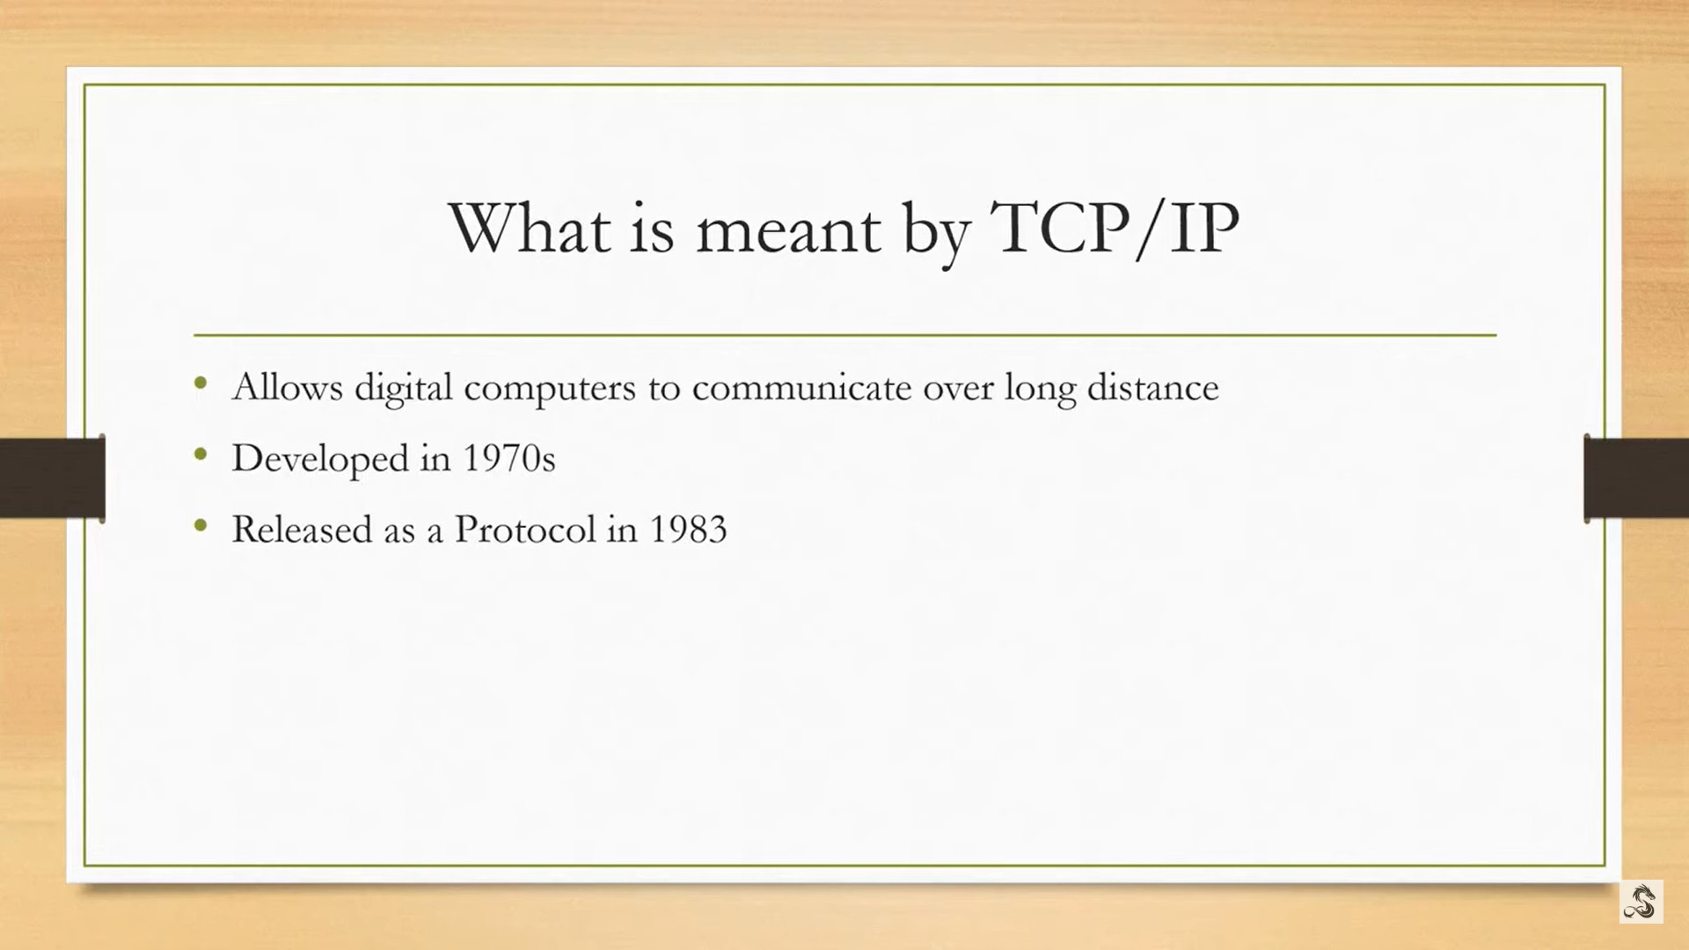

Slide 31
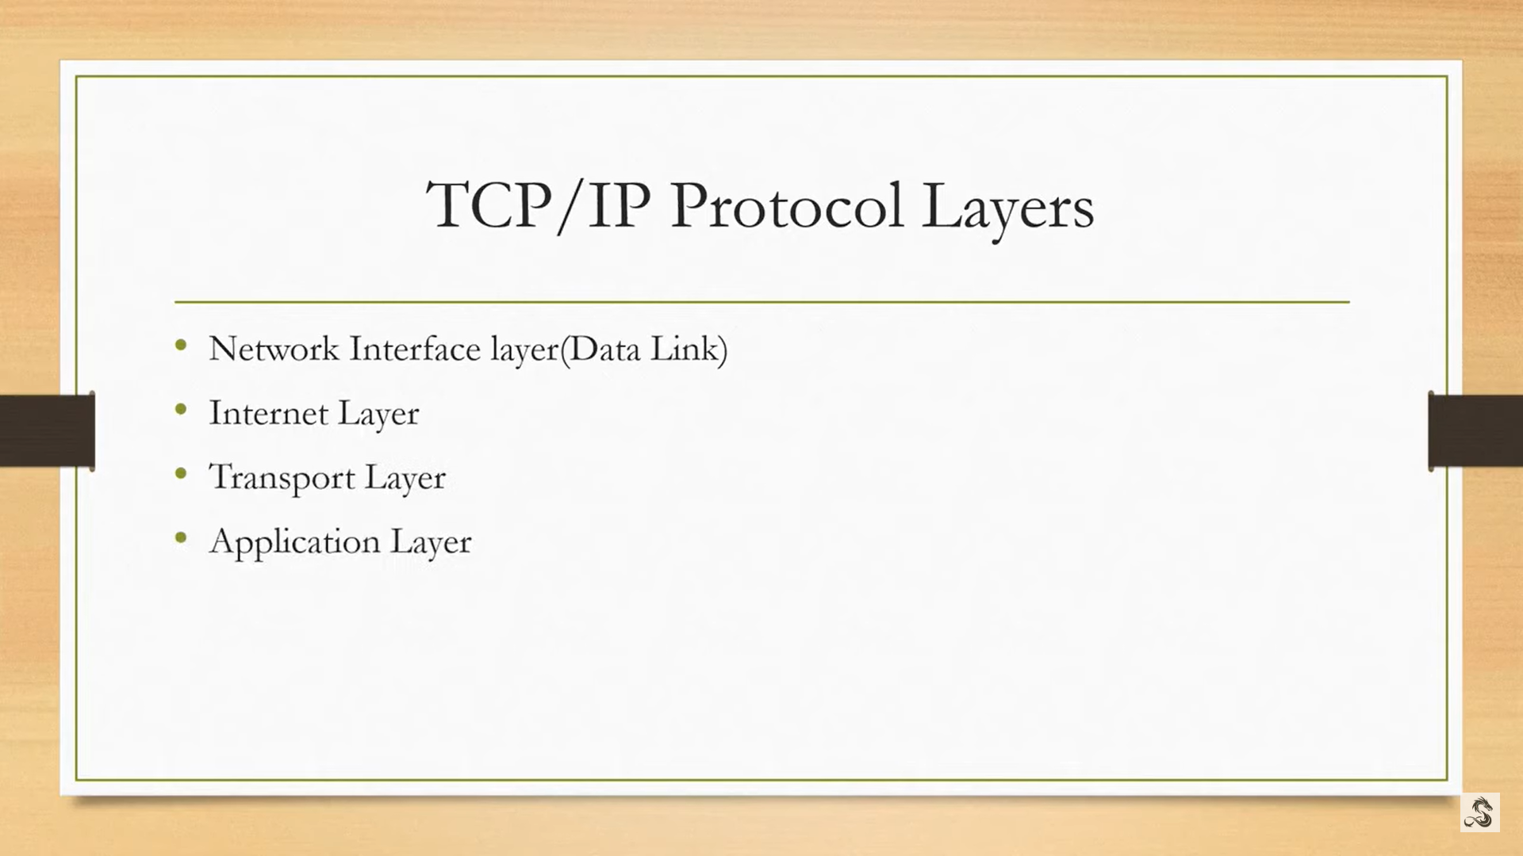

Slide 32
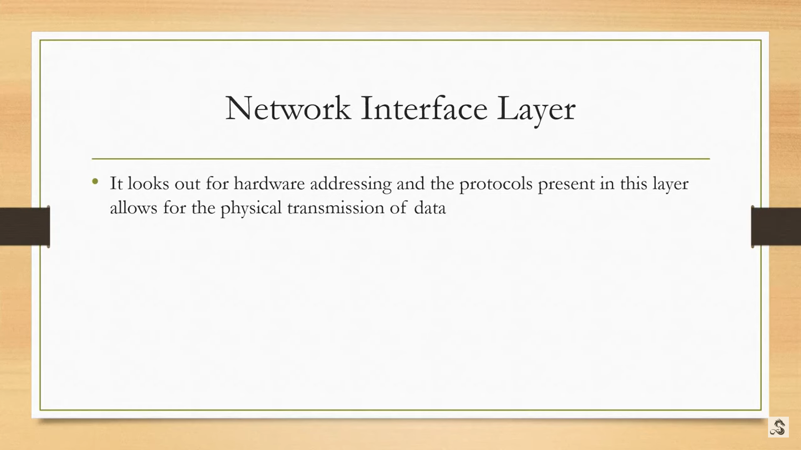

Slide 33
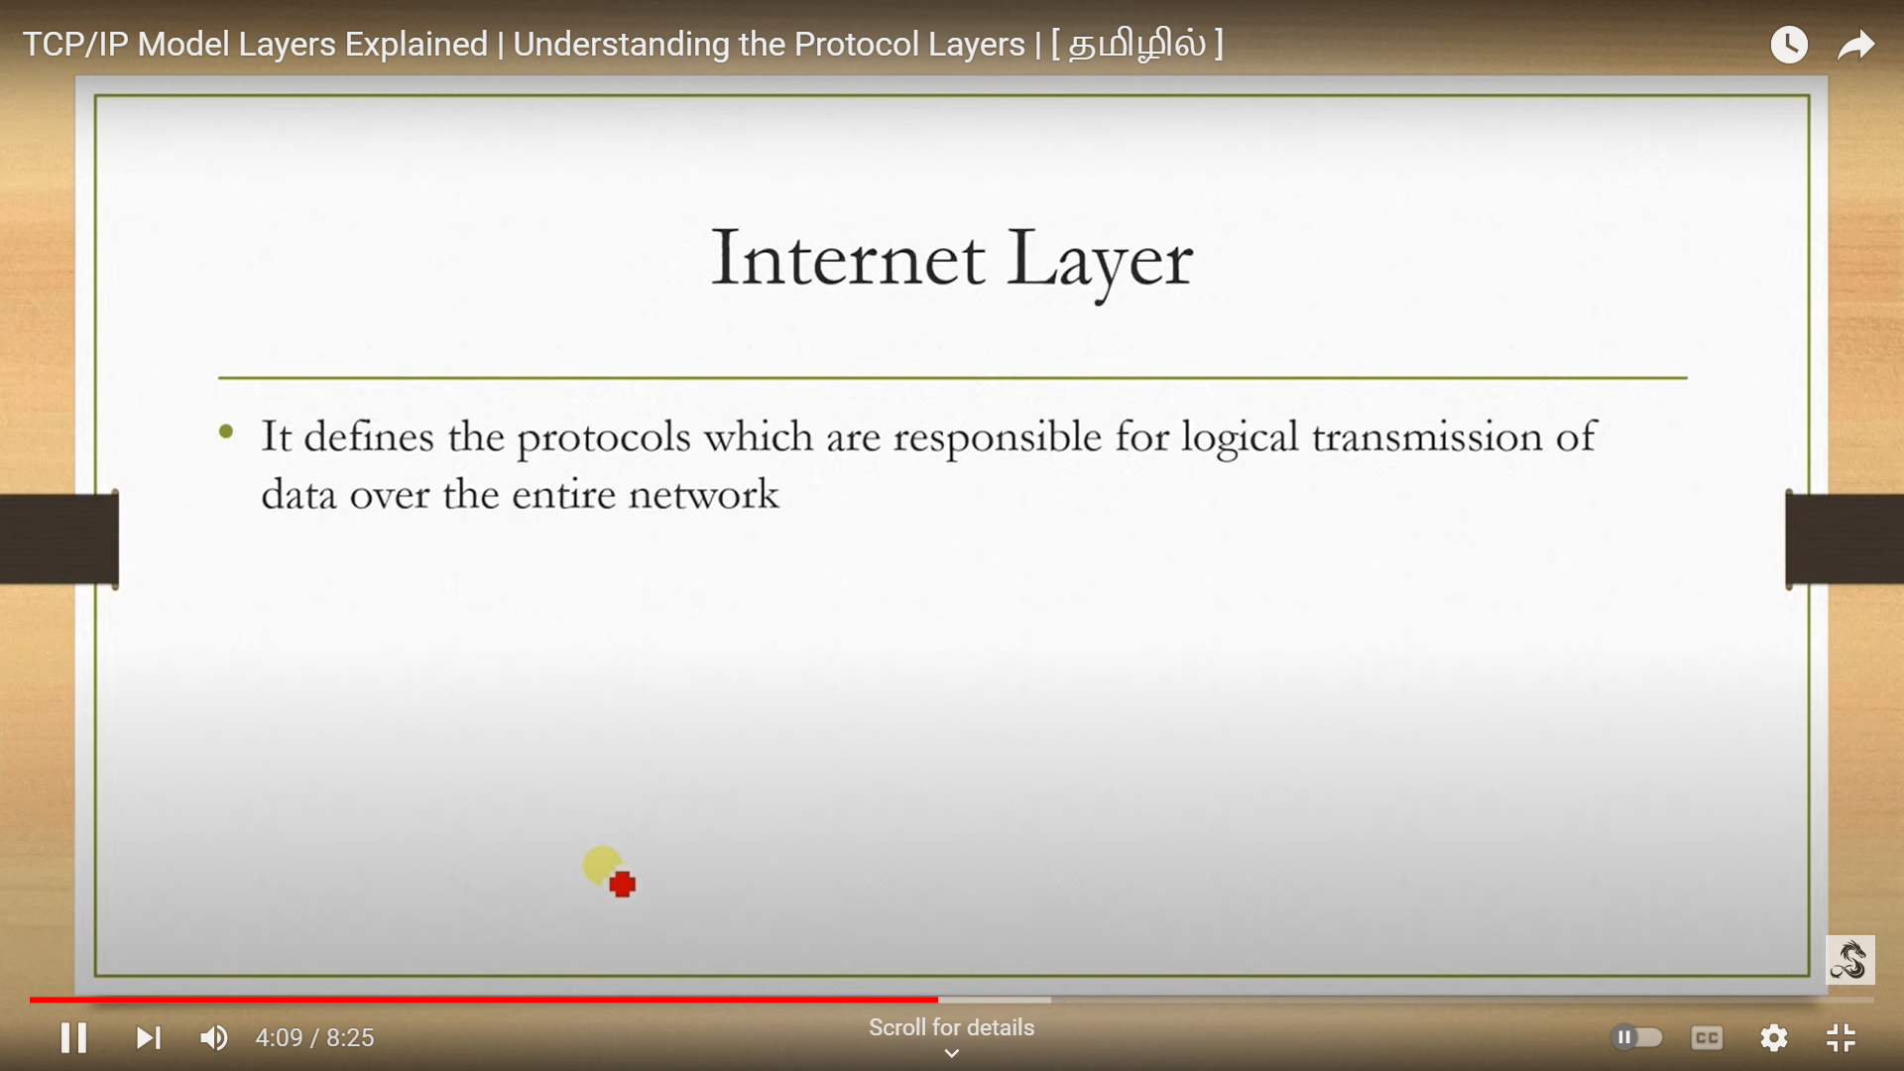

Slide 34
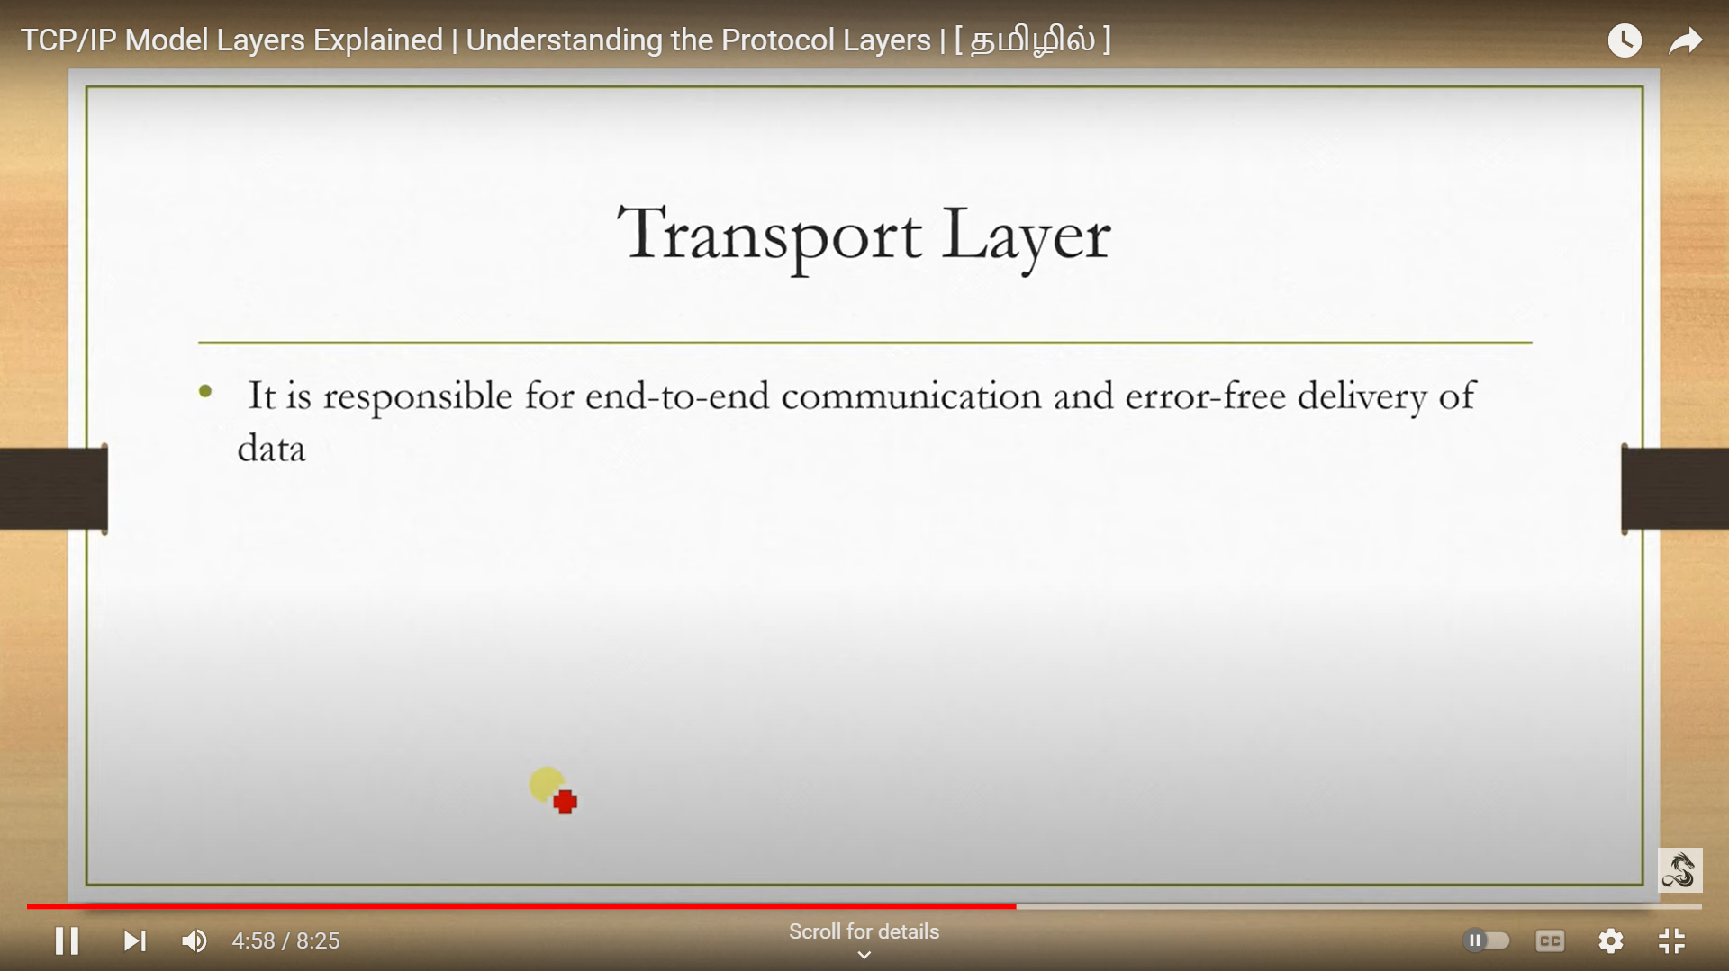

Slide 35
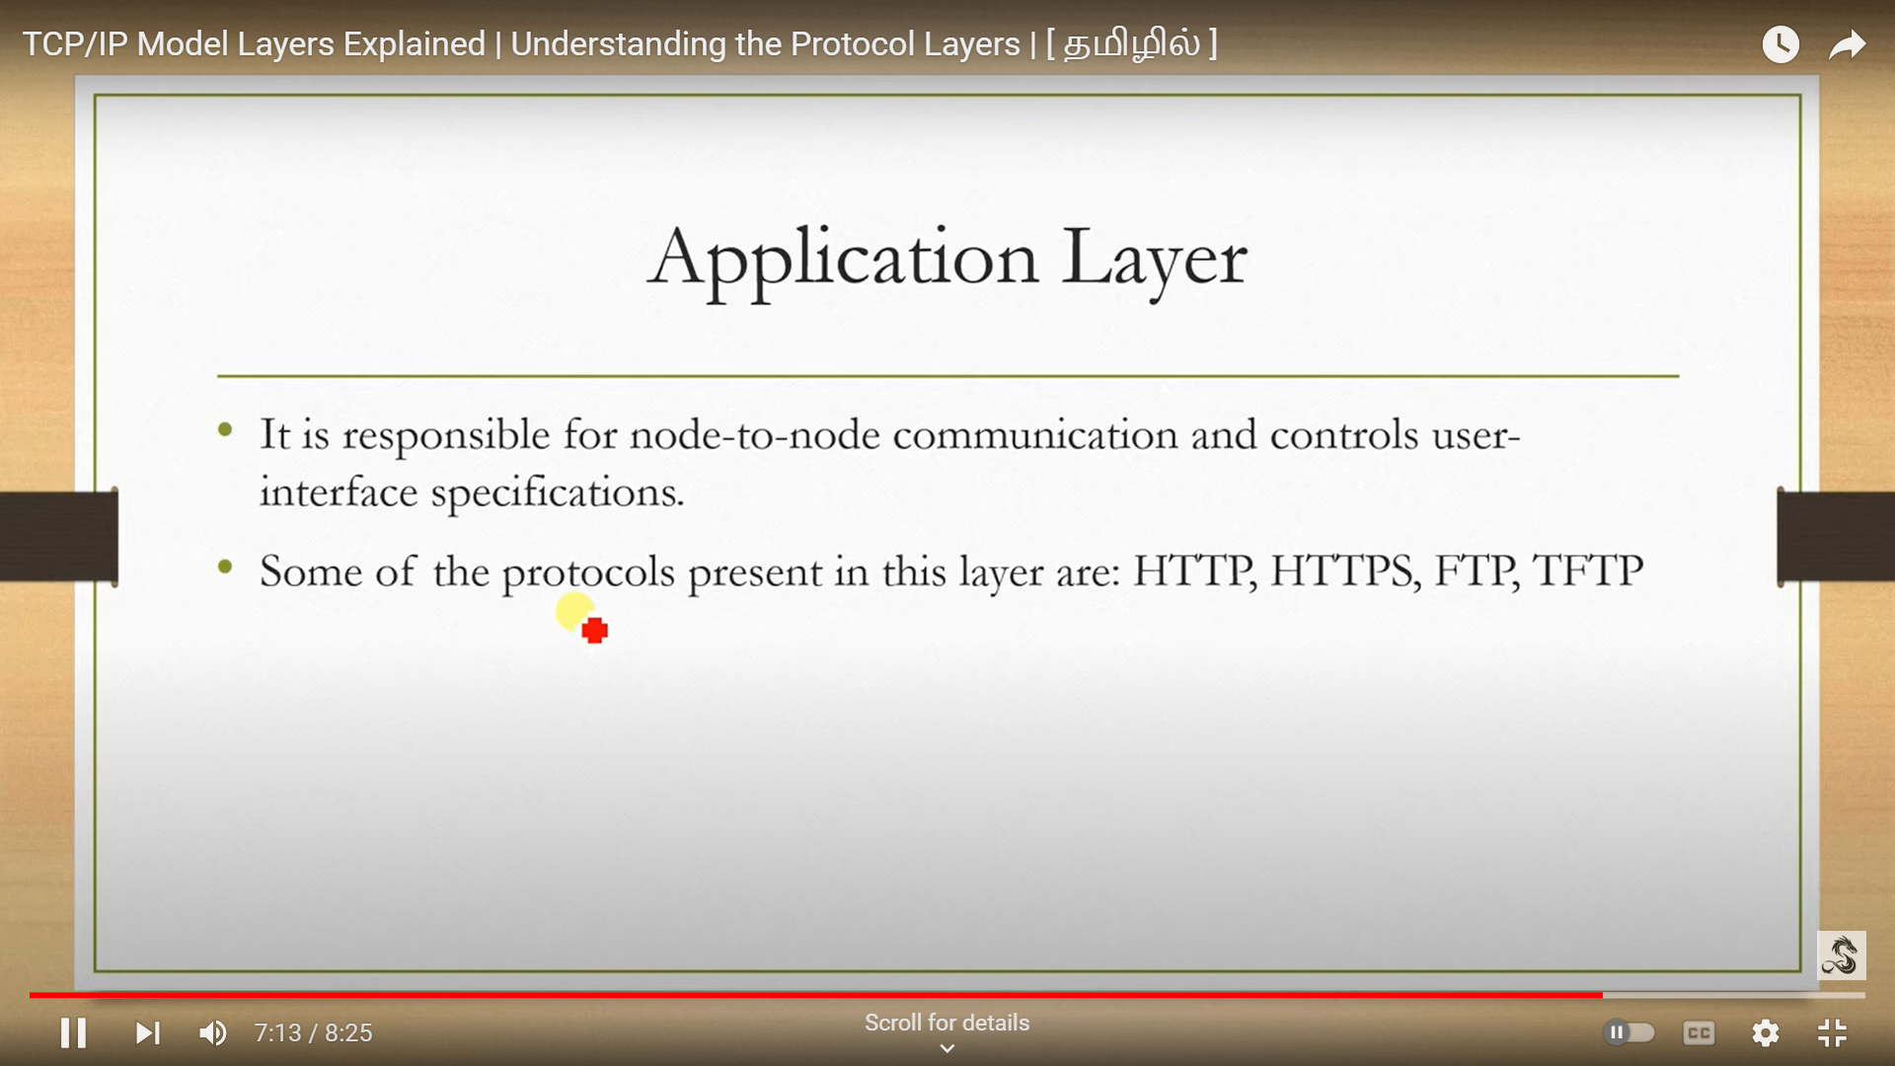

Slide 36
IP Addressing
IPV4
IPV6

Slide 37
IPV4 Addressing
Internet protocol is a protocol is used to communicate packet of data access a network.
IPV4 is controlled by IANA.(Internet Assigned Numbers Authority)
Characteristic:
Unique address
32 bit logical address
IP address have four segment
Represented in decimal form
Each octet have 8 bit
Each octet have range in between 0-255
EG:192.168.1.25
Each octet is separated with dot operator (Dotted Decimal)

Slide 38
IP address
IP address – A unique number that identifier a devices.
32 bits
Numberic values combining binary digits
Binary – 0,1
Decimal - 0 to 9

Slide 39
Eg:
10.9.0.25 (Dotted decimal)
(00001010.00001001.00000000.00001101)
IP Address Range:
0.0.0.0(00000000.00000000.00000000.00000000)
to
255.255.255.255(11111111.11111111.11111111.11111111)

Slide 40
IP address two parts
Network parts
Host parts
The network identifies network part
Network is decided by the class of the IP address
EX consider IP:
10.9.0.25(Dotted decimal)
IP:00001010.00001001.00000000.00001101(Dotted Binary)

Slide 41
Class | 1st Octet Decimal range | Network IP (N)/Host IP (H) | Default subnet mask
A | 0-127 | N.H.H.H | 255.0.0.0
B | 128-191 | N.N.H.H | 255.255.0.0
C | 192-223 | N.N.N.H | 255.255.255.0
D | 224-239 | Multi cast
E | 240-255 | Board cast

Slide 42
SPECIAL IP IN IPV4
The IP address range 127.0. 0.0 – 127.255. 255.255 is reserved for loopback, i.e. a Host's self-address, also known as localhost address. This loopback IP address is managed entirely by and within the operating system.

Slide 43
CIDR CALCULATION
A CIDR (Under Classless Inter-Domain Routing), IP address appends a suffix value stating the number of network address prefix bits to a normal IP address. For example, 192.0. 2.0/24 is an IPv4 CIDR address where the first 24 bits, or 192.0. 2, is the network address.

Slide 44
Decimal to Binary
The simplest method of converting between decimal and binary the following table
Convert a decimal number 172 to binary
128+32+8+4=172
The binary equivalent for the given decimal number 172 is 10101100
128 | 64 | 32 | 16 | 8 | 4 | 2 | 1
128 | 64 | 32 | 16 | 8 | 4 | 2 | 1
1 | 0 | 1 | 0 | 1 | 1 | 0 | 0

Slide 45
Binary to Decimal
convert from binary back to decimal is ever simpler
Apply the binary number to the conversion table
Add up any columns with binary number bit set 0 to 1
consider the binary number 11110001
128+64+32+16+1=241
128 | 64 | 32 | 16 | 8 | 4 | 2 | 1
1 | 1 | 1 | 1 | 0 | 0 | 0 | 1

Slide 46
Static IP address:
These are the address to host devices manually
Static IP address are fixed
Dynamic IP address:
These are the IP address provided to host devices automatically
These IP address are assigned with a help of protocols called(DHCP).Dynamic Host Configuration protocols.

Slide 47
Private IP address:
IP address which are assigned to Local Area Network
Private IP are non-purchasable
Public IP address:
Public IP address are purchasable
Used in wan
a public ip address is an ip address that can be accessed directly over internet
Assigned to the network router by the ISP(internet service provider)
IP address range | Number of possible address
10.0.0.0 TO 10.255.255.255 | 16,777,216
172.16.0.0 TO 172.16.255.255 | 1,048,576
192.168.0.0 TO 192.168.255.255 | 65,536

Slide 48
UNICAST:
A unicast address represents a single device in the network
MULTICAST:
A multicast address represents a group of devices in the network
BROADCAST
A broadcast address represents all devices in the network

Slide 49
Subnetting
Subnetting is a combination of two words...., i.e. Sub and Netting.
Avoid IP wastage
Implements network security
Avoid network traffic
Simplified adminisitration through network

Slide 50
Calculation
Class C
192.168.20.0
255.255.255.0 -N N N H
1111 1111.1111 11111.1111 1111.0000 0000
One bit moved
1111 1111. 1111 1111. 1111 1111.1000 0000

Slide 51
Step-1:
No.of bit moved N =1
No.of bit Non moved=7
Step-2:
No of subnet work = 2^N
= 2^1
=2.
Step-3:
No.of host per subnet= 2^H-2
= 2^7-2
= 128-2
= 126.

Slide 52
Step-4:
Change in subnet = 2^8-2^H
=2^8-2^7
=256-128
=128.
Step-5:
New subnet mask
255.255.255.128
IP address: add one from (step3)
192.168.20.0 to 192.168.20.127
192.168.20.128 to 192.168.20.255

Slide 53
Network Architeture and Topology: Computer Network architecture is define as the physical and logical design of the software and harware, protocols and media of the transmission of data. Simply we can say that how computer are organsized and how tasks are allocated to the computer A network topology is the physical and logical arragement of nodes and connection in a network.

Slide 54
Peer to Peer network:
A network in which all computer linked together
This network with all the nodes acting as both servers and clients
Equal privilge and responsibility
Work for small enviornments
No dedicated server
Each pc is used as client and server
Less costly ,easy to setup

Slide 55
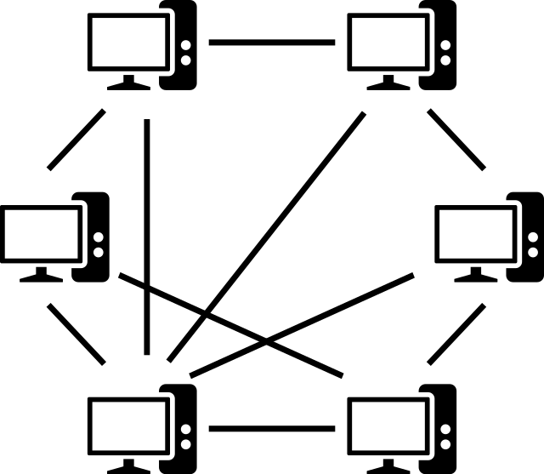

Slide 56
BUS TOPOLOGY
Bus topology is the line or horizontal topology in the network. It is the simplest physical orientation of nodes in the network. This topology is most used in local area networks where the link between each node is a single connection line or a cable through an interface.

Slide 57
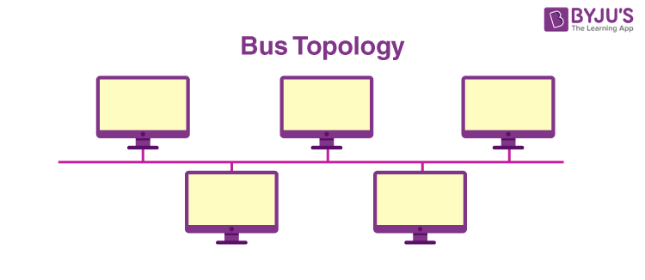
BUS

Slide 58
MESH TOPOLOGY
A mesh topology is a type of computer network in which each node (computer or other device) is connected to every other node in the network. This type of network is often used in large organisations or companies because it can handle a large amount of data traffic and can be easily expanded.

Slide 59
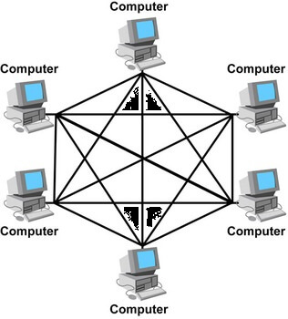
MESH

Slide 60
RING TOPOLOGY
Ring topology is a type of network configuration in which each device on the network is connected to two other devices, forming a “ring.” Data travels around the ring in one direction only, from device to device, until it reaches its destination.

Slide 61
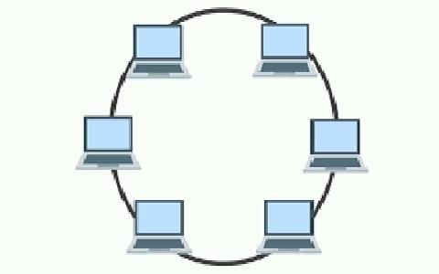
RING

Slide 62
STAR TOPOLOGY
A star network is a local area network (LAN) topology in which all nodes -- personal computers (PCs), workstations or other devices -- are directly connected to a common central computer that is often referred to as a hub. Therefore, a star network is often referred to as a hub-and-spoke network topology.

Slide 63
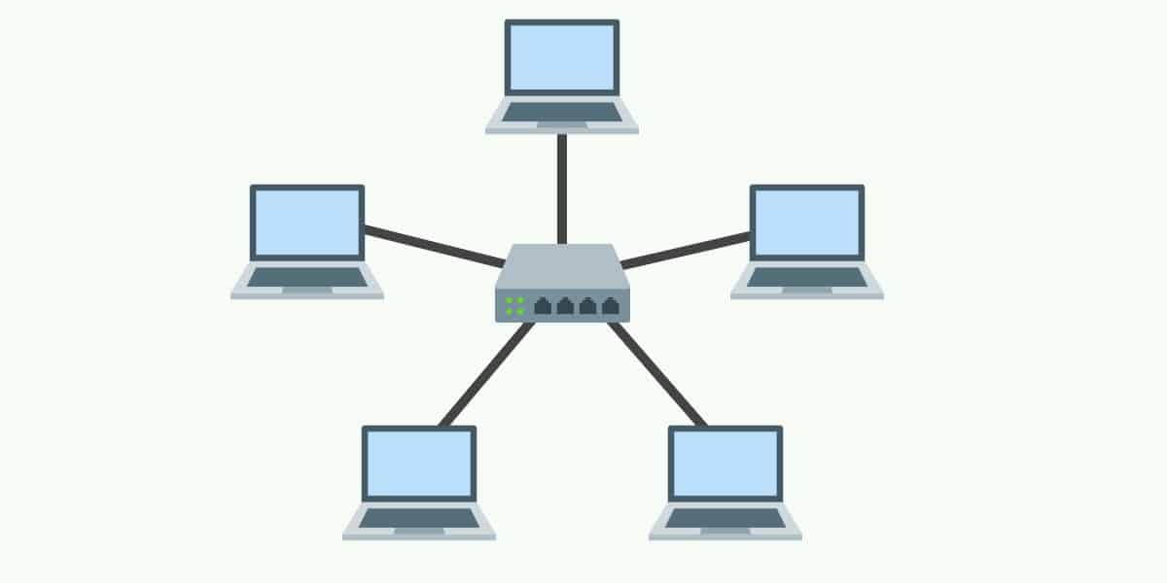
STAR

Slide 64
DIFFERENT BETWEEN 4 NETWORKS
CRITERIA | MESS | BUS | RING | STAR
Connectivity | Connected to all device | Connected to single cable | Connected to left and right side device | Connected to a centre device
Security | Low | Low | Low | High
Direction | Bi directional | Bi directional | Bi/Uni directional | Uni directional
Fault performance | Don’t affect full network | Whole network goes down | Don’t affect full network | If the middle server down, whole network goes down

Slide 65
TREE TOPOLOGY
Tree topology is a type of network topology that resembles a tree. In a tree topology, there is one central node (the “trunk”), and each node is connected to the central node through a single path. Nodes can be thought of as branches coming off of the trunk.

Slide 66
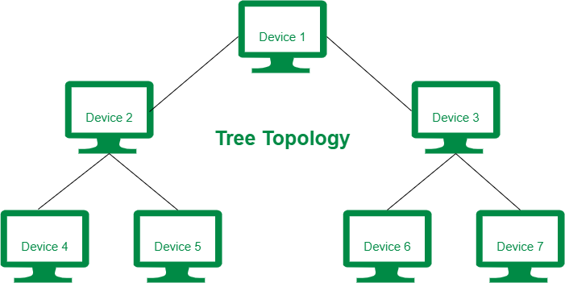
TREE

Slide 67
ADVANTAGES AND DISADVANTAGES
Advantages
Easy error deduction
Failure of single node will not affect whole network.
Disadvantages:
Maintenance configuration difficult
Difficulty of installation

Slide 68
HYBRID TOPOLOGY
Hybrid topology is a type of network topology in which two or more different topologies are integrated or combined to lay out a network. In layman's terms, hybrid topology is the combination of two or more networks

Slide 69
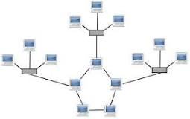
HYBRID

Slide 70
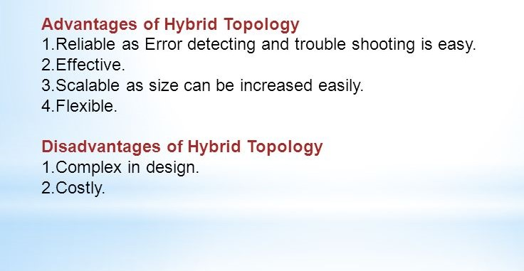
Advantage / Disadvantage

Slide 71
Uses of Flash Port in a Router
Operating System Storage
The router’s IOS (Internetwork Operating System) or firmware is stored
in flash memory.
Flash port allows upgrading/replacing the OS easily.
Configuration Backup
Stores startup configuration files (so after reboot, router reloads the same
settings).
Firmware/Software Upgrade
You can insert a flash card (or use USB/flash port) to update the router’s
software.
Extra Storage
For additional modules, log files, or system images.
Resilience
If the router OS crashes, you can reload from flash memory without
needing a TFTP server.
Important Notes
Flash memory is non-volatile → Data is not lost when power is turned off.
Modern routers often use USB flash ports instead of older PCMCIA-type flash cards.

Slide 72
Vendor | Default Router OS | Notes
Cisco | Cisco IOS (Internetwork Operating System) | Most widely used in enterprises; also has IOS XE (Linux-based) and NX-OS (for data centers).
Juniper | JUNOS | Based on FreeBSD; very stable and modular.
MikroTik | RouterOS | Popular for ISPs and small businesses; very customizable.
Aruba (HPE) | ArubaOS | Designed for wireless controllers and edge networking.
Fortinet | FortiOS | Security-focused router OS (firewall + routing).
Ubiquiti | EdgeOS / UniFi OS | For EdgeRouters and UniFi devices.
Huawei | VRP (Versatile Routing Platform) | Used in enterprise and telecom routers.
TP-Link / Netgear / D-Link (Home Routers) | Custom lightweight Linux-based OS | Usually web-interface driven; limited CLI.

Slide 73
📂 Files in a Router Flash Card
Router Operating System (IOS image)
Example: c1900-universalk9-mz.SPA.154-3.M3.bin
This is the Cisco IOS binary file the router boots from.
Without this file, the router can’t run.
Configuration Files
startup-config (saved config loaded at boot).
running-config (active config in RAM, but not usually stored directly in flash unless saved).
Bootloader / Boot Helper Files
Example: rommon or bootldr image.
Helps the router boot if the main IOS is corrupted.
Licensing Files
For newer Cisco routers, license keys or feature activation files may be stored.
VLAN Database Files (on some devices)
Example: vlan.dat — contains VLAN information.
Log Files or Crashinfo Files
Example: crashinfo_20230801-120011
Saved if the router crashes, useful for troubleshooting.
Other Optional Files
Backup IOS images (for redundancy).
Scripts, security certificates, or custom packages.

Slide 74
Gateway – Connectivity path between
Router and Switch
Giga Port – Router to Switch
Serial Port – Router to Router
Hope Address – Router to Router Line
Line Up – Gateway has to give / no shut
Route – NT Address has to give /do wr

Slide 75
Line up Router command
User mode
> enable
Previlage mode
#config t
Configure mode
(config)#
Command:
Interface gigabitethernet 0/0/0
ip address 192.168.1.1 255.255.255.0
No shutdown
exit

Slide 76
ROUTING
Routing is a process that is performed by layer 3 (or network layer) devices in order to deliver the packet by choosing an optimal path from one network to another.
TYPES OF ROUTING:
1.Static routing
2.Dynamic routing
3.Default routing

Slide 77
STATIC ROUTING
PROGRAM
>ena
#config t
# interface gig0/0/0
#ip address 192.168.1.1 255.255.255.0
#no shutdown
#exit
R2
>ena
#config t
#interface gig0/0/0
#ip address 192.168.2.1 255.255.255.0
#no shutdown

Slide 78
R1
#interface se0/2/0
#ip address 10.0.0.1 255.0.0.0
#no shutdown
R2
#interface se0/2/0
#ip address 10.0.0.2 255.0.0.0
#no shutdown
R1
Ip route 192.168.2.0 255.255.255.0 10.0.0.2
R2
Ip route 192.168.1.0 255.255.255.0 10.0.0.1

Slide 79
DYNAMIC ROUTING
Dynamic routing makes automatic adjustments of the routes according to the current state of the route in the routing table. But cannot communicate between router
PROGRAM
>ena
#config t
# interface gig0/0/0
#ip address 192.168.1.1 255.255.255.0
#no shutdown
#exit
R2
>ena
#config t
#interface gig0/0/0
#ip address 192.168.2.1 255.255.255.0
#no shutdown

Slide 80
R1
#interface se0/1/0
#ip address 10.0.0.1 255.0.0.0
#no shutdown
R2
#interface se0/1/0
#ip address 10.0.0.2 255.0.0.0
#no shutdown
R1
Ip dhcp pool dee
Network 192.168.1.0 255.255.255.0
Default-router 192.168.1.1
R2
Ip dhcp pool mee
Network 192.168.2.0 255.255.255.0
Default-router 192.168.2.1

Slide 81
DHCP SERVER MODE
Automatic Private IP Addressing (APIPA)
Line Up – All Router
NT Route – All Router
Server IP Set
Pool Creation – Server
IP Helper – All Router
Interface gig0/0/0 (Router to Switch)
Ip helper-address 192.168._._(server IP)

Slide 82
DHCP SERVER MODE
PROGRAM
>ena
#config t
# interface gig0/0/0
#ip address 192.168.1.1 255.255.255.0
#no shutdown
#exit
R2
>ena
#config t
#interface gig0/0/0
#ip address 192.168.2.1 255.255.255.0
#no shutdown
192.168.3.2
192.168.1.1
192.168.2.1

Slide 83
R1
#interface se0/2/0
#ip address 10.0.0.1 255.0.0.0
#no shutdown
R2
#interface se0/2/0
#ip address 10.0.0.2 255.0.0.0
#no shutdown
Static routing:
R1-Ip route 192.168.2.0 255.255.255.0 10.0.0.2
R2-ip route 192.168.1.0 255.255.255.0 10.0.0.1
ip route 192.168.3.0 255.255.255.0 10.0.0.1
Server ip set:
Server pool create:
R1
Interface gig0/0/0
Ip helper-address 192.168.3.2
R2
Interface gig0/0/0
Ip helper-address 192.168.3.2

Slide 84
Default routing
All router line up
Default routing:
R1:
#Ip route 0.0.0.0 0.0.0.0
10.0.0.2
R2:
#Ip route 0.0.0.0 0.0.0.0
10.0.0.1
10.0.01
10.0.0.2
192.168.1.1
192.168.1.2

Slide 85
IPV6
Internet Protocol version 6 (IPv6) is the most recent version of the Internet Protocol (IP), the communications protocol that provides an identification and location system for computers on networks and routes traffic across the Internet.
Next version of ipv4

Slide 86
IPV6 FORMAT
IPV6 IS THE 128 BIT LONG.
MUCH LARGE THAN 32 BIT IPV4 ADDRESS
IPV6 UES EIGHT GROUP OF FOUR HEXA
DECIMAL DIGITS SEPARATED BY COLONS.(:)
4 ACT AS A NETWORK AND 4 ACT AS A HOST
HexaDecimal :0123456789ABCDEF (0-15)
EX: 153A:897F:0006:0078:ABCD:4567:456F:0897

Slide 87
Methods
Addressing short method:
Two colons
153A:897F:0000:0000:0000:4567:456F:0897
153A:897F::4567:456F:897
2. Zero omitted
153A:897F:0006:0078:AB0D:4567:456F:0897
153A:897F:6:78:AB0D:4567:456F:897

Slide 88
IPV6 CIDR
Under Classless Inter-Domain Routing (CIDR), IPv6 addresses can be aggregated with prefixes of arbitrary bit length, similar to IPv4 addresses. For example, 2001:0db8:/32 is an IPv6 CIDR address, with the first 32 bits, or 2001:db8, as the network address.

Slide 89
TYPE OF COMMUNICATION
Unicast:
One to one communication.
Multicast:
One to many communication

Slide 90
Any cast
A packet sent to an anycast address is delivered to the closest interface

Slide 91
CABLING IN NETWORK
Communications cables are used to interconnect, connect and transfer data and information between computers, routers, switches and storage area networks .
These cables are essentially the carrier or media through which data flows.

Slide 92
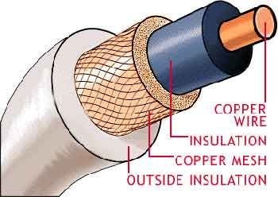
COAXIAL CABLING
A coaxial cable is an electrical cable with a copper conductor and an insulator shielding around it and a braided metal mesh that prevents signal interference and cross talk. Coaxial cable is also known as coax.

Slide 93
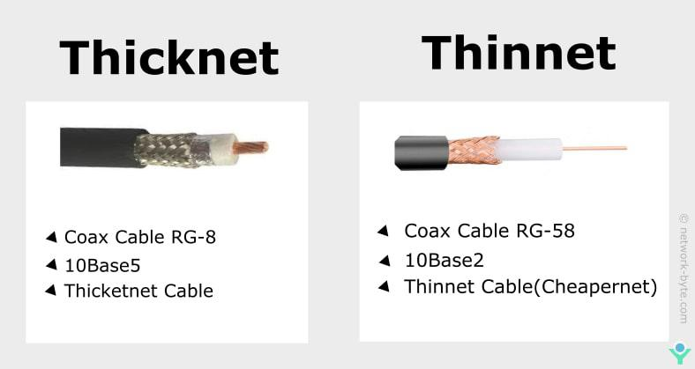
TYPE OF COAXIAL

Slide 94
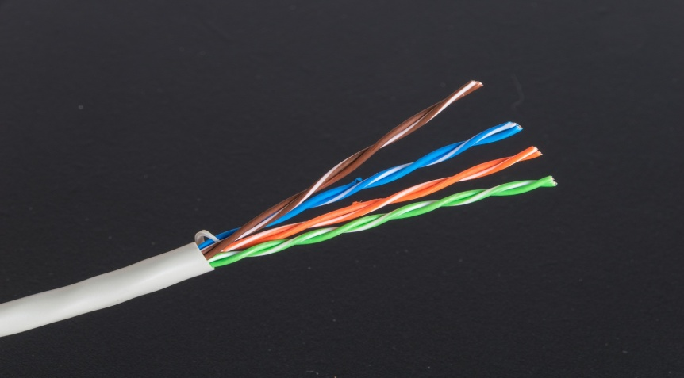
TWISTED PAIR
Twisted pair is the ordinary copper wire that connects home and business computers to the telephone company. To reduce crosstalk or electromagnetic interconnection between pairs of wires, two insulated copper wires are twisted around each other

Slide 95
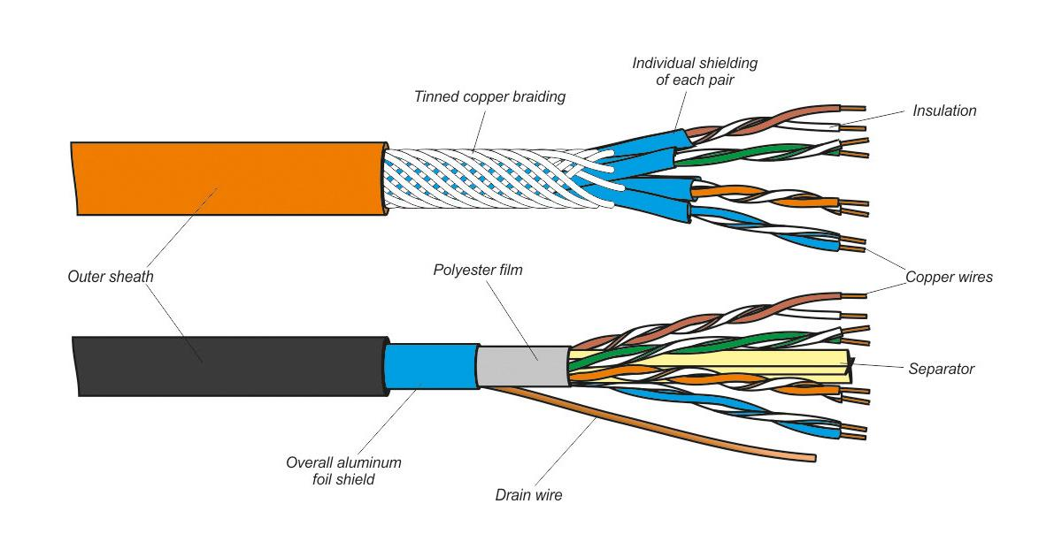
CLASSIFICATION OF TWISTED PAIR

Slide 96
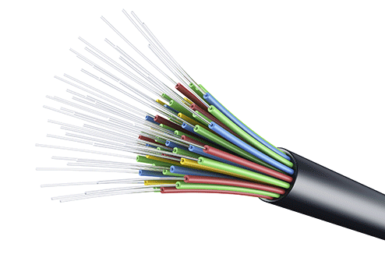
FIBER OPTIC CABLING
A fiber optic cable is made of glass or plastic and transmits signals in the structure of light signals. It involves an inner glass core surrounded by a glass cladding that reflects the light into the core. Each fiber is encircled by a plastic jacket.

Slide 97
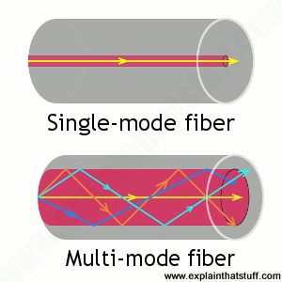
Classification of Fiber

Slide 98
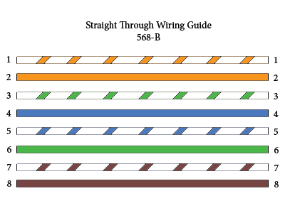
Connection Type
1.Stright throught Cable:
straight through patch cables are used to connect devices of different types, such as a computer to a network switch.

Slide 99
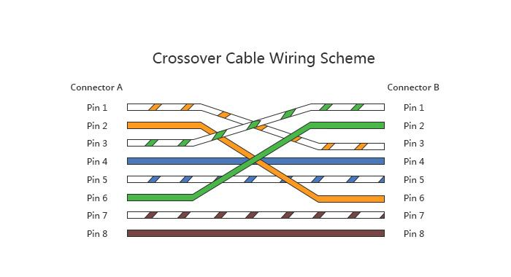
An Ethernet crossover cable is a crossover cable for Ethernet used to connect computing devices together directly. It is most often used to connect two devices of the same type, e.g. two computers.

Slide 100
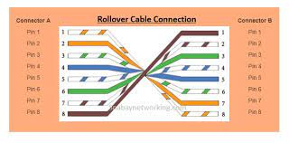
Roll over Cable:
A rollover cable (also known as a Yost cable, Cisco cable, or a Console cable) is a type of null-modem cable that is used to connect a computer terminal to a router's console port.

Slide 101
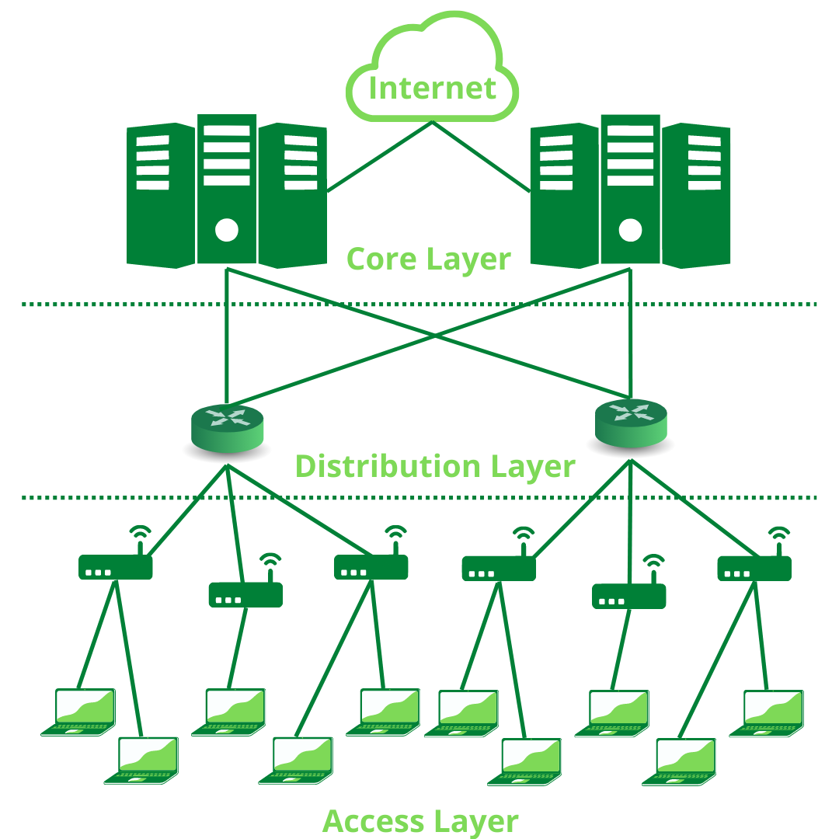
THREE LAYERS IN NETWORKING

Slide 102
Access Layer:
The Access Layer is the part of the network which enables the users to connect to the wired Ethernet Network. It enables the users to share data and resources on the local network. The devices used in this layer include Ethernet Switches and Hubs.
Distribute Layer:
It must be divided into multiple local (Access Layer) networks. the distribution layer connects these networks together. It ensures that local traffic remains confined to local networks. This layer also acts as an intermediary between the Access Layer.

Slide 103
Core Layer:
This layer is considered the backbone of a network, as it is used to connect multiple Distribution Layer devices together. This layer uses the most powerful devices to manage the traffic between the networks.

Slide 104
TYPE OF PORT
Serial Port:
Typically Serial ports are used to connect routers together.
Auxiliary Port:
The router's auxiliary (AUX) port functions as a backup async port. It is most commonly used as a backup console port.
Console Port:
The console port is used to access the router and is located on the front panel of the Route Processor.

Slide 105
Volatile Memory:
Volatile memory is computer memory that requires power to maintain the stored information; it retains its contents while powered on but when the power is interrupted, the stored data is quickly lost.
Non Volatile Memory:
Non-volatile memory (NVM) or non-volatile storage is a type of computer memory that can retain stored information even after power is removed.

Slide 106
ROM:
ROM stands for Read-Only Memory. It is a non volatile memory that is used to store important information which is used to operate the system. As its name refers to read-only memory, we can only read the programs and data stored on it.
RAM:
RAM (Random Access Memory) is the hardware in a computing device where the operating system (OS), application programs and data in current use are kept so they can be quickly reached by the device's processor. RAM is the main memory in a computer.

Slide 107
Flash Memory:
Flash memory is an electronic non-volatile computer memory storage medium that can be electrically erased and reprogrammed.

Slide 108
ROUTING CONCEPT
Routing:
Network routing is the process of selecting a path across one or more networks.
Types of Routing:
Static Routing
Dynamic Routing
Static Routing:
Manually: Remote networks are manually
entered into the route table using static routes.

Slide 109
Dynamic Routing:
Dynamically: Remote routes are automatically learned using a dynamic routing protocol.
Types :
1. IGP
Distance Vector-RIP,EIGRP
Link State- OSPF, IS-IS
EGP
Path Vector
BGP-Internal BGP
External BGP

Slide 110
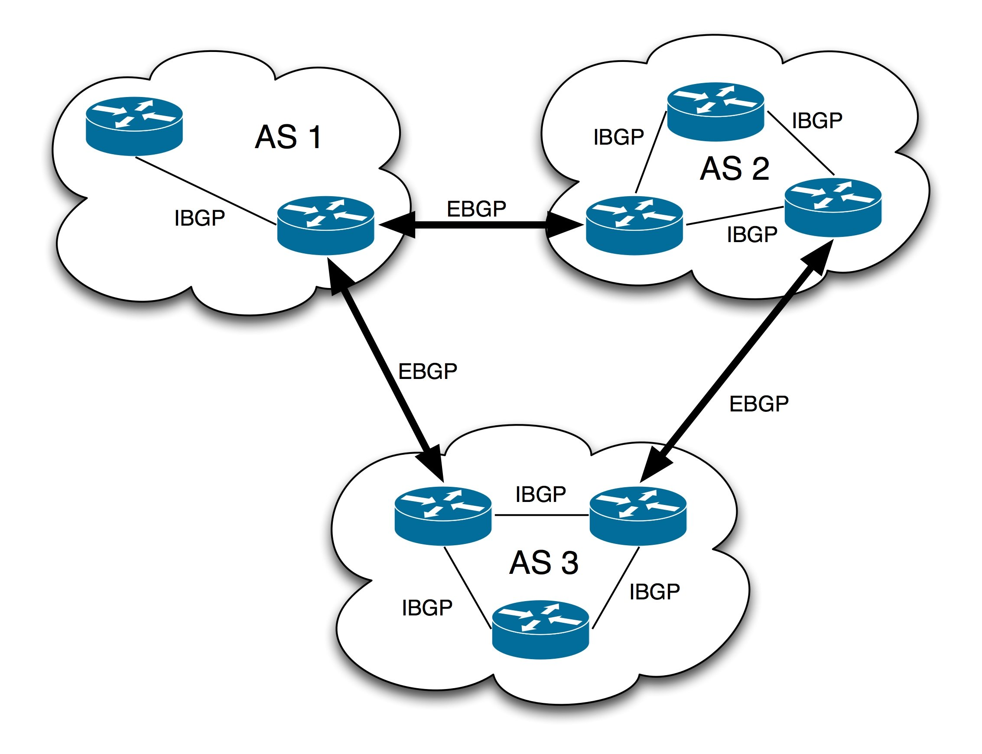

Slide 111
RIP(Routing Information Protocols):
It’s a dynamic routing protocol that uses hop count as a routing metric to find the best path between the source and the destination networks
HOP count is the number of router occurring in between the source and destination network
The path with the lowest hop count is considered as the best route to reach a network and therefore placed in the routing table
The maximum hop count allowed for RIP is 15 and a hop count 16 is considered as networks unreachable
So RIP cannot be used for large networks
RIP has three version
RIPV1 & RIPV2 (user for IPV4 )
RIP NG(RIP used Next Generation)(used for IPV6)

Slide 112
PROGRAM
R1:
#router rip
#network 192.168.1.0
#network 10.0.0.0
#network 30.0.0.0
R2:
#router rip
#network 10.0.0.0
#network 20.0.0.0
R3:
#router rip
#network 192.168.2.0
#network 20.0.0.0
#network 30.0.0.0
R2
10.0.0.2
20.0.0.2
10.0.0.1
20.0.0.1
R1
R3
30.0.0.1
30.0.0.2
192.168.2.1
192.168.1.1

Slide 113
RIP uses two message types
REQUEST : to also RIP enable neighbour routers
RESPONSE : to send the local router table to neighbouring routers.
By default, RIP enabled router will share their routing table 30 seconds.
EIGRP(Enhanced gateway Routing Protocols):
Cisco designed the protocols and is available only on cisco routers
Minimum bandwidth is used from the source to destination and the delay is measured using metric of the network
Much faster than RIP in reacting to change in the network
Does not have the 15 hop count limits of RIP.

Slide 114
PROGRAM
R1:
#Router eigrp 100
#network 192.168.1.0
#network 10.0.0.0
#network 30.0.0.0
R2:
#router eigrp 100
#network 10.0.0.0
#network 20.0.0.0
R3:
#router eigrp 100
#network 192.168.2.0
#network 20.0.0.0
#network 30.0.0.0

Slide 115
Link state :
By used this routing protocols every router create a “connectivity map” of the network.
Each router adverties infromation about it interface to its neighbours these advertisement are passed along to other router ,all routers in the network develop the same map of the network
Each router independently use the map to calculate the best routes to each destination
However , link state protocols tend to be faster in reading to change in the network than distance vector protocols.
OSPF
IS-IS

Slide 116
OSPF(Open Shortest Path First):
A link state routing protocols that was developed for IP network and is based on the shortest path first (OSPF) algorithm(Dijkstra’s algorithm)
In an OSPF network , router or system with in the same area maintain an identical link-state database (LSDB)that describe the topology of the area
Three version
OSPV1 (1989) Old not is use any more.
OSPV2 (1998) , used for IPV4.
OSPF V3 (2008) USED FOR IPV4 & IPV6.
Router store information about the network in LSA’s (LINK STATE ADVERTISEMENT) which are organized in a structure called the LSDB(Link state data base)
Router will flood LSA’S until all the router in the OSPF area developed the same map of the network

Slide 117
In OSPF , the are 3 step in the process of sharing LSA and determining the best route to each destination network
Become neighbors with other routers connected to the same segment
Exchange LSA’s with neighbor router
Calculate the best router to each destination and insert then in to the routing table
OSPF Area:
By dividing a large OSPF network in to serval small area , you can avoid the above negative effects
An Area is a set of router and link that share the same LSDB
The backbone area(area 0) Is an area that all other area must connect to
Router with all interface in the same area are called internal router
Router with interface in multiple area are called AREA BORDER ROUTER(ABR)

Slide 118
Router connected to the backbone area (area 0) are called back router
An intra-area route is a route to the destination inside the same OSPF
An inter- area route is a route to a destination outside the same OSPF
OSPF uses area to divide up the network
Small network can be single area without any negative effect on performance.
In large network, a single area design can have negative effect
SPF algorithms take more time to calculate routers
The SPF algorithms requires exponentially more processing power on the routers
The large LSDB take up more memory on the routers
Any small change in the network cause every router to flood LSA’s and run the SPF algorithms again

Slide 119
OSPF area should be contiguous (each individual area should connected let divided up)
An OSPF area must have at least one ABR connected to the backbone area.
Wild card mask:
Reverse of subnet mask is called wild card mask.
Network bit will be 0 and host bit will be 1
Eg: 192.168.2.0
Wild card mask = Broad cast – subnet mask
LSA - LINK STATE ADVERTISEMENT
LSA Stores in LSDB
link-state database (LSDB)
AREA BORDER ROUTER(ABR)

Slide 120
OSPF PROGRAM
R1
# router ospf 1
#network 192.168.1.0 0.0.0.255 area 0
#network 10.0.0.0 0.255.255.255 area 0
#network 11.0.0.0 0.255.255.255 area 0
#no shutdown
#do write
#do show ip route
R2:
# router ospf 2
#network 11.0.0.0 0.255.255.255 area 0
#network 12.0.0.0 0.255.255.255 area 0
#do write
#do show ip route

Slide 121
PROGRAM OSPF
R3
# router ospf 3
#network 192.168.2.0 0.0.0.255 area 0
#network 12.0.0.0 0.255.255.255 area 0
#network 13.0.0.0 0.255.255.255 area 0
#no shutdown
#do write
#do show ip route
R4
# router ospf 4
#network 13.0.0.0 0.255.255.255 area 0
#network 10.0.0.0 0.255.255.255 area 0
#do write
#do show ip route

Slide 122
OSPF
10.0.0.1
R1
20.0.0.1
Area 0
Back Bone Router
Area 0
10.0.0.2
20.0.0.2
ABR
ABR
30.0.0.1
50.0.0.1
R2
60.0.0.1
R5
80.0.0.1
30.0.0.2
Area 1
50.0.0.2
Area 2
60.0.0.2
80.0.0.2
R3
R4
R6
R7
40.0.0.1
40.0.0.2
192.168.1.1
70.0.0.1
70.0.0.2
192.168.2.1

Slide 123
All router line up
R1:
#router ospf 1
#network 10.0.0.0 0.255.255.255 area 0
#network 20.0.0.0 0.255.255.255 area 0
R2:
#router ospf 2
#network 10.0.0.0 0.255.255.255 area 0
#network 30.0.0.0 0.255.255.255 area 1
#network 50.0.0.0 0.255.255.255 area 1

Slide 124
R3:
#router ospf 3
#network 192.168.1.0 0.0.0.255 area 1
#network 30.0.0.0 0.255.255.255 area 1
#network 40.0.0.0 0.255.255.255 area 1
R4:
#router ospf 4
#network 40.0.0.0 0.255.255.255 area 1
#network 50.0.0.0 0.255.255.255 area 1

Slide 125
R5:
#router ospf 5
#network 20.0.0.0 0.255.255.255 area 0
#network 60.0.0.0 0.255.255.255 area 2
#network 80.0.0.0 0.255.255.255 area 2
R6:
#router ospf 6
#network 60.0.0.0 0.255.255.255 area 2
#network 70.0.0.0 0.255.255.255 area 2

Slide 126
R7:
#router ospf 7
#network 192.168.2.0 0.0.0.255 area 2
#network 70.0.0.0 0.255.255.255 area 2
#network 80.0.0.0 0.255.255.255 area 2

Slide 127
IS-IS ( Intermediate system To Intermediate system)
The IS-IS protocol is an Interior Gateway Protocol (IGP) that uses link-state information to make routing decisions.
IS-IS is a link-state IGP that uses the shortest-path-first (SPF) algorithm to determine routes.
EGP (Exterior Gateway Protocol)
EGP is a routing protocols used for exchanging routing table between different autonomous system.

Slide 128
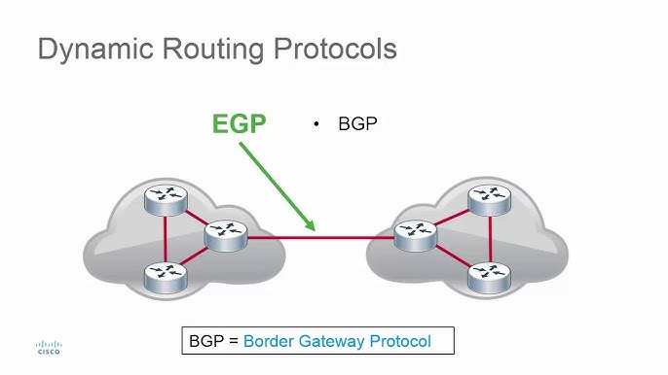

Slide 129
Path vector :
A path vector protocols is essentially a distance vector protocols that does not reply on the distance to destination to a loop free path but instead relies in the analysis of the path itself. Unlike distance-vector and link-state routing, it doesn't focus on the "least cost" path but allows source nodes to select paths based on policies and security. The Border Gateway Protocol (BGP) is the primary example of a path-vector protocol used on the internet today.
How Path-Vector Routing Works
Path Vector Creation: When a router boots, it creates a path vector containing details of the path to a destination.
Information Sharing: Routers share these path vectors with neighboring routers.
Loop Prevention: A router receiving a path vector checks if its own Autonomous System (AS) number is already present in the path. If it is, a loop is detected, and the message is ignored.
Policy-Based Routing: Routers can enforce policies by checking the path vector for specific AS numbers and dropping messages that violate these policies, preventing them from being forwarded.

Slide 130
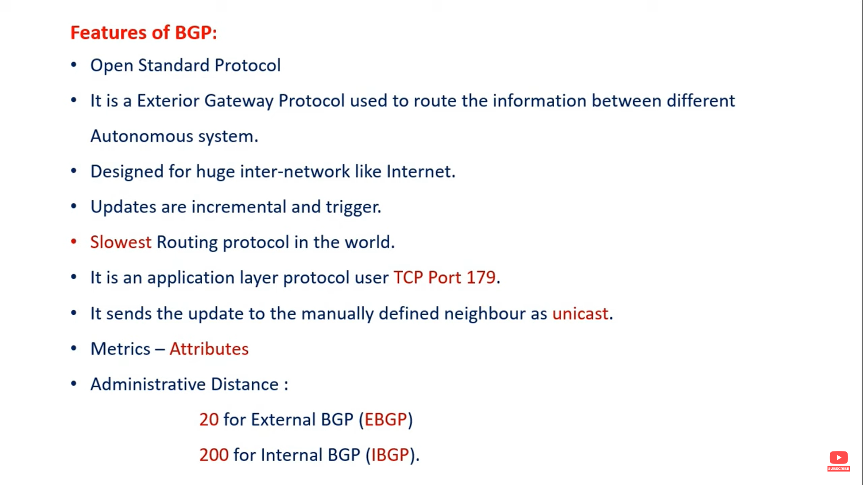

Slide 131
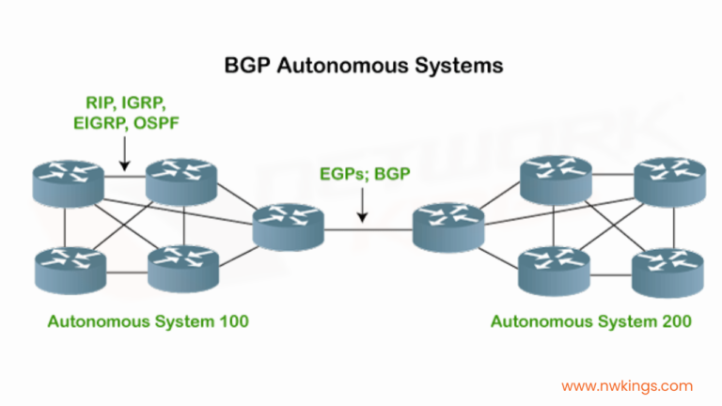

Slide 132
BGP Program
R1
# router BGP 10
#Neighbor 10.0.0.2 remote-as 20
#Network 192.168.1.0
#Exit
R2
# router BGP 20
#Neighbor 10.0.0.1 remote-as 10
#Network 192.168.2.0
#Exit

Slide 133
BGP ANOTHER PROGRAM
R2
10.0.0.1
20.0.0.1
10.0.0.2
200
20.0.0.2
R1
R3
100
300

Slide 134
R1
router bgp 100
neighbor 10.0.0.1 remote-as 200
Network 192.168.1.0
R2
router bgp 200
neighbor 10.0.0.2 remote-as 100
neighbor 20.0.0.2 remote-as 300
R3
router bgp 300
neighbor 20.0.0.1 remote-as 200
Network 192.168.2.0

Slide 135
Dynamic routing protocols metric:
A router’s route table contains the best route to each destination network at knows about
If a router using a dynamic routing protocol learns two different routes to the same destination how does it determine which is best
If uses the metric value of the routes to determine which is best
A lower metric=Better
Each routing uses a different metric to determine which routes is the best
RIP uses hop count, EIGRP use calculation of based of the bandwidth & delay and OSPF uses a cost based bandwidth (metric values)

Slide 136
Administrative Distance:
AD is a value that routers use in order to select the best path when there are two or more different router to the same destination from two different routing protocols .AD counts the reliability of a routing protocols.
Routing protocols | AD
connected | 0
static | 1
BGP(external) | 20
EIGRP | 90
IGRP | 100
OSPF | 110
RIP | 120
BGP(internal) | 200

Slide 137
Next hop:
Next hop is routing terms that refers to the next closer router a packet can go through
The next hop is among the series of routers that are connected together in a network and is the next possible destination for a data packet
Prefix:
Prefix part of IP address identifies as the physical network to which the computer is attached. prefix is also known as a network address.
172.16.0.0/16
172.16.1.0/24
172.16.1.1/32
172.16.2.0/24
Metric:
The metric is a values produced by the routing protocols algorithms . The metric values determine the best path to a destination network within a routing protocols.

Slide 138
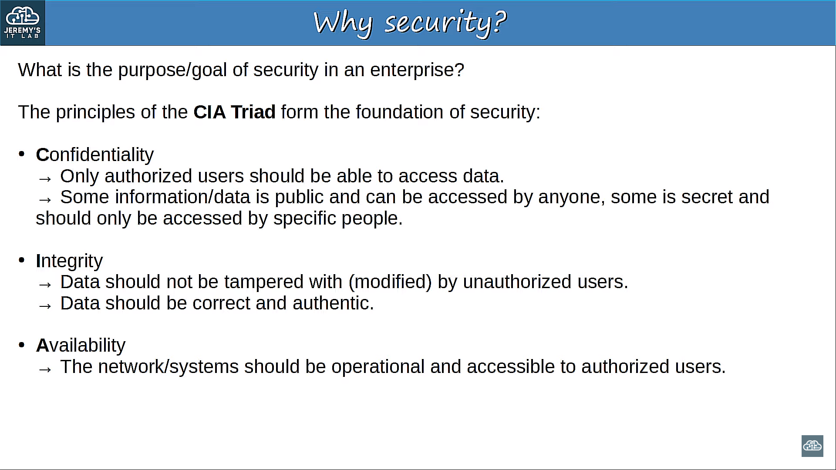
SECURITY
The CIA Triad is a foundational model representing three core principles: Confidentiality, Integrity, and Availability. By ensuring data is only accessible to authorized individuals (confidentiality), remains accurate and unaltered (integrity), and is available when needed (availability)

Slide 139
Security Fundamentals
Threats:
Any attempt to reach your n/w and obtain access to your data is a network threats
Vulnerability:
A n/w vulnerability is a weakness or flow in software ,hardware or organization processes which when compromised by a threat can result in a security reach.
Exploits:
An exploit is a code that advantage of a software vulnerability security flow .when used ,exploits allow an intruder to remotely access a network
Mitigation Techniques:
Mitigation is detection and protection strategy used to safeguard n/w ,server and application by it administrators in order to minimize the effect of malicious traffic and intrusion attempts while maintaining functionality for user

Slide 140
Router command
Config t Mode
Host name change
#hostname r1
Password
#enable password 123 (enable password)
#enable secret 456 (secret password)
#line console 0 (console password)
password abc
login
Exit

Slide 141
Telnet:
Telnet is n/w protocols user to virtual access a computer of remote system on LAN or the internet
Telnet is a client or server application protocols that provides access to virtual terminal of remote system on LAN or the internet.
2 type:
1.with user name
2.without user name
SSH:
SSH is more protect than telnet
SSH is also known as secure shell or secure socket shell, is a n/w protocols that gives users particularly system administration a secures way to access a computer over a unsecured n/w
SSH or socket shell is a n/w communication protocols that enables two computer to communication http
(hyper text transfer protocols ) which is the protocols used to transfer hyper text such as used pages and shared data

Slide 142
Without User
R1:
interface gig0/0/0
Ip address 192.168.1.1 255.255.255.0
No shutdown
Exit
Line vty 0 5 (Virtual TeleType 0-4 or 0-15)
Password abcd
Login
end

Slide 143
(config t)#
Enable Password XYZ
do write
Desktop
192.168.1.2
255.255.255.0
192.168.1.1
Command Promt
telnet 192.168.1.1
user access verification
Password : abcd
Router >Enable
Password : XYZ

Slide 144
With User
interface gig0/0/0
Ip address 192.168.1.1 255.255.255.0
No shutdown
Exit
Enable password abcd
Username Admin Password XYZ
Line vty 0 1
Login local
Exit
Do write

Slide 145
Desktop
192.168.2.2
255.255.255.0
192.168.2.1
Command promt
telnet 192.168.2.1
user name :Admin
Password :XYZ
Router >enable
Password :abcd

Slide 146
SSH - Secure Shell
It is a network protocol used to securely access and manage devices over an unsecured network (like the Internet).
Provides encryption, authentication, and data integrity for remote connections.
Commonly used by network administrators, developers, and system engineers.

Slide 147
Key Features
Secure Remote Login: Allows users to log into remote systems securely.
Data Encryption: Encrypts all transmitted data, protecting it from eavesdropping or interception.
Authentication: Supports several authentication methods (passwords, public/private keys, certificates).
Command Execution: Enables running commands on remote systems.
File Transfer: Includes tools like SCP (Secure Copy) and SFTP (Secure File Transfer Protocol).
Port Forwarding (Tunneling): Encapsulates other protocols (like HTTP or SMTP) inside an SSH session for security.
Session Multiplexing: Multiple sessions can be handled through one SSH connection.

Slide 148
How SSH Works (Step-by-Step)
Connection Initiation: The SSH client contacts the SSH server (default port 22).
Version Exchange: Client and server agree on protocol version and encryption algorithms.
Key Exchange: A secure session key is established using asymmetric encryption (e.g., RSA, Diffie-Hellman).
User Authentication: User identity is verified (via password or public key).
Secure Channel Established: Once authenticated, all communication is encrypted and integrity-protected.

Slide 149
🌐 Network Usage
Default Port: TCP port 22.
Protocol Type: Application-layer protocol
(operates over TCP/IP).
Used For:
Managing routers, switches, and firewalls remotely.
Logging into remote servers.
Securely transferring files.
Tunnelling other protocols.
Automating remote operations (via scripts).

Slide 150
Security Advantages
Protects against man-in-the-middle (MITM) attacks.
Encrypts passwords and data in transit.
Prevents unauthorized remote access.
Supports strong encryption algorithms (AES, ChaCha20, RSA, etc.).
⚠️ Security Best Practices
Disable password logins; use SSH keys instead.
Change the default port 22 to a non-standard port.
Use firewalls to restrict SSH access.
Implement Fail2Ban or similar tools to block brute-force attacks.
Regularly update OpenSSH and patch vulnerabilities.
Use strong passphrases for private keys.

Slide 151
SSH
R1:
interface gig0/0/0
Ip address 192.168.1.1 255.255.255.0
No shutdown
Exit
Hostname R1
Username abcd Password abc
Ip domain-name ns.com
Service password-encryption
Crypto key generate rsa

Slide 152
How many bits moduls :500
Enable password xyz
Line vty 0 1
Transport input ssh
Login Local
Exit
Desktop:
192.168.1.2
255.255.255.0
192.168.1.1
Command promt
ssh –l abcd 192.168.1.1
Password :abc
enable
Password xyz

Slide 153
Access Control List (ACL)
ACL refer to a specific set of rule used for filtering network traffic, especially in computer security setting
ACL deals with DENY or PERMIT condition
Two types:
Numbered ACL – set of rule identified by a numbers
Named ACL – set of rule identified by a name
Standard ACL
Extended ACL

Slide 154
Standard ACL : These ACL permit or deny packet based only on the source IP address
Extended ACL : These ACL permit or deny packet based on the source IP address , Destination IP address , protocols etc…,
Standard ACL
This will filter the full communication of the particular devices
The ACL number of standard ACL has to be between 1-99(or 1300- 1699)
Filtering is based on the source IP address
Match a network host and subnets (not selected services)
All services are blocked(cannot define selected services)

Slide 155
Extended ACL:
Each and any protocols could be blocked when deny conditions is applied
Through extended ACL the particular services can be permitted / blocked
The ACL number for the extended ACL has to be between 100 – 199 ( OR 2000 -2699)
Filtering is based on source IP address, destination IP address, protocols and ports (services)
Match specific network , host , subnet , and services
Select services can be blocked

Slide 156
Standard ACL
DO DYNAMIC ROUTING ATOMATIC IP ALLOCATION
R1:
Access-list 1 deny host 192.168.1.2
Access-list 1 permit any
Do write
Interface gig0/0/0
Ip access-group 1 in
Do write
Exit
Pc1 command prompt
Ping 192.168.2.1
192.168.3.2
192.168.1.2
192.168.1.3
192.168.2.1
192.168.2.2

Slide 157
Extended Acl:
Server:
Service ->HTTP -> ON
R2:
#access-list 100 deny tcp host 192.168.2.2 host 192.168.3.2 eq 80 //(eq-equivalent)
#Access-list 100 permit tcp any host 192.168.3.2 eq 80
#Access-list 100 permit ip any any
#interface gig0/0/0
#ip access-group 100 in
#do write
#exit
Desktop -> browser:
192.168.3.2 ->go

Slide 158
Feature | Standard ACL | Extended ACL
Definition | Filters traffic based only on source IP address. | Filters traffic based on source and destination IP address, as well as protocols and port numbers.
ACL Number Range | 1–99 and 1300–1999 | 100–199 and 2000–2699
Layer (OSI Model) | Operates at Layer 3 (Network layer) | Operates at Layer 3 and 4 (Network & Transport layers)
Filtering Criteria | Source IP address only | Source IP, Destination IP, Protocol (TCP, UDP, ICMP), Port numbers
Control Level | Provides basic access control | Provides granular and detailed access control
Placement Recommendation | Should be placed close to the destination to avoid unnecessary blocking | Should be placed close to the source to stop unwanted traffic early
Example Command | access-list 10 permit 192.168.1.0 0.0.0.255 | access-list 110 permit tcp 192.168.1.0 0.0.0.255 any eq 80
Use Case | When you need simple traffic filtering based on source | When you need to filter specific traffic types (e.g., HTTP, FTP, ICMP)
Complexity | Simple and easy to configure | More complex and flexible
Performance Impact | Lower CPU processing | Slightly higher CPU usage due to detailed filtering

Slide 159

SWITCHES

Slide 160
Feature | Multilayer Switch | Router
Definition | A network switch that works on Layer 2 (switching) and Layer 3 (routing) of the OSI model. | A device that works mainly on Layer 3 (Network Layer) to connect different networks.
Primary Function | High-speed switching within LAN + basic routing between VLANs. | Routing data between different networks (LAN, WAN, Internet).
Performance | Optimized for fast switching (hardware-based, ASIC chips). | Slower than switches in packet forwarding (software-based in many cases).
Use Case | Best for large LANs with multiple VLANs needing inter-VLAN routing. | Best for WAN connections, internet access, and inter-network communication.
Scalability | Scales well inside LAN (enterprise, data centers). | Scales well for connecting different geographical networks.
Routing Features | Supports basic routing protocols (RIP, OSPF, EIGRP in some). | Supports advanced routing protocols (OSPF, BGP, MPLS, VPN).
Cost | Generally cheaper than high-end routers for LAN use. | Usually more expensive, especially enterprise-grade routers.
Example Use | Connecting VLANs inside a company office → Marketing VLAN ↔ Sales VLAN. | Connecting office LAN to the Internet or to another branch office.

Slide 161
Types of switches
Managed Switches:
A managed network switch is a technology that allows Ethernet devices to communicate with each other and that contains features to configure, manage and monitor traffic on a Local Area Network (LAN). A managed network switch provides more control over how data travels over the network and who can access it.

Slide 162
Unmanaged switches:
Unmanaged switches use auto negotiated ports to determine parameters, such as data rates and whether to use half-duplex or full-duplex mode. Additionally, unmanaged switches have no concept of virtual LANs (VLANs). Thus, all devices belong to the same broadcast domain

Slide 163
Switch Port Security
Switch CLI
#en
#config t
#Do show port-security int fa0/1
#int fa0/1 10.0.0.5
#switchport mode access
#switchport port-security? 10.0.0.4
#enter
#enter 10.0.0.1 10.0.0.2 10.0.0.3
# do show port-security int fa0/1
# switchport port-security maximum 2
# switchport port-security violation shutdown
# switchport port-security mac-address sticky
#do write
#exit

Slide 164
Port security violation modes
Protect:
Drops packets from unknown source MAC addresses.
Does not send a notification when a violation occurs.
Allows traffic from known MAC addresses to continue.
Restrict:
Drops packets from unknown source MAC addresses.
Increments the violation counter and sends a notification when a violation occurs.
Allows traffic from known MAC addresses to continue.
Shutdown:
Disables the port immediately.
The port's LED turns off and it is moved to an error-disabled state.
Requires manual intervention to re-enable the port.

Slide 165
VLAN
Place Switch & PC's
Give IP to each PC Same Network
No Gateway Needed
Config mode:
en
config t
vlan 10
name IT
ex
vlan 20
name manager
ex
vlan 30
name tech
ex
do show vlan
SWITCH
Fa0/1
Fa0/4
10
30
192.168.1.2
Fa0/2
Fa0/3
192.168.1.5
20
20
192.168.1.3
192.168.1.4

Slide 166
int fa0/1
switchport mode access
switchport access vlan 10
ex
int range fa/2-3
switchport mode access
switchport access vlan 20
ex
int fa0/4
switchport mode access
switchport access vlan 10
ex
do show vlan

Slide 167
Trunk port
Switch 1:
Interface fa0/7
Switchport mode trunk
Exit
Vtp mode server
Vtp domain ns
Do write
Switch2:
Interface fa0/1
Switchport mode trunk
Exit
Vtp mode client
Do write
Do show vlan
Switch 2
Switch 1

Slide 168
Inter VLAN
Create a VLAN in switch without IP
Place Router
Just lineup Router without IP
Encapsulate VLAN
Assign IP & Gateway to PC’s according to encapsulation
R1
en
config t
int gig0/0/0
no shut
ex
R1
Fa0/5
SWITCH
Fa0/1
Fa0/4
10
30
192.168.1.2
Fa0/2
Fa0/3
192.168.3.2
20
20
192.168.2.2
192.168.2.3

Slide 169
int gig0/0/0.1
encapsulation dot1q 10
ip add 192.168.1.1 255.255.255.0
ex
int gig0/0/0.2
encapsulation dot1q 20
ip add 192.168.2.1 255.255.255.0
ex
int gig0/0/0.3
encapsulation dot1q 30
ip add 192.168.3.1 255.255.255.0
ex
Switch
int fa0/5
switchport mode trunk
ex

Slide 170
FTP LAB
FTP (File Transfer Protocol) is a standard network protocol used to transfer files between a client and a server over a TCP/IP network (like the Internet or a local network).
It runs on:
Port 21 (command/control connection)
Port 20 (data transfer connection — in active mode)
An FTP server stores files, and FTP clients (like FileZilla, WinSCP, or command-line FTP) can:
Upload files to the server
Download files from the server
Delete, rename, or organize files remotely

Slide 171
FTP LAB
Server:
202.84.41.2
255.255.255.0
202.84.41.1
Router:
line up:192.168.1.1
Server:
Service: ftp –on
Username: admin
Password:12345

Slide 172
Write,Read,Delete,Rename,List ( right) –add
Pc0:
192.168.1.2
255.255.255.0
192.168.1.1
Pc1:
192.168.1.3
255.255.255.0
192.168.1.1
Pc0:
Text editor:
Hi, This is my first FTP file.
CLOSE tap and save(dee.txt)

Slide 173
Pc0:
Command prompt:
Ping 202.84.41.2
ftp 202.84.41.2
Username:admin
Password:12345
Logged in
ftp> dir
ftp> put dee.txt
Transfer complete
ftp>dir

Slide 174
Pc1:
Command prompt
ftp 202.84.41.2
ftp>dir
ftp>get dee.txt
ftp>rename dee.txt hi

Slide 175
TFTP
TFTP (Trivial File Transfer Protocol) is a simplified version of FTP, used mainly for transferring small files between network devices — such as routers, switches, and servers.
Use Case | Description
1. Backup Configurations | Network admins use TFTP to back up router/switch configuration files.
2. Restore Configurations | Quickly restore saved configs to a new or reset device.
3. IOS / Firmware Upgrades | Upload or download operating system images to routers, switches, or firewalls.
4. PXE Boot (Network Boot) | Computers booting over a network use TFTP to download the initial boot files.

Slide 176
TFTP LAB
Router(config):
Hostname R1
#enable secret 123123
#exit
R1#write
R1#copy startup-config tftp
R1#copy startup-config tftp host []? 10.0.0.2
enter
10.0.0.2
R1

Slide 177
Cut router and add router same Gateway(10.0.0.1)
lineup
New Router:
Previllage mode☹(en)
#copy tftp startup-config
#host[]?10.0.0.2
#source:R1-confg (file name)
Enter
Enter
Router switch off and on

Slide 178
Feature | TFTP | FTP
Protocol Type | UDP (Connectionless) | TCP (Connection-oriented)
Default Port | 69 | 21
Authentication | None | Yes (username & password)
Security | Not secure | Can be secured with FTPS/SFTP
Speed | Faster (less overhead) | Slower (more control)
Typical Use | Config/firmware transfer, PXE boot | Web file management, uploads/downloads
Reliability | Lower (UDP) | Higher (TCP)

Slide 179
STP – Spanning Tree Protocol
Route Bridge - Lowest Priority
If priority are equal in all switch select Lowest MAC Address Value
Port connected to the route bridge is called route port
Orange Color Mark – Blocking State ( Packet wont travel in this path)
If the path not available choose Alternate Blocking State
refresh program automatically lineup
All switch
Do show spanning-tree
Send Packet from 2 to 3
Int fa 0/1
Shutdown
Send Packet from 2 to 3
Priority-35
MAC-aa:aaa:aa:aa
1
Fa0/1
Fa0/2
Priority-35
MAC- bb:bbb:bb:bbb
Priority-35
MAC- cc:ccc:cc:ccc
2
3
Destination Forward
ALT Blocking State
Destination Forward

Slide 180
RSTP - Rapid Spanning Tree Protocol
All Switches
#Spanning-tree mode rapid-pvst (Rapid Per-VLAN Spanning Tree)
#int range fa0/1-2
#switchport mode trunk
#int fa0/2
#shoutdown
#int fa0/2
#no shut
without refresh program automatically lineup
1
2
3

Slide 181
NTP
The importance of time
All devices have an internal clock (routers, switches, your PC, etc)
In Cisco IOS, you can view the time with the show clock command.
R1#show clock
00:16:00.857 UTC Sat Dec 26 2020
If you use the show clock detail command, you can see the time source.
R1#show clock detail
*00:19:49.411 UTC Sat Dec 26 2020

Slide 182

Manual Time Configuration
• You can manually configure the time on the device with the clock set command.

Slide 183
Network Time Protocol
Manually configuring the time on devices is not scalable.
The manually configured clocks will drift, resulting in inaccurate time.
NTP (Network Time Protocol) allows automatic syncing of time over a network.
NTP clients request the time from NTP servers.
A device can be an NTP server and an NTP client at the same time.
NTP allows accuracy of time within ~1 millisecond if the NTP server is in the same LAN, or within 50 milliseconds if connecting to the NTP server over a WAN/the Internet.
Some NTP servers are 'better' than others. The 'distance' of an NTP server from the original reference clock is called stratum.
NTP uses UDP port 123 to communication

Slide 184
Reference Clocks
• A reference clock is usually a very accurate time device like an atomic clock or a GPS clock.
• Reference clocks are stratum 0 within the NTP hierarchy.
• NTP servers directly connected to reference clocks are stratum 1.

Slide 185


Slide 186
NTP HIERARCHY
Reference clocks are stratum 0.
Stratum 1 NTP servers get their time from reference clocks.
Stratum 2 NTP servers get their time from stratum 1 NTP servers.
Stratum 3 NTP servers get their time from stratum 2 NTP servers.
Stratum 15 is the maximum. Anything above that is considered unreliable.
Devices can also 'peer' with devices at the same stratum to provide more accurate time.
NTP client can sync to multiple NTP Servers

Slide 187
PRIMARY SERVER:
NTP server which get their time directly from a reference clock are also called primary server
SECONDARY SERVER:
NTP server which get their time form other NTP server are called secondary server . THEY operates in server mode and client mode at the same time

Slide 188
NTP
R1
interface gig0/0/0
Ip address 192.168.1.1 255.255.255.0
No shutdown
Exit
interface gig0/0/1
Ip address 202.84.41.1 255.255.255.0
No shutdown
Exit

Slide 189
Server
Ip set:
202.84.41.2
255.255.255.0
202.84.41.1
Server-service
NTP –on
R1:
Do show clock

Slide 190
R1 Config:
Ntp server?
Ntp server 202.84.41.2
Exit
Do show ntp associations
Do show clock
Server:
Ntp- on <->off //To chnge the date and time
R1: do show clock

Slide 191
NAT
NAT (Network Address Translation) is a process used by routers or firewalls to translate private IP addresses (used inside your network) into public IP addresses (used on the Internet).
It acts like a bridge between your private LAN and the public Internet.
Private IP: 192.168.1.10 → Translated to → Public IP: 203.0.113.5
NAT hides your internal network from the outside world.
External users only see your public IP address, not your internal devices. This helps prevent direct access or attacks from the Internet.

Slide 192
Static NAT
Static NAT (Static Network Address Translation) is a one-to-one mapping between a private IP address and a public IP address.
That means a specific internal (private) device always uses the same public IP address when communicating with the Internet — and vice versa.

Slide 193
Static NAT
All router line up
Default routing:
R1:
#Ip route 0.0.0.0 0.0.0.0
10.0.0.2
R2:
#Ip route 0.0.0.0 0.0.0.0
10.0.0.1
10.0.0.1
10.0.0.2
192.168.1.1
192.168.2.1
192.168.1.2

Slide 194
R1:
#int gig0/0/0
#ip nat inside
#Exit
#Int se0/1/0
#ip nat outside
#exit
#ip nat inside source static 192.168.1.2(pc1) 100.0.0.2
#do write
#do show ip nat translation
#exit
#do debug ip nat
Send packet to Other Network
#do show ip nat translation

Slide 195
Dynamic Nat
@Dynamic NAT (Network Address Translation) works by mapping private IP addresses (like 192.168.x.x or 10.x.x.x) to public IP addresses (like 203.x.x.x) when internal users access the Internet.
@whenever an internal user (for example, 192.168.1.10) accesses the Internet, the router dynamically assigns one public IP from the pool
@When that user’s session ends, the IP is released back to the pool and can be used by another user.
Advantage | Description
Efficient public IP usage | Public IPs are assigned only when needed
Automatic translation | No need to manually create each mapping
Better security | Internal IPs stay hidden from the Internet
Limited by pool size | If all public IPs are in use, new users must wait
Temporary mapping | IP changes each time, not suitable for servers

Slide 196
Dynamic Nat
All router line up
Default routing:
R1:
#Ip route 0.0.0.0 0.0.0.0
10.0.0.2
R2:
#Ip route 0.0.0.0 0.0.0.0
10.0.0.1

Slide 197
R1:
#int gig0/0/0
#ip nat inside
#Exit
#Int se0/2/0
#ip nat outside
#exit
#access-list 20 permit 192.168.1.0 0.0.0.255
#ip nat pool abcd 20.0.0.1 20.0.0.5 netmask 255.0.0.0
#ip nat inside source list 20 pool abcd
#do write
#do debug ip nat
#exit

Slide 198
PAT – NAT Overload
PAT (Port Address Translation) is a type of NAT that allows multiple private IP addresses to share a single public IP address by using different port numbers to keep the sessions unique.
It’s sometimes called:
NAT Overload, or
Many-to-One NAT
The router replaces:
The source private IP with the public IP, and The source port number with a unique port.
When the reply comes back, the router looks at the port number to know which private device it belongs to.
This allows hundreds (or even thousands) of devices to share one public IP address simultaneously.

Slide 199
PAT(Nat overload)
All router line up
R1:
#int gig0/0/0
#ip nat inside
#Exit
#Int se0/2/0
#ip nat outside
#exit
#access-list1 permit 192.168.1.0 0.0.0.255
#ip nat inside source list1 interface se0/1/0 overload
#Do debug ip nat
#Do show ip nat translation

Slide 200
DHCP Snooping
DHCP Snooping is a security feature used mainly on network switches to protect against malicious or rogue DHCP servers on a LAN (Local Area Network).
DHCP Snooping acts as a “firewall” for DHCP traffic — it filters and monitors DHCP messages exchanged between clients and servers.
It allows DHCP responses only from trusted DHCP servers Blocks fake servers trying to hand out wrong IPs (called Rogue DHCP servers)
Without DHCP Snooping, anyone could connect a laptop or router to a LAN port, start a DHCP service, and issue fake IP addresses — leading to:
Man-in-the-middle attacks
IP address conflicts
Network downtime
Traffic redirection or sniffing

Slide 201

DHCP Snooping Database / Binding Table
The switch keeps a record of:
MAC address
Assigned IP address
VLAN number
Lease time
Interface (port)

Slide 202
DHCP Snooping
Assign IP to Servers 192.168.1.50 & 192.168.2.50
Create 1 DHCP pool in each server
Check DHCP in PC’s
( PC’s reflect both sever DHCP in every Power on)
Write Program in Switch
Check DHCP in PC’s
Switch
#en
#config t
#ip dhcp snooping
#ip dhcp snooping vlan 10
#int fa0/2 (Trusted server port)
#ip dhcp snooping trust
#do wr

Slide 203
AAA-TACACS
TACACS stands for Terminal Access Controller Access-Control System. It’s a network authentication and access control protocol developed by Cisco (modern version: TACACS+).
It’s mainly used to centralize user authentication, authorization, and accounting (AAA) for network devices like routers, switches, and firewalls.

Slide 204
1. Centralized User Management
Instead of configuring user accounts and passwords on every router or switch individually, TACACS allows central management via a single TACACS server (like Cisco ISE or Free RADIUS).
Benefit: Easier administration and consistent access policies across all devices.
2. Enhanced Security
All communication between the network device (client) and TACACS server is encrypted.
Even the command authorization data is encrypted — unlike RADIUS (which only encrypts passwords).
Benefit: Prevents credential leaks and protects access control data from sniffing.

Slide 205
The network device acts as a TACACS client.
The TACACS server validates the credentials.
Access is granted or denied based on policies defined on the server.
Enables AAA.
Uses TACACS+ server at IP 192.168.1.1 for login authentication.
Falls back to local login if TACACS server is unreachable.

Slide 206
TACACS
Router
#En
#config t
#int gig0/0/0
#ip add 192.168.1.1 255.255.255.0
#no shut
server->Desktop
IP-192.168.1.2
SM-255.255.255.255.0
Gate-192.168.1.1
server->service ->DHCP->
Pool Create - 192.168.1.1
All PC's->DHCP->On
R1
192.168.1.2
192.168.1.1
SERVER
Switch

Slide 207
Server->Service->AAA->On Service
Client Name : V1
Client IP : 192.168.1.1
Secret : 12345
Server Type Tacacs+ ---> ADD
User Name : admin
PWD : admin123 ---> ADD

Slide 208
Router->CLI
#En
#config t
#tacacs-server host 192.168.1.2
#tacacs-server key 12345
#aaa new-model
#aaa authentication login default group tacacs local
#line vty 0 3
#login authentication default
PC->CMD->telnet 192.168.1.1

Slide 209
RADIUS stands for Remote Authentication Dial-In
User Service. It is a client–server protocol used to authenticate, authorize, and account for users who connect to and use a network service.
Originally designed for dial-up networks, RADIUS is now widely used for:
Wi-Fi authentication
VPN access
Network device logins (routers, switches, firewalls)
Enterprise 802.1X authentication

Slide 210
1. Centralized Authentication
Instead of storing user credentials locally on each access point or switch, all devices use a central RADIUS server (like Microsoft NPS, Cisco ISE, or FreeRADIUS).
2. Secure Network Access (802.1X)
RADIUS is commonly used in enterprise Wi-Fi and wired networks with 802.1X authentication.
Benefit: Ensures only authorized users and devices can connect to your network (using certificates or credentials).

Slide 211
1. Centralized Authentication
Instead of storing user credentials locally on each access point or switch, all devices use a central RADIUS server (like Microsoft NPS, Cisco ISE, or FreeRADIUS).
2. Secure Network Access (802.1X)
RADIUS is commonly used in enterprise Wi-Fi and wired networks with 802.1X authentication.
Benefit: Ensures only authorized users and devices can connect to your network (using certificates or credentials).

Slide 212
4. Accounting and Auditing
RADIUS tracks:
Who connected
When they connected
How long they stayed
How much data they used
Benefit: Great for usage tracking, billing (ISPs), and auditing.

Slide 213
Router
#En
#config t
#int gig0/0/0
#ip add 192.168.1.1 255.255.255.0
#no shut
server->Desktop
IP-192.168.1.2
SM-255.255.255.255.0
Gate-192.168.1.1
All PC's->IP Manual Set
Server->Service->AAA->On Service
Client Name : V1
Client IP : 192.168.1.1
Secret : 12345
Server Type : radius ---> ADD

Slide 214
User Name : admin
PWD : admin 123 ---> ADD
Router->CLI
#En
#config t
#aaa new-model
#radius server r1_radius
#address ipv4 192.168.1.2 auth-port 1645
#Key 12345
#ex
#aaa authentication login default group radius local
#line console 0
#login authentication default
#ex
#line vty 0 4
#login authentication default
#do wr
#enable password 123
#Ex

Slide 215
Firewall
Loopback IP (eg.1.1.1.1)is necessary for firewall
Uname and PWD must match
No auto-summery - Meant "i didn't call any network" and network also 0.0.0.0
When loopback IP calls credential should be enabled

Slide 216
192.168.100.1
192.168.100.10
FIRE
WALL
100.100.100.10
100.100.100.20
192.168.1.1
5506-x
ASA0
192.168.2.1
192.168.1.2

Slide 217
R1
Line Up Router1
#hostname chennai
#router eigrp 1 (Call any routing Concept)
#no auto-summary (allow unknown network)
#network 0.0.0.0
#ex
#gig0/0/1
#ip add 192.168.100.1 255.255.255.0
#no shut

Slide 218
ASA0-Firewall
#en
#password:(no)
#config t
#int gig1/1
#ip add 192.168.100.10 255.255.255.0
#no shut
#nameif inside
#security-level 100 ( Security Level has to give for packet return back)
#exit
#int gig1/2
#ip add 100.100.100.10 255.0.0.0
#no shut

Slide 219
#nameif outside
#security-level 100
#end
#show int (show firwall details)
#show int ip brief (configuration made by us)
#config t
#router eigrp 1
#no auto-summary
#network 0.0.0.0

Slide 220
R2
#en
#config t
#int gig0/0/0
#ip add 192.168.2.1 255.255.255.0
#no shut
#ex
#int loopback 0
#ip add 8.8.8.8 255.255.255.255
#ex
#router eigrp 1
#no auto-summary
#network 0.0.0.0
#username admin privilage 15 password admin123 (firewall securtity command)
#line vty 0 4
#login local
#transport input all
#exit

Slide 221
#int gig0/0/1
#ip add 100.100.100.20 255.255.255.0
#no shut
set IP to all PC's
PC0-> cmd --> ping 8.8.8.8 (R2 loopback IP is reflect in R1)
PC0->Telnet/SSH-->
connection Type - Telnet
IP - 8.8.8.8 ---> connect
It will ask user credential
>admin
>admin123
>config t
>ex
>ping 8.8.8.8

Slide 222
VPN - GRE Tunnel
A VPN (Virtual Private Network) is a technology that creates a secure, encrypted connection between your device and another network over the internet.
In real-world networking, organizations often need to connect remote branch networks securely over a public or intermediate network. GRE tunneling is a technique that creates a virtual point-to-point link between routers, allowing different networks to communicate as if they were directly connected.
Route LAN traffic through the GRE tunnel.

Slide 223
A VPN is a secure tunnel that protects your data and hides your online identity while connecting to another network.
A VPN provides three main functions
1. Encryption
It encrypts your data so no one can read it (hackers, ISP, public Wi-Fi attackers).
2. Privacy / Anonymity
It hides your original IP address and shows the VPN server's IP instead.
3. Secure Remote Access
It allows employees or users to securely access private networks from remote locations.

Slide 224


Slide 225
R1
ip route 0.0.0.0 0.0.0.0 10.0.0.2
R2
ip route 0.0.0.0 0.0.0.0 20.0.0.1
R1
privalege mode
ping 20.0.0.1
config t
int tunnel 1
ip address 200.100.100.1 255.255.0.0
tunnel source se0/1/0
tunnel destination 20.0.0.2
no sh

Slide 226
R3
int tunnel 2
ip address 200.100.100.2 255.255.0.0
tunnel source se0/1/0
tunnel destination 10.0.0.1
no sh
R1
ip route 192.168.2.0 255.255.255.0 200.100.100.2
R3
ip route 192.168.1.0 255.255.255.0 200.100.100.1
PC0
ping 192.168.2.2
Transfer Packet
tracert 192.168.2.2
PC1
tracert 192.168.1.2

Slide 227
Feature | WEP (Wired Equivalent Privacy) | WPA-PSK (Wi-Fi Protected Access) | WPA2-PSK (Wi-Fi Protected Access II)
Introduced | 1997 | 2003 | 2004 (mandatory in 2006)
Encryption | RC4 | TKIP | AES (CCMP)
Key Length | 64-bit / 128-bit | 256-bit (via TKIP) | 128-bit (AES key)
Authentication | Open or Shared Key | Pre-Shared Key (PSK) | Pre-Shared Key (PSK)
Security Level | Very Weak | Moderate | Strong
Vulnerabilities | Key cracking, replay attacks | Dictionary attacks | Weak passwords, WPS attacks
Recommended? | ❌ No | ⚠️ Limited use | ✅ Yes

Slide 228
WPS exploits refer to security weaknesses
in Wi-Fi Protected Setup (WPS)

Slide 229

WLAN – WLC & LWAP

Slide 230
R1
Line Up – 192.168.1.1
MultiLayer Switch -> Power Replace
Laptop -> Power Off ->Remove LAN -> Insert WiFi
WLC-3504
Config → Management
192.168.1.2
255.255.255.0
192.168.1.1
192.168.1.1
Server →Ip set:
192.168.1.3
255.255.255.0
192.168.1.1
192.168.1.1

Slide 231
Server → DHCP pool create:
Name: NT1
Gateway:192.168.1.1
DNS Server:192.168.1.1
Start ip:192.168.1.5
Maximum Number of user:200
Pc IP -> DHCP – On
Pc Web browser:
192.168.1.2 ->go

Slide 232
User:admin
Password: admin
Con.password: Admin@123 ->start
1.set:
Name- CCNA1
192.168.1.2
255.255.255.0
192.168.1.1 ->next
2, Create your wireless N/W
Network name- WIFI1
Security – WPA2 personal
Passphrase – Admin@456
Con.password- Admin@456 ->next

Slide 233
3, advanced setting: -> Next
4.Apply ->ok
PC→Browser→https:192.168.1.2
Login
User:admin
Password: Admin@456
Laptop->config->wireless0->SSID->WPA2
PWD(Admin@456)->on
Mobile -> config->wireless0->SSID->WPA2 PWD(Admin@456)->on

Slide 234


Slide 235
IOT – Internet of Things
IoT, Internet of Things, is a network of physical objects that are embedded with sensors, software, and other technologies to connect and exchange data over the internet.
APPT→Port1
SSID – VV
WPA -> 11223344
Server ->
IP-192.168.1.1
SM-255.255.255.0
GW-No Need
Services->DHCP->Pool->192.168.1.1
PC-> DHCP->on
Sever->IOT Monitor->Signup -> admin & admin@123

Slide 236
FAN, BULB, GATE
Config→wireless0
SSID – VV
WPA -> 11223344
Settings→ IOT Server→ Remote Server
Sever Adddress-192.168.1.1
Uname-admin
Pwd-admin@123

Slide 237

Mail Server

Slide 238
Line up
Device | IP Address | Subnet Mask | Default Gateway | DNS
Router | 192.168.1.1 | 255.255.255.0 | — | 192.168.1.2
Server | 192.168.1.2 | 255.255.255.0 | 192.168.1.1 | 192.168.1.2
PC1 | 192.168.1.3 | 255.255.255.0 | 192.168.1.1 | 192.168.1.2
PC2 | 192.168.1.4 | 255.255.255.0 | 192.168.1.1 | 192.168.1.2
Server Configuration (Mail Server)
Server → Config → Settings
Display Name: MailServer
IP: 192.168.1.2
Gateway: 192.168.1.1

Slide 239
Server → Services → EMAIL
Enable:
SMTP (ON)
POP3 (ON)
Domain Name : mailserver.com → set
Add 2 user accounts:
Username: user1 Password: user123 → Add
Username: user2 Password: user123 → Add
On PC1:
Go to → Desktop → Email
Email Address: user1@mailserver.com
Incoming Mail Server (POP3): 192.168.1.2
Outgoing Mail Server (SMTP): 192.168.1.2
Username: user1
Password: user123

Slide 240
On PC2:
Email Address: user2@mailserver.com
Incoming: 192.168.10.2
Outgoing: 192.168.10.2
Username: user2
Password: user123
From PC1 → Send Email to PC2
Subject: Test
Body: Hello
Then check PC2 → Email → Receive

Slide 241
Feature | LAP (Lightweight Access Point) | AP (Autonomous Access Point)
Full Form | Lightweight Access Point | Autonomous Access Point
Management | Controlled and managed by a Wireless LAN Controller (WLC) | Self-managed (configured individually)
Control Type | Centralized management via WLC | Standalone operation
Configuration | Configuration pushed by WLC (SSID, security, channels, etc.) | Configured locally through CLI or GUI
Firmware / S/w Updates | Handled automatically by WLC | Manually updated on each AP
Deployment Scale | Ideal for medium to large enterprise networks with many APs | Best suited for small or home networks
Flexibility | Dependent on WLC availability | Works independently, even without WLC
Traffic Handling | User data is often tunneled to WLC for processing | User data handled locally on the AP
Cost | Higher (requires WLC) | Lower (no controller needed)

Slide 242
Router OS Type | Developer / Brand | Description
MikroTik RouterOS | MikroTik (Latvia) | Linux-based OS with advanced routing, firewall, VPN, and wireless features. Used in MikroTik RouterBOARDs or PCs.
Cisco IOS (Internetwork Operating System) | Cisco Systems | Industry-standard CLI-based router OS used in Cisco routers and switches. Supports advanced routing protocols and enterprise features.
Cisco IOS XE / XR / NX-OS | Cisco Systems | Modern versions of Cisco OS for high-end routers, carrier-grade and data center devices.
JunOS | Juniper Networks | BSD-based router OS known for reliability and scalability in large enterprise and ISP networks.
VyOS | Community-based (Open Source) | Linux-based open-source router OS supporting routing, VPN, and firewall features; great for labs or custom network setups.
pfSense | Netgate / Open Source | FreeBSD-based firewall and router OS popular for security, VPN, and home/SMB networking.
OpenWrt / DD-WRT | Open Source | Linux-based firmware for consumer routers. Allows custom configurations, firewalls, and VPNs on home routers.
EdgeOS | Ubiquiti Networks | Debian-based OS for EdgeRouter devices. Combines CLI and web GUI for advanced routing and firewalling.
FortiOS | Fortinet | Secure router/firewall OS for FortiGate appliances, focusing on UTM (Unified Threat Management).
RouterOS CHR (Cloud Hosted Router) | MikroTik | Virtualized version of RouterOS for cloud environments (VMware, KVM, AWS, etc.).

Slide 243
Multi-Layer Switch Brand | Operating System / Firmware Name
HP / Aruba | ArubaOS / ProVision
Ubiquiti | EdgeOS / UniFi Network Firmware
TP-Link | JetStream OS
D-Link | DGS Smart Firmware
Dell / Extreme | OS9 / EXOS / SmartFabric OS

Slide 244
Flash Memory (Main Storage)
The router’s operating system (RouterOS, Cisco IOS, JunOS, etc.) is stored in flash memory.
Flash is similar to a USB drive — it keeps data even when power is lost.
When the router boots up, it loads the OS from flash memory into RAM to run it.
💡 In MikroTik RouterOS:
The RouterOS firmware image is stored in the device’s internal NAND flash or CompactFlash (depending on the model).
On PC installations or CHR (cloud), it’s stored on the system drive (HDD/SSD or virtual disk).

Slide 245
🔸 2. RAM (Working Memory)
After booting, RouterOS runs entirely in RAM.
All configurations and routing tables are processed here.
When the router is turned off, anything in RAM is lost — unless it’s saved to flash.
Flash = permanent storage (like a hard drive)
RAM = temporary working space (like your computer’s mem

Slide 246
ROM (Read-Only Memory)
Contains the bootloader or firmware (for example, MikroTik’s RouterBOOT).
The bootloader’s job is to:
Initialize hardware.
Load the RouterOS image from flash memory into RAM.
Start the operating system.

Slide 247
NVRAM (Non-Volatile RAM)
Some routers (like Cisco) use NVRAM to store startup configuration files.
MikroTik stores configuration data within the RouterOS filesystem (on flash).

