Slide 1
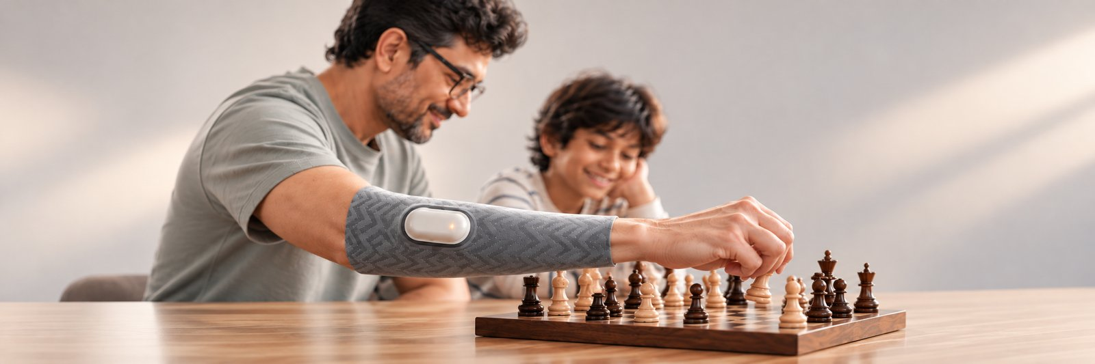
Cover Page
NILAI நிலை · steadiness
Senses tremor, separates it from intended movement, suppresses it on demand – and trains steadiness back.
Problem Statement / Concept Title
NILAI – a non-invasive AI wearable for real-time hand-tremor detection, on-demand suppression and personalised steadiness training
Theme
Assistive Technology & Accessibility (also: Healthcare · Elderly Care)
Team Name (Registered on portal)
Nilai
Team ID (Registered on portal)
HSC|TN|00325
State/UT
Real-time tremor detection
On-demand suppression
No surgery · No drugs
Tamil Nadu · Sri Sairam Engineering College, Chennai

Slide 2




Problem – Proposed Solution
Nilai
PROPOSED SOLUTION
CORE PROBLEM
NILAI is a washable forearm sleeve with a snap-in sensor pod. It reads muscle (EMG) and motion signals, separates tremor from intended movement with on-device AI, cancels it on demand with a gentle counter-pulse, and coaches steadiness through an app.
Tremor takes away the steady hand – and the activity that helps
~100 M
people worldwide live with essential tremor (1.3%) [1]
DETAILED EXPLANATION – HOW IT WORKS
Sense
Distinguish
Suppress
Train
5.8 %
of adults over 65 are affected – it rises with age [1]
3-ch dry EMG + 6-axis IMU + heart-rate on the forearm
On-device AI isolates the 4–12 Hz tremor from voluntary motion
Timed counter-pulse (EMS) damps the tremor – only when the user asks
Personalised exercises + daily tremor score for long-term control
~4.6 M
estimated in India; eating, writing, holding become hard
The vicious loop
Tremor → stop exercise → weaker control → worse tremor [2][3]
HOW IT ADDRESSES THE PROBLEM
INNOVATION & UNIQUENESS
Steady hands for eating, writing, dressing – on demand
Makes exercise possible again → breaks the loop
Daily objective tremor score instead of a rare spiral test
Caregivers & doctors track progress remotely
Reads the cause (muscle EMG), not just the visible shake
Tremor-vs-intent AI cross-checks EMG with motion – ignores vehicle/tool vibration
One closed loop: detect → suppress → train
Non-invasive, affordable, built in India
Today's options: pills that help only some, or brain surgery (DBS) costing lakhs. Severity is judged once in a while with a pen-and-spiral test – nothing at home.

Slide 3

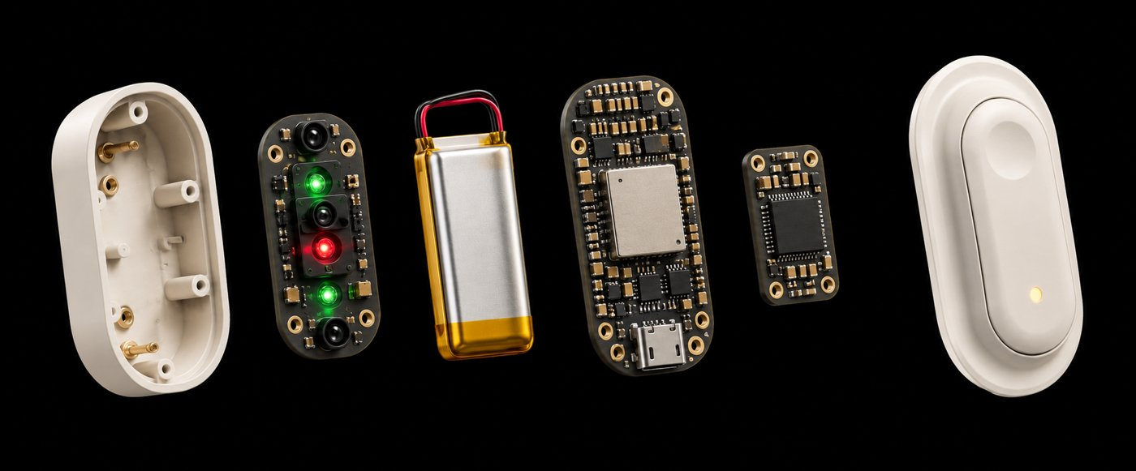
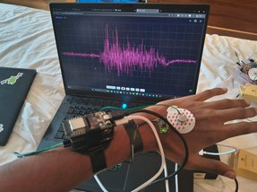
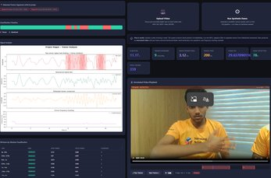




Technical Approach
Nilai
TECHNOLOGIES TO BE USED
METHODOLOGY & PROCESS – DATA FLOW
Hardware
Acquire
Pre-process
Classify
Act
Learn
ESP32-C6 (BLE + Wi-Fi 6) · MPU6050 6-axis IMU · 3-ch dry EMG · MAX30102 heart-rate · biphasic EMS driver · Li-Po
EMG + IMU + PPG on the forearm
Filter 3.5–12 Hz, PSD band-power, RMS
Tremor vs voluntary – EMG–gyro coherence
EMS anti-phase pulse, user-triggered
App: tremor score + training plan
AI & signal processing
WORKING PROTOTYPE
Python · NumPy/SciPy (band-pass, Welch PSD) · scikit-learn classifier · WFLC adaptive filter · MediaPipe/OpenCV · C++ firmware
App & backend
React Native app · Flask live dashboard · FastAPI + PostgreSQL · BLE streaming
Sensor pod: ESP32-C6, IMU, EMG, Li-Po
Live EMG waveform
Tremor-analysis dashboard
Github link
github.com/<your-repo> ← add link
BUILD PROGRESS
Demo video
STAGE 1 · DONE
STAGE 2 · DONE
STAGE 3 · NOW
STAGE 4 · NEXT
<YouTube / Drive link> ← add link
Depth-camera + gyro tremor classifier
Signal-analysis dashboard (tremor vs intent)
Forearm EMG band with live waveform
EMS suppression in the wearable pod + app
Extent of usage of AI tools
Gen-AI assistants used only for code help, literature search & slide drafting. Signal pipeline, classifier and hardware designed, trained & tested by the team.

Slide 4








Impact Potential
Nilai
~100 M
~4.6 M
1 in 17
Lakhs → ₹40K
people worldwide with essential tremor [1]
estimated in India – most never see a specialist
adults over 65 affected – India is ageing fast [1]
DBS brain surgery vs. a NILAI device
Potential impact on the target audience
Benefits of the solution
Stakeholders
People with essential tremor & Parkinson's, and the elderly
Eat, write, dress and work independently again
Return to exercise – which itself reduces tremor [3][4][5]
Daily progress score builds confidence & adherence
Social: dignity, independence, inclusion of elders; less caregiver burden
Economic: a fraction of surgery cost; shared kits for rehab centres & PHCs
Health system: remote monitoring cuts repeat clinic visits
Jobs: local assembly of sleeves & electrode kits
Patients, families & caregivers
Neurologists & physiotherapists
Rehab centres, PHCs & elder-care homes
Govt. health schemes & NGOs
CSR funders – kits for rural centres
Aligned with UN SDGs
SDG 3 · Good health & well-being
SDG 8 · Decent work
SDG 9 · Innovation
SDG 10 · Reduced inequalities

Slide 5




Feasibility and Risk Analysis
Nilai
ANALYSIS OF THE FEASIBILITY
POTENTIAL CHALLENGES & RISKS → STRATEGIES FOR OVERCOMING THEM
Technical
Challenge / risk | Level | Strategy to overcome
False triggers from vehicle / tool vibration at tremor frequency | High | Act only when EMG (muscle origin) and gyro agree – coherence check
EMS safety & user comfort | High | Current-limited driver, clinician-set limits, user-triggered only, physical stop button
Noisy dry-electrode EMG | Medium | Compression sleeve, reference electrode, signal-quality gate before any action
Medical-device approval (CDSCO) | Medium | Launch as monitoring & training aid; gather pilot data before suppression claims
Affordability in rural India | Medium | Shared CSR-funded kits at PHCs & rehab centres; B2B service model
Health-data privacy | Low | On-device processing; consent-based sharing as per DPDP Act 2023
Off-the-shelf parts; classifier, dashboard and EMG band already working (3 of 4 stages).
Economic
Target ₹40K device + annual service & app subscription; CSR funds rural kits.
Operational
Pilot with Chennai rehab & physiotherapy centres; app-based remote follow-up.
Validated
Concept recognised as a Samsung Solve for Tomorrow 2026 national finalist.

Slide 6

Team
Nilai
TEAM COMPOSITION & ROLES
YR
Yuvabharathi R
SH
S J Hema Priya
MK
Manoj Kumar K
Team Lead
Hardware & sensing
AI/ML & embedded
User research, clinical outreach, project management & pitch
EMG / EMS circuits, sensor integration, sleeve & pod design
Signal pipeline, tremor classifier, ESP32 firmware, dashboard & app
Sri Sairam Engineering College
Sri Sairam Engineering College
Sri Sairam Engineering College
CHALLENGES WE FACED
OUR JOURNEY
Raw EMG too noisy → pivoted to depth-camera + gyro first, then a dry-electrode compression band
Vibration looks like tremor → added EMG–gyro coherence so only muscle-driven tremor counts
Idea
Prototype
Wearable
Recognition
Next
Tremor ↔ inactivity loop
Classifier + dashboard
EMG band, live signals
Samsung SFT 2026 finalist
EMS pod + clinical pilot
Electronics vs. washable wear → detachable pod with pogo-pin contacts and magnetic alignment
Building an affordable, made-in-India way for people with tremor to stay independent and active.

Slide 7
References
Nilai
1
Louis ED, McCreary M. How common is essential tremor? Update on the worldwide prevalence of essential tremor. Tremor Other Hyperkinet Mov. 2021;11:28.
https://pmc.ncbi.nlm.nih.gov/articles/PMC8269764/
5
Kavanagh JJ, Wedderburn-Bisshop J, Keogh JW. Resistance training reduces force tremor and improves manual dexterity in older individuals with essential tremor. J Mot Behav. 2016;48(1):20–30.
https://pubmed.ncbi.nlm.nih.gov/25923582/
2
Louis ED, Collins K, Rohl B, et al. Self-reported physical activity in essential tremor: relationship with tremor, balance and cognitive function. J Neurol Sci. 2016.
https://pubmed.ncbi.nlm.nih.gov/27288815/
6
Riviere CN, Rader RS, Thakor NV. Adaptive cancelling of physiological tremor for improved precision in microsurgery (WFLC). IEEE Trans Biomed Eng. 1998;45(7):839–846.
https://doi.org/10.1109/10.686791
3
Farashi S, Kiani L, Bashirian S. Effect of exercise on Parkinson's disease tremor: a meta-analysis study. Tremor Other Hyperkinet Mov. 2021;11:15.
https://pubmed.ncbi.nlm.nih.gov/33981478/
7
MY Bharat – Hack for Social Cause: themes & guidelines.
https://mybharat.gov.in/pages/hack_social
4
Kadkhodaie M, Sharifnezhad A, Ebadi S, et al. Effect of eccentric-based rehabilitation on hand tremor intensity in Parkinson disease. Neurol Sci. 2020;41(3):637–643.
https://pubmed.ncbi.nlm.nih.gov/31735996/
8
Espressif ESP32-C6 product page; Upside Down Labs bio-potential (EMG) hardware.
https://www.espressif.com/en/products/socs/esp32-c6

