Slide 1

LuxeLocksHub – Cloud Computing Project
Scalable AWS Web Deployment

Slide 2


Project Overview
A cloud-hosted haircare website using AWS services:
EC2 - Elastic Compute Cloud
RDS - Relational Database Service
Lambda
API Gateway-Application Programming Interface
S3 - Simple Storage Service
IAM-Identity and Access Management

Slide 3
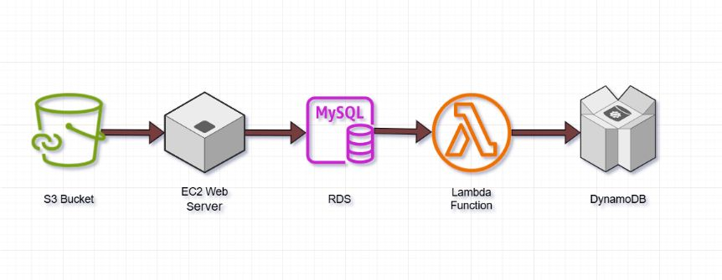
Architecture Design
• S3 for storage
• EC2 for virtual servers
• RDS for manage relational data
• Lambda for execute logic event driven task
• DynamoDB for handle unstructured data

Slide 4
Implementation Steps
• EC2: luxelockshub instance
• RDS: haicare-db
• Lambda: fetchLuxeLocksData
• API Gateway: luxelockshub
• IAM configuration
• S3 static site hosting
• Interface of LuxeLocksHub

Slide 5
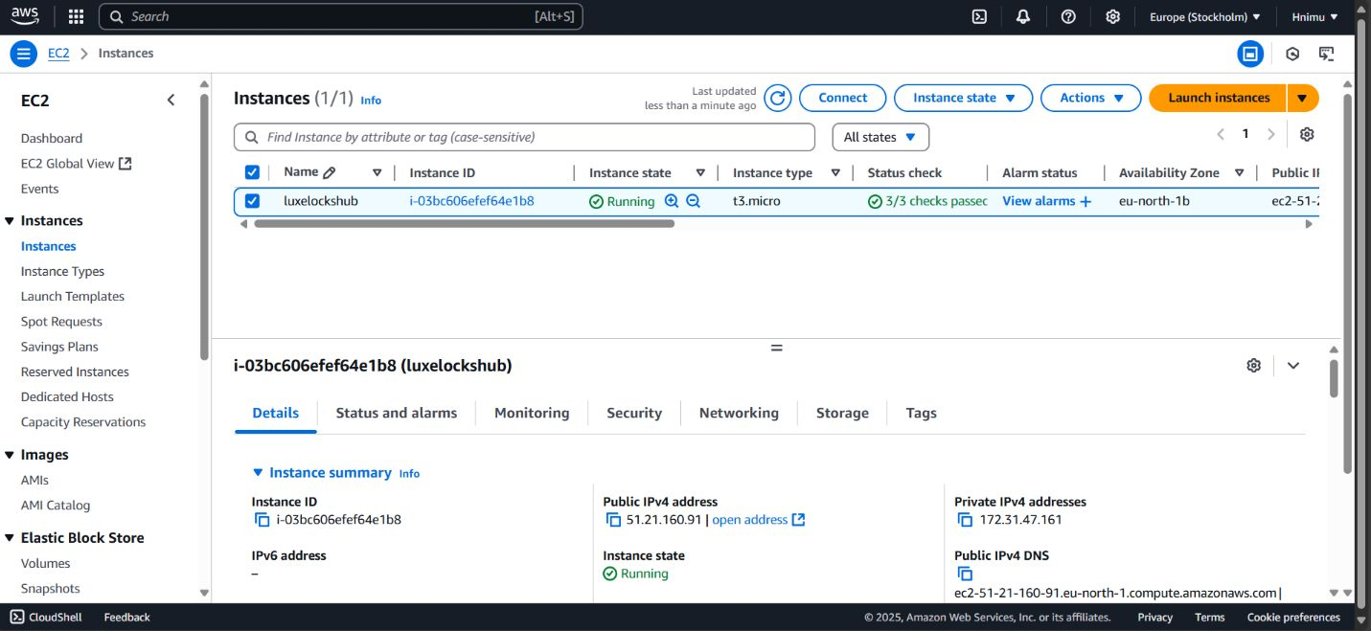
EC2 Setup:
Launched `t2.micro` EC2 instance named `luxelockshub`.
Configured security groups for SSH and HTTP access.

Slide 6
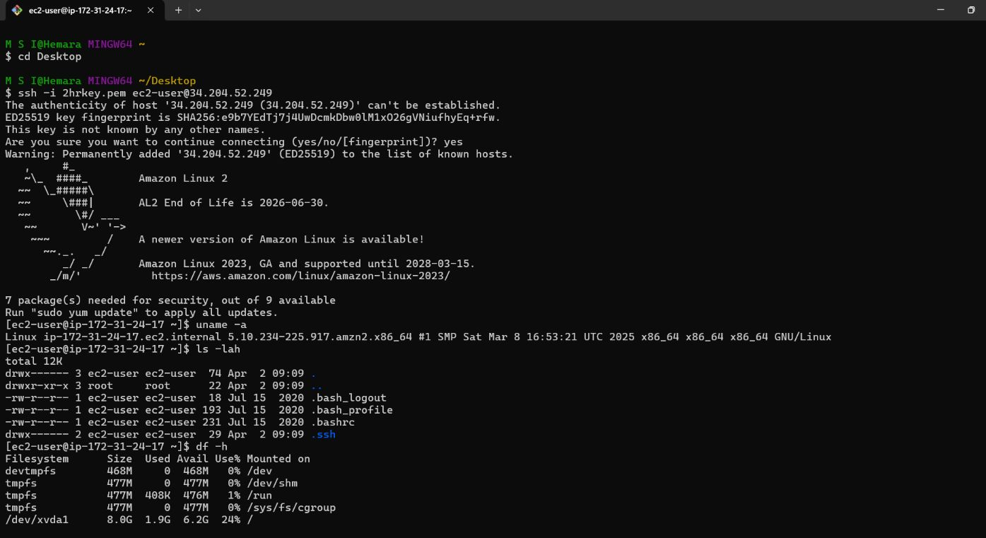

Slide 7
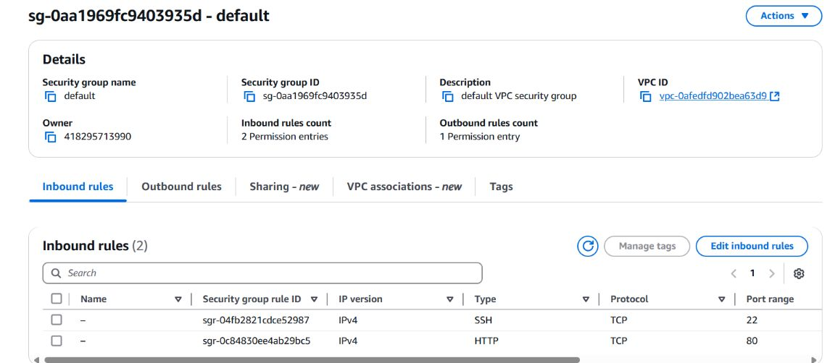
Security group

Slide 8
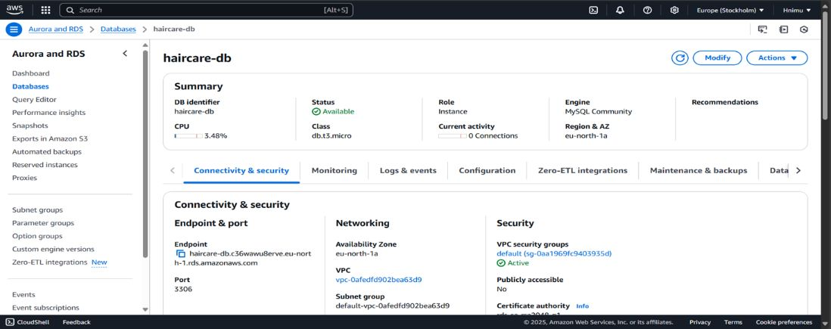
RDS Configuration:
Created `haicare-db` MySQL instance.
Enabled public access and connected from EC2.
Created tables for product data.

Slide 9
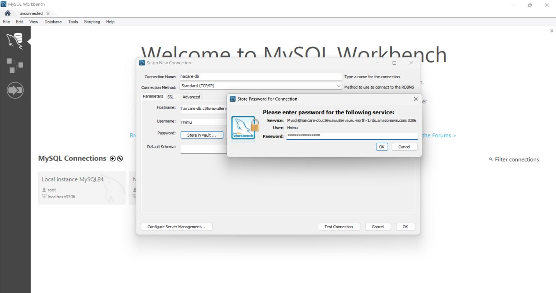

Slide 10
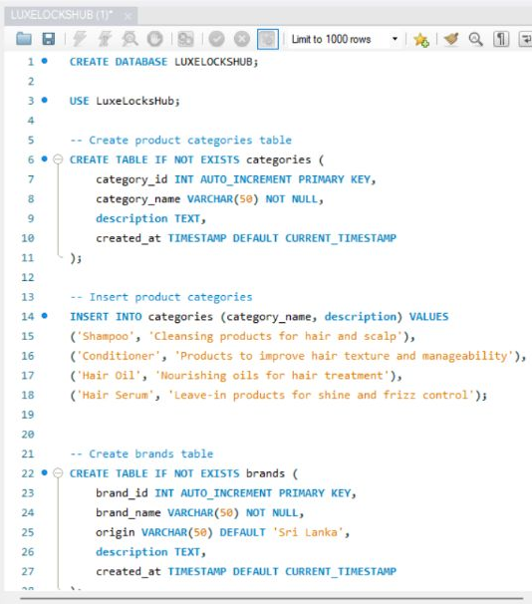
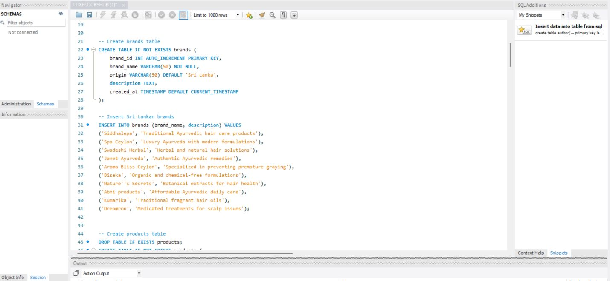
MYSQL Database

Slide 11
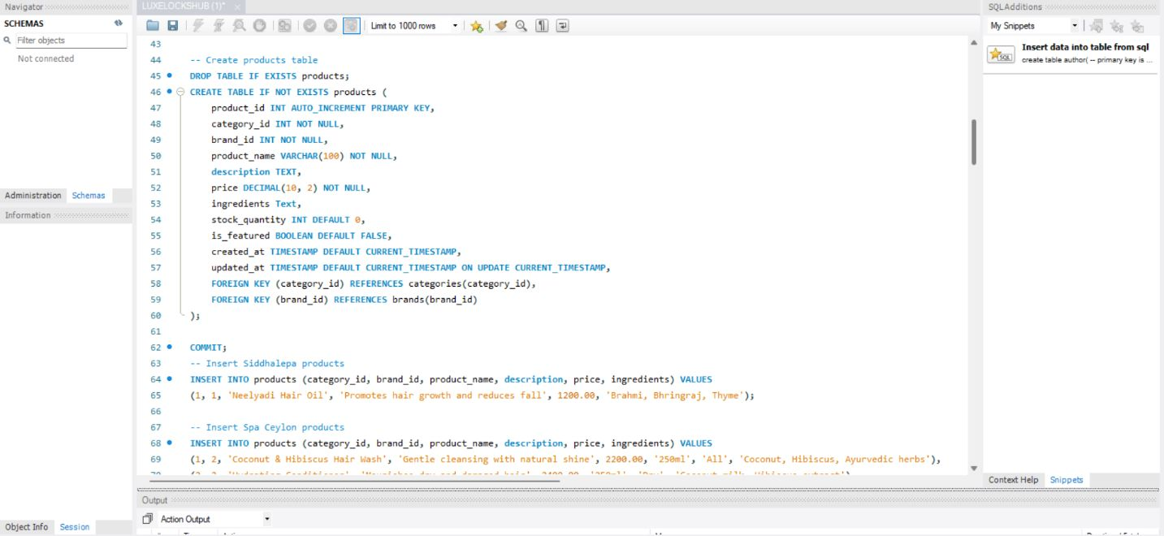
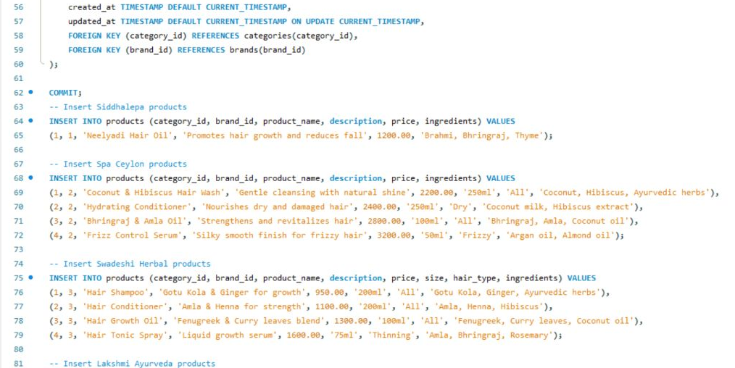

Slide 12
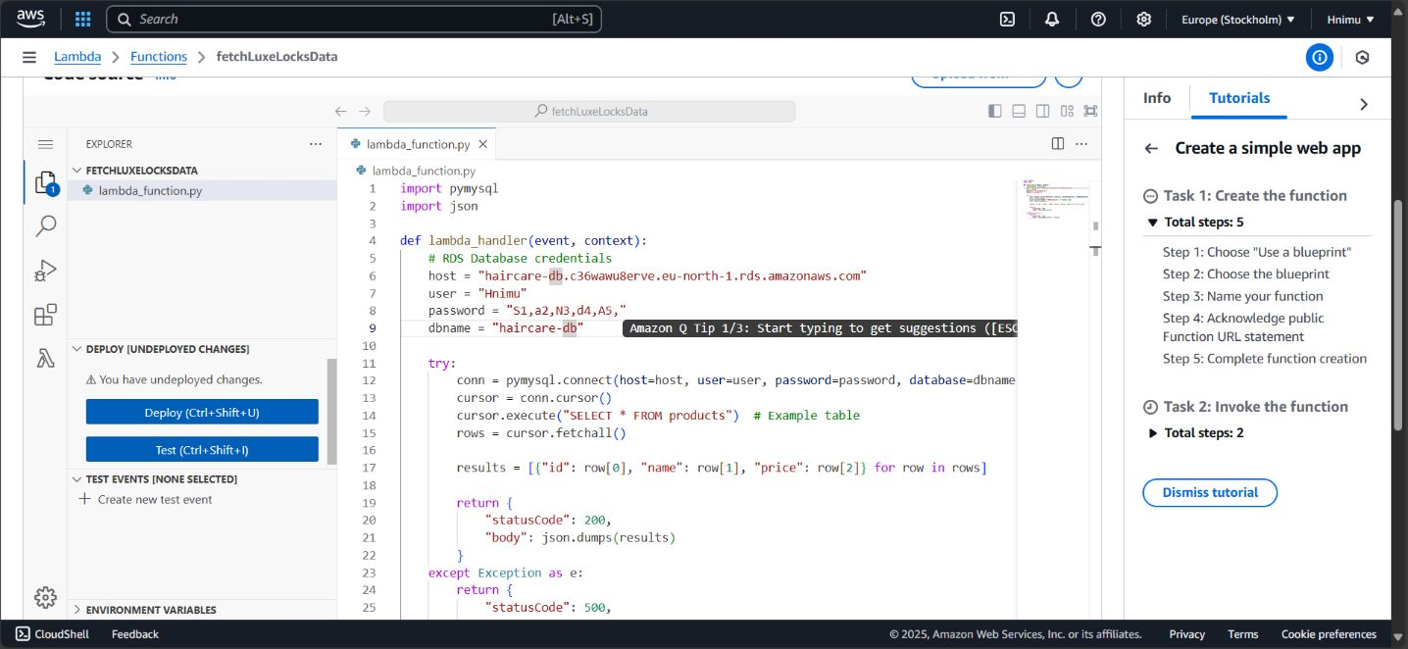
Lambda Development:
Built `fetchLuxeLocksData` to query RDS.
Set environment variables for DB connection.

Slide 13
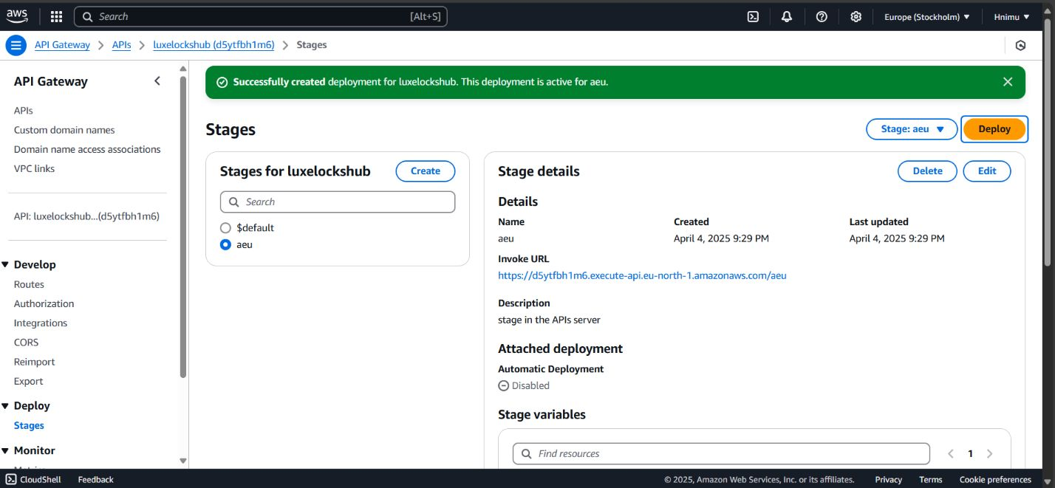
API Gateway Integration:
Created REST endpoint via API Gateway.
Integrated Lambda and deployed endpoint.

Slide 14
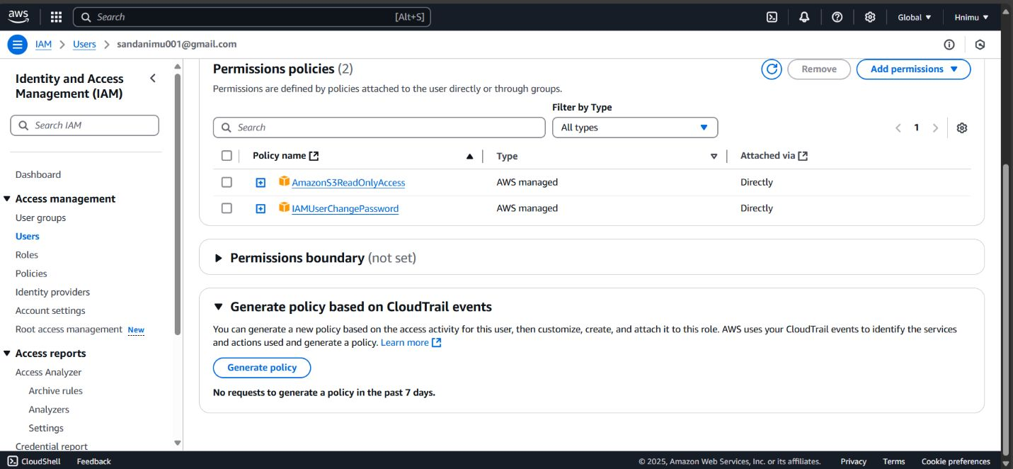
IAM Configuration:
Created user `sandanimu001@gmail.com`.
Assigned minimal permissions using policies.

Slide 15
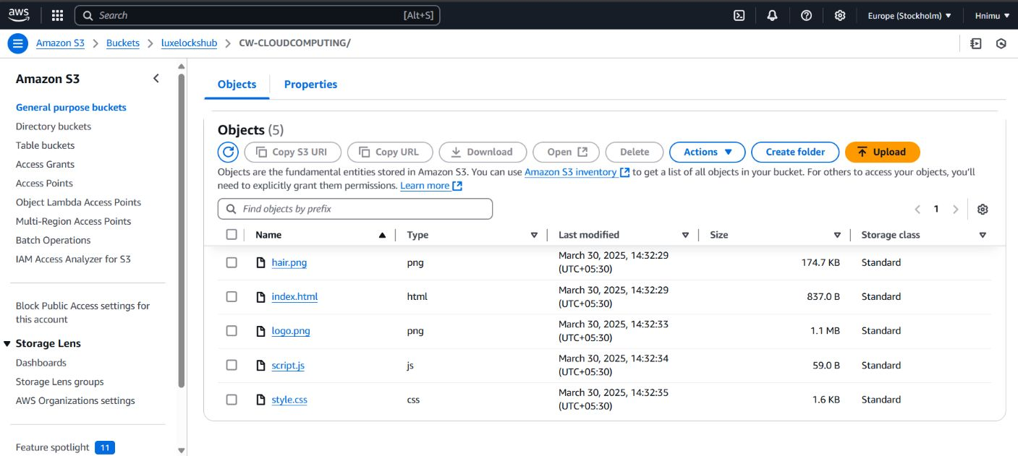
S3 Bucket:
Created `index.html` with product listings.
Uploaded to S3 with public-read access.

Slide 16
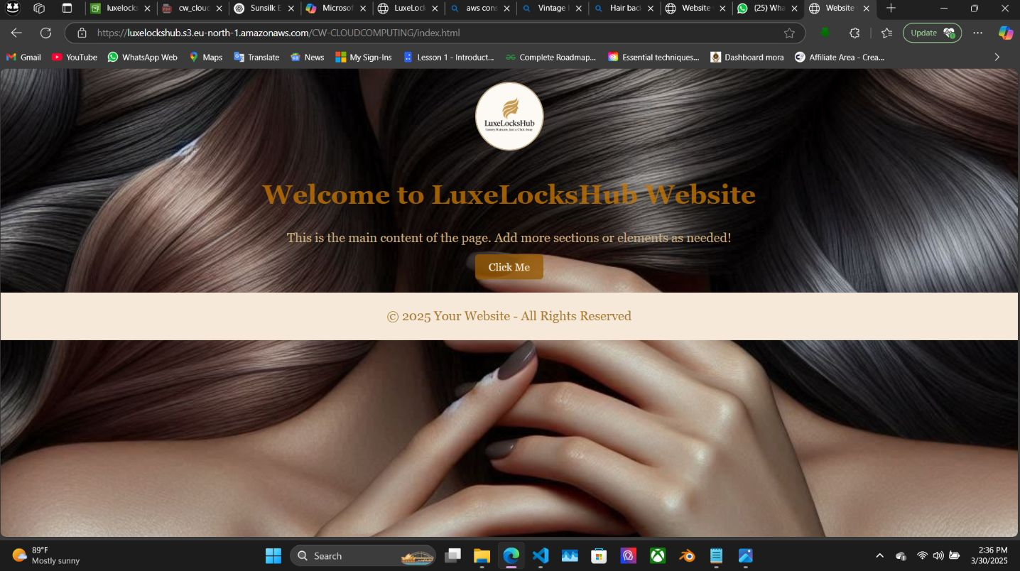
Interface of LuxeLocksHub

Slide 17
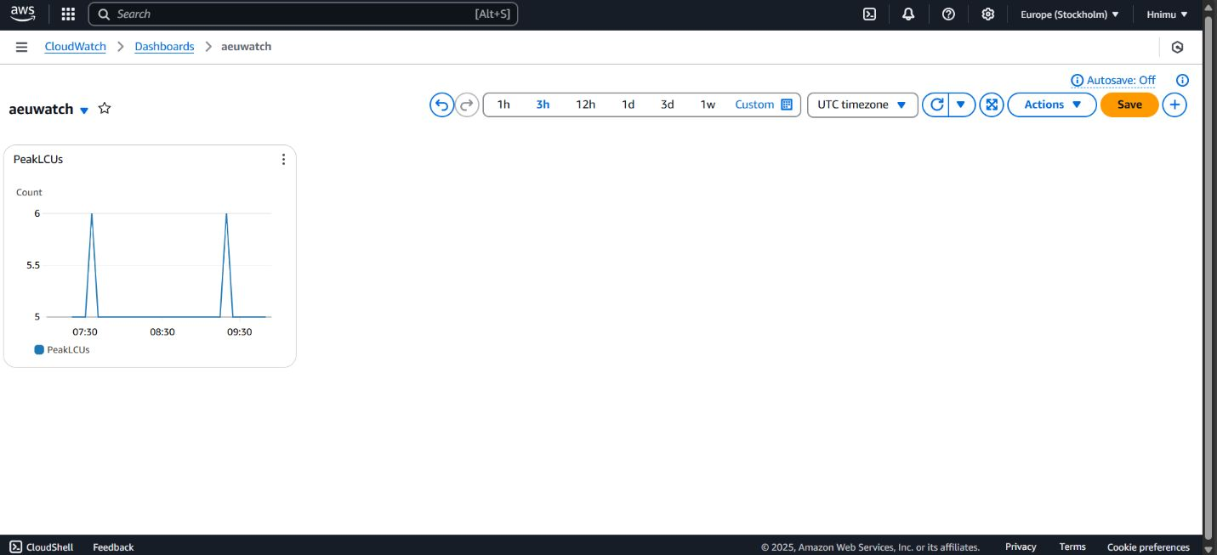
CloudWatch:
Configured metrics monitoring for EC2 and RDS.
Set up alarms to notify on resource thresholds.

Slide 18
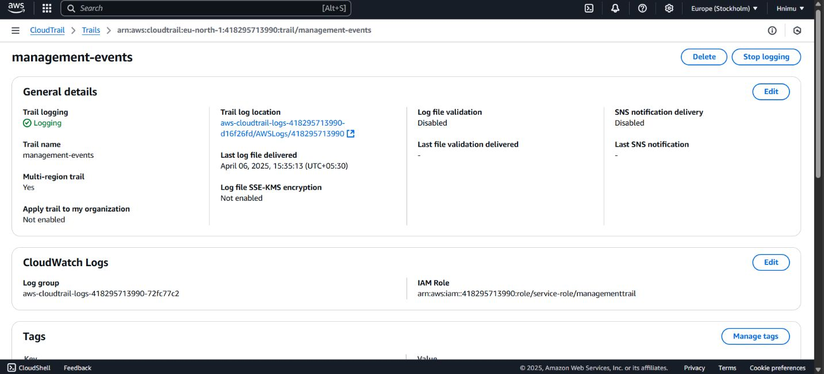
CloudTrail:
Enabled logging for AWS account activity.
Stored logs in an S3 bucket for auditing.

Slide 19
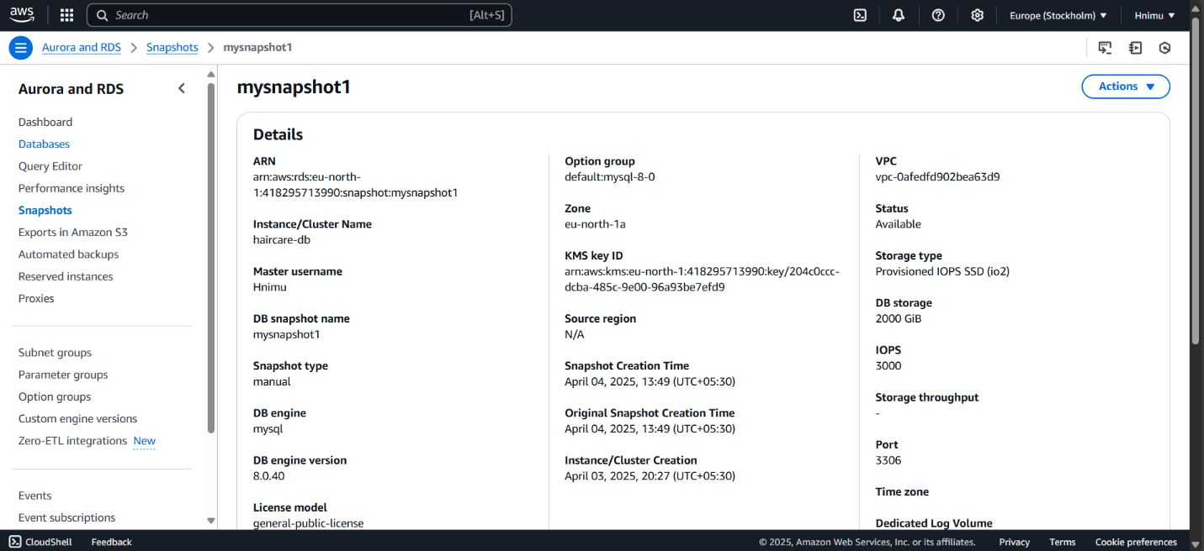
RDS Snapshot:
Created automated backups for haicare-db.
Manually initiated a snapshot before major updates.

Slide 20
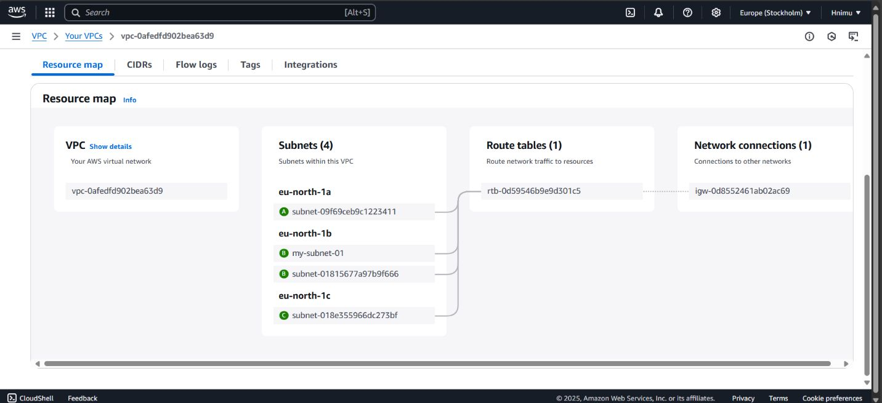
VPC:
Defined custom VPC for secure resource communication.
Configured subnets and a NAT gateway for internet access.

Slide 21
Deployed Website Links
• https://www.luxelockshub.lk
•https://luxelockshub.s3.eu-north-1.amazonaws.com/CW-CLOUDCOMPUTING/index.html

Slide 22
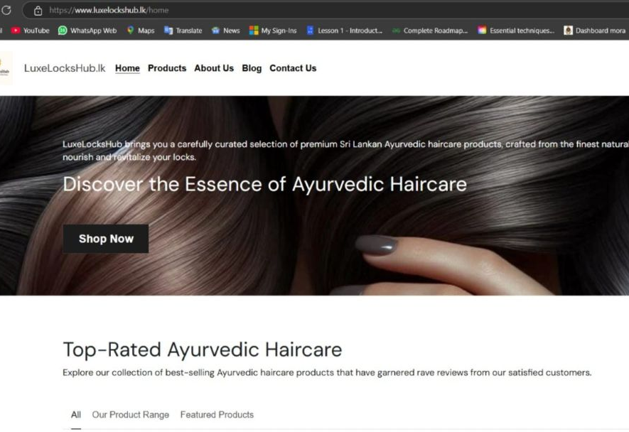

Slide 23
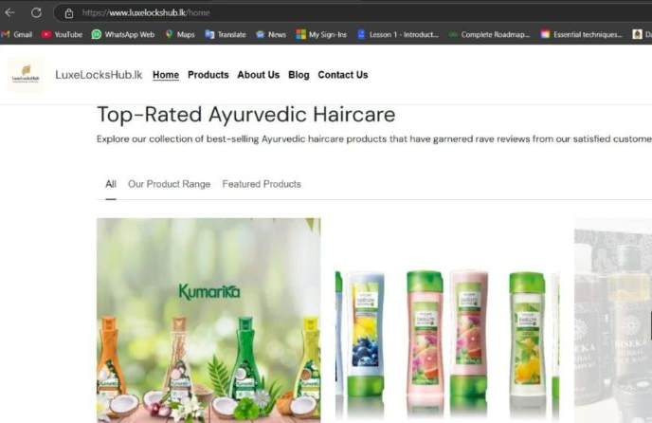

Slide 24
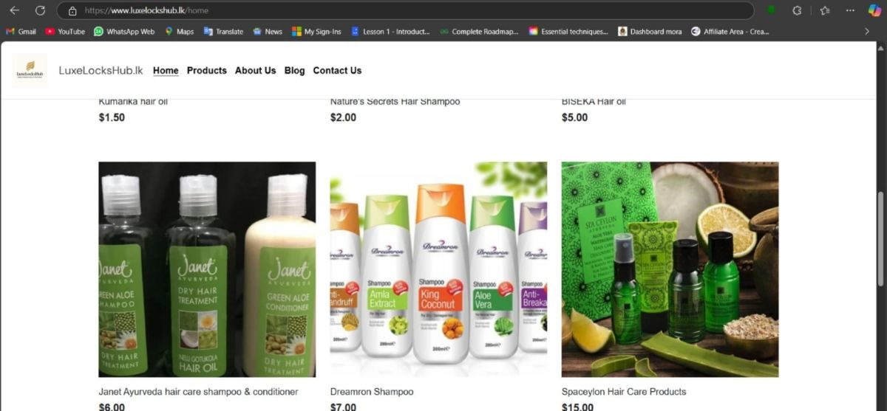

Slide 25
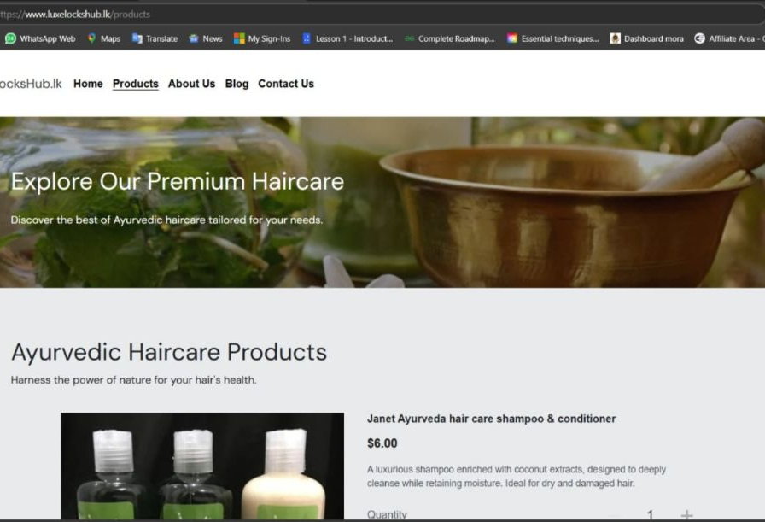

Slide 26
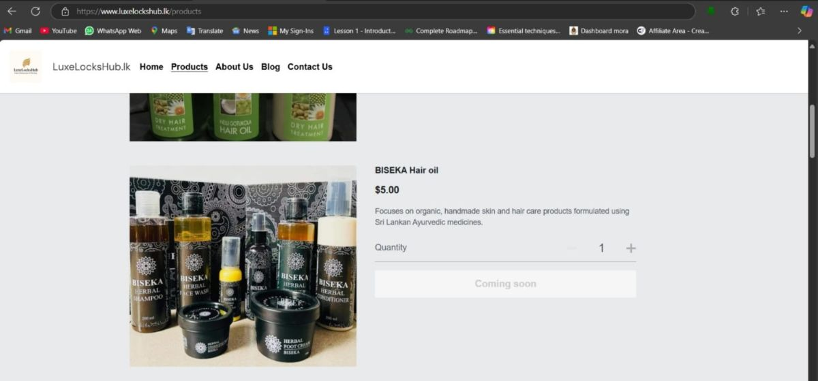

Slide 27
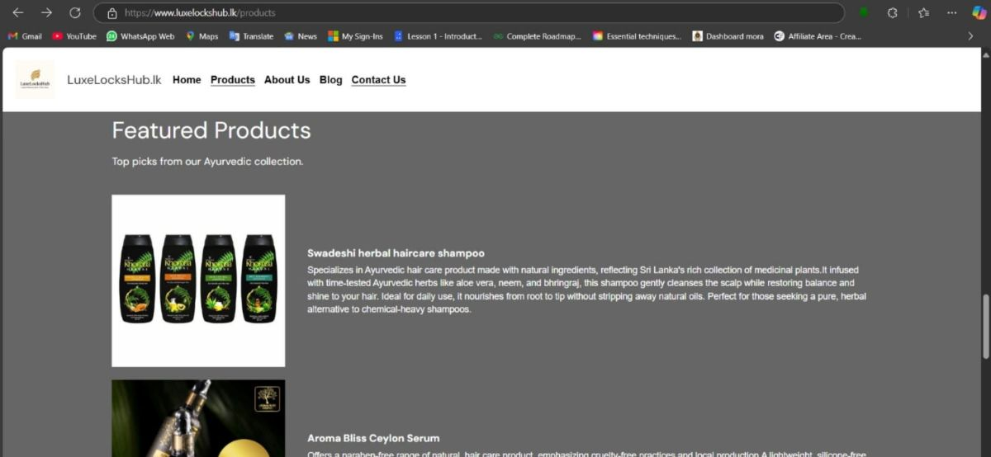

Slide 28
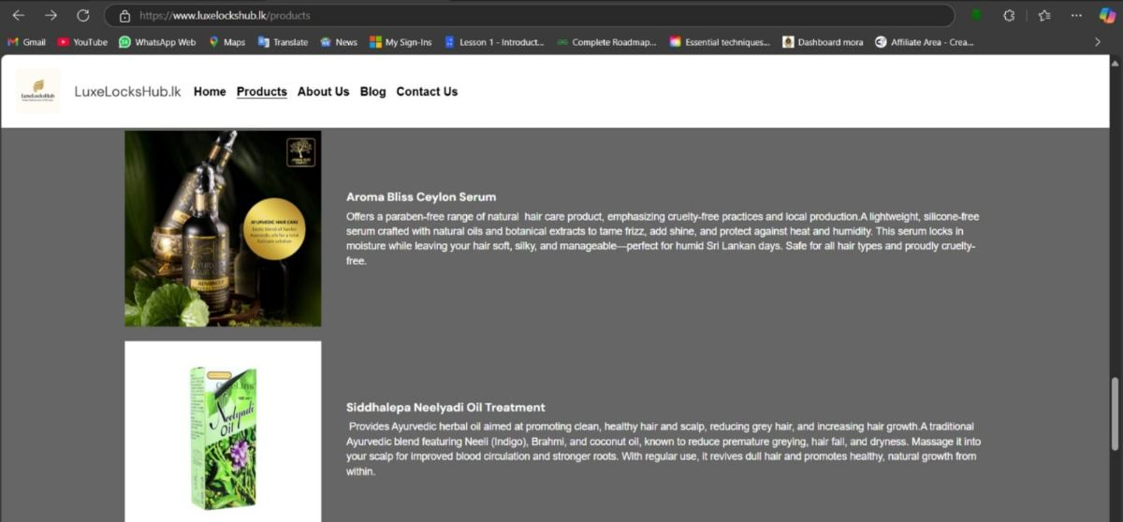

Slide 29
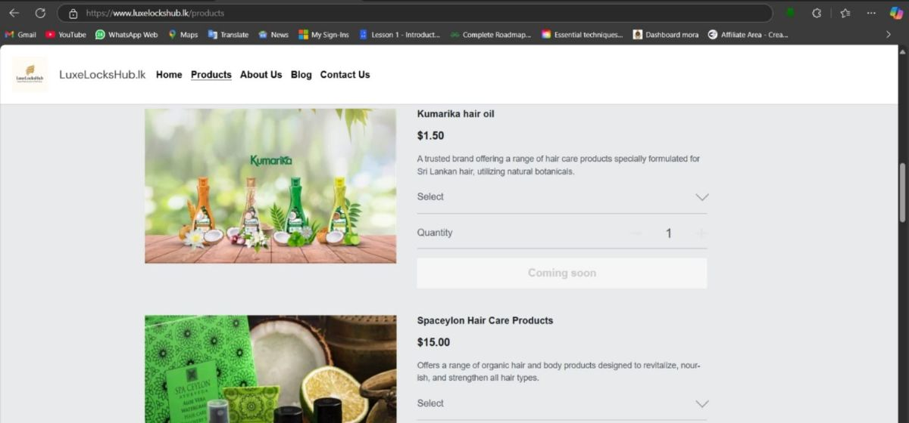

Slide 30
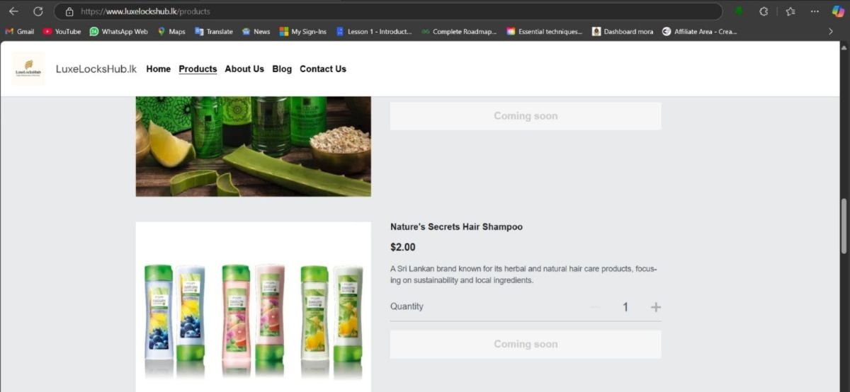

Slide 31
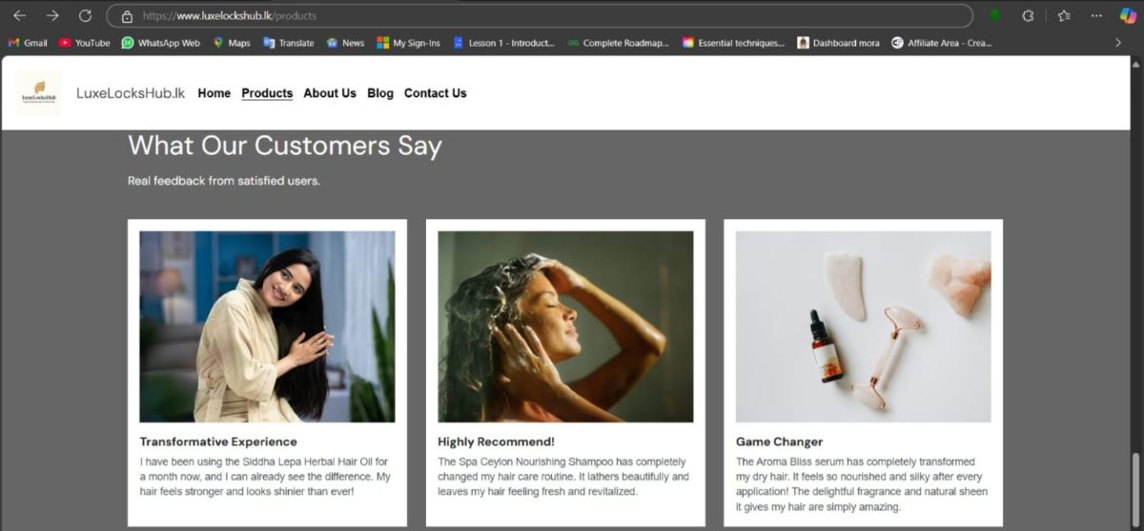

Slide 32
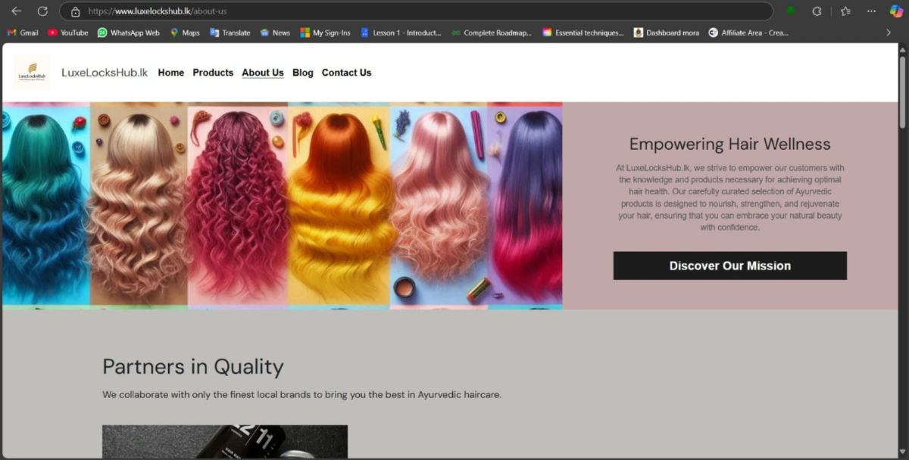

Slide 33
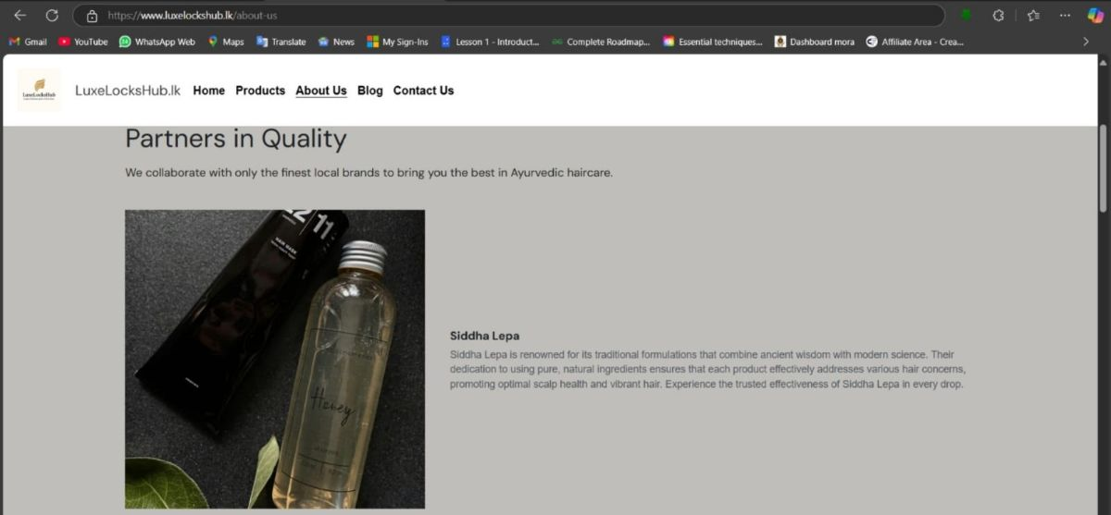

Slide 34
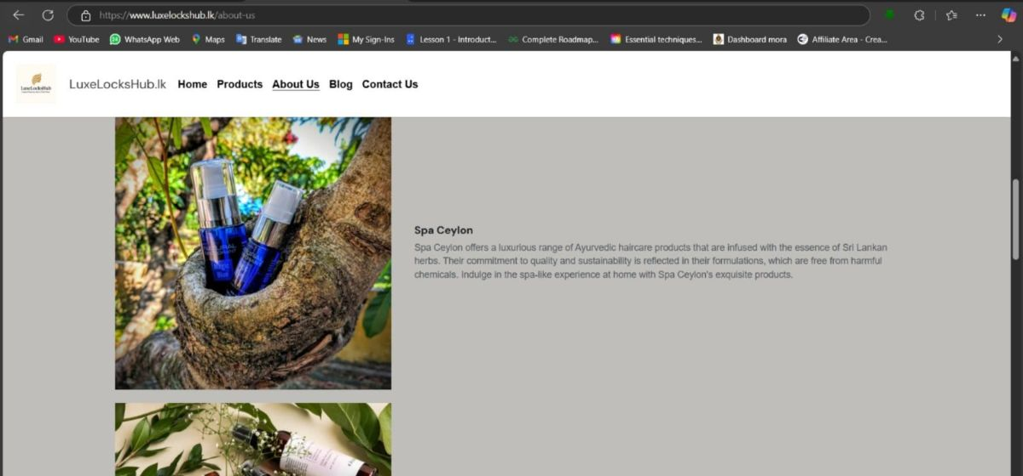

Slide 35
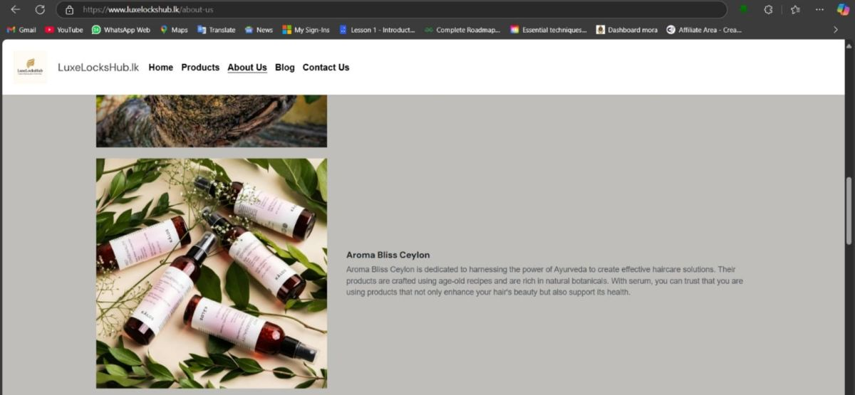

Slide 36
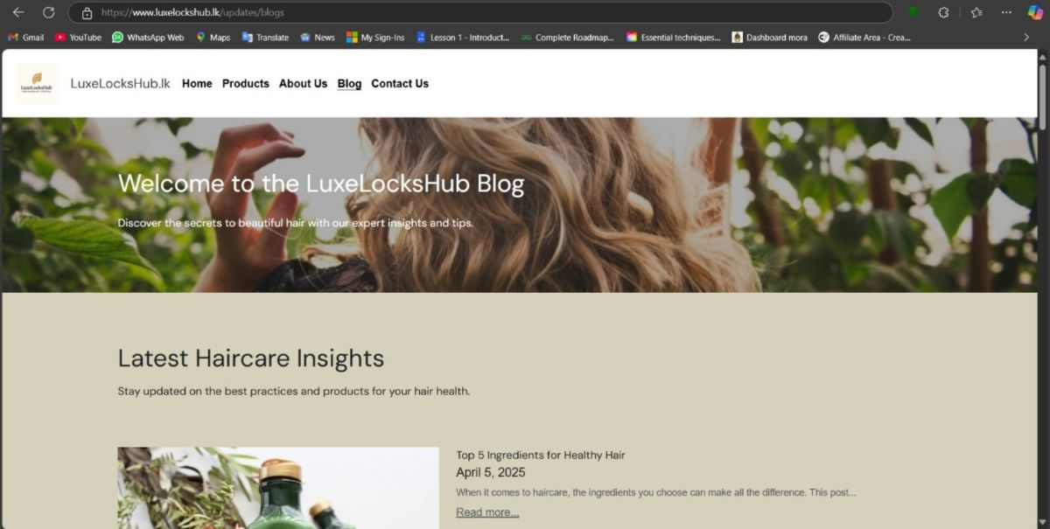

Slide 37
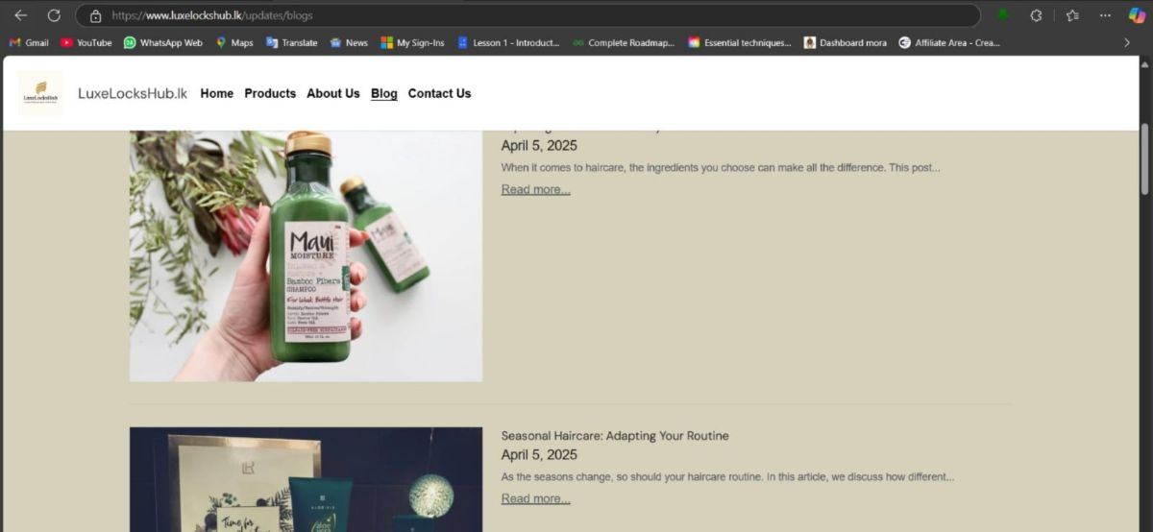

Slide 38
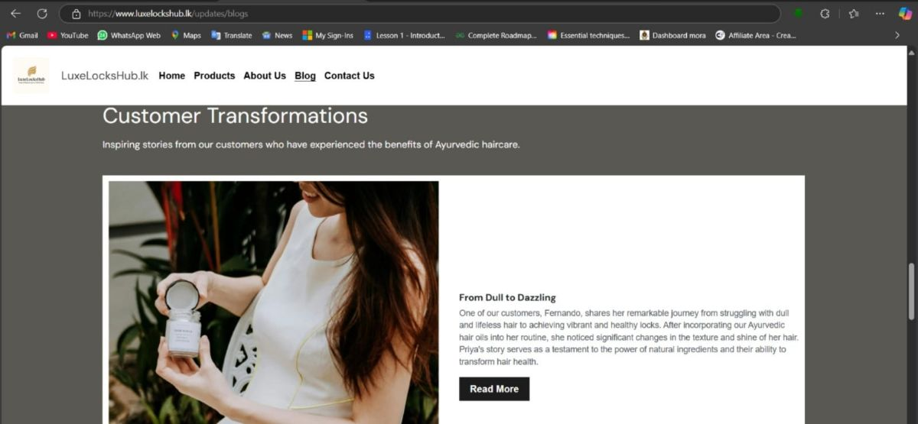

Slide 39
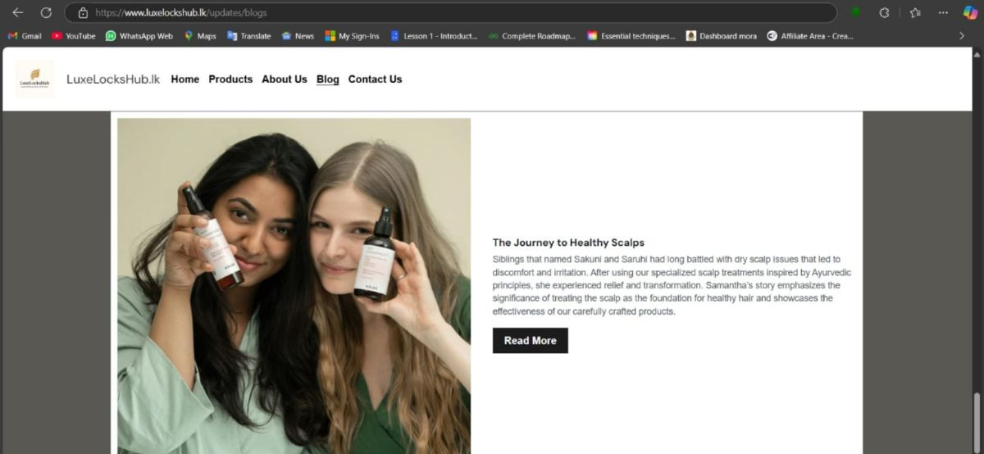

Slide 40
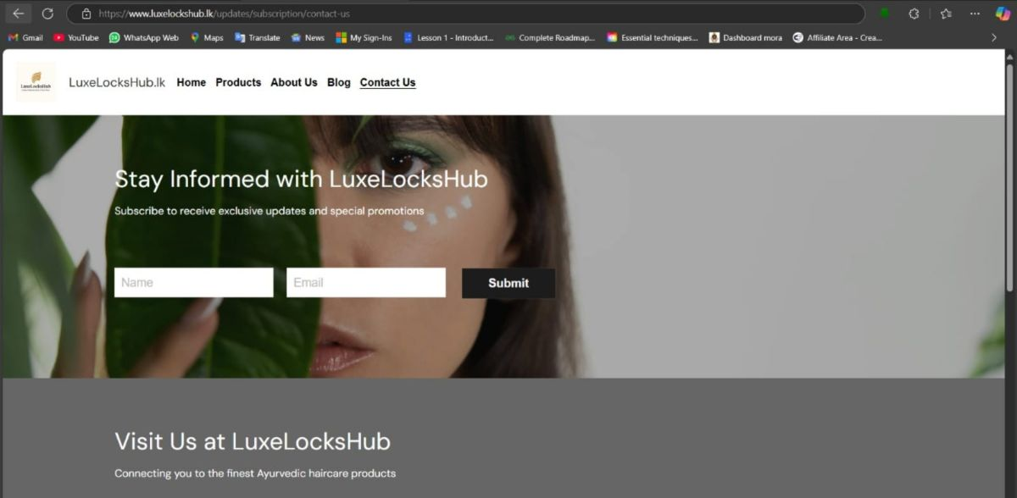

Slide 41
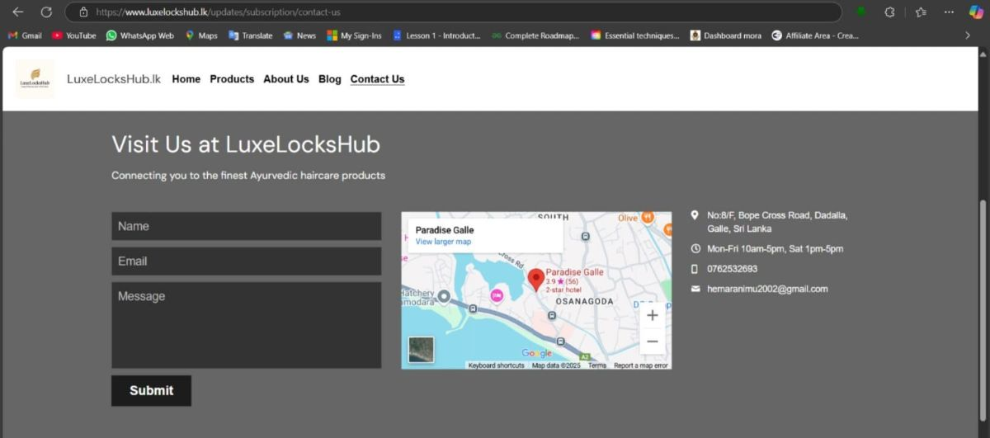

Slide 42
Cost Optimization
• Used Free Tier (t2.micro, minimal RDS)
• Database on RDS
• Plan for monitoring with CloudWatch

Slide 43
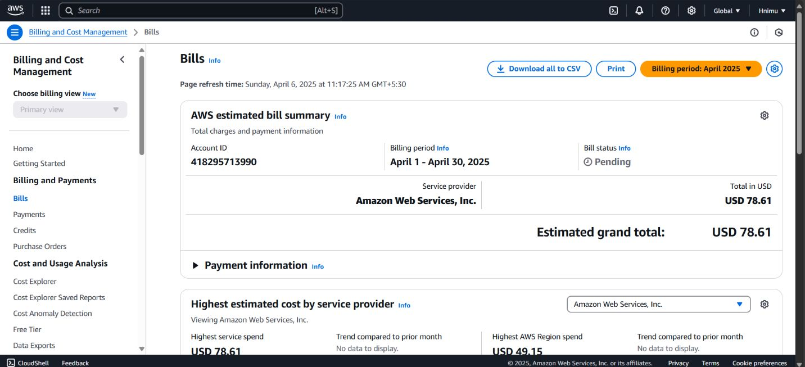

Slide 44
Challenges & Solutions
AWS setup was hard-Followed docs step-by-step.
RDS was costly-Used free tier.
Backend not linked to frontend-Connected via API Gateway.
RDS connection failed-Fixed IP, endpoint, and username.
Couldn't delete security groups-Made new ones and updated links.

Slide 45

Future Enhancements
• Advanced Security Enhancement
• User Analytics and Reporting
• Automated Cost Control & Optimization

Slide 46
Thank You!
Team members:
Hamdha (018), Rushdha(038), Hemara(014)

