Slide 1
Supply Chain Data Integration System
Visualizing Key Metrics with Streamlit & Python
PRESENTED BY: N.HEMA SANKAR

Slide 2
Project Overview
A Streamlit-based interactive dashboard for supply chain analytics.
Simulates inventory and order datasets for performance visualization.
Tracks KPIs like fill rate, inventory turnover, and stockout risks.
Reads logistics data from Excel sheets (`Orders`, `Returns`,`People`)
Fetches product and category data from external APIs (Fake Store API)
Simulates inventory activity and demand

Slide 3
Project Objectives
Provide real-time visibility into order and inventory metrics.
Simulate supply chain metrics for learning and prototyping.
Generate comprehensive downloadable Excel reports.

Slide 4
Technologies Used
Python & Pandas for data manipulation.
Streamlit for UI and interactive dashboard.
Plotly for visualizations.
ExcelWriter for report exports.

Slide 5
Core Features
KPI cards for quick overview: Orders, Fill Rate, Turnover.
Dynamic charts: Lead Time Distribution, Sales by Category.
Tabs for Performance, Inventory, Fulfillment Analytics.

Slide 6
Inventory Simulation Logic
Generates stock levels, demand, fill rate and turnover data.
Flags stockout risks based on simulated metrics.
Groups and trends data by category and date.

Slide 7
Report Export Functionality
One-click export of Orders & Inventory data.
Includes a summary sheet with average metrics.
Saves timestamped Excel reports locally.

Slide 8
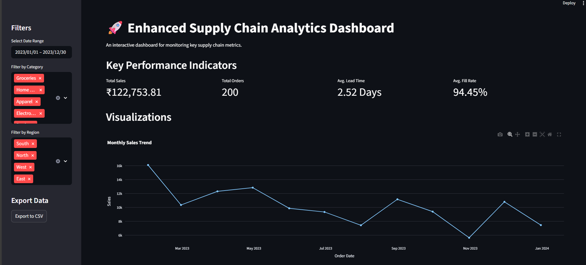
Sample Visuals & Metrics

Slide 9
Challenges & Learnings
Ensuring consistent data dimensions for visualizations.
Handling edge cases like missing categories or zero stock.
Using Python for end-to-end simulation & frontend.

Slide 10
Future Scope
Real-time API integrations (e.g. BigQuery, Snowflake).
Forecasting demand using ML models.
User-uploaded datasets and parameter tuning.

