Slide 1
CSS7000 - INTERNSHIP Review- Presentation INDUSTRY INTERNSHIP AT ELMEASURE INDIA PVT. LTD. Software Testing, Automation & AI Workflow Automation
Student Details
Name | HEMASHREE S
Roll No | 20241CAI0193
Section | 5CAI04
Under the Supervision of,
Ms. Harika P
Assistant Professor
Presidency School of Artificial Intelligence & Advanced Computing
Presidency University
Name of the Program: B.Tech in Computer Science and Engineering (Artificial Intelligence & Machine Learning)
Name of the HoD: Dr. Zafar Ali Khan N
Name of the Program Internship Coordinator: Mr. Anandan B
Name of the School Internship Coordinator: Dr. Geetha Arjunan

Slide 2
Content
About the Company/Organisation
Working domain or the technology
About your team and reporting Manager
Challenges Faced in Internship
Objectives of the work
Internship Roadmap
Github Link

Slide 3
About Elmeasure India Pvt. Ltd.
2004
Founded
Bengaluru
Headquarters, Karnataka
65+
Countries served
50K+
Satisfied clients
Smart & Sustainable Energy Management
Energy and power monitoring solutions for industries and businesses, with 7M+ products deployed in the field across 25+ industries
Key Solution Areas
Energy & Power Monitoring
IoT Energy Management
Power Quality
Industrial Communication
Electrical Control Solutions

Slide 4
Elmeasure — Technology & Impact
Technology
Impact
• IoT-enabled energy management
• Real-time monitoring
• Industrial network gateways
• Cloud connectivity for remote access
• Software-driven energy solutions
• Improved energy visibility
• Better operational efficiency
• Reduced energy waste
• Support for sustainable energy management

Slide 5
Working Domain & Technologies
Software Testing & Automation
Development & Engineering
Workflow Automation & AI
• Manual web testing
• Selenium WebDriver
• PyTest
• Page Object Model
• Python & OOP
• SQL
• Git & GitHub
• Jenkins
• PyCharm
• n8n
• JavaScript
• Google Sheets
• Gmail
• AI workflow concepts

Slide 6
About the Team & Reporting Manager
Elmeasure India Pvt. Ltd.
Testing & Automation
• Selenium • PyTest • Git / GitHub
Testing / Technical Team
Reporting Manager — Kevin
AI Department Exposure
• n8n • JavaScript • Google Sheets • Gmail
Hemashree — Intern

Slide 7
Challenges Faced During the Internship
1. Adapting to a New Workplace
• Only intern in the Testing team
• Interacting with experienced employees was new
• Gradually improved communication and confidence
2. Long Daily Commute
• Around 5–6 hours of daily travel
• Required disciplined time management
3. Limited Structured Guidance
• No single dedicated trainer throughout
• Relied on self-learning and timely guidance
4. Adapting to Multiple Technologies
• Python, Selenium, PyTest, Git, SQL, Jenkins, n8n
• Required continuous learning

Slide 8
Objectives of the Internship
1
Gain hands-on experience in real-world software testing and development workflows
2
Strengthen Python and OOP fundamentals
3
Develop web automation using Selenium, PyTest and Page Object Model
4
Learn Git & GitHub practices and SQL fundamentals
5
Explore workflow automation and AI applications using n8n
6
Improve self-learning, problem-solving and technical communication

Slide 9
Internship Roadmap
WEEK 1
WEEK 2
WEEK 3
WEEK 4
Exploration & Testing
• Application familiarization
• Manual testing
• Bug identification
• OOP / OSI basics
Python & Test Automation
• Python & OOP
• Selenium WebDriver
• PyTest
• Page Object Model
Development & Data
• Git & GitHub
• Branching & merging
• SQL
• Jenkins basics
AI & Workflow Automation
• n8n
• JavaScript workflow logic
• Google Sheets & Gmail
• AI workflow exposure

Slide 10
Project 1 — ShopperStack Web Automation
Selenium + PyTest + Page Object Model
Objective
Automate the login and selected navigation workflows of the ShopperStack web application
Framework Architecture
Test Case
LoginPage / MenPage
Technologies
Python | Selenium | PyTest | POM | PyCharm | Git/GitHub
BasePage
Major Activities
• Automated login • Parameterized login testing
• Page Object Model implementation • Hover / menu interaction
• Screenshot capture • PyTest execution
Selenium WebDriver
ShopperStack

Slide 11
Project 1 — Live Demonstration
1
Launch ShopperStack
2
Automate Login
3
Navigate to MEN
4
Hover over Menu
5
Select T-Shirt
6
Capture Screenshot
Live Demonstration
Switching to PyCharm / Browser

Slide 12
Project 2 — n8n Email Workflow Automation
Workflow Logic
Objective
Automate personalized email delivery based on user information and mail type
Google Sheets
Select Template
Check SEND STATUS
Personalize {{NAME}}
Technologies
• n8n Cloud
• Google Sheets
• Gmail
• JavaScript & expressions
• IF / Switch nodes
IF
Gmail
Loop Over Items
Update SEND STATUS
Switch by Mail / User Type

Slide 13
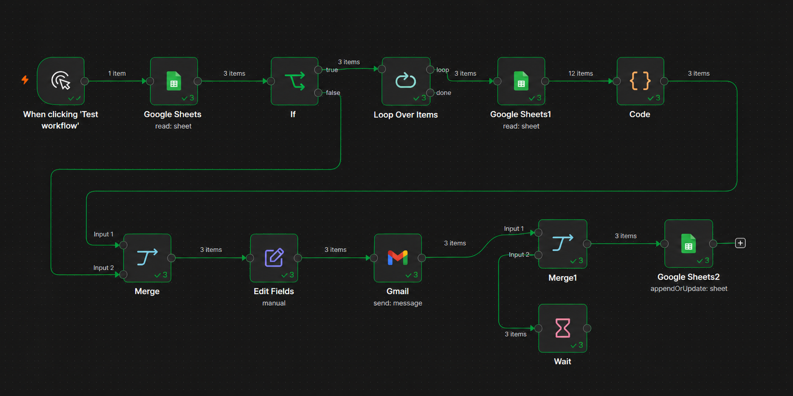
Project 2 — Workflow Demonstration
Execution Walkthrough
• Input data read from Google Sheets
• Filter pending / unsent users
• Switch logic by mail and user type
• Email template selection
• Dynamic personalization of content
• Gmail sending
• SEND STATUS updated back to the sheet
Personalization Example
Input: NAME = Hema
Template: Hello {{NAME}}
Output: Hello Hema

Slide 14
GitHub Link
Internship Work
https://github.com/Hemashree218/Elmeasure_Internship.git
PyTest Practice
https://github.com/Hemashree218/Pytest-Practice.git
n8n Workflows
https://github.com/Hemashree218/n8n-workflows.git

Slide 15
Q&A

Slide 16
THANK YOU

