Slide 1





FINAL PROJECT
ON
GENERATIVE AI
HEMASHREE D
311521104017
1

Slide 2

PROJECT TITLE
PLANT DISEASE DETECTION USING CNN
2

Slide 3

AGENDA
PROBLEM STATEMENT
PROJECT OVERVIEW
PROPOSED SOLUTION
SYSTEM APPROACH
SOLUTION DEVELOPMENT APPROACH
ARCHITECTURE
CONCLUSION
RESULT
3

Slide 4
PROBLEM STATEMENT
Plant diseases pose a significant threat to global food security, leading to substantial crop yield losses and economic impacts for farmers. Early detection and management of these diseases are crucial to prevent widespread crop damage and ensure sustainable agricultural practices. However, manual detection of plant diseases can be time-consuming, labor-intensive, and prone to human error. Therefore, there is a pressing need for automated and accurate methods for identifying and diagnosing plant diseases to support farmers in making timely interventions and optimizing crop health.
4

Slide 5
PROJECT OVERVIEW
The project aims to address the challenge of plant disease detection by leveraging deep learning techniques, specifically convolutional neural networks (CNNs) and the VGG16 architecture. By training models on a dataset of plant leaf images representing various diseases and healthy conditions, we seek to develop a robust and efficient system capable of accurately classifying plant diseases in real-time. The project involves data preprocessing, model development, training, and evaluation, culminating in the deployment of trained models for inference and prediction. The ultimate goal is to empower farmers with an automated tool for early disease detection and decision-making, thereby enhancing crop management practices and contributing to global food security.
5

Slide 6
PROPOSED SOLUTION
Custom CNN Model:
The custom CNN model comprises multiple convolutional and pooling layers followed by fully connected layers for classification.
Designed to learn hierarchical features from plant leaf images and make predictions on disease classes.
Trained using a dataset of labeled images representing various plant diseases and healthy conditions.
VGG16-Based Model:
Utilizes the VGG16 architecture, pre-trained on the ImageNet dataset, as the base model.
Custom layers are added on top of the VGG16 base to adapt it for plant disease classification.
Leveraging transfer learning to benefit from the knowledge learned by VGG16 on a diverse range of images.
6

Slide 7
SYSTEM APPROACH
Hardware Requirements
Processor: Intel Core i5 or equivalent, or higher.
RAM: Minimum 8GB, recommended 16GB or higher for optimal performance.
Storage: At least 100GB of free disk space for storing datasets and database files.
Network Connection: Required for accessing online resources, such as pre-trained models
GPU: NVIDIA GeForce GTX 1060 or higher
3/21/2024Annual Review
7

Slide 8
SYSTEM APPROACH
Software Requirements:
Operating System:
Compatible with Windows, macOS, or Linux distributions
Development Environment:
Python 3.x installed (Anaconda distribution recommended)
Integrated Development Environment (IDE) such as Google Colab
Libraries and Packages:
TensorFlow 2.x or higher
NumPy
Matplotlib
scikit-learn
Google Colab
Additional Tools:
Google Drive
7

Slide 9
SOLUTION DEVELOPMENT APPROACH
Data Collection and Preprocessing:
Preprocess the images by resizing, rescaling, and augmenting to enhance model robustness and generalization.
Model Selection:
Choose appropriate deep learning architectures for plant disease detection, such as convolutional neural networks (CNNs) and pre-trained models like VGG16.
Model Development:
Design the custom CNN model architecture, comprising convolutional, pooling, and fully connected layers.
Adapt the VGG16 architecture by adding custom layers on top to fine-tune it for plant disease classification.
Model Training and Evaluation:
Train the models using the prepared dataset, utilizing techniques like transfer learning and data augmentation.
Deployment and Inference:
Deploy the trained models for real-time inference on new plant leaf images.
8

Slide 10
MODEL ARCHITECTURE
PLANT LEAF IMAGE
DATA PRE-PROCESSING (IMAGE RESIZING, AUGMENTATION, ETC.)
CNN (CONVOLUTIONAL LAYERS, POOLING, DENSE LAYERS, DROPOUT, ETC.)
MODEL TRAINING (USING TRAINING DATASET)
MODEL (USING VALIDATION DATASET)
MODEL DEPLOYMENT (REAL-TIME INFERENCE)
6

Slide 11
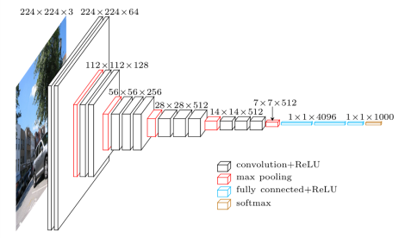
VGG16 ARCHITECTURE
VGG16 architecture comprises 16 layers arranged sequentially, including convolutional, pooling, and fully connected layers.
Each convolutional layer is followed by a max-pooling layer, contributing to the hierarchical feature extraction process.
VGG16 uses 3x3 convolutional filters with a stride of 1 throughout the network.
This uniformity simplifies the architecture while maintaining the spatial resolution of feature maps.
Initially trained on the ImageNet dataset, VGG16 learns rich hierarchical representations of visual data.
10

Slide 12
CONCLUSION
The project successfully demonstrates the effectiveness of deep learning techniques, specifically convolutional neural networks (CNNs) and the VGG16 architecture, in addressing the challenge of plant disease detection. By leveraging advanced machine learning models trained on a diverse dataset of plant leaf images, we have developed accurate and automated methods for identifying and diagnosing plant diseases. The deployed solution offers significant benefits to farmers, including early disease detection, timely intervention, and improved crop management practices, ultimately leading to enhanced crop health and increased agricultural productivity. Moving forward, continued research and development in this field hold promise for further advancements in automated agriculture and sustainable food production.
10

Slide 13
RESULTS
The results of our project showcase satisfactory performance in terms of model accuracy on validation data. Through rigorous training and optimization, our models, including custom CNN and VGG16-based architectures, demonstrated effective learning and generalization capabilities, ensuring reliable predictions for plant disease detection. By comparing the performance of these models, we were able to identify their respective strengths and weaknesses, guiding our decision-making process. Upon successful deployment, our models exhibited real-time inference capabilities, providing accurate predictions for detecting plant diseases. This deployment has significant implications for agriculture, as it empowers farmers with automated tools for timely intervention and decision-making, ultimately contributing to improved crop management practices and agricultural productivity.
10

Slide 14
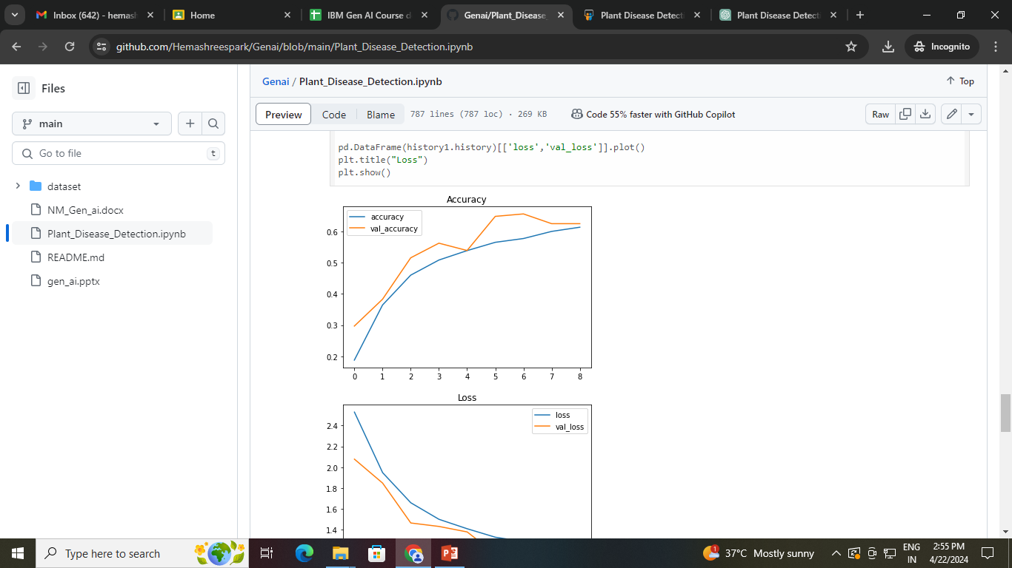
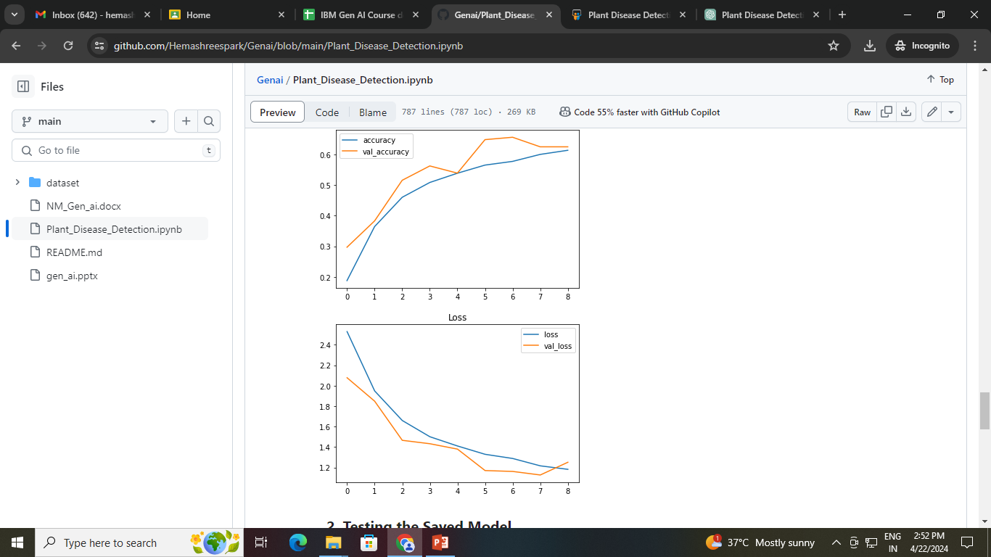
OUTPUT:
10

Slide 15
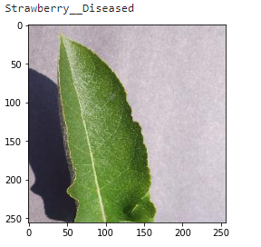
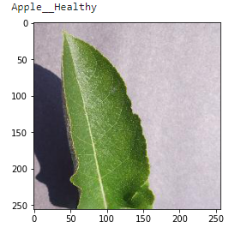
OUTPUT:
Demo Link
https://github.com/Hemashreespark/Genai.git
10

