Slide 1





FINAL PROJECT
ON
GENERATIVE AI
HEMASHREE D
311521104017
1

Slide 2

PROJECT TITLE
INTERACTIVE PDF USING GEN AI
2

Slide 3


AGENDA
PROBLEM STATEMENT
PROJECT OVERVIEW
PROPOSED SOLUTION
SYSTEM APPROACH
SOLUTION DEVELOPMENT APPROACH
CONCLUSION
RESULT
3

Slide 4
PROBLEM STATEMENT
The project aims to develop an Interactive PDF that is capable of providing the answers to the questions prompted by the user from the uploaded dataset. Current static PDF formats lack interactivity and fail to provide users with personalized assistance or real-time feedback, hindering effective communication and knowledge dissemination. Furthermore, conventional PDF editing tools lack native support for embedding responsive and integrating natural language processing (NLP) capabilities, making it challenging to create truly interactive and intuitive PDF experiences.
4

Slide 5
PROJECT OVERVIEW
The interactive PDF project aims to revolutionize the way users interact with textual content by combining advanced natural language processing (NLP) techniques with interactive document features. The project involves three main components: word embedding retrieval, document processing, and query-based interaction. The project begins with the retrieval of word embedding facilitating semantic understanding and similarity comparison between words. Next, documents are processed and segmented into smaller chunks, enabling efficient storage and retrieval of textual information. These chunks are then indexed and stored in a database for rapid access. Finally, users can interact with the system by querying for relevant information, triggering dynamic responses based on the context extracted from the document chunks.
5

Slide 6
PROPOSED SOLUTION
1.Install the dependencies:
Install the necessary libraries and modules first before further proceeding with the execution.
2.Enhanced Embedding Retrieval:
Investigate alternative embedding models and techniques to enhance the retrieval of word embedding.
3. Dynamic Chunk Splitting:
Implement a dynamic approach for splitting documents into chunks.
4. Query Optimization:
Optimize query processing algorithms to reduce search time and improve result accuracy.
6

Slide 7
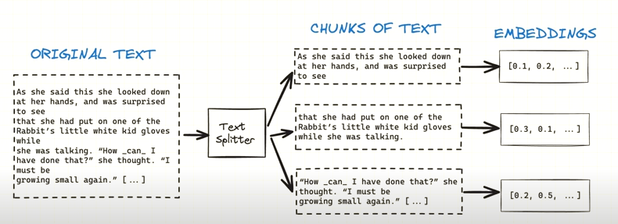
PROPOSED SOLUTION
3/21/2024Annual Review
6

Slide 8
SYSTEM APPROACH
Hardware Requirements
Processor: Intel Core i5 or equivalent, or higher.
RAM: Minimum 8GB, recommended 16GB or higher for optimal performance.
Storage: At least 100GB of free disk space for storing datasets, embeddings, and database files.
Network Connection: Required for accessing online resources, such as pre-trained models and embeddings.
3/21/2024Annual Review
7

Slide 9
SYSTEM APPROACH
Software Requirements:
Operating System: Compatible with Windows 10, macOS, or Linux
Python: Version 3.7 or higher installed on the system.
langchain: Required for various language processing functionalities.
unstructured: For document loading and processing.
chromadb: For vector storage and database management.
openai: For accessing pre-trained embeddings and language models.
tiktoken: For specific embedding-related functionalities.
7

Slide 10
SOLUTION DEVELOPMENT APPROACH
Solution Development Approach for Interactive PDF Project:
1. Requirements Analysis: Understand project needs and constraints.
2. Research: Explore existing solutions and frameworks.
3. Design: Plan system architecture, UI/UX, and algorithms.
4. Development: Build frontend, backend, and integrate components.
5. Testing: Ensure functionality through unit and integration tests.
6. Feedback and Iteration: Gather feedback, iterate on design and functionality.
7. Deployment: Deploy the system and monitor performance.
8. Maintenance: Provide ongoing support and updates.
8

Slide 11
CONCLUSION
The interactive PDF project demonstrates how digital technologies enhance document interactivity and user engagement. Despite challenges faced, it showcases the versatility and utility of interactive PDFs in various contexts. Moving forward, there's room for improvement in user experience and addressing compatibility and accessibility concerns. In conclusion, the project marks a significant advancement in document interactivity, shaping the future of information dissemination.
10

Slide 12
RESULTS
The interactive PDF project achieved its goals by enhancing document interactivity and user engagement through multimedia elements, interactive forms, and dynamic content presentation. Despite encountering challenges such as design constraints and compatibility issues, the project effectively demonstrated the versatility and utility of interactive PDFs in diverse contexts. Looking ahead, there's a clear path for further enhancing user experience and addressing compatibility and accessibility concerns. In summary, the project represents a noteworthy advancement in document interactivity, paving the way for the future of information dissemination.
10

Slide 13
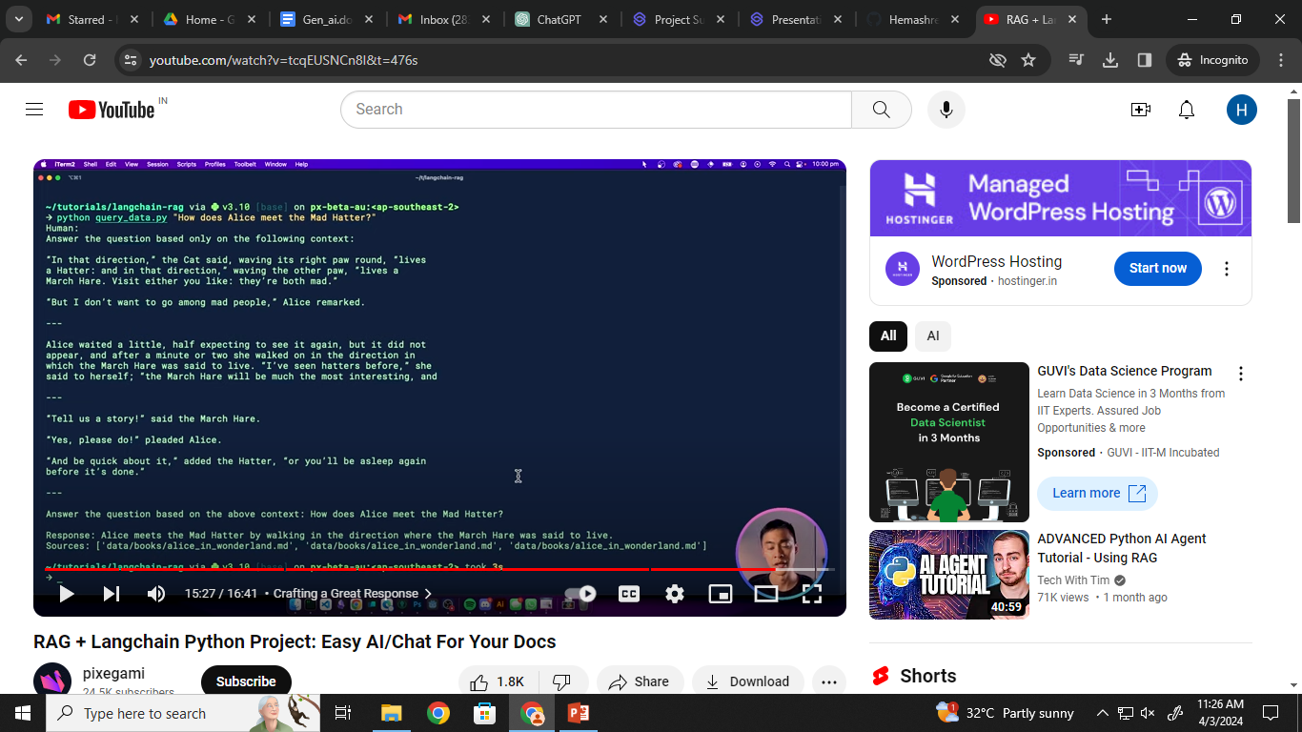
OUTPUT:
Demo Link
https://github.com/Hemashreespark/TNSDC-Generative-AI.git
10

