Slide 1
WELCOME TO
EMPLOYEE LEAVE MANAGEMENT SYSTEM

Slide 2




MEET OUR TEAM
LEAD
Hemashri U
230701114
MEMBERS
Hemnath V
230701115
Harshita M A
230701112
Himeshwar N
230701116

Slide 3

ABSTRACT
A web-based solution that simplifies leave request handling by enabling employees to apply for leave and allowing HR/Admin to manage approvals efficiently. ELMS enhances transparency, reduces paperwork, and improves communication. Key features include automated notifications, task reassignment alerts, and future-ready enhancements like AI-based approvals and attendance rewards. Built using Microsoft Azure and Agile methodology, it ensures scalability, security, and real-time tracking—making it a standout solution in modern workforce management.

Slide 4

Traditional
System
VS
Proposed
System
Paper, email, informal chats
Centralized online portal
Request Method
Manual, slow, requires follow-ups
Automated workflows with notifications
Approval Process
Frequent calculation and tracking errors
Auto-calculation ensures accuracy
Error Handling
No real-time updates
Leave Visibility
Real-time balance and status tracking

Slide 5
Why we need this application?
Applications | Advantages | Disadvantages
BamboolHR(HR &Employee Management System) | •User-friendly interface •Automates HR workflows (leave requests, approvals, payroll) •Mobile app available | Expensive for small businesses Limited customization option. No in-depth project management features
Zoho People (HR & Workflow Management System) | •Cloud-based and accessible anywhere •Affordable pricing for small businesses | •Can be complex for beginners •Some features require additional paid add-ons •Limited third-party integrations
Workday (Enterprise HR & Workflow Management) | •Strong security and compliance features •AI-powered automation •Suitable for large enterprises | High cost, not ideal for startups •Complex setup and implementation •Requires training for new users

Slide 6


Proposed
Solution
Read More

Slide 7

Streamline Leave Management
Key Features
Secure User Authentication: Role-based access control for employees, HR, and admins.
.
Intelligent Leave Analytics: Real-time attendance tracking and leave statistics.
Effortless Leave Management: Apply, track, and manage leave requests in real-time
Automated Notifications: Instant app notifications for leave approval/rejection.

Slide 8

MODULES
LEAVE MANAGEMENT SYSTEM
EMPLOYEE
MODULE
HR/ADMIN
MODULE
The employee can log in with a valid email and password
Admin can add/update/ delete leave type and departments
Update his/her profile
Admin can add an employee and also update the employee info. Also can active or block an employee.
Applied for leave
Admin can also manage the leave application(approve and not approve).
View the leave history
Change his/ her password
Every time when an employee applies for leave admin will get a notification.
Password Recovery with the valid email id and empid
Admin can change own password after login

Slide 9
MODULES
LEAVE MANAGEMENT SYSTEM
SUPER ADMIN
MODULE
The Super Admin can log in with a valid email and password
Update his/her profile
Add Employees , departments, HR Managers
in the System
Add Types of leaves like Casual leave, Sick Leave
Review Leave Request
Create Policies and Update them.

Slide 10


ASSUMPTIONS IN ELMS
If the employee gives the reason for the leave less than 5 words it gives notification
Example: If an employee enter the reason for the leave simply as “Due to fever” it alert to enter minimum 5 words are needed.
If the notified slot is not compatible with the entered time it gives alert or notify about the error.
Example: If the employee applies for half day leave for that the time slot is (1 to 5pm), but the employee entered 10 to 5 pm is not acceptable so that it gives an alert.
If an important work or event is scheduled at particular day, the leave form is disabled for that day.
Example: In the Testing department on April 21st is project final testing so none of employee should absent that day so when apply leave for that day the leave form will disabled.
If the Leave is rejected by HR/Admin they give some reason for the rejection.
Example: If an employee’s CL is completed so the HR reject this leave application.

Slide 11
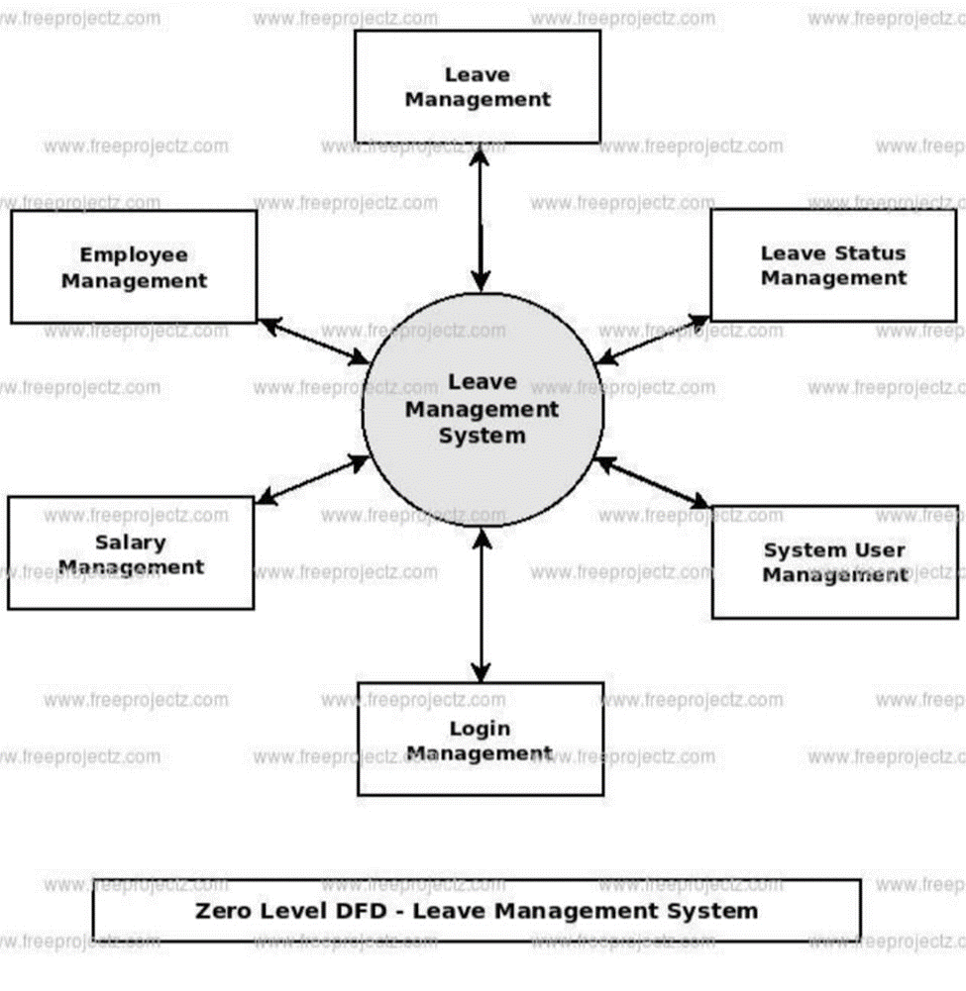
ZERO LEVEL DATAFLOW DIAGRAM

Slide 12
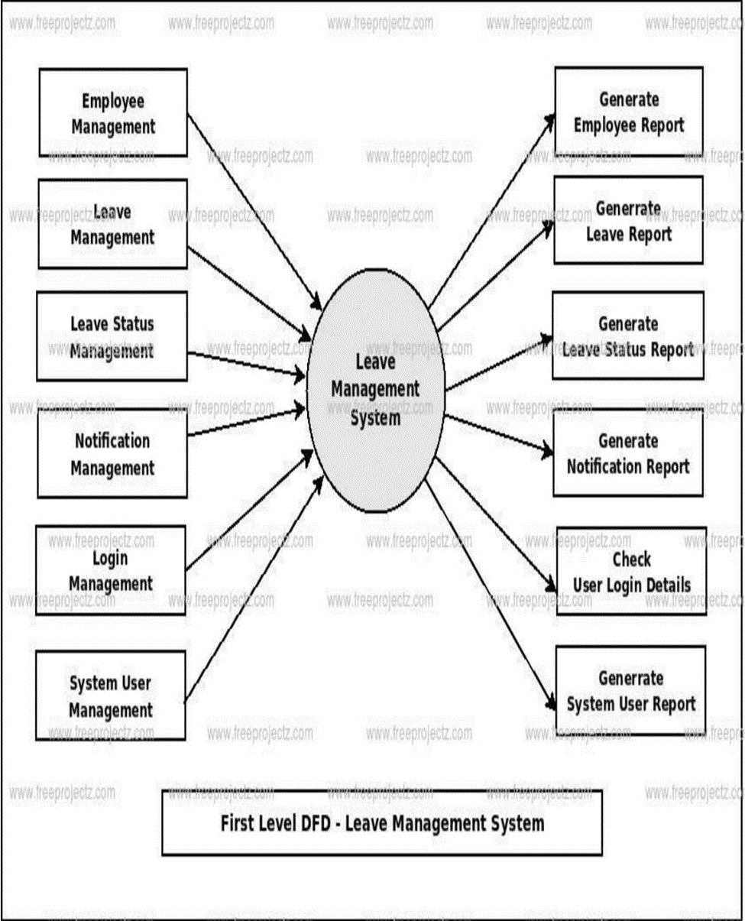
FIRST LEVEL DATAFLOW DIAGRAM

Slide 13
Unified Modeling
Diagram
CLASS DIAGRAM
STATE DIAGRAM
ACTIVITY DIAGRAM
SEQUENCE DIAGRAM
USECASE DIAGRAM
VIEW
SWIPE RIGHT

Slide 14
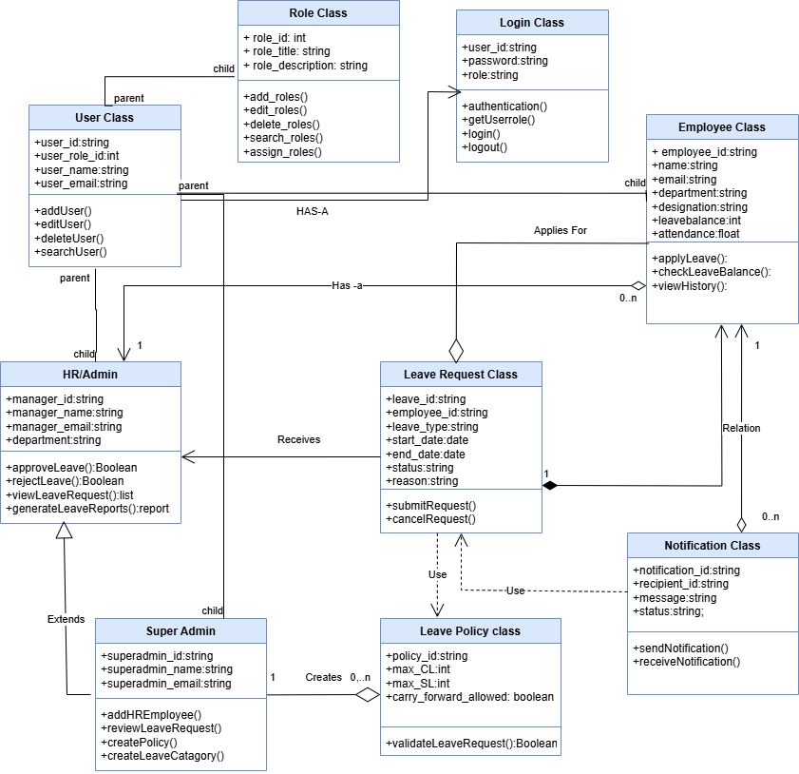
CLASS DIAGRAM

Slide 15
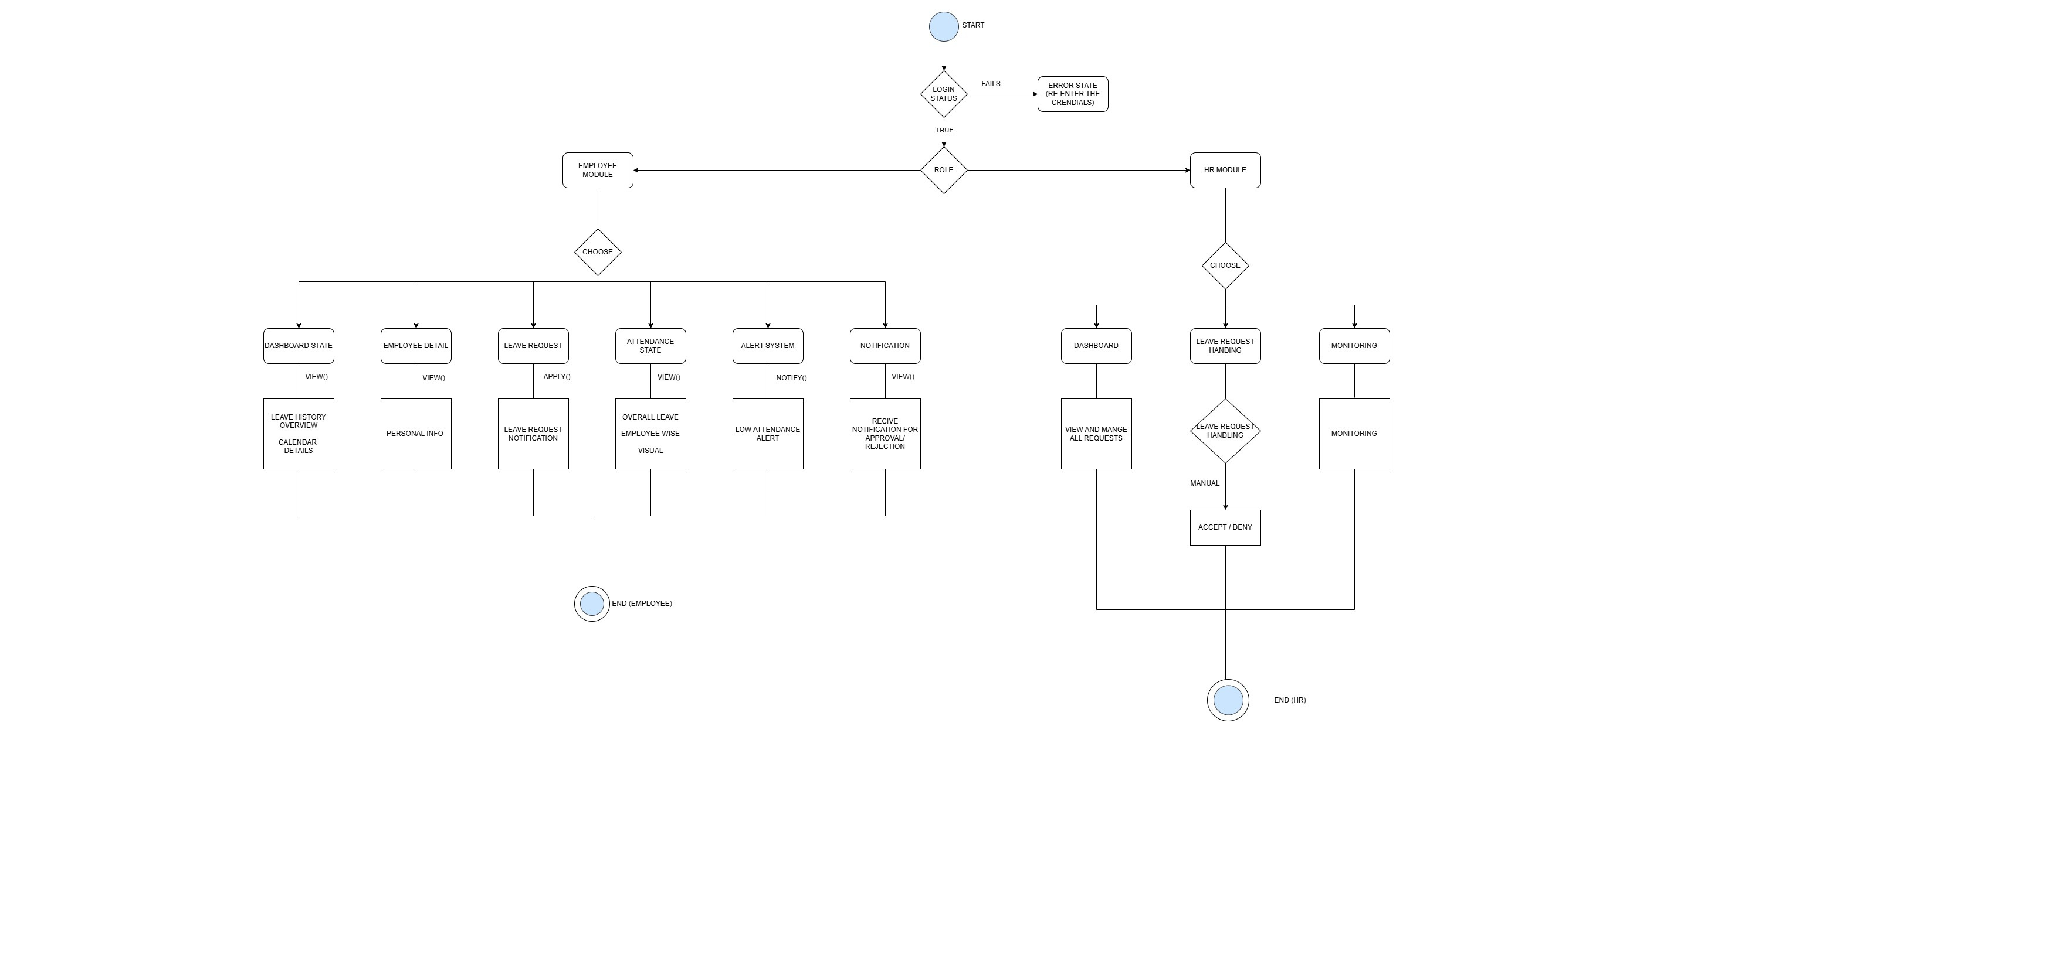
STATE DIAGRAM

Slide 16
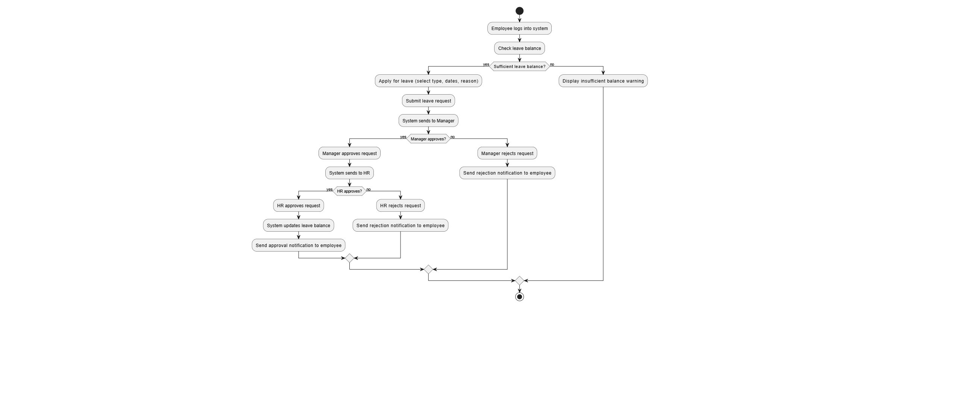
ACTIVITY DIAGRAM

Slide 17
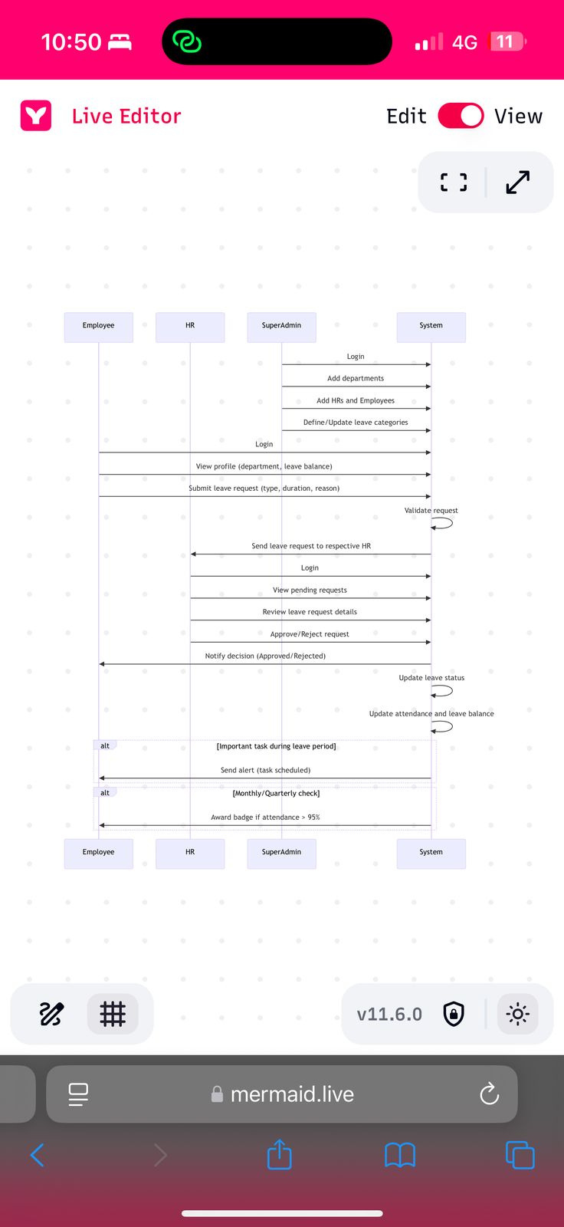
SEQUENCEDIAGRAM

Slide 18
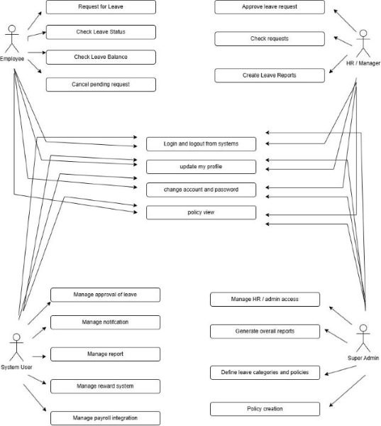
USECASE
DIAGRAM

Slide 19
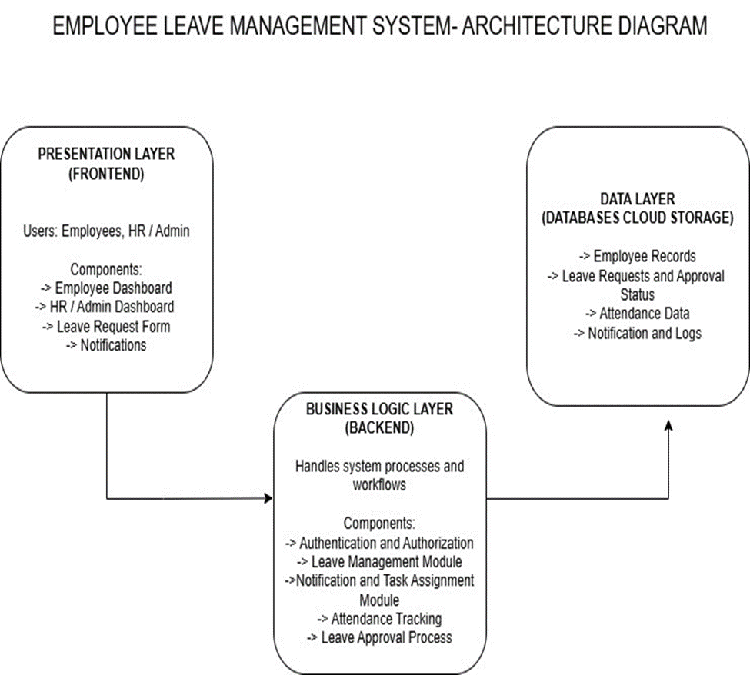
ARCHITECTURE DIAGRAM

Slide 20
REFERENCES
https://srmus.ac.in/view/governance/naac/1.3.4/Supporting%20Documents/MCA/Anjali%20Rana%20%5B20IT103017%5D.pdf
http://repository.wyb.ac.lk/bitstream/handle/1/1682/ASBIRES-2015-89.pdf?sequence=2
https://youtu.be/4wJYuvKnumY?si=MrJxOmVz0A1Da7pF

Slide 21
Thank You For Attention
See You Next

