Slide 1



Exploring Unix Text Utilities with Grep and Awk
Welcome to our presentation on Unix text utilities! Today, we'll be discussing two powerful command-line tools: Grep and Awk. With these tools, you can search, filter, and manipulate text data like a pro.
by Hema v

Slide 2
Grep Basics
Text Search
Case Sensitivity
Grep searches for specified patterns within files or standard input. Simply provide the pattern and the file or files to search.
By default, Grep is case sensitive. Use the -i option for a case-insensitive search.
Inverted Search
Line Numbers
Show lines that do not contain the specified pattern using the -v option.
Show line numbers along with matching lines with the -n option.

Slide 3
Advanced Grep
1
Recursive Search
Search directories and subdirectories recursively using -r.
Files with Matches
2
List only the names of files containing matches using -l.
3
Extract Parts of Lines
Show only the part of the line that matches the pattern using -o.

Slide 4
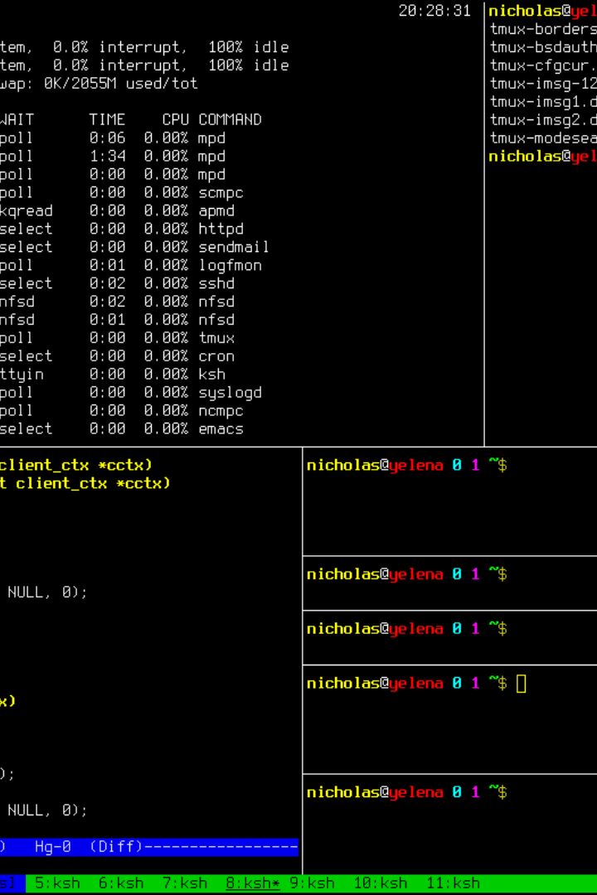
Awk Basics
1
Print Lines
2
Working with Fields
Awk is used to print specific lines from a file. For instance, specific lines that contain an error.
If your text data has fields or columns separated by delimiters, Awk can be used to work with this data.
3
Built-in Variables
Awk comes with useful built-in variables that can make complex processing easier.

Slide 5
Field Processing with Awk
Print Fields
Custom Delimiters
Formatting Output
You can use Awk to print specific fields of a file, like the first field of each line.
You can specify a custom delimiter character, e.g. comma using the -F option.
You can format your output to appear exactly as you want by using printf.

Slide 6
Advanced Awk
1
Calculations
Perform numerical calculations on data using awk. Useful for finding sums or averages of columns.
2
Conditional Processing
You can apply conditions to your processing, allowing you to parse data in new ways.
3
User-Defined Functions
Define your own functions for more complex processing.

Slide 7
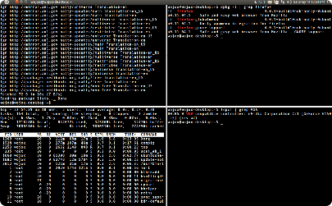

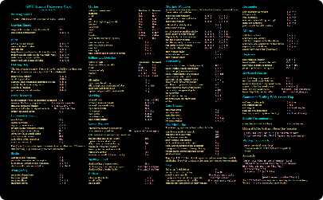
Making the Most of Grep & Awk
Tabbed Terminals
Toolbox
Keyboard Shortcuts
Use multiple terminal tabs to increase productivity when using tools like Grep and Awk.
Use Grep and Awk along with other Unix text utilities to get the most out of your data analysis.
Learn useful keyboard shortcuts to streamline your text-processing workflow.

Slide 8
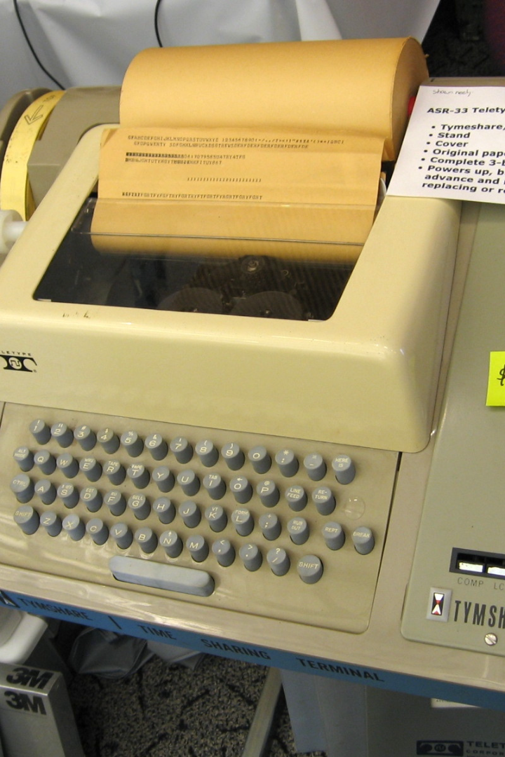
Closing Thoughts
1
Practice Your Skills
2
Become an Expert
Practice using Grep and Awk with sample data files available online.
With time and practice, you can become an expert in using Grep and Awk to manipulate data.
3
Explore More Tools
There are many other Unix text utilities worth exploring, like SED and WC, that can help you find solutions to new problems.

