Slide 1
Module 1: Introduction to Problem Solving
Hemavathy S
Assistant Professor,
School of Electronics and Engineering, Vellore Institute of Technology, Chennai
hemavathy.s@vit.ac.in
Pre-programming Phase

Slide 2
Professional Coding
Programming is the art of algorithm design and the craft of debugging errant code.
Pre-programming Phase

Slide 3
How our syllabus are framed?
Pre-Programming Phase (Module 1)
Coding Phase (Module 2 - Module 7) - Basics of Python
Pre-programming Phase

Slide 4
What is python
Python is a high-level, interpreted programming language known for its simplicity and readability. It was created by Guido van Rossum and first released in 1991.
It was named after the popular British comedy troupe Monty Python’s Flying Circus.

Slide 5
Why python is important
Readability and Simplicity: Python's syntax is designed to be easy to read and write, which makes it an excellent choice for beginners and for rapid development.
Interpreted Language: Python code is executed line by line at runtime, which makes debugging and testing easier.
Dynamic Typing: Variables in Python do not require an explicit declaration to reserve memory space. The declaration happens automatically when a value is assigned to a variable.
Versatile and Multi-Paradigm: Python supports multiple programming paradigms, including procedural, object-oriented, and functional programming.

Slide 6
Why python is important
5. Community and Ecosystem: Python has a large and active community, which contributes to a vast ecosystem of third-party packages and frameworks. Some popular ones include NumPy and pandas for data analysis, Flask and Django for web development, and TensorFlow and PyTorch for machine learning.
6. Cross-Platform: Python is cross-platform, meaning that Python programs can run on various operating systems like Windows, macOS, and Linux without requiring modification.

Slide 7

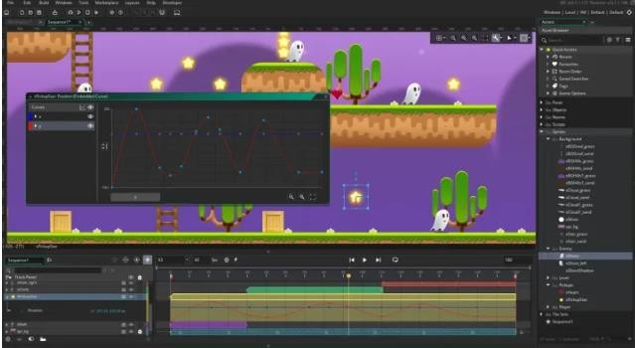

How python is integrated with real time
Web development
Data Streaming
Real time dashboards
IoT
Machine learning and AI
Game development
Financial Trading
Telecommunications
Real-time collaborations
Scientific computing and so on……

Slide 8
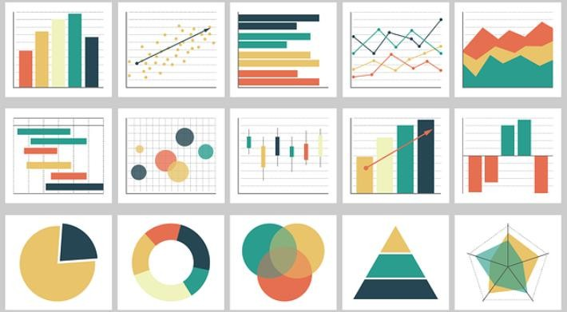
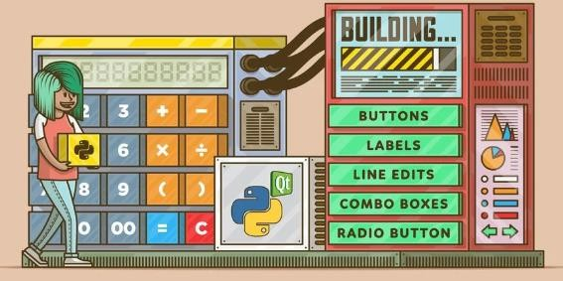
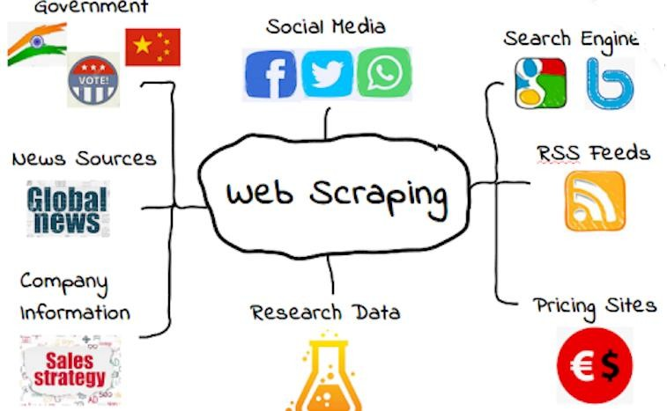
WHERE PYTHON USED?

Slide 9
Ho
How to save a file…
File→ new file→ save as→ filename.py

Slide 10
Topics to be covered in Pre-Programming Phase,
Problem Solving: Definition and Steps
Problem Analysis Chart (PAC), Interactivity Chart (IC), Input Process Output (IPO) chart, Coupling Diagram, and Data Dictionary
Developing an Algorithm Flowchart
Pseudo-code
Pre-programming Phase

Slide 11
Skills Required for a Software Engineer
Skills Required for a Software Engineer
Technical Skills
Software Design
Coding
Testing
Problem Solving Skills
logical and analytical thinking
Soft Skills
Communication
Team Work

Slide 12
Terminologies to brush up,
Problem Programmers User Software
Fact1: Computer only knows, how to follow codes in software Fact2: The programmer needs to know how to solve the problem
Pre-programming Phase

Slide 13
What is PROBLEM?
A problem is a puzzle that requires logical thought and /or mathematics to solve
A discrepancy between the current state and a desired state, necessitating action to bridge the gap.
A problem is a situation, condition, or issue that requires a solution or resolution.
It often involves obstacles that hinder progress toward a desired goal.
Problems can vary in complexity, from simple everyday tasks to intricate challenges in professional or technical fields.
Pre-programming Phase

Slide 14
Problem Solving,
Refers to identifying a challenge or obstacle and developing a strategy to overcome it.
It involves analyzing the situation, generating potential solutions, evaluating them, and implementing the most effective ones.
Problem solving is a critical skill in many fields, as it allows individuals and organizations to navigate obstacles and achieve goals efficiently.
Pre-programming Phase

Slide 15
Types of Problems
Types of Problems
All Problems do not have a straightforward solutions.
Some problems, such as balancing a checkbook or baking a cake, can be solved with a series of actions.
These solutions are called algorithmic solutions.
There may be more than one solution for a problem
Identify all possible ways to solve a problem and choose one among them

Slide 16
Types of Problems
Types of Problems
The solutions of other problems, such as how to buy the best stock or whether to expand the company, are not so straightforward.
These solutions require reasoning built on knowledge and experience, and a process of trial and error.
Solutions that cannot be reached through a direct set of steps are called heuristic solution

Slide 17
Problem Solving with Computers
Problem Solving with Computers
Computers are built to solve problems with algorithmic solutions, which are often difficult or very time consuming when input is large
Solving a complicated calculus problem or alphabetizing 10,000 names is an easy task for the computer
So the basis for solving any problem through computers is by developing an algorithm

Slide 18
Field of computers that deals with heuristic types of problems is called Artificial Intelligence (AI)
Artificial intelligence enables a computer to do things like human by building its own knowledge bank
As a result, the computer’s problem-solving abilities are similar to those of a human being.
Artificial intelligence is an expanding computer field, especially with the increased use of Robotics.

Slide 19
Machines in problem-solving,
Computer technology, completing any task fast and accuracy Steps with skills
Technology – not advanced enough to solve problem by own, hence we need to give step by step instruction to proceed
Eg: Zomato, Swiggy – Ordering our favourite, Bookmyshow – Booking cinema in no time, Amazon, Netflix, Hotstar – Entertainment all in one place.
Eg: Groceries in Netflix
Pre-programming Phase

Slide 20
Program Development Cycle
Analyze – Problem definition Design – Problem solution
Choose recipes – Flowchart, Pseudocode, Charts, and Algorithms Code – Converting algorithm to programming language
Test & Debug – Real-time errors
Documentation – Problem-solving to product development
Pre-programming Phase

Slide 21
Problem solving in some domains,
Engineering - Designing, testing, refining
Medicine - Diagnosis illness, treatment, patient care
Business - Strategic planning, managing operations, improving customer satisfaction, and driving innovation
Information Technology - software, hardware, and networks Education - Curriculum, classroom and student management Everyday life - decision making, society
Pre-programming Phase

Slide 22
Computational Problems
Computational Problems
Computation is the process of evolution from one state to another in accordance with some rules.

Slide 23
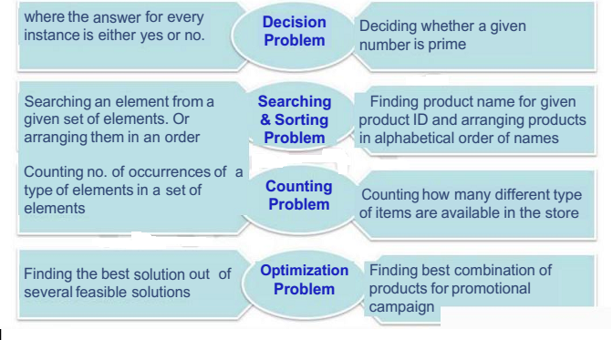
Types of Computational Problems
Types of Computational Problems

Slide 24
Logic – Basis for solving any problem
Definition : A method of human thought that involves thinking in a linear, step by step manner about how a problem can be solved
Logic is a language for reasoning.
It is a collection of rules we use when doing reasoning.
Eg: John's mum has four children.
The first child is called April.
The second May.
The third June.
What is the name of the fourth child?

Slide 25
What Problem Can Be Solved By Computer
What Problem Can Be Solved By Computer
Solving problem by computer undergo two phases:
Phase 1:
Organizing the problem or pre-programming phase.
Phase 2:
Programming phase.

Slide 26
PRE-PROGRAMMING PHASE
PRE-PROGRAMMING PHASE
Analyzing The Problem
Understand and analyze the problem to determine whether it can be solved by a computer.
Analyze the requirements of the problem.
Identify the following:
Data requirement.
Processing requirement or procedures that will be needed to solve the problem.
The output.

Slide 27
Steps in Pre-programming phase
Analyzing the Problem – Problem Analyzing Chart (PAC) - beginning analysis of the problem
Developing Interactivity Chart (IC) - overall layout or structure of the solution.
Developing Input Process Output (IPO) chart - shows the input, the processing, and the output
Algorithms - show the sequence of instructions comprising the solution
Program Flowchart - which are graphic representations of the algorithms
Pseudocode - represents a language-like solution
Pre-programming Phase

Slide 28
Problem Analyzing Chart (PAC)
A Problem Analysis Chart (PAC) is a tool used to break down and analyze a problem systematically.
It helps in organizing thoughts and data related to the problem in a structured format.
The primary purpose of a PAC is to gain a clear understanding of the problem and its components, which is crucial for developing effective solutions.
Pre-programming Phase

Slide 29
Components of PAC
Given data - All the information provided in the problem statement, including constants and variables
Required Results - Desired output or solution
Processing Required - Necessary calculations, equations, and expressions needed to transform the given data into the required results
Solution Alternatives - Potential approaches or algorithms
Pre-programming Phase

Slide 30
PRE-PROGRAMMING PHASE
All these requirements can be presented in a Problem Analysis Chart (PAC)
Data | Processing/ processing required | Required results/Output | Solution Alternatives
given in the problem or provided by the user | List of processing required or procedures. | Output requirement. | List of ideas for the solution of the problem.

Slide 31
PRE-PROGRAMMING PHASE
Payroll Problem
Calculate the salary of an employee who works by hourly basis. The formula to be used is
Salary = Hour works * Pay rate
Data | Processing | Output | Solution Alternatives
Hours work, Pay rate | Salary = Hours work * payrate | Salary | 1. Define the hours worked and pay rate as constants. ∗2. Define the hours worked and pay rate as input values.

Slide 32
Miles to Km
Write a Problem Analysis Chart (PAC) to convert
the distance in miles to kilometers where 1.609
kilometers per mile.
Data | Processing | Output | Solution Alternatives
Distance in miles | Kilometers = 1.609 x miles | Distance in kilometers | 1. Define the miles as constants. ∗2. Define the miles as input values.

Slide 33
Importance of Logic in problem solving Importance of Logic in problem solving
Determine whether a given number is prime or not?
Data | Processing | Output | Solution Alternatives
Number, N | Check if there is a factor for N | Print Prime or Not Prime | 1. Divide N by numbers from 2 to N and if for all the division operations, the reminder is non zero, the number is prime otherwise it is not prime 2. Same as 1 but divide the N from 2 to N/2 3. Same as Logic 1 but divide N from 2 to square root of N
Notes:
Example: Determine whether a given number is prime or not?
What is input?
What is Output?
What is the process involved to get the output from the input? What is the logic behind the process?

Slide 34
Example 2
Calculate the amount for call driver for our own car, who works on hourly basis
Given Data: Required Results: Processing Required:
Solution Alternatives:
Pre-programming Phase

Slide 35
Example 2
Calculate the amount for call driver for our own car, who works on hourly basis
Given Data: - Hourly wage rate for the driver (e.g., 150/hour) - Total hours worked (e.g., 8 hours) - Any additional costs (e.g., fuel, maintenance)
Required Results: Total amount to pay the driver for the hours worked, including any additional costs.
Processing Required: 1. Calculate the total payment based on hours
worked and hourly rate.
2. Add any additional costs to the total payment.
Solution Alternatives: 1. Pay the driver based on a fixed hourly rate.
Offer a bonus for overtime hours worked.
Include a fuel reimbursement policy.
Pre-programming Phase

Slide 36
Example 3
Calculate the average of five numbers by using PAC
Given Data: Required Results: Processing Required:
Solution Alternatives:
Pre-programming Phase

Slide 37
Example 3
Calculate the average of five numbers by using PAC
Given Data: Five numbers to average (e.g., 12, 15, 20, 25, 30) Required Results: Average of the five numbers (20.4) Processing Required: 1. Sum the five numbers.
2. Divide the total sum by the number of values (5).
Solution Alternatives: 1. Use a calculator for quick computation.
2. Check for any outliers that might affect the average.
Pre-programming Phase

Slide 38
Assignments - PAC
Calculate the gross pay of an employee by using PAC
Convert the distance in kilometres to miles where, 1mile = 1.609km by using PAC
Calculate the gross pay of an employee given the hours worked and rate of pay. The gross pay is calculated by multiplying the hours worked by the rate of pay.
Analyse the problem for area of circle, area = pi*radius*radius
Write a PAC to compute and display the temperature inside the earth in Celsius & Fahrenheit, where Celsius = 10*(depth) + 20 & Fahrenheit = 1.8 * (Celsius) + 32
Pre-programming Phase

Slide 39
Algorithms
An algorithm is a step-by-step procedure or formula for solving a problem.
It is a sequence of instructions that can be followed to achieve a specific goal or perform a task.
Algorithms are fundamental to computer science and programming, as they provide a clear method for processing data and making decisions.
Pre-programming Phase

Slide 40
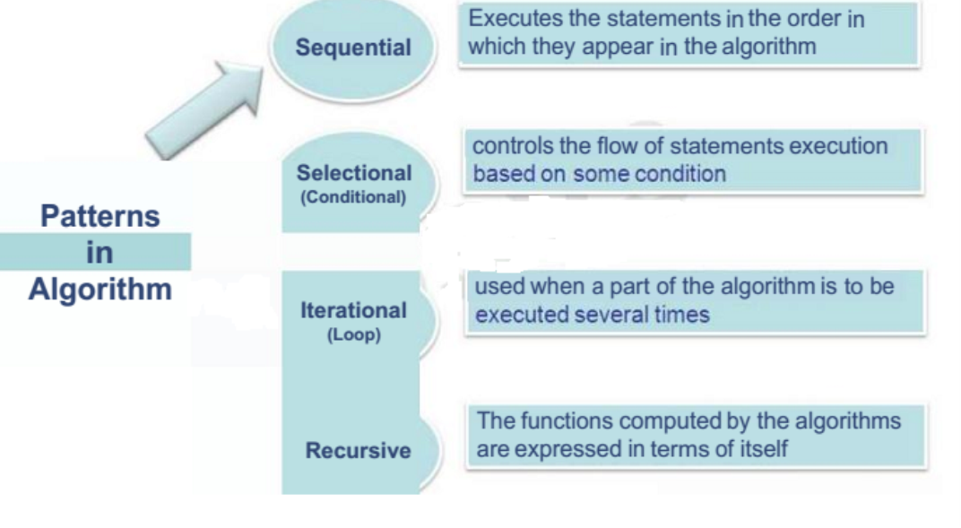
Different patterns in Algorithm

Slide 41
Algorithms
Finite Sequence: Algorithms are a finite sequence of instructions that must be followed to complete a particular task.
Well-Defined: They must be clearly defined and produce at least one output.
Input and Output: Algorithms take zero or more inputs and produce at least one output.
Execution: They must be executed and finished in a finite number of steps.
Pre-programming Phase

Slide 42
Types of Algorithms
Exact Algorithms: These solve problems exactly and are suitable for problems where exact solutions are required.
Approximation Algorithms: These provide approximate solutions and are used for problems where exact solutions are impractical.
Applications: Computer science, operations research, artificial intelligence, and bioinformatics, traveling sales man problem
Pre-programming Phase

Slide 43
Steps in Algorithmic Problem Solving
Problem Analysis: Understand the problem and identify the data requirements, processing requirements, and output requirements.
Developing a High-Level Algorithm: Create a high-level plan for solving the problem, which is often represented using pseudocode or flowcharts.
Refining the Algorithm: Add more detail to the high-level algorithm to make it more specific and executable.
Reviewing the Algorithm: Ensure the algorithm solves the problem correctly and identify opportunities for simplification or generalization.
Pre-programming Phase

Slide 44
Example 1: Cooking Maggi with Egg
Start: Begin by preparing the ingredients.
Boil Water: Pour 1.5 cups of water into a small pot and bring it to a boil.
Add Noodles: Open the Maggi noodles packet and add the noodles to the boiling water.
Add Flavor Packet: Open the flavor packet and add it to the pot. Simmer: Lower the heat and simmer the noodles for 2 minutes.
Add Egg: Crack an egg into a bowl, whisk it, and pour it into the pot. Stir: Stir the egg into the noodles until it is scrambled.
Add Cheese: Stir in 0.5 cup of grated cheese. Serve: Serve the Maggi noodles hot.
Pre-programming Phase

Slide 45
Example 2: Adding Two Numbers → Sequential Agorithm
Start: Begin the addition process. Read the First Number: 5.
Read the Second Number: 3. Add the Numbers: 5 + 3 = 8. Write the Sum: 8.
Stop: End the addition process.
Pre-programming Phase

Slide 46
Example 3: Swap Two Numbers
Step 1: Start
Step 2: Take two numbers as input. Step 3: Declare a temporary variable.
Step 4: Store the first number in the temporary variable. Step 5: Store the second number in the first number.
Step 6: Store the temporary variable in the second number. Step 7: Print the first and second numbers.
Step 8: End.
Pre-programming Phase

Slide 47
Example 4: Greater among three Numbers
Start: Begin the comparison process. Read the First Number: 5.
Read the Second Number: 8. Read the Third Number: 12.
Compare the Numbers: 5 is less than 8. Compare the Numbers: 8 is less than 12. Write the Greater Number: 12.
Stop: End the comparison process.
Pre-programming Phase

Slide 48
Selectional Algorithms

Slide 49
Algorithm for Conditional Problems
PROBLEM: To decide if a fire alarm should be sounded
ALGORITHM:
1 IF fire is detected condition
2 THEN sound fire alarm action
Another example is:-
PROBLEM: To decide whether or not to go to school ALGORITHM:
1 IF it is a weekday AND it is not a holiday
2 THEN go to school
3 ELSE stay at home

Slide 50
Pass/ Fail and Average
Pass/ Fail and Average
Write an algorithm to find the average marks of a student. Also check whether the student has passed or failed. For a student to be declared pass, average marks should not be less than 65. Step 1 : Read Marks1, Marks2, Marks3 Step 2 : Total = Marks1 + Marks2 + Marks3 Step 3 : Average = Total / 3 Step 4 : Set Output = “Student Passed” Step 5 : if Average < 65 then Set Output = “Student Failed" Step 6 : Display Output

Slide 51
Leap Year or Not
Leap Year or Not
Step 1 : Read YEAR Step 2 : IF ({YEAR%4=0 AND YEAR%100!=0)OR (YEAR%400=0)) Display "Year is a leap year" ELSE Display “Year is not a leap year" ENDIF

Slide 52
Algorithm for Iterative Problems
This type of loop keeps on carrying out a command or commands UNTIL a given condition is satisfied, the condition is given with the UNTIL command, for example:-
PROBLEM: To wash a car
ALGORITHM:
1 REPEAT
2 wash with warm soapy water
3 UNTIL the whole car is clean

Slide 53
Iterational Algorithms – Repetitive Structures
Find the average marks scored by ‘N’ number of students

Slide 54
Step 1 : Read the Number Of Students Step 2 : Let Counter = 1 Step 3 : Read Marks1, Marks2, Marks3 Step 4 : Total = Marks1 + Marks2 + Marks3 Step 5 : Average = Total / 3 Step 6 : Set Output = “Student Passed” Step 7 : If (Average < 65) then Set Output = “Student Failed" Step 8 : Display Output Step 9 : Set Counter = Counter + 1 Step 10 : If (Counter <= NumberOfStudents ) then goto step 3

Slide 55
Tasks
Write an algorithm for the following tasks.
To check if a given number is even or odd
Get two numbers. Perform
Perform Multiplication by using repeated additions
Perform Division by using repeated subtractions.

Slide 56
Assignment for Algorithms
How to make biryani? (veg/non-veg)
Find Roots of a Quadratic Equation ax2 + bx + c = 0 Find the factorial of a number
Check whether a number is prime or not
Find the Fibonacci series till the term less than 1000
Write an algorithm for the following tasks.
To check if a given number is even or odd
Get two numbers. Perform
Perform Multiplication by using repeated additions
Perform Division by using repeated subtractions.
Pre-programming Phase

Slide 57
Importance of Algorithms
Algorithms can be represented in many forms, and among that there are few methods which will be used globally.
There are few methods to represent algorithms in other forms,
Flowchart Pseudocode
It shows the logic behind algorithms without implementation. Non programmer also understand the flow.
Pre-programming Phase

Slide 58
Flowchart
A flowchart is a visual representation of the sequence of steps and decisions in a process.
It is used to illustrate the flow of data and control in a system.
Pre-programming Phase

Slide 59
Components of a Flowchart
Start: The starting point of the flowchart.
Process: The steps or actions performed in the process.
Decision: A point where the flowchart branches based on a condition.
Input/Output: The data that enters or exits the process.
Connector: Lines that connect the different components of the flowchart.
Terminal: The end point of the flowchart.
Pre-programming Phase

Slide 60
Symbols Used in Flowcharts
Rectangles: Represent processes. Oval: Start and End operation Diamonds: Represent decisions.
Parallelogram Represent inputs and outputs.
Arrows: Connect the different components of the flowchart.
Pre-programming Phase

Slide 61
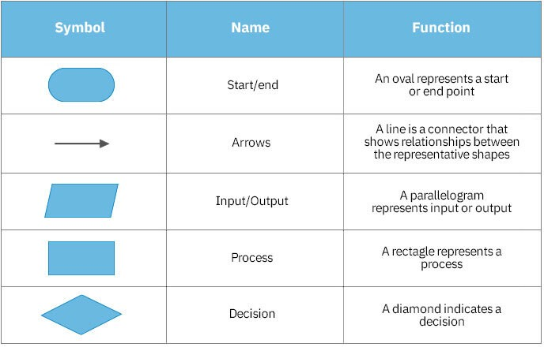
Flowchart Symbols
Pre-programming Phase

Slide 62
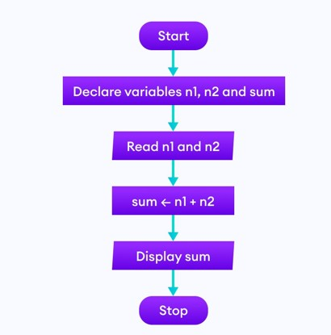
Example 1: Adding two numbers
Pre-programming Phase

Slide 63
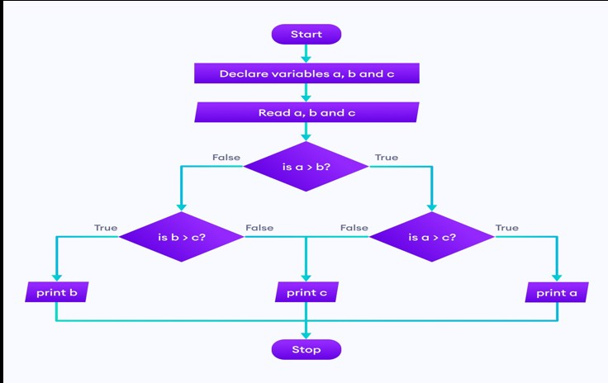
Example 2: Greatest among three numbers
Pre-programming Phase

Slide 64
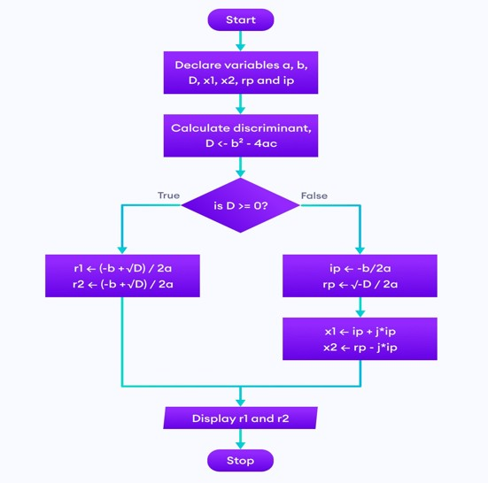
Example 3: Finding all the roots of a quadratic equation
Pre-programming Phase

Slide 65
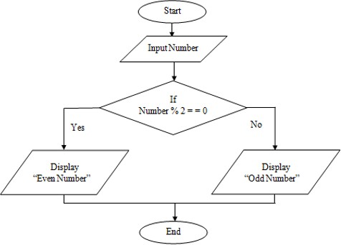
Example 4: Odd or Even
Pre-programming Phase

Slide 66
Assignment - Flowchart
Read the sequence of numbers, find the average of the number and print the average.
Find the Fibonacci series till term1000.
Hiring process in any company starting from advertisement till offer letter
Draw a flowchart for - Should I Break Up With Him or Her
Pre-programming Phase

Slide 67
Pseudocode
Pseudocode is a method used to describe the steps of an algorithm in a way that is easy to understand for anyone with basic programming knowledge.
It combines elements of programming languages with informal language to outline the logic of a program without getting bogged down by syntax rules.
This makes it a valuable tool for planning, designing, and communicating algorithms.
Pre-programming Phase

Slide 68
Common constructs used in Pseudocode
SEQUENCE: Represents linear tasks performed one after the other.
IF-THEN-ELSE: Conditional statements that dictate different actions based on conditions.
WHILE: Loops that continue as long as a condition is true. FOR: Loops that iterate a specific number of times.
REPEAT-UNTIL: Loops that continue until a condition is met. CASE: A generalized form of IF-THEN-ELSE for multiple conditions. CALL: Used for invoking classes or calling functions.
EXCEPTION: Used for handling exceptions, along with the WHEN keyword.
Pre-programming Phase

Slide 69
Pseudocode
INPUT orderAmount
IF orderAmount >= 50 THEN APPLY discount
DISPLAY "Discount has been applied!" ELSE
DISPLAY "Add more items to cart for discount!" ENDIF
END
Pre-programming Phase

Slide 70
Advantage of using Pseudocode
Simplifies Logic: It allows programmers to focus on the logic and flow of the algorithm without being distracted by specific programming syntax.
Facilitates Collaboration: Pseudocode can be easily understood by team members who may not be familiar with a specific programming language, enhancing communication.
Error Reduction: Writing pseudocode helps identify logical errors before actual coding begins, making the coding process smoother and more efficient.
Pre-programming Phase

Slide 71
Example 1: Basic Even/Odd Check
INPUT number
IF number MOD 2 = 0 THEN
DISPLAY number + " is even." ELSE
DISPLAY number + " is odd." ENDIF
END
Pre-programming Phase

Slide 72
Sequential Pattern
Sequential Pattern
Example1: Find the average runs scored by a batsman in 4 matches
Algorithm:
Step 1: Start
Step 2: Input 4 scores say runs1,runs2,runs3 and runs4
Step 3: Accumulate runs1,runs2,run3,and runs4 and store it
in the variable called total_runs
Step 4: Divide total_runs by 4 and find the average
Step 5: Display the average
Step 6: Stop

Slide 73
Flowchart
Start
Read run1, run2, run3, run4
total_run=run1+run2+run3+run4)
batting_average= total_run/4
display batting average
Stop

Slide 74
Pseudo code:
Begin
read run1,run2,run3 and run4
compute total_run= run1+run2+run3+run4
compute batting_average= total_run/4
display batting_average
end

Slide 75
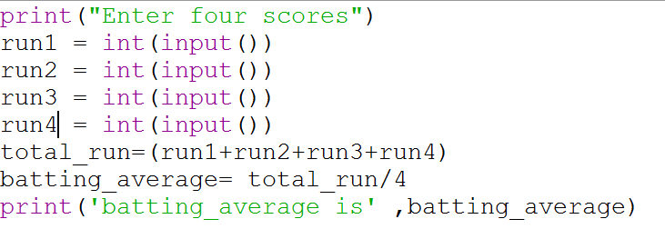
Batting Average

Slide 76
Area of a circle
Step 1 : Start
Step 2: Get the input for RADIUS
Step 3 : Find the square of RADIUS and store it in SQUARE
Step 4 : Multiply SQUARE with 3.14 and store the result in AREA
Step 5: Stop

Slide 77
Flowchart
Start
Accept radius
square = radius × radius
area= 3.14 × square
display area
Stop

Slide 78
Pseudo code:
begin
accept radius
compute square = radius * radius
compute area = pi * square
display area
end

Slide 79
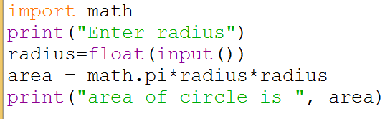
Area of a circle

Slide 80
Exercise
An university is setting up a new lab at their premises. Design an algorithm and write Python code to determine the approximate cost to be spent for setting up the lab. Cost for setting the lab is sum of cost of computers, cost of furnitures and labour cost. Use the following formulae for solving the problem:
Cost of computer = cost of one computer * number of computers
Cost of furniture = Number of tables * cost of one table + number of chairs * cost of one chair
Labour cost = number of hours worked * wages per hour

Slide 81
Budget for Lab
Input | Processing | Output
cost of one computer, number of computers, number of tables, cost of one table, number of chairs, cost of one chair, number of hours worked, wages per hour | Budget = Cost of computers + cost of furniture + labour cost Cost of computer = cost of one computer * number of computers Cost of furniture = Number of tables * cost of one table + number of chairs * cost of one chair Labour cost = number of hours worked * wages per hour | Budget for Lab

Slide 82
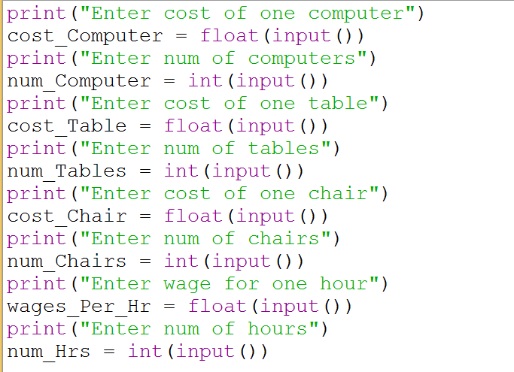
Python Program

Slide 83
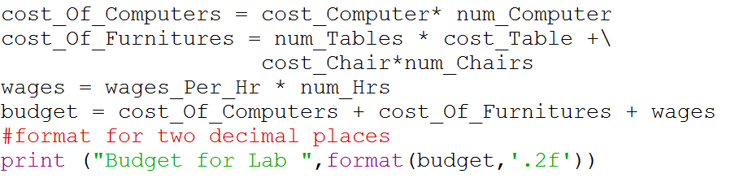
Python Program

Slide 84
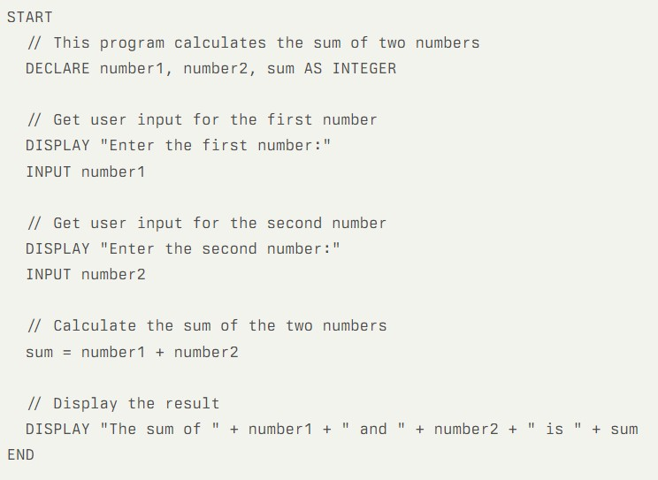
Example 2: Sum of Two Numbers
Pre-programming Phase

Slide 85
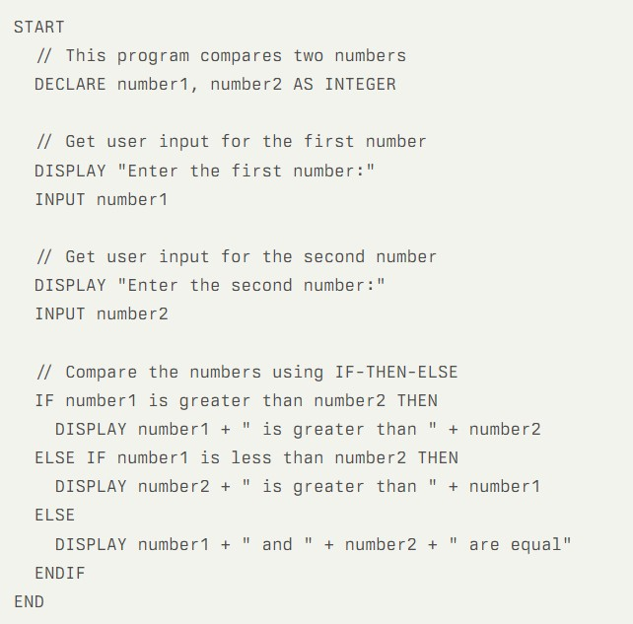
Example 3: Comparing two numbers
Pre-programming Phase

Slide 86
Assignment for Pseudocode
Write pseudocode for calculating Area (l*h) and Perimeter (2*(l+h)) of Rectangle
Write pseudocode for issue of driver license (if else)
Write pseudocode for a given number is positive or negative
Write pseudocode to read 50 numbers and find their sum and average. (for loop)
Pre-programming Phase

