Slide 1
MODULE 7 (Modules and Packages)

Slide 2
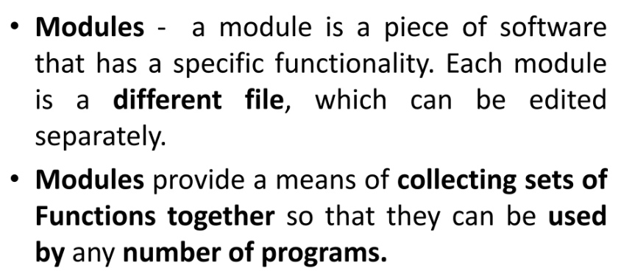
modules

Slide 3
Run time operations
Three distinct steps the first time a program imports a given file:
1. Find the module’s file.
2. Compile it to byte code (if needed).
3. Run the module’s code to build the objects it defines

Slide 4
modules
Modules are files containing Python definitions and statements (ex. name.py)
A module’s definitions can be imported into other modules by using “import name”
The module’s name is available as a global variable value
To access a module’s functions, for ex:
import random
random.seed()

Slide 5
Importing with renaming
We can import module by renaming it as follows
import math as m
Print(“The value of pi is”, m.pi)

Slide 6
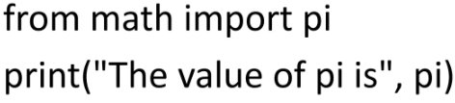
modules
Modules can contain executable statements along with function definitions
Modules can import other modules
Can import names from a module into the importing module
from mod import m1, m2 (or *)
m1()
Imports all names

Slide 7
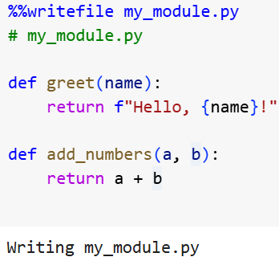
Creating a module

Slide 8
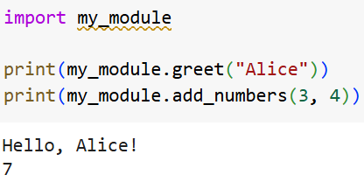

Slide 9
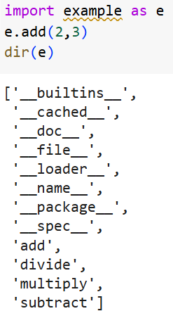
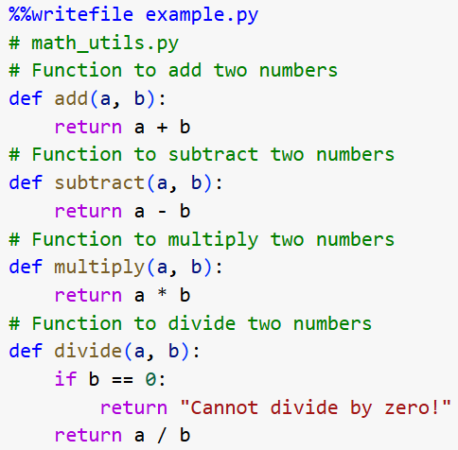

Slide 10
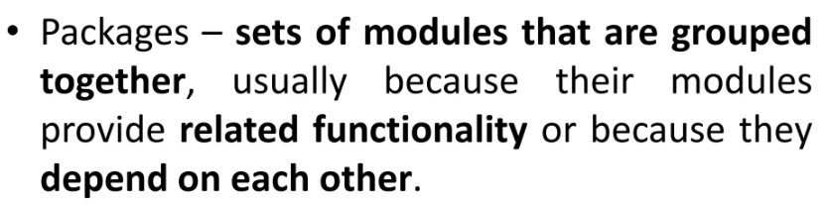
packages

Slide 11
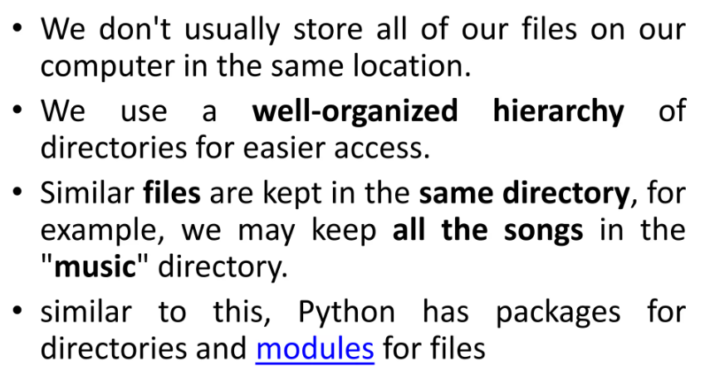

Slide 12
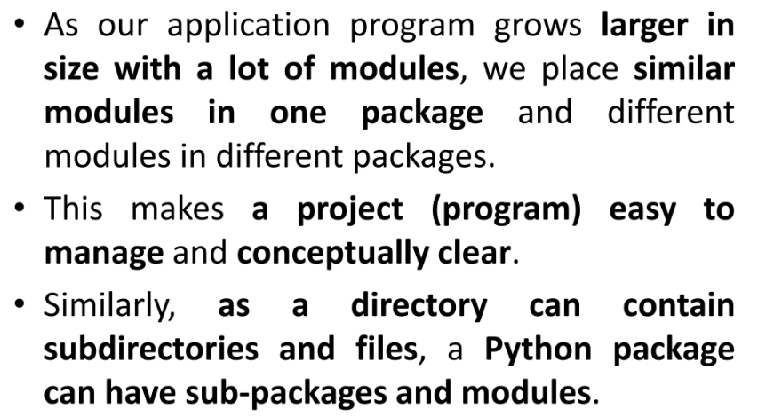

Slide 13
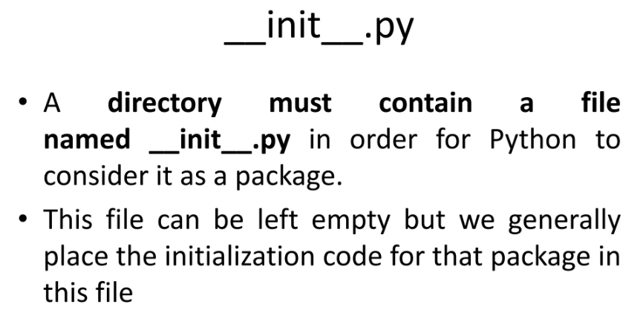

Slide 14
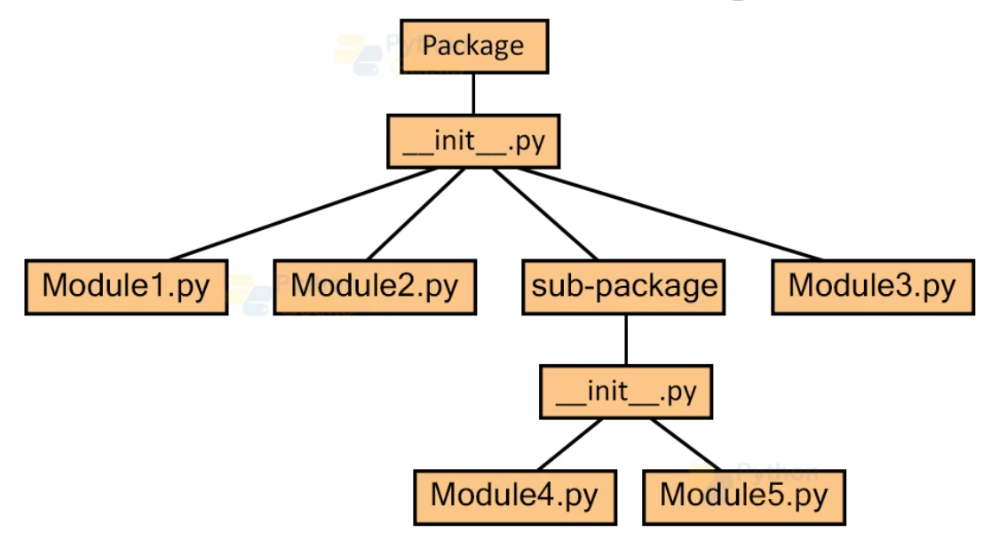
Structure of packages

Slide 15
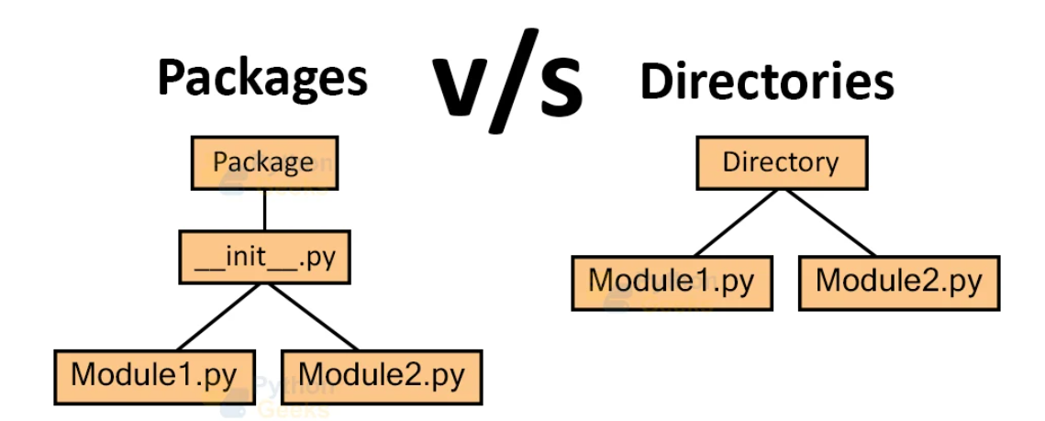
Structure of packages

Slide 16
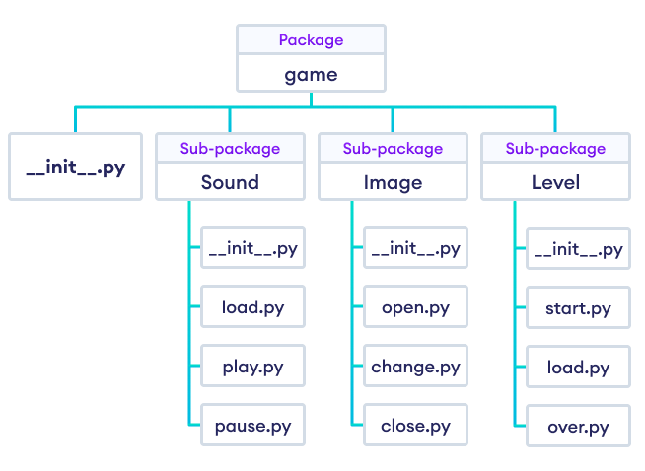

Slide 17
Term | Description | Example | Key Characteristics
Module | A single Python file containing code (functions, classes, variables). | math | Single .py file, can be imported directly.
Package | A directory containing related modules, and an __init__.py file. | json | Directory with __init__.py, can contain sub-packages.
Directory | A general folder in the file system. A package is a special type of directory. | my_folder/ | General folder for organizing files, not Python-specific.
Library | A collection of related modules and packages providing reusable functionality. | NumPy, Pandas | A collection of modules or packages, often installed via pip.

Slide 18
numpy
NumPy is Numerical Python
NumPy is a Python library.
NumPy is used for working with arrays.
NumPy is short for "Numerical Python".
NumPy is a Python library used for working with arrays.
NumPy arrays are 50times faster than python lists.
NumPy has functions which works with linear algebra, matrices, Fourier transform etc.

Slide 19
Why numpy is faster?
NumPy arrays are stored at one continuous place in memory unlike lists so processes can access and manipulate them very efficiently.
NumPy are optimized to work with latest CPU architectures.

Slide 20
Numpy arrays
An array is a collection of values , organized in a specific order.
NumPy’s main object is the homogeneous multidimensional array.
In numpy, dimensions are called axis. The number of axis is rank.

Slide 21
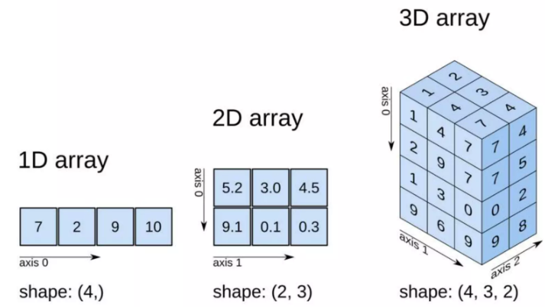

Slide 22
Installation of numpy
C:\Users\Your Name>pip pip install --upgrade pip
C:\Users\Your Name>pip install numpy

Slide 23
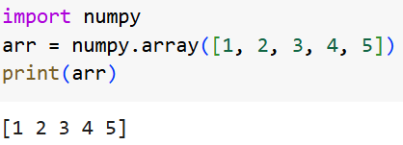
Import NumPy
NumPy is used to work with arrays. The array object in NumPy is called ndarray.
We can create a NumPy ndarray object by using the array() function.
ndarray

Slide 24
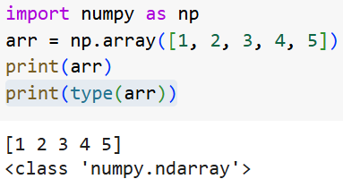
NumPy as np
NumPy is usually imported under the np.

Slide 25
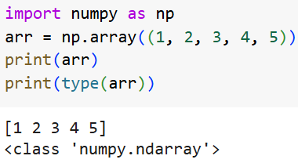
Use a tuple to create a NumPy array:

Slide 26
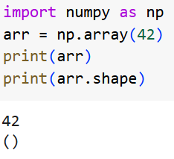
0-D Arrays
Create a 0-D array with value 42

Slide 27
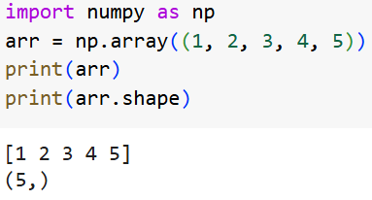
1-D Arrays
Create a 1-D array containing the values 1,2,3,4,5

Slide 28
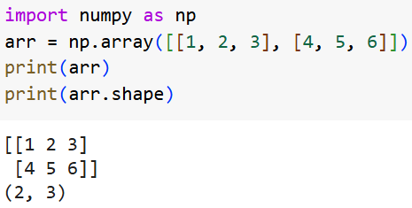
2-D Arrays
Create a 2-D array containing two arrays with the values 1,2,3 and 4,5,6

Slide 29
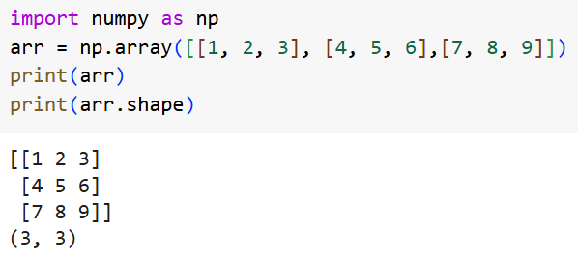

Slide 30
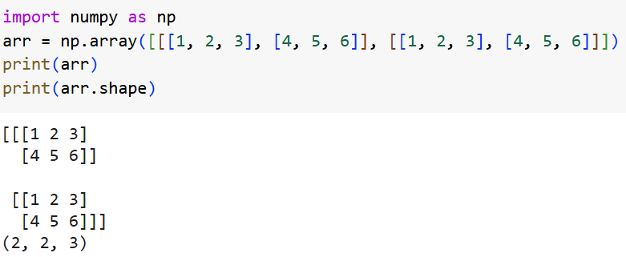
3-D arrays
Create a 3-D array with two 2-D arrays, both containing two arrays with the values 1,2,3 and 4,5,6

Slide 31
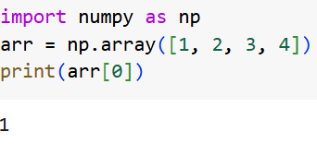
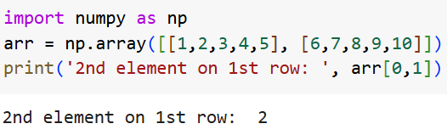
Access Array Elements
Get the first element from the following array
Get the second element from first row in the following array

Slide 32
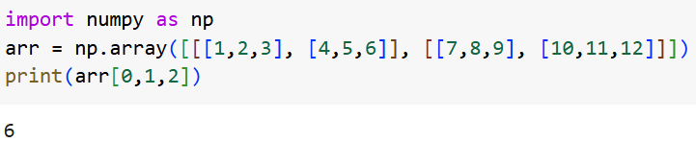
Access the third element of the second array of the first array:

Slide 33
NumPy Array Slicing
Slicing in python means taking elements from one given index to another given index.
We pass slice instead of index like this: [start:end].
We can also define the step, like this: [start:end:step].
If we don't pass start it’s considered 0
If we don't pass end its considered length of array in that dimension
If we don't pass step it’s considered 1

Slide 34
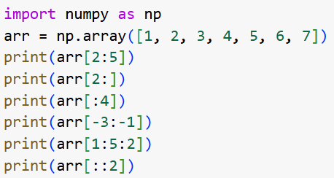

Slide 35
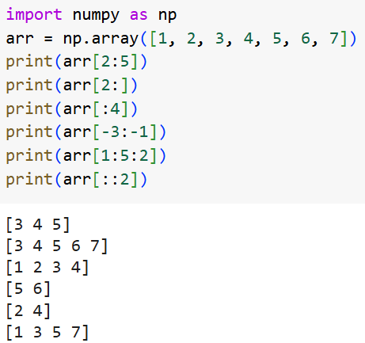

Slide 36
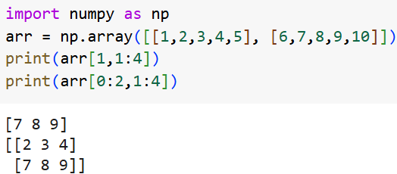

Slide 37
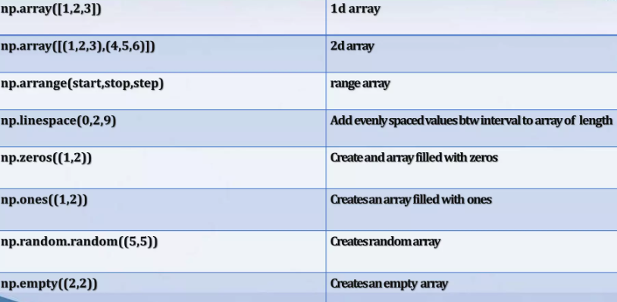
np.arange(start,stop,step)

Slide 38
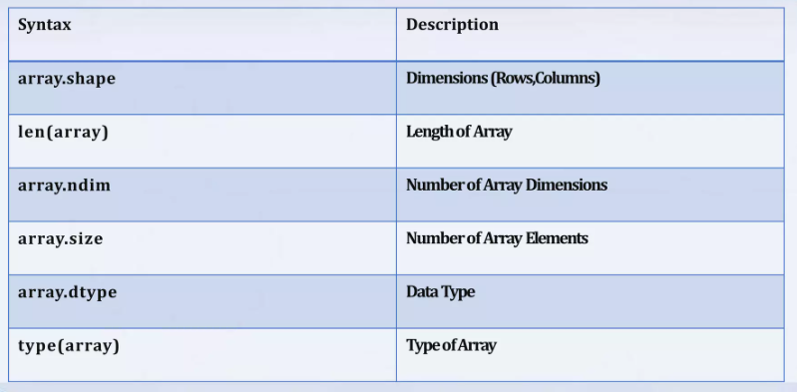

Slide 39
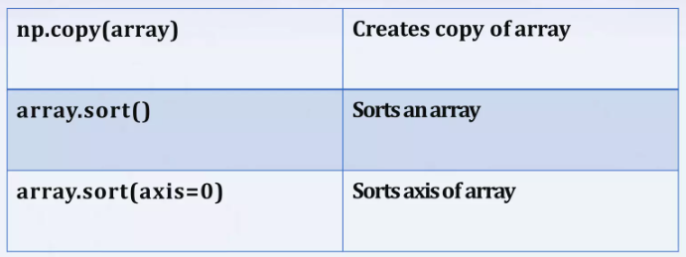

Slide 40
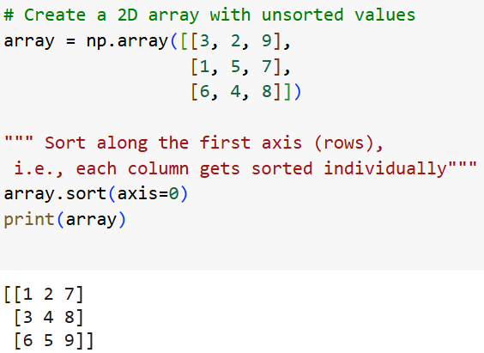

Slide 41
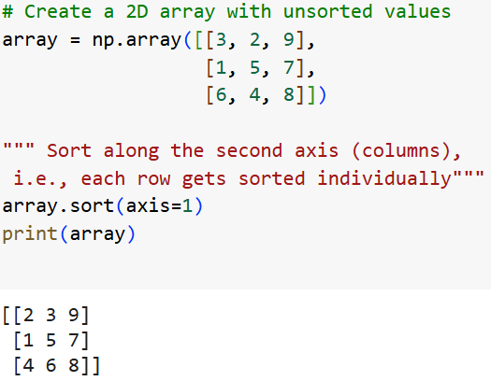

Slide 42
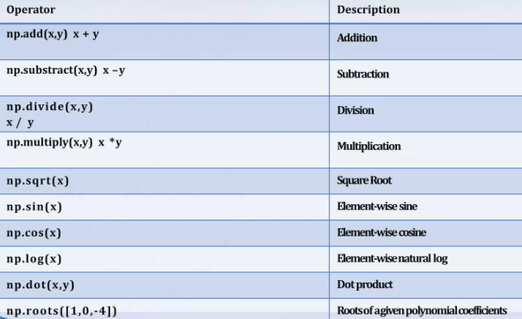

Slide 43
pandas
Pandas is a Python library used for working with data sets.
It has functions for analyzing, cleaning, exploring, and manipulating data.
Reg.no | Std Name | Class
101 | Ram | 3
102 | Kumar | 2
103 | Sam | 3

Slide 44
Installation of Pandas
Install it using this command:
C:\Users\Your Name>pip install pandas

Slide 45
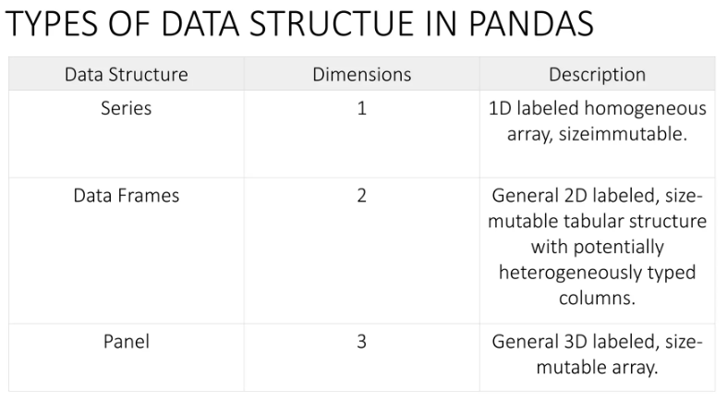

Slide 46
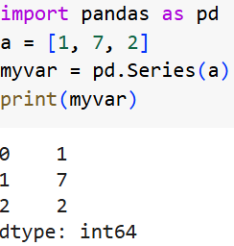
What is a Series?
A Pandas Series is like a column in a table.
It is a one-dimensional array holding data of any type.
Create a simple Pandas Series from a list:

Slide 47
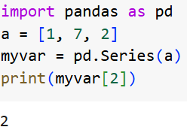
Labels
If nothing else is specified, the values are labeled with their index number. First value has index 0, second value has index 1 etc.
This label can be used to access a specified value.
print(myvar[0])
With the index argument, you can name your own labels.

Slide 48
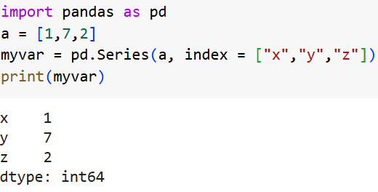

Slide 49
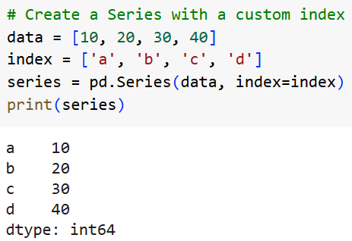

Slide 50
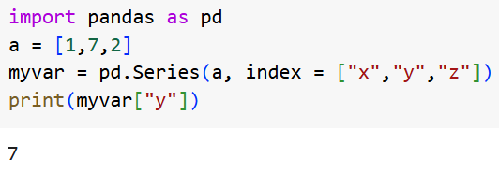

Slide 51
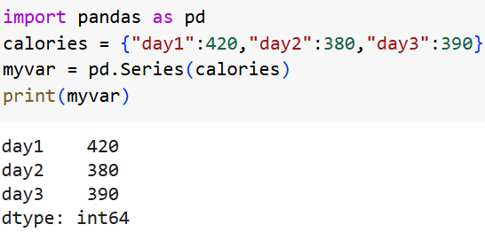
You can also use a key/value object, like a dictionary, when creating a Series.
Example : Create a simple Pandas Series from a dictionary:

Slide 52
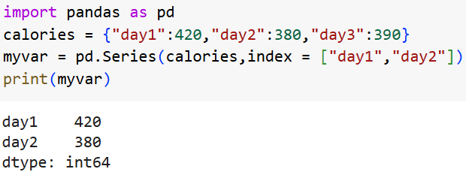
To select only some of the items in the dictionary, use the index argument and specify only the items you want to include in the Series.
Create a Series using only data from "day1" and "day2":

Slide 53

DataFrames
Data sets in Pandas are usually multi-dimensional tables, called DataFrames.
Series is like a column, a DataFrame is the whole table.
Example : Create a DataFrame from two Series:

Slide 54
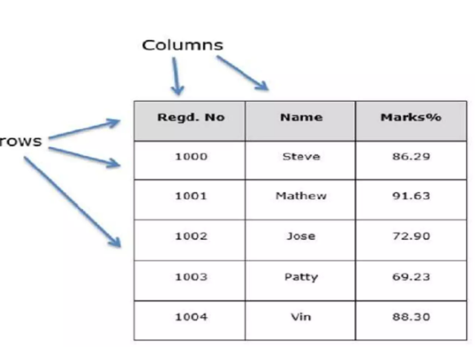

Slide 55
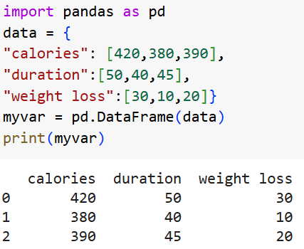

Slide 56
