Slide 1
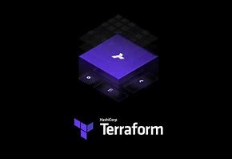
INTRODUCATION OF TerrafORm

Slide 2
Terraform
Terraform is a popular infrastructure-as-code tool that allows you to automate the provisioning and management of infrastructure resources. It uses configuration files written in the HashiCorp Configuration Language (HCL) or declarative configuration language

Slide 3
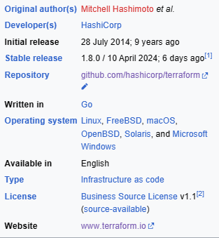


Slide 4
Use Cases Of Terraform
Provisioning Cloud Resources
Multi-Cloud Management
Infrastructure Versioning and Collaboration
Automation and Continuous Integration/Continuous Deployment (CI/CD)

Slide 5
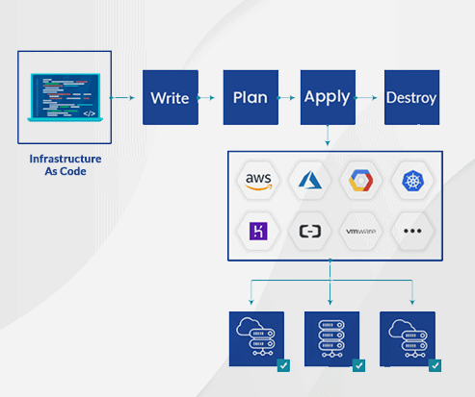
Workflow for terraform

Slide 6
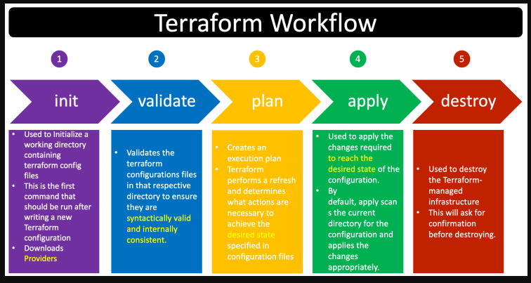
Terraform Execution flow

Slide 7
Advantages of Terraform
Declarative configuration
Support for multi providers
Reusable infrastructure code
Collaboration and version
Efficient Resource Management

Slide 8
Disadvantages of Terraform
Complexity
State management
Performance
Limited Error Handling
Limited rollback capabilities

Slide 9
Few main points
In terraform we have save the file with the .tf extension otherwise it won't support
Once we create any resource we may get two files
1) terraform.tf state file
2)terraform.tfstate.backup file
Terraform uses this state file to plan and execute changes, as well as to update and manage your infrastructure.
Were as terraform.tfstate.backup file will help us to take a backup for deleted resources script.
In Terraform, double quotes are used to denote string literals

Slide 10
Deploy a Three tier application using terraform
Three-Tier Application: The project includes a three-tier web application, consisting of:
Web Tier: This tier includes a set of web servers responsible for handling user requests and serving the application.
Application Tier: The middle tier contains application servers running the core business logic and application code.
Database Tier: The database tier houses the database server, which stores and manages the application’s data.

Slide 11
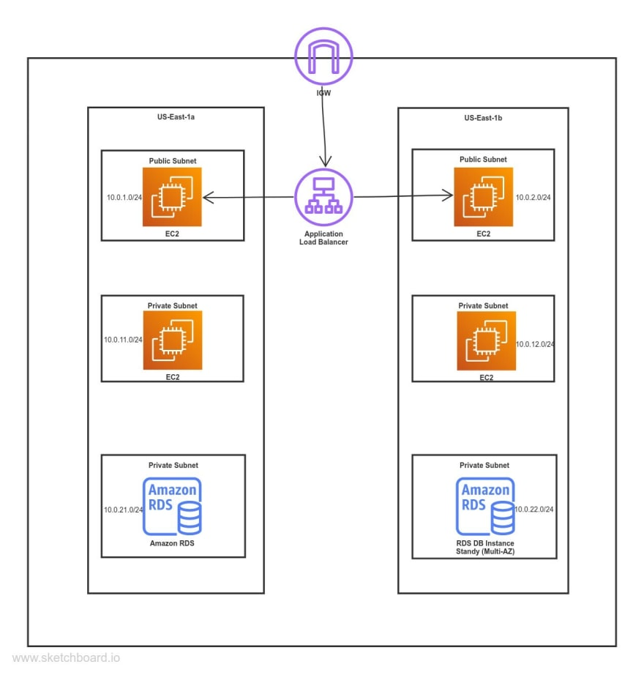

Slide 12

Let's go into the project
For our 3 tier application

Slide 13
If we create any AWS resource we have to follow below steps:
Provider script file
Variable script file
VPC script file
Subnets script file
Route table script file
Internet gateway script file
Security group script file

Slide 14
If we create any AWS resource we have to follow below steps:
8) User data script file
9) Ec2 instance script file
10)Database security group script file
11)RDS-Relation database script file
12)Output (to know the DNS name within the terminal)
13)Load balancer script file

Slide 15
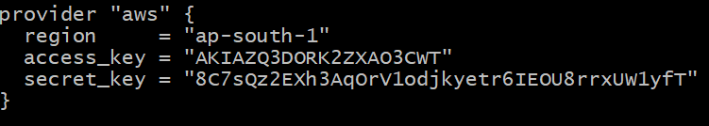
1.Creation of Provider script file (provider.tf)
IDENTIFYING THE
ERROR:
Here, I was taken a different region.
Given the access key & secret key from the IAM user.

Slide 16
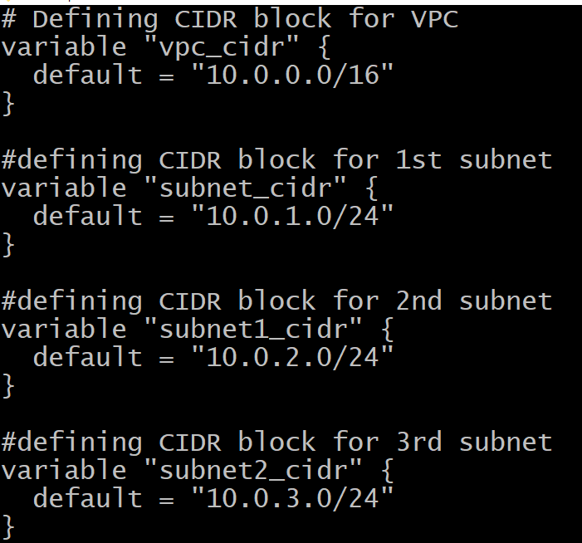
2.Creation of variable script file (var.tf)
IDENTIFYING THE
ERROR:
Up to
this is clear but remaining code has some error

Slide 17
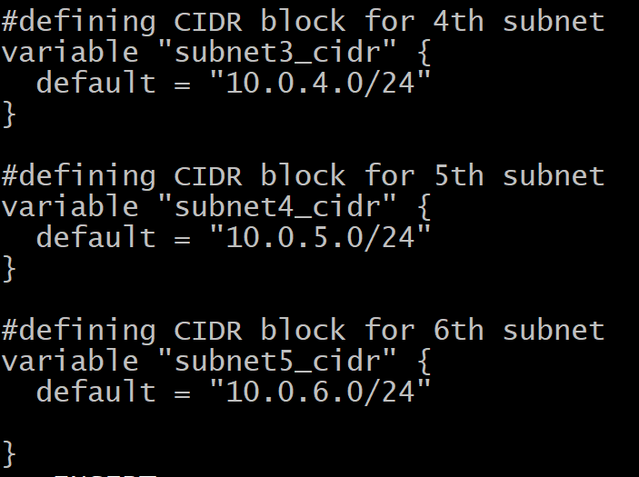
2.Creation of variable script file (var.tf)
In this no of subnets are not in the sequence & it is missing from the 4th subnet
Instead of
variable “subnet3_cidr” is placed with
variable “subnet2_cidr” to remaining all the
subnets

Slide 18
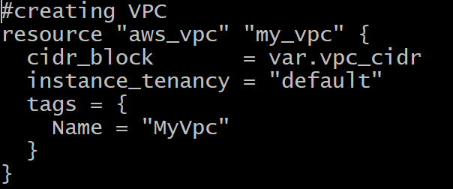
3.Creation of VPC script file (vpc.tf)
IDENTIFYING THE
ERROR:
Here, the syntax error is there Instead of
Cidr_block= var.vpc_cidr
Is given as
Cidr_block= “${ var.vpc_cidr}

Slide 19
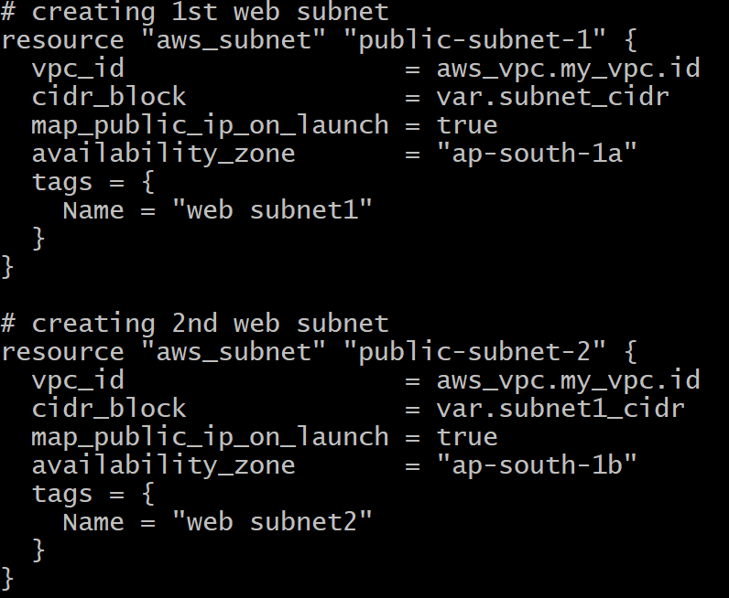
4.Creation of subnets script file (subnet.tf)
IDENTIFYING THE ERROR:
Here also the same syntax error .
If we change any region to create the instance we have give the proper availability zone

Slide 20
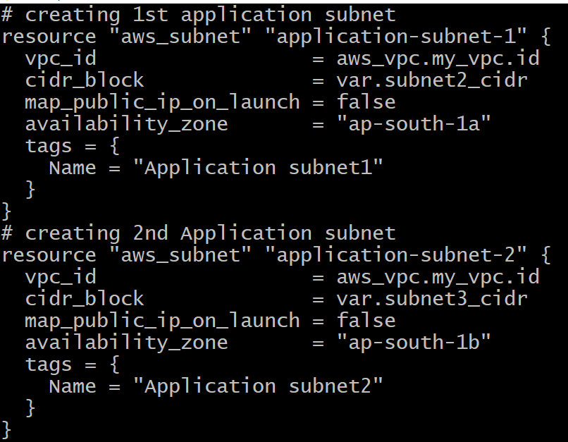
4.Creation of subnets script file (subnet.tf)
IDENTIFYING THE ERROR:
Here also the same syntax error .
If we change any region to create the instance we have give the proper availability zone

Slide 21
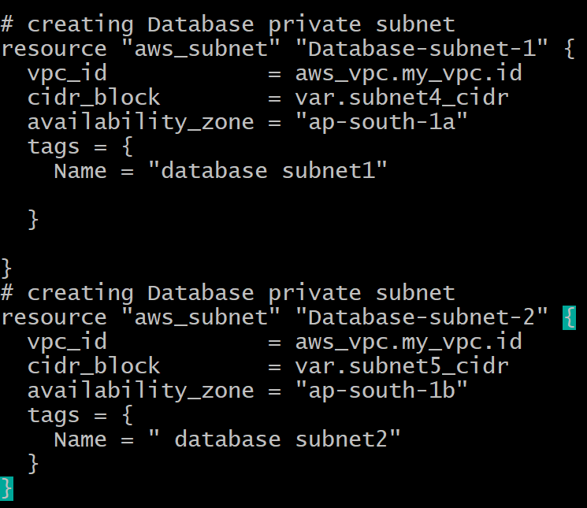
4.Creation of subnets script file (subnet.tf)
IDENTIFYING THE
ERROR:
Here also a sytnax error & check the availability zone should be different

Slide 22
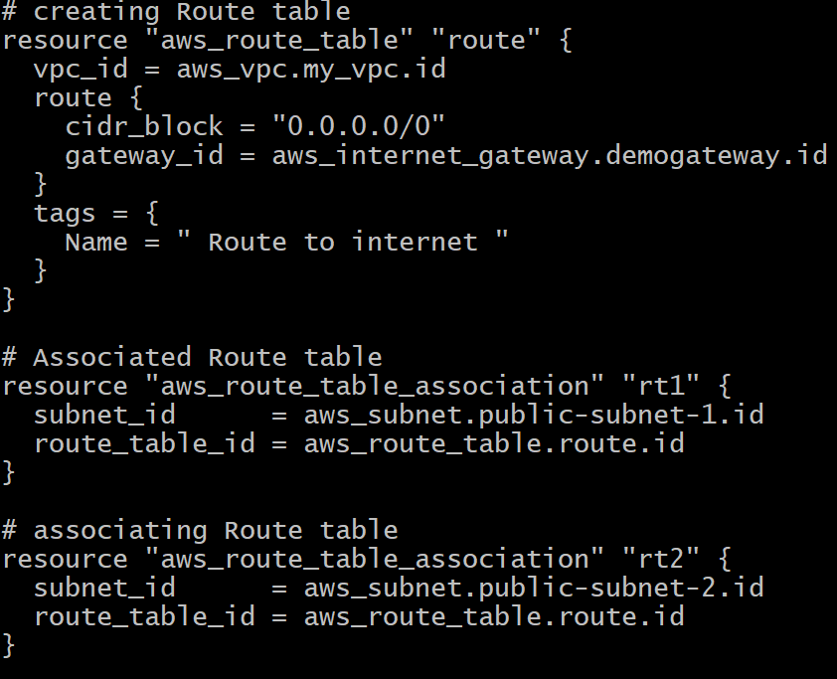
5.Creation of route table script file (route.tf)
IDENTIFYING THE
ERROR:
Here also a same syntax error
In associating a subnet_id are same it should be change
Terraform will automatically understand that you're referencing the ID attribute

Slide 23
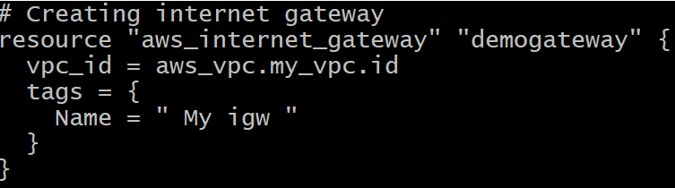
6.Creation of internet gateway script file (igw.tf)
IDENTIFYING THE
ERROR:
Here also a same syntax error.
Tags are not include no matter whether the tags are not.

Slide 24
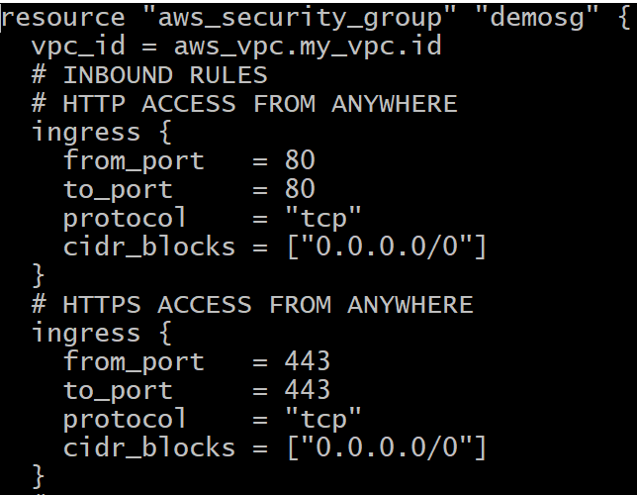
7.Creation of security group script file (sg.tf)
IDENTIFYING THE
ERROR:
Here also a Syntax errors.
Double quotes are not there terraform might interpet the value differently,leads to error & unexcepted behaviour

Slide 25
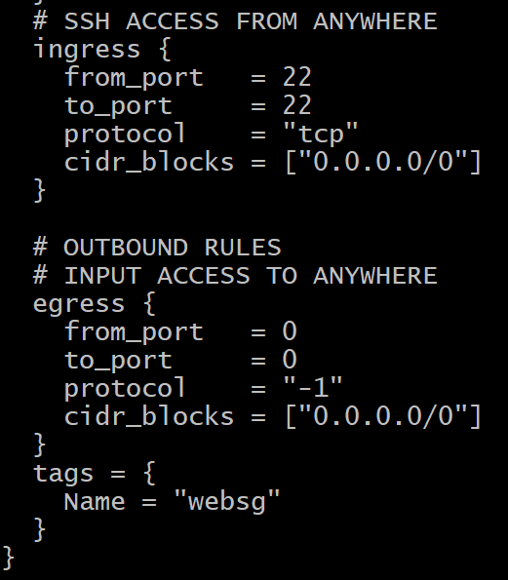
7.Creation of security group script file (sg.tf)
Here protocol = "-1" indicates that all protocols are allowed. This is a common practice for allowing unrestricted outbound traffic.

Slide 26
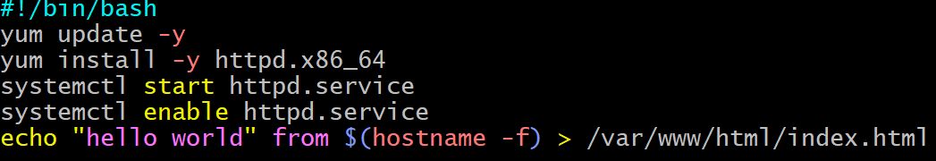
8.Creation of user data file (data.sh)
IDENTIFYING THE
ERROR:
> indicates a standard output symbol
No error

Slide 27
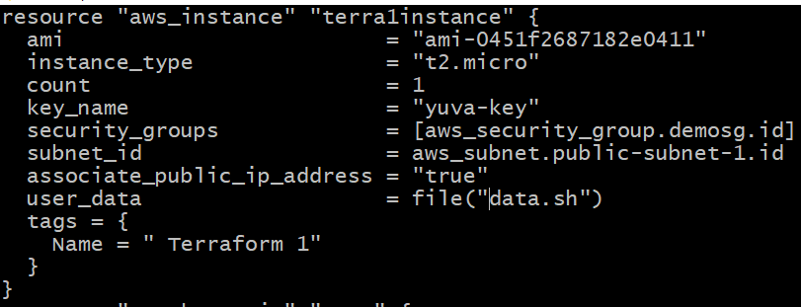
9.Creation of Ec2 instance script file (instanceec2.tf)
IDENTIFYING THE
ERROR:
Few syntax errors is observed
Subnet_ids should be changed
Associate_public_ip_address value should be in double quotes

Slide 28
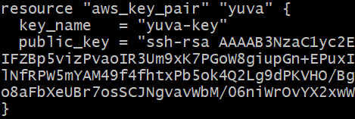
9.Creation of Ec2 instance script file (instanceec2.tf)
If the region is same we can take a same key pair otherwise we can take it from terraform registry.

Slide 29
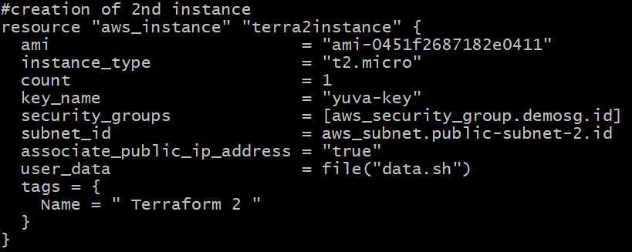
9.Creation of Ec2 instance script file (instanceec2.tf)
IDENTIFYING THE
ERROR:
Few syntax errors is observed
Subnet_ids should be changed
Associate_public_ip_address value should be in double quotes

Slide 30
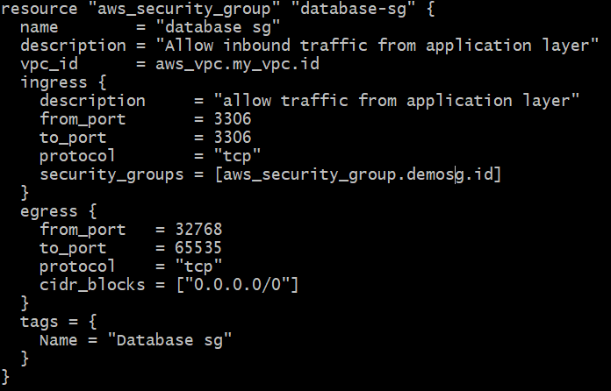
10.Creation of database security group script file (dbsg.tf)
IDENTIFYING THE
ERROR:
Here also same syntax error
Security group name should be change

Slide 31
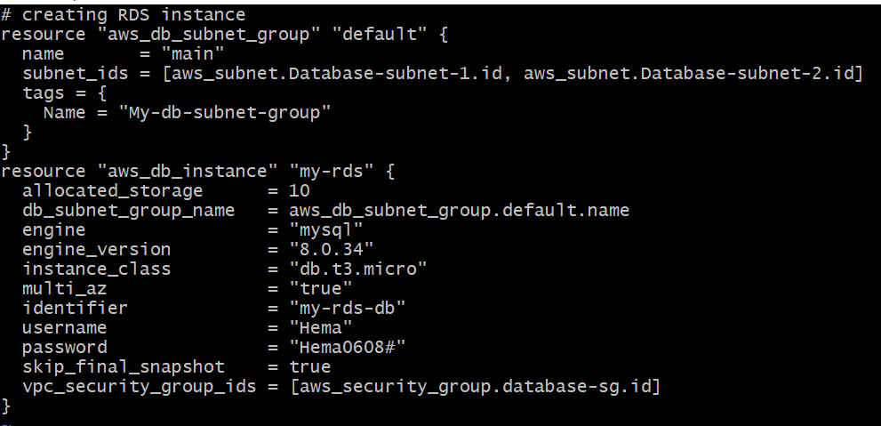
11.Creation of RDS file (rds.tf)
IDENTIFYING THE
ERROR:
Syntax error is observed & subnet_ids
Here instance class should be t3 micro t2 is not supported& engine version also not supported changed the sg name

Slide 32
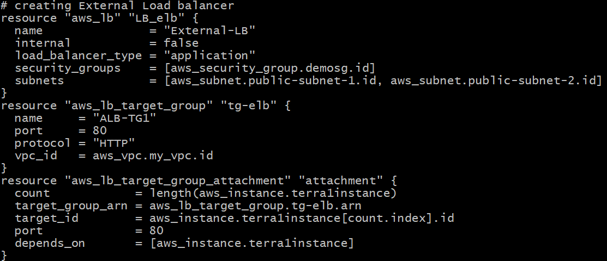
12.Creation of Load balancer file (lb.tf)
IDENTIFYING THE
ERROR:
Syntax error ,subnet names to be changed & given the proper instance names

Slide 33
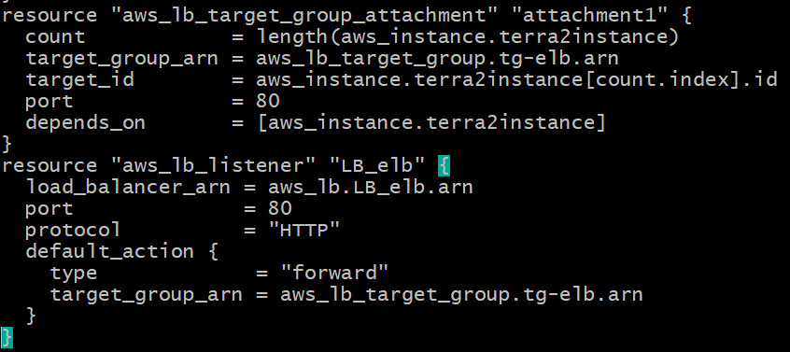
12.Creation of Load balancer file (lb.tf)
Changed the created target id name in the targe_id
And add the ALB name to the listener
changed the target group arn

Slide 34
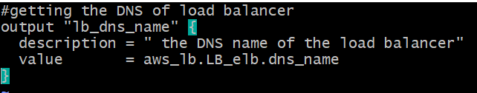
13.Creation of Output file (output.tf)
IDENTIFYING THE
ERROR:
Created ALB name should be changed

Slide 35
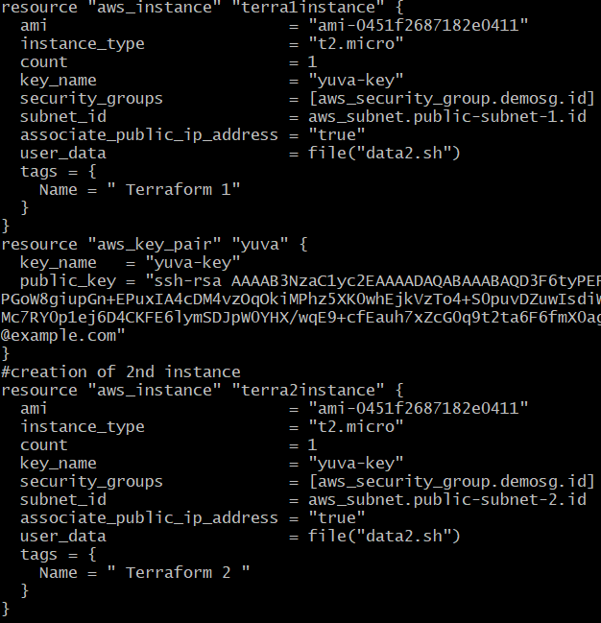
14.Deploying a application
To deploy any application within this created instance we have create or re write the user data file (data.sh)

Slide 36
14.Deploying a application
1st Application
#creating data1.sh for hosting a instance with a application
#!/bin/bash
yum update -y
yum install git -y
yum install httpd.x86_64
systemctl start httpd.service
systemctl enable httpd.service
git clone http://github.com/Hemayuva/food.git /var/www/html/
2nd Application
#creating data1.sh for hosting a instance with a application
#!/bin/bash
yum update -y
yum install git -y
yum install httpd.x86_64
systemctl start httpd.service
systemctl enable httpd.service
git clone http://github.com/Hemayuva/ecomm.git /var/www/html/

Slide 37

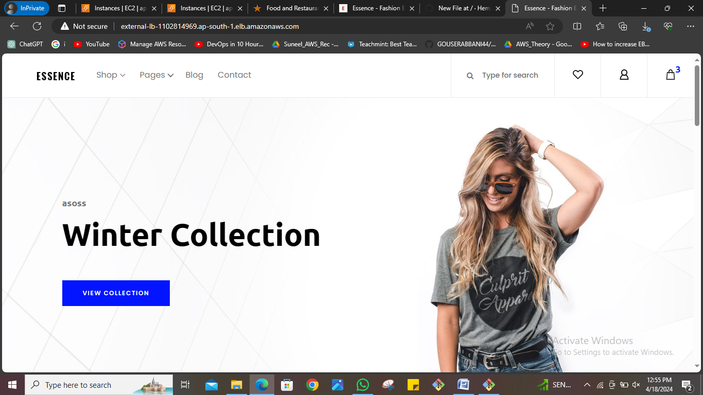
Outputs:
If the region is same we can take a same key pair otherwise we can take it from terraform registry.

Slide 38
Thank you
☺

