Slide 1

AN ALGORITHM GUESS GAME USING SOCKET PROGRAMMING
Faculty of Engineering and Technology
Department of Computer Science and Engineering
SUBJECT CODE / TITLE: 18CSC302J/ Computer Networks
Mini Project -:
T V S KRISHNA
RAMNADH REDDY
HIMESH PHANI SAI

Slide 2
Algorithum description
Fractional Knapsack:The main objective is fiiling the knapsack That maximizes the total profit earned, here the the total capacity of knapsack is 10
LCS:A subsequence is a sequence that appears in the same relative order but not necessarily contiguous
press 1 for knapsack and 2 for LCS and 0 for exiting the game

Slide 3
Introduction
In this game we will show the different algorithms to the user like 0/1 kanpsack, LCS…based on the interest the client will request the server then server will send the input values to the client then the client will send the answer to the server then server will tell to the client whether the client had sent a correct value or wrong value. Server will store the all the instances of the clients for future purposes.
This project deals with implementation of the game in a simple and easily understandable manner using socket programming. The logic of the game is coded using client and server programs. This game is played between server and client

Slide 4
Innovation idea of the project
Basically, we will solve so many algorithms and we will end by getting final result we don’t know whether the value we got is correct or not…to solve this we innovate this project.
But implementing it using client-server program along with a Graphical User Interface would be tough.
So to keep things simple, we tried to display the inputs of the algorithm and final output on the screen without GUI assistance by adding some code snippet to source code.
Also we are storing all the instances of the clients like what algorithm he played, what are the inputs generated by the server, server calculated output value and client input

Slide 5
Purpose of the project
The purpose of this project is to redesign the algorithm visualization tool game using computer network.
Since it is a strategic game, it will improve concentration of players.
Improves cognitive ability

Slide 6
Scope of the project
This is multiplayer strategy game on the linux or any compatible platform.
There is so much scope for this project in the future with making some changes and modifications.
Some of them are: Adding some more details of the players, Making themes for by integrating GUI to the project and a background music can be added.

Slide 7
Functionalities and Computing resources
The server connects to the client whenever client requests. Then client will send the name of the algorithm which he wants to play based on the given names of the algorithm
After getting req from client server will generate values and according to the user req and send it to the client. Server will automatically calculate the output and it will store whenever the client send the output value server will check the output is correct or wrong and result will be sent to the client
Server is saving all the responses of the each client in a different file for further uses.

Slide 8
Computing Resources:
Operating system: Linux or any other compatible OS.
Necessary Libraries/Modules to run some functions.
Processor: i3 Processor or Higher.
Minimum RAM Required: 512 MB.
Minimum Storage Required: 2 GB.

Slide 9
Design Constraints for required Performance Criteria:
You can’t have two programs (or two copies of the same program) listen to the same port on same machine.
As the server receives as many requests from clients so there is a chance that server can become congested and overloaded.
If the server fails for any reason, then none of the requests of the clients can be fulfilled. This leads of failure of the client server network.
Server can serve its services to two clients at any instance of time.

Slide 10
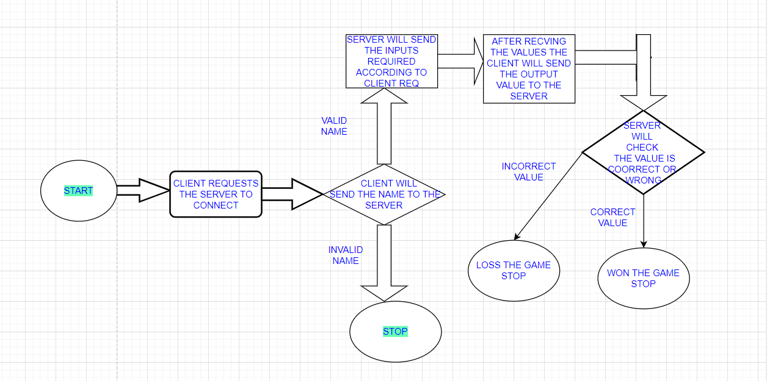
Design of the Project:

Slide 11
Thank You

