Slide 1
Image Correctness For a Product on Marketplaces
CSE7101- Capstone Project
Review-1
Batch Number: CIT_10
ROLL NUMBER | STUDENT NAME
20221CIT0006 | PR HEMESWAR RAJ
20221CIT0047 | MANASA T
20221CIT0048 | B DEEKSHITHA
Under the Supervision of,
Guide : Ms.Shivabasamma. Beli
Reviewer : Mr.Tanveer Ahmed
Name of the Program: CSE7101- Capstone Project
Name of the HoD: DrS P Anandaraj Sir
Name of the Program Project Coordinator:
Name of the School Project Coordinators: Dr. Sampath A K , Dr. Geetha A

Slide 2
Problem Statement Number:
Organization: Online E-Commerce Websites(Amazon,Myntra,Flipkart,Ajio)
Category : Software
Problem Description:
Product Name: Wireless Bluetooth Headphones – Noise Cancelling Over-Ear
Category: Electronics → Audio Devices
Description:
Experience high-quality sound with our Wireless Bluetooth Headphones designed for comfort and clarity. Featuring active noise cancellation (ANC), long-lasting 30-hour battery life, and cushioned over-ear design, these headphones are perfect for music, calls, and gaming.
Need for automated, scalable image validation
Incorrect or irrelevant product images
Manual moderation: slow, costly, and error-prone

Slide 3
Content
Problem Statement :
Online marketplaces face issues with incorrect, low-quality, or non-compliant product images, leading to poor customer experience, higher return rates, and reduced platform credibility. An automated system is needed to ensure image correctness and compliance.

Slide 4
Content
Objectives :
Ensure product images are:
Relevant to product description
High-quality and standard-compliant
Free from watermarks, text, or policy violations

Slide 5
Content
Features of the Proposed System:
Image Relevance Check – Ensures product image matches the title & description.
Background Validation – Verifies white/plain background as per marketplace standards.
Single vs. Multiple Product Detection – Confirms only one product is shown (unless bundles).
Text & Watermark Detection – Flags watermarks, logos, or promotional text.
Image Quality Checks – Validates clarity, brightness, resolution, and cropping.
Duplicate Image Detection – Prevents reuse of the same image for multiple listings.

Slide 6
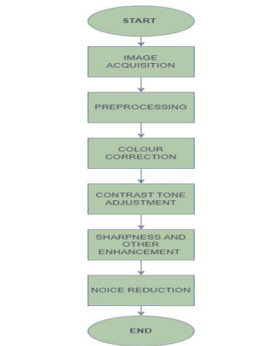
Content
System Architecture:

Slide 7
Content
Tools and Technologies :
Category Technology | Tool
Deep Learning Frameworks | TensorFlow, PyTorch
Text Detection & Processing | OCR
Image Preprocessing | OpenCV, Pillow
Evaluation Metrices | scikit-learn (Accuracy, Precision)
Development & Deployment | Jupyter Notebook / Google Colab

Slide 8
Content
Methodology:
Dataset creation (fashion, electronics, grocery, etc.)
Training & validation
Evaluation metrics (Accuracy, Precision, Recall, F1-score)

Slide 9
Content
Text Detection and Removal:
Use OCR to detect any embedded text or watermark.
Flag if policy-violating text is found.
Rule Engine:
Set validation rules (e.g., no multiple items, minimum brightness, correct aspect ratio).
Combine rule-based + AI model scores to accept/reject the image.
Evaluation Metrics:
Accuracy, Precision, Recall
False Positive Rate (e.g., wrongly rejected good image)
F1 Score

Slide 10
Content
Challenges:
Challenges | Details
Variability in Image Types | Multiple product categories may need custom image rules
Presence of Multi-Objects | Images may contain accessories or multiple products (bundled offers)
Handling Watermarks/Logos | Detecting brand-specific or faint watermarks can be difficult
Language and Text Variability | OCR must detect text in multiple languages/fonts
Generalization of Model | Avoid overfitting to a few product types; ensure it works across categories
False Positives/Negatives | A balance is needed; shouldn't wrongly reject valid images

Slide 11
Content
Expected Outcomes:
90%+ accuracy in detecting incorrect or low-quality images
Drastic reduction in manual moderation time
Enhanced trust among buyers due to higher image reliability
Higher approval rate of seller products on first upload
Lower product return rates

Slide 12
Content
Future Enhancements :
Multimodal Analysis – Combine image + product description (using CLIP/Transformers) for stronger validation.
Real-time Seller Feedback – Notify sellers instantly during upload with corrective suggestions.
Explainable AI – Provide reasons for rejection (e.g., “Multiple items detected” or “Low resolution”).
Improved Scalability – Optimize system for large-scale marketplace traffic.
Cross-Language Support – Handle text detection in multiple languages.
Automated Correction Suggestions – Recommend fixes (e.g., cropping, background removal

Slide 13
Analysis of Problem Statement
Problem Description:
In online marketplaces like Amazon, Flipkart, or Meesho, sellers frequently upload incorrect, misleading, or poor-quality images for their products. These issues cause:
Poor Customer Experience – Buyers receive products that don’t match the images.
Increased Return Rates – Misleading images lead to higher product returns.
Loss of Platform Credibility – Customers lose trust in the marketplace.
Inefficient Moderation – Manual checking of images is slow, costly, and unscalable.
There is a critical need for an automated image correctness system that can verify product images for relevance, quality, and compliance before they go live on the platform

Slide 14
Github Link
Github Link
https://github.com/HMRAJ143/Image-correctness-for-a-product-on-marketplace.git

Slide 15
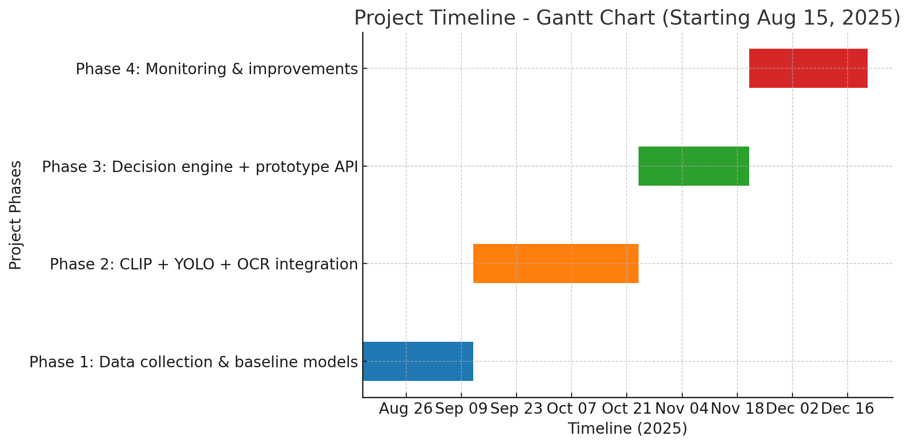
Timeline of the Project (Gantt Chart)

Slide 16
References (IEEE Paper format)
A. Krizhevsky, I. Sutskever, and G. E. Hinton, “ImageNet classification with deep convolutional neural networks,” Communications of the ACM, vol. 60, no. 6, pp. 84–90, Jun. 2017.
J. Redmon and A. Farhadi, “YOLOv3: An Incremental Improvement,” arXiv preprint arXiv:1804.02767, Apr. 2018.3.
A. Dosovitskiy et al., “An Image is Worth 16x16 Words: Transformers for Image Recognition at Scale,” arXiv preprint arXiv:2010.11929, Oct. 2020.4.
A. Radford et al., “Learning transferable visual models from natural language supervision,” in Proceedings of the International Conference on Machine Learning (ICML), 2021, pp. 8748–8763.

Slide 17


