Slide 1

Department of Computer Science and Engineering
Phase1 Presentation on
Topic : Arecanut Plant Disease Prediction
Project Guide:
Mr. Santoshkumar M
Assistant Professor
Project Coordinator:
Mrs. Sandhya R Savanur
Assistant Professor
Head of the Department:
Dr. B N Veerappa
Presented By:
Hemgirish K C [4GM20CS042]
Keerthana G U [4GM20CS048]
Lekhana K S [4GM20CS050]
Mahesh Gowda M G [4GM20CS055]

Slide 2
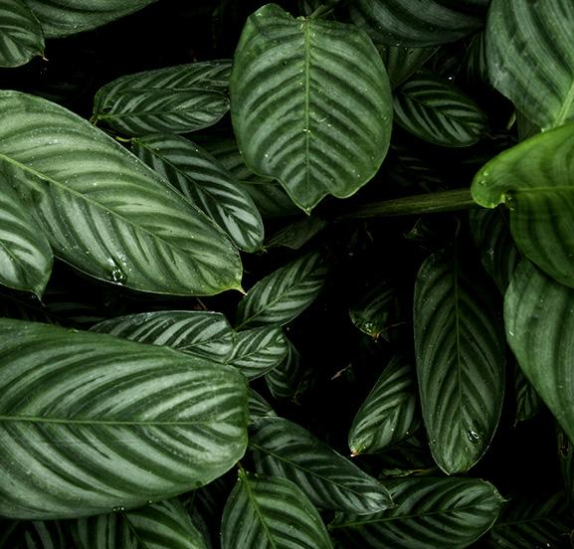
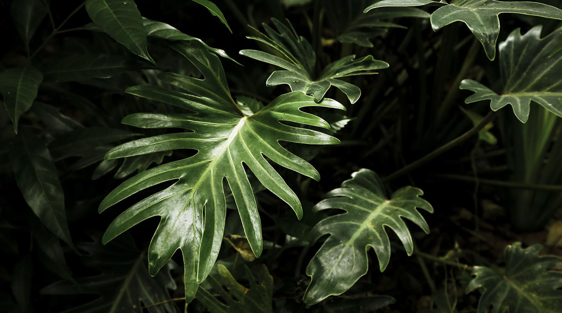
TABLE OF CONTENTS
01
05
Scope of the project
09
Output
Introduction
02
06
Methodology
10
Conclusion
Literature Survey
Hardware & Software requirements
03
07
11
References
Problem Statement
04
Objectives
08
Implementation

Slide 3
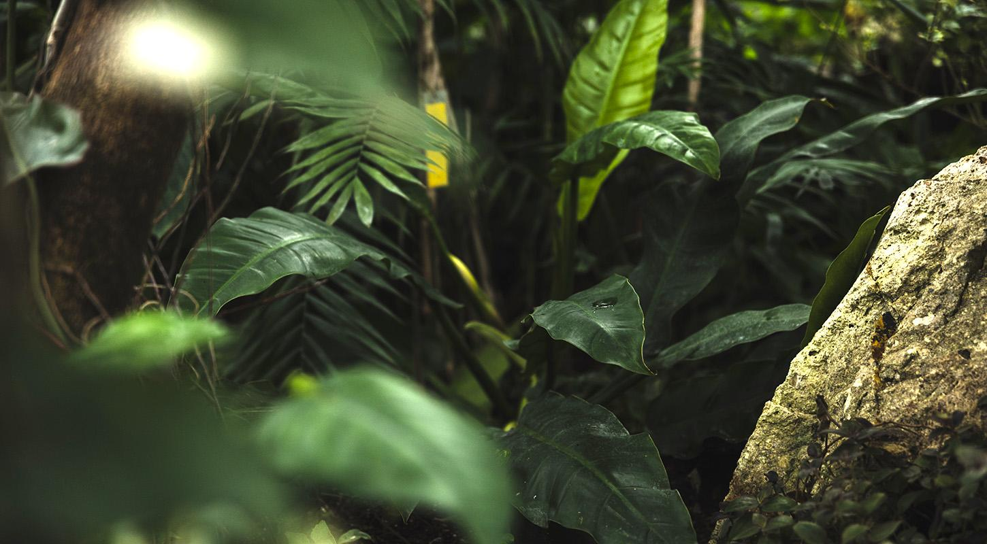
01
Introduction

Slide 4
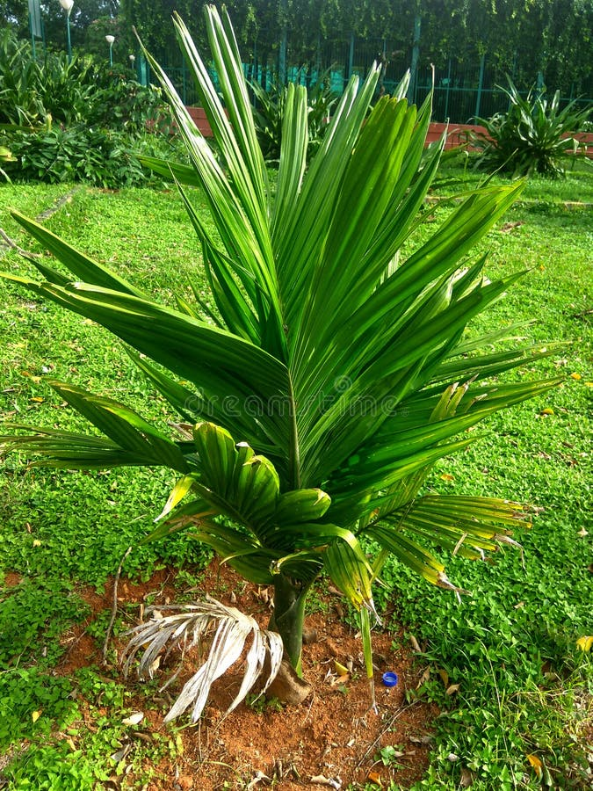
INTRODUCTION
In developing countries like India, the economy mainly depends on agriculture. Farmers in India grow a diverse range of crops in that one of them is arecanut.
Arecanut (Areca catechu) is a pivotal cash crop in South and Southeast Asia, crucial for the livelihoods of millions.
Susceptibility of Arecanut plants to various diseases poses a significant threat to their growth and quality.
Traditionally, disease diagnosis relied on manual inspection, a time-consuming and subjective process.
In response, this research explores the application of Convolutional Neural Networks (CNNs) to revolutionize Arecanut disease management.
CNNs, a subset of deep learning, have demonstrated exceptional capabilities in image classification, particularly in the realm of agricultural automation.

Slide 5
The proposed CNN-based system offers timely detection, enhanced crop health.
By automating disease classification, interventions can be swift, curbing the spread of diseases, and ensuring an objective assessment of symptoms, reducing human subjectivity.
Early detection not only improves disease management.
Moreover, the system generates valuable data for researchers and policymakers, facilitating informed decisions for sustainable crop protection.
This research strives to contribute to agricultural technology, presenting a reliable, automated solution for Arecanut disease classification.
Subsequent sections will delve into methodology, datasets, experimental results, and the broader implications of employing CNNs, emphasizing the potential for transformative disease management in Arecanut cultivation.

Slide 6
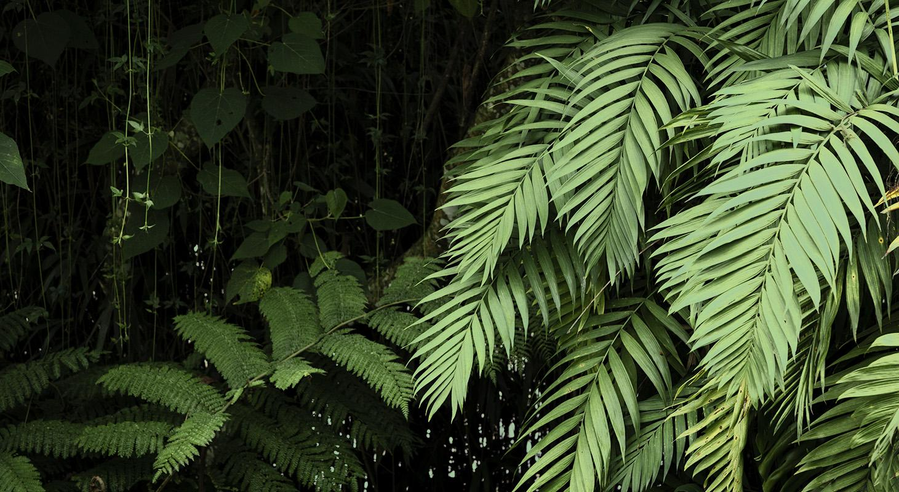
02
Literature Survey

Slide 7
LITERATURE SURVEY
Authors | Title | Year of publications | Description
Dhanuja K.C | Disease detection of arecanut using image processing | 2020 | Author followed texture-based grading of arecanut and K-nearest neighbour(KNN) algorithm is used to detect the disease in arecanut
Swathy Ann Sam, Siya Elizabeth Varghese, Pooja Murali: | Arecanut plant Disease detection using CNN | 2019 | Implemented various algorithms (SVM, KNN, Decision tree, CNN) for leaf disease detection. Achieved 86% accuracy using CNN for accurate disease identification from uploaded images.

Slide 8
LITERATURE SURVEY
Authors | Title | Year of publications | Description
Manpreet Sandhu,prathik Hadawale(UAV based) | Automated disease detection system for arecanut plants | 2018 | Employed machine learning algorithms with UAV and camera for image capture
Ashish Nage,V.R.Raut | Detection of diseases in plants | 2019 | Convolutions neural network algorithms is used to identify the diseases in plants. Author developed an android application that helps farmers in identifying plant diseases by uploading infected images parts to the systems.

Slide 9
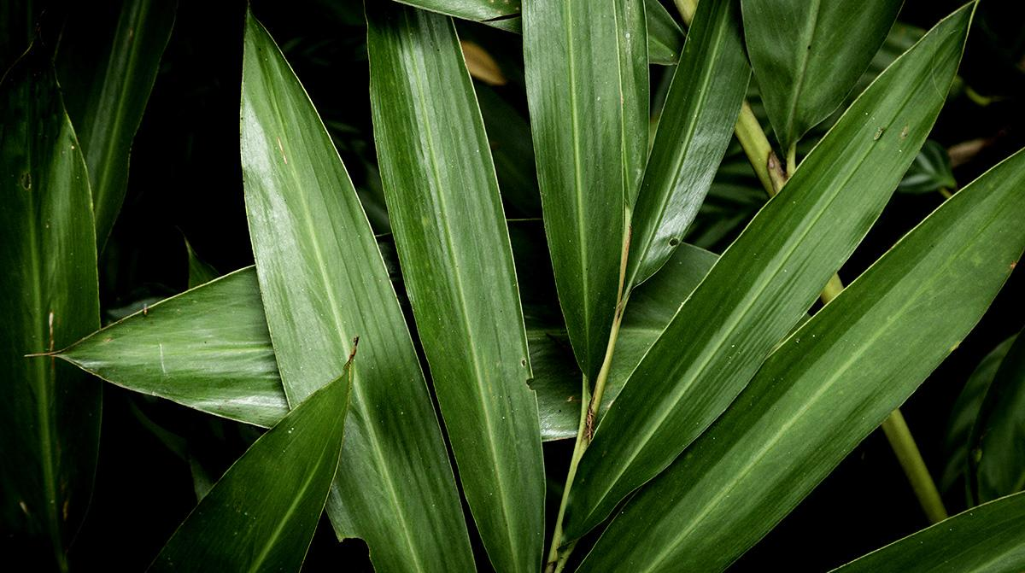
Problem Statement
03

Slide 10
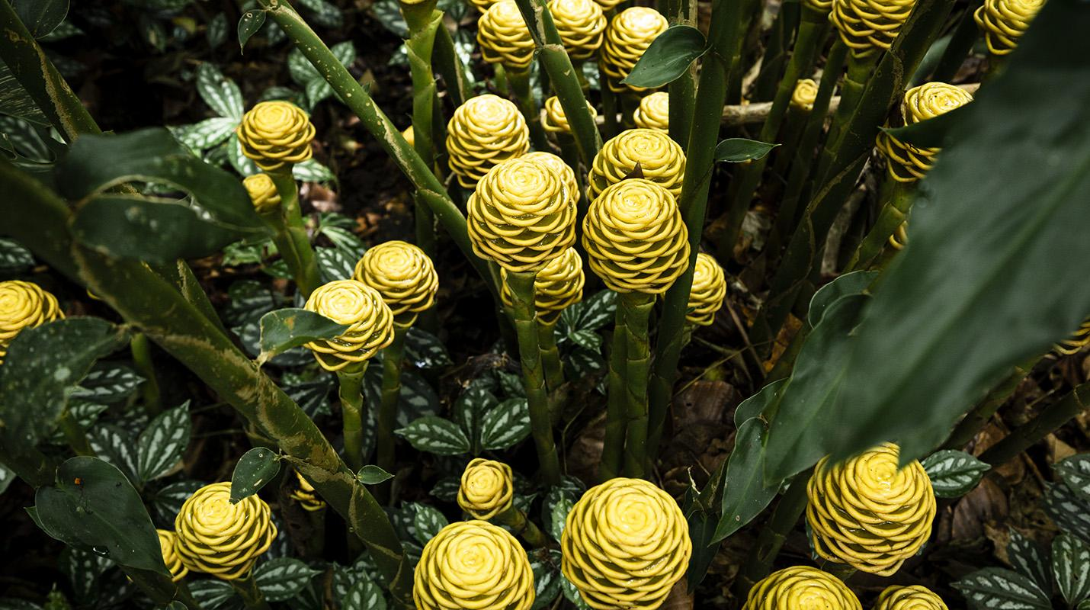
“To develop an efficient and automated system for the early detection of diseases in arecanut plants using Deep learning, particularly Convolutional Neural Networks (CNN)”

Slide 11
04
Objectives

Slide 12
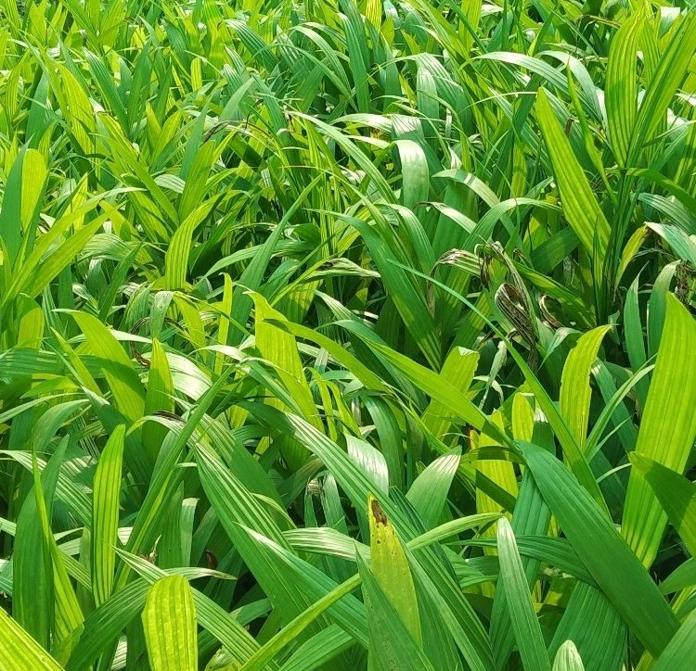
OBJECTIVES
01
02
03
Collecting the datasets that contains healthy and diseased images of nuts and trunk of the arecanut plant.
Design and develop an algorithm for early detection of disease in arecanut that can avoid the spreading of diseases.
To detect the diseases with higher accuracy.

Slide 13
Scope of the Project
05

Slide 14
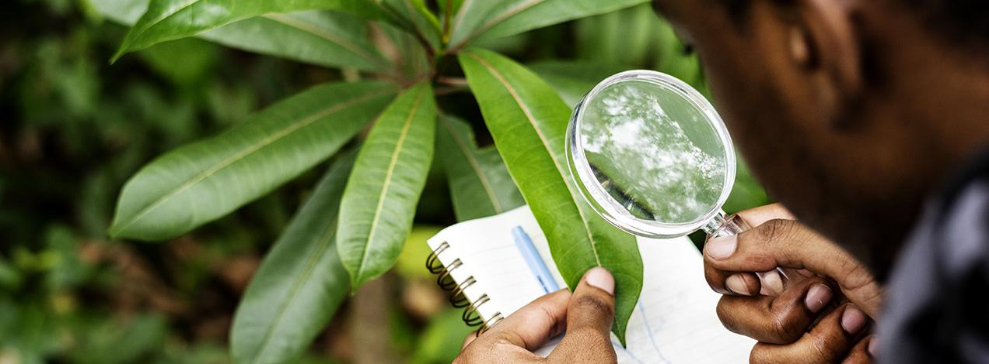
Arecanut plant disease classification using CNNs has a broad scope with the potential to significantly impact Arecanut cultivation, making it more sustainable, profitable and environmentally friendly. It also has applications in research, technology transfer and capacity building, offering benefits at multiple levels of the agricultural ecosystem.

Slide 15

CNN Algorithm

Slide 16
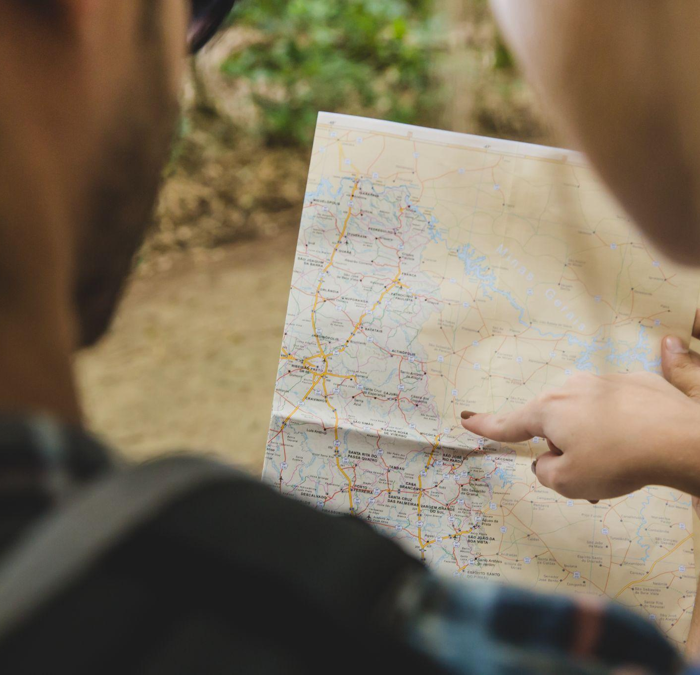
CNN is a kind of network architecture for deep learning algorithms and is specifically used for image recognition and tasks that involve the processing of pixel data.
There are other types of neural networks in deep learning, but for identifying and recognizing objects, CNNs are the network architecture of choice.

Slide 17
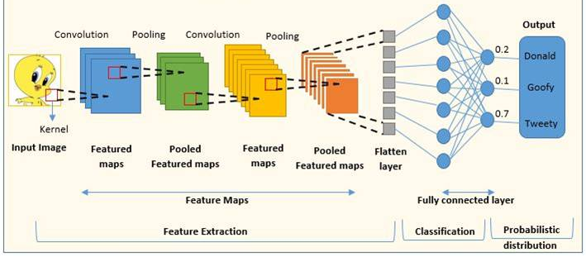
TYPICAL CNN

Slide 18
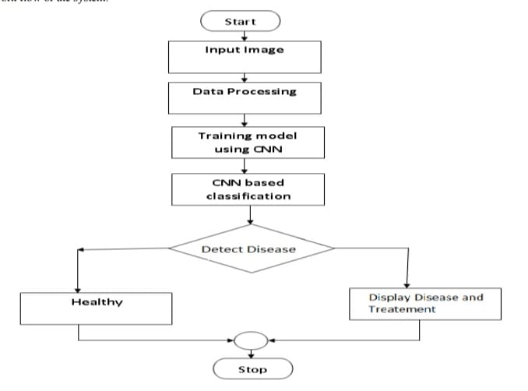
FLOW CHART

Slide 19
06
Methodology

Slide 20
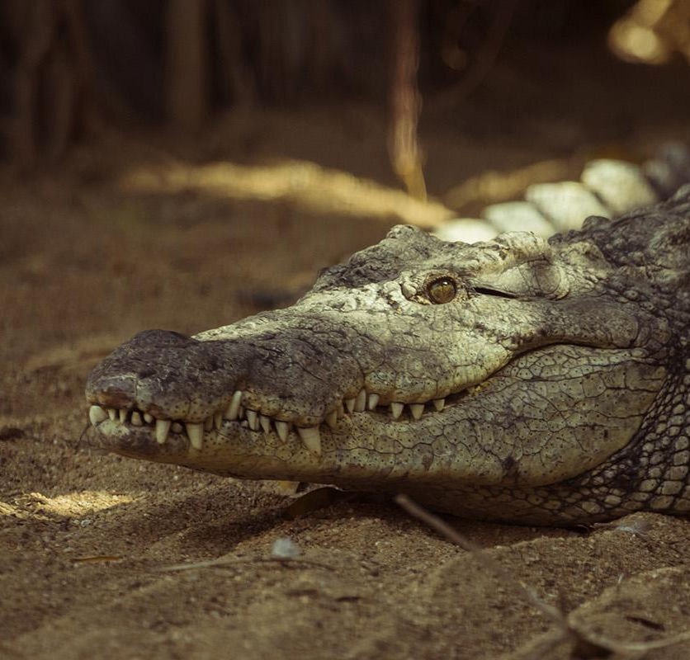
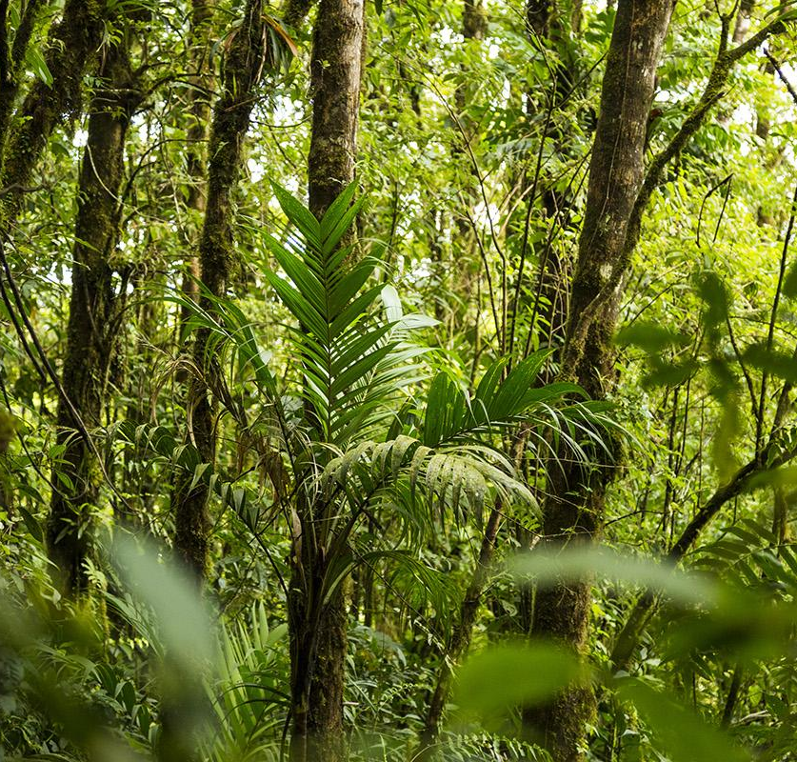
METHODOLOGY STEPS
Data Collection:
Gather a comprehensive dataset of nuts & stem images. This dataset should include samples of healthy nuts & stem and affected nuts & stem i.e., Mahali Koleroga.
Preprocessing:
Preprocess the images to ensure uniformity and quality. This includes resizing, normalization, and possibly data augmentation to increase the dataset size.
Data Splitting:
Split the dataset into training and testing sets. Typically, an 80-20 split is a good starting point.

Slide 21
Model Selection:
Choose an appropriate pre-trained CNN architecture for the task. Common choices include ResNet101V2 to fit the problem.
Transfer Learning:
Utilize transfer learning by loading the pre-trained CNN model and removing its fully connected layers, leaving the convolutional base intact. This base retains valuable features learned from a large dataset.
Feature Extraction:
Extract features from the Arecanut images using the convolutional base of the CNN. These features are used for disease classification.

Slide 22
Model Customization:
Add custom fully connected layers on top of the convolutional base to adapt the model for Arecanut disease classification. The final layer should have as many output nodes as there are classes (healthy and diseased).
Training:
Train the model using the training dataset. Employ an appropriate loss function, such as categorical cross-entropy, and an optimizer like Adam or SGD. Fine-tune the model by updating the weights of the fully connected layers.
Validation:
Monitor the model's performance on the validation dataset. Use metrics like accuracy, precision, recall, and F1-score to evaluate the model's effectiveness.

Slide 23
Hyperparameter Tuning:
Experiment with different hyperparameters, such as learning rates and batch sizes, to optimize the model's performance.
Testing:
After achieving satisfactory results on the validation set, evaluate the model's performance on the independent testing dataset to assess its generalization capabilities.
Post-processing:
Implement post-processing techniques, such as thresholding or filtering, to refine the model's predictions and reduce false positives.

Slide 24
Visualization and Interpretation:
Visualize the model's predictions and feature maps to gain insights into its decision-making process. This can help in understanding which image regions are crucial for disease classification.
Deployment:
If desired, deploy the trained model for practical use, such as real-time disease detection in Arecanut plantations using cameras or drones.
Maintenance and Updates:
Regularly update the model with new data to ensure it can adapt to evolving disease patterns. Continuous improvement and maintenance are essential for long-term success.

Slide 25
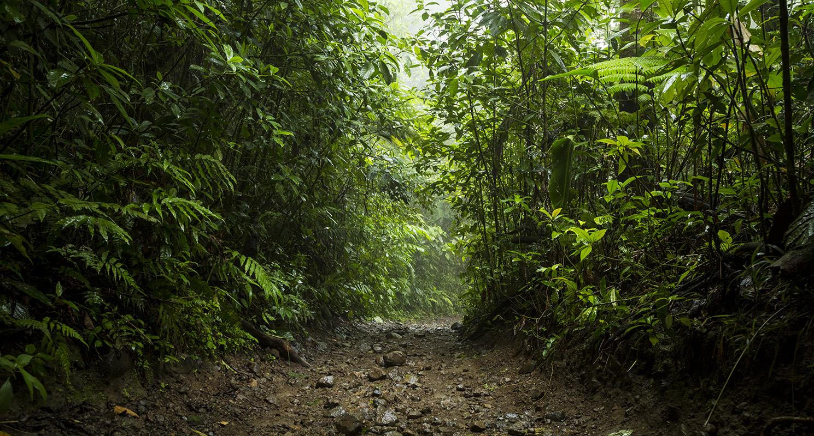
Documentation:
Document the entire methodology, including model architecture, training parameters, and results, to facilitate reproducibility and further research in this domain.

Slide 26
Hardware & Software requirements
07

Slide 27
Hardware Requirements
A computer with a multi-core processor for faster processing.
Sufficient RAM (at least 8 GB) for handling large datasets.
A graphics card with GPU acceleration capabilities for training deep learning models faster.
Sufficient storage space for storing the dataset and trained models.

Slide 28
SOFTWARE REQUIREMENTS
01 |  | Python programming language for coding the machine learning algorithms.
02 |  | OpenCV library for image processing and feature extraction.
03 |  | Jupyter & VS Code for IDE.
04 |  | TensorFlow or PyTorch for building and training deep learning models.
05 |  | Scikit-learn library for machine learning algorithms and evaluation metrics.
06 |  | Framework for developing the web application for the arecanut classification system like flask.

Slide 29
Implementation
08

Slide 30
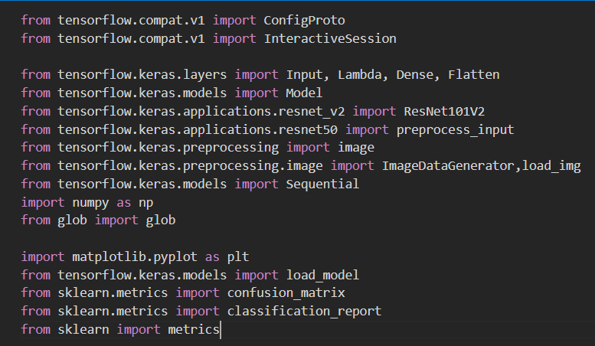
LIBRARIES USED
OVERVIEW DIAGRAM

Slide 31
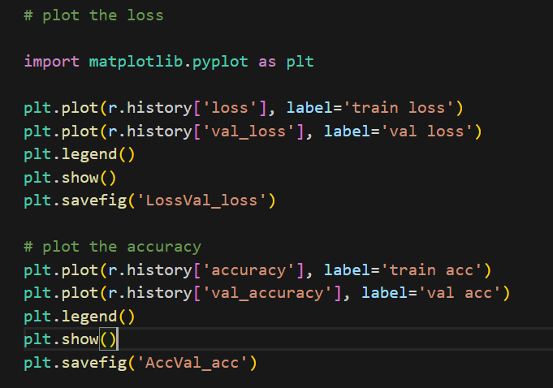
OVERVIEW DIAGRAM
PLOT OF LOSS & ACCURACY

Slide 32
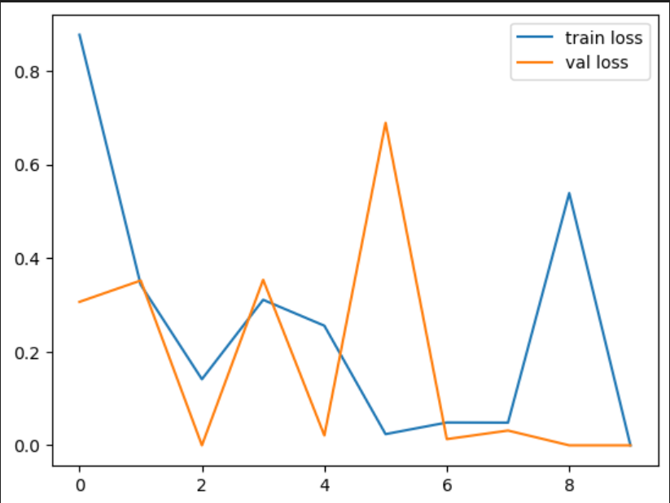
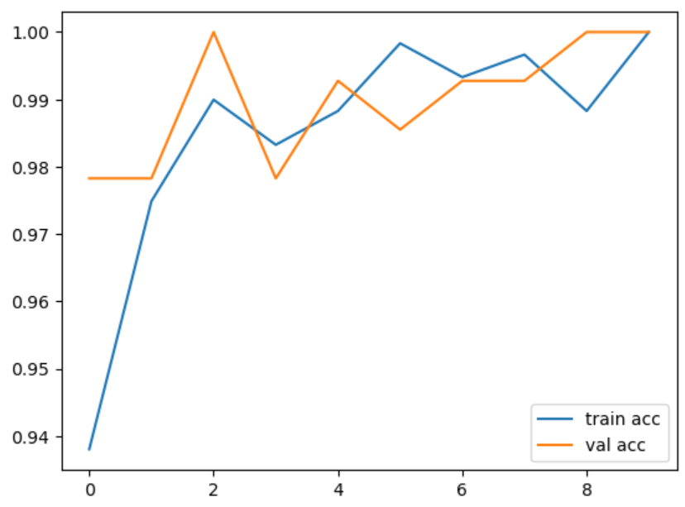
OVERVIEW DIAGRAM
SNAPSHOTS OF THE OUTPUT
Loss
Accuracy

Slide 33
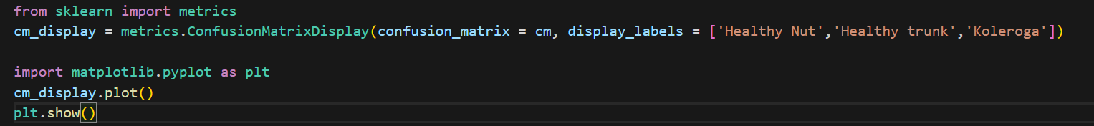
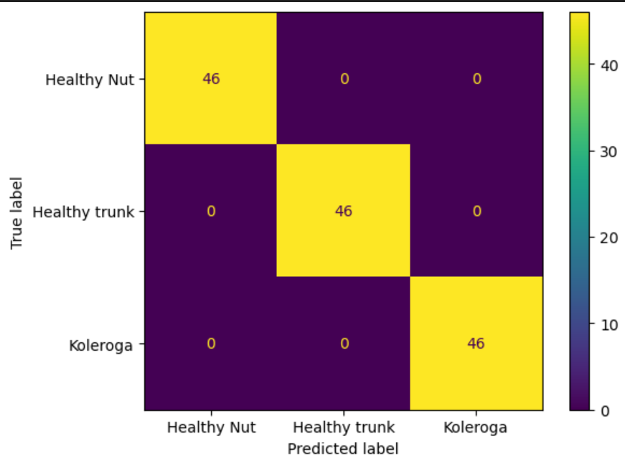
OVERVIEW DIAGRAM
CONFUSION MATRIX

Slide 34
09
Conclusion

Slide 35
CONCLUSION
This project focuses on the early detection of diseases in Arecanut plant using Convolutional Neural Networks. Experimentation is conducted using diseased and healthy arecanut image dataset.
The input image is first pre-processed, followed by feature extraction, training, and classification. The proposed System detects diseases of arecanut.
Depending on the quality of the input image and the stage of the disease, the experimental results show varying levels of disease detection accuracy.

Slide 36
References
10

Slide 37
REFERENCES
Dhanuja K C. Areca Nut Disease Detection using Image Processing Technology. International Journal of Engineering Research 2020 V9. 10.17577/IJERTV9IS080352.
Mallaiah, Suresha & Danti, Ajit & Narasimhamurthy, S. Classification of Diseased Arecanut based on Texture Features. International Journal of Computer Applications. 2014.
Manpreet Sandhu, Pratik Hadawale, Saumaan Momin, Prof. Ajitkumar Khachane. Plant Disease Detection using ML and UAV. International Research Journal of Engineering and Technology 2020 V7.

Slide 38
Anandhakrishnan MG Joel Hanson, Annette Joy, Jeri Francis, Plant Leaf Disease Detection using Deep Learning and Convolutional Neural Network, International Journal of Engineering Science and Computing, Volume 7, Issue No.3, March 2017
Manisha Bhange, H.A. Hingoliwala, Smart Farming: Pomegranate Disease Detection Using Image Processing, Procedia Computer Science, Volume 58,2015, Pages 280-288, ISSN 1877-0509.

Slide 39
THANK YOU

