Slide 1
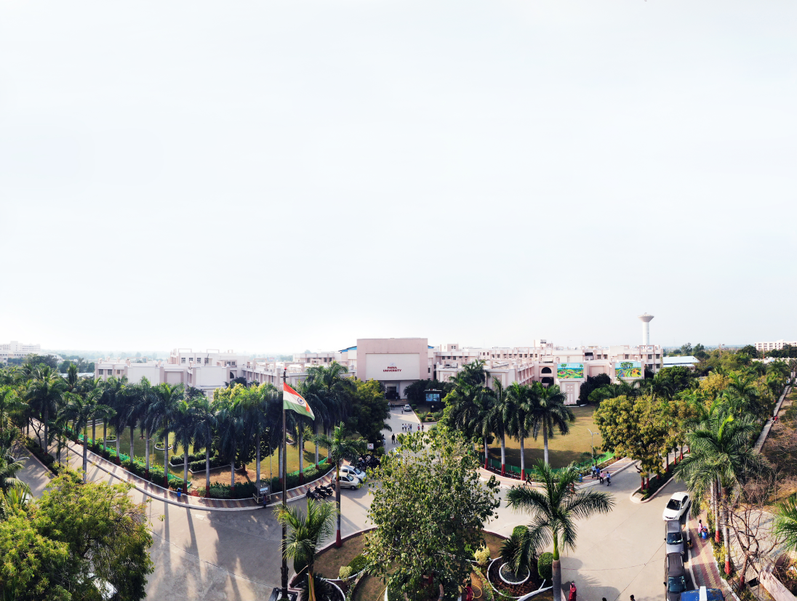


Computer Networks (203105255)
Prof. Nirav Patel, Assistant Professor
Computer Science & Engineering

Slide 2
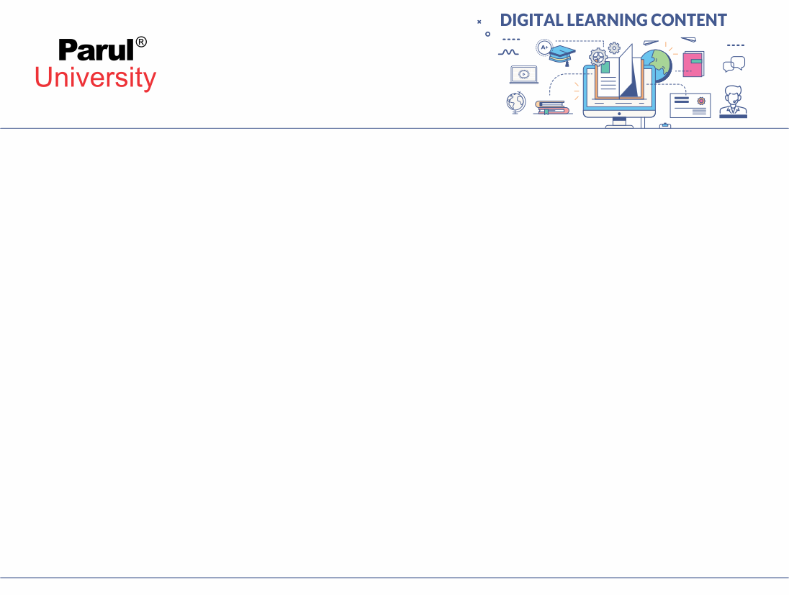


Text Books for Computer Networks
Computer Networks, Andrew S. Tanenbaum and David J. Wetherall; PEARSON Edition
Data Communication and Networking, Behrouz A. Forouzan; fourth edition; Tata Mc Graw Hill
Data and Computer Communication, W. Stallings; McMillan
Internetworking with TCP/IP Principles, Protocols and Architecture, Douglas E Comer
TCP/IP Illustrated, Richard Stevens

Slide 3
CHAPTER-1
DATA COMMUNICATION COMPONENTS
Representation of data and its flow Networks, Various Connection Topology, Protocols and Standards, OSI model, Transmission Media, LAN:Wired LAN, Wireless LANs, Connecting LAN and Virtual LAN, Techniques for Bandwidth utilization: Multiplexing - Frequency division, Time division and Wave division, Concepts on spread spectrum.

Slide 4
DATA COMMUNICATION COMPONENTS
Data: The collection of raw/unorganized facts and figures is called Data/input.
Information: The processed form of data is called information/output.
Data Communication are the exchange of data between two devices via some form of transmission medium such as a wire cable.

Slide 5
DATA COMMUNICATION COMPONENTS
1. Sender
2. Receiver
3. Medium
4. Message
5. Protocol

Slide 6
DATA COMMUNICATION COMPONENTS[1]
Rule-1
Rule-2
.
.
Rule n
Rule-1
Rule-2
.
.
Rule n
Protocol
Protocol
Message
Sender
Receiver
Medium
(Image Source:-Raw Image)

Slide 7
DATA COMMUNICATION COMPONENTS
1. Sender: The computer which sends the message is the sender. It can be a device, a phone handset, a video camera, etc.
2. Receiver: The computer receiving the message is the receiver. It may be a computer, a workstation, a phone handset, a television, etc.
3. Medium: The medium of communication is the physical route from sender to receiver through which a message passes. Twisted pair wire, coaxial cable, fiber-optic cable, laser or radio (terrestrial or satellite microwave) waves can be used.
4. Message: The message to be transmitted is the transmission (data). It may consist of, or any combination of, text, number, images, sound, or video.
5. Protocol: A protocol is a set of rules for communicating data. It represents an agreement between devices that communicate.
Two devices can connect but not interact without a protocol, just like a person who speaks German can not be understood by a person who only speaks Japanese.

Slide 8
Data flow (simplex, half-duplex, and full-duplex)[1]
Direction of Data
Mainframe
Station
Medium
Simplex
(Image Source:-Raw Image)

Slide 9
Data flow (simplex, half-duplex, and full-duplex)
Direction of Data at time 1
Station
Station
Direction of Data at time 2
Medium
Half Duplex
(Image Source:-Raw Image)

Slide 10
Data flow (simplex, half-duplex, and full-duplex)
Direction of Data all the time
Station
Station
Medium
Full Duplex
(Image Source:-Raw Image)

Slide 11
What is Computer Network?[2]
Computer Network is a system in which multiple computers are connected to each other to share information and resources.
The main purpose of computer network is to share the information among the computers. We can use wired media or wireless media for connection among computers. Internet is well known example of computer network.
Station 1
Station 2
Wireless
Station 4
Station 3
Wired
(Image Source:-Raw Image)

Slide 12
Advantages of Computer Network
File sharing
Resource sharing
Better connectivity and communications
Internet access
Entertainment
Flexible access
Instant and multiple access

Slide 13
What is Topology?[2]
Topology: Geometric representation of how the computers are connected to each other is known as topology
Types of Topology
1.Mesh
2.Star
3.Bus
4.Ring 5. Hybrid

Slide 14
Bus Topology
There is a main cable in the bus topology, and all devices are connected via drop lines to this main cable.
A system called a tap is available that links the drop line to the main cable. As all the information is transmitted over the main cable, there is a drop line limit and the distance that a main cable can have.

Slide 15
Bus Topology[2]
Drop Line
Cable
Bus Topology
(Image Source:-Raw Image)

Slide 16
Advantages and Disadvantages of Bus Topology
Bus Topology Advantages
Simple installation, connecting each cable to the backbone cable.
Less needed cables than topology for mesh and stars
Bus Topology Drawbacks
Difficult identification of faults.
Not scalable, since there is a limit on how many backbone cable nodes you can link on.

Slide 17
Star Topology[2]
In star topology, any device in the network is linked to a hub called a central device.
Star topology does not allow direct communication between devices, unlike mesh topology, a system would have to communicate via the hub.
If one computer wishes to send data to another device, the data must be sent to the hub first, and the data must then be transmitted to the specified device by the hub.

Slide 18
Star Topology
HUB
Star Topology
(Image Source:-Raw Image)

Slide 19
Advantages and Disadvantages of Star Topology
Advantages of Star Topology
It is less costly since each system requires only one I / O port and needs to be linked to a single link hub.
Simpler to install.
Less cables are needed since only the hub needs to be attached to each device.
If one connexion fails, other connections will operate just fine. Stable.
Simple fault detection as it is possible to quickly identify the connexion.
Disadvantages of Star Topology
If the hub goes down, none of the devices can run without the hub.
Since it is the core structure of star topology, the Hub needs more energy and frequent maintenance.

Slide 20
Ring Topology[2]
.
Each device is aligned with the two devices on either side of it in the ring topology. A system has two dedicated point-to - point connections to the devices on either side of it.
This arrangement forms a ring, so it is called the ring topology. If a computer wishes to transmit data to another device, then the data is transmitted in one direction, each device has a repeater in ring topology, if the received data is intended for another device, then the repeater forwards this information before it is received by the intended device.

Slide 21
Ring Topology
Ring Topology
(Image Source:-Raw Image)

Slide 22
Advantages and Disadvantages of Ring Topology
Advantages in Ring Topology
Simple to mount.
Managing is simpler when to add or delete a system from the topology only two connections are needed to be modified.
Disadvantages in Ring Topology
A connection failure will fail the whole network as the signal will not move forward due to failure.
Data traffic problems, as all the data is circulated in a ring.

Slide 23
Mesh Topology[2]
Any device in the mesh topology is linked by a special point-to - point connexion to every other device on the network.
It means the connexion includes only the data for the two connected devices when we say it is committed.
Let's just assume we have n network devices so that any system must connect to (n-1) network devices. There will be n(n-1)/2 number of connections in interface mesh topology.

Slide 24
Mesh Topology
Mesh Topology
(Image Source:-Raw Image)

Slide 25
Advantages and Disadvantages of Mesh Topology
Mesh Topology Advantages
No network traffic problems as there is a dedicated connexion between two devices which ensures the connexion is only accessible for those two devices.
Mesh topology is stable and durable since one link loss has little effect on other connections and connectivity with other network devices.
Topology of the mesh is safe, as the connection to the point is not permitted.
It is quick to detect fault.
Mesh Topology Drawbacks
Tedious and headache are the number of wires used to connect each device.
As each unit must be attached to other units, the necessary number of I / O ports must be massive.
Scalability concerns when a computer can not connect to a huge number of devices through a special point-to - point connection.

Slide 26
Hybrid Topology[2]
A combination of two or more topology is known as hybrid topology. For example a combination of star and mesh topology is known as hybrid topology.

Slide 27
Hybrid Topology
HUB
Ring Topology
Star Topology
Hybrid Topology
(Image Source:-Raw Image)

Slide 28
Advantages and Disadvantages of Mash Topology
Hybrid topology advantages
For eg, we should decide on topology depending on criteria. Scalability is our issue, so instead of bus technology, we can use star topology.
Scalable, so we can link additional computer networks with diverse topologies to existing networks.
Hybrid topology disadvantages
It is hard to locate faults.
It's difficult to mount.
Development is dynamic and so repair is costly.

Slide 29
Protocol and Standards[1]
Protocol: A protocol is a series of rules accepted between sender and receiver. Without a protocol two machines may be connected but can not communicate. Without a protocol.
We need to establish a collection of rules, called a protocol, to establish secure communication or data sharing between two separate devices.
For example, ftp is the protocol used for file sharing of the data in internet, similarly smtp protocol is used by email services connected to the internet.
Rule-1
Rule-2
Rule n
Protocol
Protocol
Rule-1
Rule-2
Rule n
Message
Sender
Receiver
Medium
(Image Source:-Raw Image)

Slide 30
OSI Model [2]
we will discuss OSI model in computer network and seven layers of OSI model in detail.
1. OSI Model stands for Open System interconnection model. 2. OSI Model defines how data is transferred from one computer to another computer. 3. Two machines attached to a LAN and connectors pass data using the NIC in a very simple scenario. This is a computer network, except where all systems use separate operating systems, such as one system runs on windows and another on MacOS, the function of an OSI model, a 7-layer model that determines how data can transmission between different systems, occurs here.
4. OSI model was introduced by International Organisation for standardisation (ISO) in 1984.

Slide 31
OSI Model
5. There are seven layers in a OSI model
Application layer
Presentation Layer
Session layer
Transport layer
Network Layer
DataLink layer
Physical layer

Slide 32
OSI Model
Data
7. Application
RECEIVE
SEND
Human Computer Interaction
Data
6.Presesentation
Usable format like encryption, compression
Data
5. Session
Session Management
Segments
4. Transport
Transmission protocol like TCP and UDP
Packets
3. Network
Physical path for Routing, IP
Frames
2. Data Link
Framing, Error Control
Bits
1. Physical
Movements of individual bits
Form of Data
Layers
OSI MODEL
(Image Source:-Raw Image)

Slide 33
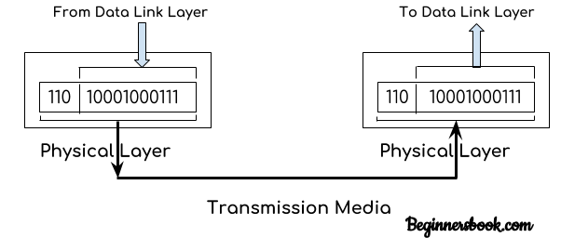
Physical Layer
The physical layer is responsible for movements of individual bits from one hop (node) to the next.
A frame is nothing but a sequence of bits such as 1001011. Physical layer converts these binary sequences into signals and transfer it through a transmission media such as cables etc.
(Image Source:-https://beginnersbook.com/2019/04/osi-model-in-computer-network/)

Slide 34
Data Link Layer
Data link layer receives the data from network layer.
There are two types of addressing assigned to the packets. Logical addressing: The logical address assigns IP addresses to data packets to both the sender and recipient. This is done at the network layer.
Physical addressing: Physical addressing is done at data link layer where MAC addresses of sender and receiver are assigned to each data packets.
Data unit in the data link layer is called frame.
A frame is transferred from one computer to another computer and transmission is done through a transmission media such as wire, cable etc. Both sender and receiver computer has NIC that helps in sending and receiving frame.
These NICs presents at sender and receiver provides a physical link between sender and receiver.

Slide 35
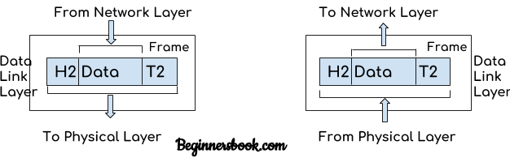
Data Link Layer
Main functions of data link layer: Media Access control management
Flow control Error Control
Framing
Addressing
(Image Source:-https://beginnersbook.com/2019/04/osi-model-in-computer-network/)

Slide 36
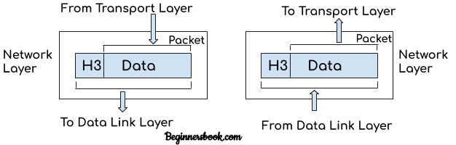
Network Layer
The main purpose of network layer is to receive the data segments from transport layer and transfer them from one computer to another computer on different network.
The main functions of network layer: Logical Addressing (IP Addressing)
Routing
Packetizing
(Image Source:-https://beginnersbook.com/2019/04/osi-model-in-computer-network/)

Slide 37
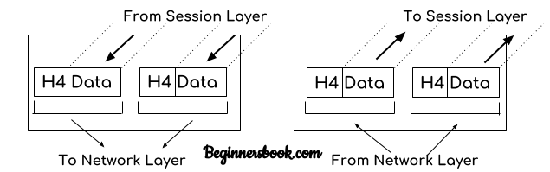
Transport Layer
The main role of transport layer is to check the reliability of data communication and communication.
The main functions of transport layer are: Segmentation and reassembly
Connection control
Flow control
Error control
(Image Source:-https://beginnersbook.com/2019/04/osi-model-in-computer-network/)

Slide 38
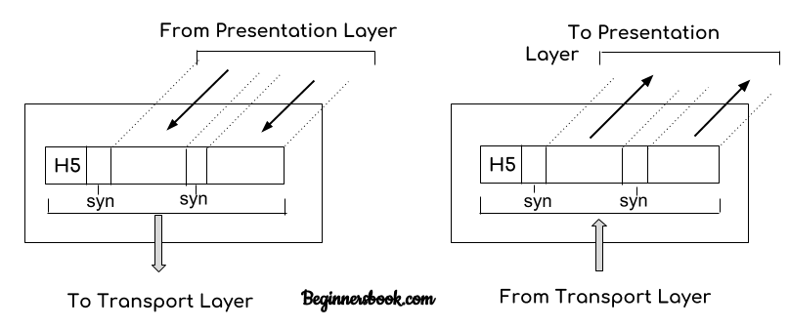
Session Layer
(Image Source:-https://beginnersbook.com/2019/04/osi-model-in-computer-network/)

Slide 39
Session Layer
The main role of session layer is to setup and maintain the connection between different systems.
Main functions of session layer: Authentication
Authorization
Session management

Slide 40
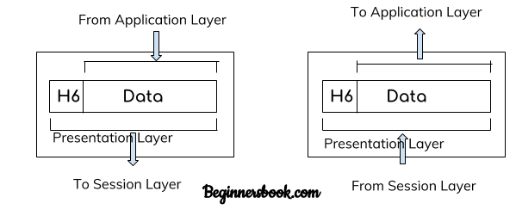
Presentation Layer
(Image Source:-https://beginnersbook.com/2019/04/osi-model-in-computer-network/)

Slide 41
Presentation Layer
Presentation layer receives the data from top most layer which is application layer.
Functions of Presentation layer:
Translation
Encryption
Compression

Slide 42
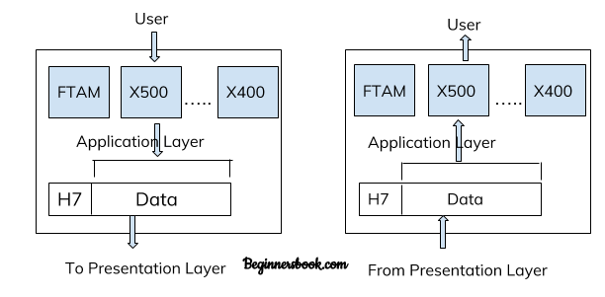
Application Layer
(Image Source:-https://beginnersbook.com/2019/04/osi-model-in-computer-network/)

Slide 43
Application Layer
1. Application layer is used by computer applications such as google chrome, outlook, FireFox, Skype etc. 2. Application layer defines the protocols that are used by computer applications for example: HTTP and HTTPS protocols are used by web browsers such as google chrome, FireFox, Safari etc.
FTP protocol is used for file transfer between two or more computers.
SMTP protocol is used for emails
Telnet is used for virtual terminals.
There are dozens of other protocol that forms the application layer, such as NFS, FMTP, DHCP, SNMP, POP3, IRC, NNTP etc.
3. In short you can say that application layer provides the services to computer applications with the help of protocols that are defined in it.
.

Slide 44
What is Transmission media? [4]
Transmission media is a communication medium from the sender to the recipient. Electromagnetic signals are used to send data.
The main functionality of the transmission media is to carry the information in the form of bits through LAN(Local Area Network).
It is a physical path between transmitter and receiver in data communication.
In a copper-based network, the bits in the form of electrical signals.
In a fiber based network, the bits in the form of light pulses.

Slide 45
Causes Of Transmission Impairment:
Attenuation: Attenuation means energy loss, i.e. the signal intensity decreases with the distance increase that causes energy loss.
Distortion: Distortion takes place when the signal form is changed. Different signals of different frequency are tested for such distortion. The propagation speed of each frequency variable is their own, which contributes to the distortion of the delay at a different time.
Noise: If data is passed through a transmission medium, it is added with a certain unwanted signal which produces the noise.
Transmission Impairment
Attenuation
Distortion
Noise
(Image Source:-Raw Image)

Slide 46
Transmission Media:[4]
Transmission Media
Guided Media
Unguided Media
Coaxial
Fibre Optics
Twisted Pair
Radiowave
Microwave
Infrared
Shielded
Unshielded
(Image Source:-Raw Image)

Slide 47
Guided Transmission Medium
Guided transmission media are also called bounded media or wired media. They comprise cables or wires through which data is transmitted.
They are called guided since they provide a physical path from the sender device to the receiver device.
The signal traveling through these media are bounded by the physical limits of the medium.
The most popular guided media are −
Twisted pair cable
Coaxial cable
Fiber optics

Slide 48
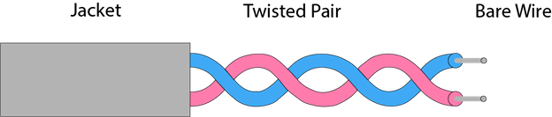
Twisted pair cable
Twisted pair is a physical media consisting of a twisted pair of cables.
Compared to other transmission media, a twisted cable is inexpensive. The twisted cable is easy to mount and is a lightweight cable.
The frequency range for twisted pair cable is from 0 to 3.5KHz.
(Image Source:-https://www.javatpoint.com/guided-transmission-media)

Slide 49
Types of Twisted pair cable
Unshielded Twisted Pair:
An unshielded twisted pair is widely used in telecommunication. Following are the categories of the unshielded twisted pair cable:
Category 1: Category 1 is used for telephone lines that have low-speed data.
Category 2: It can support upto 4Mbps.
Category 3: It can support upto 16Mbps.
Category 4: It can support upto 20Mbps. Therefore, it can be used for long-distance communication.
Category 5: It can support upto 200Mbps.

Slide 50
Types of Twisted pair cable
Advantages Of Unshielded Twisted Pair:
It is cheap.
Installation of the unshielded twisted pair is easy.
It can be used for high-speed LAN.
Disadvantage:
This cable can only be used for shorter distances because of attenuation.

Slide 51
Types of Twisted pair cable
Shielded Twisted Pair
A shielded twisted pair is a cable that contains the mesh surrounding the wire that allows the higher transmission rate.
Characteristics Of Shielded Twisted Pair:
The cost of the shielded twisted pair cable is not very high and not very low.
An installation of STP is easy.
It has higher capacity as compared to unshielded twisted pair cable.
It has a higher attenuation.
It is shielded that provides the higher data transmission rate.
Disadvantages
It is more expensive as compared to UTP and coaxial cable.
It has a higher attenuation rate.

Slide 52
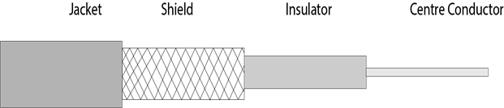
Coaxial Cable
cable
Coaxial cables are most frequently used media , for example a coaxial cable is typically a television cord.
The cable 's name is coaxial since it is parallel to two conductors.
Compared with the twisted cable it has a higher frequency.
Copper is the inner conductor of the coaxial cable, and a coaxial mesh is the outer conductor. The middle core consists of a non-leading cover which separates the inner conductor from the outside conductor.
The middle core is in responsible of transmitting the data, while the copper mesh prevents the EMI(Electromagnetic interference).
(Image Source:-https://www.javatpoint.com/guided-transmission-media)

Slide 53
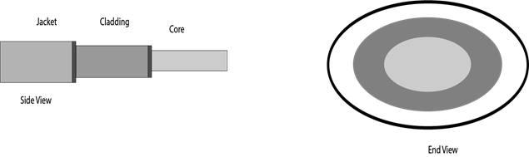
Fibre Optic
Fiber optic cable is a communication cable which uses electrical signals.
Fiber optics is a cable containing the plastic coated fibres that transmit the data through light pulses.
The plastic layer avoids heat, cold, electromagnetic interference of the Optical Fibers from other cables.
Fiber optics provide faster data than copper wires.
(Image Source:-https://www.javatpoint.com/guided-transmission-media)

Slide 54
Unguided Transmission Medium
Unguided transmission media are also called wireless media.
They transport data in the form of electromagnetic waves that do not require any cables for transmission.
These media are bounded by geographical boundaries. These type of communication is commonly referred to as wireless communications.
Unguided signals can travel in three ways −
Ground propagation
Sky propagation
Line – of – sight propagation
The commonly used unguided transmissions are −
Radio transmission
Microwave transmission
Infrared transmission
Light transmission

Slide 55
Radio waves
Radio waves are the electromagnetic waves emitted to the free space in all directions.
Radio waves are omnidirectional, i.e. the propagation of signals in all directions.
The frequency range is 3khz to 1 khz for radio waves.
In the case of radio waves, the sending and receiving antenna are not aligned, i.e., the wave sent by the sending antenna can be received by any receiving antenna.
An example of the radio wave is FM radio.

Slide 56
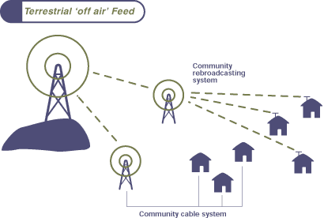
Radio waves[7]
(Image Source:-https://tara.layak.in/transmission-media/)

Slide 57
Microwaves
In straight line, microwaves can move and so precisely align the transmitter and receiver stations.
The spread of microwave is line–of– sight. So the towers that hoist the stations should be installed so that contact does not interfere with the curvature of the earth and some other barrier.
As it is unidirectional it can receive signals without interference on multiple receivers in a row.
Microwave facilities do not move. Indoor recipients are therefore not successful.

Slide 58
Infrared
Infrared waves are those in the electromagnetic spectrum between the frequencies 300GHz and 400THz. They are longer than the visible light but they are shorter than the microwave. Infrared propagation is line of sight.
They can not penetrate walls, and these rays interfere with sunlight. Thus, long-range communication can not be used. As their use is closed, they do not need government permits to apply.

Slide 59
Types of Computer Networks[5]
There are various categories of computer network. It can be categories by their size, objective and usage .
The important factor can be geographic area to be covered, transmission rate, throughput, etc. It may vary from category to category.
Some of the different networks based on size are:
Local Area Network - LAN
Metropolitan Area Network - MAN
Wide Area Network - WAN

Slide 60
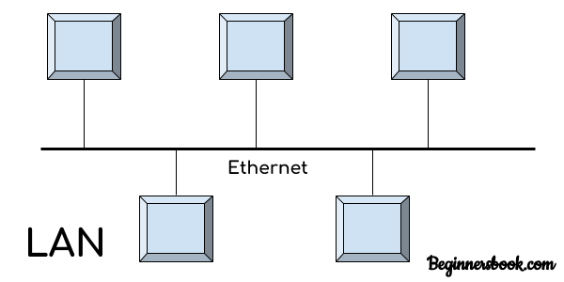
Local Area Network-LAN[5]
A local area network (LAN) is a computer network that interconnects computers within a limited region. It can be used for college, home/residence, laboratory, university campus, office building.
It is applicable when small region is to be covered and good transmission to be achieved.
(Image Source:-https://beginnersbook.com/2019/03/types-of-computer-network-lan-man-and-wan/)

Slide 61
Wired LAN
An electronic circuit or hardware grouping in which the configuration is determined by the physical interconnection of the components

Slide 62
Wireless LAN
Communications that take place without the use of interconnecting wires or cables, such as by radio, microwave, or infrared light
Wireless networks can be installed:
Peer-to-peer “Ad hoc” mode—wireless devices can communicate with each other
"Infrastructure" mode—allows wireless devices to communicate with a central node that can communicate with wired nodes on that LAN

Slide 63
Virtual LAN (VLAN)
A virtual LAN, known as a VLAN, is a group of hosts with a common set of requirements that communicate regardless of their physical location
Sometimes called a “logical network”
Has the same attributes as a physical LAN, but allows for end stations to be grouped together even if they are not located on the same network switch
Network reconfiguration can be done through software
The VLAN controller can change or add workstations and manage load balancing and bandwidth allocation more easily than with a physical picture of the LAN
Network management software keeps track of relating the virtual picture of the local area network with the actual physical picture

Slide 64
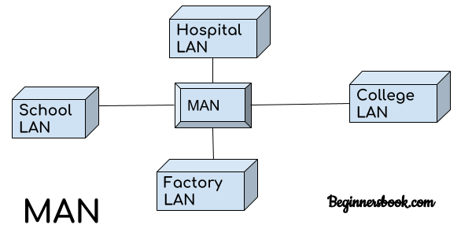
Metropolitan Area Network-MAN[5]
A metropolitan area network (MAN) is a computer network that interconnects with computer in a metropolitan area like city.
MAN covers larger area than LAN but smaller than the area covered by a WAN.
The transmission speed of a MAN is moderate/average.
It is also used to interconnection of several local area network.
(Image Source:-https://beginnersbook.com/2019/03/types-of-computer-network-lan-man-and-wan/)

Slide 65
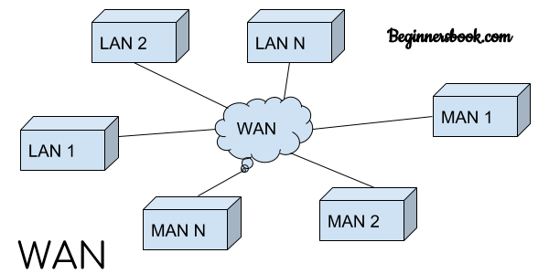
Wide Area Network[5]
A wide area network (WAN) is a computer network that exists over a large-scale geographical area.
A WAN connects different networks, including local area networks (LAN) and metropolitan area networks (MAN).
It may be located with in a state or a country or it may be interconnected around the world.
(Image Source:-https://beginnersbook.com/2019/03/types-of-computer-network-lan-man-and-wan/)

Slide 66
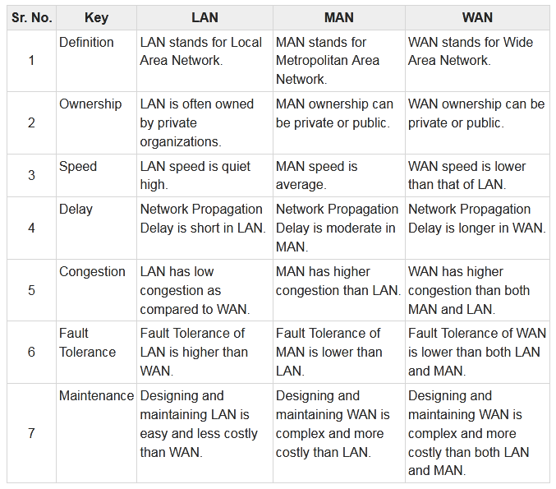
Comparison of Computer Networks[6]
(Source:-https://www.tutorialspoint.com/difference-between-lan-man-and-wan)

Slide 67
Techniques for Bandwidth Utilization[1]
Bandwidth utilization is the wise use of available bandwidth to achieve specific goals.
Efficiency can be achieved by multiplexing; i.e., sharing of the bandwidth between multiple users.

Slide 68
Multiplexing
A communication channel such as an optical fiber or coaxial cable can carry only one signal at any moment in time.
This results in wastage of bandwidth. However, we can overcome this drawback by using a technique called multiplexing.
By using the multiplexing technique, we can easily send multiple signals simultaneously over a communication channel (medium).
Multiplexing is a technique which combines multiple signals into one signal, suitable for transmission over a communication channel such as coaxial cable or optical fiber. Multiplexing is also sometimes referred to as muxing.

Slide 69
Without Multiplexing[1]
One channel One signal
Source
Dest.
Channel 1
Source
Dest.
Channel 2
Source
Dest.
Channel 3
(Image Source:-Raw Image)

Slide 70
With Multiplexing[1]
Source
Dest.
Channel
MUX
DEMUX
Source
Dest.
Source
Dest.
(Image Source:-Raw Image)

Slide 71
Multiplexing And Demultiplexing[1]
MUX-Multiplexer
DEMUX- Demultiplexer
n inputs
n outputs
MUX
DEMUX
1 Link n Channels
(Image Source:-Raw Image)

Slide 72
Categories of multiplexing
Frequency Division Multiplexing
Wavelength Division Multiplexing
Time Division Multiplexing

Slide 73
Frequency-division multiplexing (FDM)[1]
Input Lines
Output Lines
Channel 1
MUX
DEMUX
Channel 2
Channel 3
(Image Source:-Raw Image)

Slide 74
Frequency-division multiplexing (FDM)[1]
Source 1 (20 KHz)
Dest. 1
Channel 1
MUX
DEMUX
Source 2 (30 KHz)
Channel 2
Dest. 2
Channel 3
Source 3 (40 KHz)
Dest. 3
Guard Band
(Image Source:-Raw Image)

Slide 75
Frequency-division multiplexing (FDM)
The transmitter end contains multiple transmitters and the receiver end contains multiple receivers. The communication channel is present between the transmitter and receiver.
At transmitter end, each transmitter sends a signal of different frequency. In the figure, the transmitter 1 sends a signal of 30 kHz, transmitter 2 sends a signal of 40 kHz, and transmitter 3 sends a signal of 50 kHz.
These signals of different frequencies are then multiplexed or combined by using a device called multiplexer. It then transmits the multiplexed signals over a communication channel.
At the receiver end, the multiplexed signals are separated by using a device called demultiplexer.

Slide 76
Frequency-division multiplexing (FDM)
It then sends the separated signals to the respective receivers. figure, the receiver 1 receives signal of 30 kHz, receiver 2 receives signal of 40 kHz, and receiver 3 receives signal of 50 kHz.
Advantages of Frequency Division Multiplexing (FDM)
1. It transmits multiple signals simultaneously.
2. In frequency division multiplexing, the demodulation process is easy.
3. It does not need Synchronization between transmitter and receiver.
Disadvantages of Frequency Division Multiplexing (FDM)
It needs a large bandwidth communication channel.

Slide 77
Frequency-division multiplexing (FDM)
Applications of Frequency Division Multiplexing (FDM)
1. Frequency division multiplexing is used for FM and AM radio broadcasting.
2. It is used in first generation cellular telephone.
3. It is used in television broadcasting.

Slide 78
Wavelength division multiplexing (WDM)[1]
Source 1 (ʎ1)
Dest. 1
(ʎ1)
Channel
MUX
DEMUX
Source 2 (ʎ2)
Dest. 2
(ʎ2)
Source 3 (ʎ3)
Dest. 3
(ʎ3)
(Image Source:-Raw Image)

Slide 79
Wavelength division multiplexing (WDM)
Wavelength division multiplexing is an analog technique. It is the most important and most popular method to increase the capacity of an optical fiber.
The working principle of wavelength division multiplexing is similar to frequency division multiplexing. The only difference is in wavelength division multiplexing optical signals are used instead of electrical signals.
Wavelength division multiplexing is a technology in which multiple optical signals (laser light) of different wavelengths or colors are combined into one signal and is transmitted over the communication channel. Thus multiple signals are transmitted simultaneously over a single communication channel.

Slide 80
Wavelength division multiplexing (WDM)
Advantages of Wavelength Division Multiplexing (WDM)
1. WDM allows transmission of data in two directions simultaneously
2. Low cost
3. Greater transmission capacity
4. High security
5. Long distance communication with low signal loss

Slide 81
Time Division Multiplexing(TDM)[1]
Source 1 Slot 1
Dest. 1
Slot 1
Slot 3
Slot 2
Slot 1
MUX
DEMUX
Source 2 Slot 2
Dest. 2
Slot 2
Source 3 Slot 3
Dest. 3
Slot 3
(Image Source:-Raw Image)

Slide 82
Time Division Multiplexing(TDM)
Time Division Multiplexing is a technique in which multiple signals on the same communication channel are combined and transmitted one after another.
The signals on the receiver side are separated and received. A consumer receives each signal at a different time.
Both signals of various frequencies are transmitted simultaneously in frequency division multiplexing. But in time division multiplexing, both signals are broadcast at various intervals, running at the same frequency.
In time division multiplexing, a fixed time period called the time slot during which data is transmitted is allocated to each user. The time interval (time slot) allocated to each recipient (user) is so limited that it will not be noticed by the receiver that any time has been spent serving another recipient (user).

Slide 83
Time Division Multiplexing(TDM)
In time division multiplexing, all signals are not transmitted simultaneously; instead, they are transmitted one after another. For example, as shown in the above figure, at first, we send signal 1. Then after second signal 2 and then after third signal 3 finally. Thus, each user occupies an entire bandwidth for a short period of time.

Slide 84
Spread Spectrum technology
Problem with conventional wireless system
1) Interference
When another signal transmitted on or very near the frequency of desired signal
2) interception
Third party work as a listener so constant frequency signal not well suited to application in which information must kept confidential between the source and destination.

Slide 85
Spread Spectrum technology[1]
Solution: spread the narrow band signal into a broad band signal using a special code.
Expansion of signals bandwidth.
Spread data signal on a frequency spectrum.
power
interference
spread signal
power
signal
spread
interference
detection at
receiver
f
f
(Image Source:-Raw Image)

Slide 86
Types of Spread Spectrum
Frequency Hopping Spread Spectrum (FHSS)
Space application ,HF radio ,military ,WLAN
Direct Sequence Spread Spectrum
WLAN,CDMA radio, Cordless phone,GPS , military

Slide 87
References
Behrouz A. Forouzan, Data Communication and Networking, Tata Mc Graw Hill
Andrew S. Tanenbaum and David J. Wetherall, Computer Networks, PEARSON Edition
https://beginnersbook.com/2019/04/osi-model-in-computer-network/
https://www.javatpoint.com/guided-transmission-media
https://beginnersbook.com/2019/03/types-of-computer-network-lan-man-and-wan/
https://www.tutorialspoint.com/difference-between-lan-man-and-wan
https://tara.layak.in/transmission-media/

Slide 88


www.paruluniversity.ac.in

