Slide 1
CSE4074- Forensics analytics
An Integrated Forensic Intelligence Framework Using Benford’s Law and a Graph Neural Network for Explainable and Graph-Based Financial Fraud Detection

Slide 2

Problem Statement
Background
The rapid growth of digital banking and online payment systems has increased the frequency and complexity of financial fraud. Fraudsters often operate through interconnected customers, merchants, devices, and accounts, making detection more challenging.
Challenges
  Traditional models analyze transactions independently.
  Hidden relationships among financial entities remain undetected.
  Class imbalance affects model performance.
  Existing AI models lack transparency for forensic investigations.
Current fraud detection approaches are unable to effectively detect sophisticated and coordinated financial fraud due to limited relationship analysis, absence of statistical forensic validation, and poor interpretability of AI-based predictions.

Slide 3
Existing Work & Research Gap
Base Paper
A Novel Graph Learning Framework for Interpretable and Imbalance Financial Fraud Detection
Engineering Applications of Artificial Intelligence (Elsevier, 2026)
Existing Work (Base Paper – IFDetector)
The existing framework focuses on graph-based fraud detection by modeling relationships among financial entities.
Key Features
  Graph Neural Network (GNN) for relational learning
  Adaptive graph sampling for large financial networks
  Contrastive learning to improve fraud representation
  Interpretable graph embeddings for fraud prediction
Research Gap
Despite its effectiveness, the framework has several limitations:
  Does not analyze numerical anomalies in transaction values.
  Benford's Law is not incorporated for forensic validation.
  Fraud decisions rely only on graph learning.
  No unified fraud risk score combining statistical and graph evidence.
  Limited support for investigator-oriented fraud analysis.
Phishing
Malware
Identity Theft

Slide 4
Research Gap
Existing Methods | Limitation
Rule-Based Systems | Detect only known fraud rules
Machine Learning | Treats transactions independently
Benford's Law | Used separately from AI models
Graph Neural Networks | Lack explainability
Explainable AI | Explains features but not fraud networks

Slide 5
Novelty
  Hybrid Integration of Three Complementary Techniques
  Benford's Law as a Learnable Feature
  Graph-Based Detection of Fraud Rings
  Dual Explainability

Slide 6
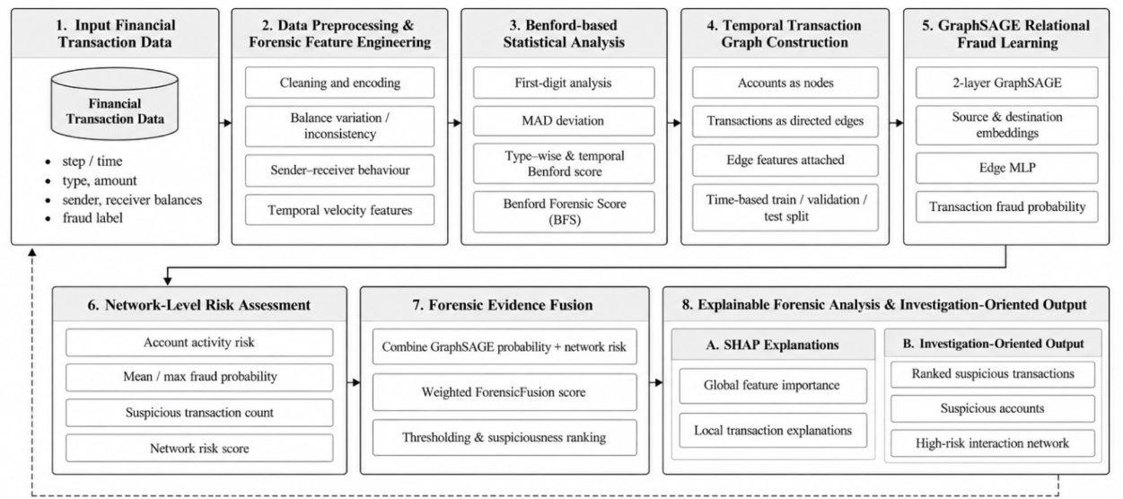
Proposed Framework

Slide 7
Proposed Contributions
Key Contributions
  Detect numerical anomalies using Benford's Law
  Learn hidden fraud patterns using Graph Neural Networks
  Generate transparent predictions through Explainable AI
  Compute a Hybrid Fraud Risk Score by combining statistical and graph-based evidence
Technology Stack
Programming Language: Python
Data Processing: Pandas, NumPy
Graph Neural Networks: PyTorch Geometric (GraphSAGE)
Graph Construction and Visualization: NetworkX
Explainable AI: SHAP (KernelExplainer)
Phishing
Malware
Identity Theft

Slide 8
Expected Outcomes
Expected Outcomes
  Improved fraud detection accuracy
  Early identification of coordinated fraud networks
  Reduced false positive rate
  Explainable and auditor-friendly fraud predictions
  Interactive visualization for forensic analysis
Applications
  Banking and Financial Services
  Digital Payment Systems
  Insurance Fraud Detection
  Anti-Money Laundering (AML)
Phishing
Malware
Identity Theft

Slide 9
Conclusion
ForensicFusion extends the existing graph-based fraud detection framework by integrating Benford's Law, Graph Neural Networks and Explainable AI into a single forensic intelligence system.
The proposed framework aims to improve detection accuracy, provide interpretable predictions, and support investigators through a comprehensive fraud risk assessment platform.
Phishing
Malware
Identity Theft

