Slide 1


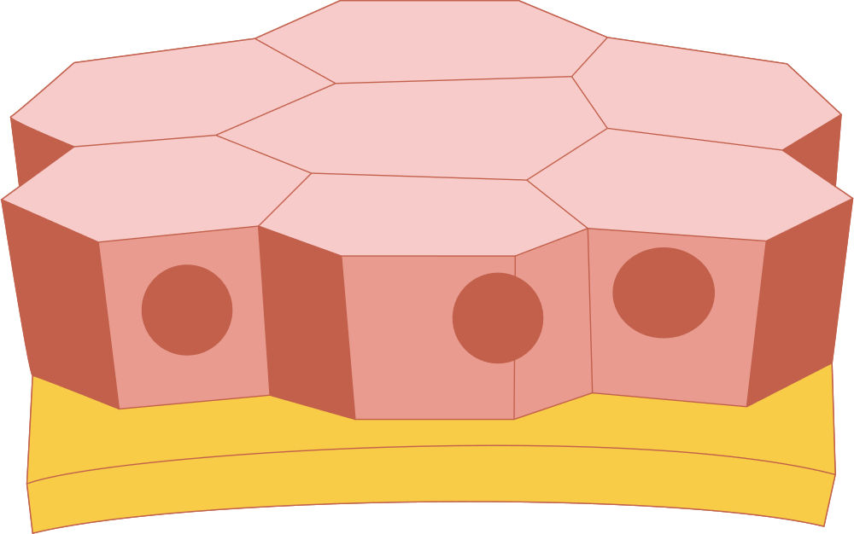
Enhanced Active Contour–Based Skin Lesion Segmentation and Ensemble Classification Using Gradient Boosting and Extra Trees
BY
HEMILA SARAVANAN-23MIA1048
LOKIREDDY MADHAVI-23MIA1135

Slide 2
MOTIVATION
Skin cancer, especially melanoma, is highly fatal if not detected early. Manual dermoscopic diagnosis is often subjective and time-consuming, leading to inconsistencies in detection. Automated segmentation and classification systems can provide accurate, consistent and early diagnosis support for clinicians.
PROBLEM STATEMENT
Existing skin lesion analysis methods struggle with low contrast, irregular boundaries and uneven illumination. They rely heavily on handcrafted features that fail to capture complex lesion patterns. Traditional classifiers like KNN and SVM offer limited performance in high-dimensional, non-linear feature spaces, highlighting the need for a more robust and adaptive approaches.

Slide 3
BASE PAPER SUMMARY
Base Paper:
“Active Contours Based Segmentation and Lesion Periphery Analysis for Characterization of Skin Lesions in Dermoscopy Images”
— Riaz et al., IEEE Journal of Biomedical and Health Informatics, 2019
Ideas from base paper:
The base work by Riaz et al. introduced the Kullback–Leibler Level Set (KL–LS) model for probabilistic active contour segmentation of skin lesions. The method accurately refined lesion boundaries by comparing intensity distributions inside and outside the contour. It employed Local Binary Pattern (LBP) and center-corrected LBP features for texture representation and used K-Nearest Neighbors (KNN) and Support Vector Machine (SVM) classifiers for lesion classification.
Limitations:
  It relied on limited texture features.
  It lacked robustness for high-dimensional data .
  It did not incorporate ensemble or feature-level fusion strategies, resulting in restricted accuracy and generalization.

Slide 4
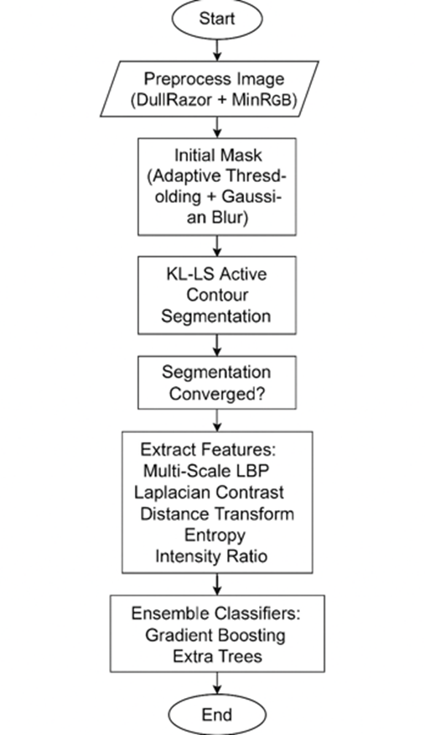
PROPOSED METHODOLOGY
The proposed system enhances segmentation and classification through a multi-stage pipeline:
  Preprocessing:
    Hair removal using DullRazor.
    MinRGB conversion for illumination correction.
    Adaptive threshold initialization.
  Segmentation:
    KL–LS active contour model to refine lesion boundaries using intensity PDFs.
  Feature Extraction:
    Multi-scale LBP for textural analysis.
    Laplacian Contrast for edge sharpness.
    Distance Transform for shape irregularities.
    Entropy for texture randomness.
    Intensity Ratio for color contrast.
  Classification:
    Ensemble learning using Gradient Boosting and Extra Trees classifiers.

Slide 5
EXPERIMENTAL SETUP
Datasets Used:
  PH2 Dataset: 200 dermoscopic images with labeled classes (common nevi, atypical nevi, melanoma).
  ISIC Dataset: Diverse real-world lesion images from multiple acquisition centers.
Tools & Libraries:
The system was implemented in Python, utilizing libraries such as OpenCV for image preprocessing and segmentation, scikit-learn for ensemble classification (Gradient Boosting and Extra Trees), NumPy and pandas for numerical computation and data management, and matplotlib and tqdm for visualization and performance tracking.
Evaluation Metrics:
  Accuracy (%) and ROC (%) metrics to measure classification efficiency and discriminative capability.
  visual comparisons of segmentation masks, feature maps, and periphery analysis were performed to qualitatively assess the performance.

Slide 6
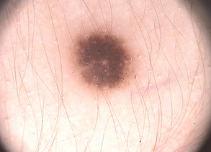
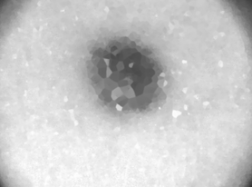
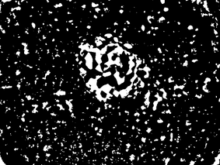
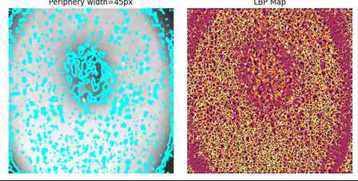

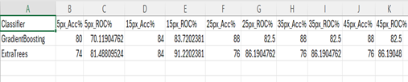
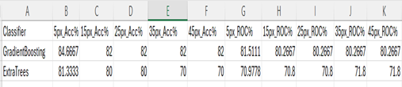
RESULTS AND VISUAL ANALYSIS
Image Outputs:
Original → Preprocessed → KL–LS Segmented Mask → Feature Extraction
Classification Metrics:
PH2 Dataset
ISIC Dataset

Slide 7
Key Findings
  KL–LS model provided precise boundary refinement even for irregular lesions.
  Multi-domain features (LBP, Laplacian contrast, distance transform, entropy, intensity ratio) significantly improved discriminative power.
  Ensemble classifiers outperformed KNN and SVM by ~10–15% in accuracy.
  PH2 dataset achieved the highest performance due to controlled acquisition conditions.
  ISIC results confirmed robust generalization across varied imaging environments

Slide 8
CONCLUSION AND FUTURE ENHANCEMENTS
Conclusion:
The proposed active contour–based segmentation with ensemble classification achieved superior performance in lesion analysis. Integration of multi-domain features with Gradient Boosting and Extra Trees resulted in improved accuracy, stability, and interpretability compared to traditional methods.
Future Enhancements:
  Incorporate deep CNN-based feature fusion with active contour initialization.
  Extend analysis to multi-class classification (benign, atypical, melanoma).
  Develop a real-time diagnostic application for clinical use.
  Explore explainable AI (XAI)-SHAP or LIME techniques for interpretability.

Slide 9
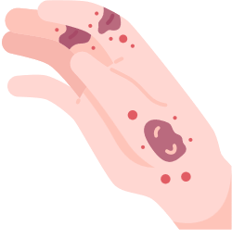

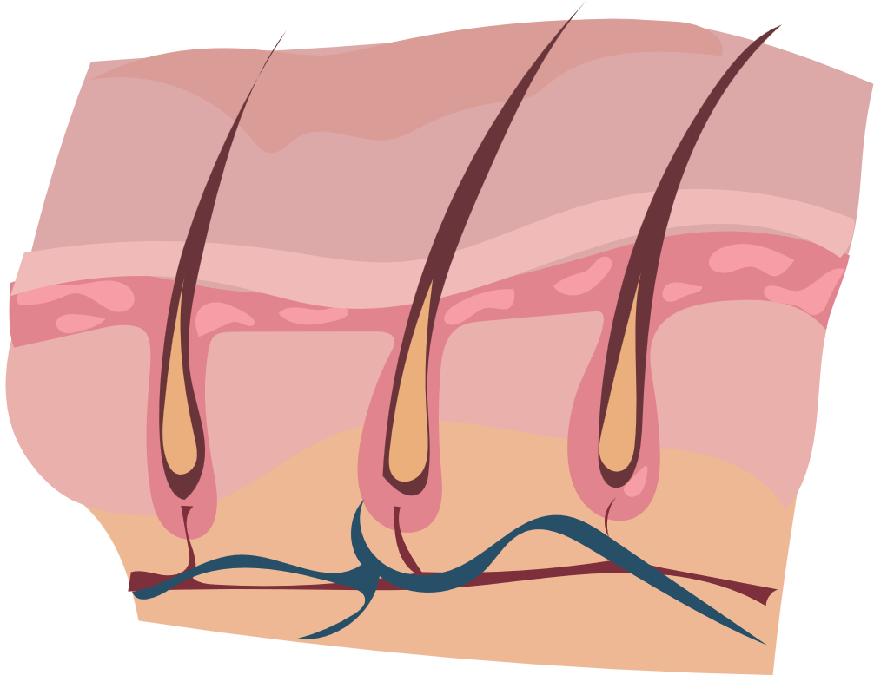
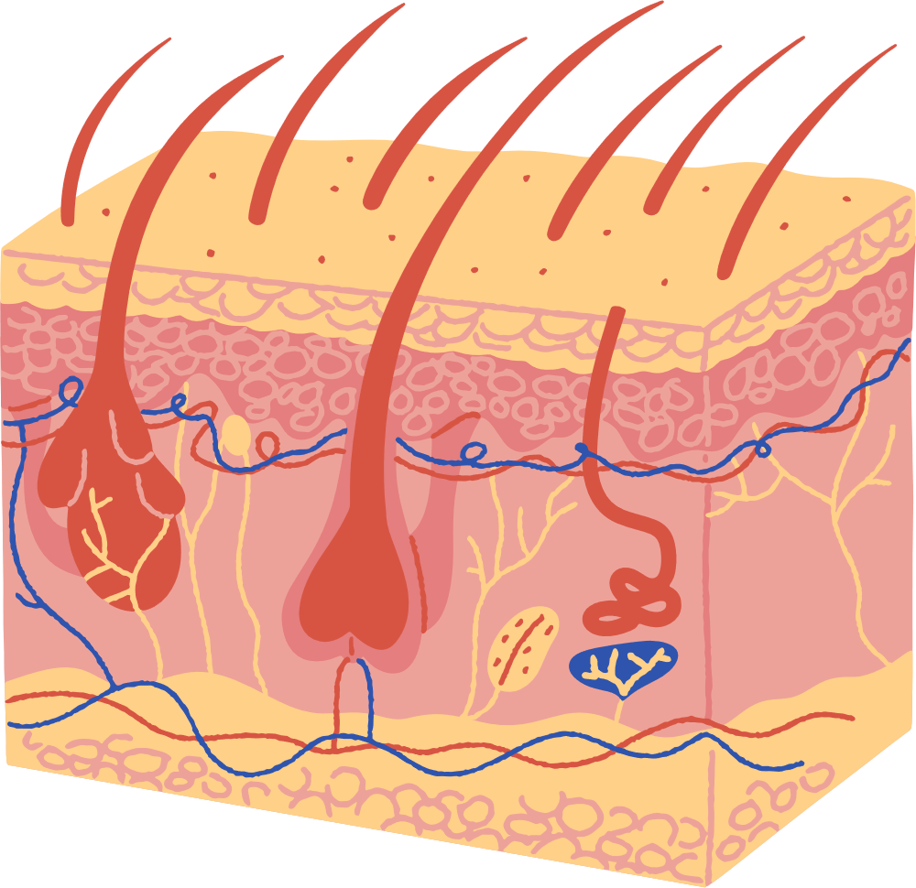
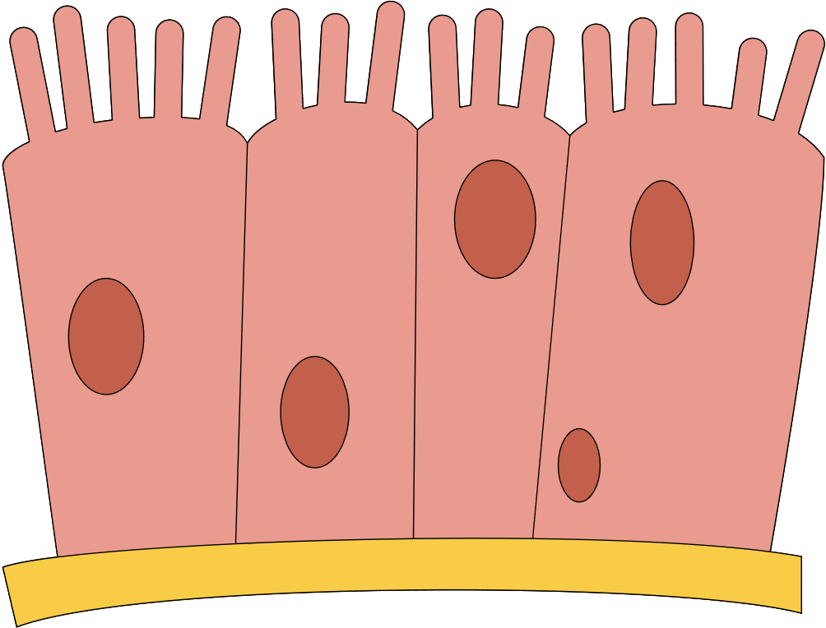
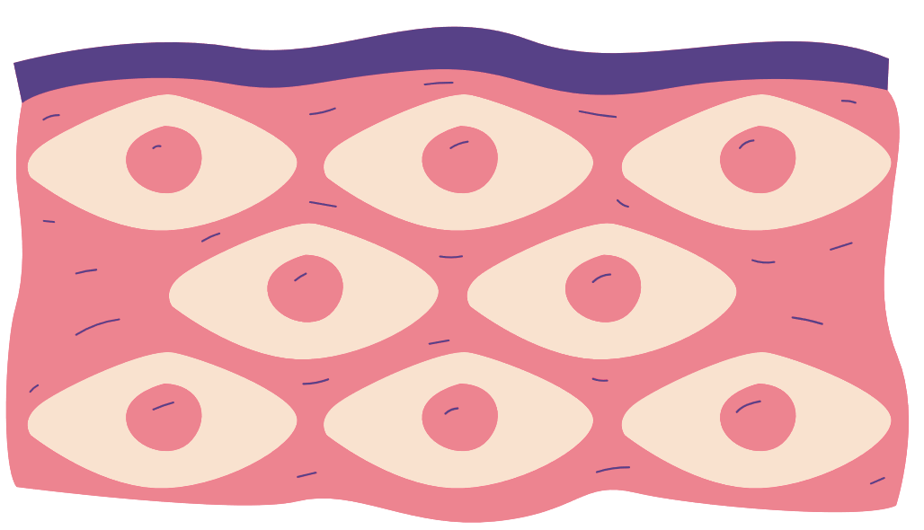
Thank You

