Slide 1

Recommender Systems
A Hybrid Explainable Framework for Context-Aware Consumer Complaint Resolution Recommendation Using Transformer Embeddings and Historical Case Retrieval
Hemila Saravanan - 23MIA1048
Lokireddy Madhavi – 23MIA1135

Slide 2
Problem Statement
  Financial institutions receive a large volume of consumer complaints, making complaint handling slow and resource-intensive.
  Existing NLP models mainly focus on complaint classification, sentiment analysis, and routing, but do not recommend appropriate resolutions based on historical complaint cases.
  Manual complaint resolution often leads to inconsistent decisions, longer response times, and reduced customer satisfaction.
  Therefore, an intelligent and explainable complaint resolution recommendation system is required to support faster and more accurate decision-making.

Slide 3
Objectives
  Develop an NLP-based framework to understand consumer complaint narratives.
  Integrate complaint text with structured complaint attributes for comprehensive analysis.
  Retrieve semantically similar historical complaints.
  Recommend the most appropriate resolution based on historical complaint cases.
  Provide explainable AI-based recommendations to improve transparency and decision support.

Slide 4
Novelty
  Intelligent Resolution Recommendation Instead of Complaint Classification
  Retrieval-Augmented Complaint Analysis
  Hybrid Complaint Representation
  Transformer-Based Semantic Understanding

Slide 5
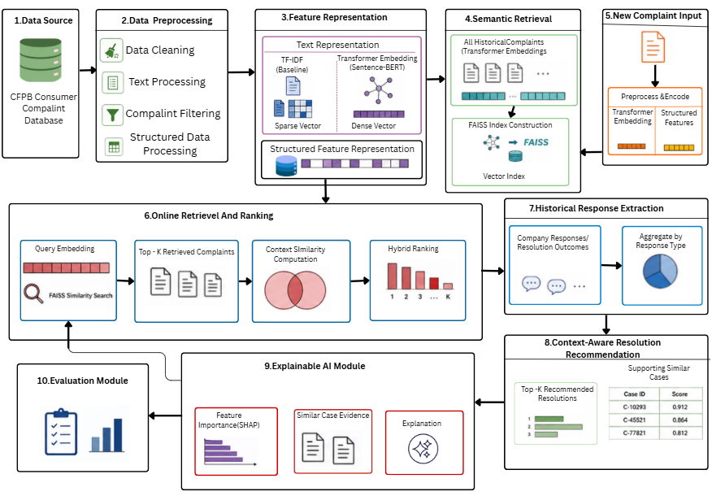
Methodology

Slide 6
Thank you

