Slide 1
Hybrid Edge-Aware Deep Learning Framework for Rooftop Solar Potential Assessment
23MIA1048- Hemila saravanan
23MIA1162- Samyuktha s

Slide 2
Abstract
The increasing demand for renewable energy has highlighted the importance of efficiently identifying suitable locations for rooftop solar photovoltaic (PV) installations. Traditional rooftop assessment methods rely on manual inspections, which are time-consuming, expensive and impractical for large-scale deployment. This project proposes an automated rooftop solar potential assessment system that combines classical image processing techniques with deep learning-based semantic segmentation to analyze high-resolution aerial imagery. Initially, preprocessing techniques including Gaussian filtering, median filtering, Contrast Limited Adaptive Histogram Equalization (CLAHE) and normalization are applied to improve image quality. Classical feature extraction methods such as Canny edge detection, adaptive thresholding, contour detection, and morphological operations are employed to enhance structural information. A deep learning segmentation model, such as U-Net or DeepLabV3+, is then used to accurately identify rooftop regions. Based on the segmented rooftops, geometric properties including rooftop area, orientation, shadow coverage and obstacle presence are estimated to compute a Solar Suitability Score that reflects the feasibility of photovoltaic installation. The proposed system provides an efficient, scalable and cost-effective solution for urban solar resource assessment supporting sustainable energy planning and accelerating the adoption of renewable energy technologies.

Slide 3
Introduction
Rooftop solar installation depends on several physical factors such as roof area, orientation, shadows and obstacles.
Manual rooftop assessment is time-consuming and difficult to perform consistently for a large number of buildings.
This project proposes an automated image-based rooftop solar suitability analysis system.
The system combines classical image processing and deep learning-based semantic segmentation.
Extracted rooftop features are fused to generate a solar suitability score, category, and installation recommendation.

Slide 4
Objectives
Image Processing & Segmentation Objectives
To organize and preprocess aerial rooftop images for reliable analysis.
To reduce image noise while preserving important rooftop structures.
To enhance local contrast under varying illumination and shadow conditions.
To extract rooftop boundaries and structural features using edge-aware image processing.
To develop a hybrid segmentation approach combining classical image processing with deep learning.
To obtain refined rooftop and obstacle masks for further analysis.

Slide 5
Objectives
Rooftop Analysis & Solar Suitability Objectives
To estimate physical rooftop area using rooftop pixels and Ground Sampling Distance (GSD).
To determine roof orientation using geometric methods such as bounding rectangles and PCA.
To identify and quantify shadow coverage within rooftop regions.
To analyze rooftop obstacles that may affect solar installation.
To generate normalized suitability scores for area, orientation, shadow and obstacles.
To calculate an overall 0–100 solar suitability score and provide an automated installation recommendation.

Slide 6
Methodology
Image Processing & Hybrid Segmentation
1. Data Preparation & Preprocessing
Organize aerial images and rooftop masks.
Train / Validation / Test split.
Gaussian + Median filtering for noise reduction.
CLAHE for contrast enhancement.
Intensity normalization.
I_norm = (I - I_min) / (I_max - I_min)
2. Edge-Aware Feature Extraction
Canny edge detection
Adaptive thresholding
Morphological operations
Contour detection
G = √(G_x² + G_y²)
3. Hybrid Roof & Obstacle Segmentation
Classical branch → structural/boundary information.
Deep-learning branch → rooftop semantic information.
Combine both outputs → Refined Hybrid Rooftop Mask.
Segmentation evaluated using IoU.
IoU = |P ∩ G| / |P ∪ G|

Slide 7
Methodology​
Rooftop Analysis & Solar Suitability Assessment
4. Geometric & Environmental Analysis
Calculate rooftop area using pixel count and GSD.
Estimate roof orientation using bounding geometry / PCA.
Detect and quantify shadow regions.
Analyze obstacle coverage.
A_roof = N_pixels × GSD²
Shadow Coverage = (N_shadow / N_roof) × 100
5. Solar Suitability Assessment
Generate normalized:
  Area Score
  Orientation Score
  Shadow Score
  Obstacle Score
Combine scores using predefined weights.
S = w_A × A + w_O × O + w_S × S_h + w_B × B
w_A + w_O + w_S + w_B = 1
Final Score ∈ [0, 100]
Final Output:
Suitability Score → Suitability Category → Automated Recommendation

Slide 8
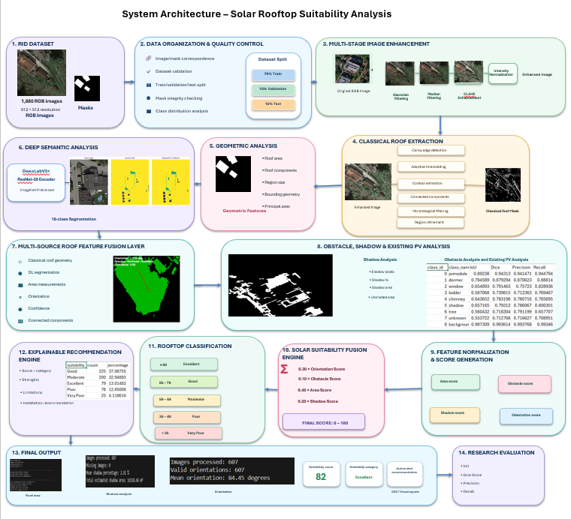
System Architecture

Slide 9

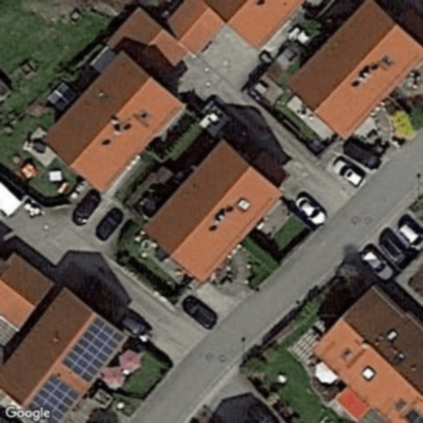
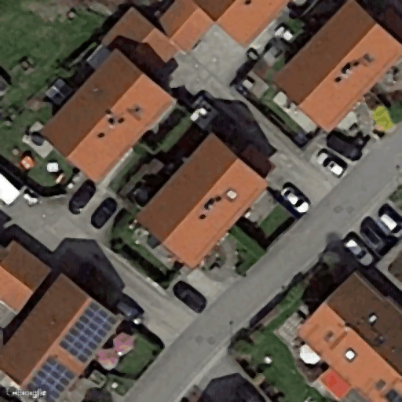
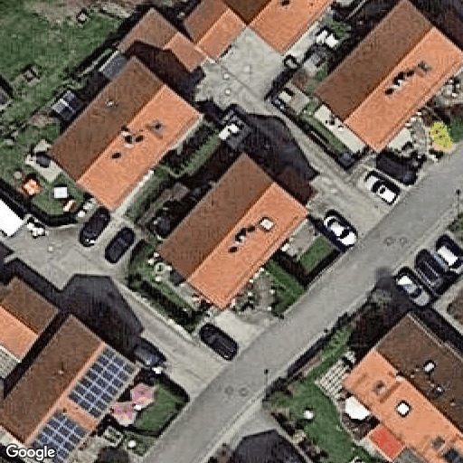
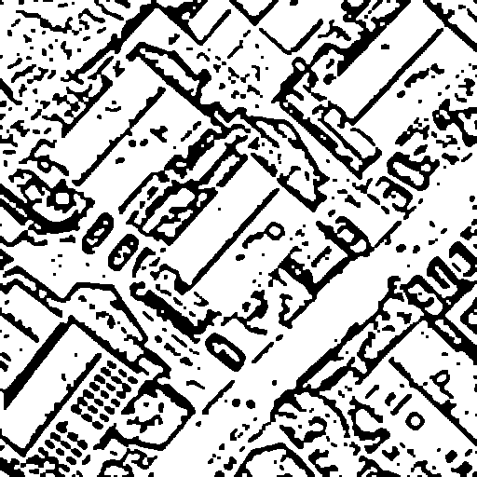
OUTPUT
GROUND TRUTH
GAUSSIAN FILTERING
MEDIAN FILTERING​
CLAHE FILTERING​
ADAPTIVE THRESHOLDING​

Slide 10
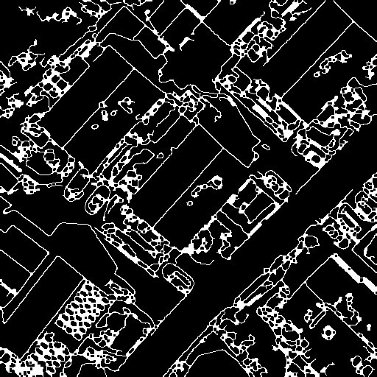
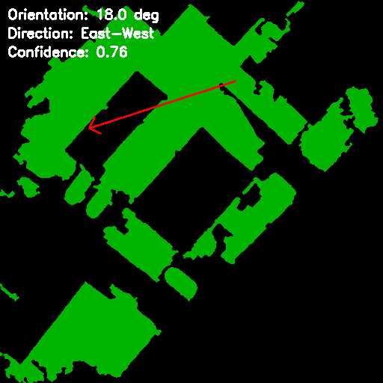
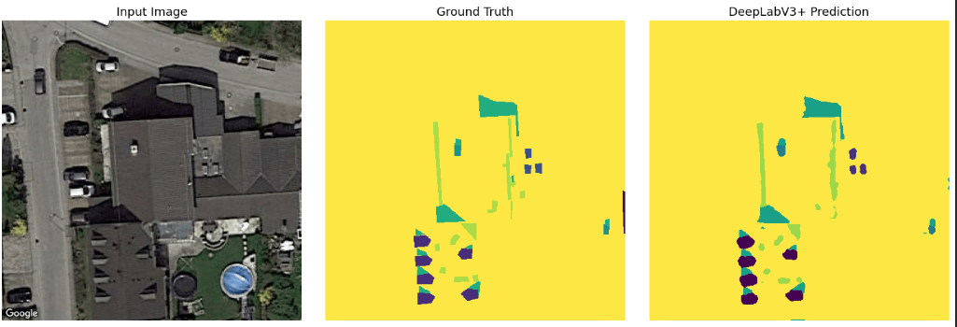
OUTPUT
CANNY EDGE
ROOF ORIENTATION​
SEGMENTATION

Slide 11
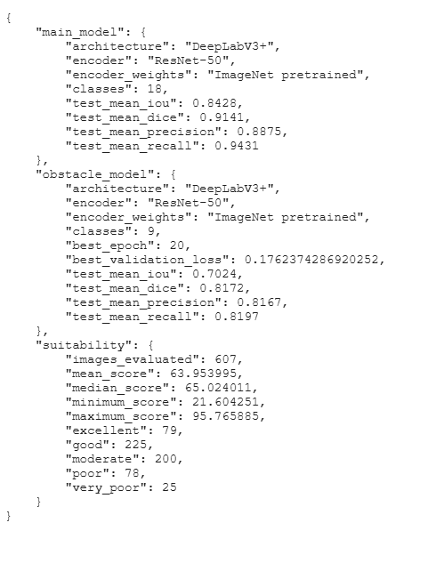
CONCLUSION
Rooftop regions successfully identified through hybrid segmentation.
Geometric and environmental parameters extracted from rooftop regions.
Solar suitability calculated using weighted feature fusion.
Final output provides an interpretable suitability score and recommendation.

