Slide 1
Prepwise
By:
Tushar Vimalbhai Patel
Het Parikh
Hemin Patel
Meet Patel
A GRE Preparation Platform

Slide 2
About Prepwise
Prepwise is an innovative online platform designed to aid students in preparing for the GRE exam. Our platform is structured to cover various aspects of the GRE, offering practice questions, learning tools, and mock tests to ensure comprehensive preparation. With modules dedicated to both Quantitative Reasoning and Verbal Reasoning, Prepwise is your go-to resource for mastering the GRE.

Slide 3
Tech. Stack
Frontend
ReactJS – A powerful JavaScript library for building user interfaces, ensuring a responsive and dynamic experience for users.
Backend
NodeJS/Express – A JavaScript runtime for building scalable and fast backend services.
Database
MongoDB – A NoSQL database that allows for flexible data storage and quick retrieval of user data, practice questions, and test results.

Slide 4
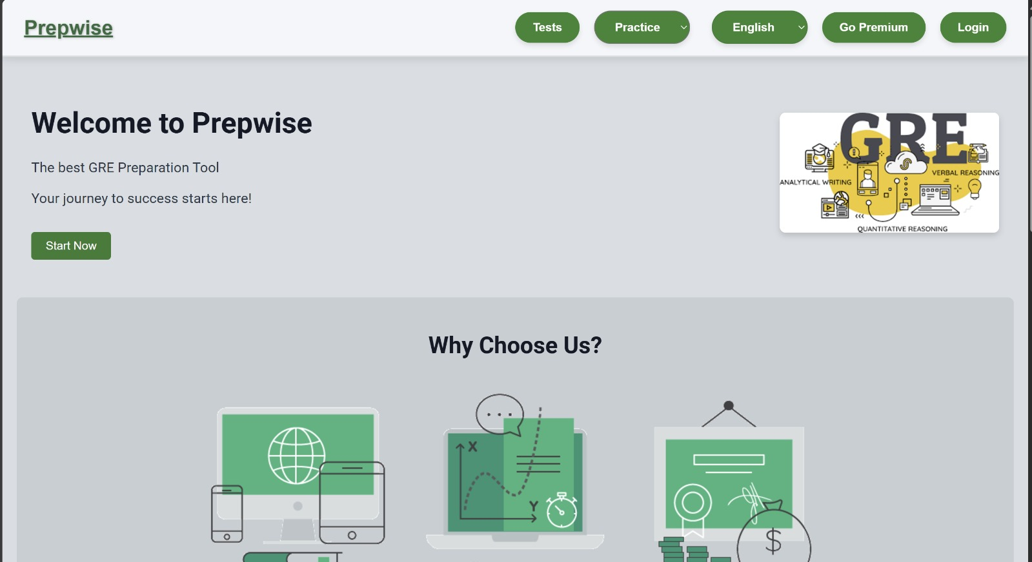

Slide 5
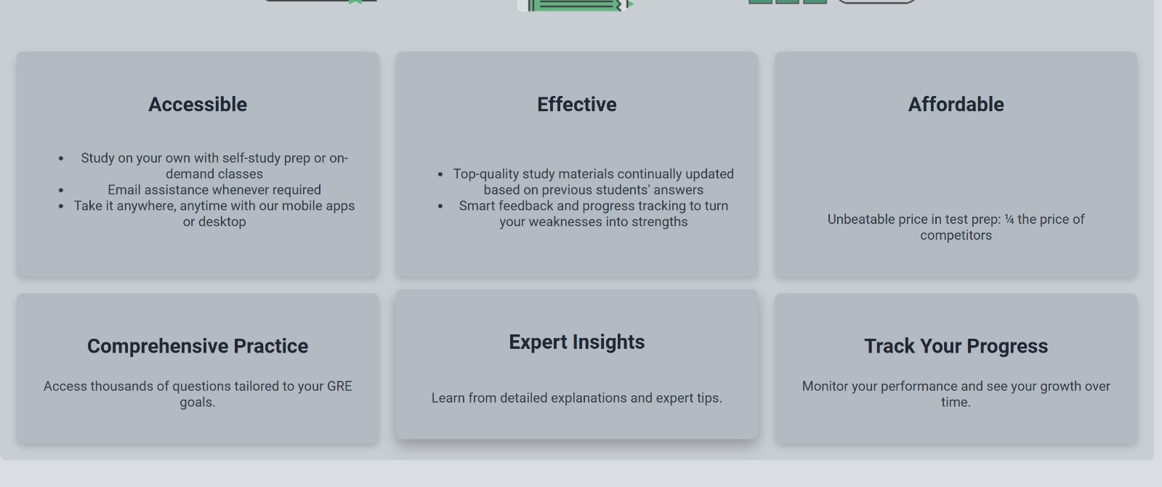

Slide 6
Key Features
Quantitative Reasoning Module: This module contains a wide range of practice questions focused on the Quantitative Reasoning section of the GRE. It provides users with interactive problem-solving exercises and detailed explanations to help improve their math skills and problem-solving strategies.
Verbal Reasoning Module: Designed to enhance verbal reasoning abilities, this module includes practice questions focused on the verbal section of the GRE. It helps users sharpen their vocabulary, reading comprehension, and Sentence Completion.

Slide 7
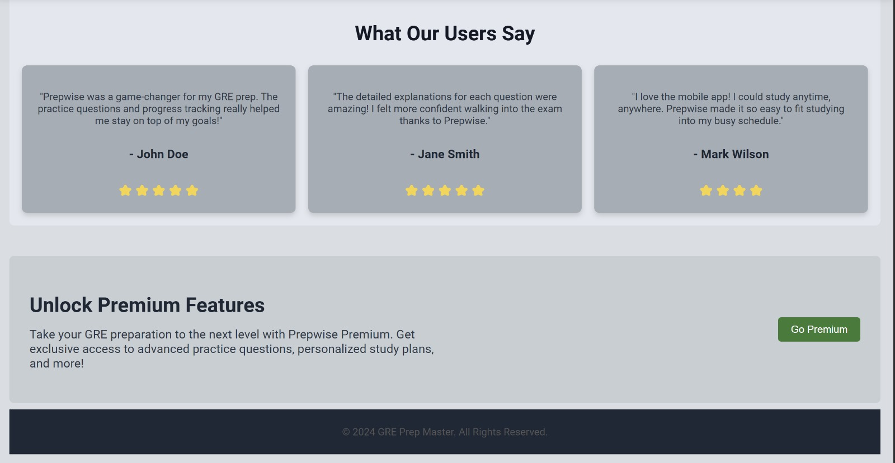

Slide 8
Key Features
Flashcards Section: A valuable learning tool for memorizing vocabulary and solving quantitative problems. This section allows users to study GRE-related vocabulary through flashcards and simultaneously work on quant questions, reinforcing both areas of study.
GRE Simulation Tests: Prepwise offers full-length practice tests that simulate the real GRE exam environment. These tests are designed to give users a sense of the timing and structure of the actual exam. For premium users, we provide detailed score analysis, offering insights into their potential GRE scores and suggestions for areas that need improvement.

Slide 9
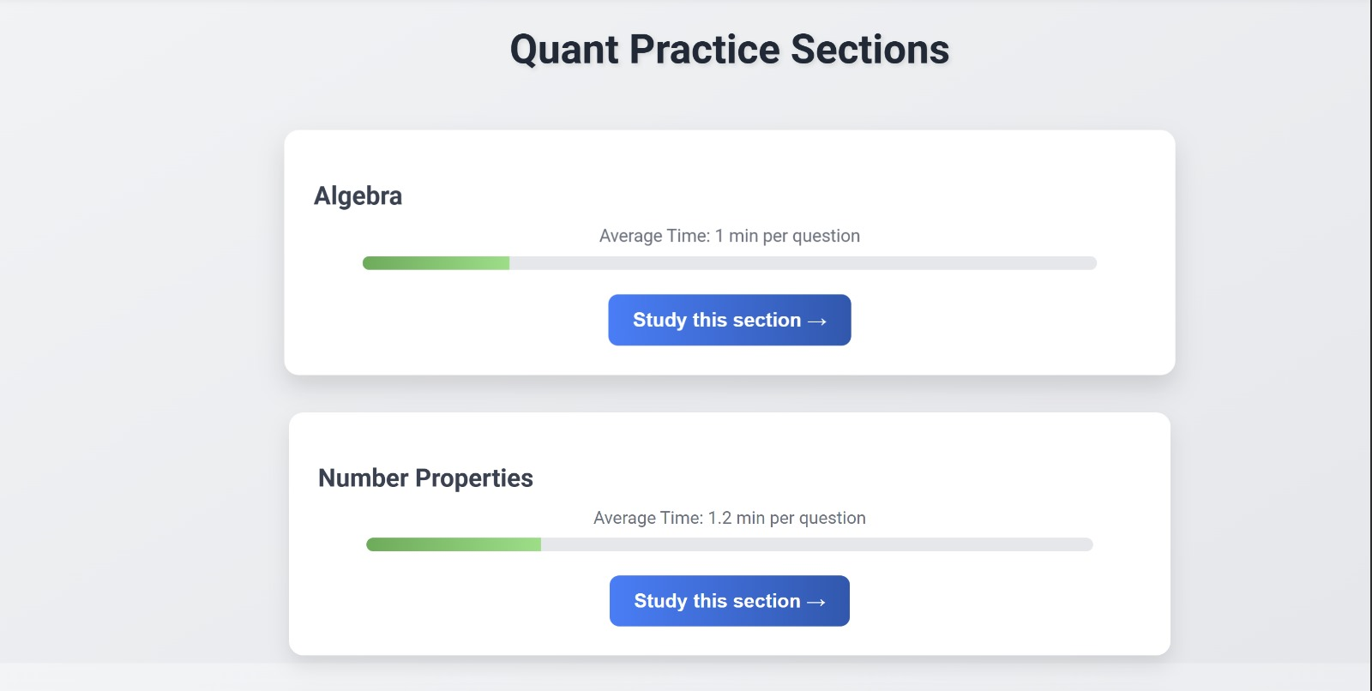

Slide 10
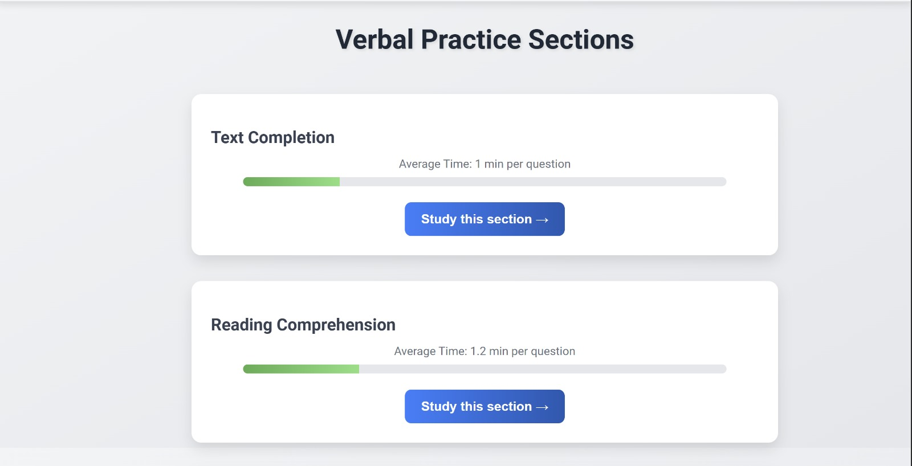

Slide 11
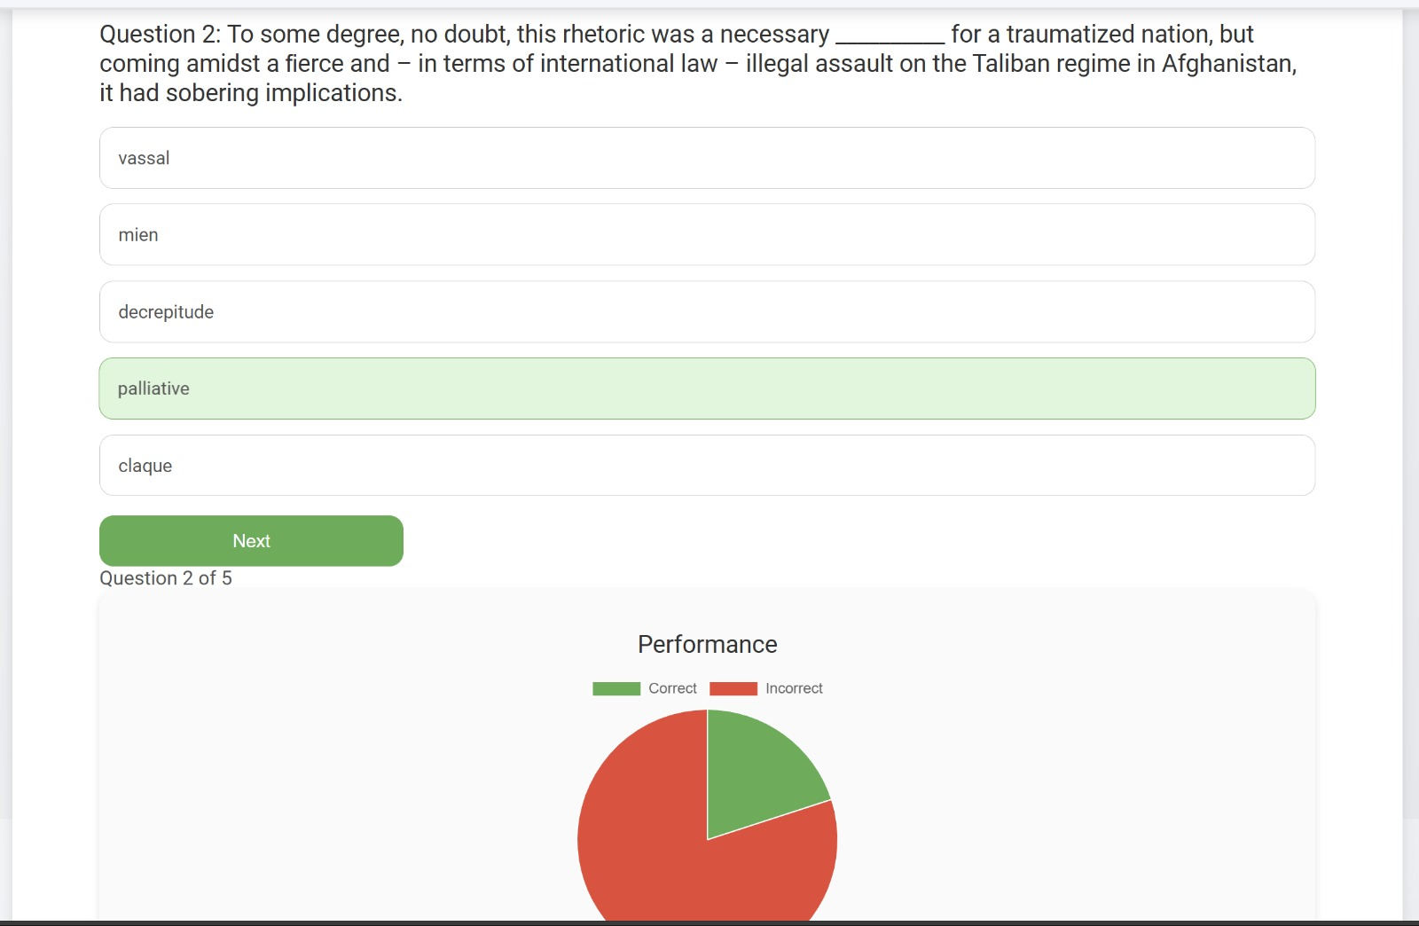

Slide 12
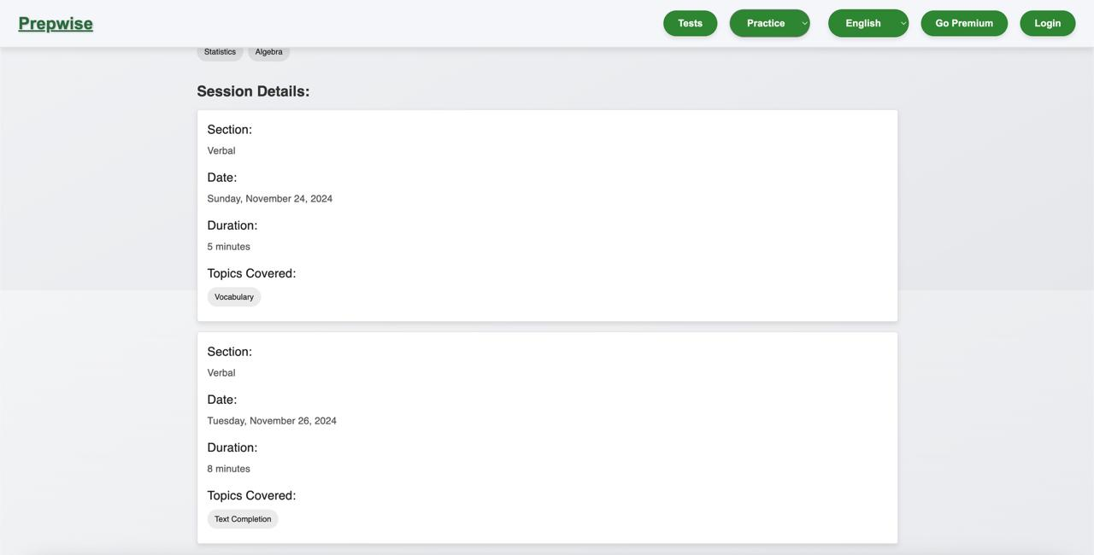

Slide 13
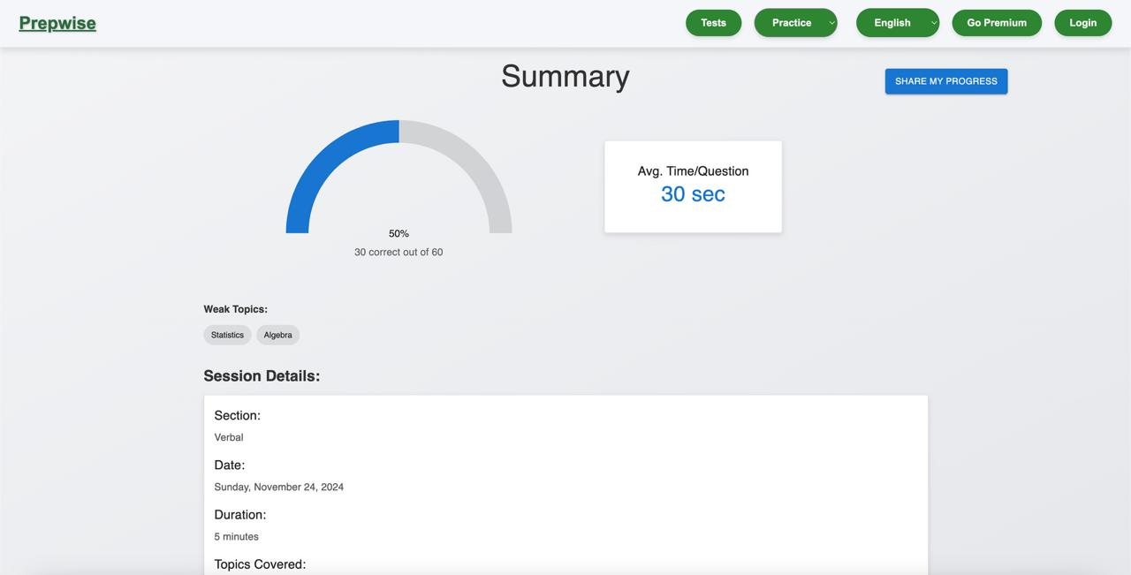

Slide 14
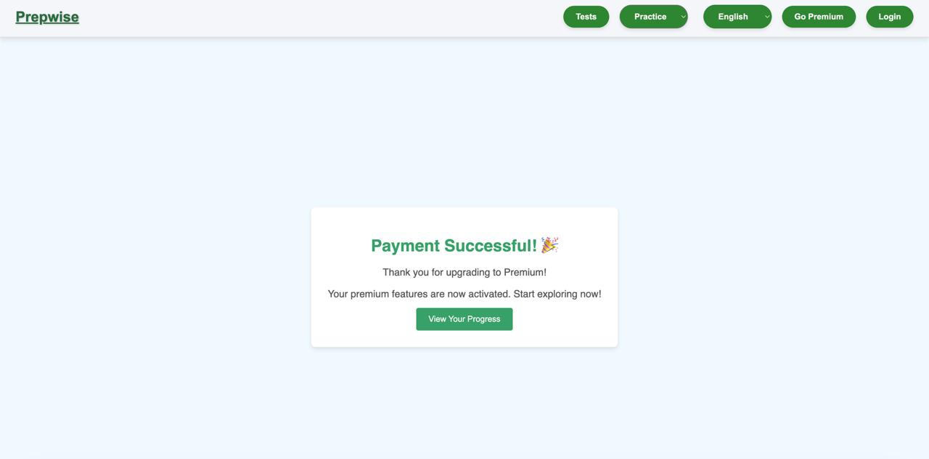

Slide 15
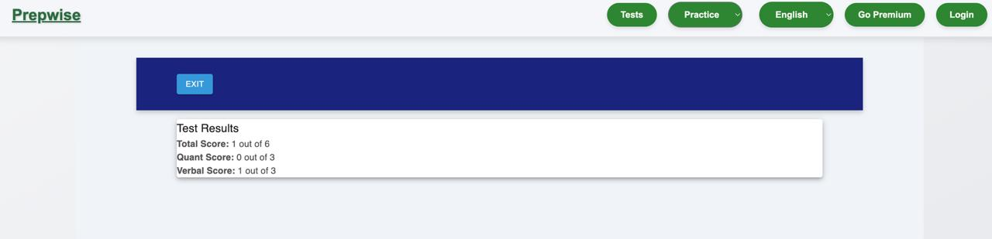

Slide 16
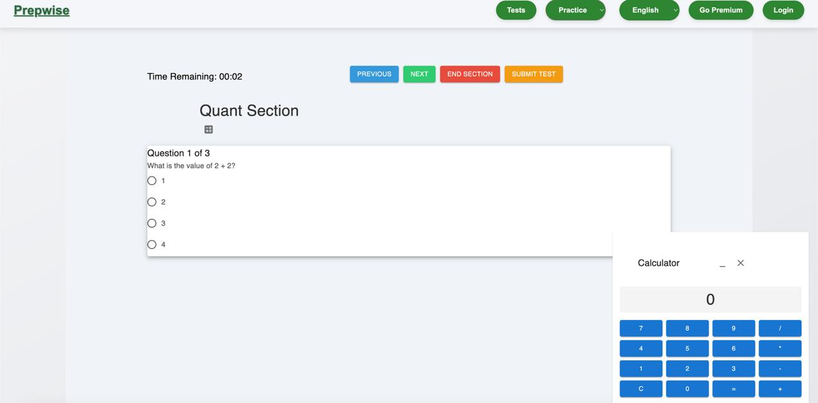

Slide 17
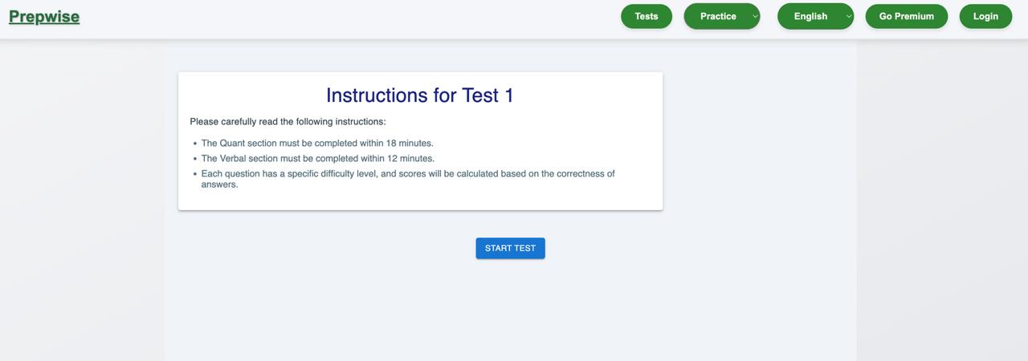

Slide 18
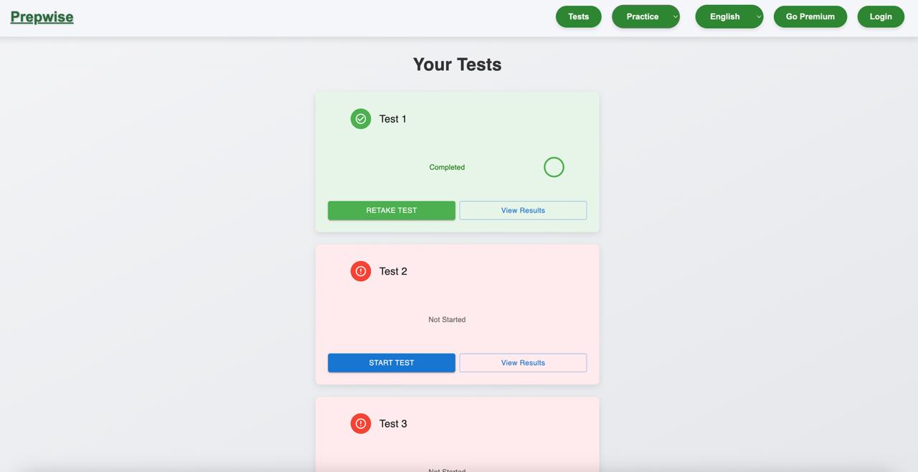

Slide 19
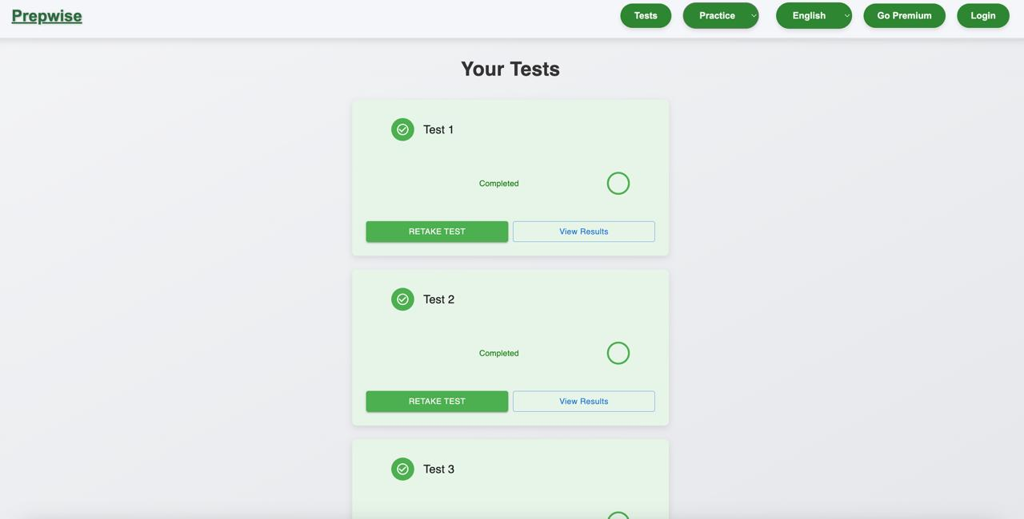

Slide 20
Premium User Features
Score Analysis:
Premium users gain access to in-depth score analysis after completing practice tests. This feature provides a breakdown of performance in each section, predicts final GRE scores, and offers tailored recommendations for improving weak areas.

Slide 21
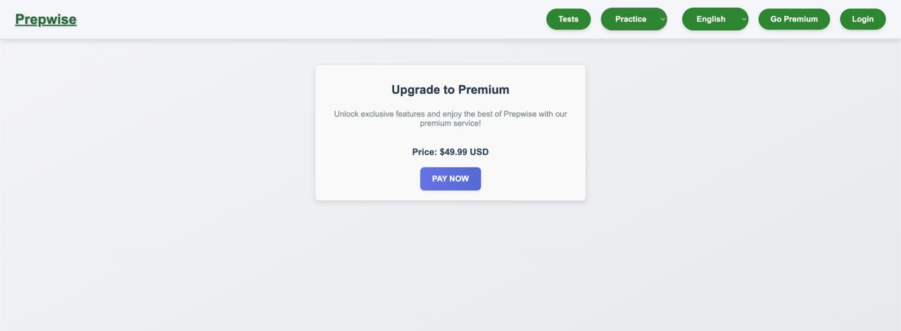

Slide 22
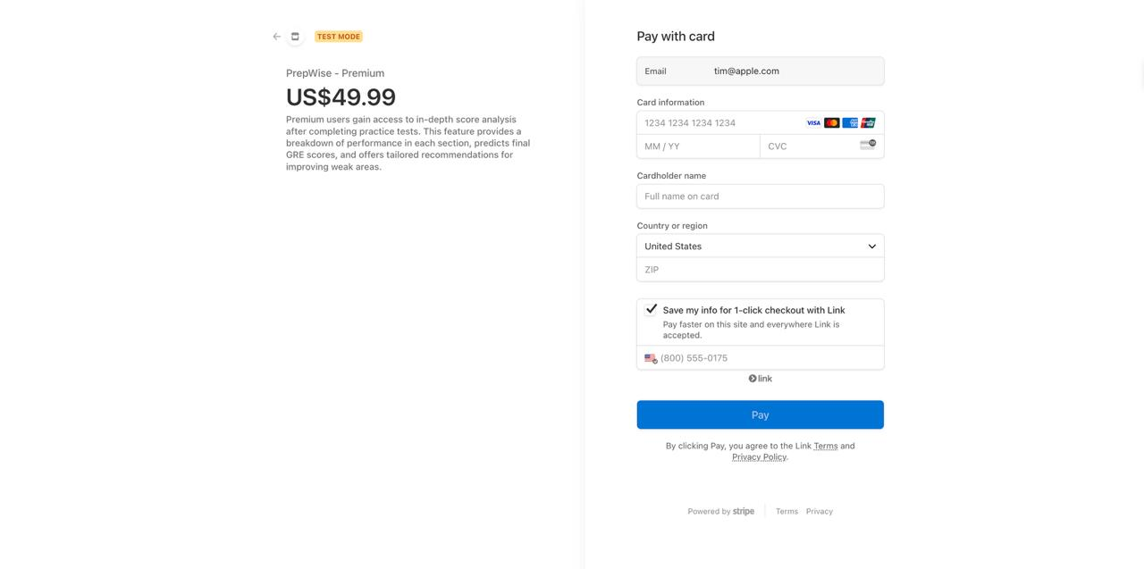

Slide 23
Thank You

