Slide 1
Capstone Project :
The Battle of Neighborhoods
By : Heminkumar Modi

Slide 2
Client interested in starting a restaurant in the best locality of all the cities in United states. Location defines a best locality based on the following constraints:
1: Population density of a locality
2: Per Capital income
3: Population of each location
4: Venues in each locality
The category of the venues that he's interested in are: a: Food b: Entertainment Shops & Service c: College and University Event d: Travel & Transport
Introduction

Slide 3
Data source
List of all the cities in United States with population density and coordinates:
Link:https://en.wikipedia.org/wiki/List_of_United_States_cities_by_population
List of all the cities in United States with Per Capita Income:
Link:https://en.wikipedia.org/wiki/List_of_United_States_counties_by_per_capita_income
Four Square API: https://foursquare.com

Slide 4
Methodology
To do the analysis and suggest the best location, following are the steps we have to follow:
The Wikipedia page (https://en.wikipedia.org/wiki/List_of_United_States_cities_by_population) was scraped using the BeautifulSoup library to build a pandas dataframe listing the cities, states, coordinates, area and population density. The dataframe was cleaned and processed appropriately.
The Wikipedia page (https://en.wikipedia.org/wiki/List_of_United_States_counties_by_per_capita_income) was scraped using the BeautifulSoup library to build a pandas dataframe listing the cities, states and precipitate income. The dataframe was cleaned and processed appropriately.
The Foursquare API used to get the venues in each city of United States
Based on the categories of each venue as decided by the Client, assigned weights to each of them and got the city that has the maximum weight.
Once the city is finalized, again use Four Square API to get the venues within that city and assign weights to each category.
Use K means to cluster the venues based on the category and get the coordinates of the cluster that has maximum weight which is also our preferred location to setup a restaurant.

Slide 5
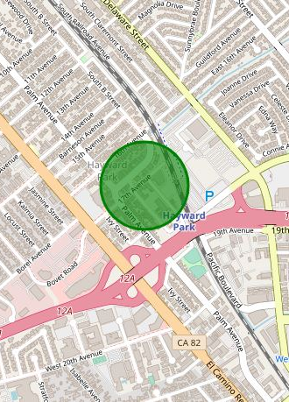
result
State: California
City: San Mateo
Location: Between 17th Avenue and Palm Avenue

Slide 6
Recommendations & improvement
In the Four-Square API, we have queried the Venues of a locality by specifying the LIMIT and Radius of our choice. We have chosen less LIMIT as the number of API calls that can be done using a free account in Four Square are less. We can increase the limit for more accurate results.
In the venue categories we are choosing only few out of 2000 that are available to give weights and identify the best cluster. Hence, assigning weights must be done relatively for each category and then considering a greater number of venue categories would actually yield better output

Slide 7
THANK YOU

