Slide 1
Applying Machine and Deep Learning to Cybersecurity
By Hemlata

Slide 2
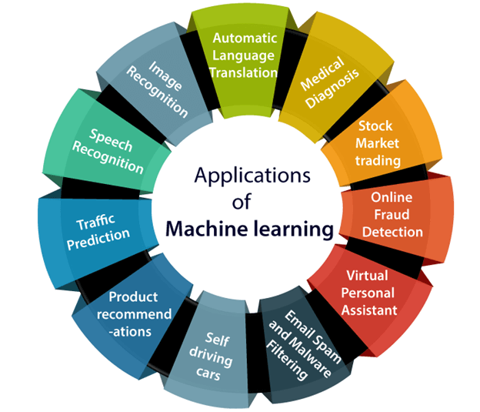
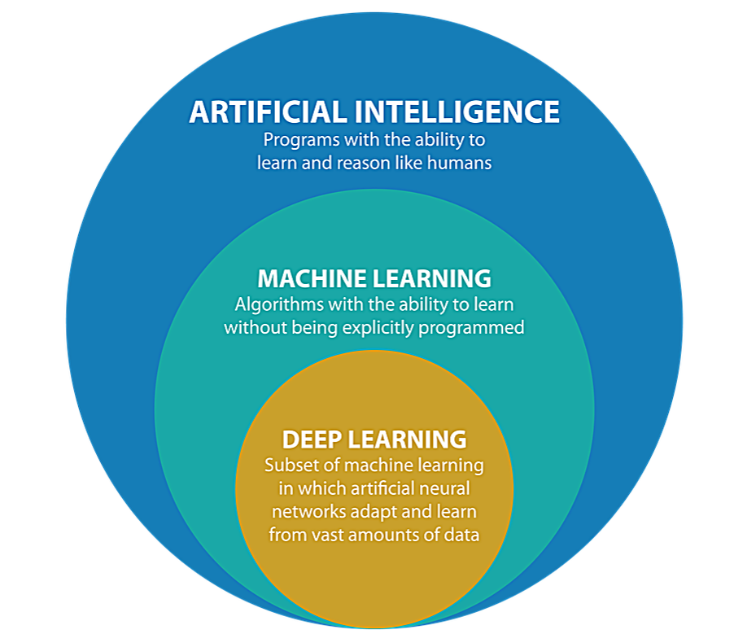
Introduction to Artificial Intelligence

Slide 3
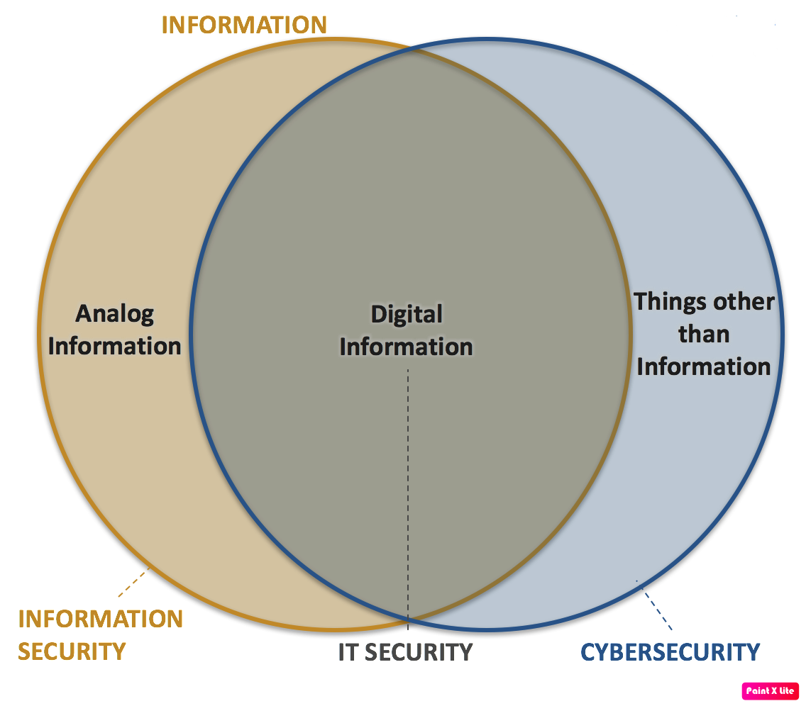
CYBERSECURITY
The ability to protect or defend the use of cyberspace from cyber attacks.
protect information from unauthorized access, use, disruption, modification or destruction, regardless of whether the information is stored electronically or physically.
(set of technologies and processes designed to protect computers, networks, programs and data from attacks and unauthorized access, alteration, or destruction)
(concerned with the systems that store, process, transfer and make available electronic data)

Slide 4
CYBER SECURITY ASPECTS
Area of
Focus
Network Intrusion Detection
Malicious URL Detection
Spam Email Detection
Image Spam Detection
Malware Analysis
Domain Generation Algorithms

Slide 5
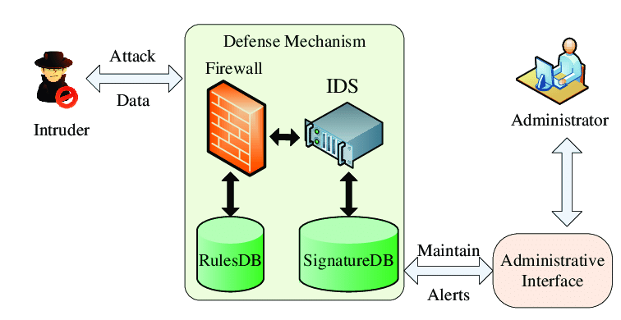
NETWORK INTRUSION DETECTION
Points to cover:
What is Intrusion Detection System and how it works?
What is Network Intrusion Detection System?
What is Host Intrusion Detection System
IDS vs FIREWALL
Why ML/DL in IDS?
Most techniques used in today's IDS are not able to deal with the dynamic and complex nature of cyber attacks on computer networks.
Hence, efficient adaptive methods like various techniques of machine learning can result in higher detection rates, lower false alarm rates and reasonable computation and communication costs.

Slide 6
MALICIOUS URL DETECTION

Slide 7
How to Apply AI to IDS and URL Analysis
Artificial Intelligence methods primarily includes the following four steps:
Useful Dataset Creation/Collection
Feature Engineering/ Extraction
Appropriate algorithm Selection: KNN, SVM, Decision Tree, Bayes, DBM, CNN, and LSTM.
Train and evaluate model performance. (For different algorithms, evaluate and select the best performing model.)
Use the trained model to classify or predict the unknown data.

