Slide 1
Data Science Project
Predicting the outcome of soccer games

Slide 2
Agenda
Data Set
Technique
Actual State
Notes:
All

Slide 3
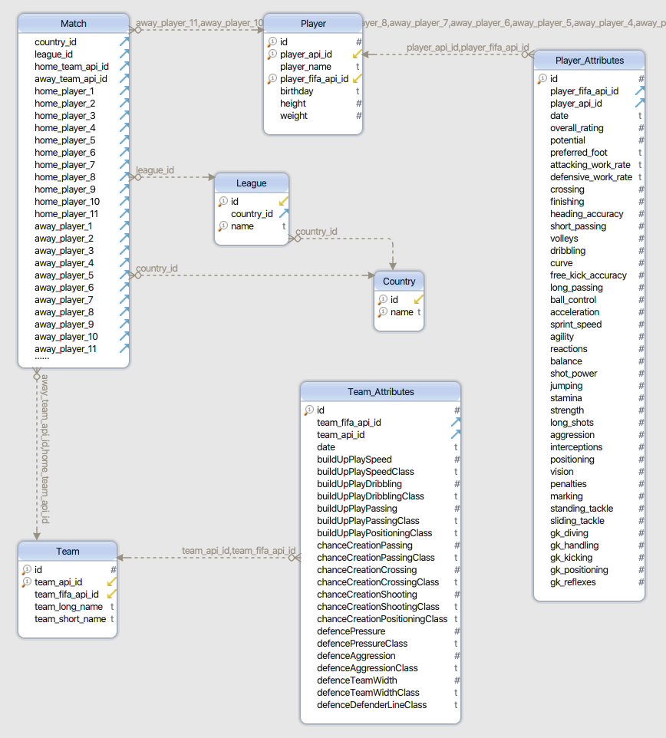
Data Set

Slide 4
Technique
Python
Tensorflow

Slide 5
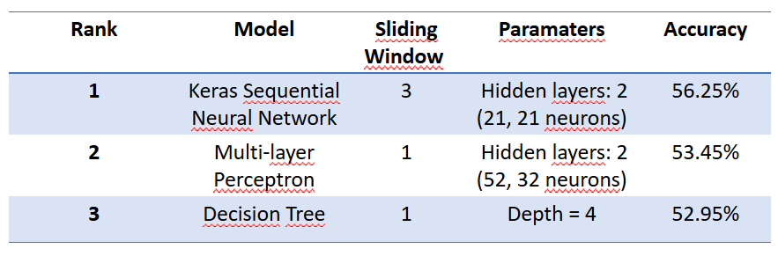
Actual State

Slide 6
Thank you for your attention!

