Slide 1
Data Science Project
Predicting the outcome of soccer games

Slide 2
Agenda
Notes:
All

Slide 3
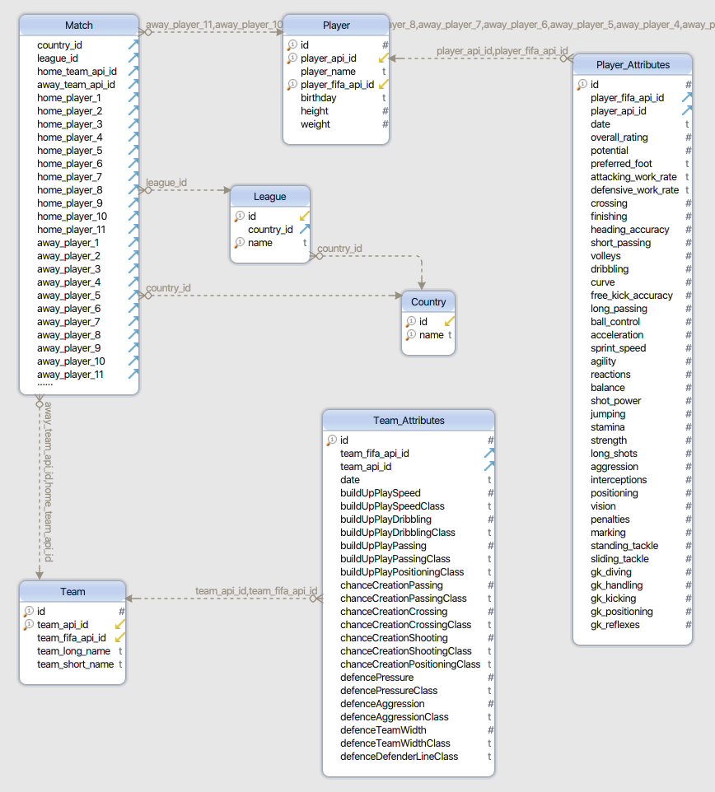
1. Data Profiling
Notes:
Sergej

Slide 4
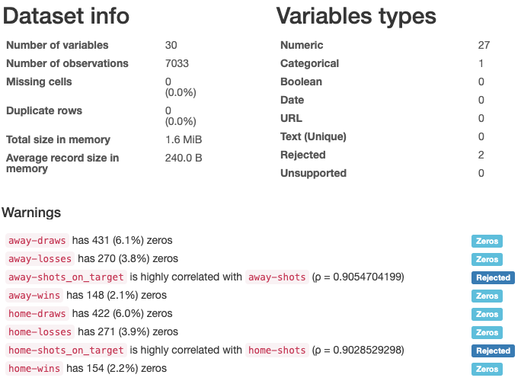
1. Data Profiling
Notes:
Sergej

Slide 5
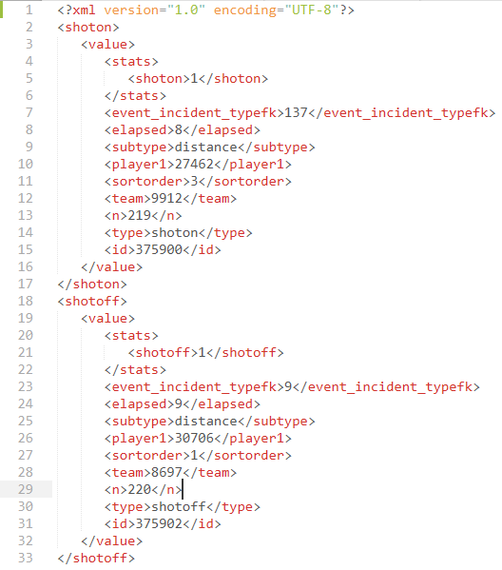
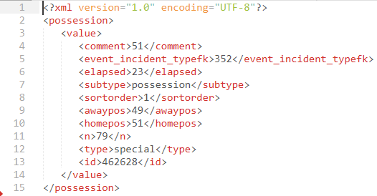
2. Data Pre-Processing - Feature Extraction
Notes:
Martin

Slide 6
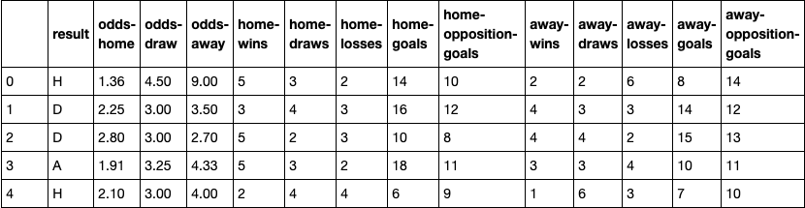
2. Data Pre-Processing - Sliding Window Option 1
Notes:
Sergej

Slide 7
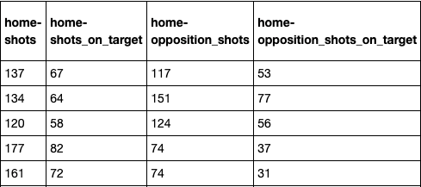
2. Data Pre-Processing - Sliding Window Option 2
Notes:
Sergej

Slide 8
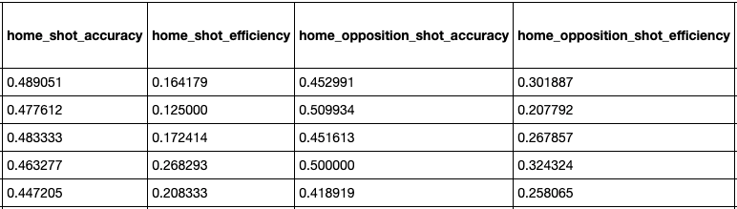
2. Data Pre-Processing - Sliding Window Option 3
Notes:
Sergej

Slide 9
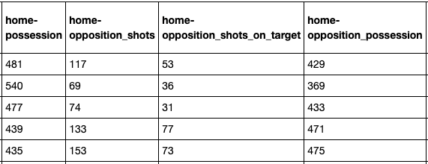
2. Data Pre-Processing - Sliding Window Option 4/5
Notes:
Sergej

Slide 10
3. Modeling
Select Modeling Techniques
Supervised Machine Learning Algorithms: Multi-class classification
Decision Tree and Neural Networks
Generate Test Design
Data Splitting:
Training set (70%) and test set (30%) not shuffled
Test set (5%), Training set (80% of the remaining 95%) and Validation set (20% of the remaining 95%)
Strategy to Stop: Automated stop (0.001 loss improve or 1000 epochs)
Test Criteria: Accuracy
Notes:
Khaled, Lisa

Slide 11
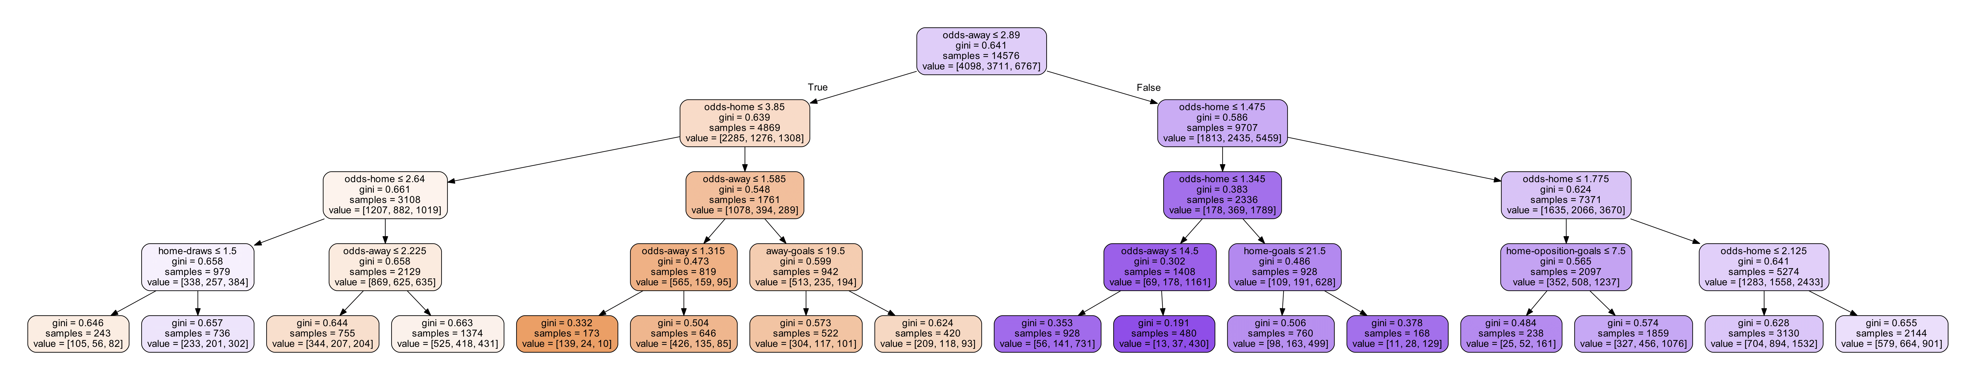
3. Modeling
3. Build Models
Decision Tree
Dataset: First sliding window option (13 features)
Depth of the tree: 4
Accuracy: 52.95%
Notes:
Khaled, Lisa

Slide 12
3. Modeling
Multi-layer Perceptron
Dataset: First sliding window option (13 features)
Hidden layers: 2(52,32 neurons)
Output layer: 3 neurons
Activation functions: sigmoid and softmax
Optimizer: stochastic gradient descent
Accuracy: 53.45% for training dataset and 52.77% for testing dataset
Notes:
Khaled, Lisa

Slide 13
3. Modeling
Keras Sequential Neural Network
Different depths: from 1 to 4 hidden layers
Activation functions: ReLU and Softmax(last layer, multi-class classification)
Optimizer: Adam
Optimizations: gradual reduction of learning rate, batch size optimized for GPUs, patience of 200 epochs
Loss function: Sparse Categorical Crossentropy (due to class-encoding)
Regularization techniques : weight regularization (L2) and/or dropout
Accuracy: 56.25%
Notes:
Sergej

Slide 14
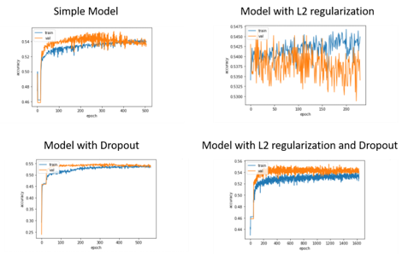
3. Modeling
The history of the accuracy of several models with different parameters
Notes:
Sergej

Slide 15
3. Modeling
Models with different regularization techniques
Notes:
Sergej

Slide 16
3. Modeling
Models with different amount of hidden layers and neurons per layer
​
Notes:
Martin

Slide 17
3. Modeling
Models with different amount of hidden layers and neurons per layer​
Notes:
Martin

Slide 18
3. Modeling
Models with different amount of hidden layers and neurons per layer​
Notes:
Martin

Slide 19
3. Modeling
Models with different amount of hidden layers and neurons per layer​
Notes:
Martin

Slide 20
3. Modeling
Models with different amount of hidden layers and neurons per layer​
Notes:
Martin

Slide 21
4. Evaluation
Notes:
Khaled, Lisa

Slide 22
5. Conclusion & Outlook
Notes:
Khaled, Lisa

Slide 23
Thanks for your attention!
Notes:
All

