Slide 1
Data Science Project
Geocoding/Routing with Pelias and Valhalla
Predicting the outcome of soccer games

Slide 2
Agenda
Geocoding with Pelias and routing with Valhalla
Our Tasks
Results
Open Tasks
Predicting the outcome of soccer games
Goals
Data Profiling
Data Pre-Processing
Modeling
Evaluation
Conclusion & Outlook
Notes:
All

Slide 3
Geocoding/ Routing with Pelias and Valhalla
Notes:
Martin, Sergej

Slide 4
1. Our Tasks
Virtual infrastructure:
Setup a virtual machine
Install and configure Pelias and Elasticsearch
Install and test routing engines
Data acquisition and preparation:
Gather postcode data of Europe from different sources
Merge the postcode data into a single custom source (Pelias/Elasticsearch)
Calculate 2-digit postcode centroids from the custom dataset
Notes:
Martin

Slide 5
1. Our Tasks
Geocoding and routing:
Test geocoding with Pelias based on the prepared 2-digit postcode centroids
Test routing between 2-digit centroids with a routing engine (Valhalla or Graphhopper)
Hardware infrastructure
Establish VPN Connection for computer cluster on campus Eselsberg
Notes:
Martin

Slide 6
2. Results - Virtual infrastructure
Setup a virtual machine
Install and configure Pelias and Elasticsearch → Installation has been documented in an installation guide
Notes:
Martin

Slide 7
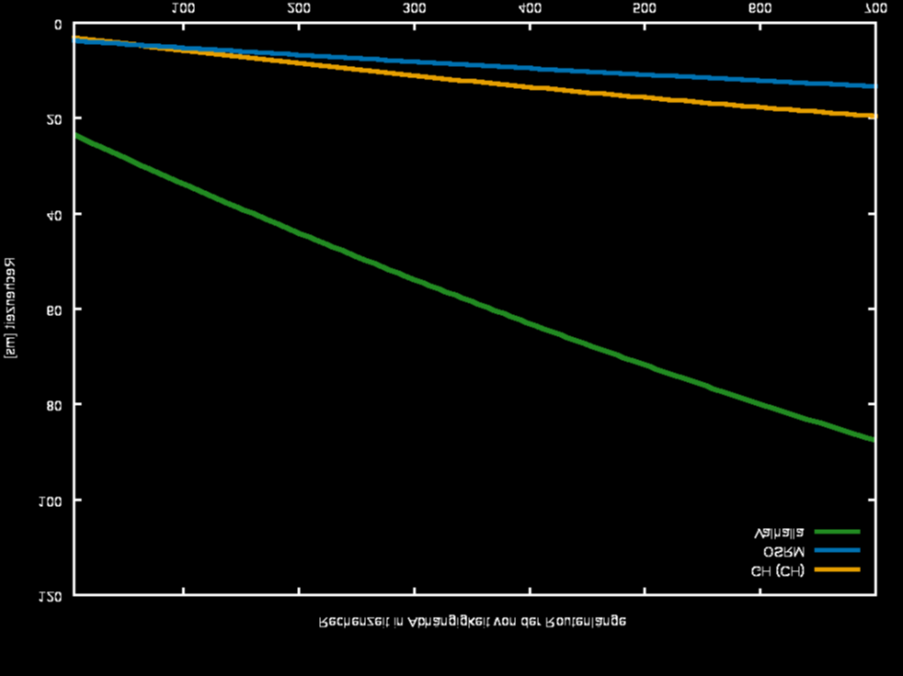
2. Results - Virtual infrastructure
Install and test routing engines
Notes:
Sergej

Slide 8
2. Results - Data acquisition and preparation
Gather postcode data of Europe from different sources
Merge the postcode data into a single custom source (Pelias/Elasticsearch)
Calculate 2-digit postcode centroids from the custom dataset (3-digit for Malta)
Notes:
Sergej

Slide 9
2. Results - Geocoding and routing
Test geocoding with Pelias based on the prepared 2-digit postcode centroids
http://141.59.29.110:4000/v1/search?text=MT558&sources=geonamesandpostcodeinfo
http://141.59.29.110:4000/v1/search?text=DE89&sources=geonamesandpostcodeinfo
Test routing between 2-digit centroids with a routing engine (Valhalla or Graphhopper)
curl http://141.59.29.110:8002/route --data '{"locations":[{"lat":48.1331,"lon":11.6046,"type":"break"},{"lat":47.9419,"lon":11.2759,"type":"break"}],"costing":"auto","directions_options":{"units":"km"}}' | jq '.'
Notes:
Sergej

Slide 10
3. Open Tasks
Establish VPN Connection for computer cluster on campus Eselsberg
Notes:
Martin

Slide 11
Predicting the outcome of soccer games
Notes:
All

Slide 12
0. Goals
Improve skills in python
Gaining knowledge about data-preprocessing
Gaining knowledge about neural network
Finding the right features
Normalizing the features in a proper way
Finding a good model for the prediction
Getting a decent accuracy with the prediction

Slide 13
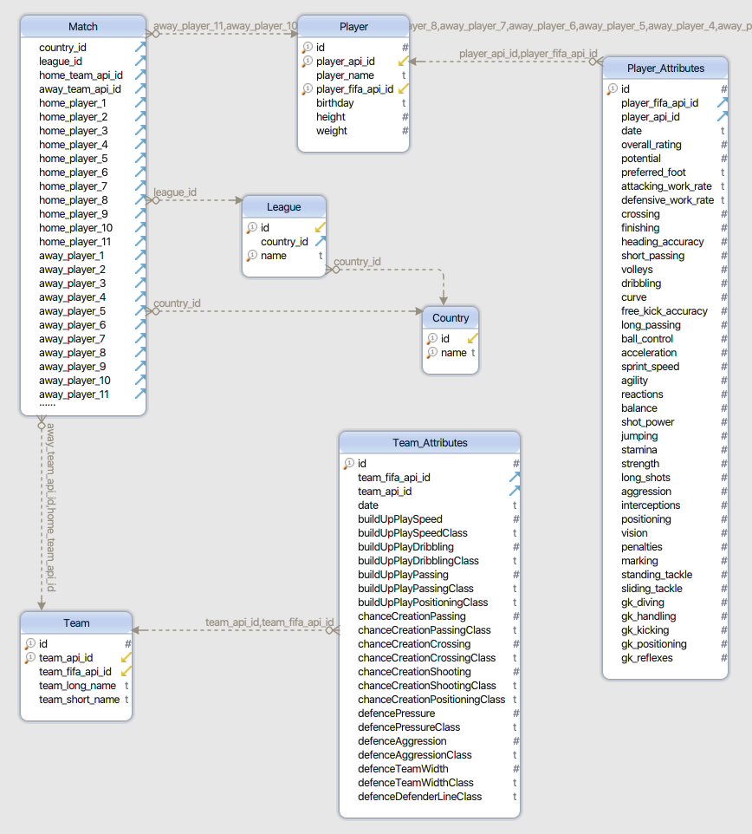
1. Data Profiling
Notes:
Sergej

Slide 14
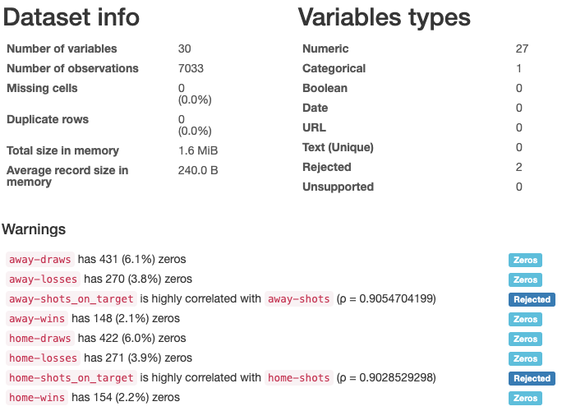
1. Data Profiling
Notes:
Sergej

Slide 15
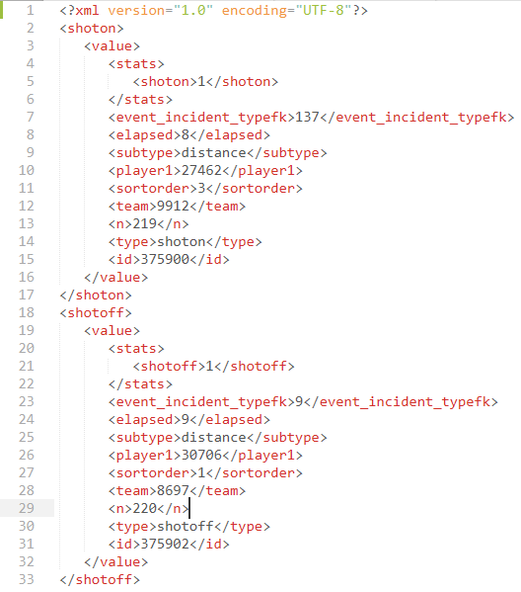
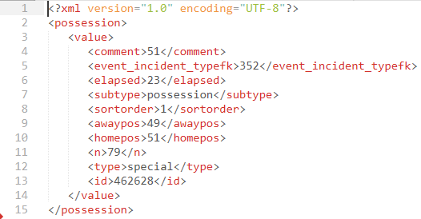
2. Data Pre-Processing - Feature Extraction
Notes:
Martin

Slide 16
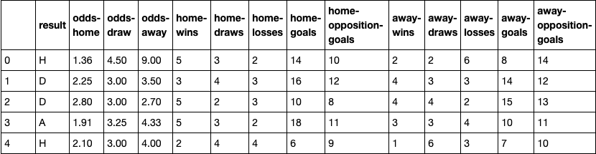
2. Data Pre-Processing - Sliding Window Option 1
Notes:
Sergej

Slide 17
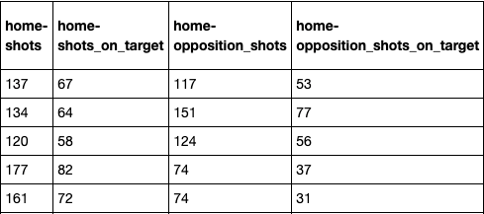
2. Data Pre-Processing - Sliding Window Option 2
Notes:
Sergej

Slide 18
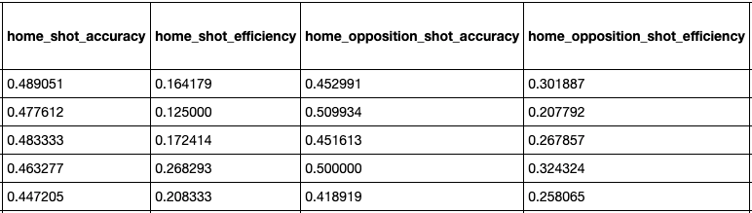
2. Data Pre-Processing - Sliding Window Option 3
Notes:
Sergej

Slide 19
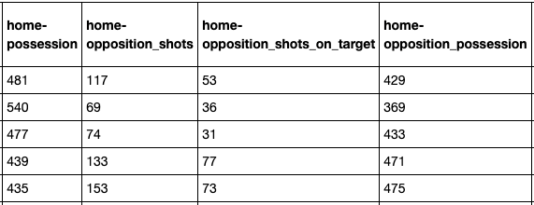
2. Data Pre-Processing - Sliding Window Option 4/5
Notes:
Sergej

Slide 20
3. Modeling
Select Modeling Techniques
Supervised Machine Learning Algorithms: Multi-class classification
Decision Tree and Neural Networks
Generate Test Design
Data Splitting:
Training set (70%) and test set (30%) not shuffled
Test set (5%), Training set (80% of the remaining 95%) and Validation set (20% of the remaining 95%)
Strategy to Stop: Automated stop (0.0001 loss improve or 1000 epochs)
Test Criteria: Accuracy
Notes:
Khaled, Lisa

Slide 21
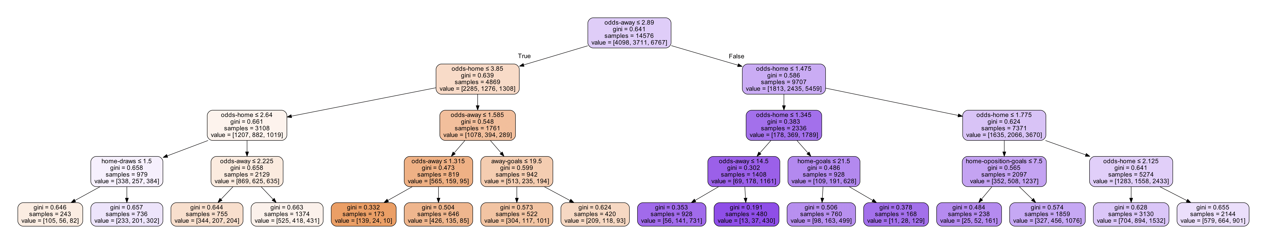
3. Modeling
3. Build Models
Decision Tree
Dataset: First sliding window option (13 features)
Depth of the tree: 4
Accuracy: 52.95%
Notes:
Khaled, Lisa

Slide 22
3. Modeling
Multi-layer Perceptron
Dataset: First sliding window option (13 features)
Hidden layers: 2(52,32 neurons)
Output layer: 3 neurons
Activation functions: sigmoid and softmax
Optimizer: stochastic gradient descent
Accuracy: 53.45% for training dataset and 52.77% for testing dataset
Notes:
Khaled, Lisa

Slide 23
3. Modeling
Keras Sequential Neural Network
Different depths: from 1 to 4 hidden layers
Activation functions: ReLU and Softmax(last layer, multi-class classification)
Optimizer: Adam
Optimizations: gradual reduction of learning rate, batch size optimized for GPUs, patience of 200 epochs
Loss function: Sparse Categorical Crossentropy (due to class-encoding)
Regularization techniques : weight regularization (L2) and/or dropout
Accuracy: 56.25%
Notes:
Sergej

Slide 24
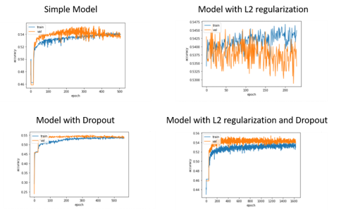
3. Modeling
The history of the accuracy of several models with different parameters
Notes:
Sergej

Slide 25
3. Modeling
Models with different regularization techniques
Notes:
Sergej

Slide 26
3. Modeling
Models with different amount of hidden layers and neurons per layer
​
Notes:
Martin

Slide 27
3. Modeling
Models with different amount of hidden layers and neurons per layer​
Notes:
Martin

Slide 28
3. Modeling
Models with different amount of hidden layers and neurons per layer​
Notes:
Martin

Slide 29
3. Modeling
Models with different amount of hidden layers and neurons per layer​
Notes:
Martin

Slide 30
3. Modeling
Models with different amount of hidden layers and neurons per layer​
Notes:
Martin

Slide 31
4. Evaluation
Notes:
Khaled, Lisa

Slide 32
5. Conclusion
Scrum Team-Work
Learned very much about Neural Network
Decent Outcome
Looking forward to work further on the project
Notes:
Khaled, Lisa

Slide 33
Outlook
Test different paramaters (activation functions, optimizers)
Test different modeling techniques: Logistic Regression
Test different features
Deployment (Flask app)

Slide 34
Thanks for your attention!
Notes:
All

