Slide 1
Social Media Community Using Optimized Clustering Algorithm

Slide 2
Objective :
The objective is to develop an optimized clustering algorithm to organize social media users into communities based on their interests, interactions, and behavior.
Benefits of the Optimized Clustering Algorithm for Social Media Community
Community Detection: Identifies distinct user communities based on interests and interactions, enabling businesses to understand trends and user preferences.
Enhanced Customer Insight: Provides valuable insights into customer behavior, aiding targeted marketing and personalized content delivery.
Resource Management: Helps in efficient allocation of resources such as customer support and advertising budgets based on community needs.
Personalized Engagement: Facilitates tailored engagement strategies and offerings for improved customer satisfaction and loyalty.

Slide 3
Data Sharing Agreement :
Sample file name (ex insta_me.py)
Length of date stamp(8 digits)
Length of time stamp(6 digits)
Number of Columns = 13
Column names = 'Impressions', 'From Home', 'From Hashtags', 'From Explore','From Other', 'Saves', 'Comments', 'Shares', 'Likes', 'Profile Visits', 'Follows', 'Caption', 'Hashtags'],
Column data type = int64

Slide 4
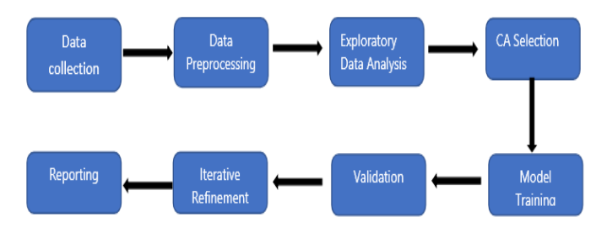
Architecture

Slide 5
Data Validation and Data Transformation :
Name Validation - Validation of files name as per the DSA. We have created a
regex pattern for validation. After it checks for date format and time format if
these requirements are satisfied, we move such files to "Saves" else
"Deleted_folder.“
Number of Columns – Validation of number of columns present in the files, and if
it doesn't match then the file is moved to "Deleted_folder.“
Name of Columns - The name of the columns is validated and should be the same
as given in the schema file. If not, then the file is moved to "Deleted_folder".
Data type of columns - The data type of columns is given in the schema file. It is
validated when we insert the files into Database. If the datatype is wrong, then the
file is moved to "Deleted_folder".
Null values in columns - If any of the columns in a file have all the values as
NULL or missing, we discard such a file and move it to "Deleted_folder".

Slide 6
Data Insertion in Database:
Table creation :- Table name “instagram" is created in the database for
inserting the files. If the table is already present then new files are inserted in the
same table.
Insertion of files in the table - All the files in the "saves" are inserted
in the above-created table. If any file has invalid data type in any of the columns,
the file is not loaded in the table

Slide 7
Q1) What was the source of data for the project?
The data for community detection was obtained from various social media platforms, collected through APIs and web scraping.
Q2) What was the type of data used for the project?
The data consisted of user interactions, behavior, and interests, comprising a combination of numerical and categorical values.
Q3) What was the complete flow followed in this Project?
The complete flow involved data collection, preprocessing, feature engineering, optimized clustering algorithm development, model evaluation, community visualization, and insights generation. (Refer to slide 5 for a detailed flow).
Q4) What was the approach for managing incompatible data or files that didn't pass validation?
Q & A

Slide 8
Incompatible files were archived and a list of these files was shared with the stakeholders. A "bad data" folder was created to store these files.
Q5) How were logs managed throughout the project?
Different logs were maintained for file validation, data insertion, model training, prediction, and other relevant steps.
Q6) What techniques were used for data pre-processing in the project?
Techniques included removing unwanted attributes, visualizing relationships between variables, handling distributions of continuous values, handling outliers, data cleaning and imputation for null values, converting categorical data into numeric values, and scaling the data.
Q7) How was training performed and what models were used?
Prior to training, clustering was performed to divide the data into clusters. Training and validation data were divided based on the clusters. Algorithms such as SVM, XGBoost were used, and models were saved based on the performance for each cluster.
Q8) How was prediction performed in the project?.

Slide 9
Testing files were obtained from social media platforms. The data went through the same process of clustering, and the appropriate model was loaded based on the cluster number for prediction.
Q9) What were the different stages of deployment for the project?
After model development, the deployment involved testing in different environments (e.g., Fire, Earth) to ensure functionality and performance before the final deployment in the production environment.
*****

