Slide 1
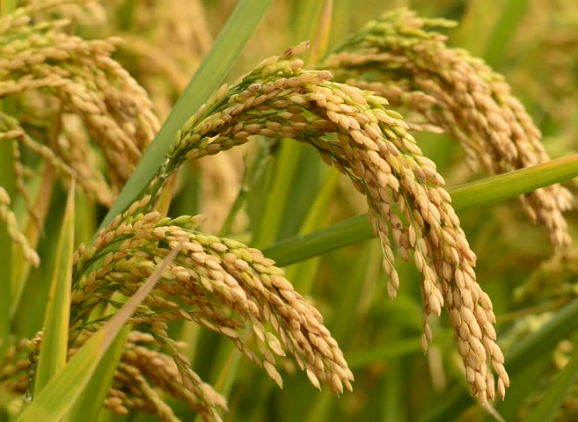
Organic Rice
Presented by
KOLA REDDY NAGESWARI
2015018066
III B. Sc., Agriculture

Slide 2
Introduction
Rice (Oryza sativa) is staple food for more than half of the world population.
India is the world's second largest producer of Rice, Wheat and other cereals.
This cereal contributes a considerable amount of calories to the consumer.

Slide 3
Cond...
Conventional rice production we uses over 40 different agro chemicals to control weeds, diseases and insects - pesticides which puts consumer health at risk.
Organic rice production systems have a lot of advantages over conventional rice cultivation practices.

Slide 4
Extent of organic rice in India
India is a major exporter of organic rice in the International market.
During 2008-09, around 5630 MT of organic basmati rice was exported from India through APEDA.
Since, the demand is increasing nature for organic rice year by year.

Slide 5
What is Organic rice?
Organic rice is cultivated by using natural and not chemical fertilizers, which are harmful to health and environment as well.
Agro-ecosystem health & biodiversity
Biological cycle and soil biological activity

Slide 6
Needs of organic cultivation
Sound
ecosystem
Free from chemical
Fat
free
Fiber
value
Low sugar content
Soil
fertility

Slide 7
Nutritional properties Organic Rice and conventional Rice (USDA)
 | Organic rice | Conventional rice
Calorie | 218 | 250
Carbohydrate | 46 grams | 53 grams
Dietary fibre | 4 grams | 1 gram
Glycemic index | 59 | 89
Organic rice are rich in minerals and vitamins
Lesser G.I food does not cause in rapid sugar spike but feel full for longer period of time

Slide 8
Challenges for Organic Rice Cultivation
Rice is the major crop that receives maximum quantity of fertilizers (40%) and pesticides (17-18%) and
These practices pose major challenges in organic rice farming for nutrient and pest management.
Yield reduces in the conversion (initial) period.

Slide 9
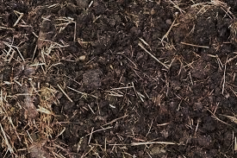
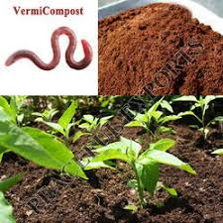
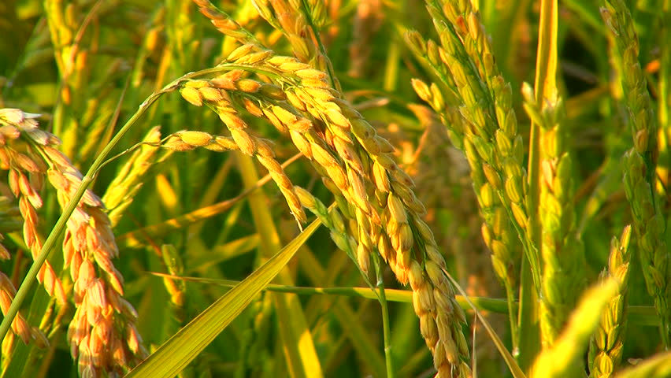
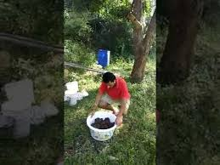
Package of practices for
Organic Rice

Slide 10
Step for organic rice production
Zero budget natural farming
Jeeva amruth
Waking up of farmer’s friend (soil fertility)

Slide 11
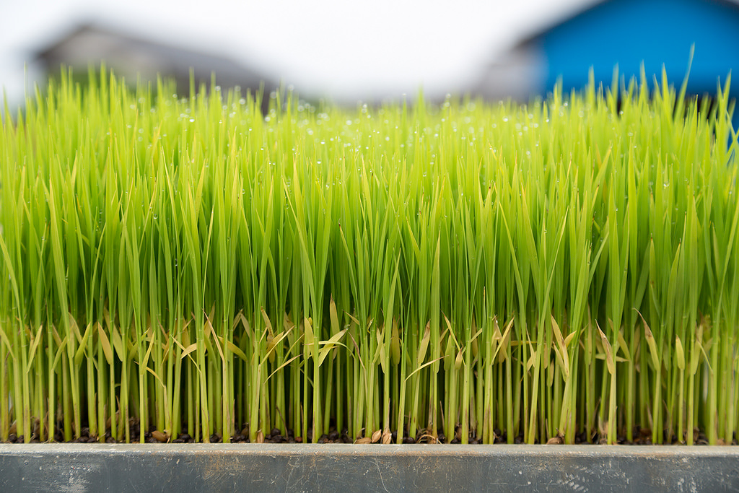
Nursery Management

Slide 12
i) Nutrient Management
During seed bed preparation, organic manures such as FYM, Compost, vermin - compost can be used @ 5t/ha of nursery area.
Gana jeeva amuruth :200kg/acre
ii) Seed treatment
Plant protection
Beejamrut: 3 liter/ac of Seeds
Prevents seed borne disease

Slide 13
Bio fertilizer
Azospirillum and phosphorus solubilizing bacteria 10 gram each/kg of Seeds.
Uses: Fix atmospheric nitrogen 30-35 kg N/ha/season, solubilizes phosphorus and silicon and induce drought tolerant.

Slide 14
Special nursery management Practices
i) Dhrava jeeva amrut (7 DAS)
1 ac : 200 litres
ii) Sour butter milk (9 DAS)
1 ac 100 liter water + 3 liter sourbutter milk
Benefit:
Strengthen the seed and
Increase the milking stage and reduces the pest incidence (Main filed)

Slide 15
Organic manure application
During land preparation 10 t of FYM/ha + 5 tons paddy straw and 10 tones of in-situ grown dhaincha/sunhemp green manure/ha needs to be incorporated.
In the last puddle, vermi-compost @ 2 t/ha may be applied (optional).
Through these organics, approximately 150 kg N, 40 -50 kg P₂O₅, 100 - 120 kg K₂O and micronutrients can be supplied.

Slide 16
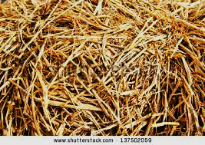
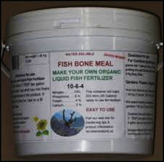
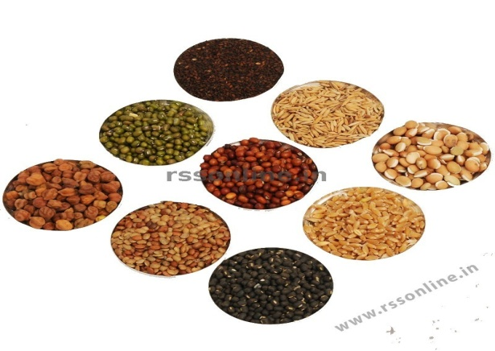
SPECIAL TECHNIQUES FOLLOWED IN MAINFIELD:
Apply Gana jeevamruth: 200 kg / ac
Dry rice straw:10 kg
N: growing legumes plants as cover crop
P: Fish bone meal
K: rice straw and manures
Apply Navadhanayaa mixed powder at first showering time: indirect source for N, P, K and about 16 essential nutrients.

Slide 17
Bio - fertilizers
Bio-fertilizers such as Azospirillum or PSB/PSM @ 2 - 3 kg /ha mixed with 25 kg FYM or VC and applied to the soil just before planting.
Blue green algae @ 10 kg/ha, 10 days after planting.
Apply azolla @ 1 t/ha, 7-10 days after transplanting and incorporated after 3 weeks.

Slide 18
Special Care after Transplanting
After transplanting once per 15 days spray with
Fish meal amino acid (Fish meal is a good source phosphorus 12%) and
Dharava jeeva amrut - 200 liter/ac Spray 4 times in crop period.
Panchakavya: apply 10th, 15th, 30th & 50th day
Spray 6 lit of sourbutter milk/ac in 200 liter of water: At milking stage:

Slide 19
Weed suppression
Weed control and soil fertility are the principal challenges associated with organic rice production.
Primary weed - control practices include crop rotations, land leveling, seedbed preparation.
Water management.
Rotary hoeing.

Slide 20
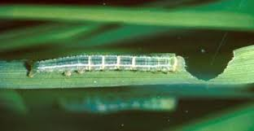
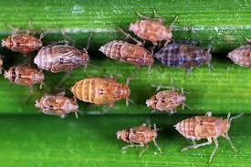
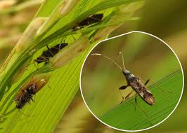
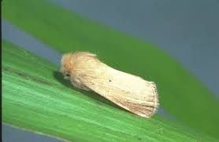
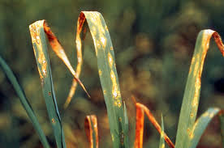
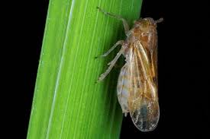
Pest and Disease management

Slide 21
Pest and disease management
Agniyasthiram - removes 75% of insect and pest.
20 lit
Tobacco leaves
3kg
0.5kg
3kg
Custard apple leaves
0.5kg

Slide 22
Cont…
Agni yasthiram - 200ml /10 l of water in addition to this neemayasthiram is used
Fall armyworm and chinch bug - flush of water.
Stinkbugs and water weevils - Timely planting, variety selection and cultural practices.

Slide 23
Research Evidence

Slide 24
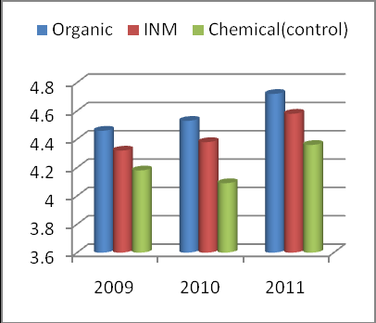
Effect of organic and inorganic nutrition of rice on grain yield (2009-11)
Dr Y. V. Singh

Slide 25
Conclusion
Investment
Nutritional value
Soil fertility
Health issues
Yield

Slide 26


