Slide 1
Presentation
On Project Defense Of
“Food House”
Presenting By:
Hemraj Kalathoki/Roshani Dhital
Roll No: 10/15
BCA 4th Semester

Slide 2
Food House

Slide 3
Introduction
“Food House” is a web-based application.
Designed for customers to provide healthy, good foods as fast as possible.
Purpose to build this system is to provide fast, secure, reliable food service to customers. Like: students, officer workers etc.
This website will serve as an effective medium for ordering foods item online for customer.

Slide 4
Problem Statement
Difficult to find Hygiene foods and quality foods.
Food quality are not good on physical hotels/foody places.
User cannot able to order properly their foods in existing system.
Difficult to determine the foods are available or not.
Difficult for the people to find the particular foody places in crowded areas

Slide 5
Objectives
To give facilities to the people to view and order the items.
To give the easy information to all the customers about the services
To serve customer well service of foods in short time that helps to save time consumption.

Slide 6
Limitations
There is no automated system, so user have to check out menu manually.
User should have basic knowledge of technology.
There is no online payment for now.

Slide 7
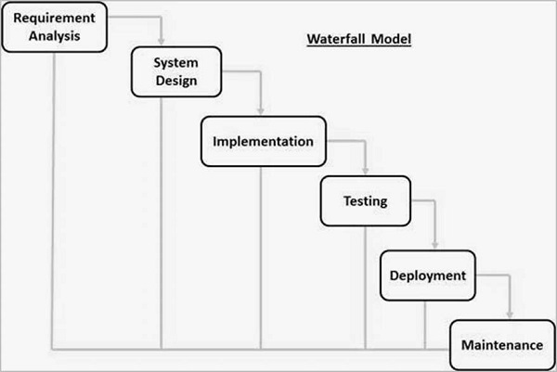
Methodology
Fig. : Waterfall Model

Slide 8
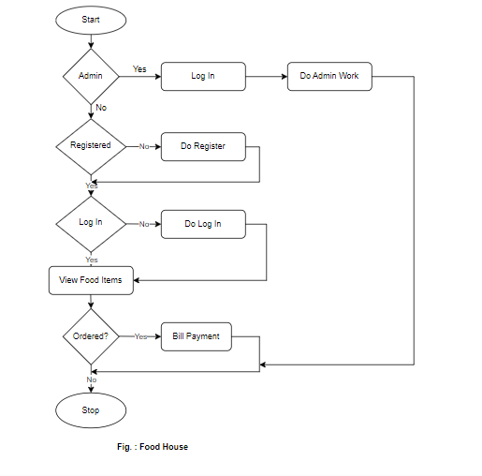
Flow Chart

Slide 9
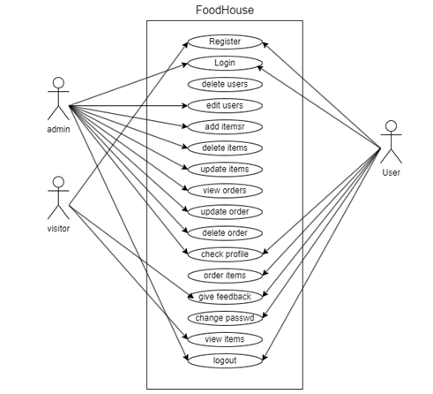
UseCase Diagram

Slide 10
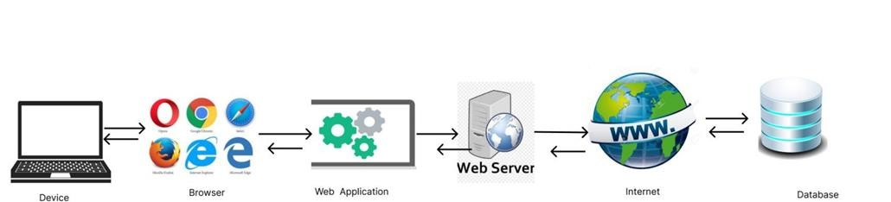
System Architecture

Slide 11
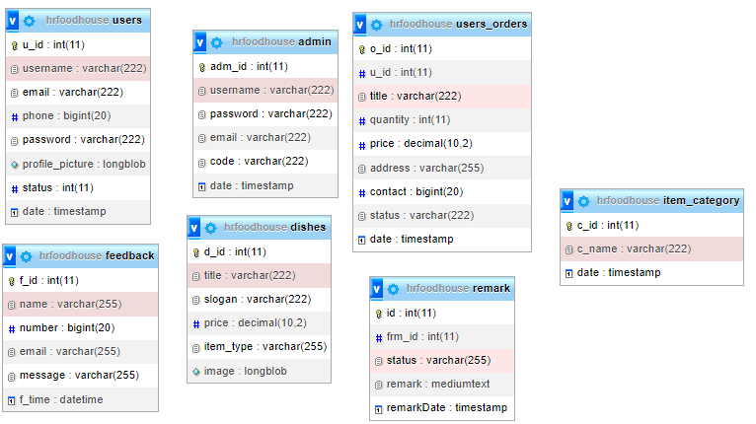
Database Schema

Slide 12
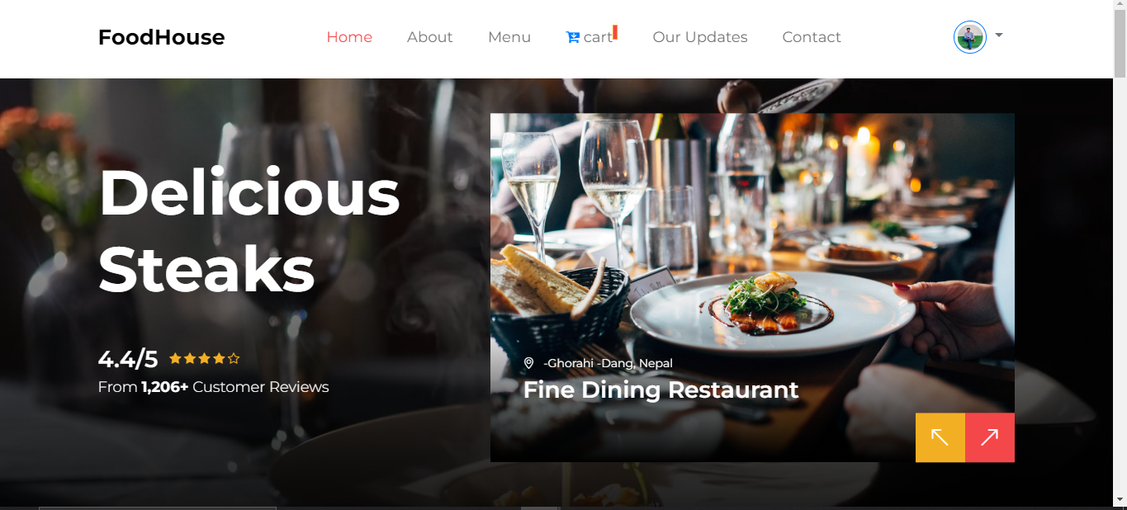
Homepage design of FoodHouse

Slide 13
Tools And Techniques
Frontend : HTML, CSS, Bootstrap-5, javascript, Ajax
Backend : php,
Database : mysql,
Server : Local server i.e.: Xampp,
Text Editor : Vs code, sublime text 3.

Slide 14
Feasibility Study
Technical Feasibility : Developing a “Food House” is technically feasible as we have the necessary software, hardware and knowledge of programming language like Html, Css, js, php etc.
Economical Feasibility : The system utilizes an open-source technologies, and does not require a additional software and hardware and also there are not any recurring cost rather than internet.
Operational Feasibility : As the user interface is quite good and the normal user also can use the system easily. To operate a system no any extra training is required, so this system is operationally feasible.

Slide 15
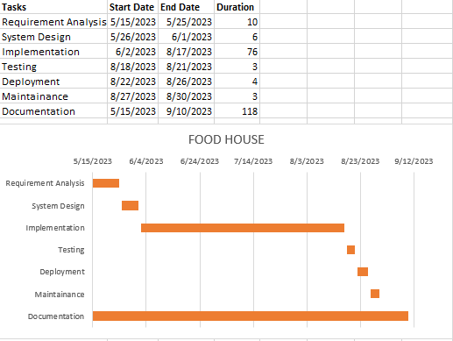
Gantt Chart

Slide 16
Results And Outcome
With the help of this system user are able to do :
  To order food online,
  To save time of search of foody place,
  To facilitate to have hygiene foods.

Slide 17
QUERIES SESSION….
(Any Questions ?)

Slide 18
Let’s See our project

