Slide 1

UDEMY COURSE
ANALYSIS

Slide 2
CONTENT
Sl. No. | Title
1 | Problem Statement
2 | Project Overview
3 | Why We need this?
4 | How it will help people?
5 | Solution
6 | How it’s unique
7 | Result
8 | Meet Our Team

Slide 3

PROBLEM STATEMENT
Udemy is a popular online learning platform that offers a wide range of courses on various subjects.
As the platform grows, both in terms of course offerings and user base, there is a need to analyze the data to gain insights into the performance and popularity of different courses.

Slide 4

PROJECT OVERVIEW
The Udemy Course Analysis project aims to provide valuable insights into the performance and popularity of courses on the Udemy platform.
Leveraging Jupyter Notebooks, the analysis will be conducted on diverse datasets, exploring factors influencing course success and providing actionable recommendations for course creators and learners.

Slide 5

WHY WE NEED THIS?
Optimizing Course Creation
Innovation and Adaptation
Enhancing User Experience
Data-Driven Decision-Making

Slide 6

HOW IT WILL HELP PEOPLE?
Course Creators:
  Insights into the factors influencing course popularity, such as topic trends, instructor performance, and pricing, can help creators optimize their course content to meet market demands.
  Identification of top-rated and popular instructors allows creators to assess their competition and understand characteristics contributing to instructor success.
Learners:
  Analysis of course ratings, enrollment trends, and reviews empowers learners to make informed decisions about which courses to enroll in, ensuring they choose high-quality and relevant content.
  The recommendation system can assist learners in discovering courses aligned with their preferences and interests.

Slide 7

OUR SOLUTION
Course Popularity and Performance:
  Examine the distribution of course ratings and enrollment numbers.
  Identify factors influencing course popularity, such as duration, price, and topic.
  Use regression analysis to understand the impact of different variables on course success.
Market Trends:
  Analyze trends in course topics and categories over time.
  Identify emerging topics and popular categories using time-series analysis.
  Explore the impact of external factors (e.g., current events) on course demand.

Slide 8

WHAT MAKES OUR CONCEPT UNIQUE?
Incorporating real-time user behavior changes for relevant and up-to-date recommendations.
Implementing machine learning models for forecasting future trends in course popularity.
Enhancing user experience with interactive visualizations within Jupyter Notebooks.

Slide 9
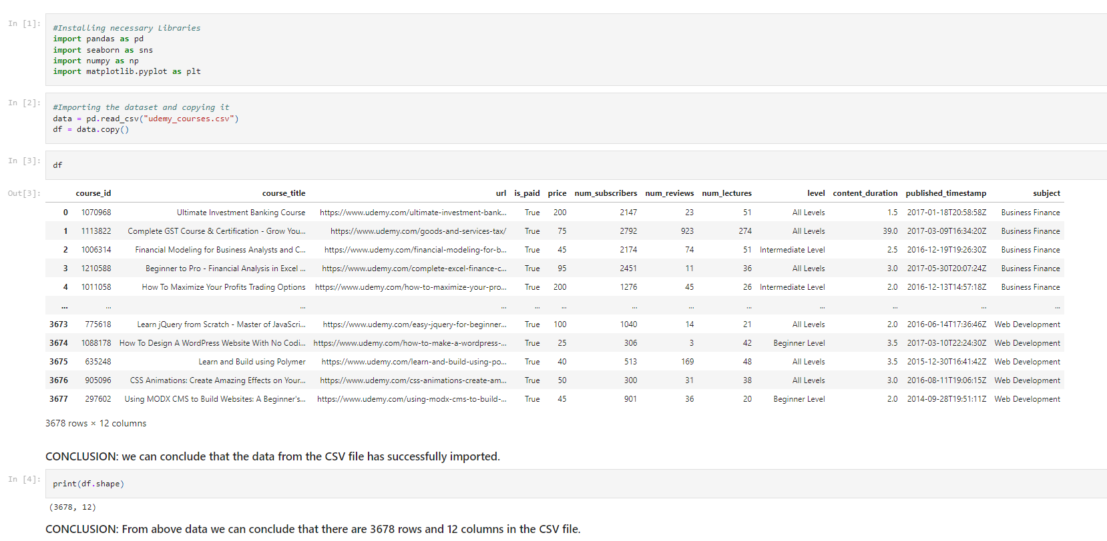
RESULT

Slide 10
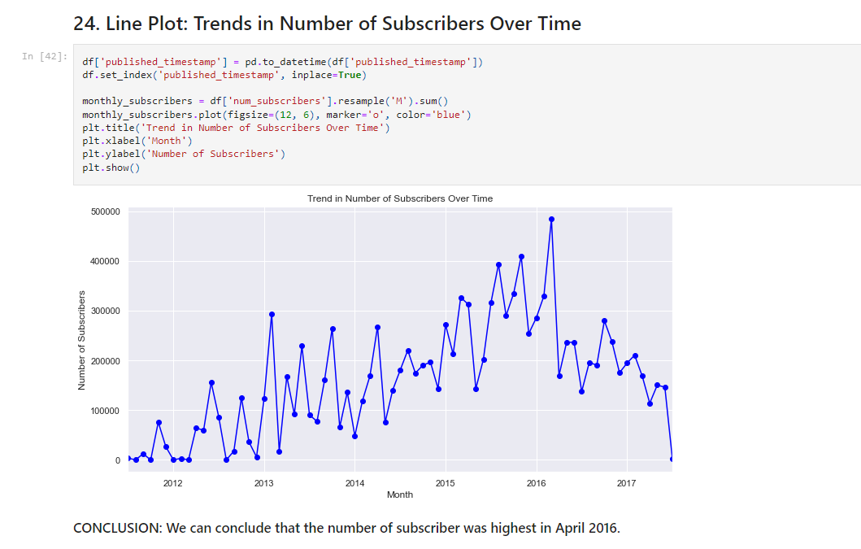
RESULT(Contd.)

Slide 11



MEET OUR TEAM
SUMIT KAYAL
Student of NSTI Howrah, Dasnagar
ADIT-IBM
Roll No.- 327
RAHUL KUMAR
Student of NSTI Howrah, Dasnagar
ADIT-IBM
Roll No.- 320
HENA DHAWA
Student of NSTI Howrah, Dasnagar
ADIT-IBM
Roll No.- 312

Slide 12

THANK YOU

