Slide 1
Hot Bods
Is there a relationship between obesity and states that are colder/hotter than average?
Notes:
Becca

Slide 2
Hypothesis
Null: There is no statistically significant relationship between average state temperature and average state obesity rate
Alternative: Average state temperature correlates to average state obesity rate at a 95% confidence level
Notes:
Becca

Slide 3


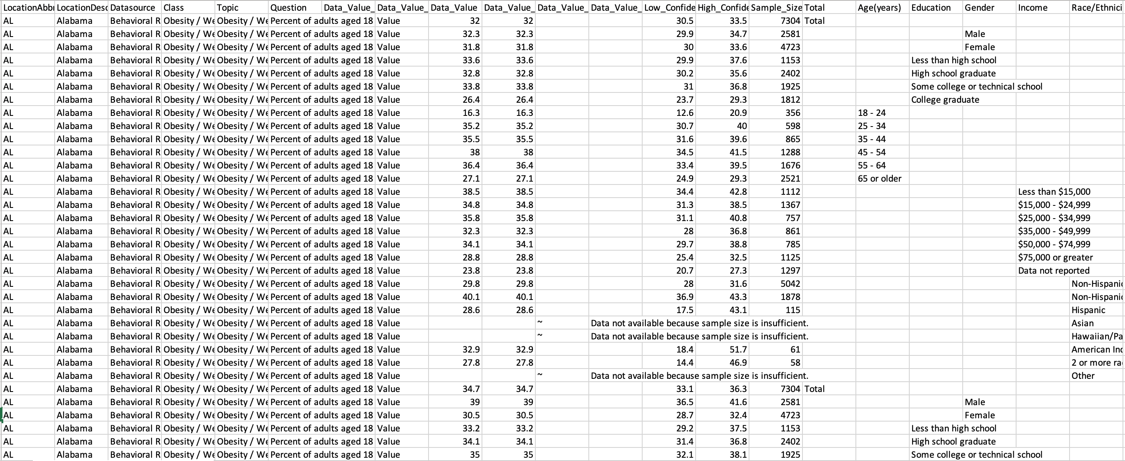

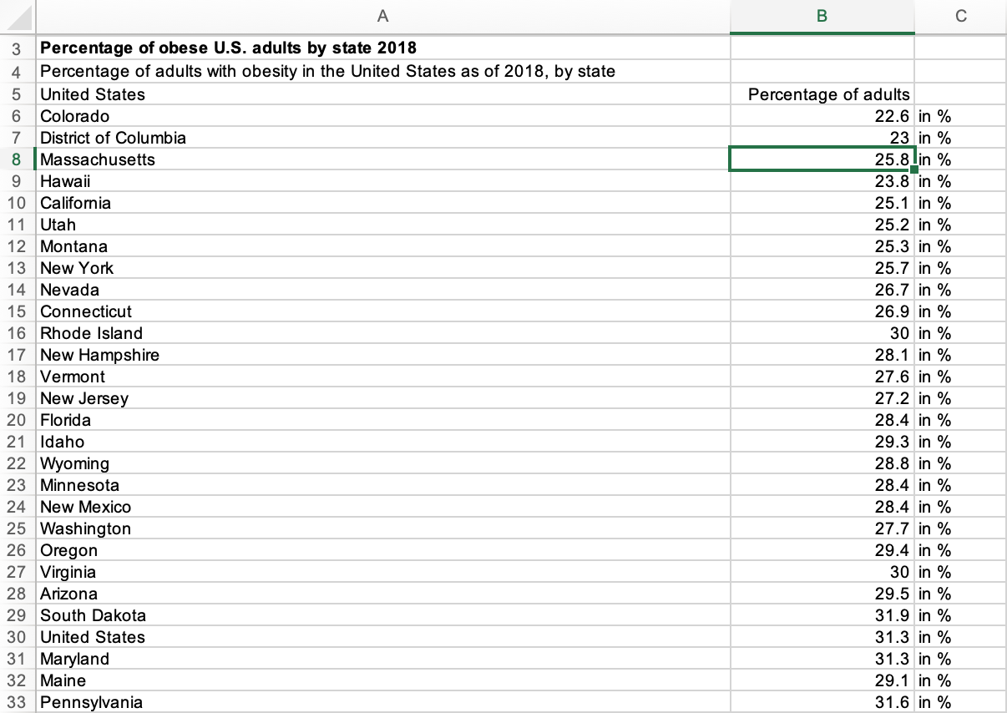
Search for a data source
Originally found what we thought was a great set of data, but would have had to drop 95% due to incomplete information. Other data sources were too sparse, which would be limiting.
Notes:
Becca

Slide 4
Chosen Data sources
Selected data for use was 2010 American obesity rate and health risk factor data by state from Data World and national climate data from the National Climatic Data Center, NOAA.
Notes:
Becca

Slide 5
Methodology
Analyze temperature data
Compare temperature patterns to identify unique behavior by region
Rank states by mean temperature to identify states with extreme temperatures
Combine those finding to visualize trends
Analyze Obesity data
Rank states by mean obesity to identify states with highest and lowest obesity rates
Search for any outlier state populations with obesity rates outside of the norm
Compare Data sets
Run a linear regression on our two variables to identify potential correlation

Slide 6
Analysis

Slide 7
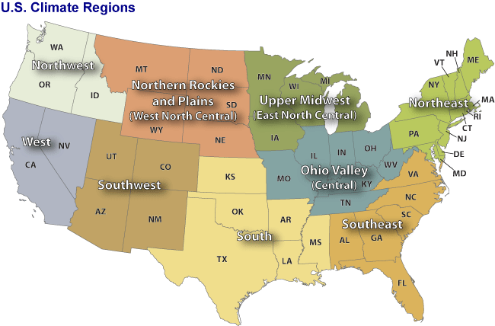
9 Regions
Notes:
Marina

Slide 8
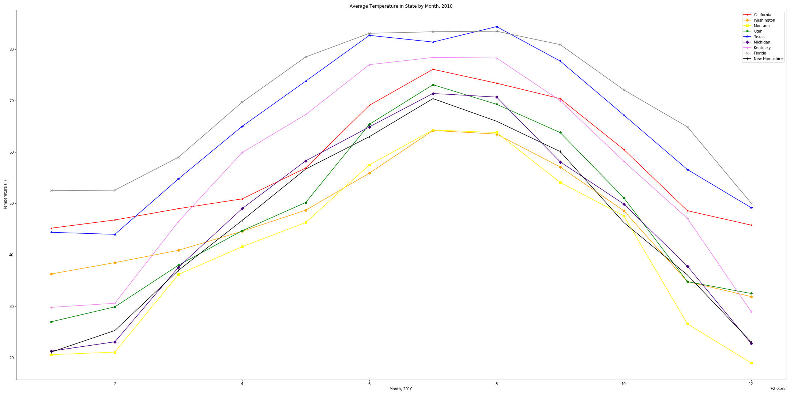
Climates by Region
Notes:
Marina

Slide 9
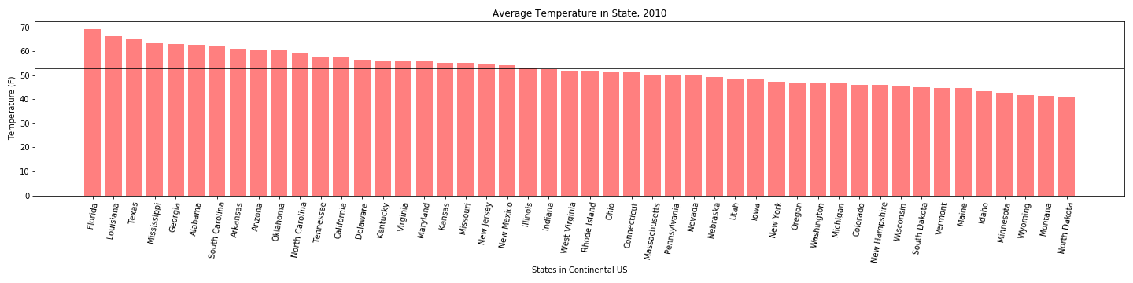
2010 mean temperature by state
Notes:
Marina

Slide 10
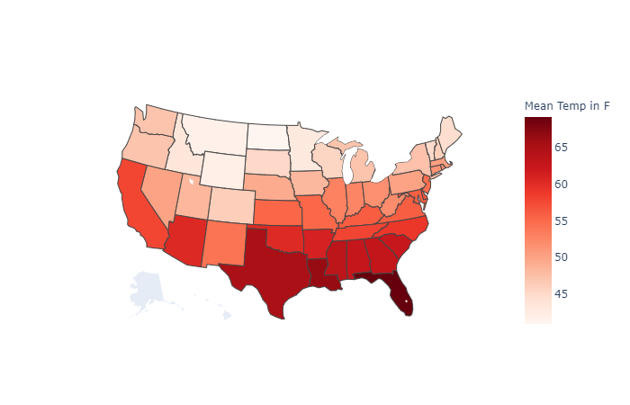
2010 mean temperature by state
Notes:
Marina

Slide 11
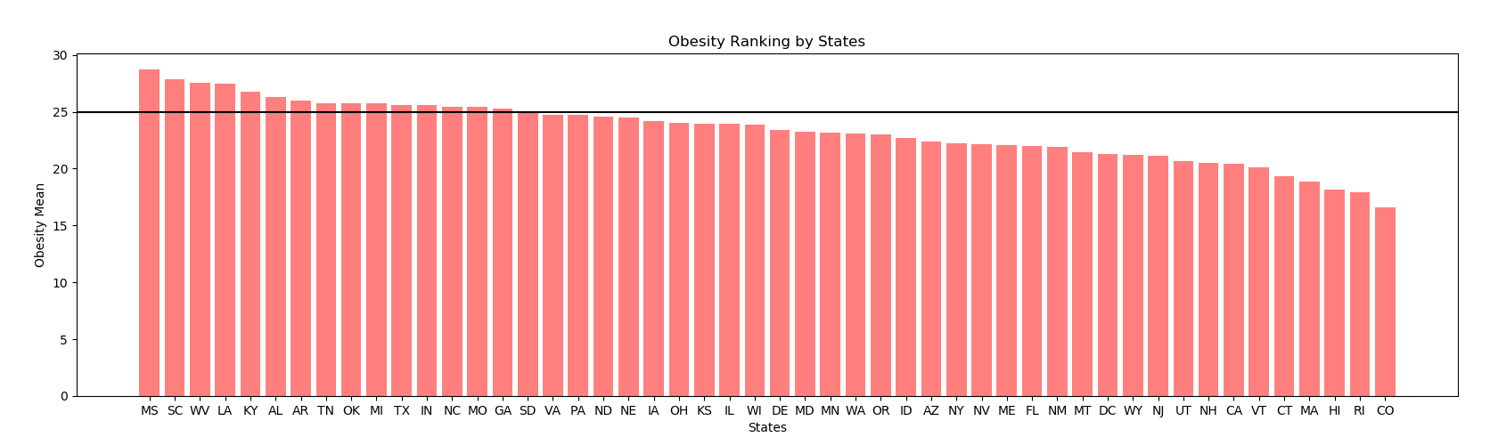
Initial Comparison
Notes:
Marina: Louisiana, Mississippi, Alabama, Arkansas, Oklahoma, South Carolina, North Carolina, Tennessee, Kentucky, and Missouri have above average obesity and temperatures

Slide 12
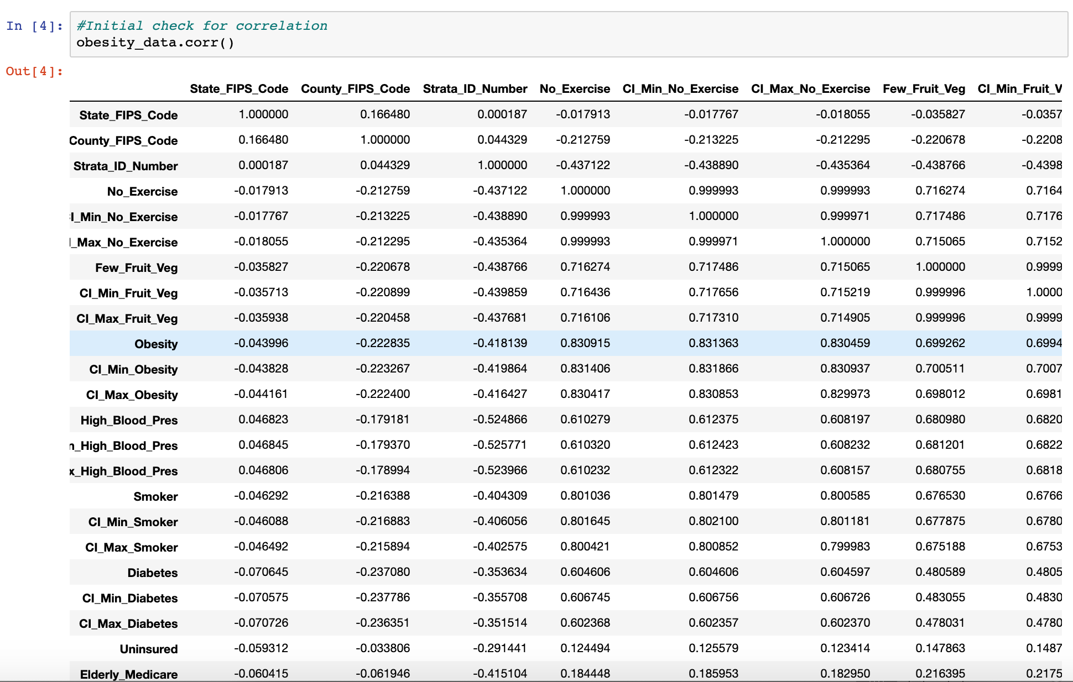
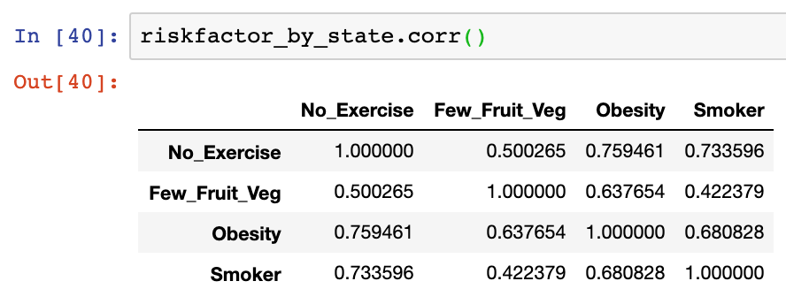

Exploring Obesity Data Set
Initial Testing
Cleaned Subset
Notes:
Marina: Louisiana, Mississippi, Alabama, Arkansas, Oklahoma, South Carolina, North Carolina, Tennessee, Kentucky, and Missouri have above average obesity and temperatures

Slide 13
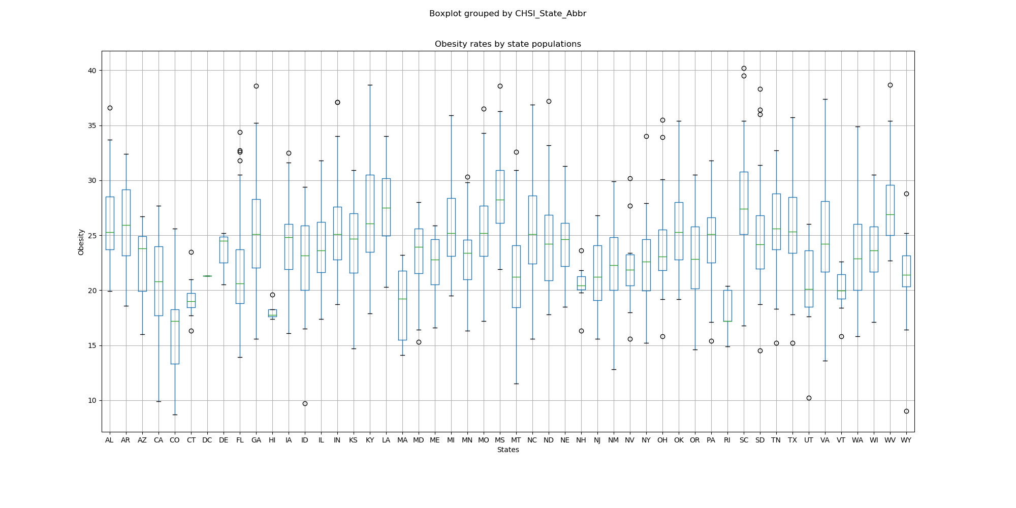
Obesity by State Boxplot
Statistic=11.554393289970982 and pvalue=2.6714108531690735e-75
Notes:
Hena

Slide 14
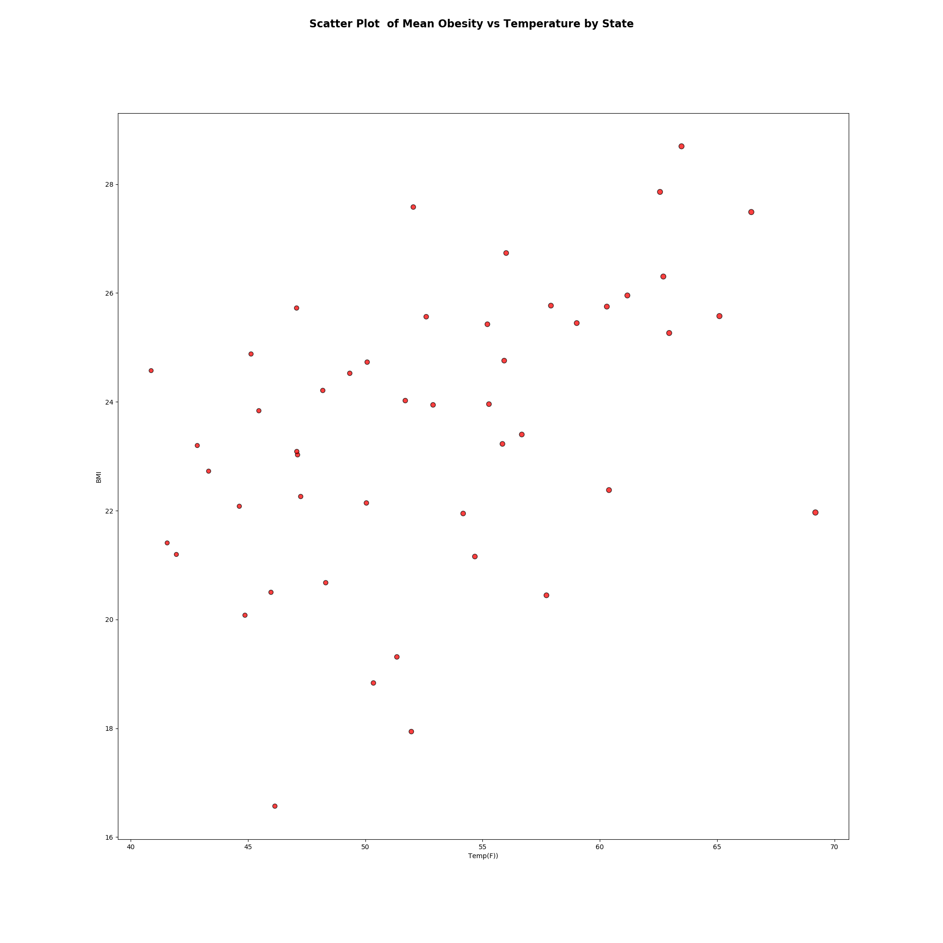
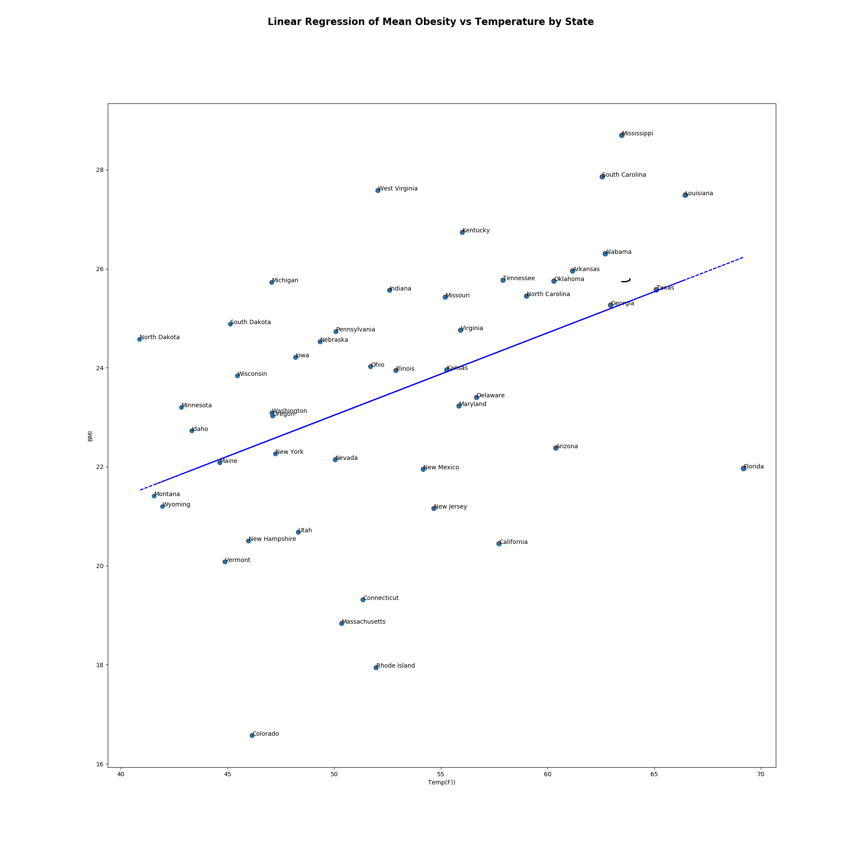
Temperature and Obesity plots
We cannot prove a significant difference in the obesity means by population of each state
Notes:
Hena

Slide 15
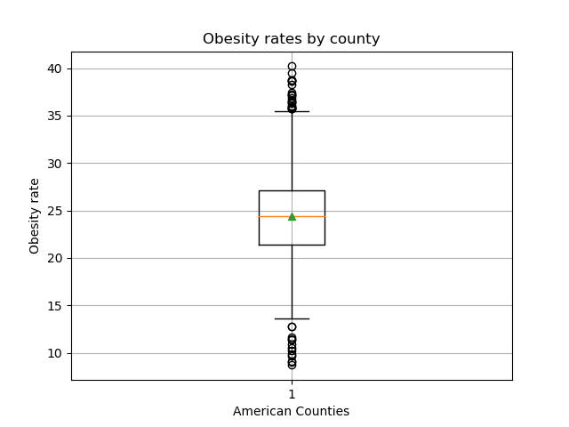
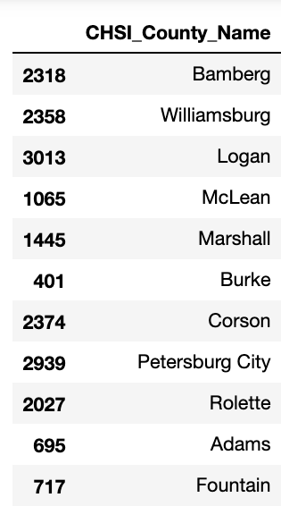
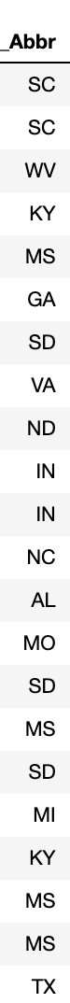
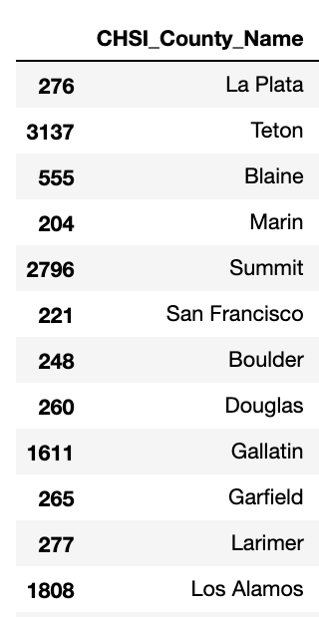
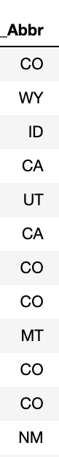
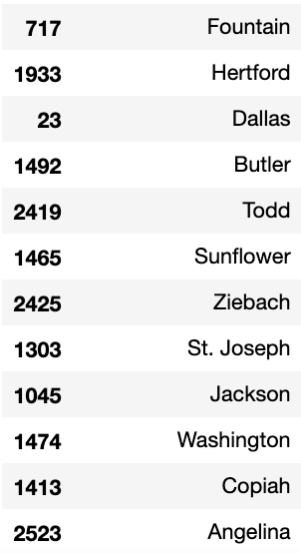
Outliers
No outliers at the state level
Outliers at the county level were detected
Highest Quartile
Lowest Quartile
Notes:
Becca

Slide 16
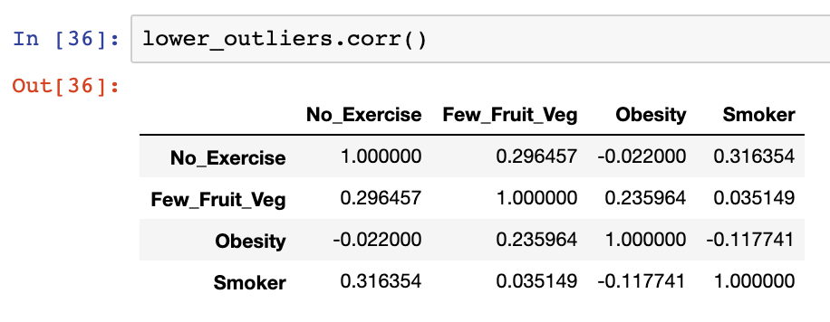
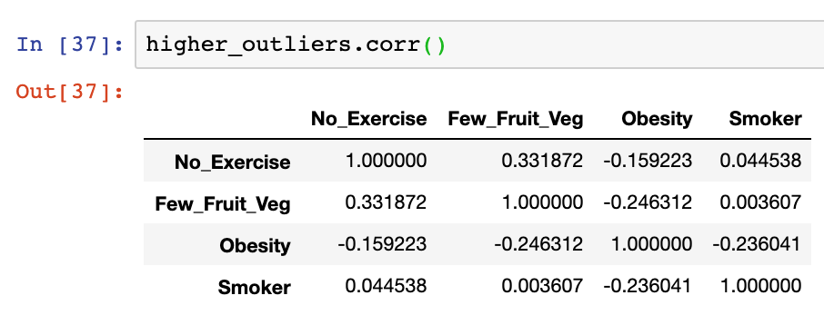
Testing within the County outliers
Within outlier subsets, there was not evidence to support statistical correlation within the tested factors
Notes:
Becca

Slide 17
Conclusion

Slide 18
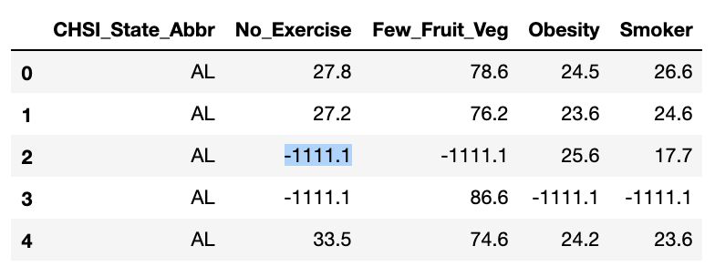
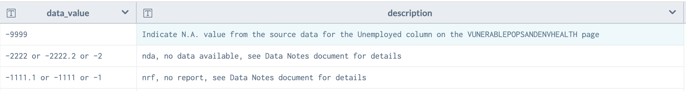
Data Limitations
Incomplete data sets limited our analysis from factors such as income range, gender, age, etc, which led us to data that included only health risk factors in a one-year range
Obesity data at county level, but weather data was not
Select county data had “1111.1” meaning that there was missing reports
Notes:
Sabir

Slide 19
Conclusion
We failed to reject the null hypothesis, meaning that there is no significant relationship between obesity and the state temperature, with a pvalue of 2.6714108531690735e-75
Notes:
Sabir

Slide 20
Further Scope
Multi-variant analysis such as polynomial regressions on factors such as income level, demographic, education, ethnicity, distance to fast food restaurants (KFC), co-morbidity or autoimmune disorders such as thyroid and fatty liver disease
Notes:
Sabir

Slide 21
Thank you!

