Slide 1
Deep Learning–Based Sales Forecasting and Trend Prediction System for Retail Business Optimization
SYSTEM ANALYSIS AND DESIGN
DEPARTMENT OF INFORMATION TECHNOLOGY
HENRY OCHIENG ONYANGO
SCT221-0733/2022
SUPERVISOR: DR. DENNIS KABURU

Slide 2
Objectives
General Objective is to develop a deep learning–based sales forecasting and trend prediction system that enhances retail business optimization through accurate demand prediction and intelligent data-driven decision support.
Specific Objectives
To analyze historical retail sales data and identify patterns relevant to sales forecasting.
To implement classical statistical forecasting models including ARIMA and Exponential Smoothing as baseline methods for sales prediction.
To develop an LSTM-based deep learning model for retail sales forecasting.
To compare the forecasting accuracy of the LSTM model with classical forecasting techniques using standard evaluation metrics (MAE, RMSE, MAPE).

Slide 3
Analysis- Feasibility Study
Technical feasibility: The system uses a fully open-source, well-documented stack including Python with Flask, TensorFlow for LSTM deep learning, Pandas/NumPy for data preprocessing, and Scikit-learn for baseline models. All libraries are freely available and proven in production forecasting applications. A standard development laptop with 8GB RAM and an Intel Core i5 processor is sufficient for model development and training.
Economic feasibility: This is critical for a small to medium retail context. The core software stack is entirely open source, eliminating software licensing costs. The estimated total project cost is only 14,000 Kenyan Shillings, covering cloud computing (Google Colab Pro for 6 months) and internet connectivity. No expensive proprietary forecasting software is required.
Operational feasibility: The system is delivered as a web application accessible through any modern browser, requiring no client-side installation. The interface includes AI-generated natural language explanations of forecasts, making complex deep learning outputs understandable to non-technical retail managers. Role-based access control separates administrator and user functions.
All three dimensions confirm the project is viable.

Slide 4
System Specification
Functional requirements:
The system shall allow registered users to upload historical retail sales data in CSV format through a drag-and-drop or file-selection interface and validate the format or allow users to add individual sales records manually through a web form without uploading a file.
The system shall automatically map non-standard product category labels in uploaded files to a predefined list of fourteen standard categories, assigning unmapped labels to an 'Others' category.Claim chat feature between the finder and the owner.
The system shall train an LSTM-based deep learning model for each distinct product category and geographical region combination in the database, provided the combination contains at least ten records.
The system shall support model training using ARIMA and Exponential Smoothing as classical baseline methods for comparative evaluation.
The system shall generate sales forecasts for a user-specified horizon of 7 to 90 days using the LSTM, ARIMA, or Exponential Smoothing model as selected by the user and display each forecast with a corresponding 95 percent confidence interval derived from Monte Carlo Dropout sampling.
The system shall generate a natural language AI explanation for each forecast, describing the predicted trend, growth rate, and business implications using the Pollinations AI text API.
The system shall allow users to compare LSTM, ARIMA, and Exponential Smoothing forecasts side by side on a single interactive chart, accompanied by metric-based comparison statistics.
Non-functional requirements:
All user passwords shall be stored as salted hashes generated by the Werkzeug security library. User sessions shall expire automatically after seven days of inactivity. All database queries shall use parameterised statements to prevent SQL injection.Hash all passwords using bcrypt for security.
The SQLite database shall operate in Write-Ahead Logging (WAL) mode to prevent data corruption under concurrent read-write access.
All primary system functions shall be reachable from the main navigation sidebar in a maximum of two clicks. All form interactions shall display clear success or error feedback messages within one second of submission.
The system shall function correctly on any client device running a modern web browser (Chrome, Firefox, Edge, or Safari), without requiring the installation of any client-side software beyond the browser itself.

Slide 5
Analysis – Data collection
To gather requirements, I used three complementary approaches:
First, a structured interview with a purposively selected sample of ten participants: five retail business managers, three data analysts working in retail environments, and two inventory planners. Interviews focused on current forecasting tools, stockout problems, and desired analytical outputs.
Second, document analysis of sample retail transaction datasets sourced from Kaggle and the UCI Machine Learning Repository, which provided direct insight into data structure, variability, and temporal patterns.
Third, observation of existing spreadsheet-based forecasting processes.
Key findings from the data:
All five managers confirmed their current process relies on spreadsheet-based historical averages, which routinely fail to anticipate demand spikes during promotional periods.
Stockouts during seasonal peaks were cited as the most costly problem, with three managers estimating revenue losses of between 10 and 20 percent of expected sales.
Document analysis confirmed sales time series exhibit strong weekly seasonality, with correlation at lags of 7 and 14 days, and non-linear demand responses to promotional discounts.

Slide 6
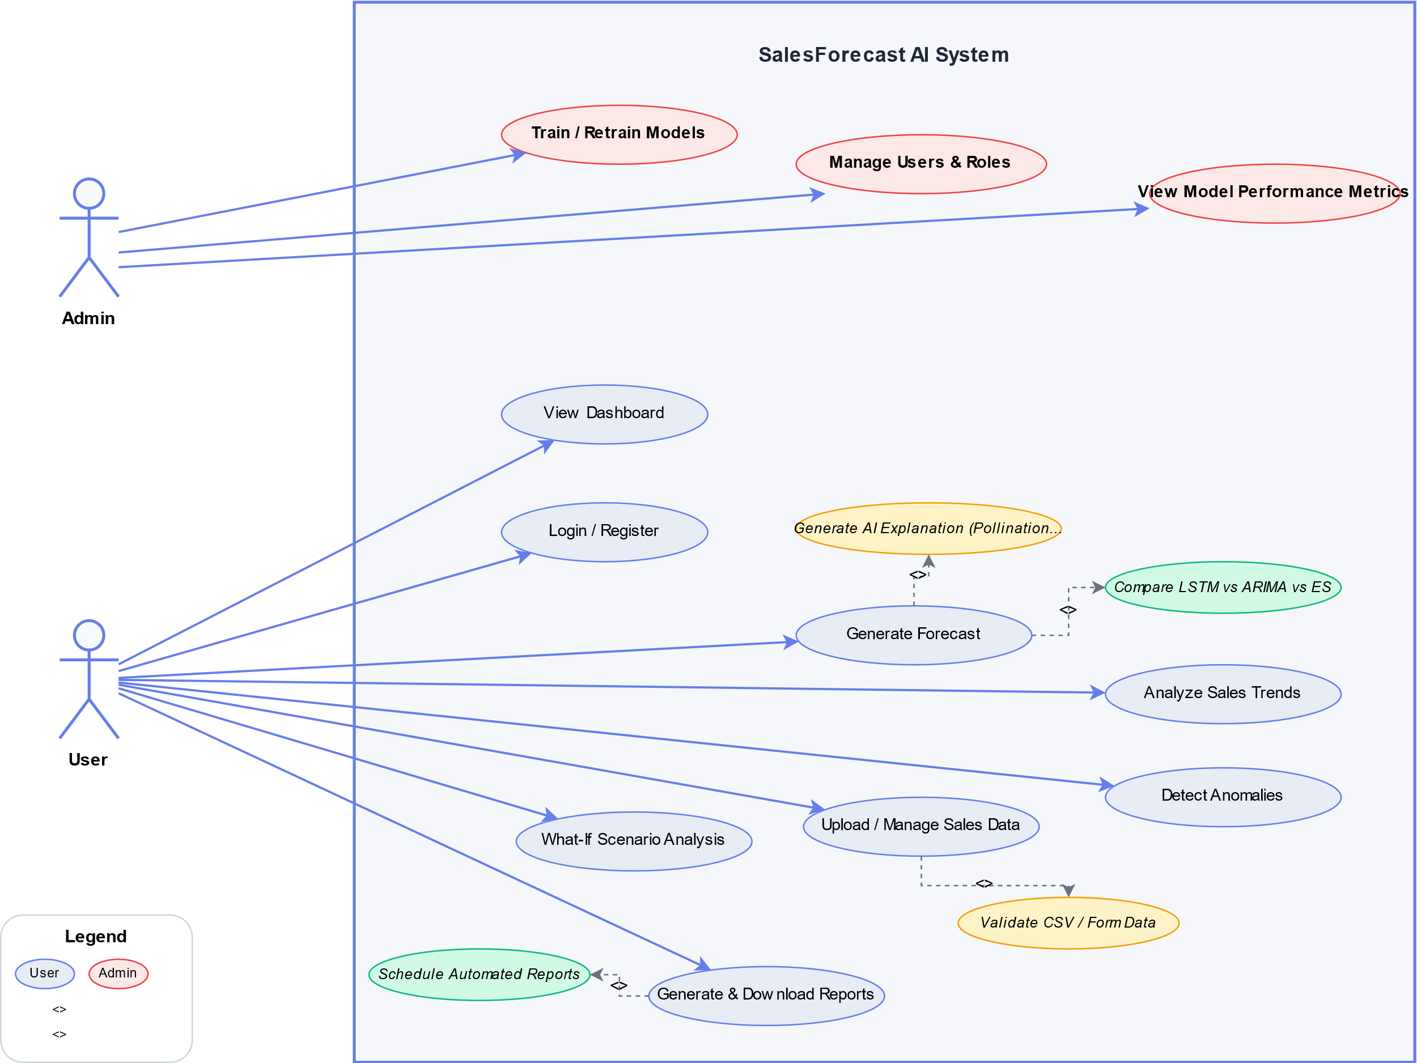
Use Case Diagram
The use case diagram captures the interactions between the system and its two primary actors: Administrator and User (Retail Manager) .
Administrator Actor encompasses all capabilities available to the general User, plus exclusive access to model training and user management functions
System Boundary: All use cases are contained within the "Sales Forecasting System" boundary. External entity is the Pollinations AI Service called by the LLMExplainer to generate natural language explanations of forecasts and trends.

Slide 7
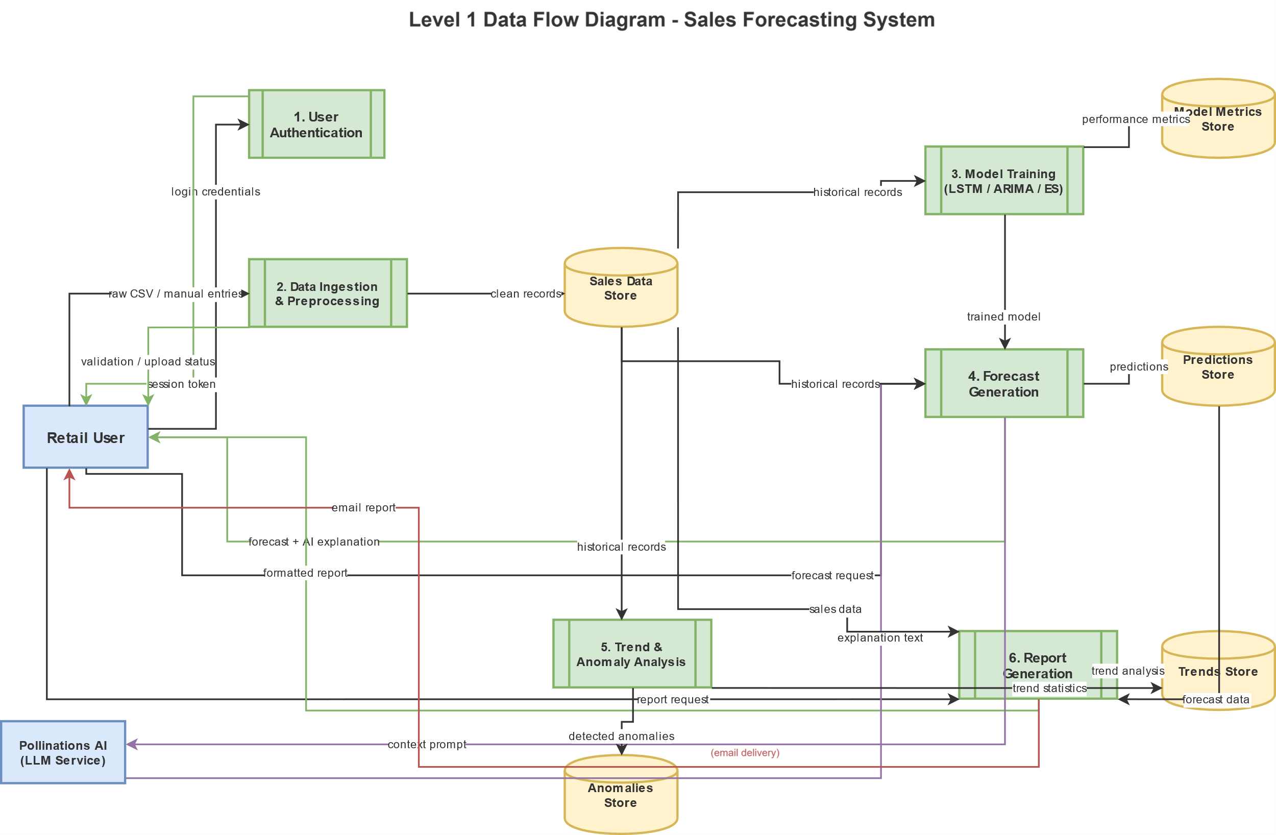
Data Flow Diagram
The Level 1 DFD expose the major internal processes and data stores of the system. Six principal processes are identified.
•Process 1 (User Authentication) receives login credentials from the Retail User and produces an authenticated session token.
•Process 2 (Data Ingestion and Preprocessing) accepts raw CSV uploads or manual form entries, validates them, and writes clean records to the Sales Data Store.
•Process 3 (Model Training) reads historical records from the Sales Data Store, applies feature engineering, trains the LSTM model, and writes performance metrics to the Model Metrics Store.
•Process 4 (Forecast Generation) reads from the Sales Data Store and the trained model files, generates predictions, and writes results to the Predictions Store.
•Process 5 (Trend and Anomaly Analysis) reads from the Sales Data Store, detects anomalies, computes trend statistics, and writes findings to the Trends and Anomalies Stores.
•Process 6 (Report Generation) reads from the Sales Data Store, Predictions Store, and Trends Store, produces formatted reports, and dispatches them to the user directly or via the Email Service.

Slide 8
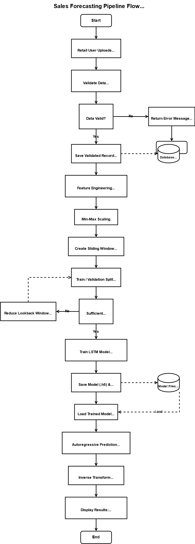
Design – Logical and flow charts
The forecasting pipeline is the core process of the system and follows a clearly defined sequential control flow:
The process begins when a user selects a product category, region, and forecast horizon on the Generate Forecast screen.
Step 1 – Data Availability Check: The system queries the database to count available records for the selected combination. If fewer than 90 records exist but at least 10 are available, the user is prompted with an option to proceed with reduced accuracy.
Step 2 – Model Selection: The user chooses between LSTM (primary deep learning model), ARIMA, or Exponential Smoothing (baseline models for comparison).
Step 3 – Forecast Generation: The selected model executes. For LSTM, this involves loading the pre-trained model, preparing sequential input data using a lookback window adapted to available data size, and generating predictions with Monte Carlo Dropout for confidence intervals.
Step 4 – AI Explanation: The forecast results are sent to the Pollinations AI API, which returns a natural language narrative explaining the predicted trend, growth rate, and business implications.
Step 5 – Visualization: Results are displayed as an interactive Plotly line chart with shaded confidence bands, alongside summary statistics, the AI explanation panel, and a comparison chart showing all three model forecasts overlaid.
This design decision to provide both numerical forecasts and natural language explanations addresses the stakeholder requirement for interpretable outputs that non-technical retail managers can act upon.

Slide 9
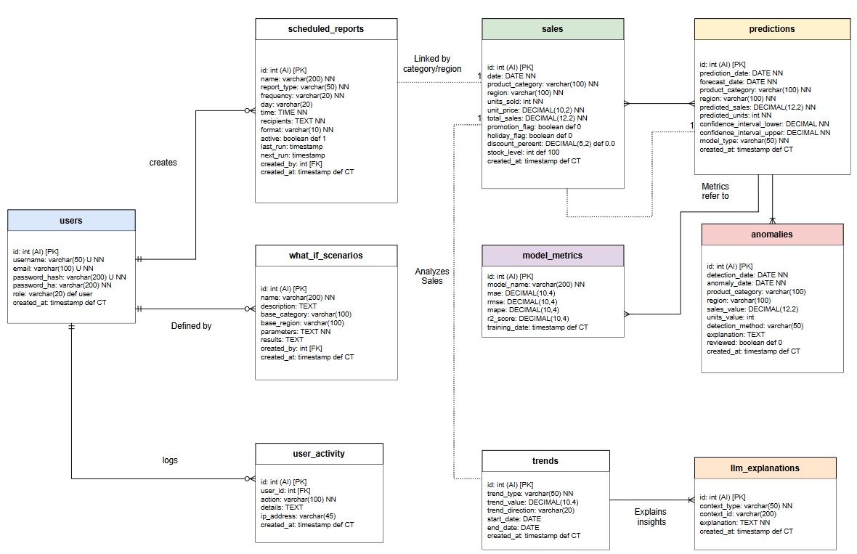
Design – Database Schema
This translates the logical model into a physical SQLite schema. The complete schema comprises ten tables with foreign key constraints and indexes for query performance.

Slide 10
Design – UI and Usability Principles
The user interface is designed using HTML, CSS, and JavaScript with a consistent dark-themed design language, featuring a fixed left-side navigation sidebar, card-based content areas, and Plotly.js interactive charts. The interface is fully responsive and accessible on any modern browser.
Key wireframe screens:
The Dashboard shows key performance metrics (total sales, monthly growth rate, total units, AI predictions count), a 30-day sales trend chart, a category distribution pie chart, and recent predictions immediately upon login.
The Generate Forecast screen (the primary research implementation) presents a three-card model selector (LSTM, ARIMA, Exponential Smoothing), dropdown menus for product category and region, a range slider for forecast period (7–90 days), and a real-time data availability indicator that queries the database when category and region are selected. After submission, results display as a summary statistics bar, an interactive line chart with shaded confidence bands, an AI insights panel with natural language narrative, and a model comparison chart.
Usability principles applied:
Minimizing user effort: Form fields include contextual validation feedback. The data availability indicator prevents failed forecast attempts.
Consistency: Same layout and interaction patterns across all eleven screens.
Feedback: Loading states and real-time validation messages guide user actions.
Role-based access: Administrator links (Model Training, User Management) appear only for admin users, reducing cognitive load for general users.

Slide 11
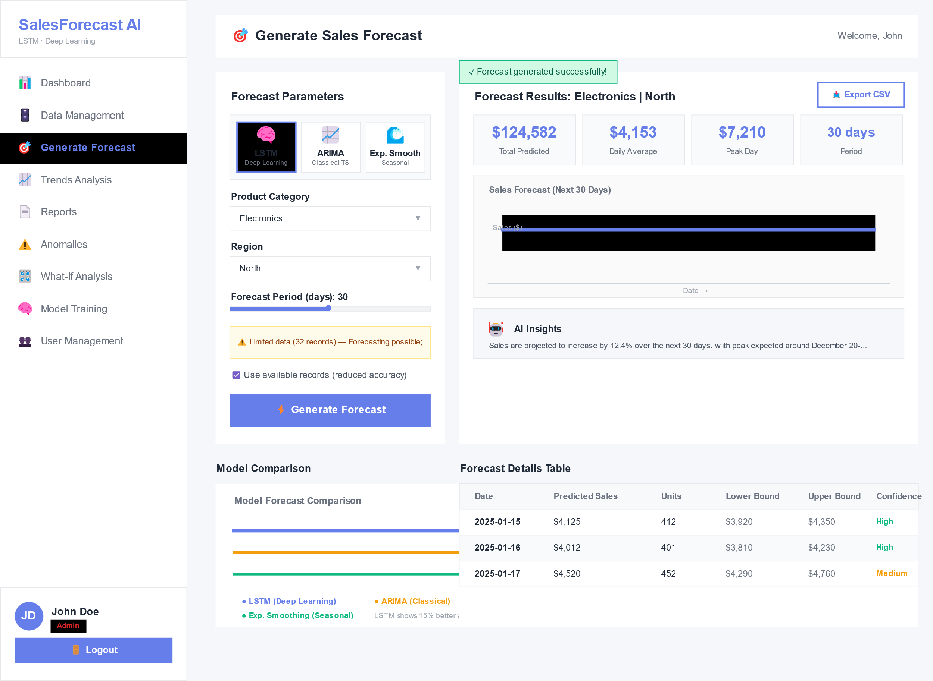
Wireframe – Forecast Page
wireframe for the Generate Forecast screen, which implements the primary research objective of the project.

Slide 12
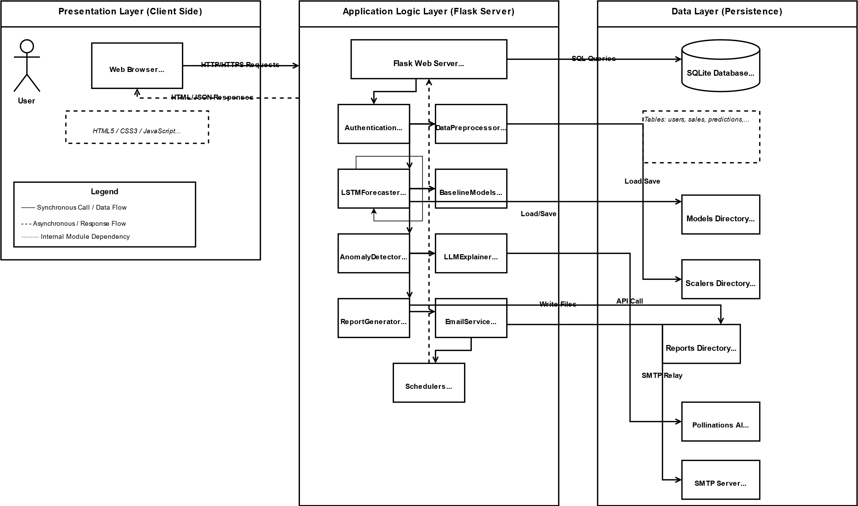
Design – System Architecture
The system follows a three-tier layered architecture comprising a Presentation Layer, an Application Logic Layer, and a Data Layer.
Presentation Layer: Eleven HTML templates rendered server-side by Flask, including Dashboard, Data Management, Generate Forecast, Trends Analysis, Reports, Anomaly Detection, What-If Analysis, Model Training, User Management, Login, and Register screens. All templates feature a consistent left-side navigation sidebar and Plotly.js interactive charts.
Application Logic Layer: Modular Python classes including LSTMForecaster, DataPreprocessor, BaselineModels, AnomalyDetector, LLMExplainer, ReportGenerator, EmailService, and background scheduler daemons.
Data Layer: SQLite relational database operating in WAL journaling mode, with trained LSTM model weights persisted as HDF5 (.h5) files.
This architecture was selected for its separation of concerns, independent testability of each component, and seamless Python integration for TensorFlow deep learning models.

