Slide 1
A DEEP LEARNING–BASED SALES FORECASTING AND TREND PREDICTION SYSTEM FOR RETAIL BUSINESS OPTIMIZATION
DEPARTMENT OF INFORMATION TECHNOLOGY
HENRY OCHIENG ONYANGO
SCT221-0262/2022
SUPERVISOR: DR. DENNIS KABURU

Slide 2
Background of the study
Sales forecasting plays a critical role in retail decision-making, influencing inventory control, supply chain management, and revenue planning. Traditionally, retailers have relied on statistical forecasting methods which often struggle with complex and non-linear sales patterns. With the increasing availability of sales data and advances in artificial intelligence, machine learning and deep learning techniques such as Long Short-Term Memory (LSTM) networks have gained prominence for time-series forecasting. This project is motivated by the growing need for more accurate, data-driven forecasting systems in modern retail environments.

Slide 3
Problem Statement
Many retail businesses continue to experience inaccurate sales forecasts due to reliance on classical forecasting methods that cannot effectively model seasonality, trends, and sudden changes in consumer behavior. Poor forecasting leads to overstocking, stock-outs, and financial losses. Although advanced AI models exist, their adoption is limited due to complexity and lack of interpretability. There is therefore a need for an intelligent sales forecasting system that improves prediction accuracy while remaining practical and understandable for retail decision-makers.

Slide 4
Project Proposal
This project proposes the development of an AI-based sales forecasting system that integrates Long Short-Term Memory (LSTM) networks with classical forecasting techniques. The system will analyze historical sales data, generate forecasts, and compare the performance of deep learning models against traditional statistical approaches. In addition, Large Language Models (LLMs) will be incorporated to support interpretation and explanation of forecast results, enhancing usability and decision support for retail managers.

Slide 5
Objectives
General Objective
To develop a deep learning-based sales forecasting and trend prediction system for retail business optimization.
Specific Objectives
To analyze historical retail sales data and identify patterns relevant to sales forecasting.
To implement classical statistical forecasting models as baseline methods for sales prediction.
To develop an LSTM-based deep learning model for retail sales forecasting.
To compare the forecasting accuracy of the LSTM model with classical forecasting techniques using standard evaluation metrics.

Slide 6
Research Questions
What patterns and trends can be identified from historical retail sales data that are relevant to sales forecasting?
How do classical statistical forecasting techniques perform when applied to retail sales data?
How effective is the LSTM-based model in forecasting retail sales compared to classical forecasting methods?
To what extent does the LSTM model improve forecasting accuracy over classical techniques based on MAE, RMSE, and MAPE?

Slide 7
Methodology
The project adopts the Design Science Research Methodology to guide the development of the forecasting system. Historical retail sales data will be collected, cleaned, and prepared for analysis. Classical forecasting models and LSTM networks will be implemented and trained on the data, followed by performance evaluation using error metrics such as MAE and RMSE. The methodology supports iterative design, implementation, and evaluation to ensure the system effectively addresses the identified problem.

Slide 8
Literature Review
Existing literature indicates that classical forecasting methods are easy to interpret and computationally efficient but perform poorly with complex and volatile sales data. Recent studies demonstrate that LSTM networks provide higher accuracy by capturing non-linear patterns, trends, and seasonality in time-series data. Emerging research also highlights the potential of Large Language Models in explaining predictive outputs and supporting decision-making, although their application in sales forecasting remains limited.

Slide 9
Research Gaps
Despite the success of LSTM models in time-series forecasting, limited research has focused on comparing them directly with classical methods in practical retail settings. Additionally, few studies integrate interpretative tools such as Large Language Models to enhance usability and understanding of forecasting outputs. This project addresses these gaps by combining predictive accuracy with explainable AI for improved retail decision support.

Slide 10
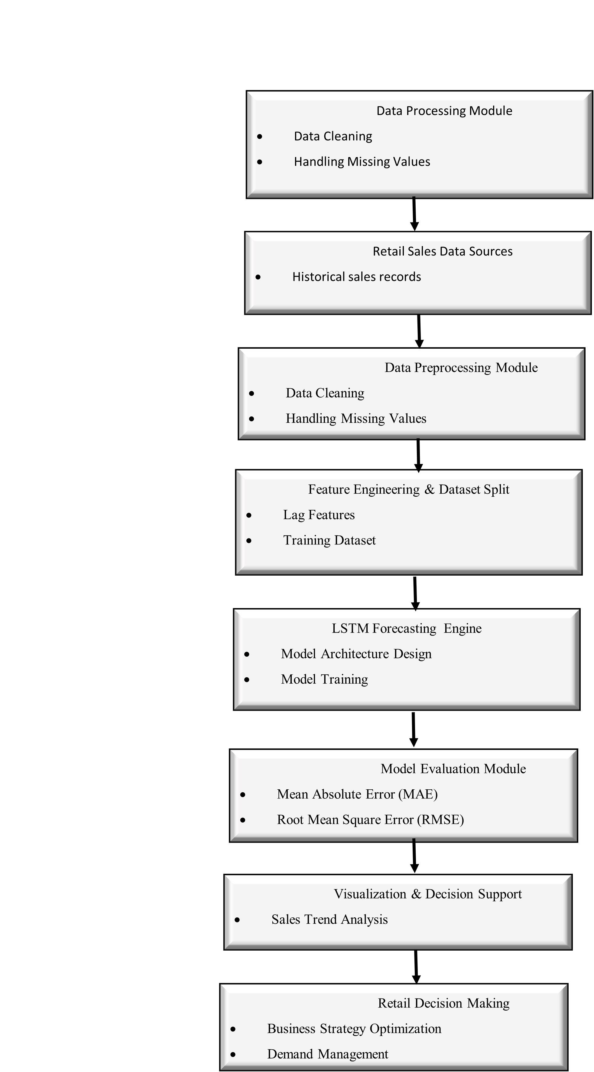
System Architecture

Slide 11
Budget
Item | Quantity | Unit Cost (KSh) | Total Cost (KSh)
Laptop | 1 | Owned | -
Cloud Computing (Google Colab Pro – 6 months) | 1 | 6,000 | 6,000
Internet & Data | 6 months | 1,000 | 6,000
Printing & Binding | — | — | 1,000
Miscellaneous | — | — | 1,000
Total Estimated Cost |  |  | 14,000

Slide 12
Project Schedule
Activity | Month 1 | Month 2 | Month 3 | Month 4 | Month 5 | Month 6
Proposal Writing & Approval | ███
Literature Review | ███ | ███
Requirements Analysis |  | ███
Data Collection |  | ███ | ███
Data Preprocessing |  |  | ███
Model Design (LSTM Architecture) |  |  | ███ | ███
Model Training & Validation |  |  |  | ███ | ███
System Integration & Testing |  |  |  |  | ███
Results Analysis & Evaluation |  |  |  |  | ███
Final Report Writing |  |  |  |  | ███ | ███
Submission & Presentation |  |  |  |  |  | ███

Slide 13
THANK YOU

