Slide 1


GENDER VIOLENCE
Violence Against Women and Girls
Mid-Term Project: Hend Ismail
Notes:
slidesppt.net

Slide 2
Agenda Style
01
Introduction
02
Features Transformation
03
Analysis Questions
04
Result
05
Steps of the Dataset
06
Conclusion

Slide 3
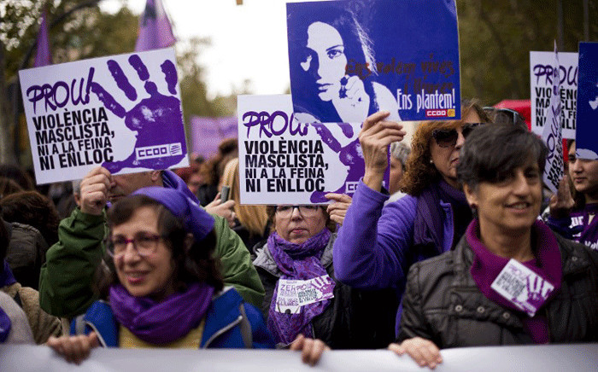
Introduction
Violence against women and girls is a global
pandemic which affects 1 in 3 women in their
lifetime. This issue causes a significant future cost if developing countries fail to address it.
As a result, reducing violence against women
and girls require sustained engagement
between the community and multiple
stakeholders and a multi-approach such as
increasing social norms regarding gender roles.
International Day for the Elimination of Violence against Women (2018)

Slide 4

The Importance of Preventing Gender Violence and the World Economy
Investing in, and prioritising, the prevention of violence against women and girls is critical for achieving positive social, economic and political impacts for all.
VAWG costs countries and governments billions of dollars in healthcare and legal costs, all of which could be saved and redirected to other needs, if it were prevented.
For example,
In 2016, the cost of VAWG globally was approximately US$1.5 trillion. That is approximately 2% of the global gross domestic product (GDP)
Notes:
slidesppt.net

Slide 5

The Initiative is so named as it brings focused attention to this issue, bringing it into the spotlight and placing it at the centre of efforts.
To achieve the 2030 Agenda for Sustainable Development including Women empowerment.

Slide 6

Feature Transformation:
Data Analysis

Slide 7
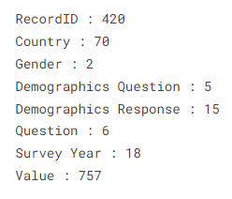
Features of the Dataset
This Dataset includes a survey taken from men and women in 70 Developing countries, such as Africa, Asia and South America.
The survey explores the attitudes and perceived justifications given for committing acts of violence toward women and girls.
Shows the sociodemographic factors including: Education Level, Marital status, Residence, Employment and Age group (how these factors affect committing any acts of violence against women and girls).
Notes:
slidesppt.net

Slide 8
If She
she burns the food
argues
goes out without telling
neglects the children
refuses to have sex
at least one specific reason
Record ID | Numeric value unique to each question by country.
Country | Place survey was conducted.
Gender | Male or Female.
Demographics Question | Marital status, education level, employment status, residence type, or age.
Demographic Response | Demographic segment into which the respondent falls.
Question | Describing what reasons are used to justify Violence against women and girls.
Survey Year | Year in which the Demographic and Health Survey (DHS) took place.
Value | % of people surveyed in the relevant group who agree with the Justifications of Violence against women and girls.
Notes:
slidesppt.net

Slide 9
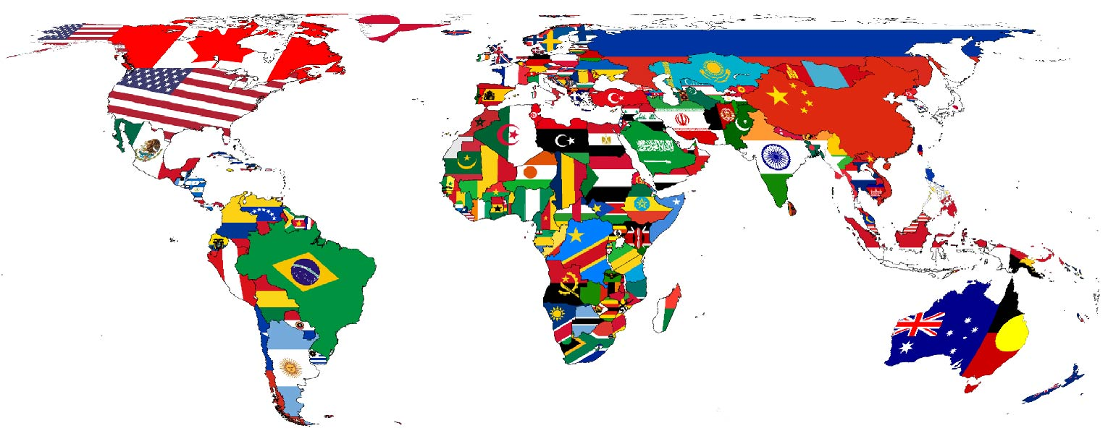
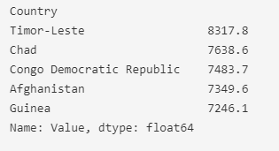
Analysis Questions
What are the top 5 maximum countries that used violence against women and girls?
Notes:
slidesppt.net

Slide 10
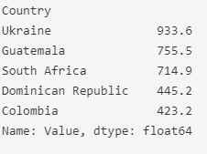
What are the least 5 minimum countries that used violence against women and girls?

Slide 11

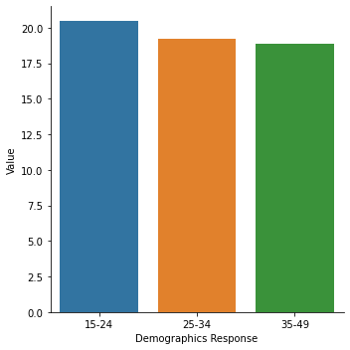
What is the most exposed age group?
The most exposed age group is 15-24, with a median of 17.50 and a max of 80.1, while the absolute max is for 25-34 age group.

Slide 12
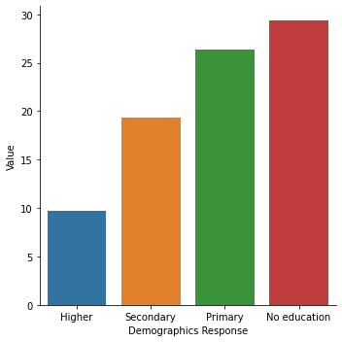

Is Education level could make a difference in reducing violence against women and girls?
Higher education level will ensure a small median per cent of 4.2%, while No education shows a 21.55% median and an 82% maximum violence per cent.

Slide 13

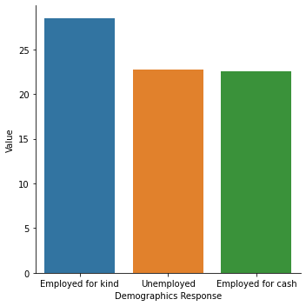
Do employed women tend to be more exposed to violence than unemployed women?
Employment factor: the median is varying from 14.55% to 20.15%. The women that work tend to be more exposed to violence.

Slide 14
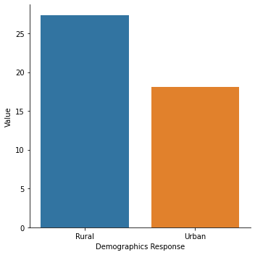
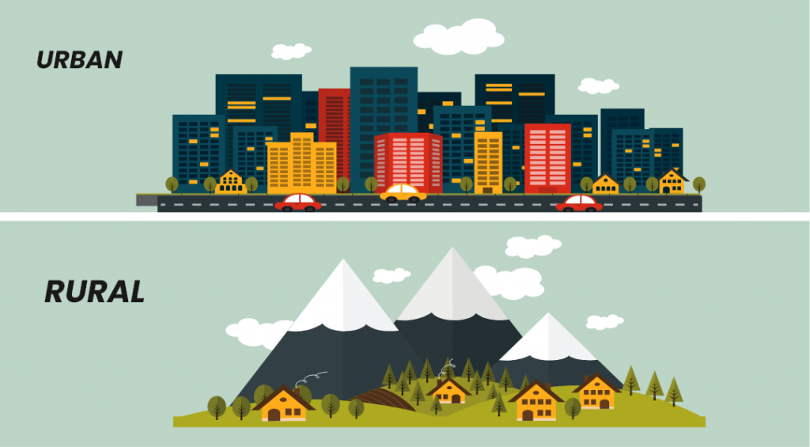
Where does violence against women expose more? (Hint: Rural or Urban)?
Women living in Rural areas tend to be exposed to violence more than Women living in Urban areas.

Slide 15
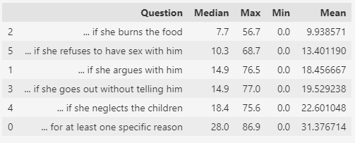
Which Question is most used to justify violence against women and girls?
If She
Burning Food
If She
Goes out without telling him
Neglects the children
At least one specific reason
Argue with him

Slide 16
Result Summary
Age: 15-24 | Status: Married | Justification for Violence: ”For at least one specific reason”
Education: no | Residence: Rural | Employment: Yes
Africa
Notes:
slidesppt.net

Slide 17
Steps of the Dataset
Explore the Data
Handling Missing Values
Handling Datetime
Analyse the columns (Univariate analysis, Bivariate)
Pre- processioning of the Data
Answering Analysis Questions
Handling Outliers.
Drop the unused Columns.
Split x and Y.
Dealing with Categorical Data.
Nominal “no arrangement” (One Hot Encoding), Ordinal “by order” (label encoding (prefer to be done manually).
Split data into Train and Test.
Handling Imbalance Data. (only for classification data)
Feature Scaling.

Slide 18
Conclusion
Violence against women continues to be an obstacle to achieving equality and peace (Human Rights).
the Sustainable Development Goals (SDGs) can not be achieved without putting an end to violence against women and girls.

