Slide 1


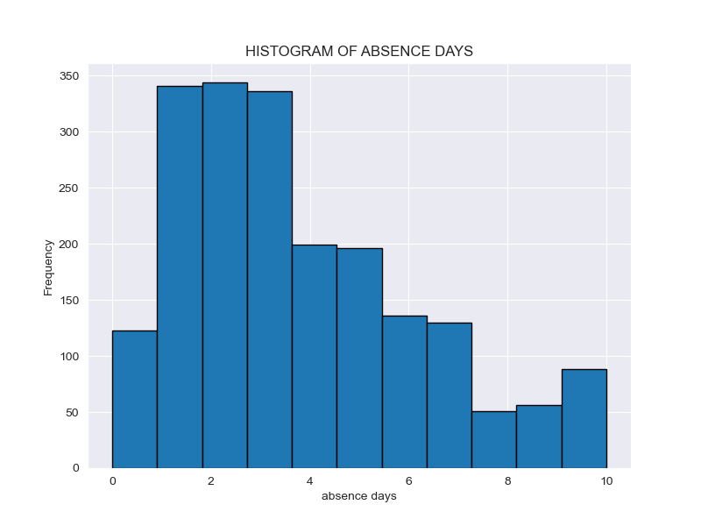
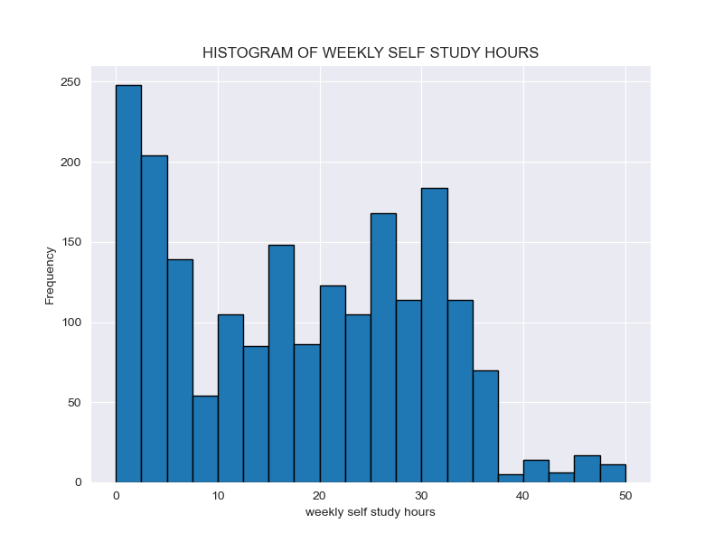
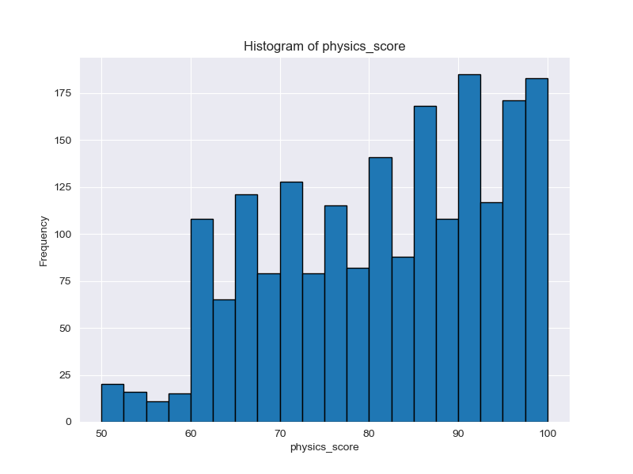
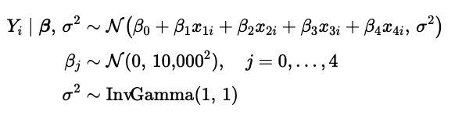
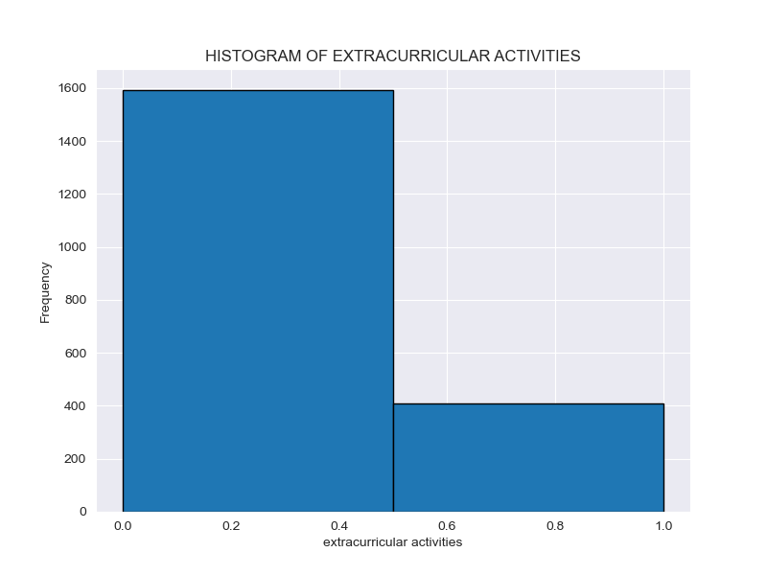
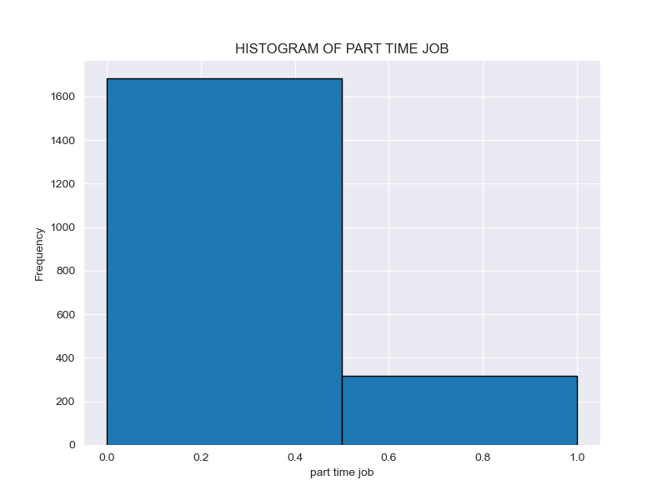
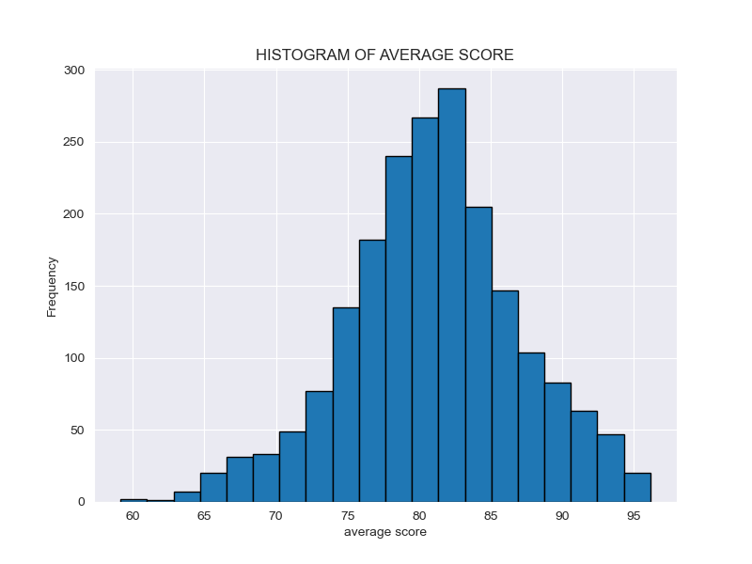
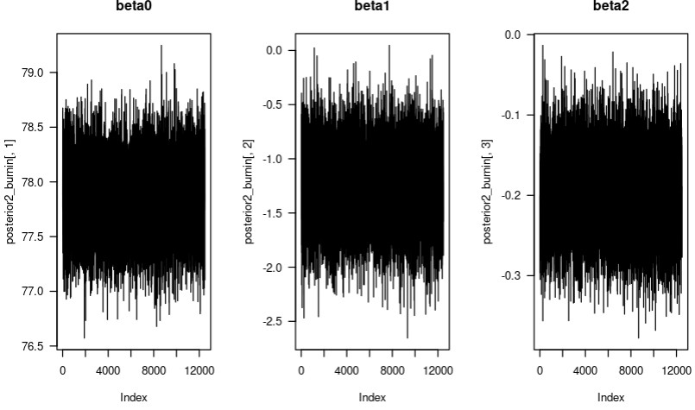
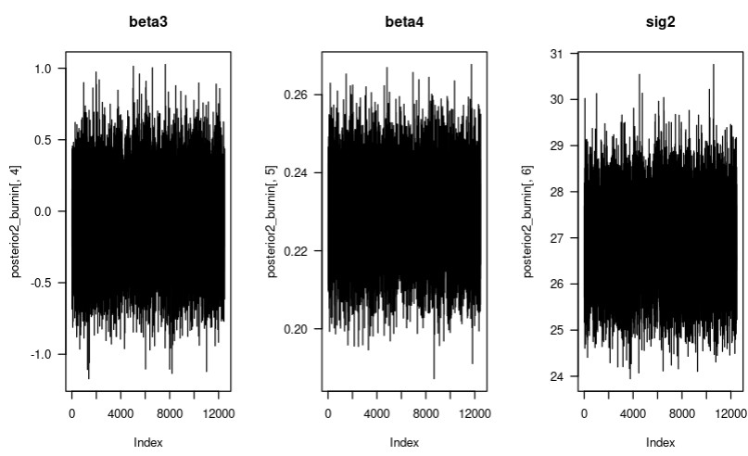
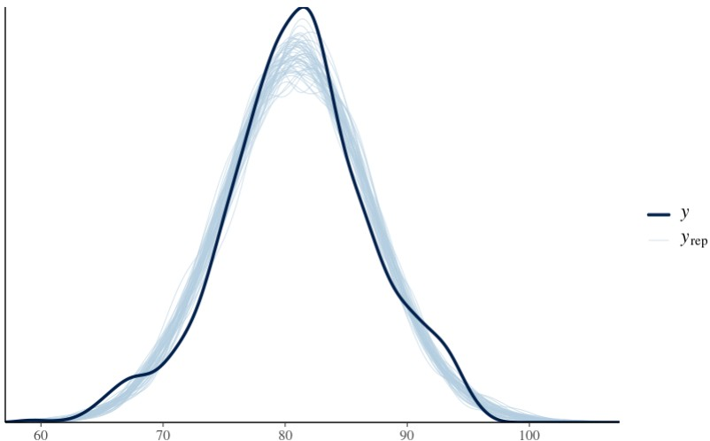
Student Performance | Group I
Authors: Andrew Henderson, Carlos Mabrey, Seth Hillis, Jessica Reyes
STAT 440 | Bayesian Data Analysis - Colorado State University
Exploratory Data Analysis
Algorithm Outline
Define response variable (y) and predictor variables (x)
* Response variable: average_score
* Predictor variables: part_time_job, absence_days, extracurricular_activities, self_study_hours
#Create design matrix X
* X, n, p
#Set hyperparameters
* tau², a, b, mu0, S
#Place to store data for posterior samples (& the starting values)
* beta, sigma²
#Compute transpose of design matrix X & transpose of X and vector y
* XX, Xy
#For loop
* Compute variance
* Compute mean
* Update beta
* Update Sig²
#Store results for posterior samples (beta & sigma²)
#Remove burn-in (50%)
Frequency
Frequency
Frequency
Days Absent
Weekly Study Hours
Physics Score
Frequency
Frequency
Frequency
Extra Curricular Activities (0=No)
Part Time Job (0=No)
Gender (0=Famale)
Statement of Research Question
What are the effects of part_time_job, absence_days, extracurricular_activities, weekly_self_study_hours have on student performance (average_score).
Statement of Model & Justification
Block Gibbs Sampler –It handles more complex models with lots of predictor variables.
Rstanarm – Assumes distributions from the data, does not need to be given the prior distributions explicitly.
Model Checking
Interpretation of Results
.
The random intercept shows a student that has no job, no extra curriculars, present every day, and no study hours each week earn a 77.84% on average, with SD of 0.31%
Students with a part time job are expected to have an average grade difference of -1.27% points on the estimated average grade, with a SD of 0.33%
Each day a student is absent their grade is expected to change by -0.20% per day they are absent, with a SD of 0.05%
Students who participate in extra curricular activities show an average difference of -0.09% points with a SD of 0.29%
Each hour per week a student studies shows and average change of 0.23% per hour with a SD of 0.01%
Random Intercept
Part Time Job
Absent Days
Extra Curricular Activities
Weekly Study Hours
Sig2
Conclusions
The largest indicator for a student's grade from our project is the weekly self study hours. With an average increase of .23% increase in their grade per hour studied each week.
The next most important indicator is the absence days, which shows an average of .20% per day the student miss class.
The part time job indicator shows a minor impact of -1.27% on a student's grade if they have a part time job
The least impactful indicator was extracurricular activities only showing an average change of -0.09%, which is smaller than its’ standard deviation.

