Slide 1


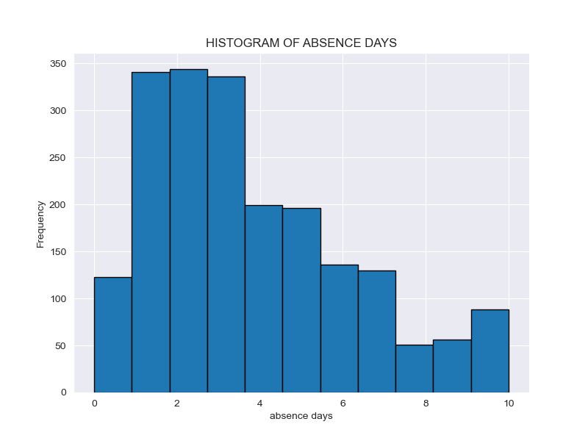
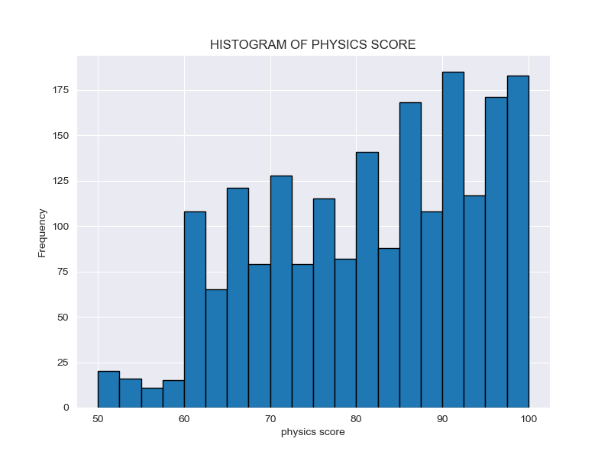
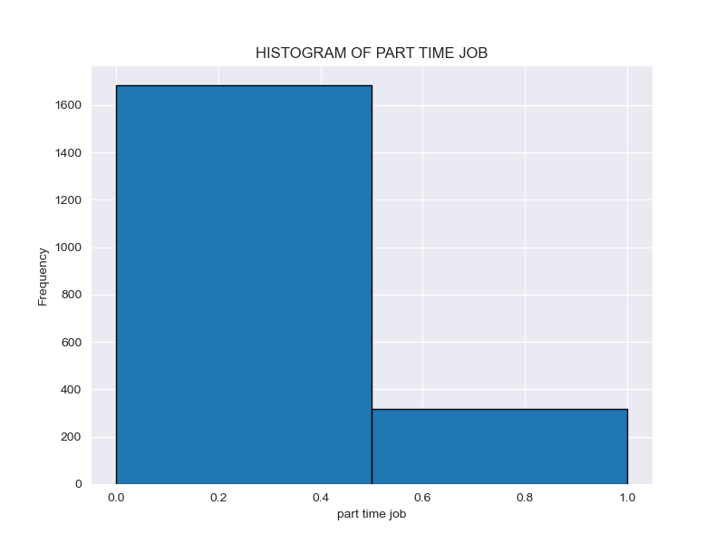
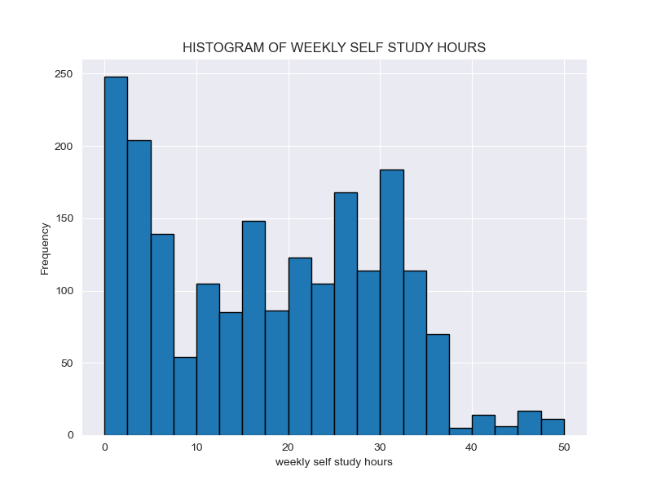
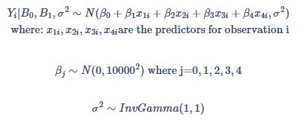
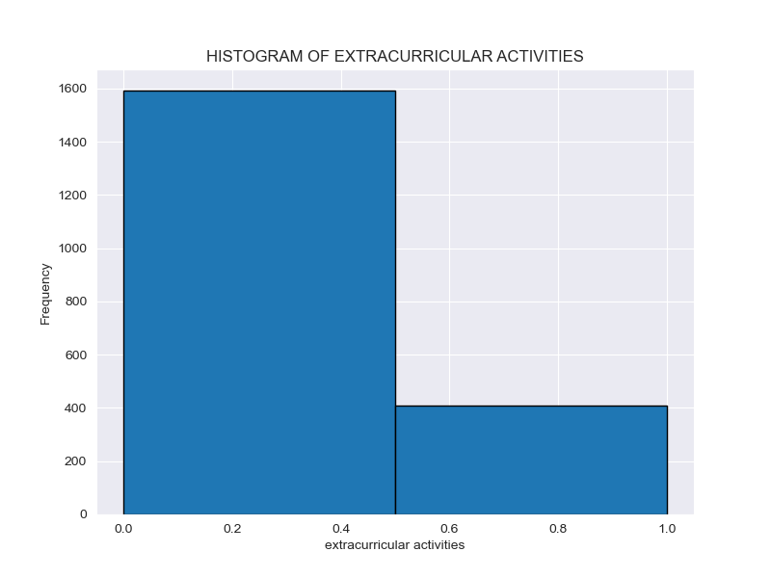
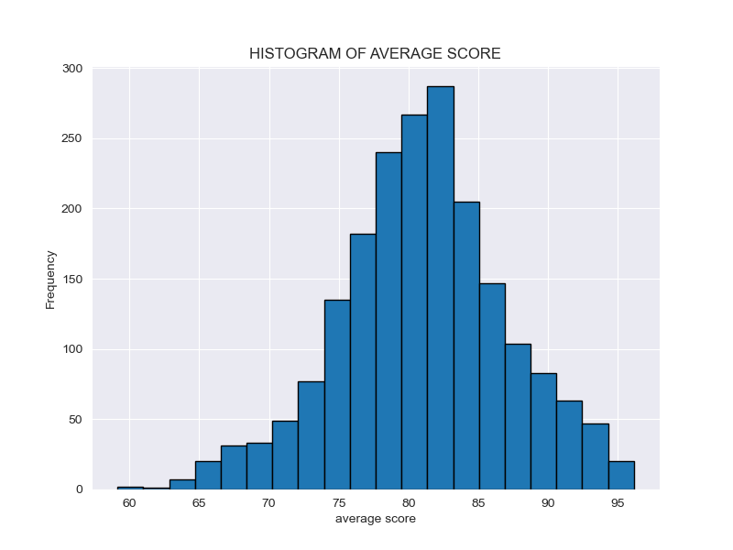
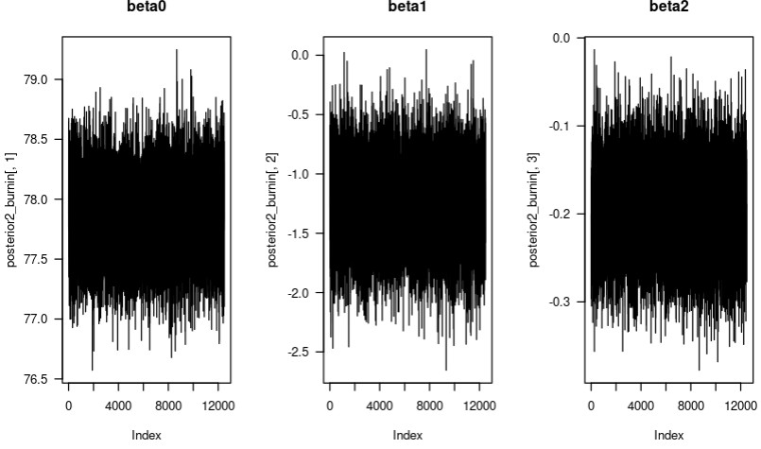
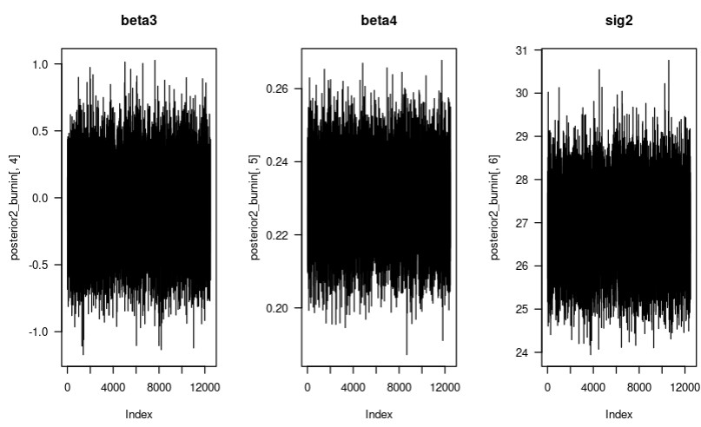
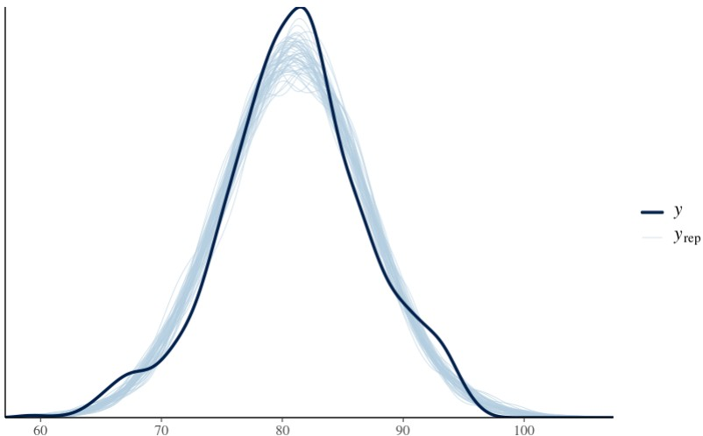
Student Performance | Group I
Authors: Andrew Henderson, Carlos Mabrey, Seth Hillis, Jessica Reyes
STAT 440 | Bayesian Data Analysis - Colorado State University
Exploratory Data Analysis
Algorithm Outline
Response variable: average_score
Predictor variables: part_time_job, absence_days, extracurricular_activities, self_study_hours
Design Matrix: cbind(1, x1, x2, x3, x4)
#Gave values for Hyperparameters
#Place to store data
#For loop
* Update beta
* Update Sig2
#Store results
#Remove burn-in
Statement of Research Question
What are the effects of part_time_job, absence_days, extracurricular_activities, weekly_self_study_hours have on student performance (average_score).
Statement of Model & Justification
Block Gibbs Sampler –It handles more complex models with lots of predictor variables.
Rstanarm – Assumes distributions from the data, does not need to be given the prior distributions explicitly.
Model Checking
Interpretation of Results
.
Conclusions

