Slide 1


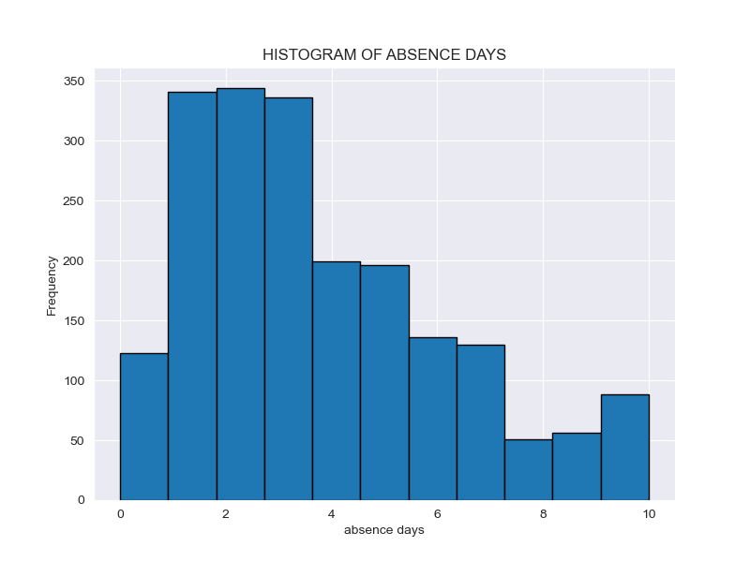
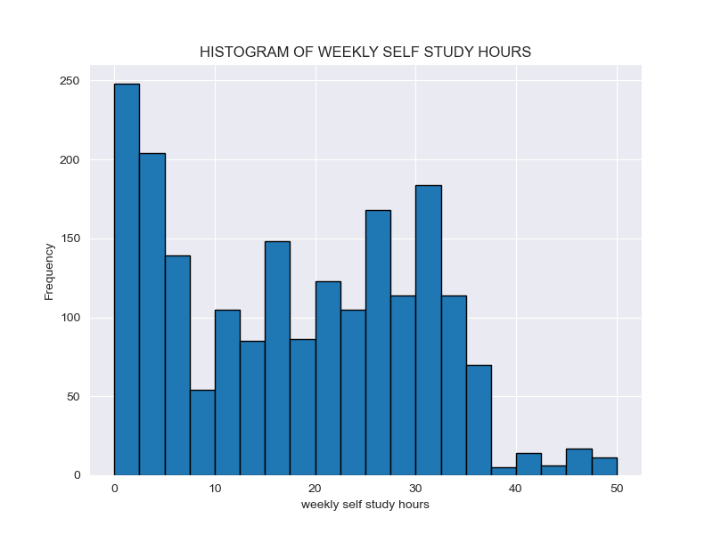
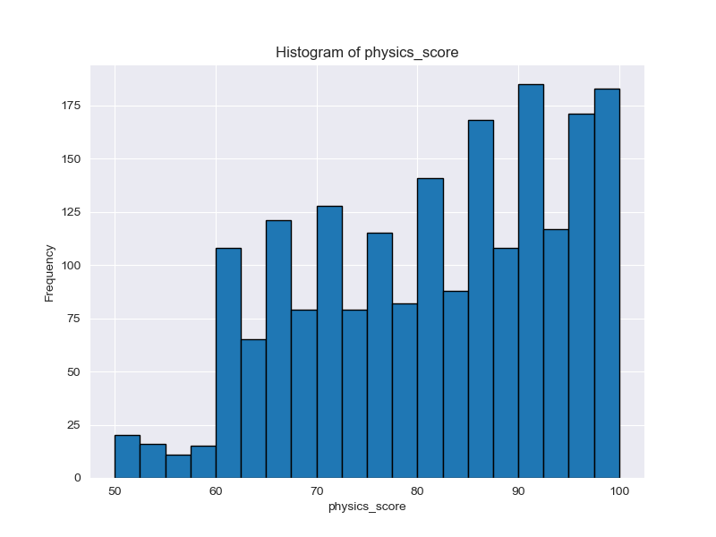
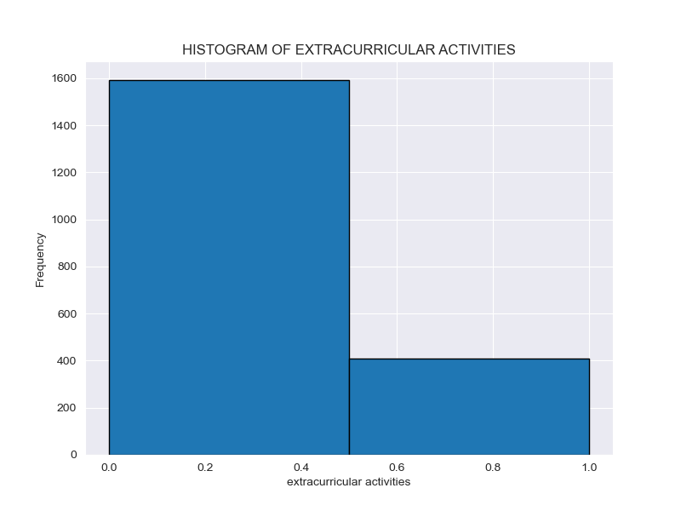
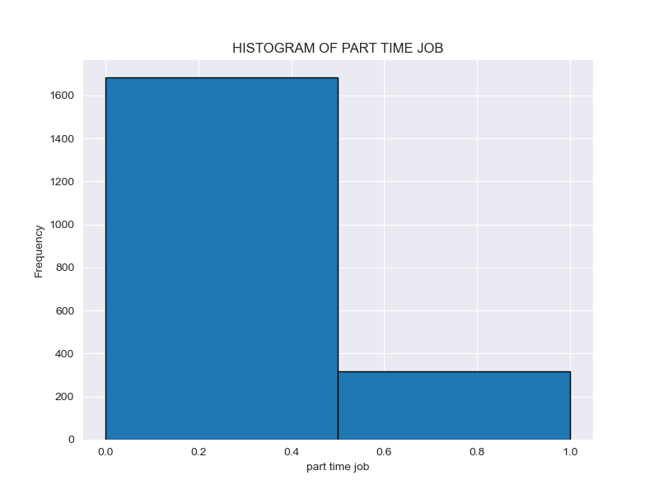
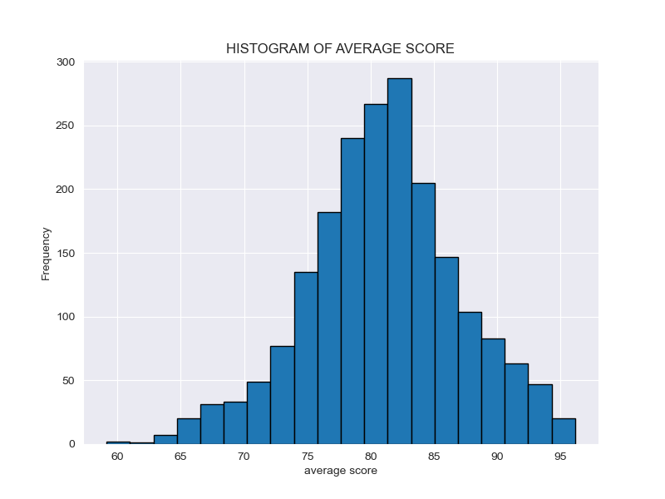
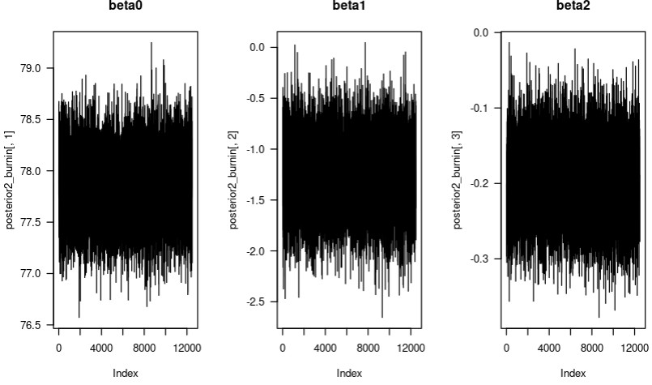
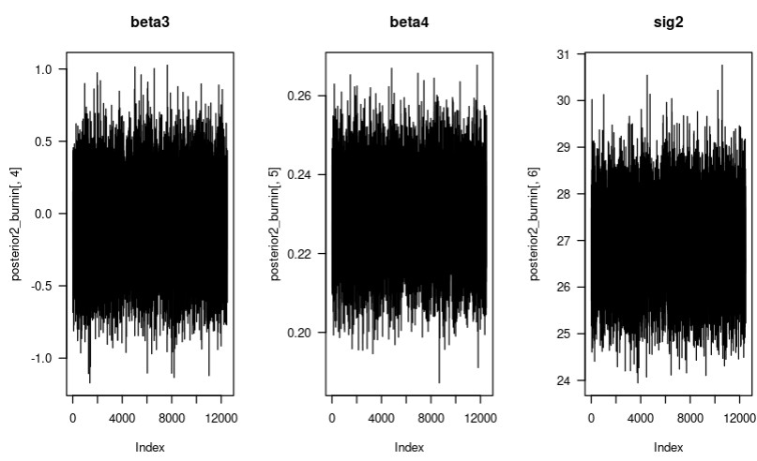
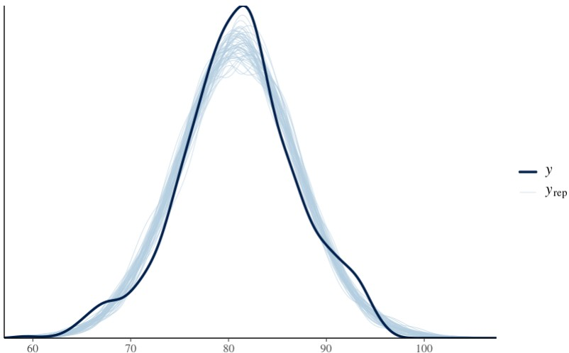
Student Performance | Group I
Authors: Andrew Henderson, Carlos Mabrey, Seth Hillis, Jessica Reyes
STAT 440 | Bayesian Data Analysis - Colorado State University
Exploratory Data Analysis
Algorithm Outline
Frequency
Frequency
Frequency
Days Absent
Weekly Study Hours
Physics Score
Frequency
Frequency
Frequency
Extra Curricular Activities (0=No)
Part Time Job (0=No)
Gender (0=Famale)
Statement of Research Question
What are the effects of part_time_job, absence_days, extracurricular_activities, weekly_self_study_hours have on student performance (average_score).
Statement of Model & Justification
Block Gibbs Sampler –It handles more complex models with lots of predictor variables.
Rstanarm – Assumes distributions from the data, does not need to be given the prior distributions explicitly.
Model Checking
.
Interpretation of Results
Conclusions

