Slide 1


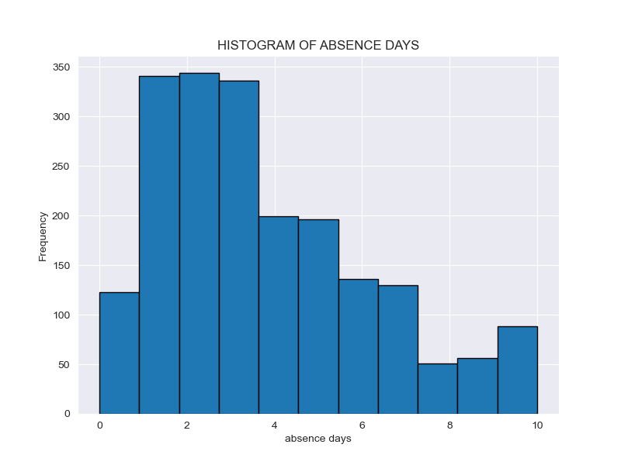
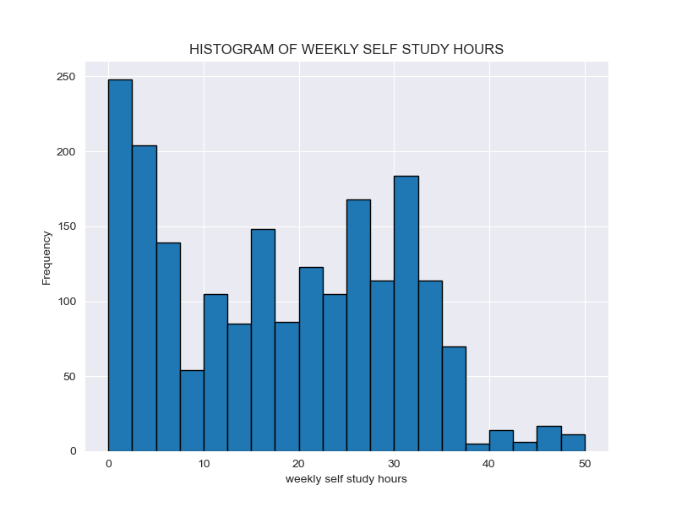
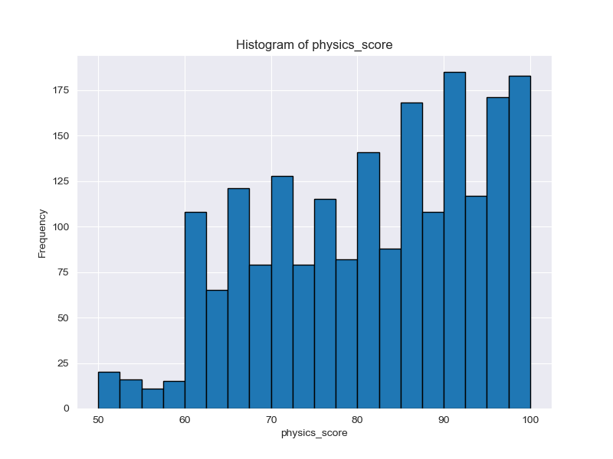
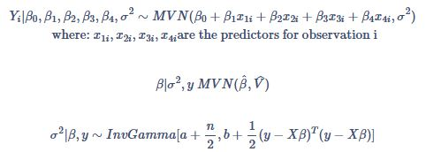
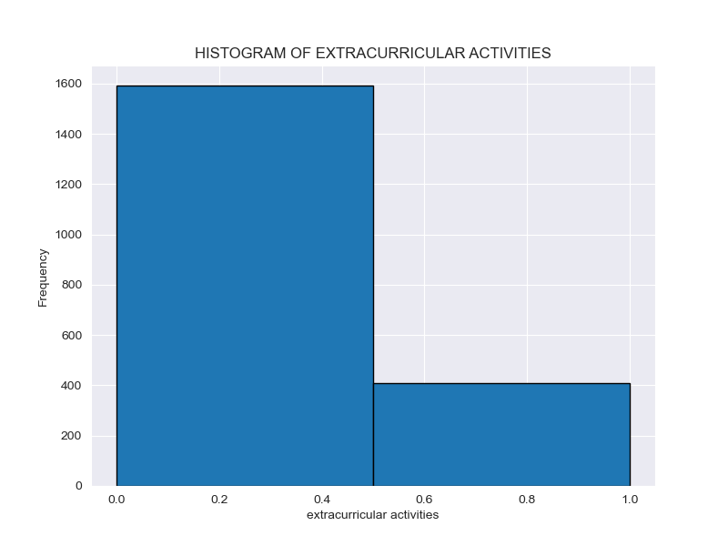
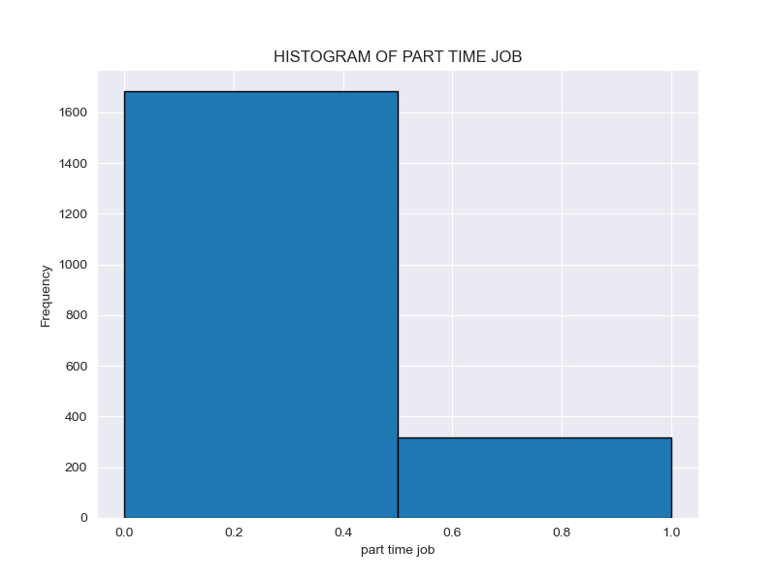
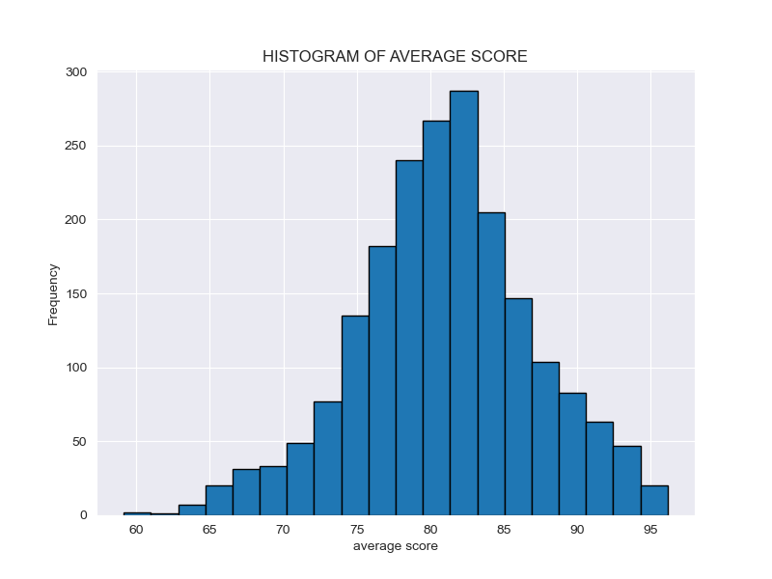
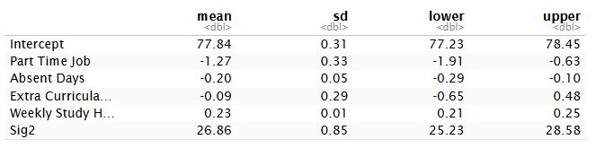
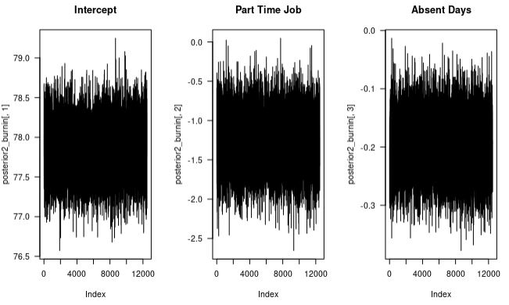
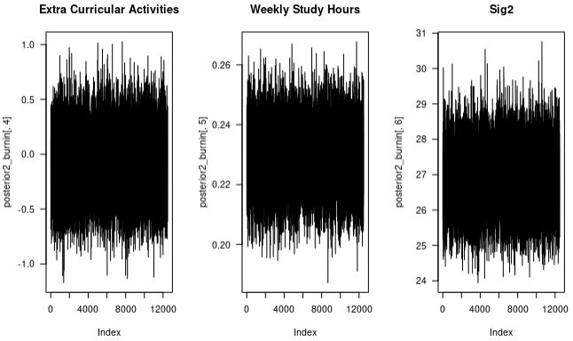
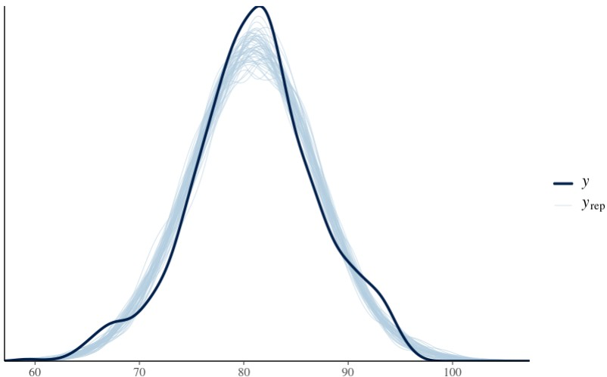
Student Performance | Group I
Authors: Andrew Henderson, Carlos Mabrey, Seth Hillis, Jessica Reyes
STAT 440 | Bayesian Data Analysis - Colorado State University
Exploratory Data Analysis
Algorithm Outline
Model checking included results from both our Block Gibbs Sampler and rstanarm to compare outcomes.
The results table is based on the output from our Block Gibbs Sampler.
Exploratory data analysis graphs were created in Jupyter notebook using Python.
We analyzed results from both models to ensure good convergence from the trace plots (Block Gibbs Sampler) and posterior predictive checks (rstanarm).
Frequency
Frequency
Frequency
Days Absent
Weekly Study Hours
Physics Score
Frequency
Frequency
Frequency
Extra Curricular Activities (0=No)
Part Time Job (0=No)
Gender (0=Famale)
Statement of Research Question
What effects do part time jobs, absences, extracurricular activities, and weekly self study hours have on student academic performance (average score)?
Statement of Model & Justification
Interpretation of Results
Block Gibbs Sampler – Handles complex models with many predictor variables.
RStanarm – Assumes distributions from the data; no need to specify them manually.
Both models were used to compare outcomes, which were highly consistent across methods.
Intercept
A student with no job, no extracurriculars, zero absences, and no study hours per week is expected to earn an average grade of 77.84% (SD = 0.31%).
Part-Time Job
Students with a part-time job earn 1.27% lower grades on average (SD = 0.33%). 95% CI: [-1.91, -0.63] → Negative association
Absent Days
Each day absent leads to a 0.20% drop in grade (SD = 0.05%).
95% CI: [-0.29, -0.10] → Likely negative effect
Extracurricular Activities
Associated with a -0.09% difference in grades (SD = 0.29%).
95% CI: [-0.65, 0.48] → Uncertain effect (includes 0)
Weekly Study Hours
Each additional study hour per week increases grades by 0.23% (SD = 0.01%).
95% CI: [0.21, 0.25] → Strong positive effect
Model Checking
.
Conclusions
The most important indicator on student grades was weekly self study hours. With an average increase of .23% increase in their grade per hour studied each week.
The second strongest indicator was absence days, showing an average of .20% per day the student miss class.
The part time job indicator shows a minor impact of -1.27% on a student's grade if they have a part time job.
The least impactful indicator was extracurricular activities only showing an average change of -0.09%, which is smaller than its’ standard deviation.

