Slide 1


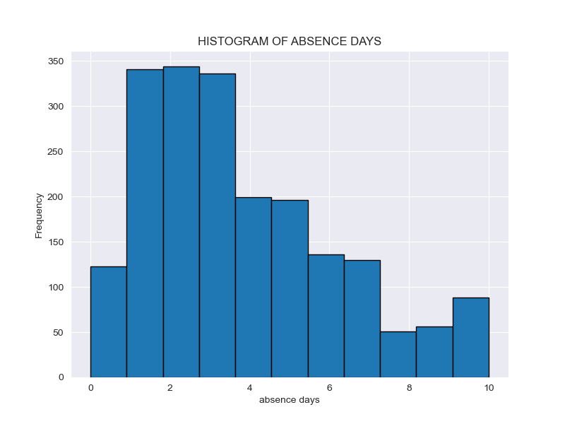
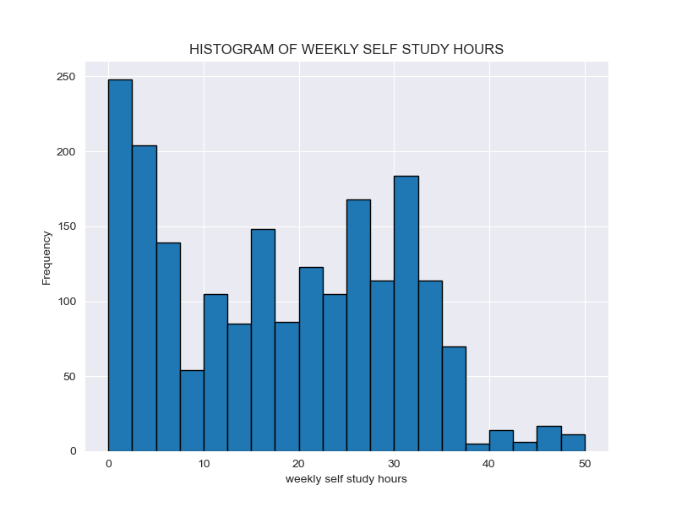
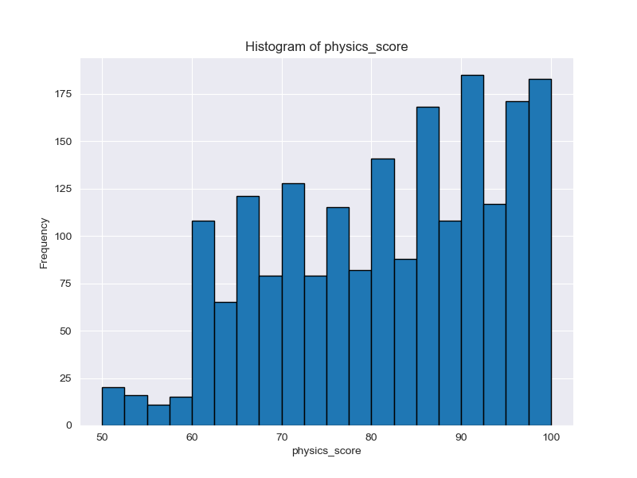
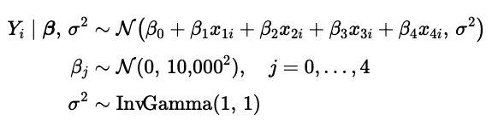
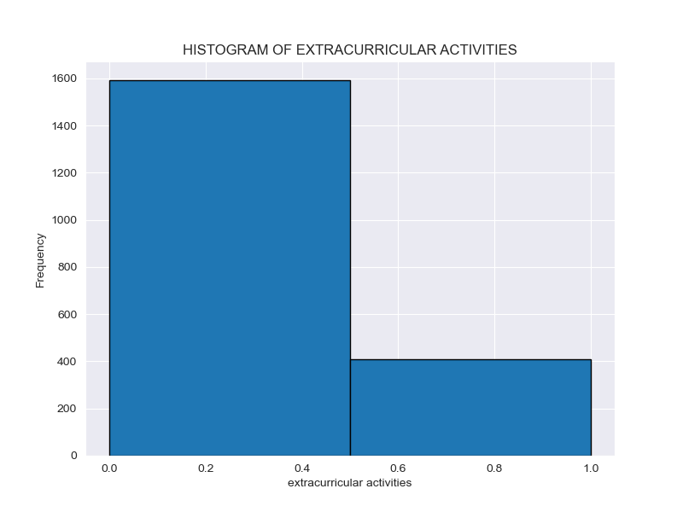
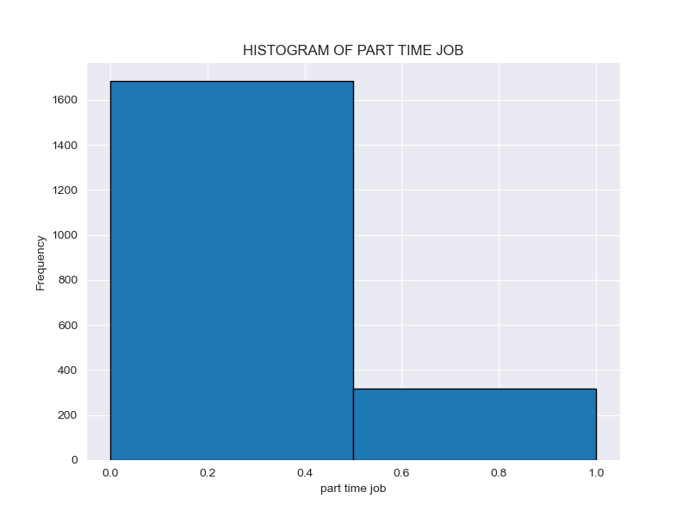
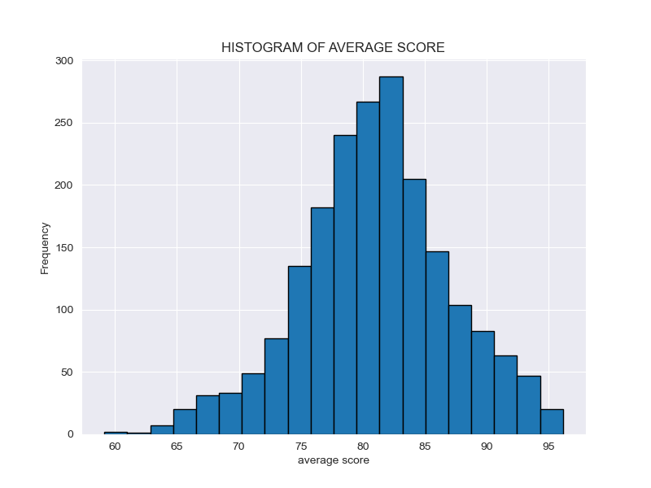
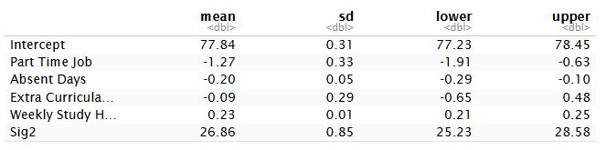
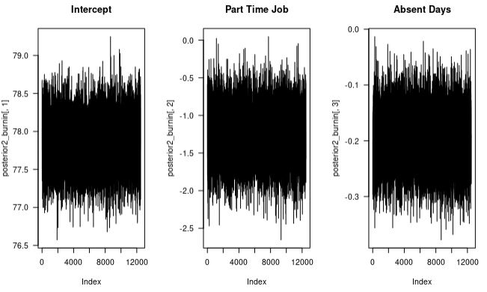
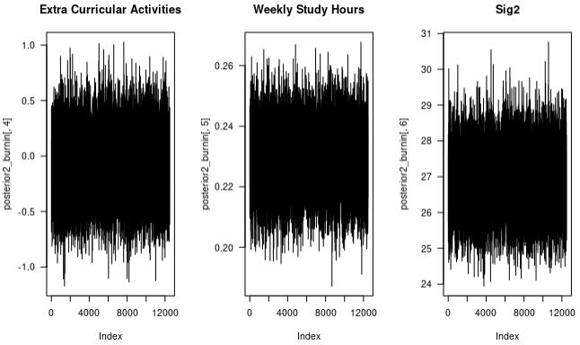
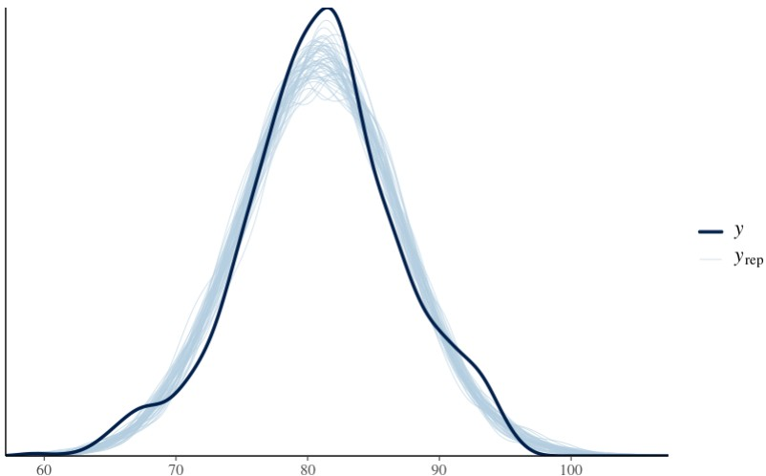
Student Performance | Group I
Authors: Andrew Henderson, Carlos Mabrey, Seth Hillis, Jessica Reyes
STAT 440 | Bayesian Data Analysis - Colorado State University
Exploratory Data Analysis
Algorithm Outline
Model checking included results from both our Block Gibbs Sampler and rstanarm, to compare outcomes.
The table of results is based on the output from our Block Gibbs Sampler.
Exploratory data analysis graphs were created in Jupyter notebook using Python.
We analyzed results from both models to ensure good convergence from the trace plots (Block Gibbs Sampler) and posterior predictive checks (rstanarm).
Frequency
Frequency
Frequency
Days Absent
Weekly Study Hours
Physics Score
Frequency
Frequency
Frequency
Extra Curricular Activities (0=No)
Part Time Job (0=No)
Gender (0=Famale)
Statement of Research Question
What are the effects of part_time_job, absence_days, extracurricular_activities, weekly_self_study_hours have on student performance (average_score).
Statement of Model & Justification
Interpretation of Results
Block Gibbs Sampler –It handles more complex models with lots of predictor variables.
Rstanarm – Assumes distributions from the data, does not need to be given the prior distributions explicitly.
*We used both models to compare results (although they were very similar).
The intercept shows a student that has no job, no extra curriculars, present every day, and no study hours each week earn a 77.84% on average, with SD of 0.31%
Students with a part time job are expected to have an average grade difference of -1.27% points on the estimated average grade, with a SD of 0.33%. The 95% credible interval is [-1.91, -0.63], suggesting a meaningful negative association.
Each day a student is absent their grade is expected to change by -0.20% per day they are absent, with a SD of 0.05%. The 95% credible interval is [-0.29, -0.10], indicating a likely negative effect.
Students who participate in extra curricular activities show an average difference of -0.09% points with a SD of 0.29%. The 95% credible interval is [-0.65, 0.48], which includes 0, suggesting the effect is uncertain.
Each hour per week a student studies shows and average change of 0.23% per hour with a SD of 0.01%. The 95% credible interval is [0.21, 0.25], indicating a strong positive association.
Model Checking
.
Conclusions
The largest indicator for a student's grade from our project is the weekly self study hours. With an average increase of .23% increase in their grade per hour studied each week.
The next most important indicator is the absence days, which shows an average of .20% per day the student miss class.
The part time job indicator shows a minor impact of -1.27% on a student's grade if they have a part time job
The least impactful indicator was extracurricular activities only showing an average change of -0.09%, which is smaller than its’ standard deviation.

