Slide 1
Alec Henderson
Sedan Analysis

Slide 2
Yo Andrew
I am super not familiar with powerpoints so feel free to edit and reorganize text to give things a better flow.
I tend to add too much info so creative freedom with cutting text is also fine.
Data visualization is definitely something that I am improving upon
Thank you

Slide 3
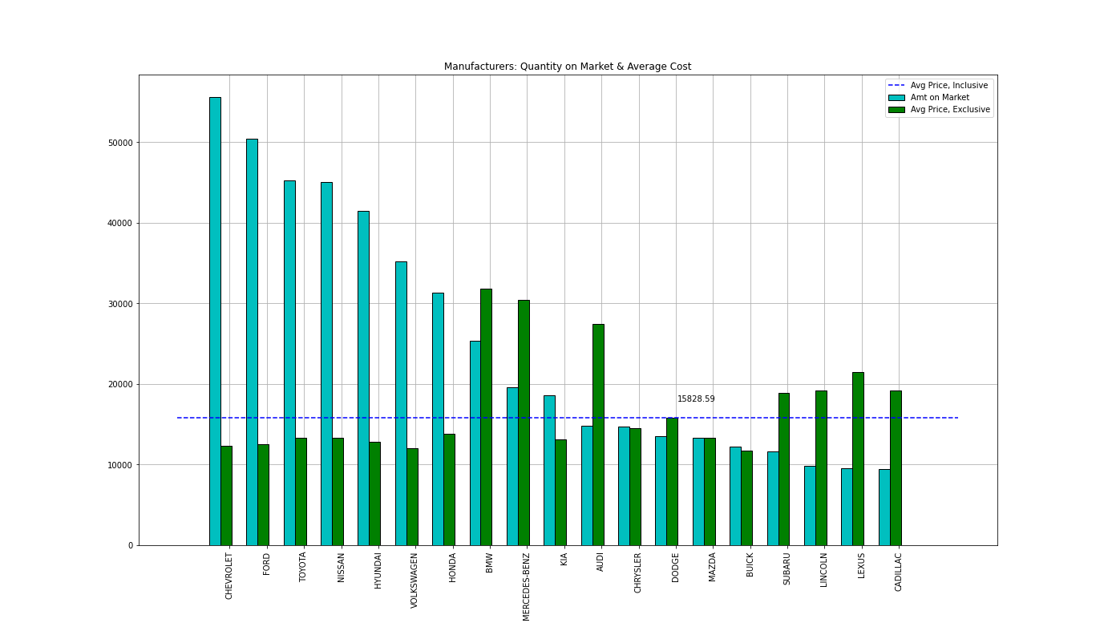
Who are the most popular?
Items are popular for a reason.
The price and quantity available shift according to a few factors.
This bar chart is all inclusive and needs filtering.

Slide 4
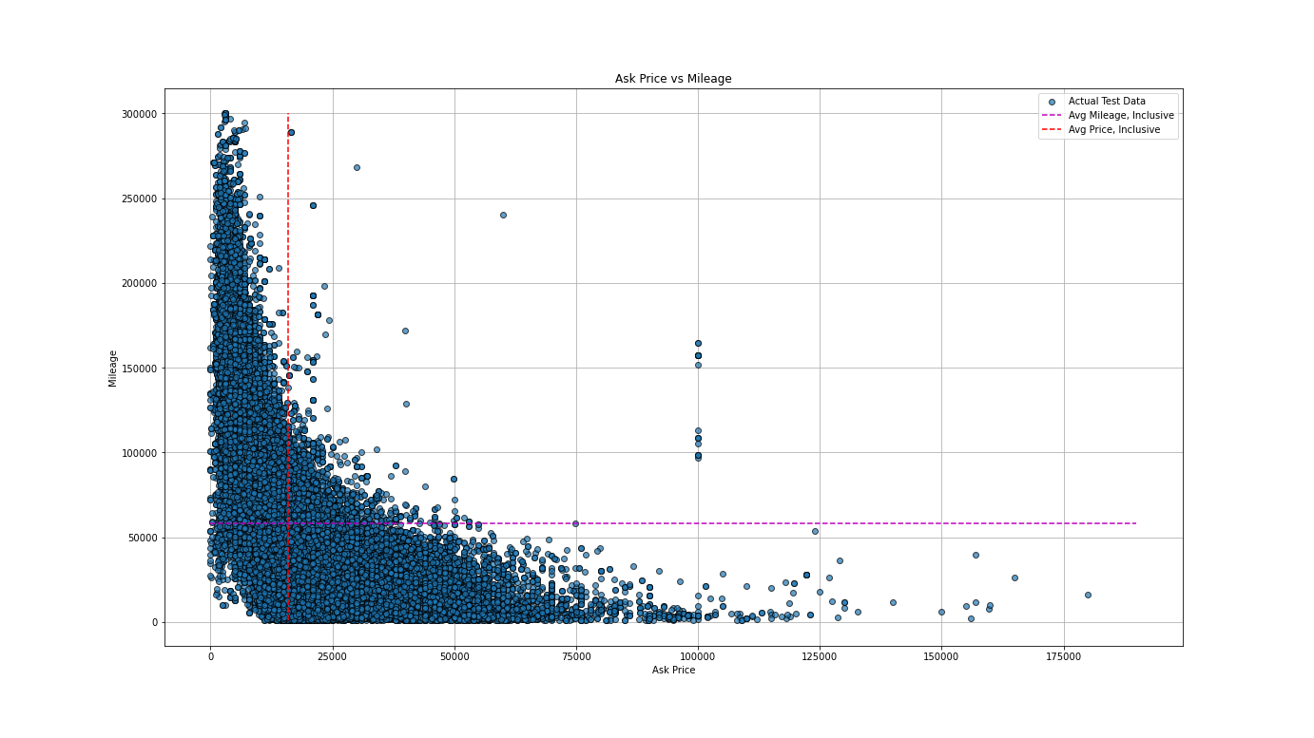
Who is the Affordable Manufacturer?
First, I found the key information for all Sedans: Ask Price and Mileage.
There is an observable trend with the Ask Price lowering as the Mileage Increases.
But which Manufacturer contains the vehicles below the market average for those metrics?

Slide 5
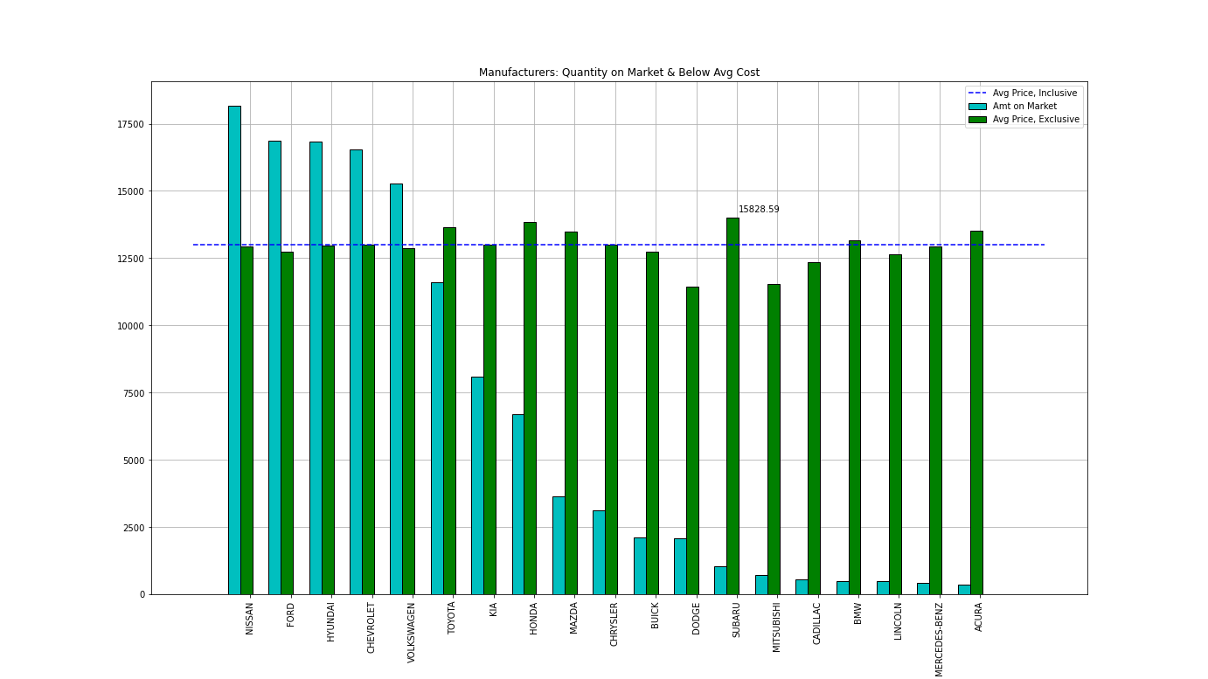
After filtering above average costs the dynamic shifts
Luxury vehicles still embrace scarcity
The top 4 most affordable manufacturers account for roughly 50% of all available sedans at this price range

