Slide 1

PRT661 DATA SCIENCE PRACTICE
FORECASTING ASSAULT RATES ACROSS NT REGIONS TO SUPPORT PUBLIC SAFETY RESOURCE PLANNING
Submitted by: Group DAN2 - THEME2
Lecturer: Dr Thuseethan Selvarajah
Student:
Thi Xuan Thanh Tran (Emma) - S389244
Ngoc Anh Nguyen (Will) - S386805
Van Hoi Dang (Hendrick) - S395598
Le Nhat Minh Tran (Thomas) - S390789

Slide 2


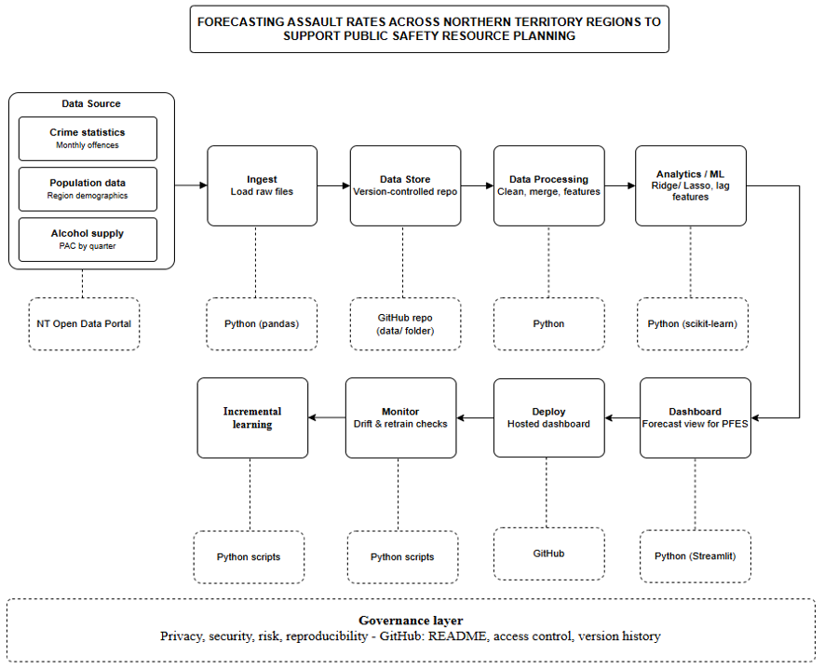
NT Assault Forecasting
55,146
crime records merged
6
NT regions
Greater Darwin, Top End, Central Australia,
Big Rivers, Barkly, East Arnhem
2015-2025
10-year monthly panel
4
models benchmarked
Linear Regression, Ridge, Lasso,
XGBoost

Slide 3
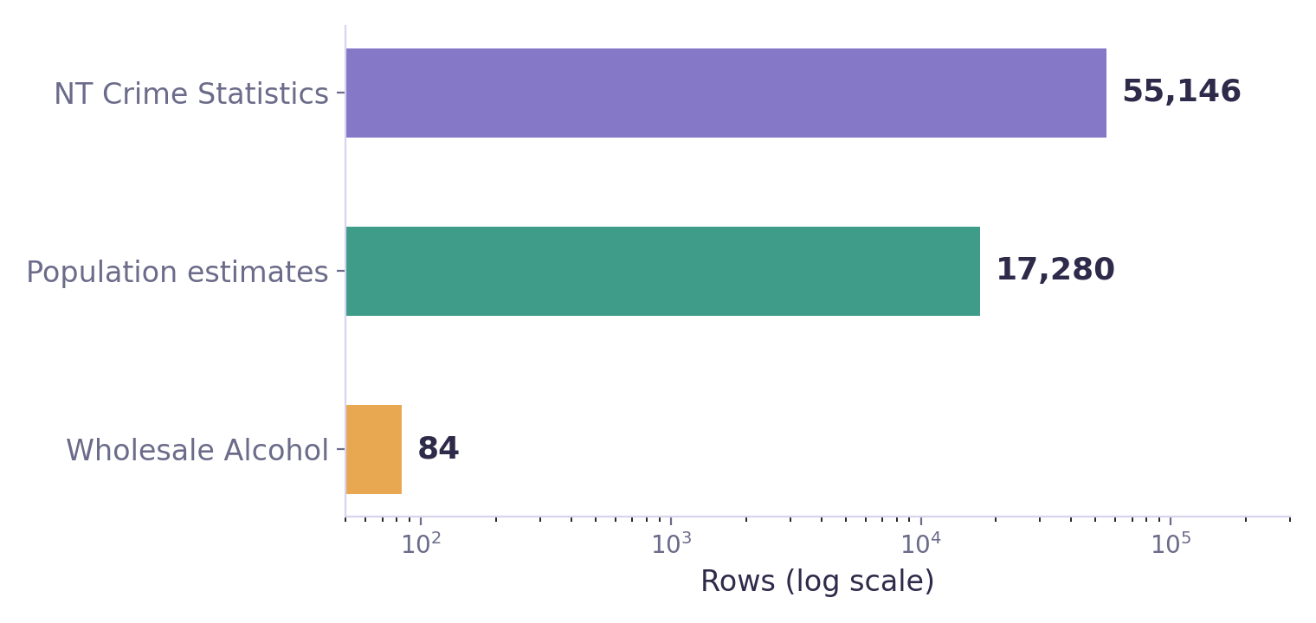
Where the Data Comes From
NT Crime Statistics
55,146 rows · CSV · 2015-2025 · Irregular cadence
Population Estimates
17,280 rows · XLSX · 1986-2025 · Annual
Wholesale Alcohol Supply
84 rows · XLSX · 2023-2025 only · Quarterly
5 automated checks on every ingest run
Fuzzy filename matching
Empty-dataframe check
Duplicate column-name check
Fully-null column check
Row/column counts + warnings → manifest.json
Alcohol supply data only covers 2023-2025 (12 quarters) - far shorter than the 2015-2025 crime/population window. This limits Model B (Slide 11) to a much smaller sample.
Fuzzy filename matching handles naming differences between teammates' downloads. Every run writes manifest.json with row/column counts for traceability.

Slide 4
Problems & Solutions
SOLUTION
Two systems, two label sets
11-entry manual translation table
NT Police switched recording systems (PROMIS → SerPro, Nov 2023) and reclassified offence categories (ANZSOC, Apr 2025) — old and new files use different category names for the same offence
e.g. ‘Acts intended to cause Injury’ (old) → ‘02 Assault’ (ANZSOC)
SOLUTION
7 police regions ≠ 6 government regions
Two-stage crosswalk: direct name-map (6 regions) + SA2 lookup table (16 codes) for generic ‘NT Balance’ rows
Crime data is reported by 7 NT Police districts; population & alcohol data use 6 NT Government (NTG) statistical regions. Without correction, Greater Darwin's population would be counted under both ‘Darwin’ and ‘Palmerston’ rows — doubling the denominator and halving true per-capita rates
e.g. Darwin + Palmerston → Greater Darwin = 34,454 assaults (2015-2025)
SOLUTION
Rows ≠ offences
Multiply the Yes/No flag by Number of offences per row before aggregating, not row count
One row can represent hundreds of offences (‘Number of offences’ column) - counting flagged ROWS badly undercounts true alcohol/DV-linked offence volume
5,081 alcohol-flagged rows = 46,306 actual offences (9.1× higher) · 6,246 DV-flagged rows = 59,567 offences
  Computed directly from the raw CSVs (Yes/No flag × Number of offences per row, summed)
SOLUTION
November 2023 recording gap
Retained as NaN, never imputed — avoids injecting artificial values into the assault time series
The PROMIS→SerPro system migration left November 2023 entirely unrecorded in both crime files
Confirmed via manifest.json null-check: exactly 1 of 132 months (0.8%) affected

Slide 5
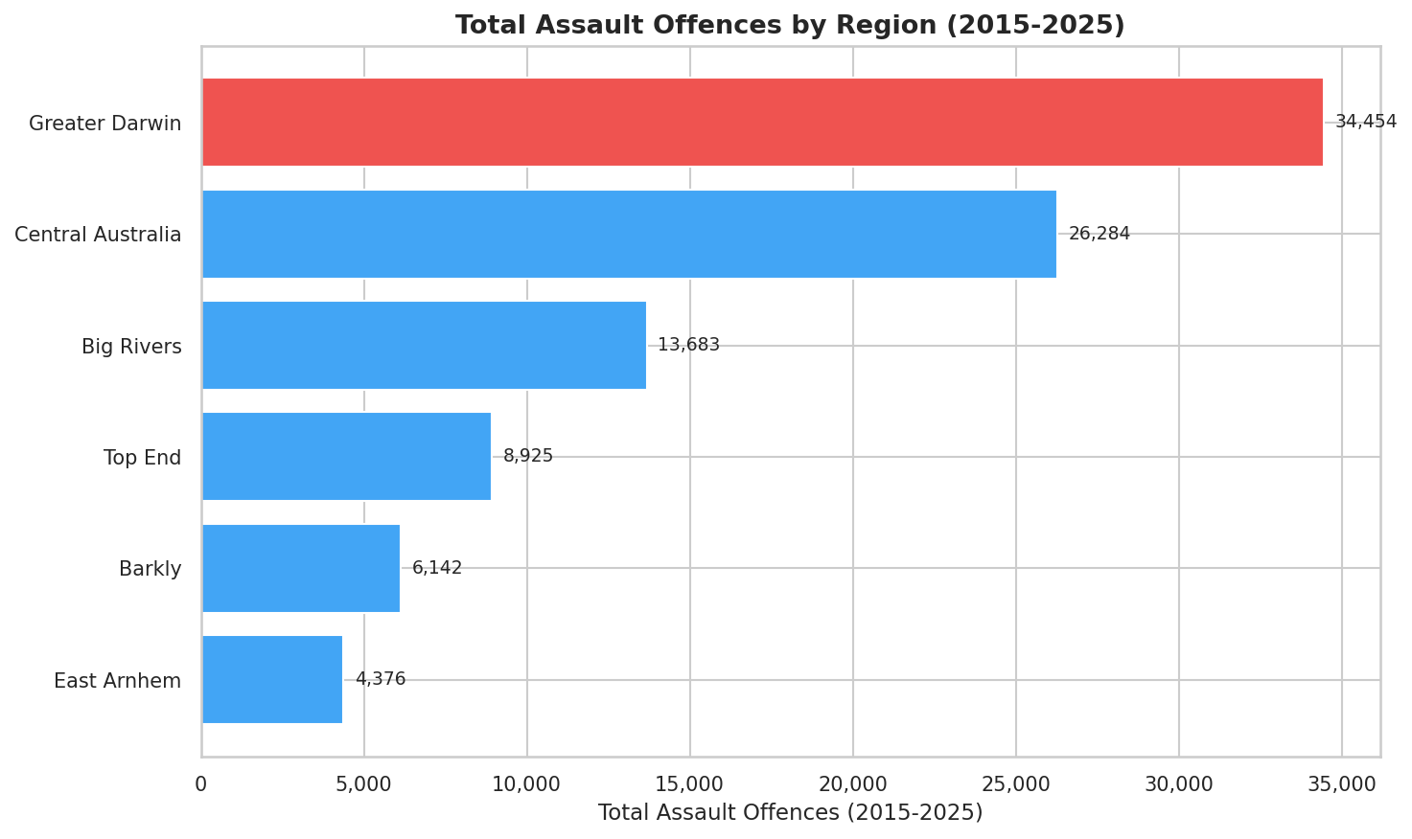
Bringing the Three Datasets Together
Crime (Year x Month x Region)
LEFT JOIN Alcohol (Year x Quarter x Region)
LEFT JOIN Population (Year x Region)
nt_crime_merged_2015_2025.csv
696 rows
0 PAC nulls
Nov 2023 = NaN
usable panel
in 2023-2025
confirmed ✓

Slide 6
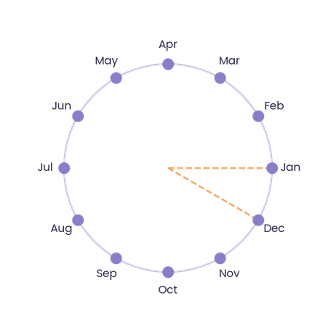

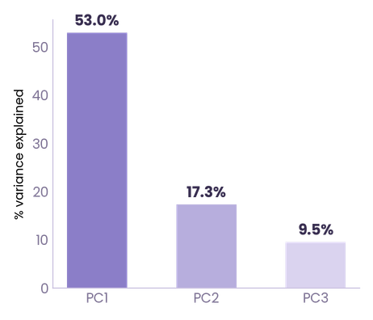
Features Built from the Merged Data
log(Assault_rate)
sin_month, cos_month
Season (wet/dry)
Right-skewed → log-normal for linear models
Cyclic encoding preserves Jan-Dec adjacency
Nov-Apr indicator, cited link to crime incidence
Skewness: 0.96 → 0.06 after transform
Computed directly from the pipeline (skew of Assault_offences before/after log1p)
Wet 398.7 vs dry 403.1/100k (~1%) - weak alone. Basis: Blakeslee et al. (2018)
Nov-Apr months and this comparison come from the code
lag1, lag3, lag12
PCA (diagnostic only)
alcohol_per_capita
Short / quarterly / yearly dependence
Condenses correlated age bands into components
Per-capita PAC — fair cross-region comparison
Autocorrelation: lag1=0.90 · lag3=0.84 · lag12=0.84
Computed directly from the panel (correlation between rate and each lag)
Total PAC declining: 2.43M L (2023) → 2.28M L (2025)
Computed directly from the raw wholesale-alcohol XLSX files
* Diagnostic only - not merged into model features (candidate for future work)

Slide 7
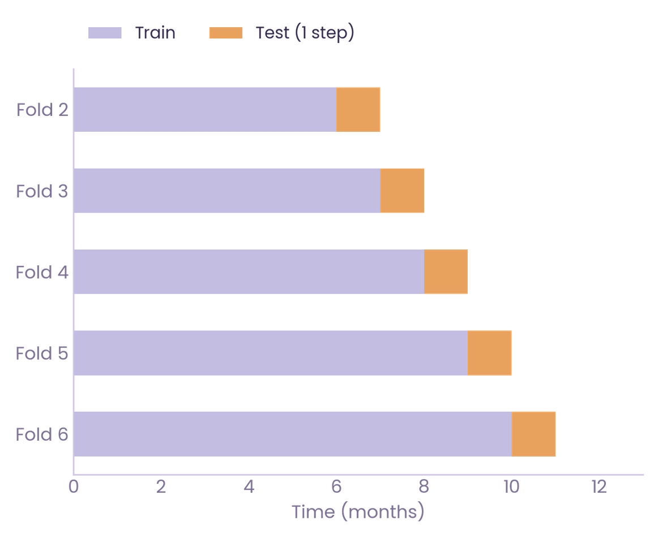
How We Validated Without Leaking Future Data
TRAIN . 2015-2022
TEST . 2023-2025
504 rows
192 rows
Leakage controls
Baselines tested (evaluation.py)
Temporal cut-off, no random split
Seasonal naive
TimeSeriesSplit cross-validation
12-month moving average
Rolling-origin backtest (evaluation.py)
-> Model must beat both to be accepted
Last 6 months excluded from training
Sanity check: does the split add up?
696
504
192
6 regions × ~116 months
train rows (72%)
test rows (28%)
Expanding-window backtest: 60-month minimum training window, expanding by 3 months per origin, tested at forecast horizons h = 1, 3, 6, and 12 months

Slide 8
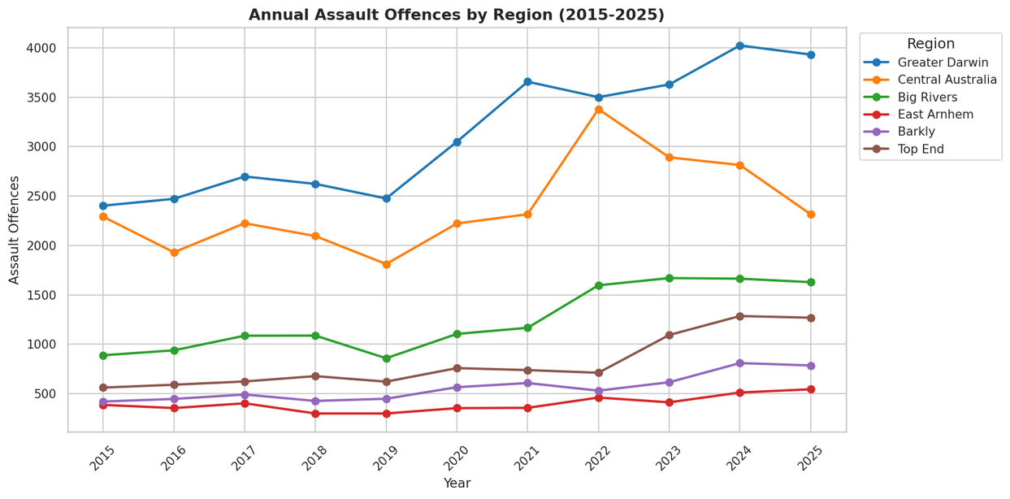
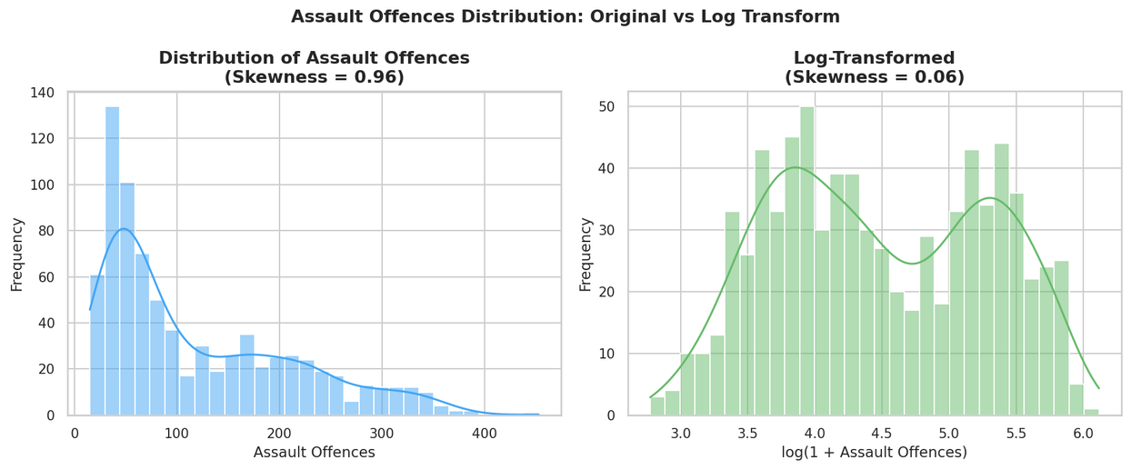
What the Data Tells Us Before Modelling
Assault offences have risen since 2020, sharpest in Top End and Big Rivers (+70% and +51%)
Log transform reduces skew (0.96 -> 0.06) - stabilises the target for linear models

Slide 9
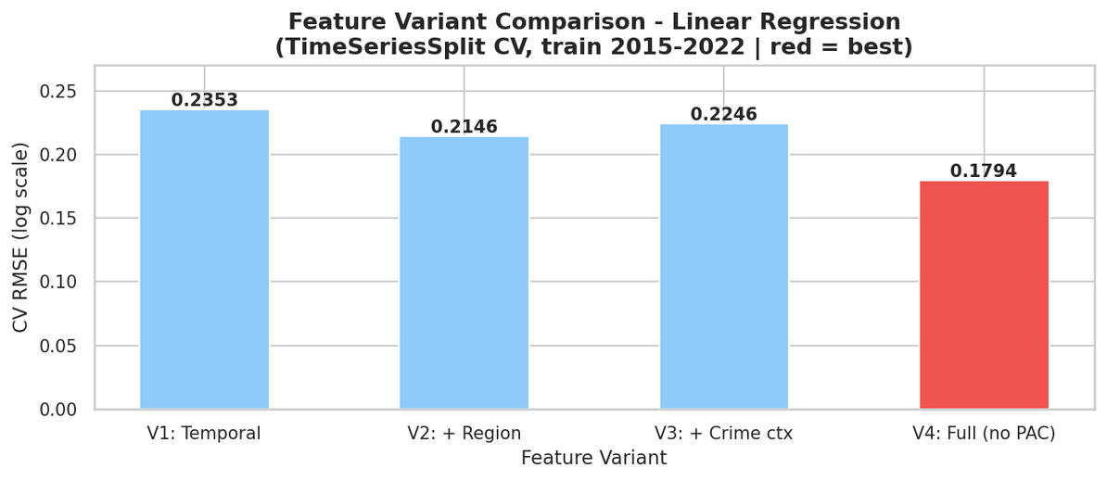
Choosing the Right Feature Set
V1
sin/cos month, Season, lag1/3/12
V2
+ region dummies
V3
+ Alcohol_offences, DV_offences
V4 Full
0.1794
+ Alcohol_offences, DV_offences + region dummies - selected
Why did V3 get worse before V4 fixed it?
V2 → V3: RMSE rose slightly from 0.2146 to 0.2246 (+4.7%) when crime-context features were added without region dummies
Cause: Crime-context features alone do not control for region-level baseline differences in offence volume
Fix (V3→V4): adding region dummies alongside crime-context features (V4) lets region terms absorb the baseline gap.
Region fixed effects (V3→V4) provided the largest single improvement - confirms temporal autocorrelation in assault rates

Slide 10
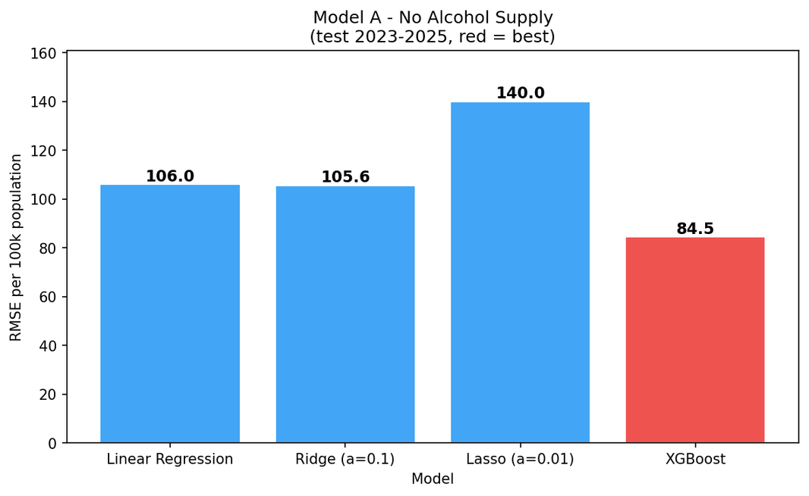
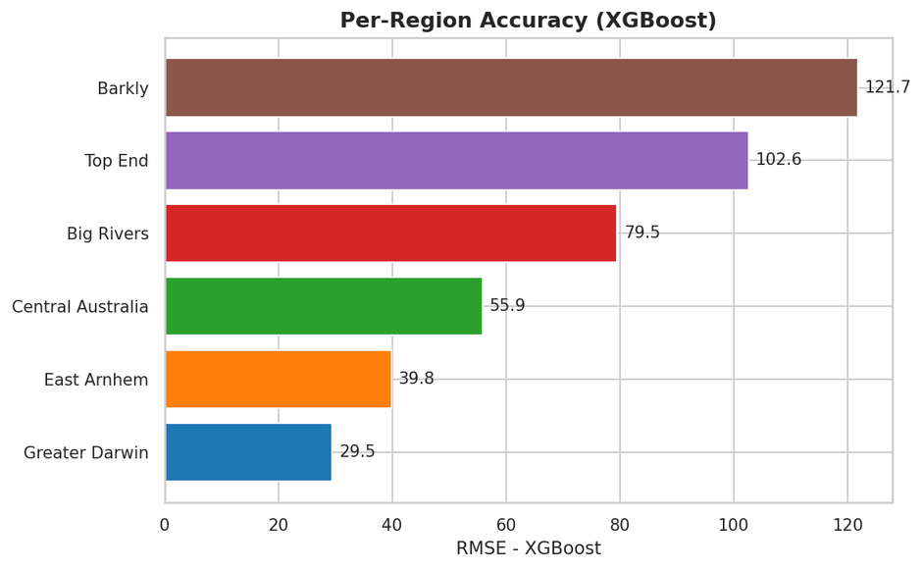
How the Models Performed
RMSE per 100k population
Per-region RMSE - XGBoost
Single train/test split - a stricter rolling-origin backtest changes this ranking (next slide)

Slide 11
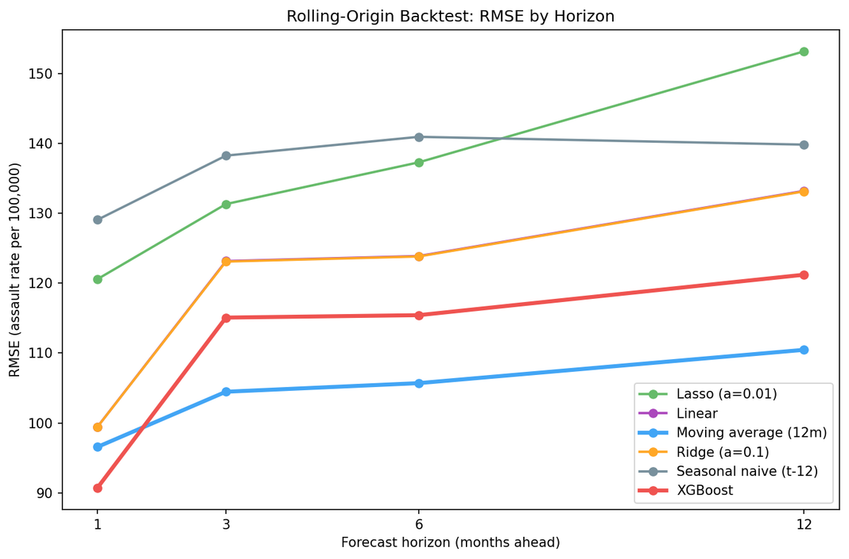
Which Evaluation Do We Trust?
Single train/test split (previous slide) - XGBoost wins - RMSE 84.5 per 100k
Rolling-origin backtest (this slide) - XGBoost wins at 1 month; 12-month moving average wins from 3 months onward (3, 6, 12)
Why - at 1 month there is enough recent signal for XGBoost to exploit; beyond that, assault rates are dominated by a slow-moving local level and added model complexity helps little
Practical implication - XGBoost for 1-month-ahead forecasts; 12-month moving average as the reference forecast from 3 months onward
Rolling-origin backtest (evaluation.py) - leakage-free, repeated out-of-sample tests at each horizon
Reported as a finding, not a failure - any model we deploy must now beat this benchmark

Slide 12
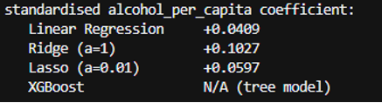
Does Alcohol Supply Improve Predictions?
Model A - no alcohol
Model B - with alcohol
Train 2015-2022 (504 rows) - Test 2023-2025 (192 rows)
Train 2023-2024 (120 rows) - Test 2025 (72 rows)
Model
RMSE(log)
MAE(log)
RMSE(100k)
Model
RMSE(log)
MAE(log)
RMSE(100k)
Linear Reg
0.2010
0.1686
106.0
Linear Reg
0.1284
0.0838
57.1 - best
Ridge (a=0.1)
0.2004
0.1681
105.6
Ridge (a=1)
0.1607
0.1139
79.8
Lasso (a=0.01)
0.2153
0.1693
140.0
Lasso (a=0.01)
0.2058
0.1553
116.1
XGBoost
0.1517
0.1227
84.5 - best
XGBoost
0.1945
0.1407
94.1
The alcohol_per_capita coefficient stays small and positive across all models (+0.04 to +0.06)
Model B trains on far fewer rows (120 vs 504) over a different period - RMSE differences reflect data scarcity as much as the alcohol predictor. Alcohol shows a small, positive, but weak and uncertain association with assault rates.

Slide 13
Ethics & Governance
CARE Principles Applied
C — Collective Benefit
Forecasts are designed to support public safety resource planning across all NT regions, not to surveil or target any individual or community group.
A — Authority to Control
All data is sourced from publicly released NT Government datasets. No personal or identifiable information is collected or stored.
R — Responsibility
The pipeline logs every ingest run to manifest.json for full traceability. Provisional months are excluded from evaluation to prevent misleading accuracy claims.
E — Ethics
Forecast outputs should inform planning decisions, not be used to justify increased policing of specific communities. Model limitations (small alcohol sample, regional aggregation) are explicitly documented.

Slide 14
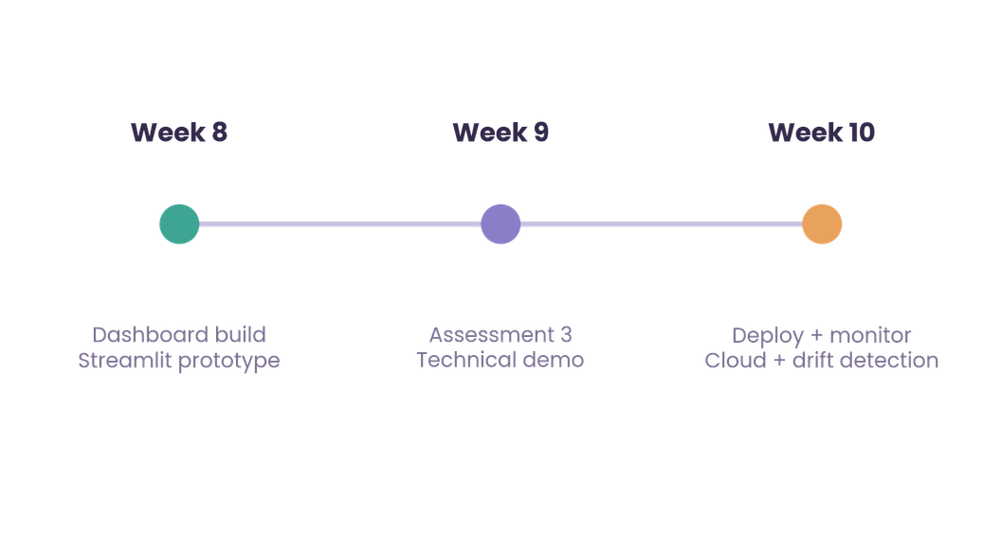
Pipeline Status
DONE
IN PROGRESS
Raw data ingestion + validation
Streamlit dashboard (Week 8)
Schema harmonisation (PROMIS -> ANZSOC)
Deployment to Streamlit Cloud (Week 10)
Region crosswalk (7 -> 6 regions)
Monitoring + drift detection (Week 10)
Feature engineering (lags, cyclical, PCA)
Model training + evaluation (4 models)
Leakage-free CV + rolling-origin backtest
End-to-end pipeline in a single script
Ethics & governance reviewed (CARE Principles)
The pipeline is complete and reproducible. All remaining work is dashboard and deployment.

Slide 15
Conclusions & Recommendations
What We Found
Recommendations
XGBoost achieves the best short-horizon accuracy: 29% skill improvement over seasonal naive at h = 1 month
Deploy XGBoost for 1-month-ahead operational forecasts
Beyond 1 month, the 12-month moving average outperforms all models at h = 3, 6, and 12 — added complexity does not help at longer horizons
Use 12-month moving average as the reference benchmark for 3–12 month planning horizons
Alcohol supply shows a small positive association with assault rates (+0.04 to +0.06 per capita) but the 2023–2025 window is too short to draw firm conclusions
Collect alcohol supply data from 2015 onward to properly evaluate its predictive value

Slide 16
Thank you!

