Slide 1
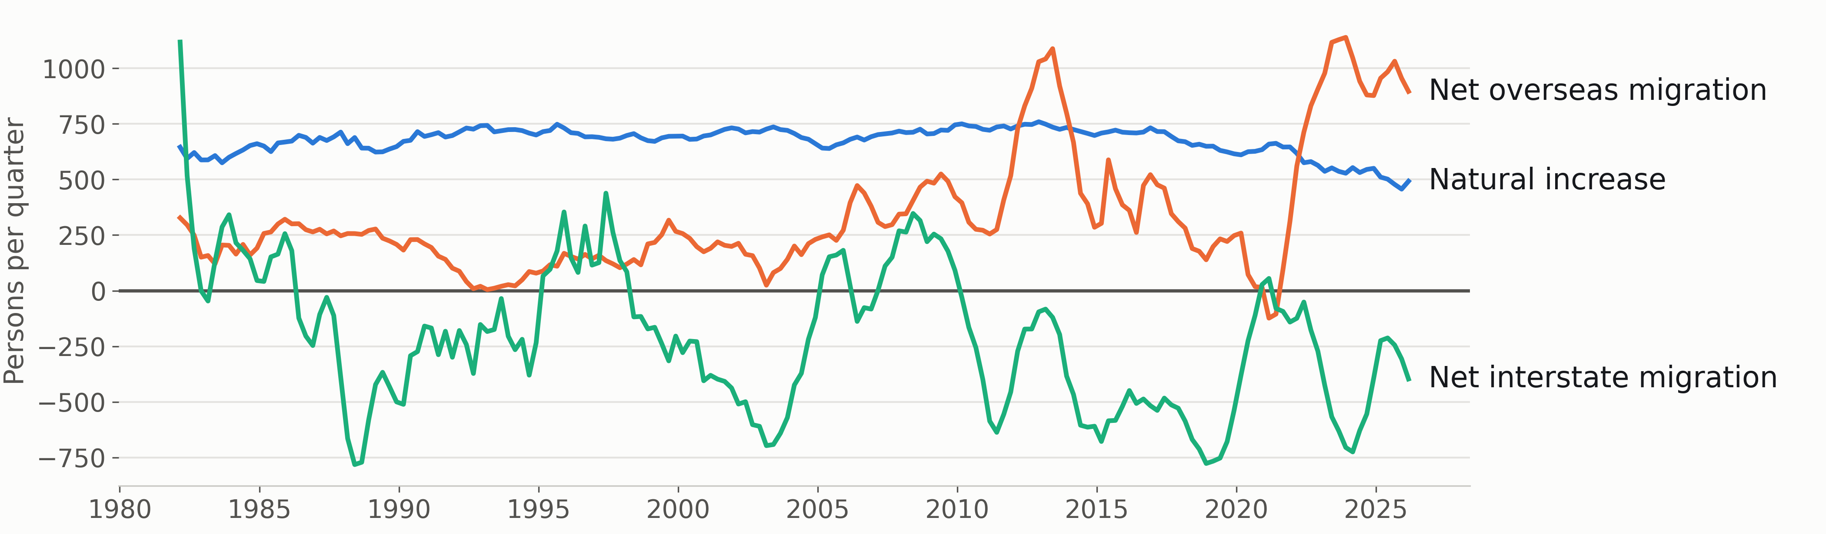
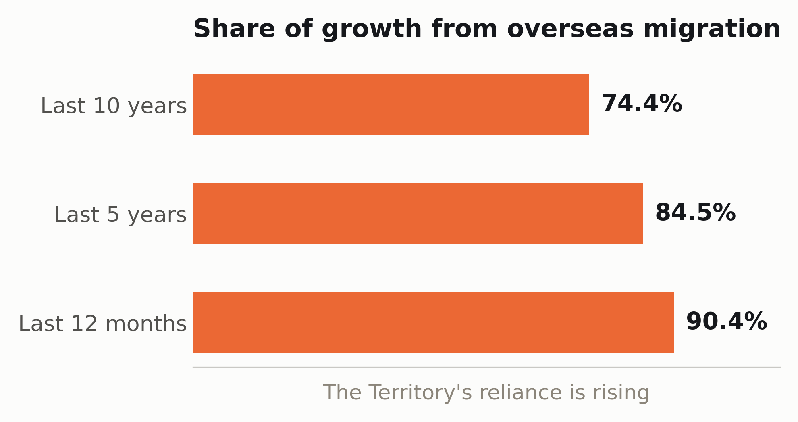
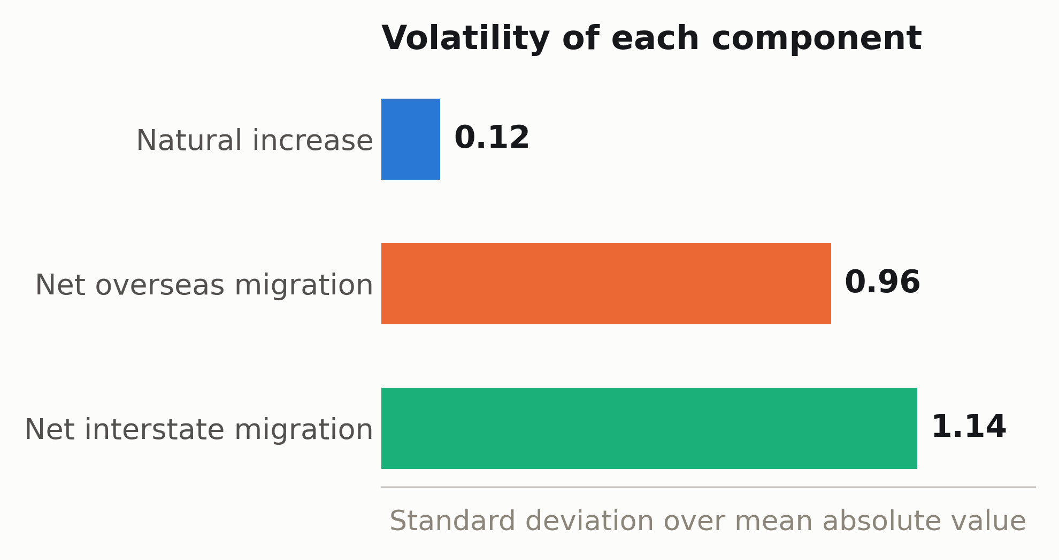
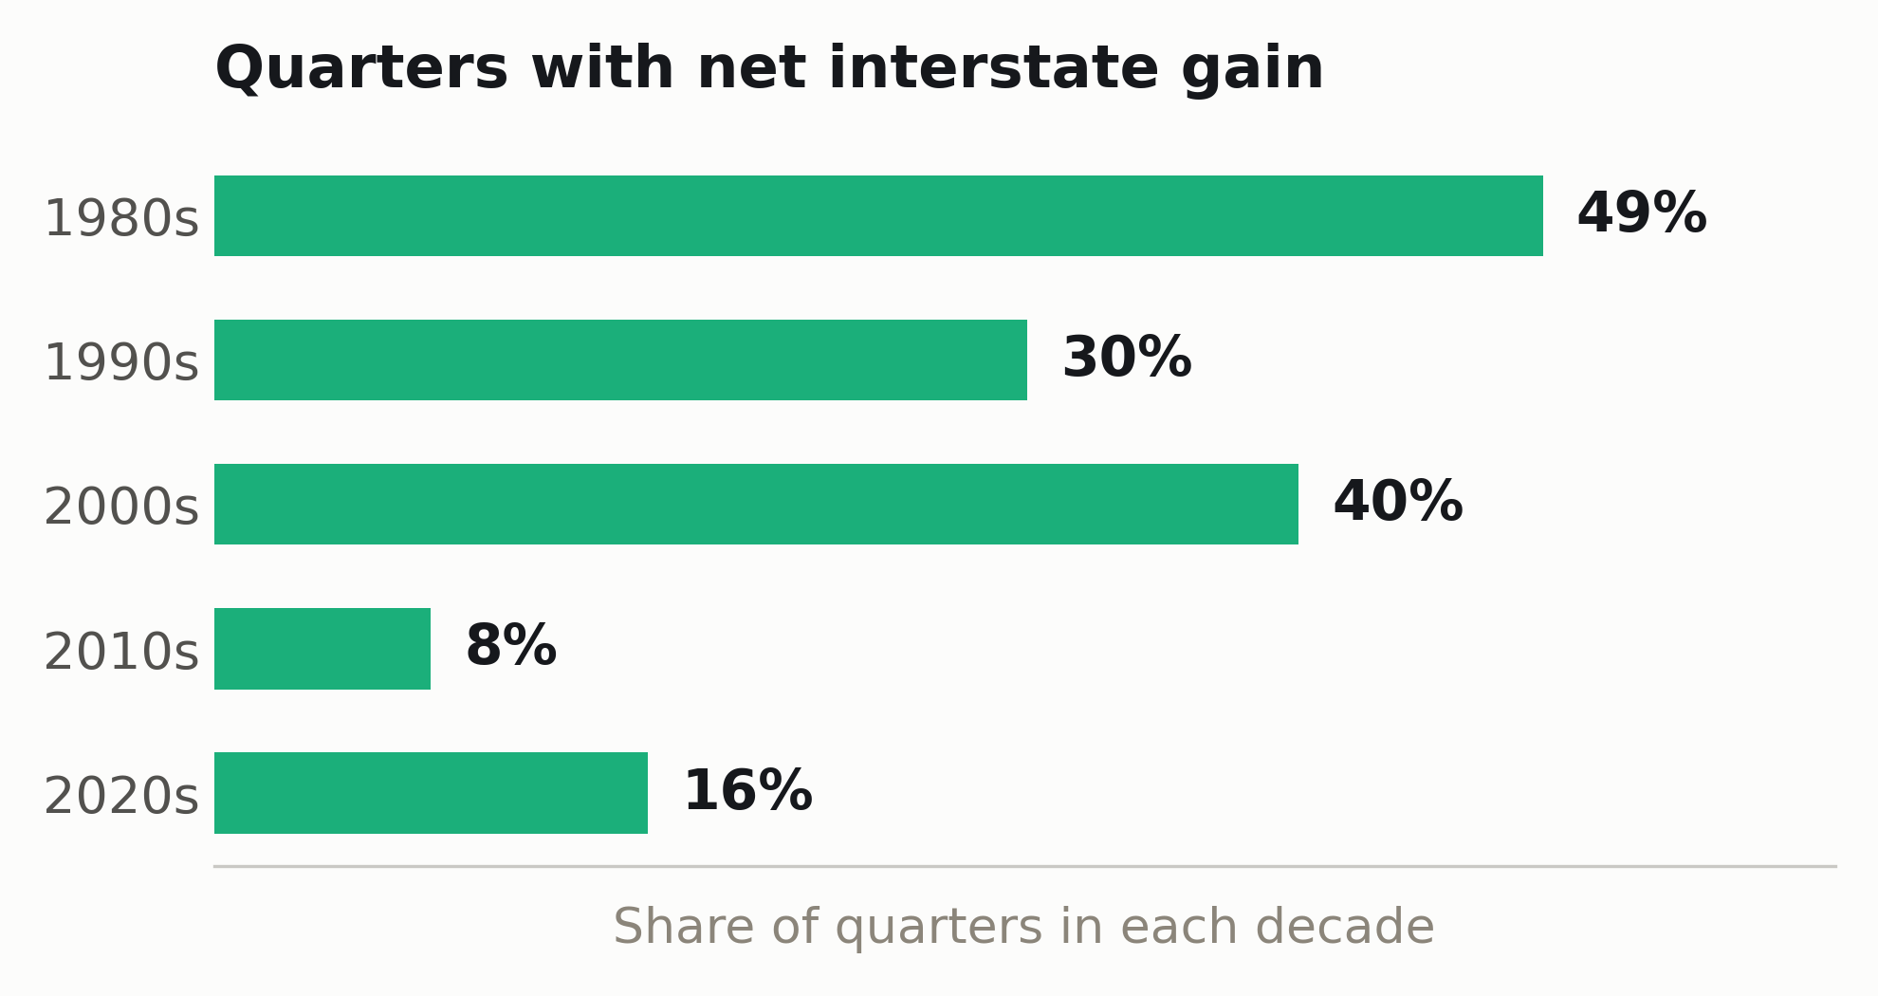

CDU IT CODE FAIR 2026 · POSTER COMPETITION · POS006
The Territory's Population Equation
Where Northern Territory population growth comes from, and which component makes forecasting it hardest
Van Hoi (Hendrick) Dang · Ngoc Ngan Le · Phuong Vy Ho · Thi Kim Anh Bui | Master of Data Science, Faculty of Science and Technology, Charles Darwin University
90.4%
of the Northern Territory's population growth in the year to March 2026 came from net overseas migration.
Natural increase added 1,969. Interstate migration subtracted 1,589. Overseas migration added 3,585. Total growth 3,965, on a population of 268,899.
ABSTRACT
BACKGROUND
METHODOLOGY
The Northern Territory is the only Australian jurisdiction that loses residents to other states while still growing. This project asked how much of that growth comes from each of the three components of population change, and how reliable those estimates are. Quarterly components for the NT were extracted from ABS table 310102, June 1981 to March 2026 (180 quarters), and reconciled against the published change before analysis. In the latest twelve months net overseas migration accounted for 90.4% of growth, up from 74.4% across the last decade. Net interstate migration has been negative for 18 consecutive quarters, and was positive in only 8% of quarters in the 2010s against 49% in the 1980s. Both migration components are far more volatile than natural increase. Territory population growth now rests on its least stable inputs. The analysis is descriptive and makes no policy recommendation.
The Northern Territory plans schools, hospitals and housing from population forecasts. A forecast is only as stable as the parts it is built from.
Population change has exactly three components:
change = natural increase + net interstate migration + net overseas migration
The ABS publishes all three every quarter, for every state and territory. What is not published is how much of the Territory's growth each component carries, or how steady each one is. Those two questions decide how much confidence a planner can place in a headline growth figure.
Source. ABS tables 310102 (components) and 310104 (population), March 2026.
Extract. Python pipeline locates the NT columns by header text, so an ABS layout change fails loudly rather than silently.
Validate. Components must sum to the published change. They do, exactly: 3,965 against 3,965.
Measure. Coefficient of variation against mean absolute value, because interstate migration is mostly negative.
Reproduce. One command re-runs everything when the next quarter publishes.
OBJECTIVES
Quantify the contribution of each component to NT population growth, June 1981 to March 2026.
Measure the volatility of each component across the full series.
Determine whether growth depends on the components that are least stable.
Validate every figure against the change ABS publishes, before reporting it.
RESULTS
Natural increase is steady and slowly declining. Overseas migration has become the Territory's engine of growth. Interstate migration has spent most of the last fifteen years below zero.
Northern Territory population change by component. Four-quarter rolling average, June 1981 to March 2026. Source: ABS table 310102.
CONCLUSIONS
CODE AND DATA
Overseas migration now carries 90.4% of the Territory's growth, up from 84.5% over five years and 74.4% over ten. The reliance is increasing, not steady.
The interstate deficit is recent. Net interstate migration was positive in 49% of quarters in the 1980s and 8% in the 2010s, and has been negative for 18 straight quarters since September 2021.
Natural increase is the only steady component (coefficient of variation 0.13). Interstate (1.14) and overseas (0.96) migration are roughly eight times more variable.
Territory growth has shifted onto its least stable inputs, so forecast uncertainty now sits in the migration components. A single headline growth rate does not show this.
Every figure on this poster is produced by the pipeline in this repository, from the ABS files cited below. Scan for the code, the cleaned series and an interactive version of the chart above.
LIMITATIONS
github.com/HendrickDang/nt-population-equation
Net overseas migration uses the 12-of-16-month rule, so a person can change category without changing address. Interstate movement is derived from administrative address records, so people who rarely update them are counted late or not at all. Census undercount is higher in the Territory than nationally, particularly in remote communities, and estimated resident population is rebased after each Census. These remain estimates, and this project treats them as such.
REFERENCES
Australian Bureau of Statistics. (2026). National, state and territory population, March 2026 [Data set]. abs.gov.au
Northern Territory Government. (2026). Population. NT Economy. nteconomy.nt.gov.au

