Slide 1
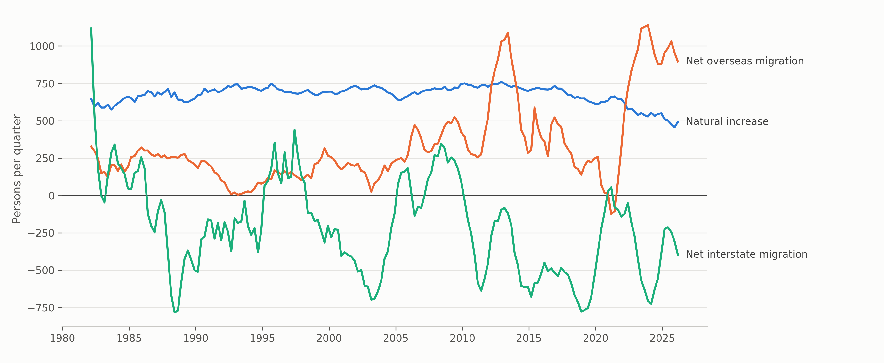
The Territory's Population Equation
Northern Territory population change by component, June 1981 to March 2026
Van Hoi (Hendrick) Dang · Ngoc Ngan Le · Phuong Vy Ho · Thi Kim Anh Bui
Four-quarter rolling average. Source: ABS, National, state and territory population, tables 310102 and 310104 (March 2026). Code and data: github.com/HendrickDang/nt-population-equation
Notes:
One static slide. No animation, no transitions, no audio or video.
Figures are spoken, not printed: overseas migration accounted for 90.4% of growth in the year to March 2026.

