Slide 1

CSS frameworks: Bootstrap
CITS3403 and CITS5505 - Agile Web Development
Unit Coordinator: Matthew Daggitt
2024 Semester 1

Slide 2
CSS frameworks

Slide 3
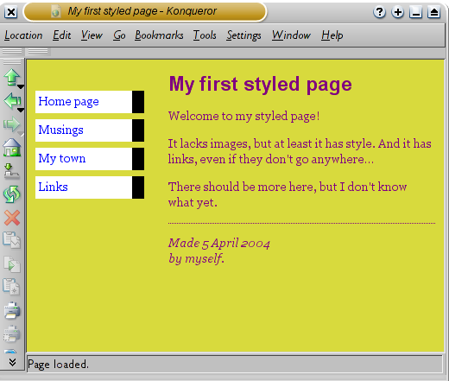
Challenges with CSS
CSS is a powerful language for creating and implementing a presentation style for a website/application.
However, there are several limitations:
Some simple operations, like centering pictures or text can be unintuitive.
It is difficult to create responsive styles that change depending on the device on which they are being viewed.
Many websites don’t require the full power of CSS and can be styled using a simpler subset of operations.
Producing an attractive style is a highly creative activity!

Slide 4
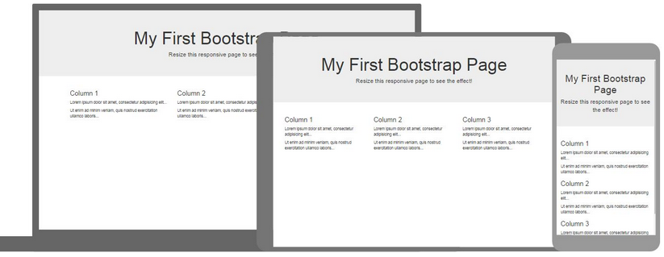
Frameworks
CSS frameworks are open-source libraries for developing responsive web-applications.
Frameworks use CSS and JavaScript to build style components in a reasonably aesthetic way with very little effort.
A big advantage is that they are normally designed to be responsive, so one application will look good on mobile devices, tablets and PCs with minimal effort.

Slide 5
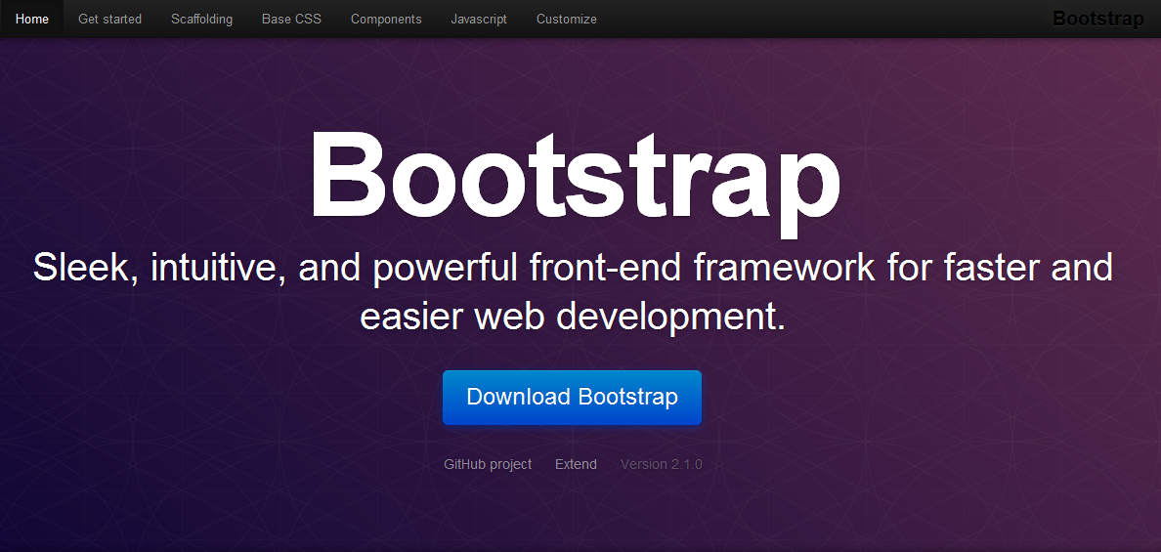
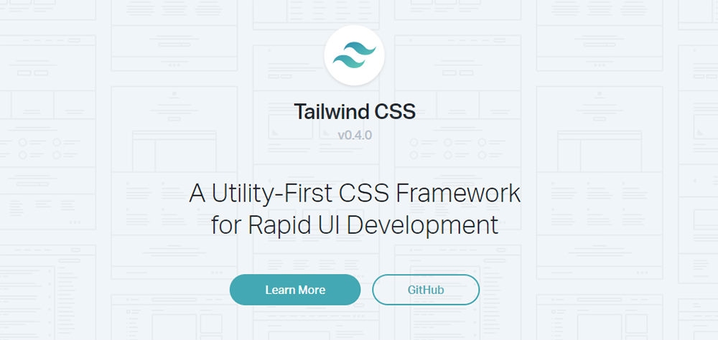
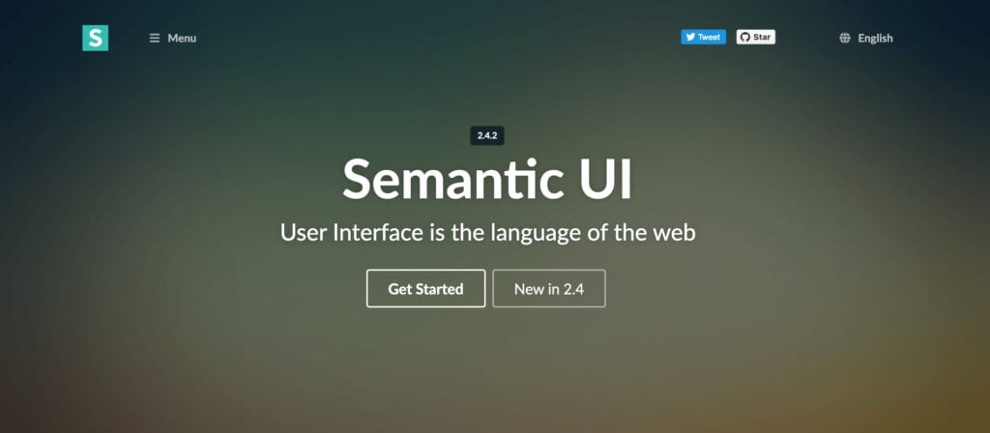
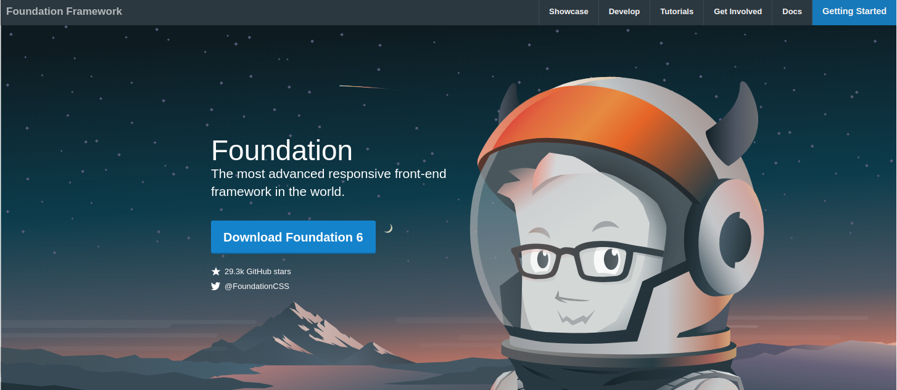
Common frameworks
Disadvantage: websites built with the same framework will often appear visually similar.

Slide 6
The Bootstrap framework

Slide 7
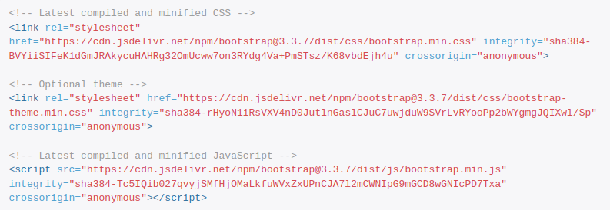
Loading Bootstrap
To include Bootstrap components and styles in your page, you can either download and host the code yourself, or just reference a Content Delivery Network in the header of your web-page.
Bootstrap consists of a CSS file, a JavaScript file and optional theme files.

Slide 8
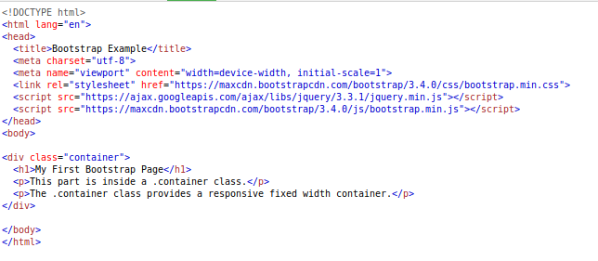
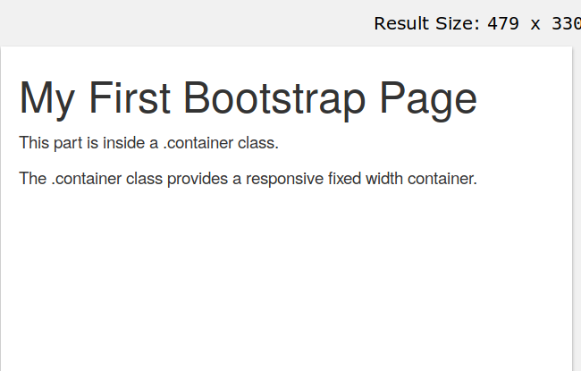
Your first Bootstrap page
Include the CDN libraries, and a meta-tag setting the viewport width to device width (for zooming and scaling)
The container class automatically sets margins that respond to the page size.

Slide 9
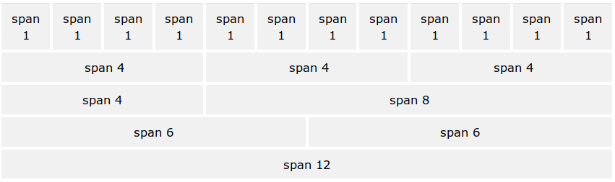
The Bootstrap grid system
Bootstrap uses rows of 12 columns for layout. Every component (or div) can be specified to span a number of these columns.
The layout can be specified with respect to the device size (extra small, small, medium and large).
The number of spanned columns should always add up to 12.

Slide 10
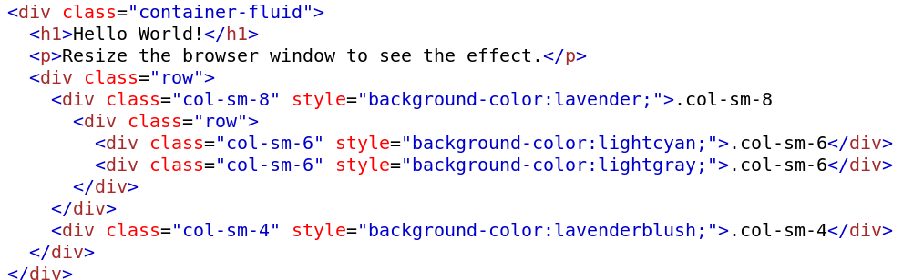
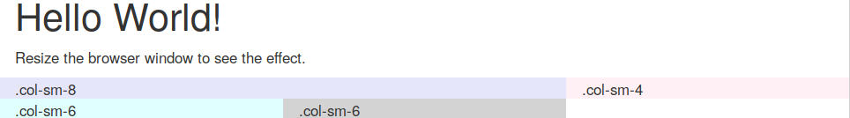
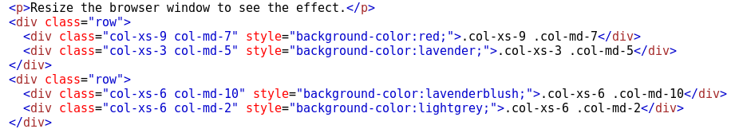
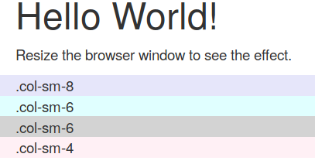
The Bootstrap grid system
The div class col-sm-3 means take three columns on all devices small, or larger. Extra small devices will stack the content vertically.
The grid layout can be nested so a span of eight columns could be divided into 12.
We can specify different layout for different devices, so something can be specified to take 3 columns on a large device, but 6 on a small.

Slide 11
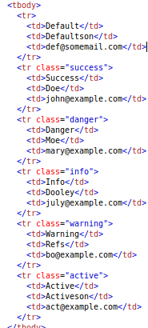
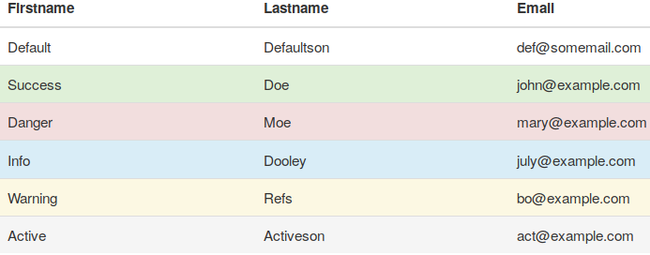
Bootstrap tables
The class table adds basic styling to a table, with horizontal lines and padding.
There are additional classes table-striped, table-bordered, table-hover and table-condensed, with different styles and effects.
There are also classes for table rows and cells for different effects.

Slide 12

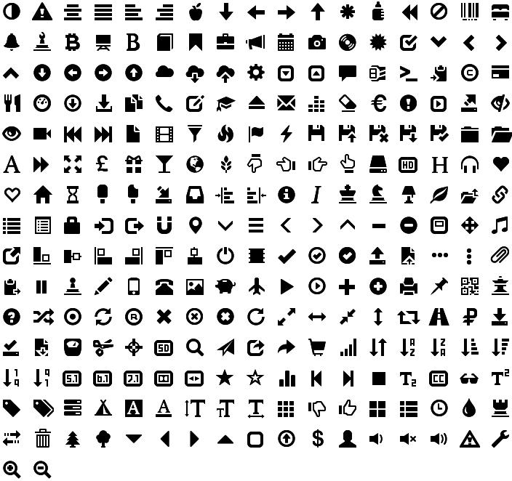

Glyphicons
Bootstrap comes with 200 icons to use, called Glyphicons.
These are rendered as text, so will resize with headers etc.
The glyphicon syntax just applies a class to an empty span.

Slide 13
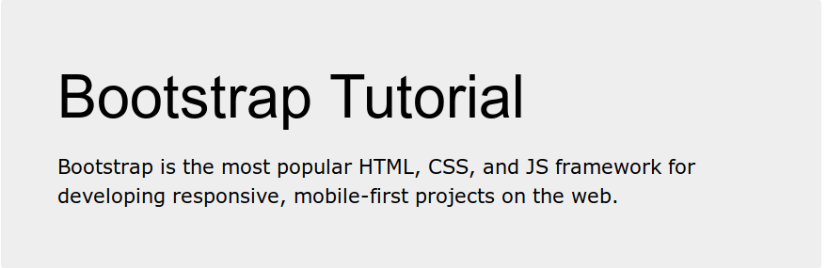
Other features of Bootstrap
Bootstrap also supports widgets such as jumbotrons modals, form layouts, carousels.
It is worthwhile taking the time to get familiar with these, as they can make a web-page look professional with relatively little effort.
See the w3schools tutorial: https://www.w3schools.com/bootstrap/default.asp or the Bootstrap site https://getbootstrap.com/docs/4.3/getting-started/

