Slide 1




ETH Quantum
Hackathon 2024
Software: Process management problem
Hardware: Flux qubit quantum circuit
Group: Banana State
Date: 18.09.2023

Slide 2
Table of contents
Motivation
Process management problem
Overview and mathematical formulation
Cost function with ancilla qubits
Solution for a restricted qubit number
Comparison with the analytic solution
Digital and analog quantum algorithms
Quantum Approximate Optimization Algorithm (QAOA)
Quantum Adiabatic Evolution (QAE)
Comparison between QAOA and QAE
Hardware implementation via Flux Qubits
Walkthrough
Energy spectrum
Research
References
05.05.2024
ETH Quantum Hackathon 2024 – Qilimanjaro Quantum Tech
Folie 2

Slide 3
Motivation
05.05.2024
ETH Quantum Hackathon 2024 – Qilimanjaro Quantum Tech
Folie 3
Notes:
In this problem… investigate how to convert an optimization problem into a Hamiltonian and how to find the approximate ground state with a digital and an analog quantum computing method.
Afterwards we discuss how to create a quantum circuit for this application using Flux qubits

Slide 4
Process management problem
Overview and mathematical formulation
Cost function with ancilla qubits
Solution for a restricted qubit number
Comparison with the analytic solution
05.05.2024
ETH Quantum Hackathon 2024 – Qilimanjaro Quantum Tech
Folie 4

Slide 5


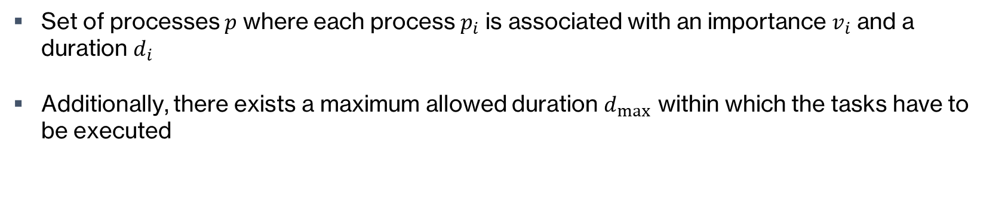
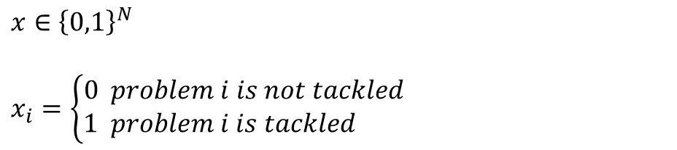
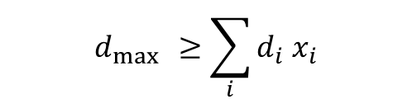
Process management problem
Overview and mathematical formulation
Set of processes $p$ where each process $p_{i}$ is associated with an importance $v_{i}$​ and a duration $d_{i}$​
Additionally, there exists a maximum allowed duration $d_{\max{ }}$within which the tasks have to be executed
Mathematical formulation:
Variables:
$v_{i}$ importance of task $i$
$d_{i}$ duration of task $i$
$$f\left(x\right)=\sum_{i}^{ }{v_{i} x_{i}}$$
Maximize:
$x∈{\left\{0,1\right\}}^{N}$
$x_{i}=\left\{\begin{aligned}0 problem i is not tackled \\ 1 problem i is tackled \end{aligned}\right.$
$$d_{\max{ }}≥\sum_{i}^{ }{d_{i} x_{i}}$$
Constraint:
05.05.2024
ETH Quantum Hackathon 2024 – Qilimanjaro Quantum Tech
Folie 5
Notes:
SKIP!!!

Slide 6


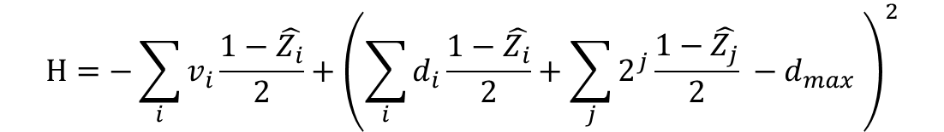
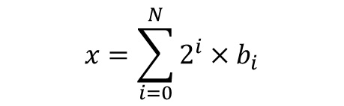




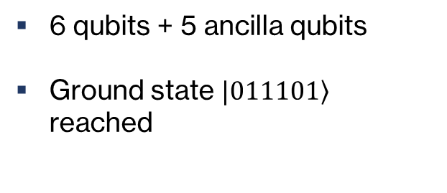
Process management problem
Cost function with ancilla qubits
$$\sum_{i∈S}{v_{i} }$$
$$x=\sum_{i=0}^{N}{2^{i}×b_{i}}$$
Rewriting the problem
$$\sum_{i∈S}{v_{i} }$$
$$\sum_{i∈S}{d_{i}+x=d_{max} }$$
$$\sum_{i∈S}{d_{i}≤d_{max} }$$
$$b_{i}∈\left\{0,1\right\}$$
$$0≤x≤d_{max}$$
Cost Hamiltonian
In practice
Optimization Hamiltonian (without constraints):
$$H=−\sum_{i}{v_{i}}\frac{1−\hat{Z_{i}}}{2}+{\left(\sum_{i}{d_{i}}\frac{1−\hat{Z_{i}}}{2}+\sum_{j}{2^{j}}\frac{1−\hat{Z_{j}}}{2} −d_{max} \right)}^{2}$$
6 qubits + 5 ancilla qubits
Ground state $|\left.011101\right\rangle$ reached
05.05.2024
ETH Quantum Hackathon 2024 – Qilimanjaro Quantum Tech
Folie 6

Slide 7
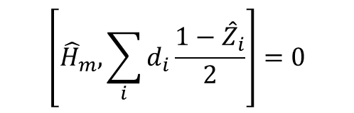





Process management problem
Discussion of a subspace solution
$$f\left(x\right)=\sum_{i}^{ }{v_{i} x_{i}}$$
Use the normal value Hamiltonian without constraint
The constraint is naturall satisfied if we restrict the states to the subspace $S$
Analytical approach
Numerical approach
Start initially in the ground state
Use a mixer Hamiltonian that conserves the duration or stays in the subspace
Construct a mixer Hamiltonian that is more likely to map the states to ones with lower duration
$${\hat{H}}_{m}: \left| ψ> → \right| φ>$$
$$\left[{\hat{H}}_{m}, \sum_{i}{d_{i}\frac{1−{\hat{Z}}_{i}}{2}}\right]=0$$
$${\hat{H}}_{m}: S→S$$
$\left\langle ψ \left|\sum_{i}{d_{i}\frac{1−{\hat{Z}}_{i}}{2}}\right| ψ\right\rangle >\left\langle φ \left|\sum_{i}{d_{i}\frac{1−{\hat{Z}}_{i}}{2}}\right| φ\right\rangle$
05.05.2024
ETH Quantum Hackathon 2024 – Qilimanjaro Quantum Tech
Folie 7

Slide 8
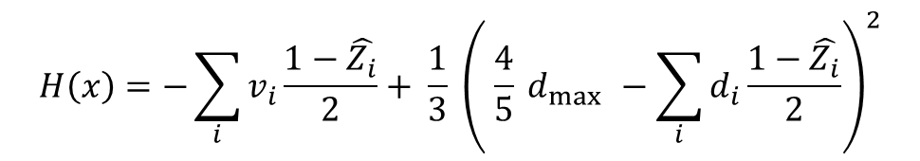

Process management problem
Solution for a restricted qubit number
Cost Hamiltonian:
Variables:
$v_{i}$ Importance of task $i$
$d_{i}$ Duration of task $i$
$\hat{Z_{i}}$ Pauli-z acting on qubit $i$
Center of optimization
Penalty factor
$$H\left(x\right)=−\sum_{i}^{ }{v_{i}}\frac{1−\hat{Z_{i}}}{2}+ \frac{1}{3} {\left( \frac{4}{5} d_{\max{ }}−\sum_{i}^{ }{d_{i}\frac{1−\hat{Z_{i}}}{2}}\right)}^{2}$$
05.05.2024
ETH Quantum Hackathon 2024 – Qilimanjaro Quantum Tech
Folie 8

Slide 9
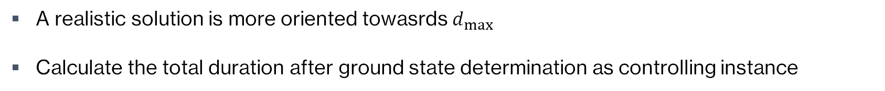
Process management problem
Solution for a restricted qubit number
Cost Hamiltonian:
Variables:
${ v}_{i}$ Importance of task $i$
$d_{i}$ Duration of task $i$
$\hat{Z_{i}}$ Pauli-z acting on qubit $i$
Center of optimization
Penalty factor
$$H\left(x\right)=−\sum_{i}^{ }{v_{i}}\frac{1−\hat{Z_{i}}}{2}+ \frac{1}{3} {\left( \frac{4}{5} d_{\max{ }}−\sum_{i}^{ }{d_{i}\frac{1−\hat{Z_{i}}}{2}}\right)}^{2}$$
Optimization term
Constraint / Penalty term
A realistic solution is more oriented towasrds $d_{\max{ }}$
Calculate the total duration after ground state determination as controlling instance
towards
05.05.2024
ETH Quantum Hackathon 2024 – Qilimanjaro Quantum Tech
Folie 9
Notes:
Coming from the ancilla soluiton
Now we implement the restriction – only 6 qubits
We approximate the inequality with a quadratic term
Effectively implementing an equality with a small shift to lower times
In real scenario we want to use our avilable time most effectively but also dont come too close to the deadline

Slide 10
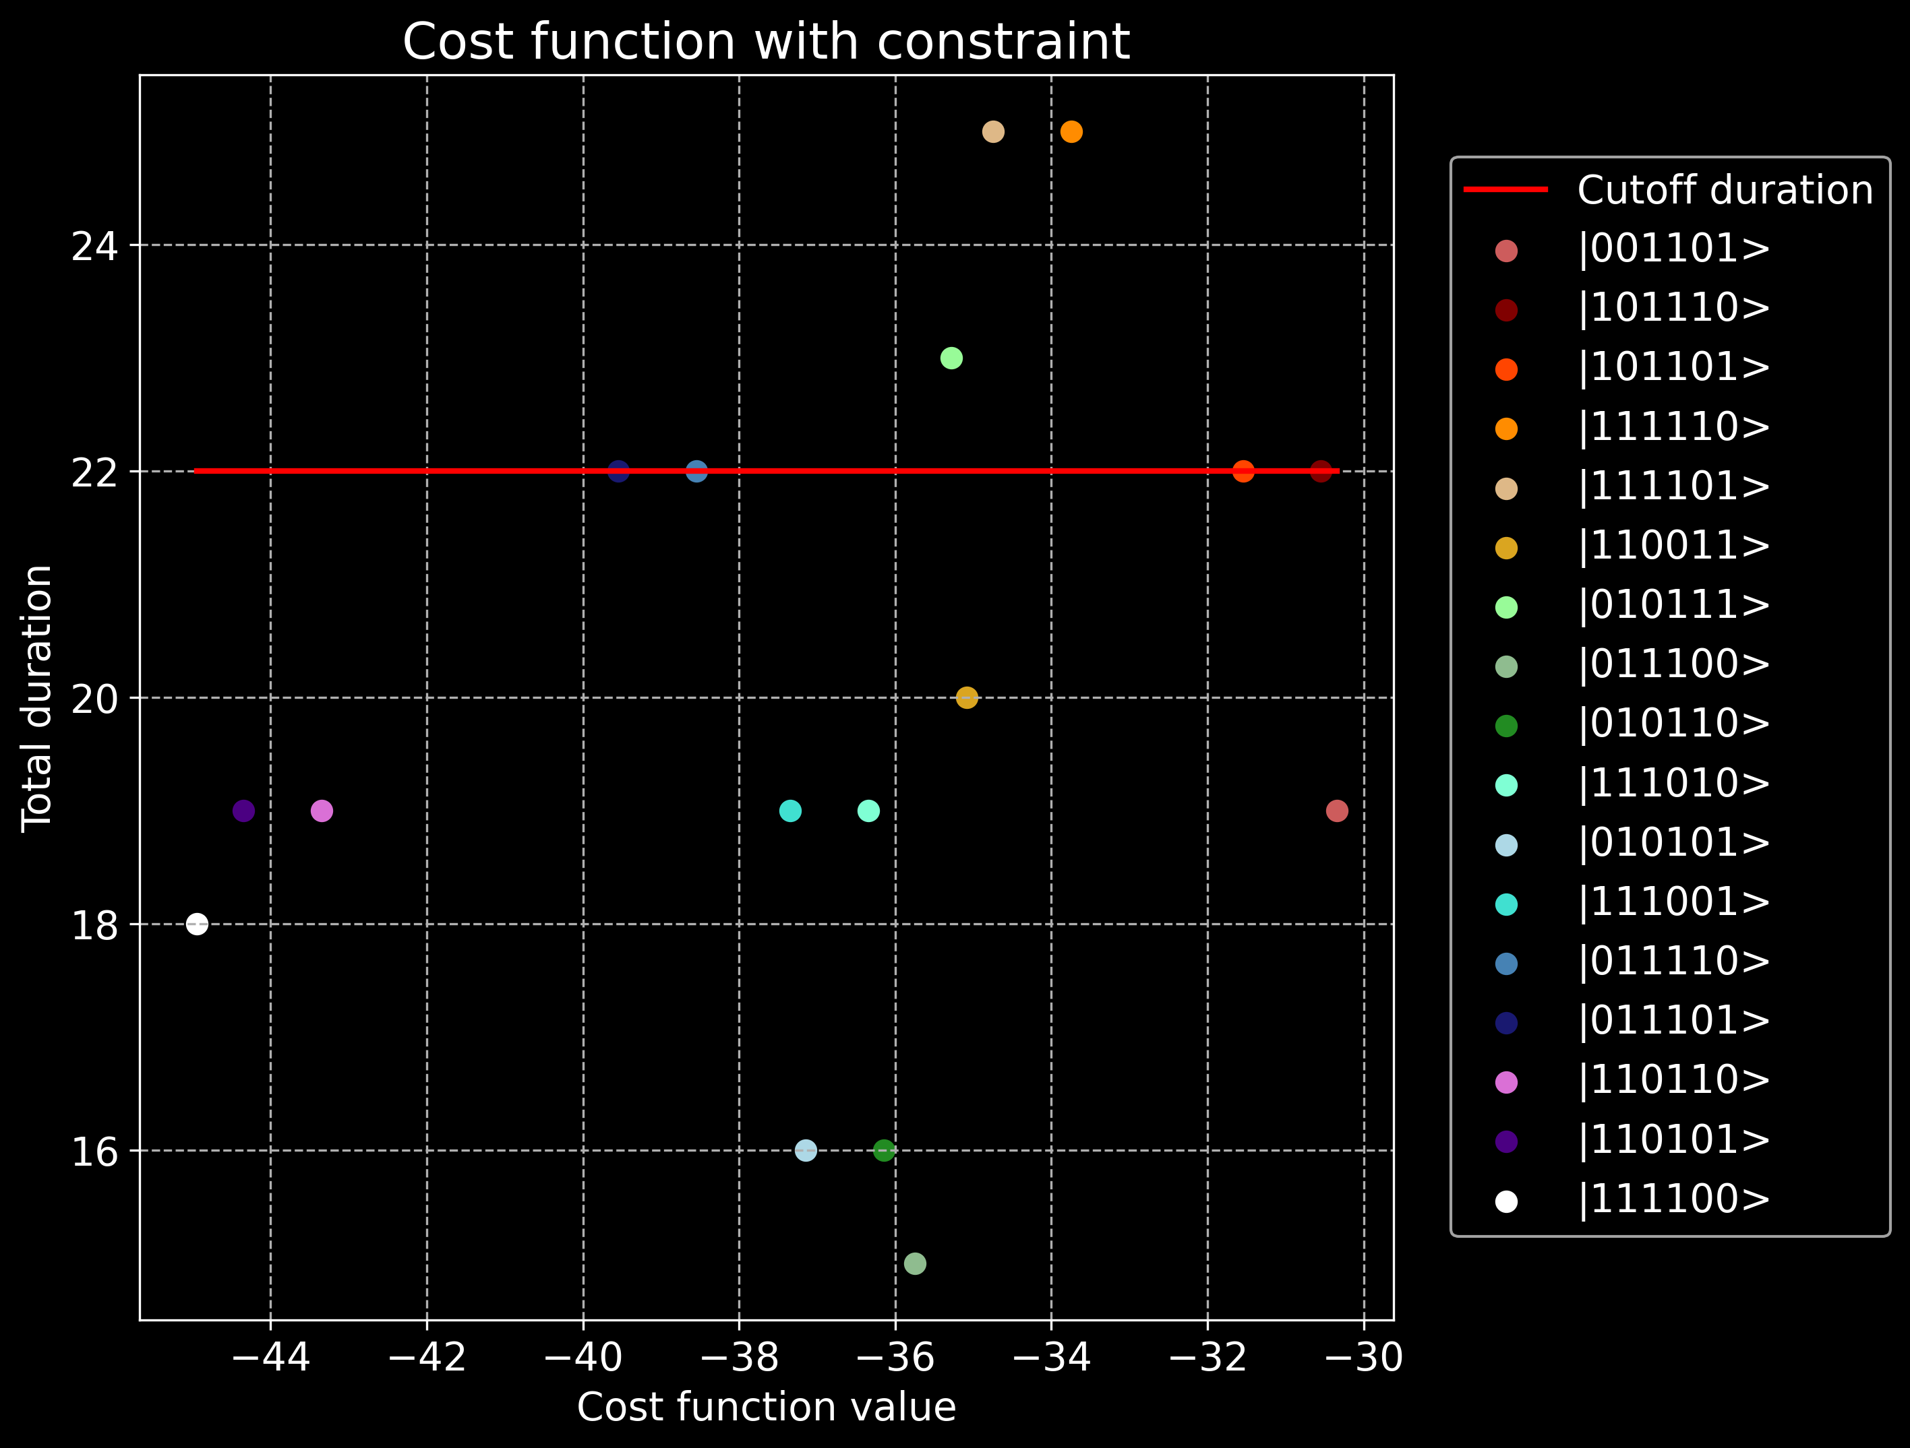
Notes:
Using the previous Hamiltonian we get the following 16 states which a evaluated as favorable
The ground state lies in S

Slide 11
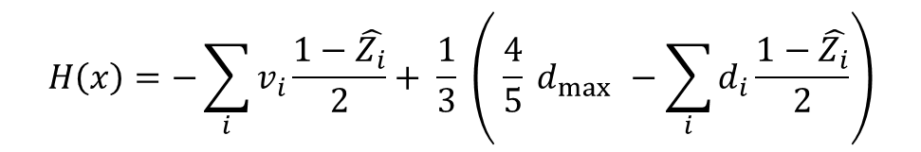

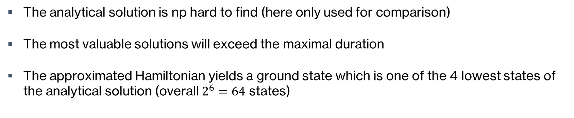
Process management problem
Comparison with the analytic solution
Optimization Hamiltonian (without constraints):
Variables:
$v_{i}$ Value of task $i$
$d_{i}$ Duration of task $i$
$\hat{Z_{i}}$ Pauli-z acting on qubit $i$
$$H\left(x\right)=−\sum_{i}^{ }{v_{i}}\frac{1−\hat{Z_{i}}}{2}+ \frac{1}{3} \left( \frac{4}{5} d_{\max{ }}−\sum_{i}^{ }{d_{i}\frac{1−\hat{Z_{i}}}{2}}\right)$$
The analytical solution is np hard to find (here only used for comparison)
The most valuable solutions will exceed the maximal duration
The approximated Hamiltonian yields a ground state which is one of the 4 lowest states of the analytical solution (overall $2^{6}=64$ states)
05.05.2024
ETH Quantum Hackathon 2024 – Qilimanjaro Quantum Tech
Folie 11
Notes:
Since the overall number ob tasks is small – also use brute force to calculate ideal ground state
By just omitting penalty term

Slide 12
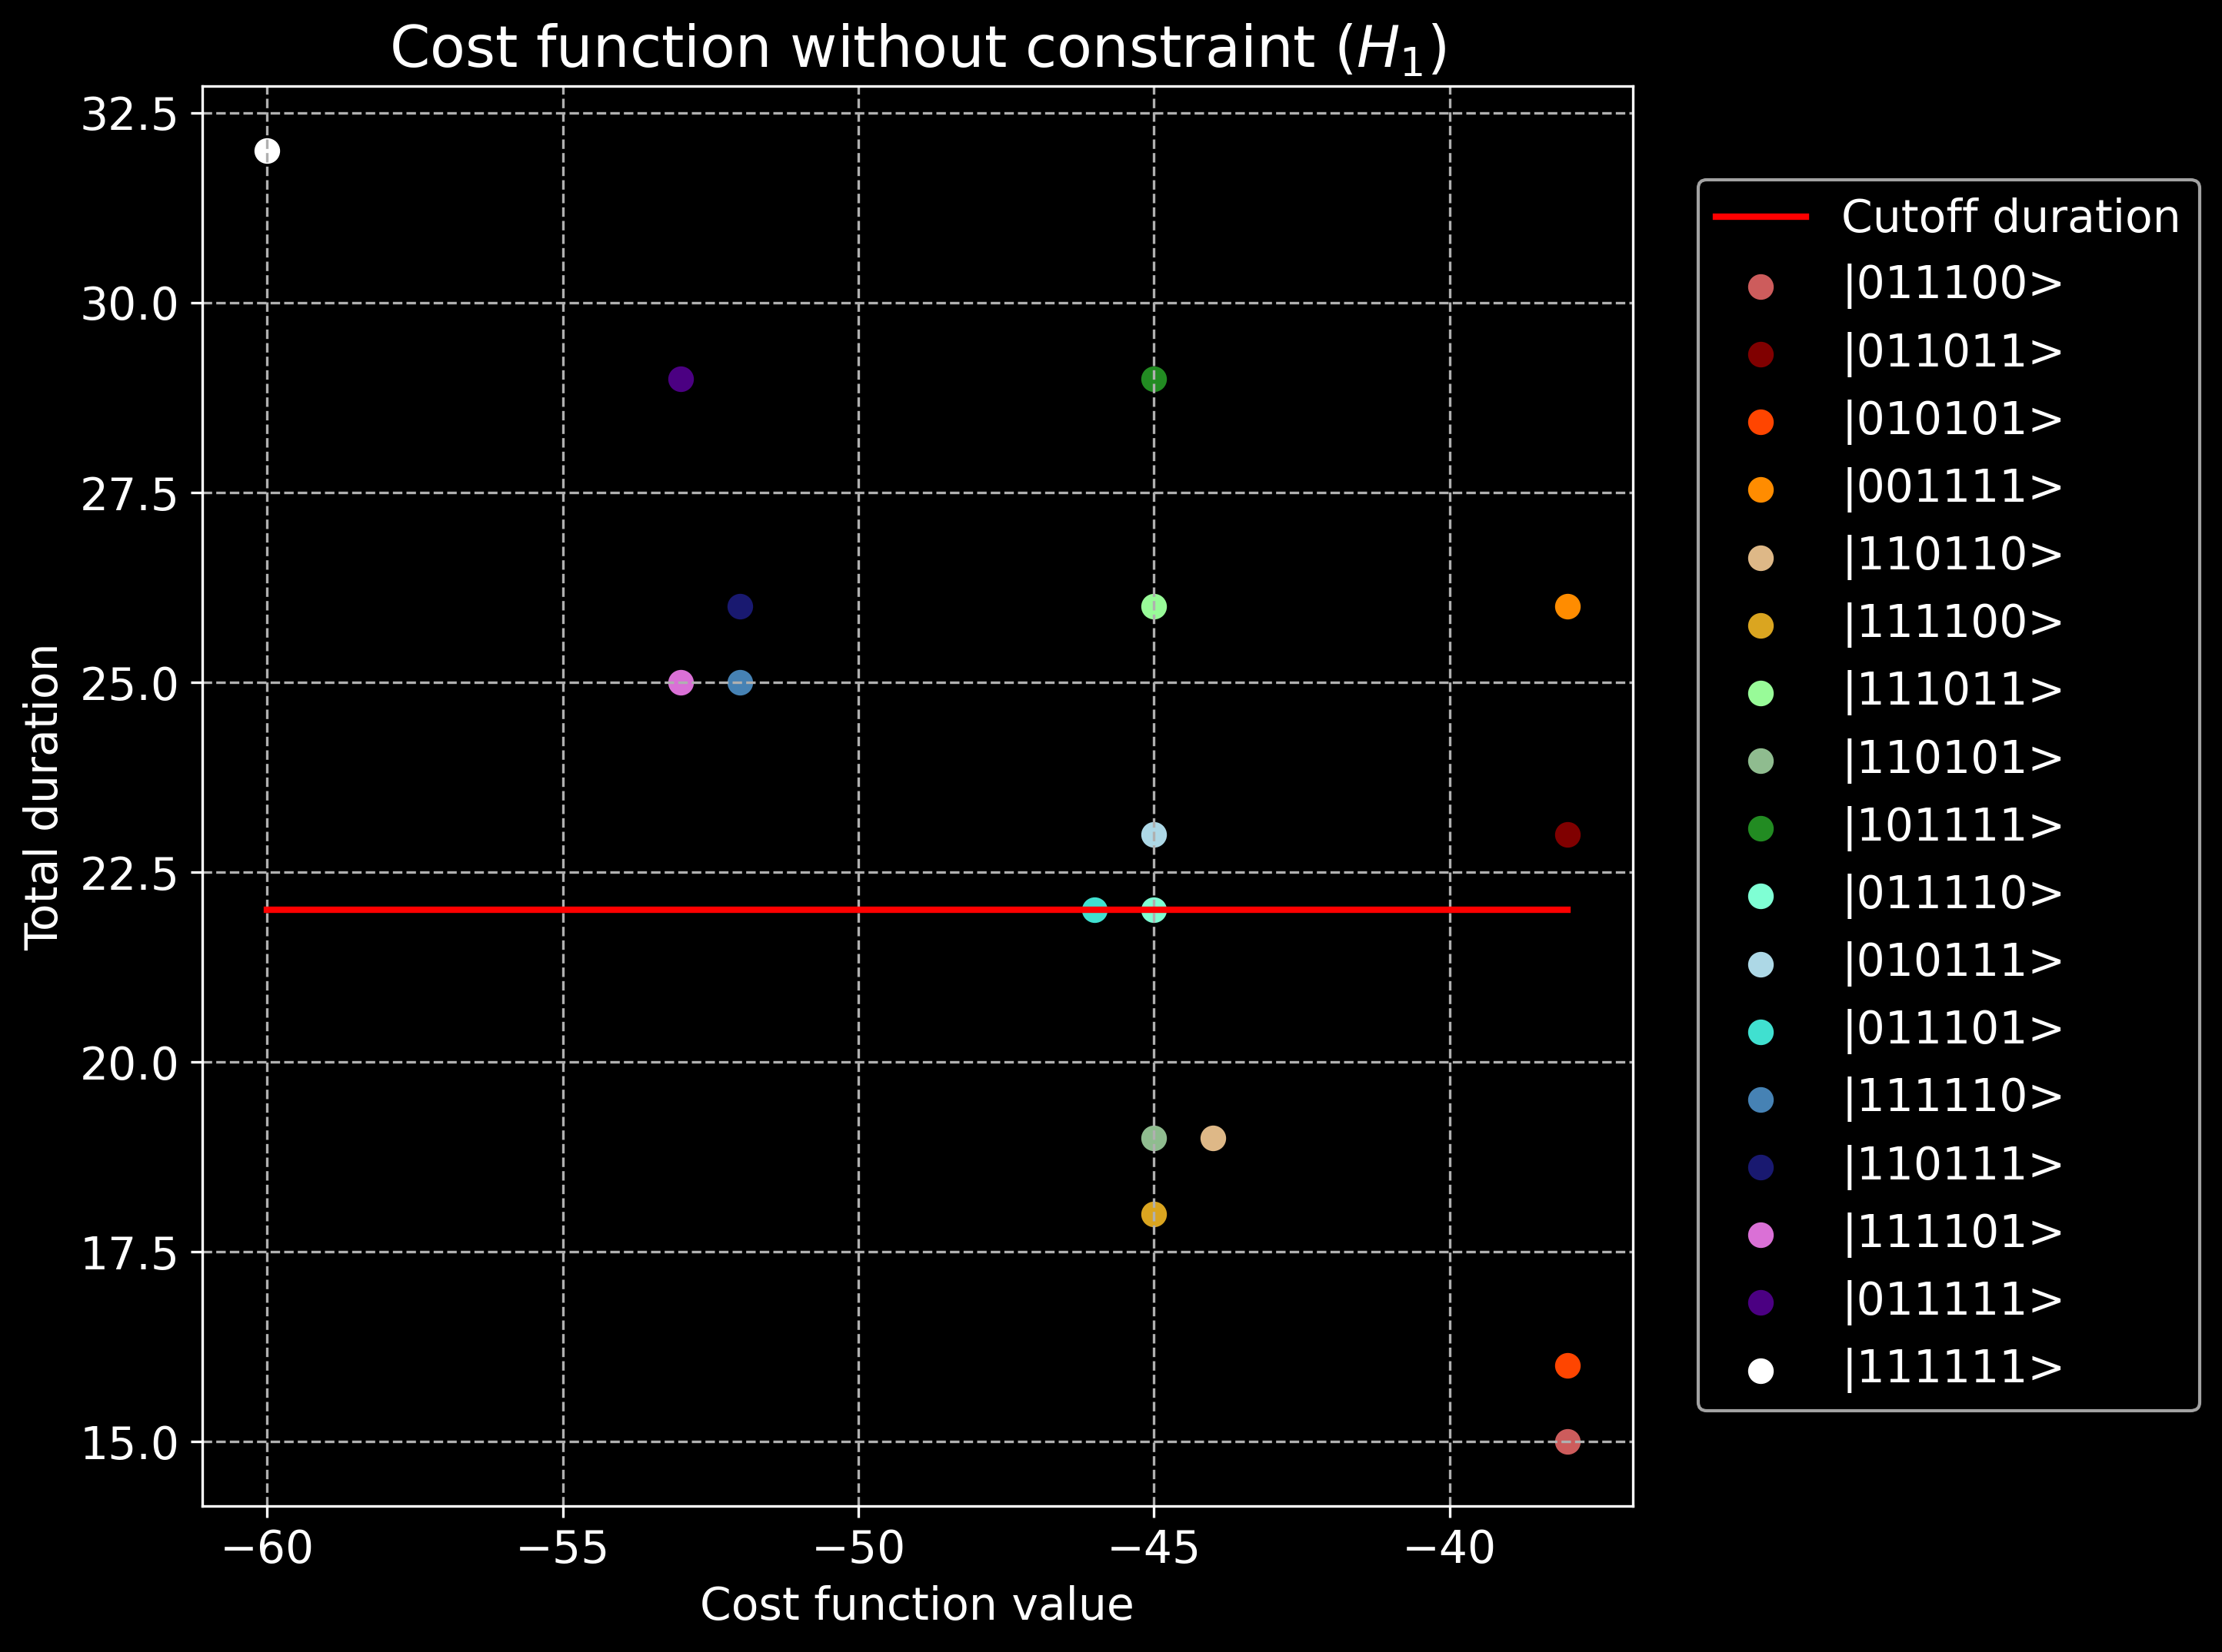
Notes:
Most valuable to do everything but of course we exceed the maximum
The ground state is given here
The previously determined solution is shown here, among the 4 best solutions

Slide 13
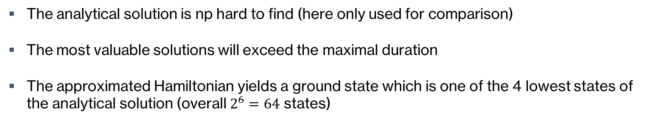
Process management problem
Comparison with the analytical solution
Optimization Hamiltonian (without constraints):
Variables:
$v_{i}$ Value of task $i$
$d_{i}$ Duration of task $i$
$\hat{Z_{i}}$ Pauli-z acting on qubit $i$
$$H\left(x\right)=−\sum_{i}^{ }{v_{i}}\frac{1−\hat{Z_{i}}}{2}+ \frac{1}{3} \left( \frac{4}{5} d_{\max{ }}−\sum_{i}^{ }{d_{i}\frac{1−\hat{Z_{i}}}{2}}\right)$$
The analytical solution is np hard to find (here only used for comparison)
The most valuable solutions will exceed the maximal duration
The approximated Hamiltonian yields a ground state which is one of the 4 lowest states of the analytical solution (overall $2^{6}=64$ states)
05.05.2024
ETH Quantum Hackathon 2024 – Qilimanjaro Quantum Tech
Folie 13

Slide 14
Digital and analog quantum algorithms
Quantum Approximate Optimization Algorithm (QAOA)
Quantum Adiabatic Evolution (QAE)
Comparison between QAOA and QAE
05.05.2024
ETH Quantum Hackathon 2024 – Qilimanjaro Quantum Tech
Folie 14

Slide 15
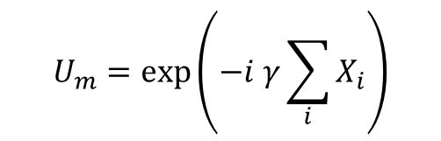




Digital and analog quantum algorithms
Quantum Approximate Optimization Algorithm (QAOA)
Application of two unitary operators sequentially on initial state
Encoding of the problem in the phase separation operator
The other operator is called "mixer" operator
Mixing operator & unitary:
Cost unitary:
$$H_{m}=\sum_{i}^{ }{X_{i}}$$
$$U_{m}=\exp\left(−i γ\sum_{i}^{ }{X_{i}}\right)$$
$$U_{m}=\exp\left(−i βH_{c}\right)$$
for $H_{c}$ as cost Hamiltonian
Here $β$and $γ$are trainable parameters
05.05.2024
ETH Quantum Hackathon 2024 – Qilimanjaro Quantum Tech
Folie 15
Notes:
SKIP!!!

Slide 16



Digital and analog quantum algorithms
Quantum Adiabatic Evolution (QAE)
Definition of a simple Hamiltonian with known ground state
Adiabatic transfer to the cost Hamiltonian in a time interval $t∈\left[0,1\right]$
Adiabatic transfer:
$$H_{0}=\sum_{i}^{ }{X_{i}}$$
$H_{c}$ as cost Hamiltonian
with known ground state
$H\left(s\right)=s\left(t\right) H_{c}+\left(1−s\left(t\right)\right) H_{0}$ for $s(t=0)=0$and $s(t=1)=1$
If the transfer is sufficiently slow, the system remains in the ground state
05.05.2024
ETH Quantum Hackathon 2024 – Qilimanjaro Quantum Tech
Folie 16
Notes:
SKIP!!!

Slide 17
Digital and analog quantum algorithms
Comparison between QAOA and QAE
Randomize initial values and record 150 runs
Compare the ground states and quantify energy deviations for each run
Ground state comparison:
Method 1 | Method 2 | Matching probability
Diagonalization | QAOA | 22.67%
QAOA | QAE | 22.67%
QAE | Diagonalization | 96.0%
05.05.2024
ETH Quantum Hackathon 2024 – Qilimanjaro Quantum Tech
Folie 17
Notes:
Having set the approximated Hamiltonian, we compare the three solution methods
We performed 150 runs with random initial values and determine how often this yields to the same outcomes
We see that Quantum Adiabatic Evolution is very close to

Slide 18
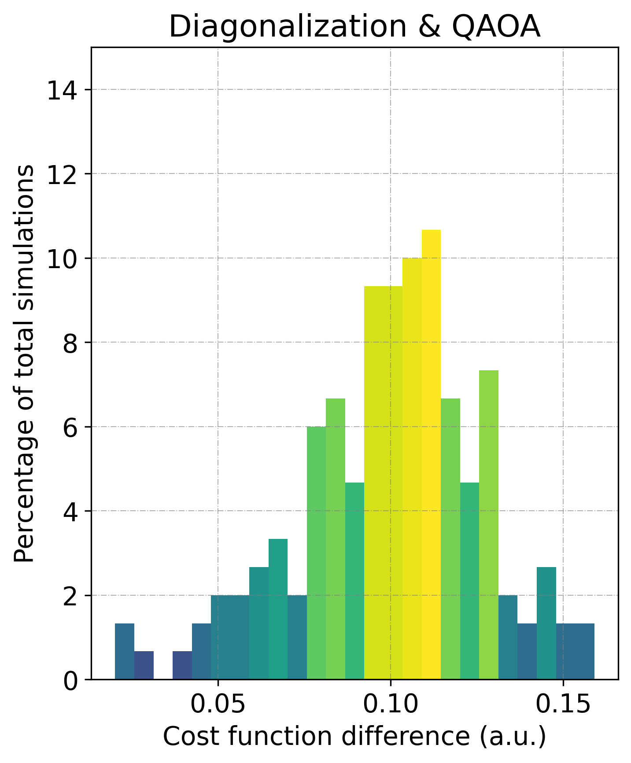
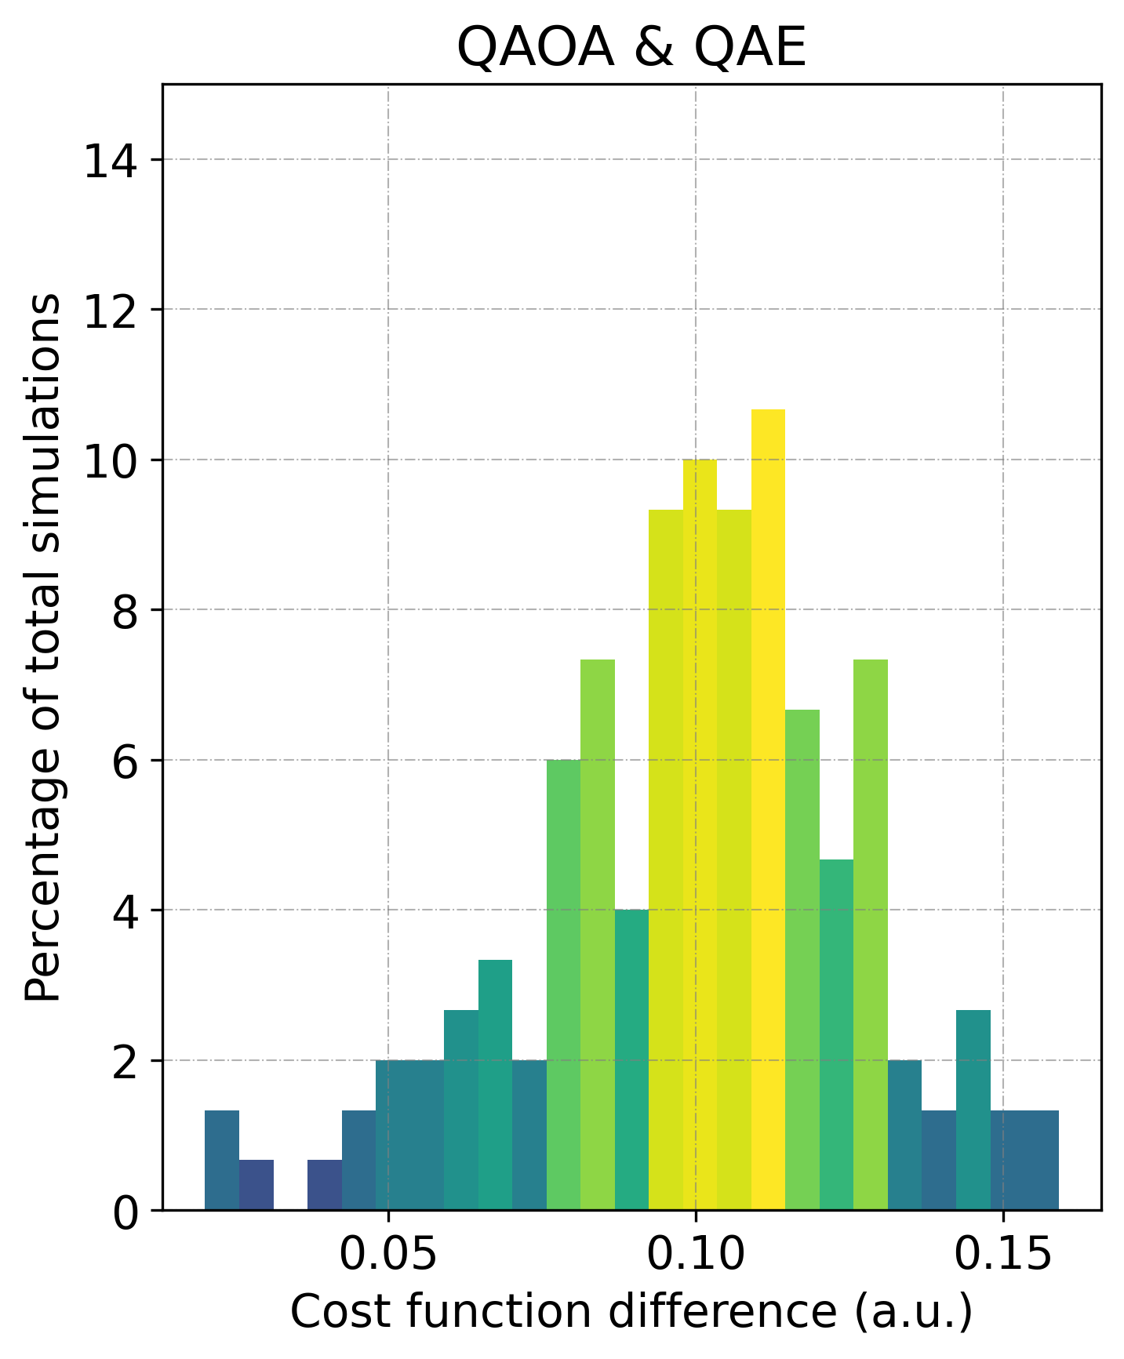
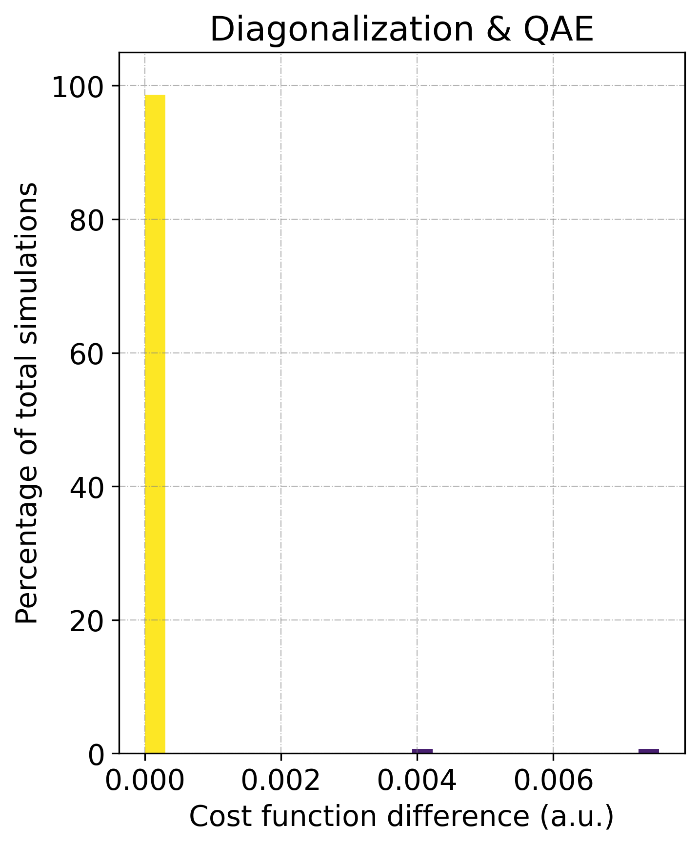
Digital and analog quantum algorithms
Comparison between QAOA and QAE
05.05.2024
ETH Quantum Hackathon 2024 – Qilimanjaro Quantum Tech
Folie 18

Slide 19
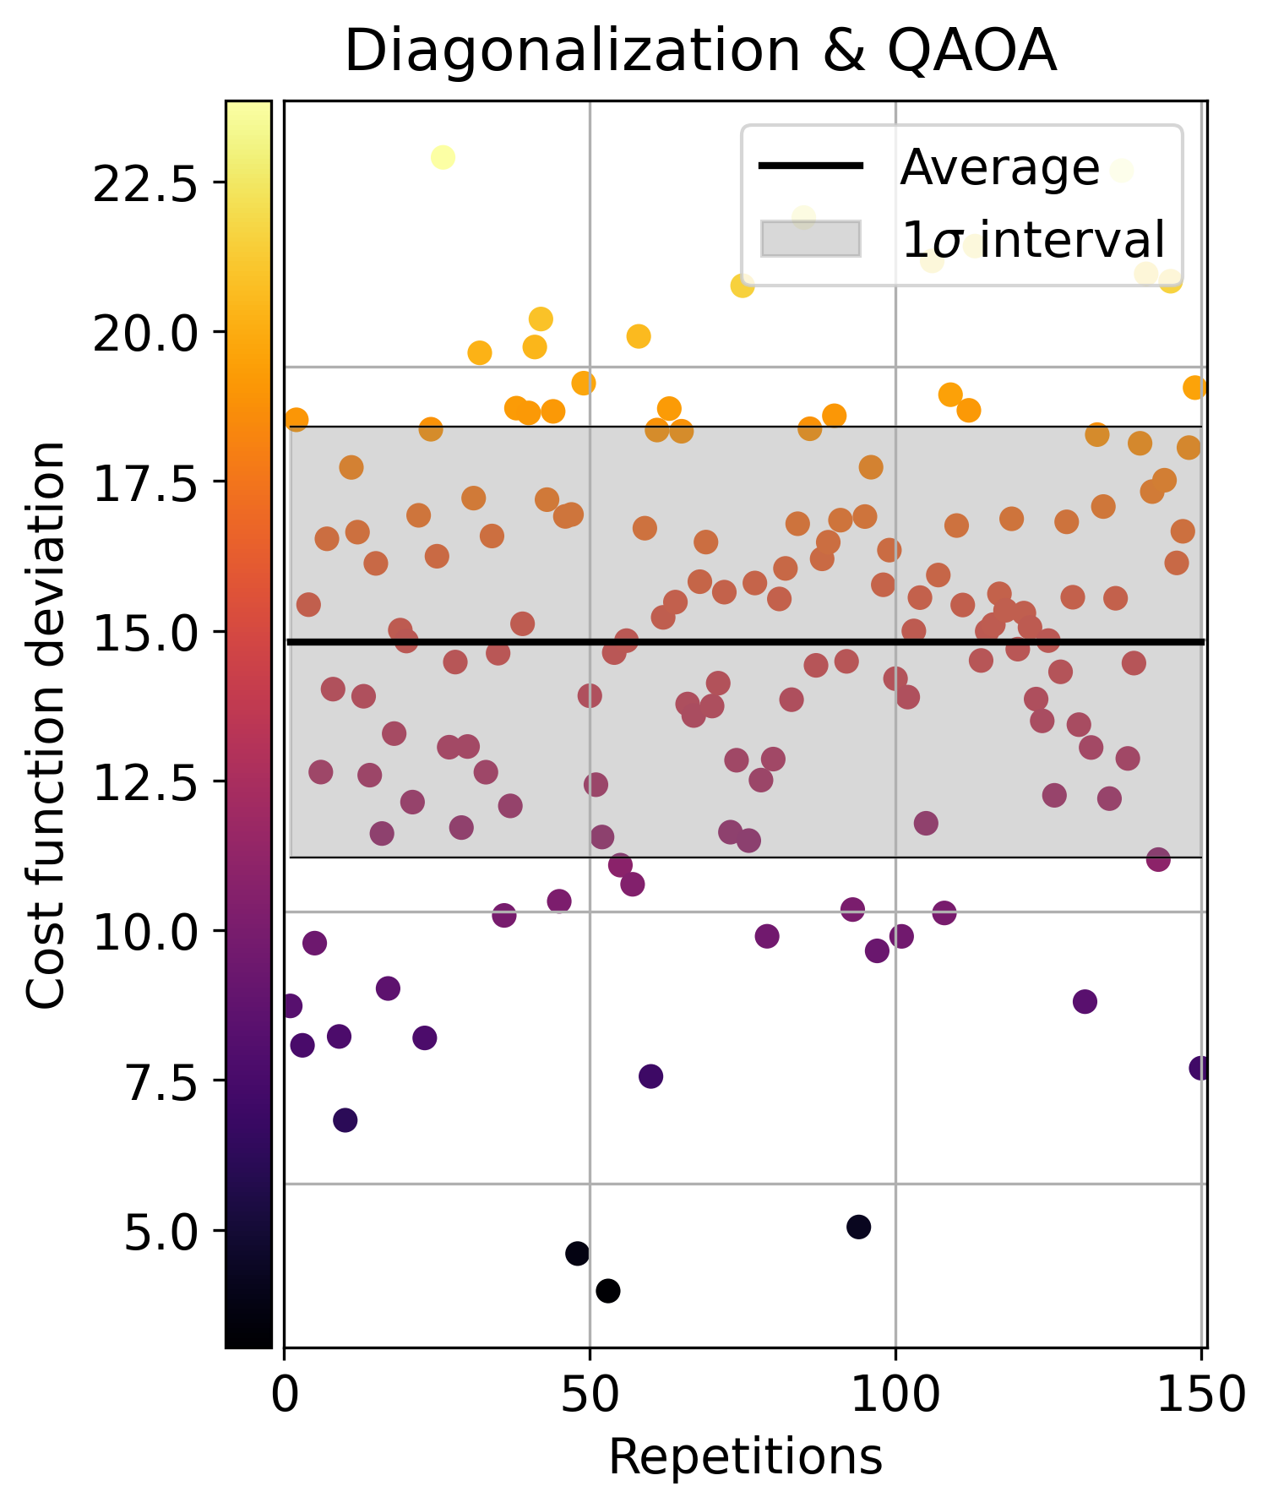
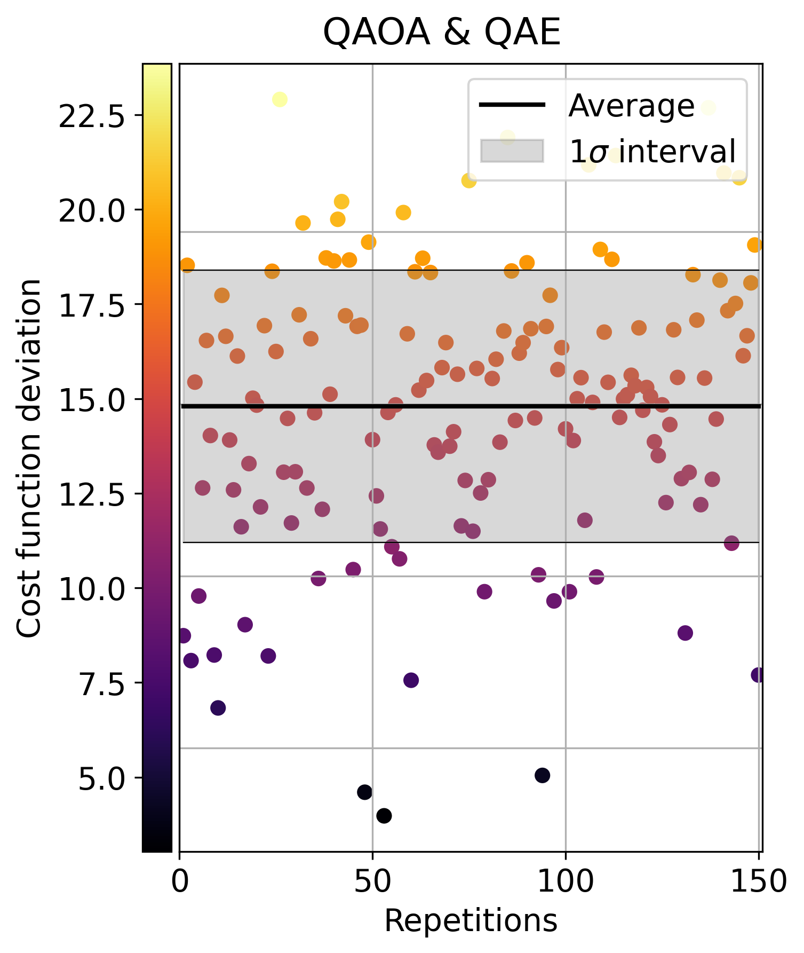
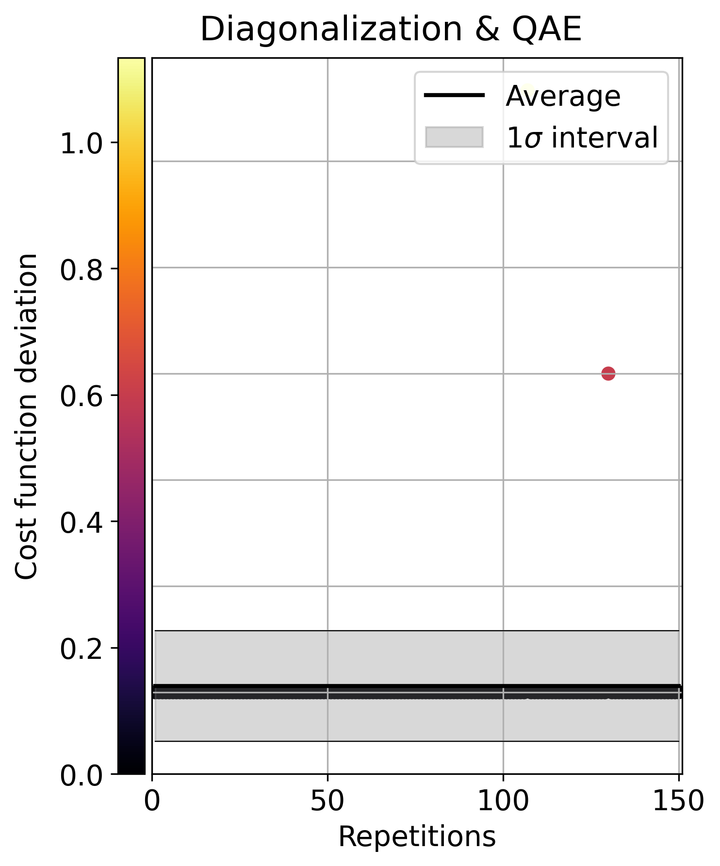
Digital and analog quantum algorithms
Comparison between QAOA and QAE
05.05.2024
ETH Quantum Hackathon 2024 – Qilimanjaro Quantum Tech
Folie 19

Slide 20
Hardware implementation via Flux Qubits
Walkthrough
Energy spectrum
Research
05.05.2024
ETH Quantum Hackathon 2024 – Qilimanjaro Quantum Tech
Folie 20

Slide 21
Hardware implementation via Flux Qubits
Walkthrough
3 qubits + 3 couplers
Only lowest eigenvalues and eigenenergies
Hamiltonian coefficients
Ising schedule
Flux schedule
Energy spectrum
05.05.2024
ETH Quantum Hackathon 2024 – Qilimanjaro Quantum Tech
Folie 21
Notes:
Now, we'll quickly walk you through the Hardware part of the challenge, for which we only have 3 qubits.
First, we create the circuit with the values that are given to us, and since we have 3 qubits, we use also 3 couplers to get the interaction in between all of them.
Even if we are only doing three qubits, the problem can get extremely costly computational-wise, so what we do is truncate the eigenvalues and eigenenergies we get for the circuit elements to the lower 5 in the case of qubits and 2 for couplers. Additionally, we also use the pairwise Schrieffer Wolff method instead of the normal one to further reduce the computational cost, this only considers the nearest neighbors’ interaction .
Having done the circuit, we need to find the Ising schedule now.
We start by writing the Hamiltonian coefficients from the theoretical Hamiltonian we got previously and we see that we get both interacting and non-interacting terms as we should.
We feed these coefficients along with the number of points we want our annealing schedule to have to a function which will give us its Ising coefficients.
Once we have the Ising schedule it is easy to get the flux schedule with which we can calculate the energy spectrum of the circuit.

Slide 22
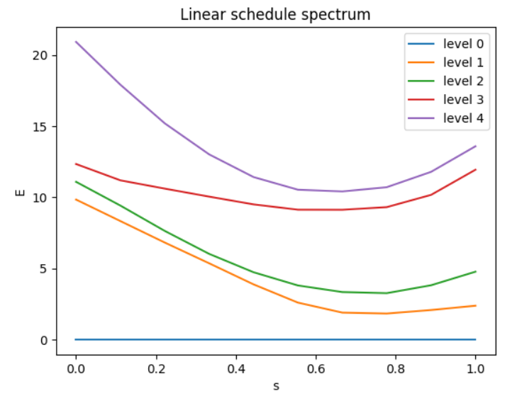
Hardware implementation via Flux Qubits
Energy spectrum – Cost Hamiltonian
05.05.2024
ETH Quantum Hackathon 2024 – Qilimanjaro Quantum Tech
Folie 22
Notes:
In this energy spectrum, we see that there are no crossings and the energy gap between the ground and the first excited level of the circuit is quite low.
Also, to get the Ising schedule we can use whatever time dependance we want, in our case we've tried with the linear and exponential. the latter worked better but, in both cases, we got high relative errors in qubit residuals. This is most likely due to the shape of the problem.

Slide 23
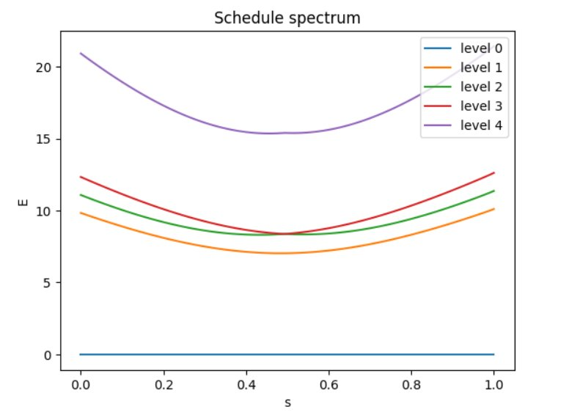
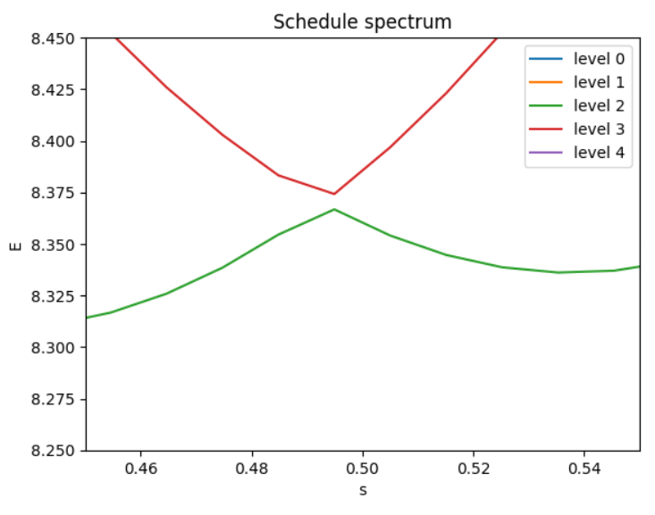
Hardware implementation via Flux Qubits
Energy spectrum – modified Hamiltonian
05.05.2024
ETH Quantum Hackathon 2024 – Qilimanjaro Quantum Tech
Folie 23
Notes:
That is why we've decided to play around with the Hamiltonian and try to reduce these errors and get a higher gap so that the process can be done faster since the time dependence is inversely proportional to the inverse of the gap between these two levels. We've achieved this by, instead of using the cost Hamiltonian as before, using a simpler one consisting of just Z gates (meaning that we also don't get any coupling). From this energy spectrum, we see more clearly that the linear annealing schedule fulfils the adiabatic theorem; we have a gradually changing Hamiltonian, allowing for the system to adapt its configuration while forcing the preservation of eigenstates of the Hamiltonian. Thus, the eigenstates of the initial Hamiltonian will end in corresponding states of the final Hamiltonian; this we can observe by the presence of an avoidant crossing between the 2nd and 3rd levels, which can be useful for implementing some gates like the cPhase one.

Slide 24
References
[Sch22] Adiabatic Spectroscopy and a Variational Quantum Adiabatic Algorithm; https://arxiv.org/abs/2103.01226;
Schiffer et al. (2022)
[Mat20] Direct estimation of the energy gap between the ground state and excited state with quantum annealing; https://arxiv.org/abs/2007.10561; Matsuzaki et al. (2020)
[Doo20] Simulating quantum circuits by adiabatic computation; improved spectral gap bounds; https://arxiv.org/abs/1906.05233; Dooley et al. (2020)
[Maj05] Spectroscopy on two coupled flux qubits; https://arxiv.org/abs/cond-mat/0308192; https://arxiv.org/abs/cond-mat/0308192; Majer et al. (2005)
05.05.2024
ETH Quantum Hackathon 2024 – Qilimanjaro Quantum Tech
Folie 24

