Slide 1


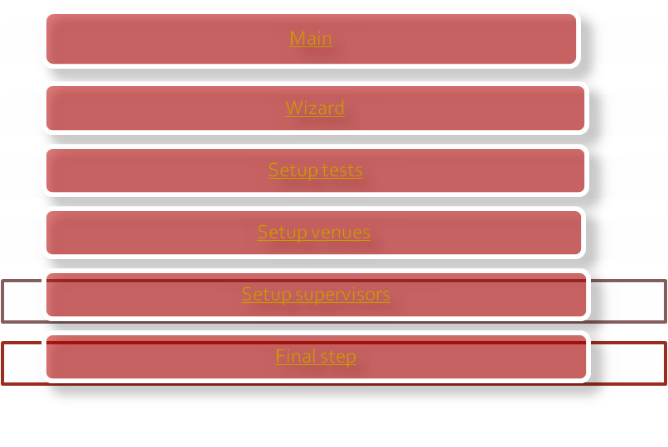

A tutorial with video assistance
Click here to advance

Slide 2
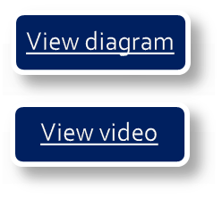
Main
This is the first form you will see when running the program. From this form you can access all the other forms enabling you to complete the schedule. Before you start it is recommended that you get lists of all the needed information.
Lists of:
all the tests. (Grade, Subject, Student count, test time)
All the venues. (Venue name, Capacity)
All the supervisors. (Surname, Name)
When you have all this information you can start setting up the tests. If you are a beginner you should start the step wizard rather than going through each step on your own.
Go back to main menu

Slide 3
Main Diagram
Back
Go back to main menu

Slide 4
Main Video
Click on video to start playing
Back
Go back to main menu

Slide 5
Wizard
The wizard will take you through the 3 base steps to continue on to the final step.
Steps:
Step 1: Set up the tests.
Step 2: Set up the venues.
Step 3: Set up the Supervisors
Final step: The final step can only be done if the 3 steps above has been completed successfully. The application will search for the 3 needed files and if they are found, you can start this step.
*Make sure you save each of your 3 base steps, otherwise you won’t be able to complete the setup.
Go back to main menu

Slide 6
Wizard Diagram
Back
Go back to main menu

Slide 7
Wizard Video
Click on video to start playing
Back
Go back to main menu

Slide 8

Setup Tests
Setting up the tests’ table is straightforward and easy. Start entering the data(Grade, Subject, Student count, Test time) in the first open row. When all the data has been entered there will be a new open row created below. When you have entered all the tests you have to save the table to a text file. Click the “Save to textfile” button and enter the name you wish to save it as. If you come back to the form you can load the file again and make changes to it, remember to save it again. At the right of the table there’s a panel showing you stats of the tests you have entered.
Check table: This button checks whether you have entered all the data correctly. A check runs automatically whenever you save or refresh stats. If the check has found any errors you will get a message/s showing you where the error is.
The check function runs through each row in the table checking if column:
One is 8,9,10,11 or 12.
Two has a subject entered.
Three and four are numeric values.
Go back to main menu

Slide 9
Tests Diagram
Back
Go back to main menu

Slide 10
Tests Video
Click on video to start playing
Back
Go back to main menu

Slide 11

Setup Venues
Similar to setting up the tests, you just have to enter the data(Venue name, Capacity, Level) in the table. The level column can be ignored, this function may be added in later versions. As in setting up tests you have to save this table to a text file and you will be able to load it again at a later stage.
The check function in this table runs through each row in the table checking if column:
One has a name entered.
Two has a Capacity(maximum number of seats) entered, must be numeric.
Three can be open.
Go back to main menu

Slide 12
Venues Diagram
Back
Go back to main menu

Slide 13
Venue Video
Click on video to start playing
Back
Go back to main menu

Slide 14

Setup Supervisors
As in the previous two tables, you just have to enter the data(Surname, Name, Level, Hours) of each supervisor. Remember to save your table when you are finished.
Level: The level indicates the number of hours the supervisor has to do. This enables you to automatically allocate the hours of each supervisor. For more information click here.
Hours: This column can either be entered manually or left open. After you have entered all the supervisors, you can allocate the hours with the application.
The check function in this table runs through each row in the table checking if column:
One and two has a surname and name entered.
Three has a level entered(0-3).
Four has a numeric value indicating the hours.
Go back to main menu

Slide 15
Supervisors Diagram
Back
Go back to main menu

Slide 16
Supervisors Video
Click on video to start playing
Back
Go back to main menu

Slide 17
Final step
If you have created the three text files in the base steps, you can start the final step.
Load files into setup: On this panel you have to select the 3 separate files(Tests, Venues and Supervisors) and load them.
Review and stats: This panel enables you to see the three tables and there stats.
Setup days: Here you can either “Calculate the recommended setting” or manually enter your settings.
Maximize Editing: This button allows you to expand and shrink the form to ease the editing.
Calendar: The days of the examination period are displayed here and can be selected.
Go back to main menu

Slide 18
Final Diagram
Back
Go back to main menu

Slide 19
Final Video
Click on video to start playing
Back
Go back to main menu

