Slide 1
Project Progress Update

Slide 2
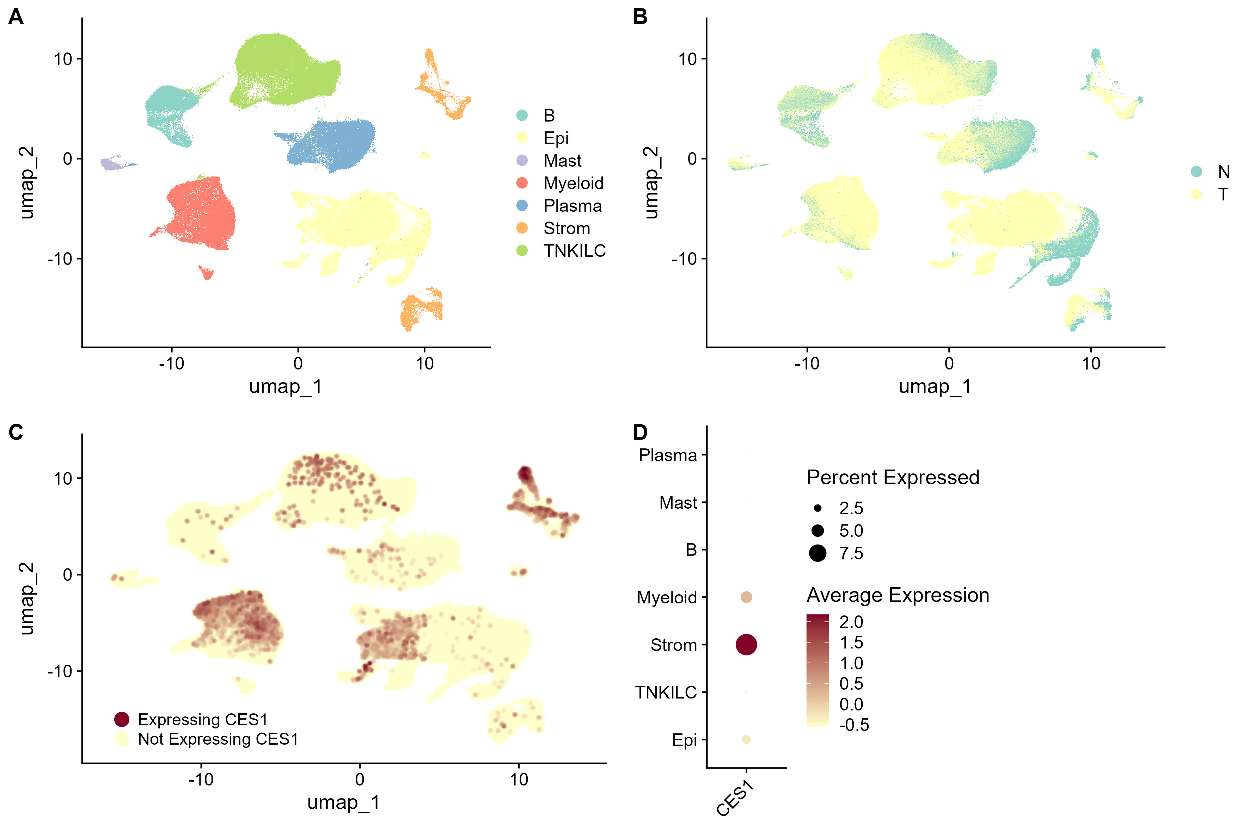
Figure 1: Stromal and Myeloid populations linked to elevated CES1 expression. (A) UMAP plot of 7 cell subtypes with labels from Pelka et al.. (B) Clustering distribution of cells from N and T samples. (C) Clustering distribution of cells expressing CES1. (D) CES1 expression analysis of labelled cell clusters.

Slide 3
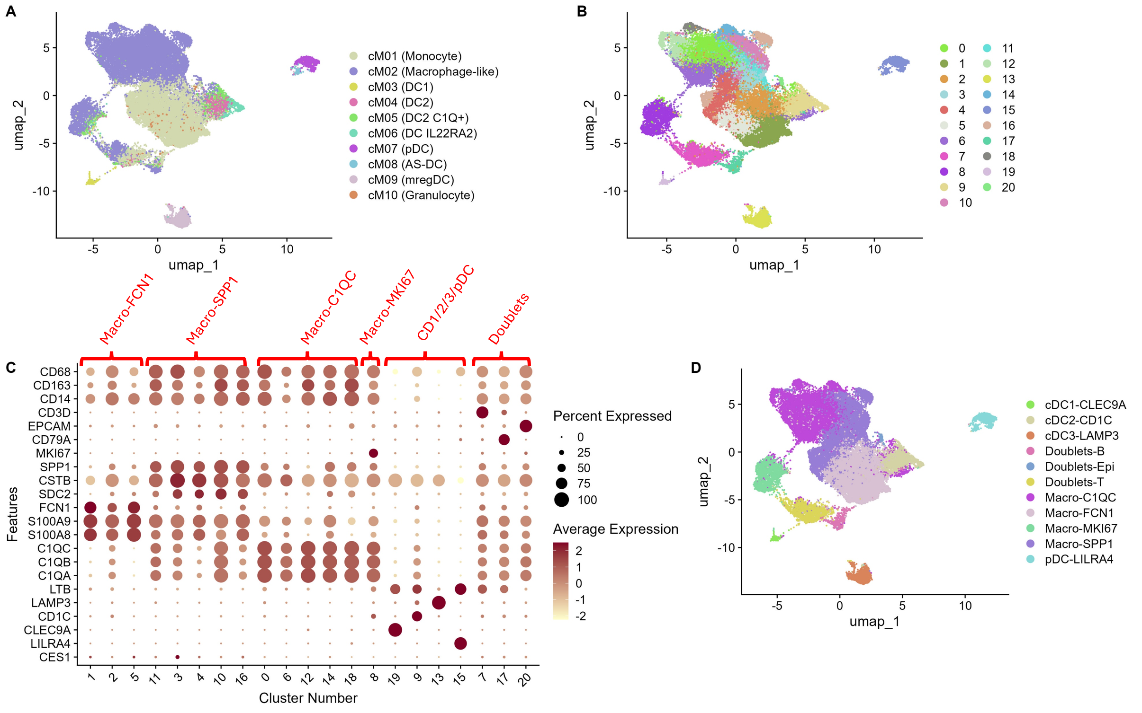
Figure 2: Identification of Myeloid subsets in CRC. UMAP plot labelled with distinct myeloid clusters from Pelka et al. (A) , using cluster numbers (B), and using annotations (D) obtained using feature identification and a dot plot of the scaled average expression of key myeloid marker genes (C) following Xie et al. workflow.

Slide 4
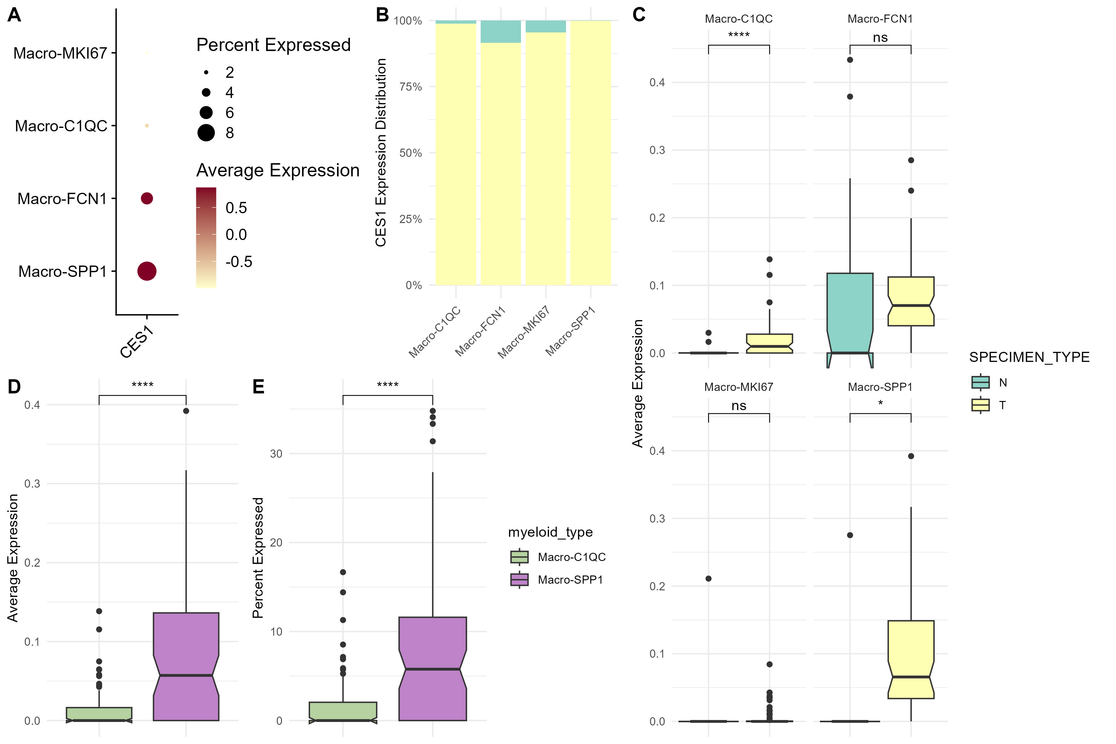
Figure 3: SPP1+ Macrophages exhibit significantly higher CES1 expression comparative to C1QC+ Macrophages. (A) CES1 expression analysis between macrophage groups. (B) Percentage distribution of cells between N and T tissue which express CES1 in macrophage subgroups. (C) Box plots of the comparative average CES1 expression between N and T tissue for macrophage subgroups. (D,E) Comparative CES1 average expression and percent expressed between T tissue SPP1 and C1QC macrophage groups. ns-Non Significant,*P,0.05,****P,0.0001, Paired T-test.

Slide 5
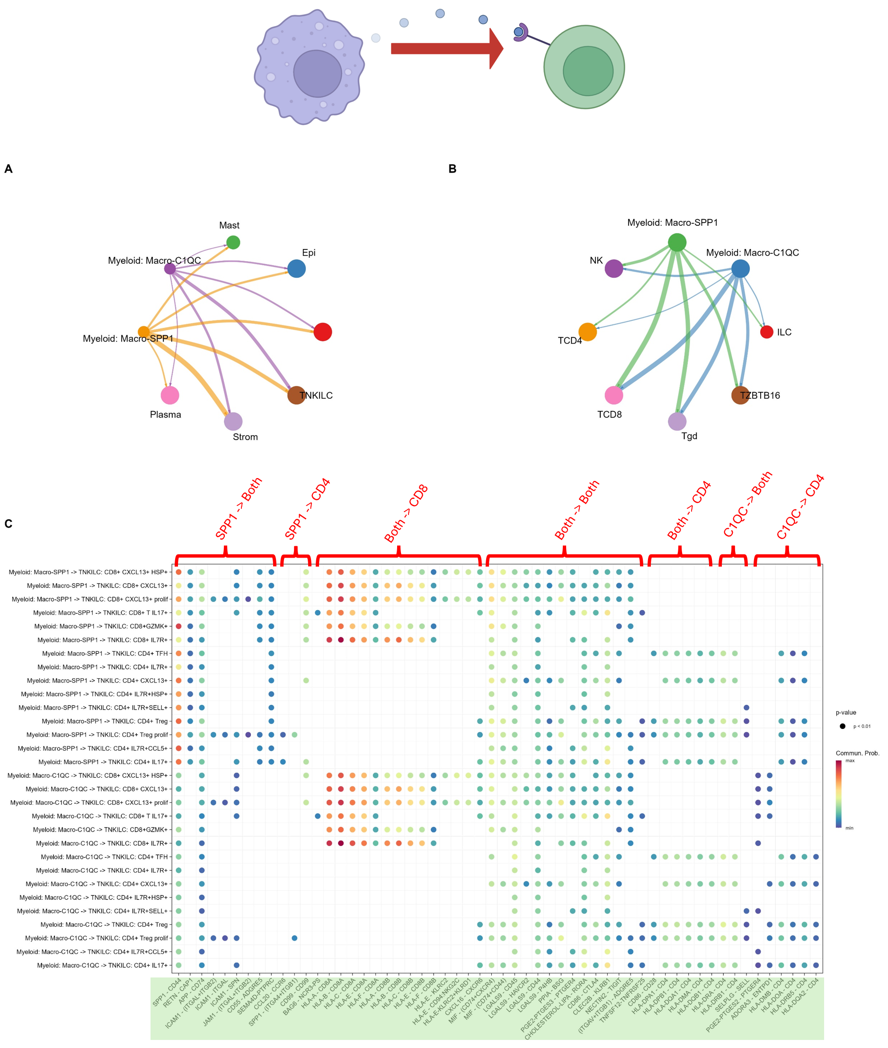
Figure 4: SPP1+/C1QC+ Macrophage outgoing Ligand-Receptor Interactions.
Cellchat circle plot depicting compare outgoing interaction strength between SPP1+/C1QC+ macrophages and general cell types (B) and T cell subtypes (B). (C) Pathway level comparison of Ligand-Receptor interaction communication probability (CP) between SPP1+/C1QC+ macrophages and CD4+/CD8+ T cell subtypes. Interaction labelled “SPP1” when (SPP1-CP)µ > 2(C1QC-CP)µ and vice versa. All combinations in-between classified as “both”. This is repeated for CD4/CD8 classifications.

Slide 6
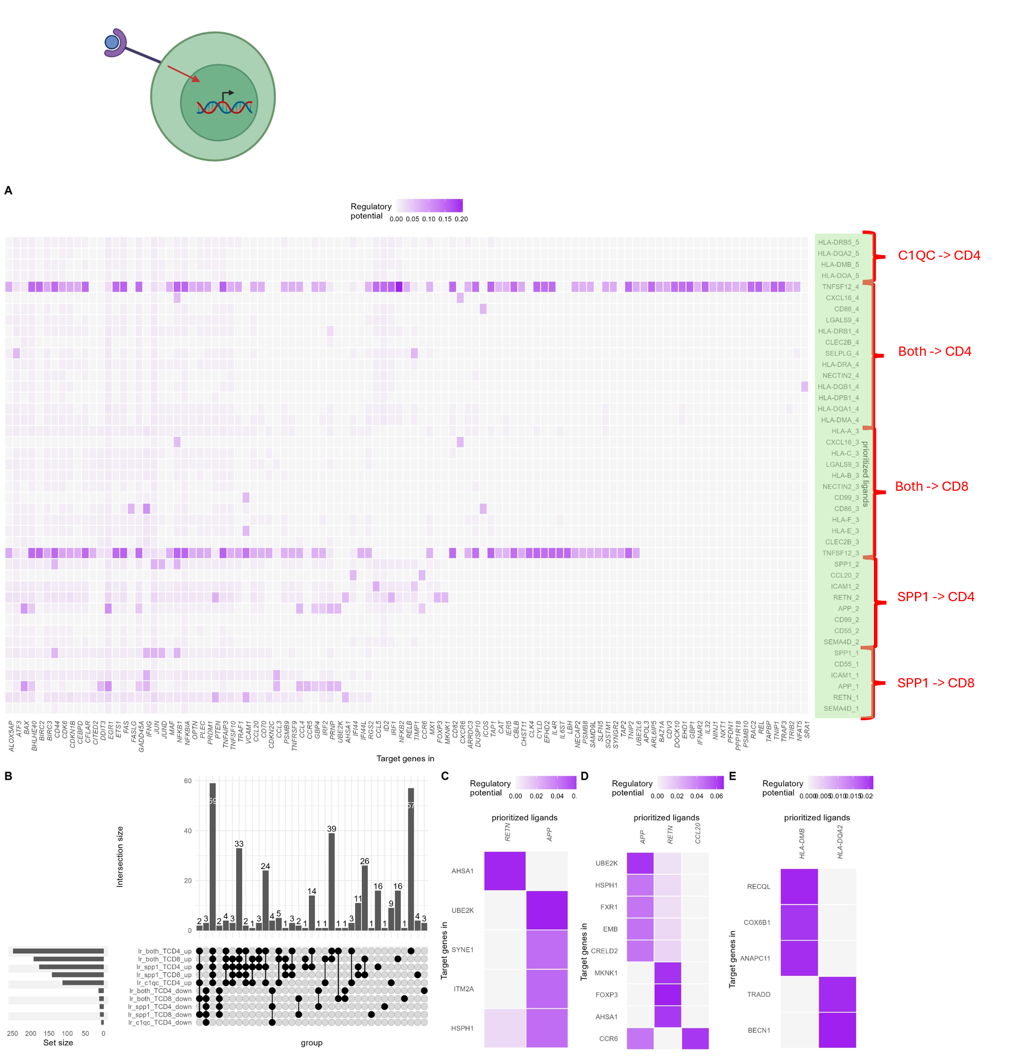
Figure 5: SPP1+ Macrophages could enhance inflammatory and immunosuppressive singalling pathways in T-Cells through RETN, APP and CCL20.
(A) Heatmap of gene regulatory potential (RP) of prioritised ligands between SPP1+/C1QC+ macrophages and CD4+/CD8+ T cells in N vs T samples. Interaction labelled “SPP1” when (SPP1-CP)µ > 2(C1QC-CP)µ and vice versa. All combinations in-between classified as “both”. (B) Complexupset plot showing overlap of genes within each condition. RP Heatmap filtered to include genes uniquely upregulated via specific SPP1-TCD8 (C) or SPP1-TCD4 (D) labelled interactions (no unique gene upregulations present for C1QC-TCD8/TCD4 labelled interactions), then further filtered by max(RP) for easier visualisation.

Slide 7
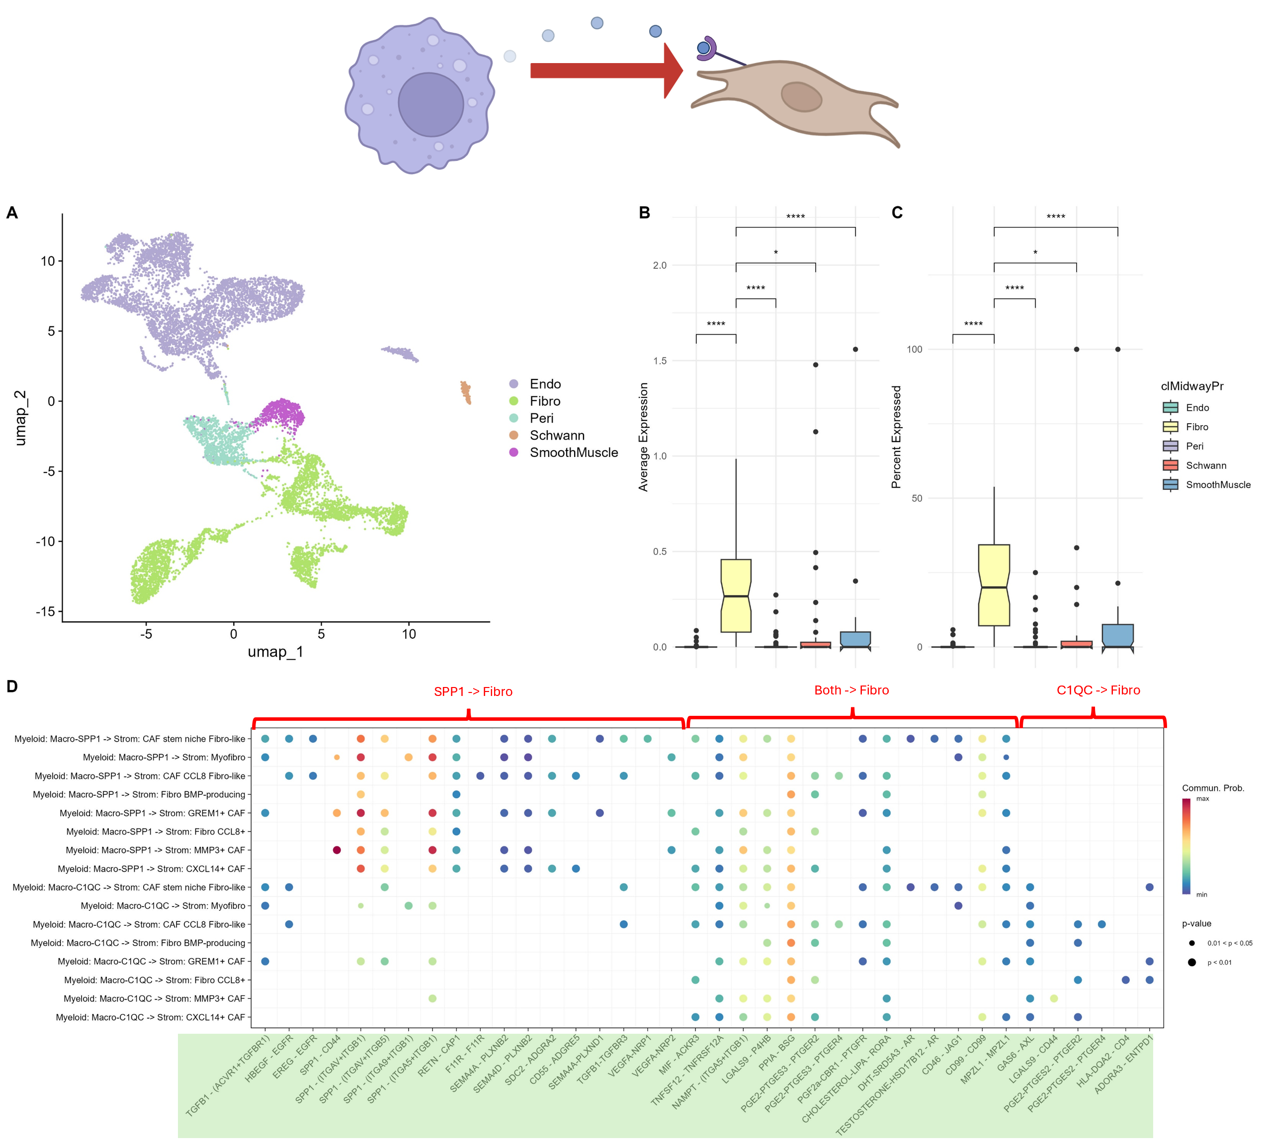
Figure 6: SPP1+/C1QC+ Macrophage to high-CES1 Fibroblast L-R analysis.
(A) UMAP plot of 5 distinct stromal clusters with labels from Pelka et al.(B,C) Comparative CES1 average expression and percent expressed between Stromal subgroups. ns-Non Significant, *P,0.05,****P,0.0001, Paired T-test.(D) Pathway level comparison of Ligand-Receptor interaction communication probability (CP) between SPP1+/C1QC+ macrophages and Fibroblast subtypes. Interaction labelled “SPP1” when (SPP1-CP)µ > 2(C1QC-CP)µ and vice versa. All combinations in-between classified as “both”.

Slide 8
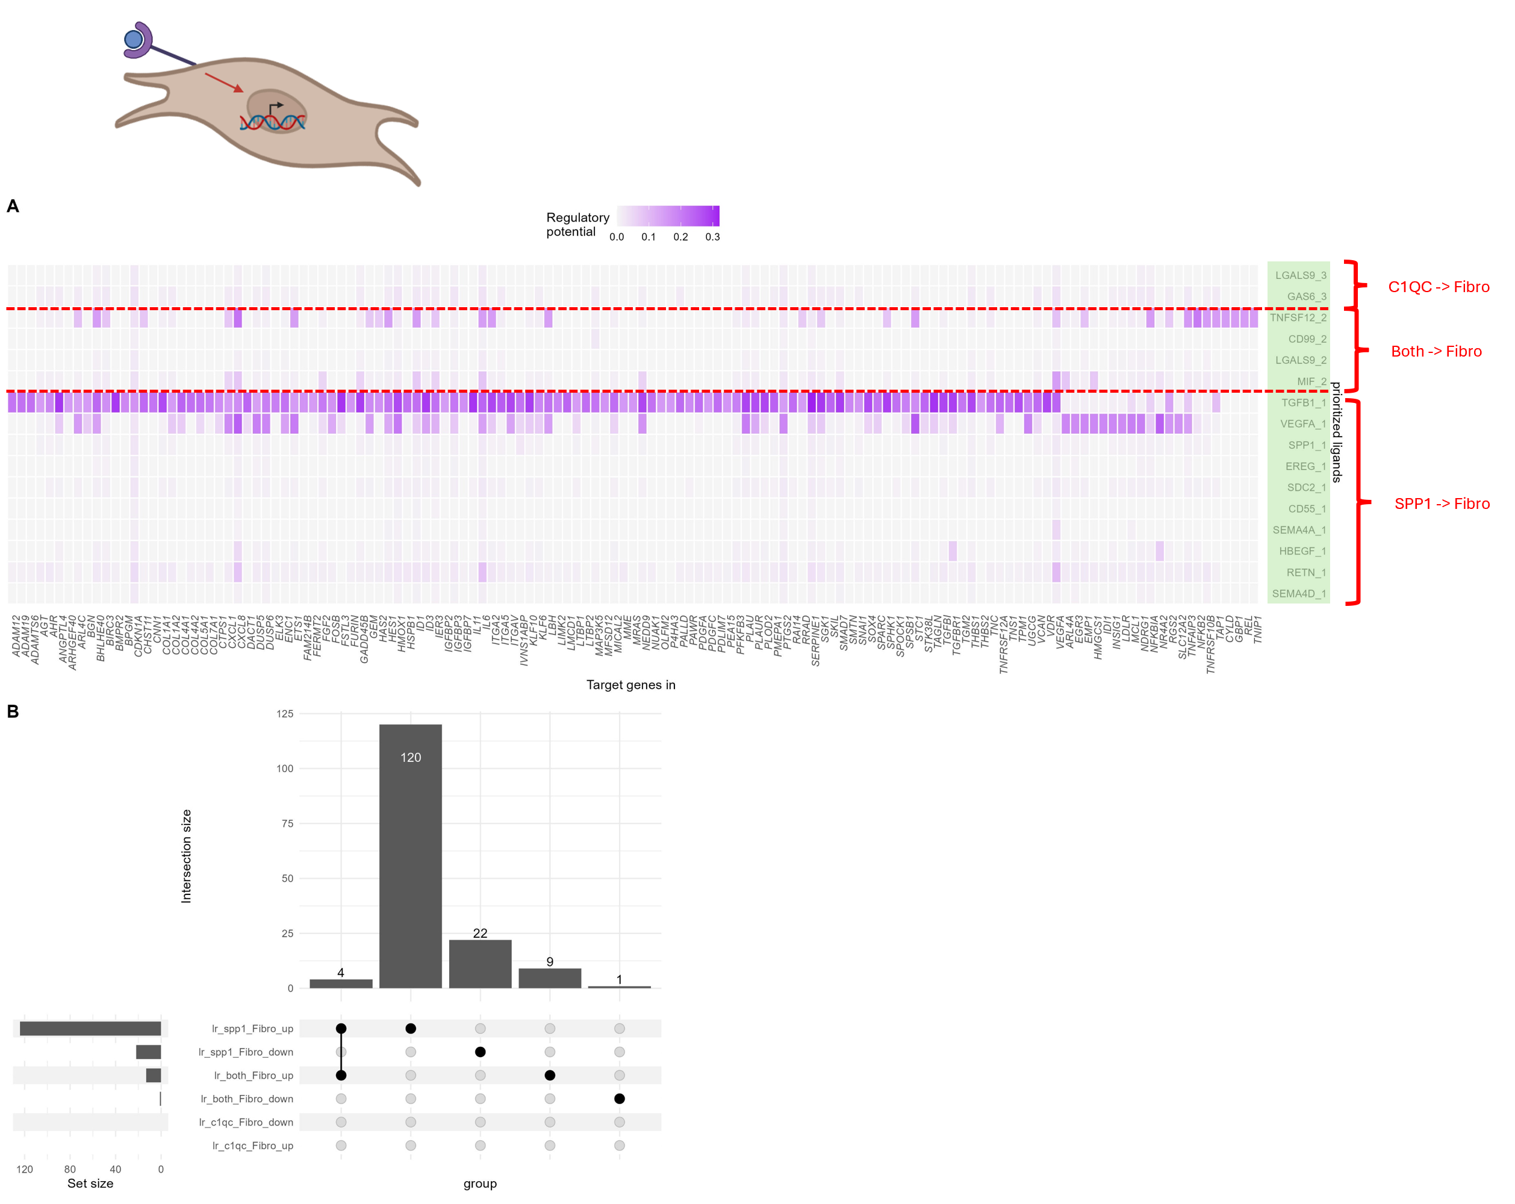
Figure 7: SPP1-Macrophages upregulate Tumour-enhancing TGFB1 and VEGFA signalling. (A) Heatmap of gene regulatory potential (RP) of prioritised ligands between SPP1+/C1QC+ macrophages and Fibroblasts in N vs T samples. Interaction labelled “SPP1” when (SPP1-CP)µ > 2(C1QC-CP)µ and vice versa. All combinations in-between classified as “both”. (B) Complexupset plot showing overlap of genes within each condition. RP Heatmap filtered to include genes uniquely upregulated via specific SPP1-Fibro (C), or C1QC-Fibro (D) labelled interactions then further filtered by max(RP) for easier visualisation. (E) Comparative GSEA GO Enrichment Analysis of upregulated genes from each labelled L-R interaction group.

Slide 9
SPP1+ Macrophages
L-R interactions
CD4/CD8+ T cells
Decreased NLRP3 inflammasome priming, IL-1B, and HIF1a
Drives T cell glycolytic reprogramming, activation and immuno-suppression
Increased CCL20-CCR6
?
Sustained PPARy signalling and lipid handling and anti-inflammatory polarization
T cell migration, proliferation, PD-1 upregulation. May drive exhaustion and immune evasion
High CES1 Expression
Increased APP-CD74
Upregulates genes: AHSA1 (immunosuppression), MNK1 (anti-tumour), FOXP3 (immunosuppression)
TAG hydrolysis, increased free fatty acids, increased FAO
T cell proliferation, exhaustion and immune evasion
?
Increased RETN-CAP1

Slide 10
C1QC+ Macrophages
L-R interactions
CD4/CD8+ T cells
Increased NLRP3 inflammasome priming, IL-1B, and HIF1a
Supports antigen-specific CD4+ T recognition- improved prognosis but can drive exhaustion
Increased HLA-DMB
Upregulates genes: RECQL4 (enhancing immune recognition (maybe supports evasion)), ANAPC11,COX6B1 (metabolic support), TRADD (pro survival and inflammatory), BECN1 (inflammation control)
Decreased PPARy signalling and retention of inflammasome-active antigen presenting
Low CES1 Expression
Direct cytotoxic killing of tumour cells
TAG accumulation (liptoxicity) and oxidative stress
Increased HLA-DQA2
Correlation with PD-L1 upregulation and CD8 exhaustion (but my results suggest no CD8 communication

Slide 11
SPP1+ Macrophages
L-R interactions
CAFs
Decreased NLRP3 inflammasome priming, IL-1B, and HIF1a
Initiates angiogenesis, metastasis and immune escape
Secretes Lipids to support tumour growth
Increased VEGFA
CAF differentiation to angiogenic myCAF
Sustained PPARy signalling and lipid handling and anti-inflammatory polarization
High CES1 Expression
Increased TGFB1
Driving lipid rich FAO phenotype 1
FA synthesis phenotype 2
CD36
TAG hydrolysis, increased free fatty acids, increased FAO
?
High CES1 Expression

Slide 12
Older/original/editable figures

Slide 13
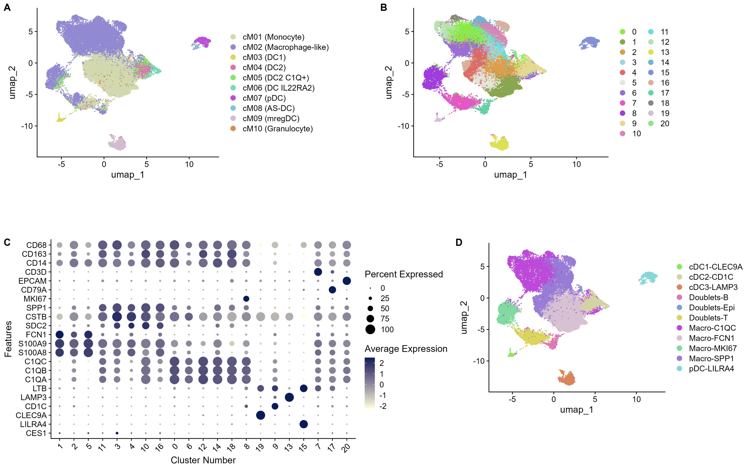
Macro-FCN1
Macro-SPP1
CD1/2/3/pDC
Macro-MKI67
Macro-C1QC
Doublets
Figure 2: Clustering Analysis of Myeloid Cells Reveals Genetically Distinct SPP1+/C1QC+ Macrophage Populations

Slide 14
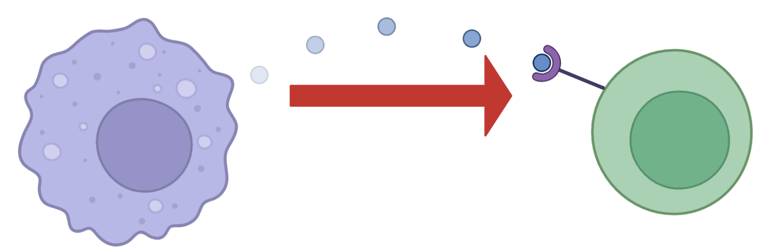
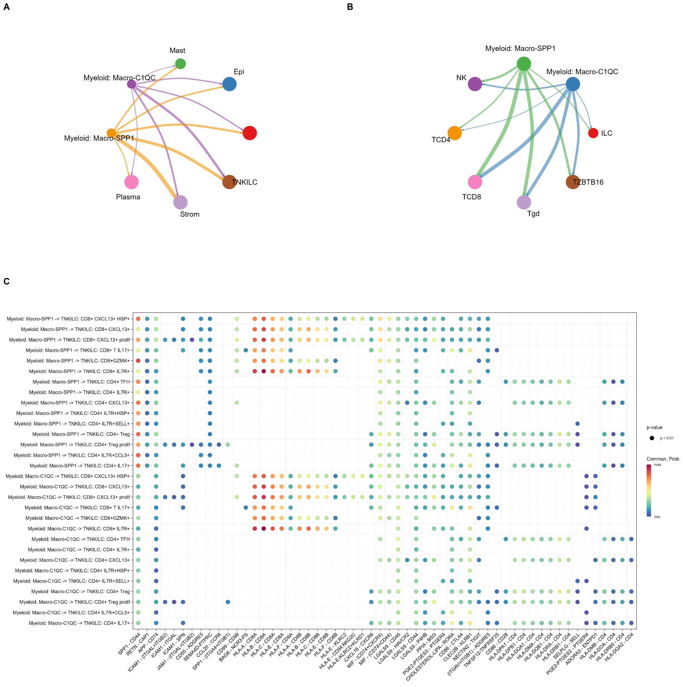
SPP1 -> Both
SPP1 -> CD4
C1QC -> Both
Both -> CD8
Both -> Both
Both -> CD4
C1QC -> CD4
CD8
SPP1
CD4
CD8
C1QC
CD4

Slide 15
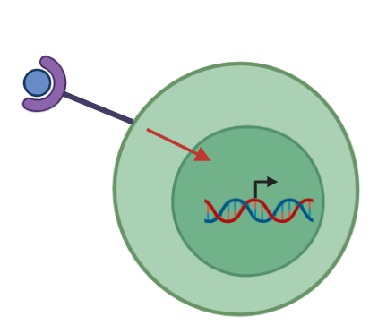
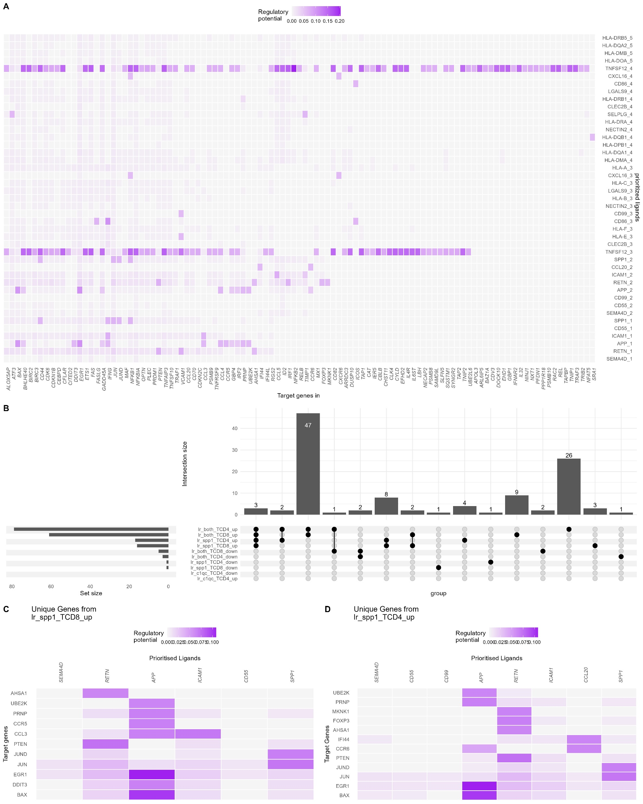
C1QC -> CD4
Both -> CD4
Both -> CD8
SPP1 -> CD4
SPP1 -> CD8

Slide 16
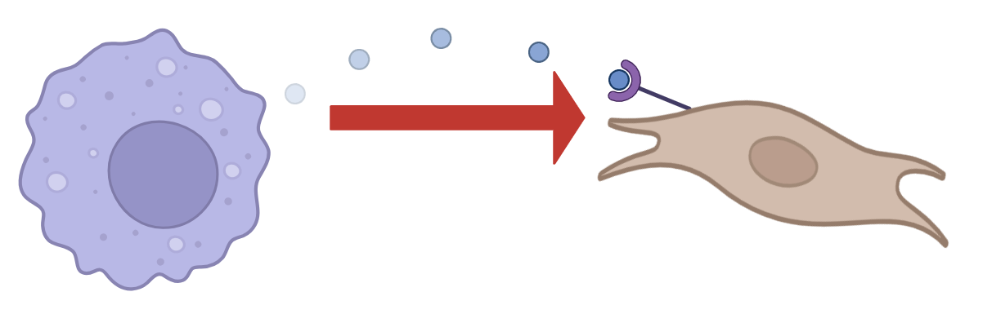
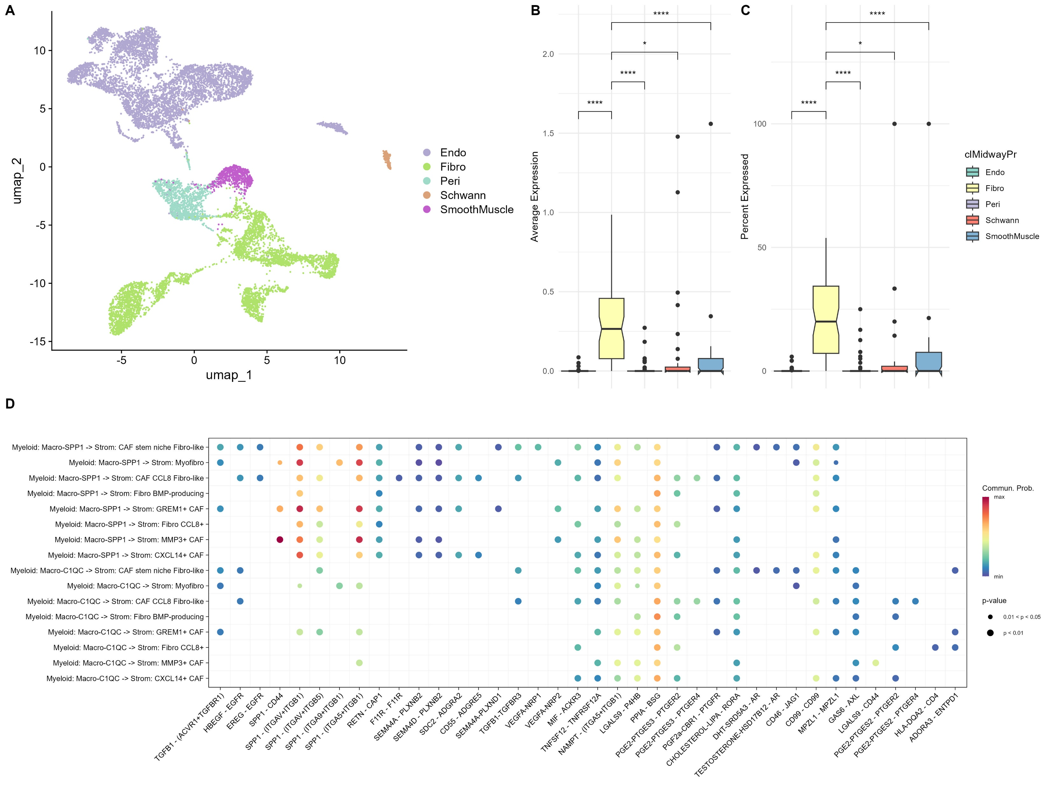
SPP1 -> Fibro
Both -> Fibro
C1QC -> Fibro
SPP1
C1QC

Slide 17
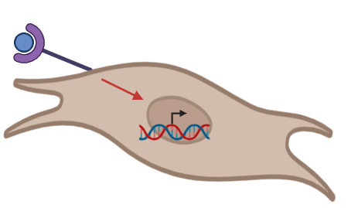
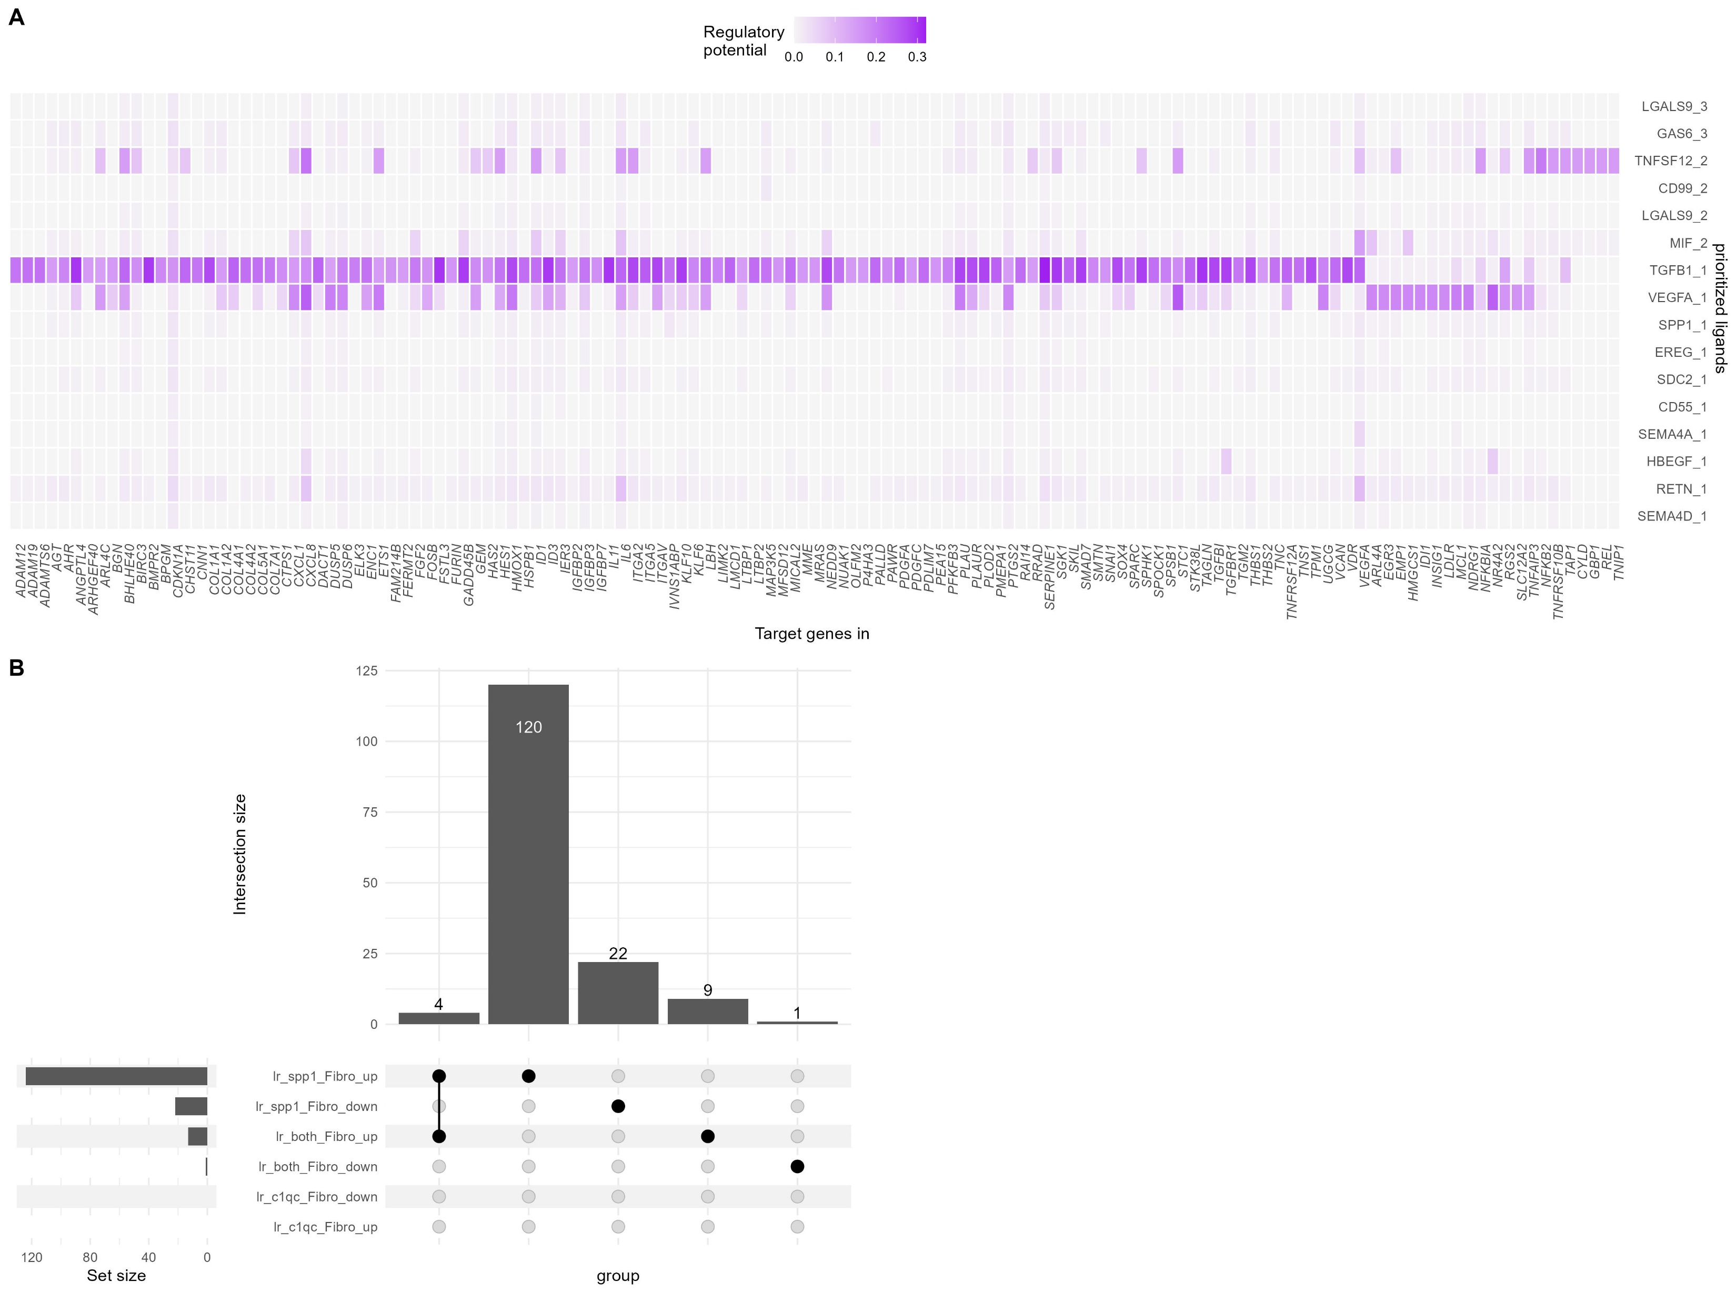
C1QC -> Fibro
Both -> Fibro
SPP1 -> Fibro

Slide 18
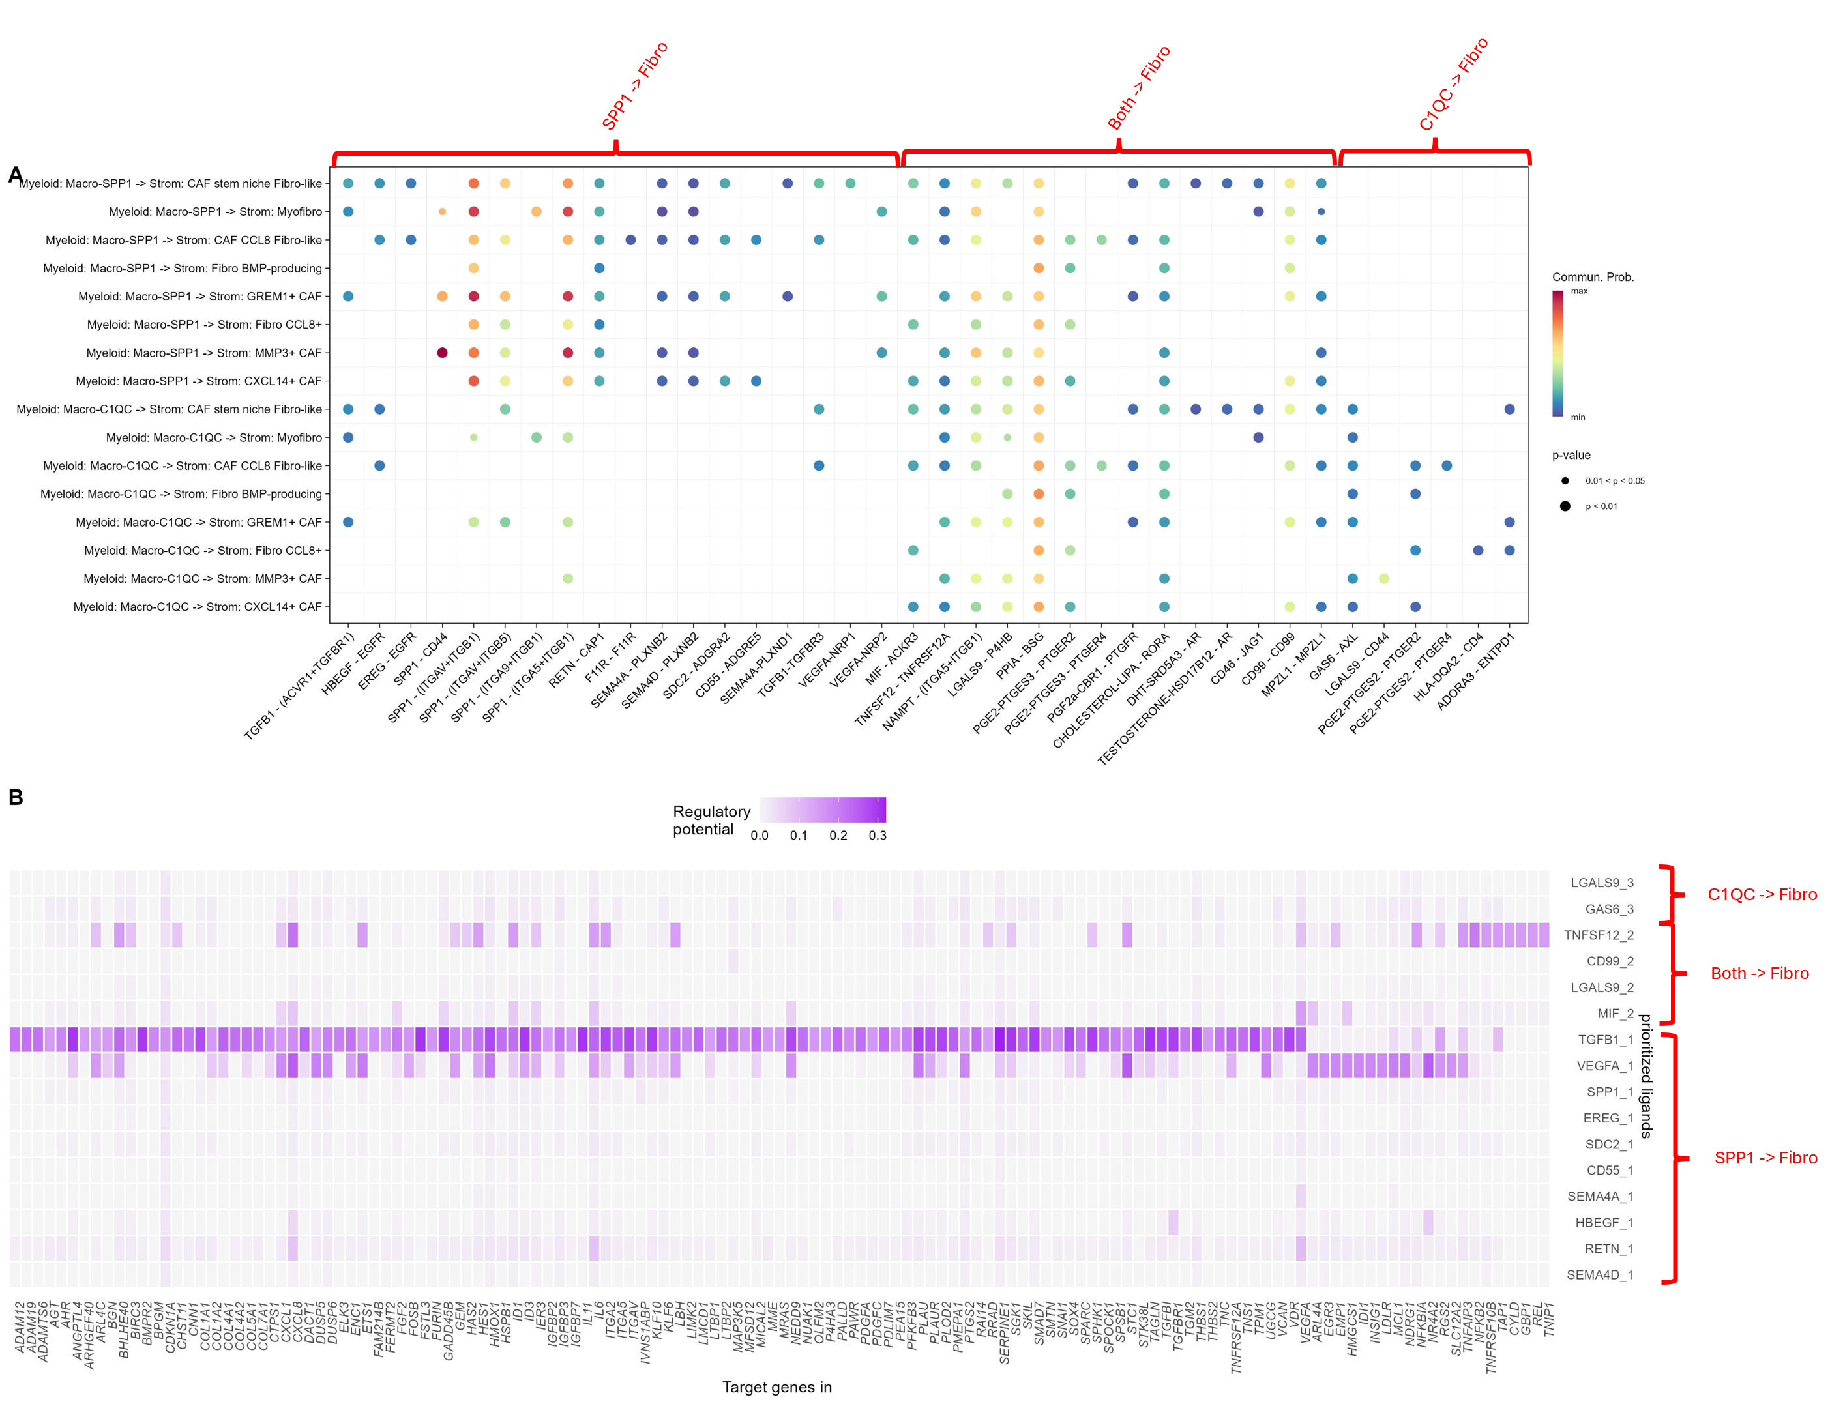
Figure 5: Cellchat and Nichenet analysis shows cell type specific Ligand-Receptor interactions and Gene expression relationships.
Pathway level comparison of Ligand-Receptor interaction communication probability (CP) (A) and gene regulatory potential (RP) of prioritised ligands (B) between SPP1+/C1QC+ macrophages and CD4+/CD8+ T cell subtypes in N vs T samples. Interaction labelled “SPP1” when (SPP1-CP)µ > 2(C1QC-CP)µ and vice versa. All combinations in-between classified as “both”. This is repeated for CD4/CD8 classifications. In (B) “both” labels not present between CD4 and CD8 due to distinct gene regulations in each.

Slide 19
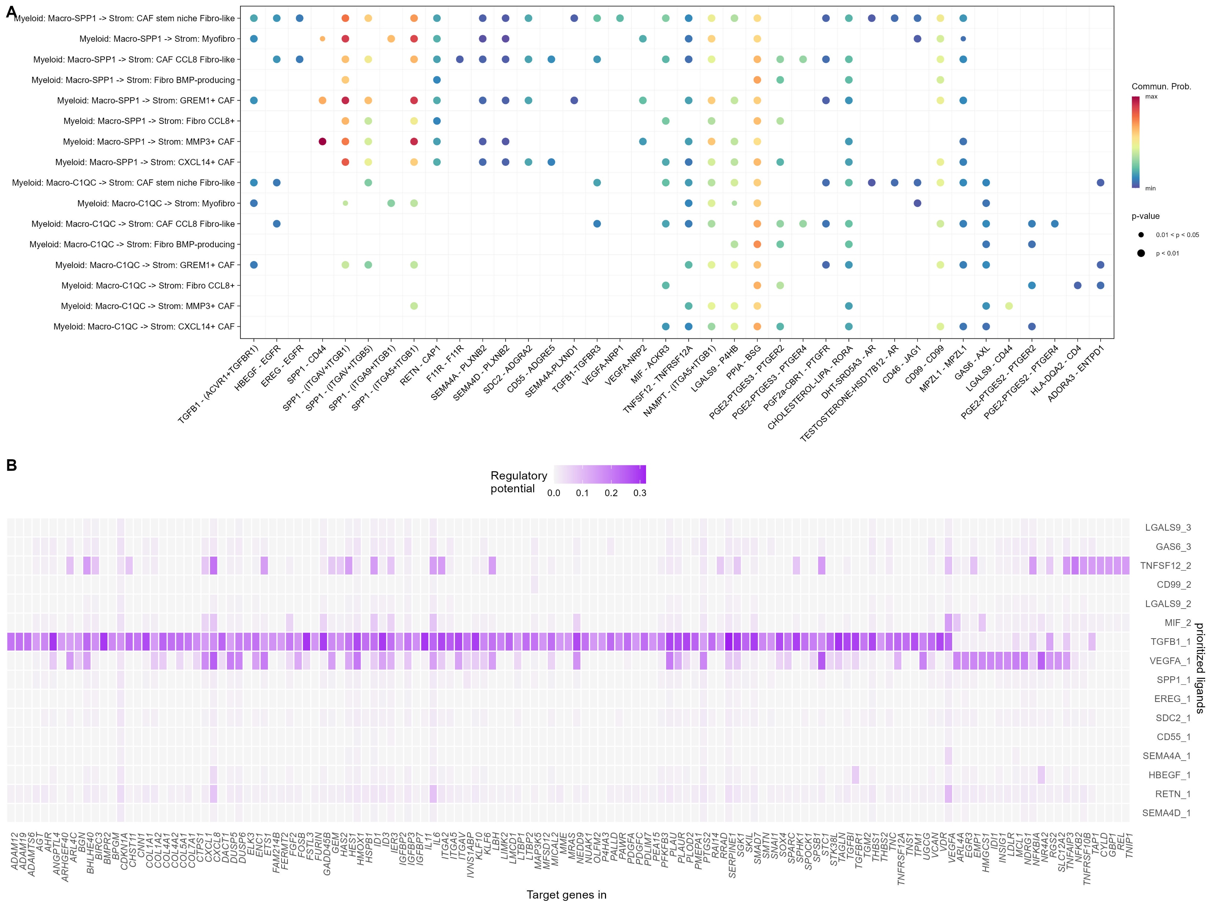
SPP1 -> Fibro
Both -> Fibro
C1QC -> Fibro
C1QC -> Fibro
Both -> Fibro
SPP1 -> Fibro

