Slide 1
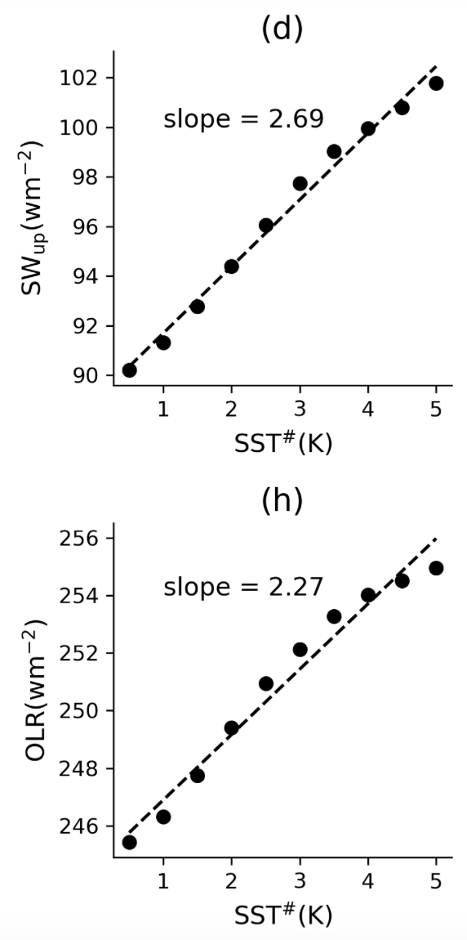
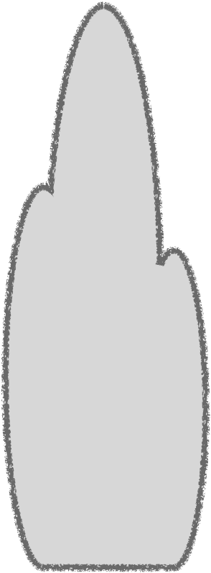
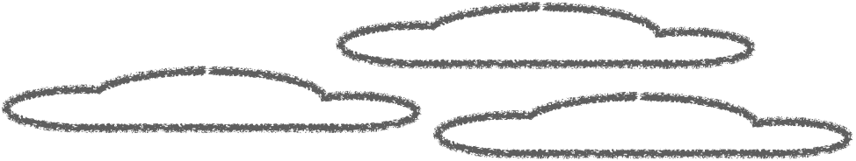


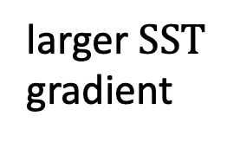

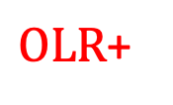




$$OLR$$
$$T_{500}$$
$$SST$$
$${SW}_{up}$$
larger $SST$ gradient
$OLR$+
$$T_{500}+$$
stronger inversion
drier
$$SST$$
SST# means average among warmest 30% SSTs minus tropical average SST
$${SW}_{up}+$$

