Slide 1

CSCE 5218
Deep Learning
Recurrent Neural Networks
Slides adapted from Adriana Kovashka

Slide 2
Plan for this lecture
Recurrent neural networks
Basics
Training (backprop through time, vanishing gradient)
Recurrent networks with gates (GRU, LSTM)
Applications in NLP and vision
Neural machine translation (beam search, attention)
Image/video captioning

Slide 3
Recurrent neural networks

Slide 4
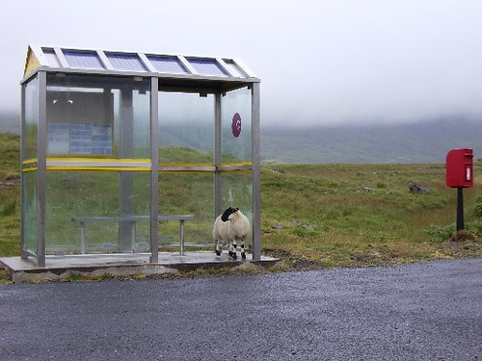
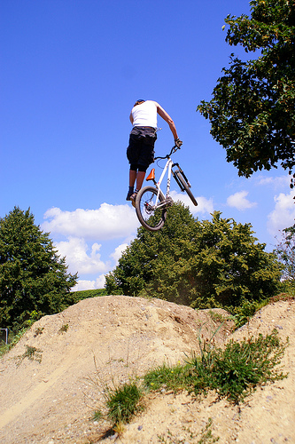
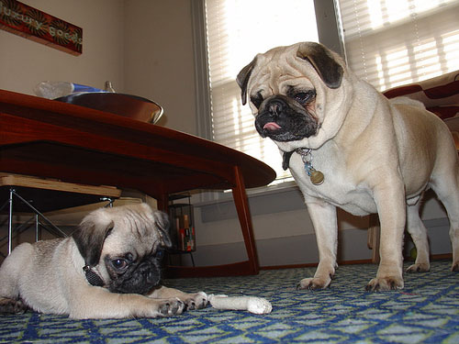
Some pre-RNN captioning results
This is a picture of one sky, one road and one sheep. The gray sky is over the gray road. The gray sheep is by the gray road.
Here we see one road, one sky and one bicycle. The road is near the blue sky, and near the colorful bicycle. The colorful bicycle is within the blue sky.
This is a picture of two dogs. The first dog is near the second furry dog.
Kulkarni et al., CVPR 2011
Notes:
This is a picture of one sky, one road…

Slide 5

Results with Recurrent Neural Networks
Karpathy and Fei-Fei, CVPR 2015

Slide 6
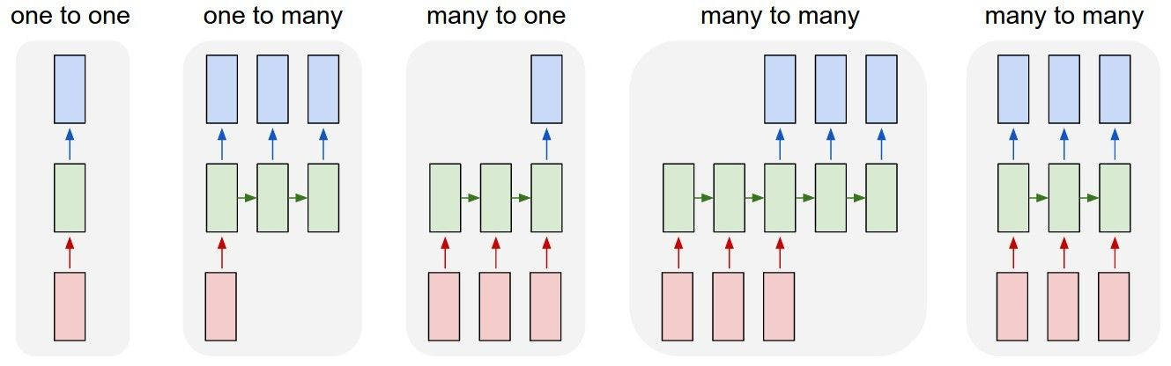
Recurrent Networks offer a lot of flexibility:
vanilla neural networks
Andrej Karpathy

Slide 7
Recurrent Networks offer a lot of flexibility:
e.g. image captioning
image -> sequence of words
Andrej Karpathy

Slide 8
Recurrent Networks offer a lot of flexibility:
e.g. sentiment classification
sequence of words -> sentiment
Andrej Karpathy

Slide 9
Recurrent Networks offer a lot of flexibility:
e.g. machine translation
seq of words -> seq of words
Andrej Karpathy

Slide 10
Recurrent Networks offer a lot of flexibility:
e.g. video classification on frame level
Andrej Karpathy

Slide 11
Recurrent Neural Network
RNN
RNN
x
Andrej Karpathy

Slide 12
Recurrent Neural Network
y
usually want to output a prediction at some time steps
RNN
x
Adapted from Andrej Karpathy

Slide 13

Recurrent Neural Network
We can process a sequence of vectors x by applying a recurrence formula at every time step:
y
RNN
new state
old state input vector at
some time step
some function
with parameters W
x
Andrej Karpathy

Slide 14
Recurrent Neural Network
We can process a sequence of vectors x by applying a recurrence formula at every time step:
y
RNN
Notice: the same function and the same set of parameters are used at every time step.
x
Andrej Karpathy

Slide 15

(Vanilla) Recurrent Neural Network
The state consists of a single “hidden” vector h:
y
RNN
x
Andrej Karpathy

Slide 16
Character-level language model example
Example
RNN
x
y
Vocabulary: [h,e,l,o]
Example training sequence: “hello”
Andrej Karpathy

Slide 17
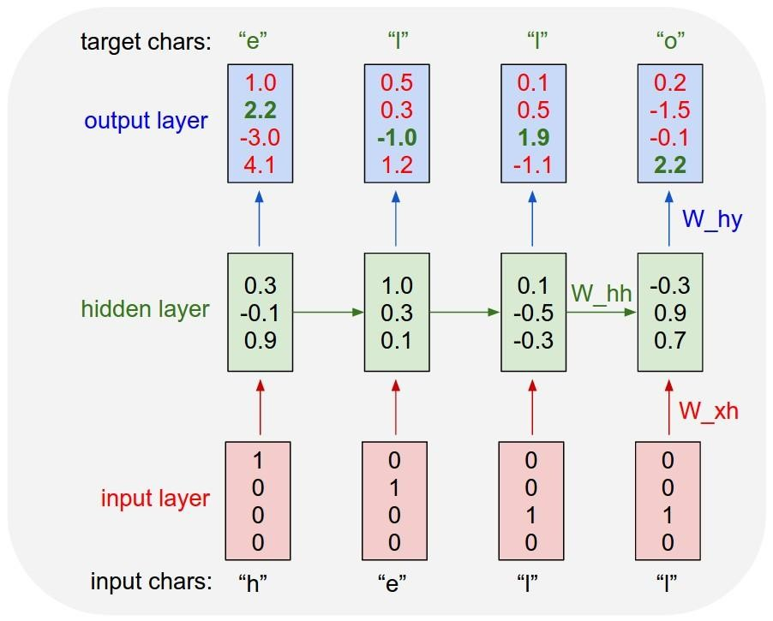
Example
Character-level language model example
Vocabulary: [h,e,l,o]
Example training sequence: “hello”
Andrej Karpathy

Slide 18
Example
Character-level language model example
Vocabulary: [h,e,l,o]
Example training sequence: “hello”
Andrej Karpathy

Slide 19
Example
Character-level language model example
Vocabulary: [h,e,l,o]
Example training sequence: “hello”
What kind of loss can we formulate?
Andrej Karpathy

Slide 20




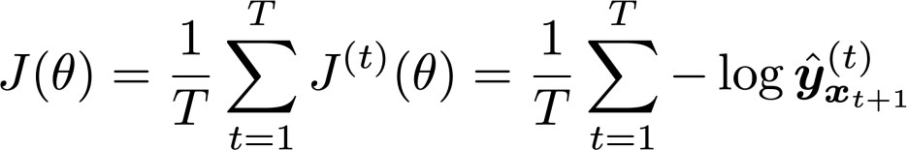
Training a Recurrent Neural Network
Get a big corpus of text which is a sequence of words
Feed into RNN; compute output distribution for every step t.
i.e. predict probability distribution of every word, given words so far
Loss function on step t is cross-entropy between predicted probability
distribution , and true next word (one-hot); V is vocabulary
Average this to get overall loss for entire training set:
Adapted from Abigail See

Slide 21








The vanishing/exploding gradient problem
The error at a time step ideally can tell a previous time step from many steps away to change during backprop
Multiply the same matrix at each time step during backprop
yt−1
y_{t}
yt+1
ht−1
h_{t}
ht+1
W
W
xt−1
x_{t}
xt+1
Richard Socher

Slide 22
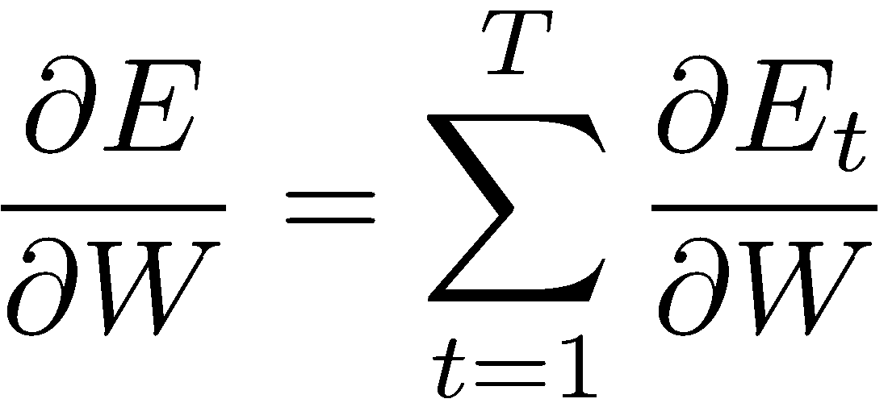
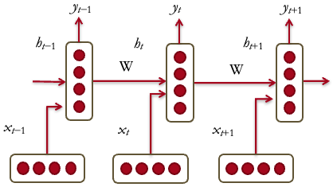
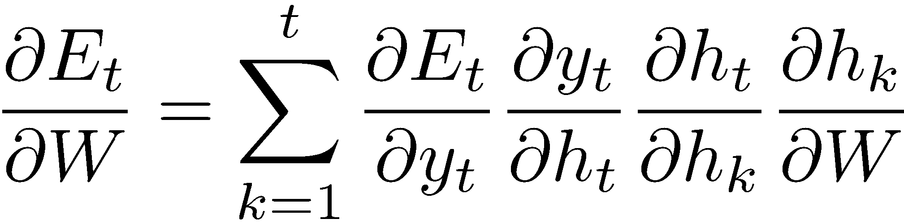
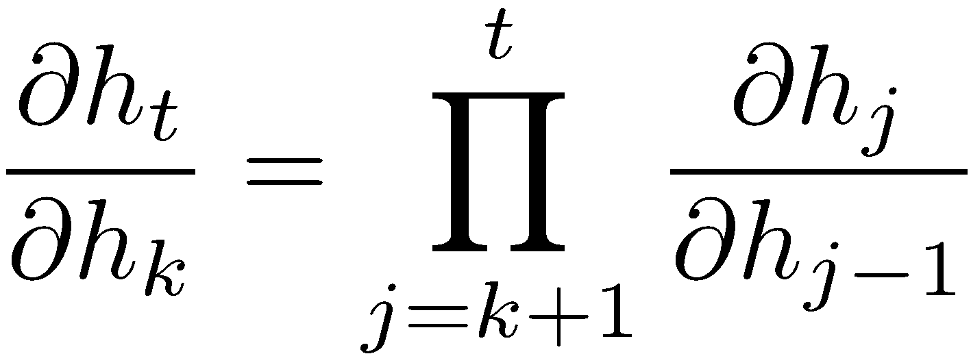
The vanishing gradient problem
Total error is the sum of each error at time steps t
Chain rule:
More chain rule:
Derivative of vector wrt vector is a Jacobian matrix of partial derivatives; norm of this matrix can become very small or very large quickly [Bengio et al 1994, Pascanu et al. 2013], leading to vanishing/exploding gradient
Adapted from Richard Socher

Slide 23
Now in more detail…

Slide 24


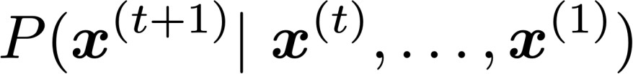


Language Modeling
Language Modeling is the task of predicting what word comes next.
books
laptops
the students opened their
exams
minds
More formally: given a sequence of words
compute the probability distribution of the next word
,
:
where can be any word in the vocabulary
A system that does this is called a Language Model.
Abigail See

Slide 25
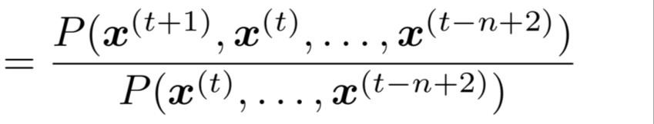
n-gram Language Models
First we make a simplifying assumption:
preceding n-1 words.
n-1 words
depends only on the
(assumption)
prob of a n-gram
(definition of conditional prob)
prob of a (n-1)-gram
Question: How do we get these n-gram and (n-1)-gram probabilities?
Abigail See

Slide 26
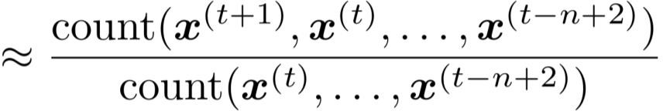
n-gram Language Models
First we make a simplifying assumption:
preceding n-1 words.
n-1 words
depends only on the
(assumption)
prob of a n-gram
(definition of conditional prob)
prob of a (n-1)-gram
Question: How do we get these n-gram and (n-1)-gram probabilities?
Answer: By counting them in some large corpus of text!
(statistical approximation)
Abigail See

Slide 27


Sparsity Problems with n-gram Language Models
Sparsity Problem 1
Problem: What if “students opened their ” never occurred in data? Then
has probability 0!
(Partial) Solution: Add small 𝛿 to the count for every . This is called smoothing.
Sparsity Problem 2
Problem: What if “students opened their” never occurred in data? Then we can’t calculate probability for any !
(Partial) Solution: Just condition
on “opened their” instead.
This is called backoff.
Note: Increasing n makes sparsity problems worse.
Typically we can’t have n bigger than 5.
Abigail See
Notes:
numerator – 分子
denominator – 分母

Slide 28















A fixed-window neural Language Model
books
laptops
output distribution
a
zoo
hidden layer
concatenated word embeddings
words / one-hot vectors
the
students
opened
their
Abigail See

Slide 29

A fixed-window neural Language Model
Improvements over n-gram LM:
books
No sparsity problem
Don’t need to store all observed n-grams
laptops
Remaining problems:
a
zoo
Fixed window is too small
Enlarging window enlarges
Window can never be large enough!
We need a neural architecture that can process any length input
the
students
opened
their
Abigail See

Slide 30




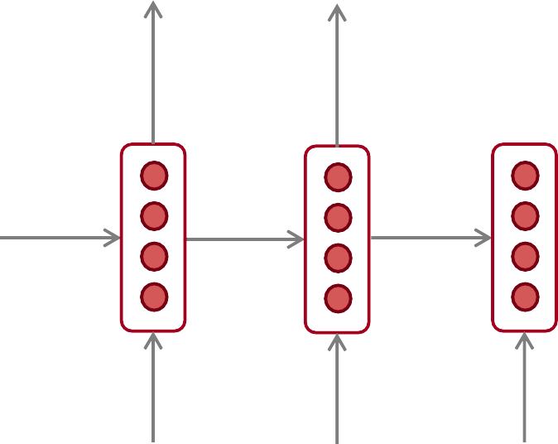











Recurrent Neural Networks (RNN)
A family of neural architectures
Core idea: Apply the same weights repeatedly
outputs (optional)
…
hidden states
…
input sequence (any length)
…
Abigail See

Slide 31


















A RNN Language Model
books
laptops
output distribution
a
zoo
hidden states
is the initial hidden state
word embeddings
words / one-hot vectors the students
opened
their
Note: this input sequence could be much
longer, but this slide doesn’t have space!
Abigail See

Slide 32
A RNN Language Model
books
laptops
RNN Advantages:
Can process any length input
Computation for step t can (in theory) use information from many steps back
Model size doesn’t
increase for longer input
Same weights applied on every timestep, so there is symmetry in how inputs are processed
a
zoo
RNN Disadvantages:
Recurrent computation is slow
In practice, difficult to access information from many steps back
the
students
opened
their
Abigail See

Slide 33

Recall: Training a RNN Language Model
Get a big corpus of text which is a sequence of words
Feed into RNN-LM; compute output distribution for every step t.
i.e. predict probability distribution of every word, given words so far
Loss function on step t is cross-entropy between predicted probability
distribution , and the true next word (one-hot for ):
Average this to get overall loss for entire training set:
Abigail See

Slide 34




Training a RNN Language Model
= negative log prob
of “students”
Loss
Predicted prob dists
…
Corpus
the
students
opened
their
exams
…
Abigail See

Slide 35
Training a RNN Language Model
= negative log prob
of “opened”
Loss
Predicted prob dists
…
Corpus
the
students
opened
their
exams
…
Abigail See

Slide 36
Training a RNN Language Model
= negative log prob
of “their”
Loss
Predicted prob dists
…
Corpus
the
students
opened
their
exams
…
Abigail See

Slide 37
Training a RNN Language Model
= negative log prob
of “exams”
Loss
Predicted prob dists
…
Corpus
the
students
opened
their
exams
…
Abigail See

Slide 38
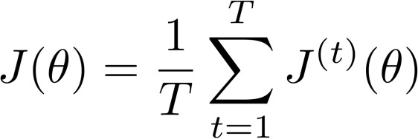
Training a RNN Language Model
Loss
+
+
+
+ … =
Predicted prob dists
…
Corpus
the
students
opened
their
exams
…
Abigail See

Slide 39










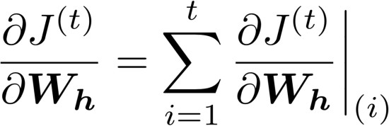
Backpropagation for RNNs
…
…
Question: What’s the derivative of
w.r.t. the repeated weight matrix
?
“The gradient w.r.t. a repeated weight is the sum of the gradient
w.r.t. each time it appears”
Answer:
Abigail See

Slide 40
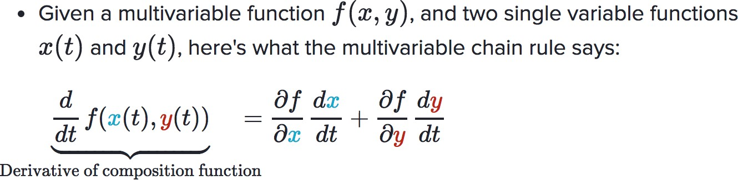
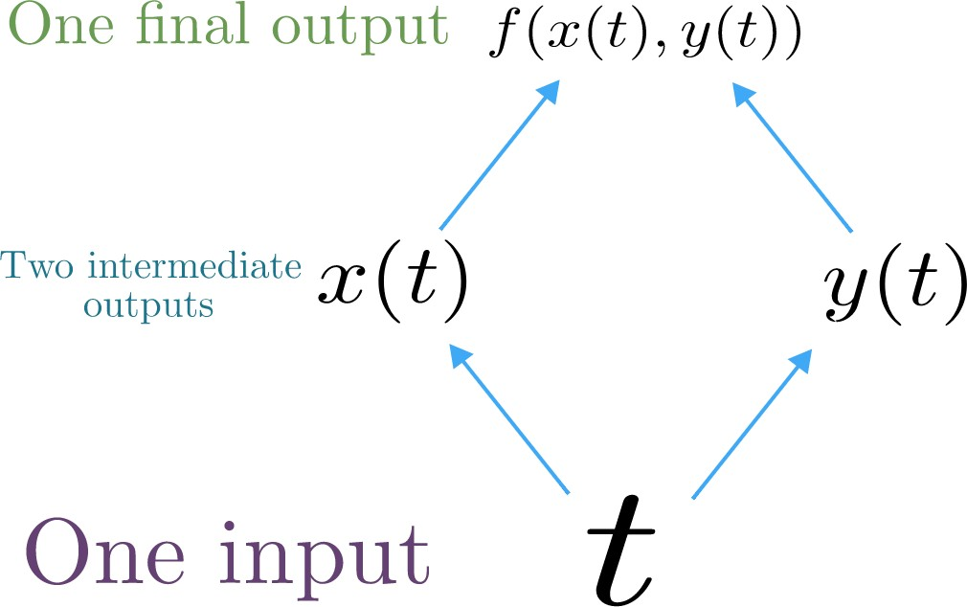
Multivariable Chain Rule
Source:
https://www.khanacademy.org/math/multivariable-calculus/multivariable-derivatives/differentiating-vector-valued-functions/a/multivariable-chain-rule-simple-version
Abigail See

Slide 41
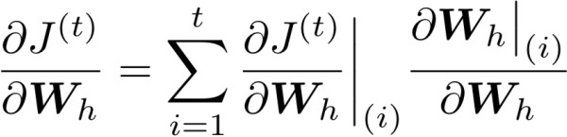




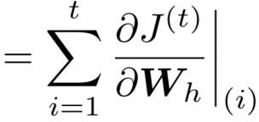



Backpropagation for RNNs: Proof sketch
In our example:
Apply the multivariable chain rule:
= 1
…
Source:
https://www.khanacademy.org/math/multivariable-calculus/multivariable-derivatives/differentiating-vector-valued-functions/a/multivariable-chain-rule-simple-version
Abigail See

Slide 42
Backpropagation for RNNs
…
…
Answer: Backpropagate over timesteps i=t,…,0, summing gradients as you go.
This algorithm is called
“backpropagation through time”
Question: How do we calculate this?
Abigail See

Slide 43
Vanishing gradient intuition
Abigail See

Slide 44
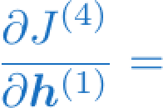
Vanishing gradient intuition
?
Abigail See

Slide 45









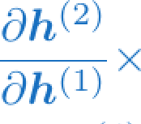
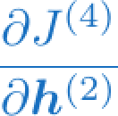
Vanishing gradient intuition
chain rule!
Abigail See

Slide 46
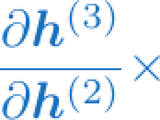
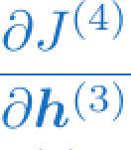
Vanishing gradient intuition
chain rule!
Abigail See

Slide 47
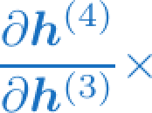
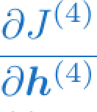
Vanishing gradient intuition
chain rule!
Abigail See

Slide 48
Vanishing gradient intuition
Vanishing gradient problem: When these are small, the gradient signal gets smaller and smaller as it backpropagates further
What happens if these are small?
Abigail See

Slide 49

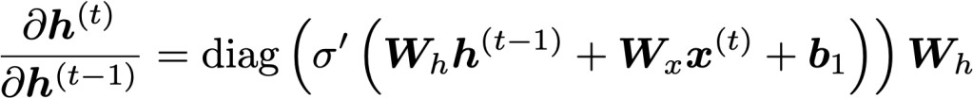


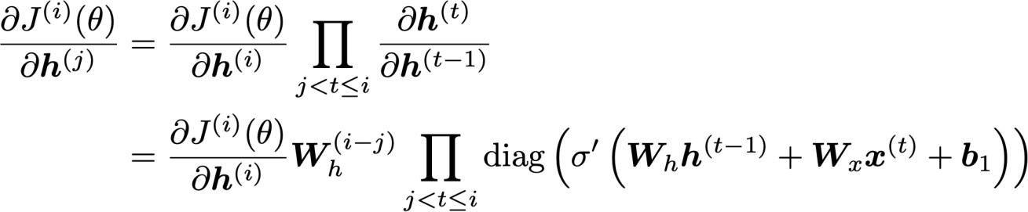

Vanishing gradient proof sketch
Recall:
Therefore:
(chain rule)
Consider the gradient of the loss on step i, with respect
to the hidden state on some previous step j.
(chain rule) (value of )
If W_{h} is small, then this term gets
vanishingly small as i and j get further apart
Abigail See
Source: “On the difficulty of training recurrent neural networks”, Pascanu et al, 2013. http://proceedings.mlr.press/v28/pascanu13.pdf

Slide 50
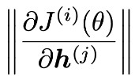
Vanishing gradient proof sketch
Consider matrix L2 norms:
Pascanu et al showed that that if the largest eigenvalue of W_{h} is
less than 1, then the gradient will shrink exponentially
There’s a similar proof relating a largest eigenvalue >1 to
exploding gradients
Source: “On the difficulty of training recurrent neural networks”, Pascanu et al, 2013. http://proceedings.mlr.press/v28/pascanu13.pdf
Adapted from Abigail See

Slide 51

Why is vanishing gradient a problem?
Gradient signal from faraway is lost because it’s much
smaller than gradient signal from close-by.
So model weights are only updated only with respect to near effects, not long-term effects.
Abigail See

Slide 52
Effect of vanishing gradient on RNN-LM
LM task: When she tried to print her _____, she found that the printer was out of toner. She went to the stationery store to buy more toner. It was very overpriced. After installing the toner into the printer, she finally printed her tickets.
To learn from this training example, the RNN-LM needs to model the dependency between “tickets” on the 7th step and the target word “tickets” at the end.
But if gradient is small, the model can’t learn this dependency
So the model is unable to predict similar long-distance dependencies at test time
Adapted from Abigail See

Slide 53
Effect of vanishing gradient on RNN-LM
is
LM task: The writer of the books
are
Correct answer: The writer of the books is planning a sequel
Syntactic recency: The writer of the books is (correct)
Sequential recency: The writer of the books are (incorrect)
Due to vanishing gradient, RNN-LMs are better at learning from sequential recency than syntactic recency, so they make this
type of error more often than we’d like [Linzen et al 2016]
Abigail See
“Assessing the Ability of LSTMs to Learn Syntax-Sensitive Dependencies”, Linzen et al, 2016. https://arxiv.org/pdf/1611.01368.pdf

Slide 54
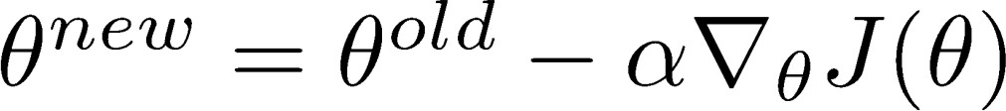
Why is exploding gradient a problem?
If the gradient becomes too big, then the SGD update step becomes too big:
learning rate
gradient
This can cause bad updates: we take too large a step and reach a bad parameter configuration (with large loss)
In the worst case, this will result in Inf or NaN in your network (then you have to restart training from an earlier checkpoint)
Abigail See

Slide 55
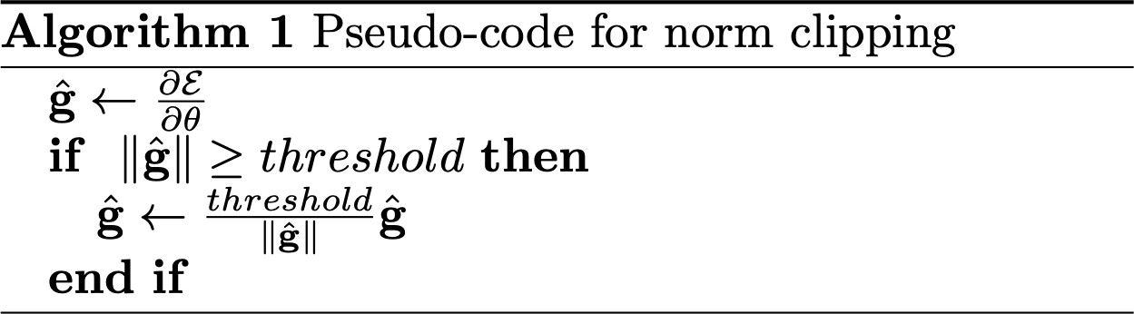
Gradient clipping: solution for exploding gradient
Gradient clipping: if the norm of the gradient is greater than some threshold, scale it down before applying SGD update
Intuition: take a step in the same direction, but a smaller step
Abigail See
Source: “On the difficulty of training recurrent neural networks”, Pascanu et al, 2013. http://proceedings.mlr.press/v28/pascanu13.pdf

Slide 56
RNNs with Gates

Slide 57
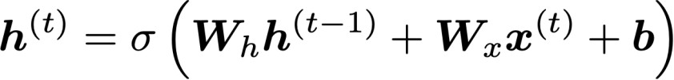
How to fix vanishing gradient problem?
The main problem is that it’s too difficult for the RNN to learn to
preserve information over many timesteps.
In a vanilla RNN, the hidden state is constantly being rewritten
How about a RNN with separate memory?
Richard Socher

Slide 58
Gated Recurrent Units (GRUs)
More complex hidden unit computation in recurrence!
Introduced by Cho et al. 2014
Main ideas:
keep around memories to capture long distance dependencies
allow error messages to flow at different strengths depending on the inputs
Richard Socher

Slide 59
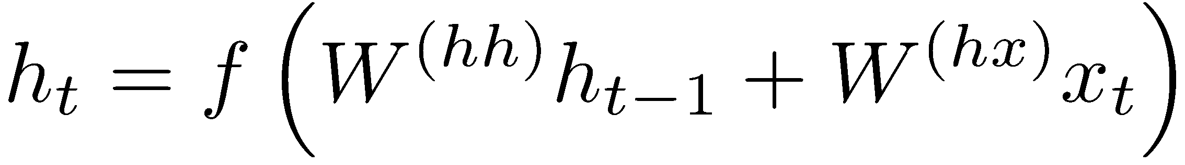
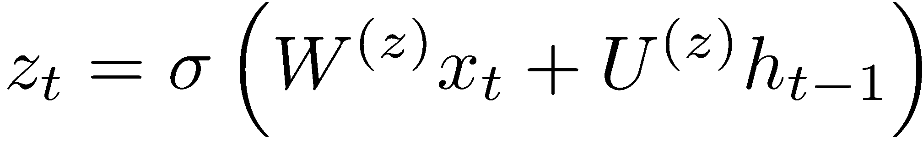
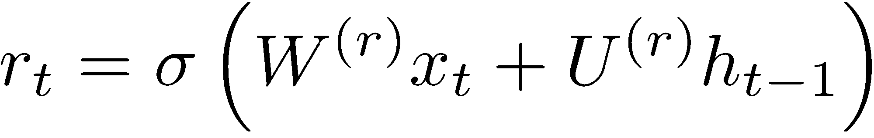
Gated Recurrent Units (GRUs)
Standard RNN computes hidden layer at next time step directly:
GRU first computes an update gate (another layer) based on current input word vector and hidden state
Compute reset gate similarly but with different weights
Richard Socher

Slide 60
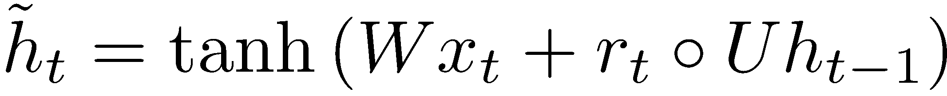
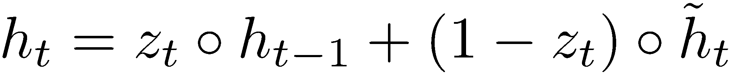
Gated Recurrent Units (GRUs)
Update gate
Reset gate
New memory content:
If reset gate unit is ~0, then this ignores previous memory and only stores the new word information
Final memory at time step combines current and previous time steps:
Update gate: controls what parts of hidden state are updated vs preserved
Reset gate: controls what parts of previous hidden state are used to compute new content
Richard Socher

Slide 61
Gated Recurrent Units (GRUs)
ht-1
h_{t}
Final memory
~_{ht}
Memory (reset)
~ht-1
Update gate
zt-1
z_{t}
Reset gate
rt-1
r_{t}
Input:
xt-1
x_{t}
Richard Socher

Slide 62
Gated Recurrent Units (GRUs)
If reset r is close to 0, ignore previous hidden state: Allows model to drop information that is irrelevant in the future
If update z is close to 1, can copy information through many time steps, i.e. copy-paste state: Less vanishing gradient!
Units with short-term dependencies often have reset gates (r) very active; ones with long-term dependencies have active update gates (z)
Adapted from Richard Socher

Slide 63
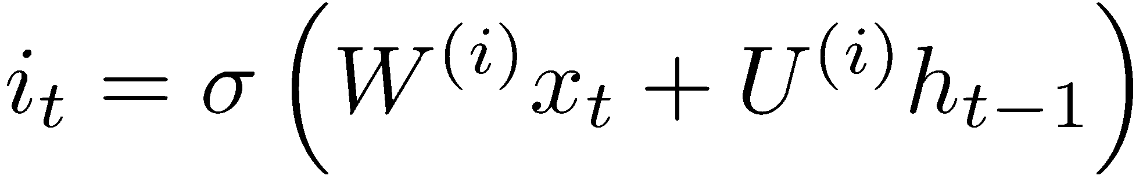
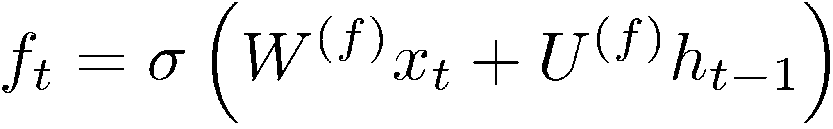
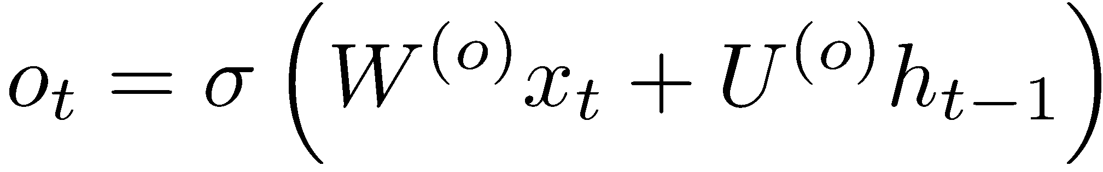
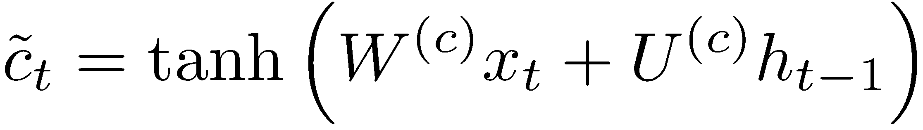
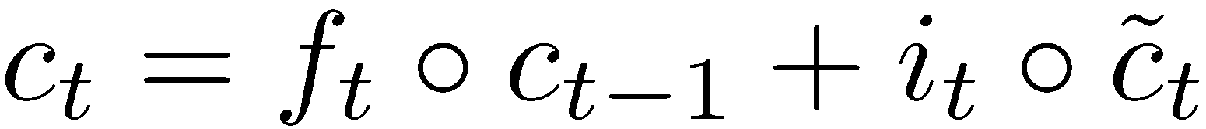
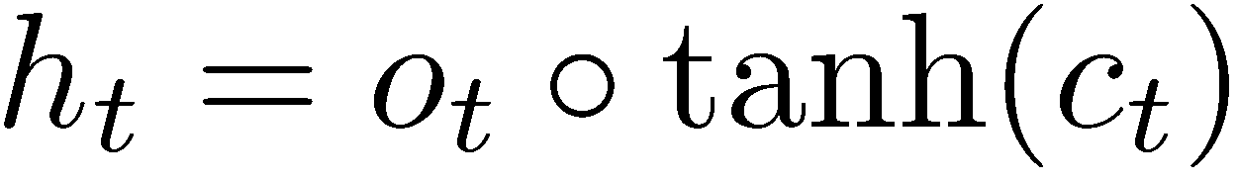
Long-short-term-memories (LSTMs)
Proposed by Hochreiter and Schmidhuber in 1997
We can make the units even more complex
Allow each time step to modify
Input gate (current cell matters)
Forget (gate 0, forget past)
Output (how much cell is exposed)
New memory cell
Final memory cell:
Final hidden state:
Adapted from Richard Socher

Slide 64
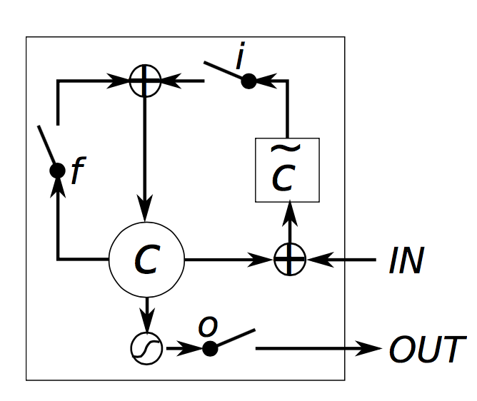
Long-short-term-memories (LSTMs)
Intuition: memory cells can keep information intact, unless inputs makes them forget it or overwrite it with new input
Cell can decide to output this information or just store it
Richard Socher, figure from wildml.com

Slide 65


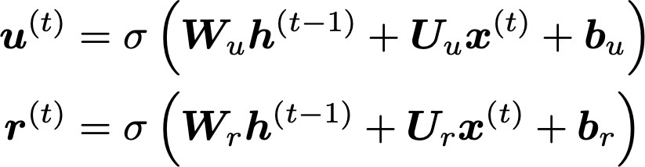
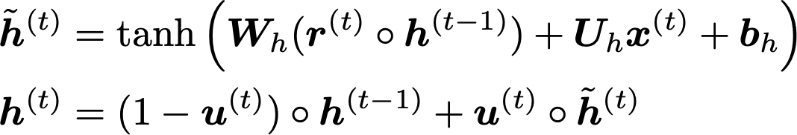
Review on your own: Gated Recurrent Units (GRU)
Proposed by Cho et al. in 2014 as a simpler alternative to the LSTM.
On each timestep t we have input and hidden state (no cell state).
Update gate: controls what parts of hidden state are updated vs preserved
Reset gate: controls what parts of previous hidden state are used to compute new content
New hidden state content: reset gate selects useful parts of prev hidden state. Use this and current input to compute new hidden content.
Hidden state: update gate simultaneously controls what is kept from previous hidden state, and what is updated to new hidden state content
How does this solve vanishing gradient? GRU makes it easier to retain info long-term (e.g. by setting update gate to 0)
Abigail See
"Learning Phrase Representations using RNN Encoder–Decoder for Statistical Machine Translation", Cho et al. 2014, https://arxiv.org/pdf/1406.1078v3.pdf

Slide 66

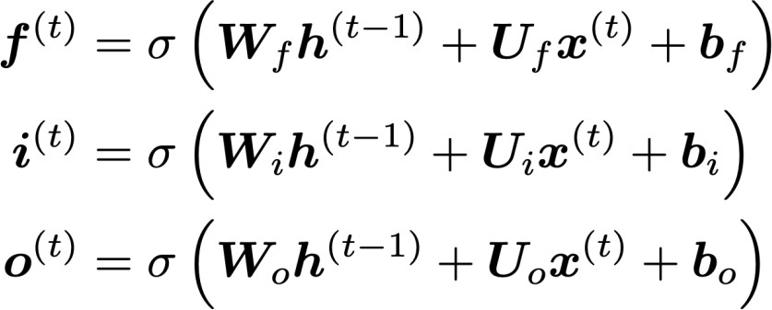
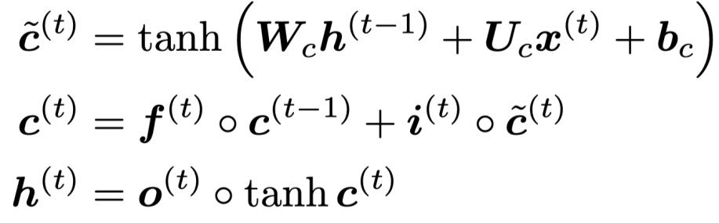
Review on your own: Long Short-Term Memory (LSTM)
We have a sequence of inputs , and we will compute a sequence of hidden states and cell states . On timestep t:
Sigmoid function: all gate values are between 0 and 1
Forget gate: controls what is kept vs forgotten, from previous cell state
Input gate: controls what parts of the new cell content are written to cell
All these are vectors of same length n
Output gate: controls what parts of cell are output to hidden state
New cell content: this is the new content to be written to the cell
Cell state: erase (“forget”) some content from last cell state, and write (“input”) some new cell content
Hidden state: read (“output”) some content from the cell
Gates are applied using element-wise product
Abigail See

Slide 67
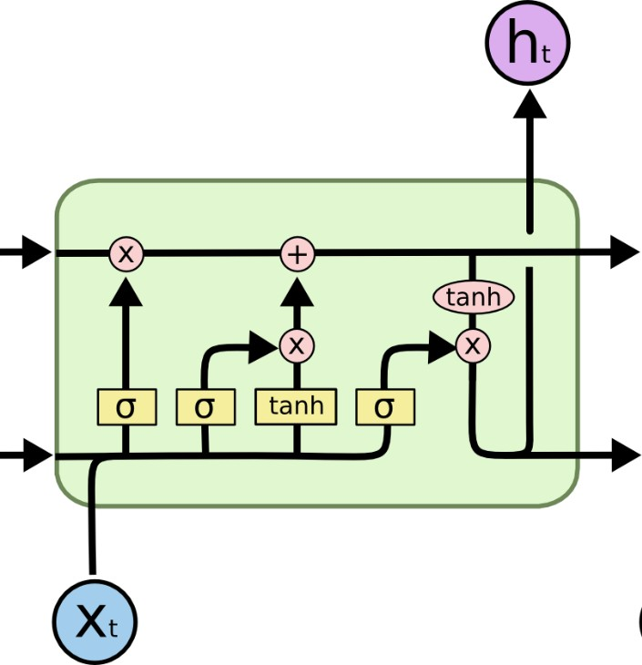

Review on your own: Long Short-Term Memory (LSTM)
You can think of the LSTM equations visually like this:
Write some new cell content
Forget some
cell content
c_{t}
c_{t}
^{c}t-1
f
i_{t}
o_{t}
Output some cell content to the hidden state
Compute the forget gate
t
~_{c}
t
^{h}t-1
h_{t}
Compute the input gate
Compute the new cell content
Compute the output gate
Abigail See
Source: http://colah.github.io/posts/2015-08-Understanding-LSTMs/

Slide 68
LSTM vs GRU
Researchers have proposed many gated RNN variants, but LSTM and GRU are the most widely-used
The biggest difference is that GRU is quicker to compute and has fewer parameters
There is no conclusive evidence that one consistently performs better than the other
LSTM is a good default choice (especially if your data has particularly long dependencies, or you have lots of training data)
Rule of thumb: start with LSTM, but switch to GRU if you want something more efficient
Abigail See

