Slide 1

CSCE 5218
Deep Learning
Neural Network Basics
Slides adapted from Adriana Kovashka

Slide 2
Plan for this lecture (next few classes)
Definition
  Architecture
  Basic operations
  Biological inspiration
Goals
  Loss functions
Training
  Gradient descent
  Backpropagation
Hands-on exercise

Slide 3
Definition

Slide 4
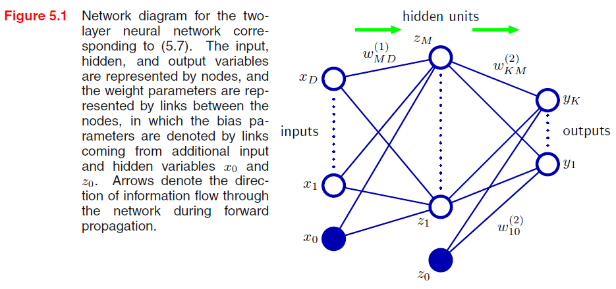


Neural network definition
Raw activations:
Nonlinear activation function h (e.g. sigmoid, tanh, RELU): e.g. z = RELU(a) = max(0, a)
Figure from Christopher Bishop
Notes:
w^T x + b = [sum_{i=1, ..., d} w_i * x_i ] + b
w: dx1 vector
x: dx1 vector
w' = [w; b] : (d+1)x1 vector
x' = [x; 1] : (d+1)x1
w'^T x' = w^T x + b

Slide 5

Neural network definition
Layer 2
Layer 3 (final)
Outputs
Finally:
(multiclass)
(binary)
(binary)

Slide 6
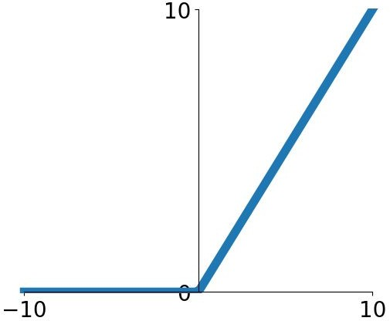
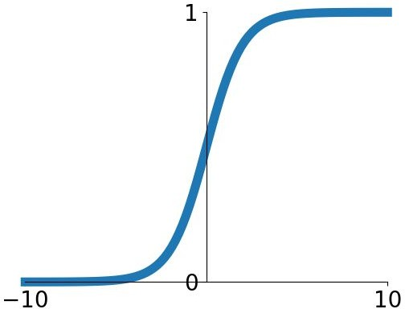


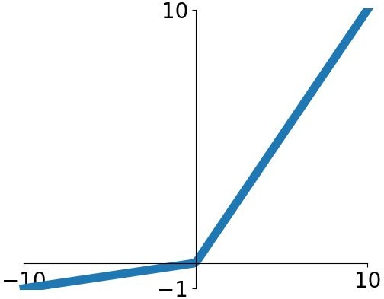
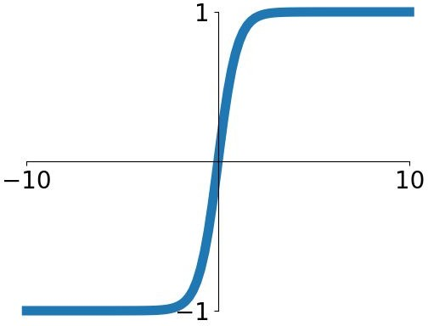


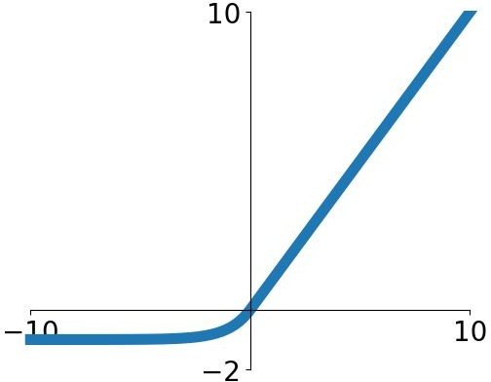
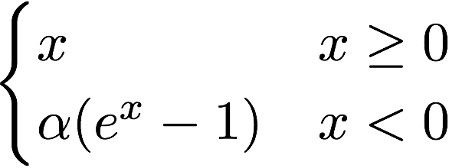

Activation functions
ReLU
Sigmoid
tanh
Leaky ReLU
ELU
Maxout
Fei-Fei Li & Justin Johnson & Serena Yeung Lecture 6 - April 19, 2018
Fei-Fei Li, Andrej Karpathy, Justin Johnson, Serena Yeung

Slide 7
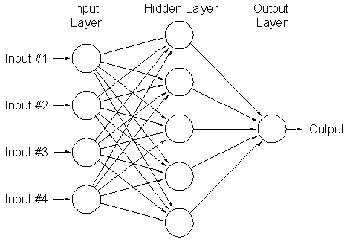
A multi-layer neural network…
Is a non-linear classifier
Can approximate any continuous function to arbitrary accuracy given sufficiently many hidden units
Lana Lazebnik

Slide 8
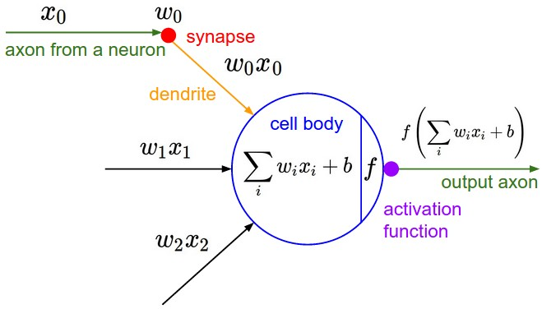
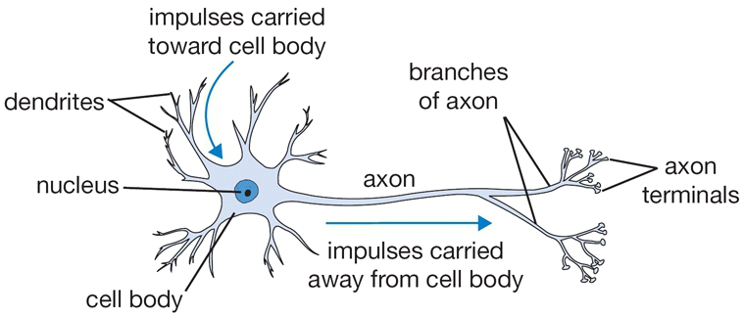
Inspiration: Neuron cells
Neurons
  accept information from multiple inputs
  transmit information to other neurons
Multiply inputs by weights along edges
Apply some function to the set of inputs at each node
If output of function over threshold, neuron “fires” (activated)
Text: HKUST, figures: Andrej Karpathy
Notes:
From Wikipedia: At the majority of synapses, signals are sent from the axon of one neuron to a dendrite of another... All neurons are electrically excitable, maintaining voltage gradients across their membranes… If the voltage changes by a large enough amount, an all-or-none electrochemical pulse called an action potential is generated, which travels rapidly along the cell's axon, and activates synaptic connections with other cells when it arrives.

Slide 9
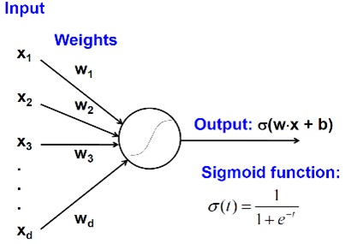
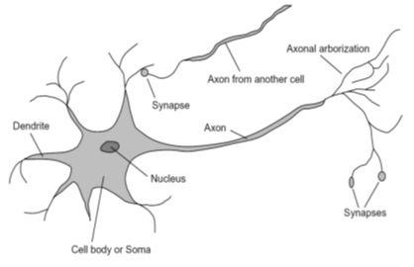
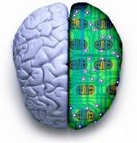
Biological analog
A biological neuron
An artificial neuron
Jia-bin Huang

Slide 10
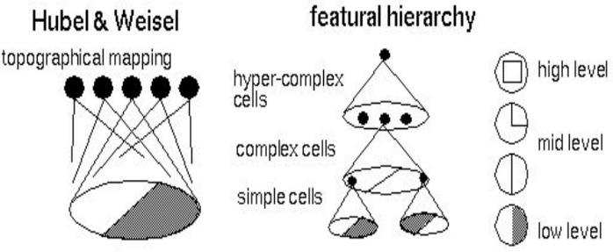
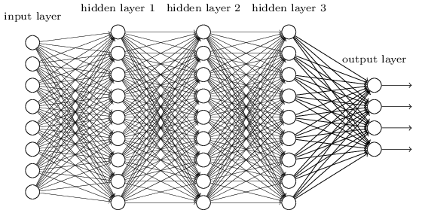
Biological analog
Hubel and Weisel’s architecture
Multi-layer neural network
Adapted from Jia-bin Huang

Slide 11
Feed-forward networks
Cascade neurons together
Output from one layer is the input to the next
Each layer has its own sets of weights
HKUST

Slide 12
Feed-forward networks
Inputs multiplied by initial set of weights
HKUST

Slide 13
Feed-forward networks
Intermediate “predictions” computed at first hidden layer
HKUST

Slide 14
Feed-forward networks
Intermediate predictions multiplied by second layer of weights
Predictions are fed forward through the network to classify
HKUST

Slide 15
Feed-forward networks
Compute second set of intermediate predictions
HKUST

Slide 16
Feed-forward networks
Multiply by final set of weights
HKUST

Slide 17
Feed-forward networks
Compute output (e.g. probability of a particular class being present in the sample)
HKUST

Slide 18
Deep neural networks
Lots of hidden layers
Depth = power (usually)
Weights to learn!
Weights to learn!
Weights to learn!
Weights to learn!
Figure from http://neuralnetworksanddeeplearning.com/chap5.html

Slide 19
Goals

Slide 20
How do we train deep networks?
No closed-form solution for the weights (can’t set up a system A*w = b, solve for w)
We will iteratively find such a set of weights that allow the outputs to match the desired outputs
We want to minimize a loss function (a function of the weights in the network)
For now, let’s simplify and assume there’s a single layer of weights in the network, and no activation function (i.e., output is a linear combination of the inputs)

Slide 21
Finding the optimal w: Example
Suppose w is just a scalar, w, that can only take values 1, 2, 3
Suppose L(w=1) = 2, L(w=2) = 5, L(w=3) = 0.5
Find the optimal w as argmin_w L(w)
What is the optimal w?
Now suppose L^(w) = L(w) + ||w||
L^(1) = 2+1 = 3
L^(2) = ?
L^(3) = ?
Now what is the optimal w?

Slide 22
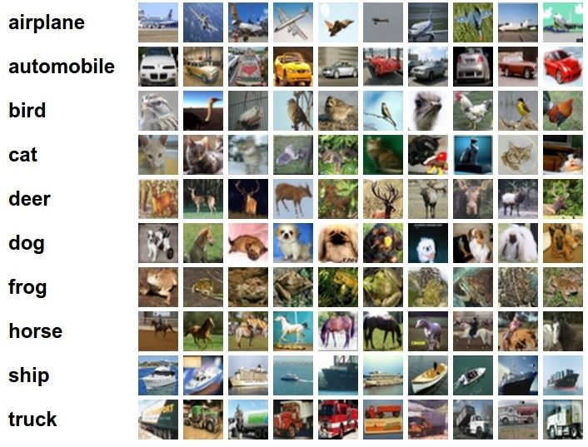
Classification goal
Example dataset: CIFAR-10 10 labels
50,000 training images each image is 32x32x3
10,000 test images.
Andrej Karpathy

Slide 23


Classification scores
image
parameters
f(x,W)
10 numbers, indicating class scores
[32x32x3]
array of numbers 0...1 (3072 numbers total)
Andrej Karpathy

Slide 24
Linear classifier
3072x1
(+b)
10x1
10x1
10x3072
10 numbers, indicating class scores
[32x32x3]
array of numbers 0...1
parameters, or “weights”
Andrej Karpathy

Slide 25
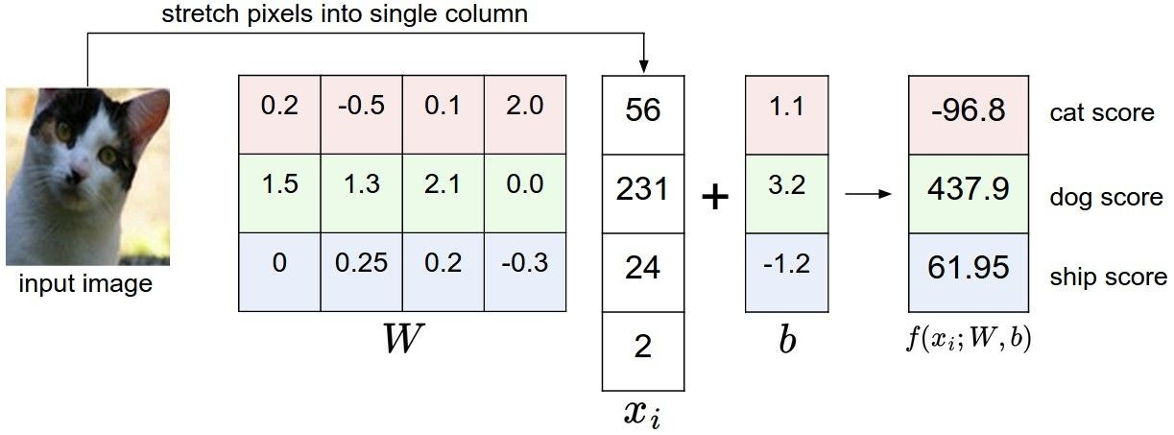
Linear classifier
Example with an image with 4 pixels, and 3 classes (cat/dog/ship)
Andrej Karpathy

Slide 26


Linear classifier
Going forward: Loss function/Optimization
TODO:
1. Define a loss function that quantifies our unhappiness with the scores across the training data.
cat car frog
3.2
5.1
-1.7
1.3
4.9
2.0
2.2
2.5
-3.1
2. Come up with a way of efficiently finding the parameters that minimize the loss function. (optimization)
Adapted from Andrej Karpathy

Slide 27
Linear classifier
Suppose: 3 training examples, 3 classes. With some W the scores
are:
cat car frog
3.2
5.1
-1.7
1.3
4.9
2.0
2.2
2.5
-3.1
Adapted from Andrej Karpathy

Slide 28









Linear classifier: Hinge loss
Suppose: 3 training examples, 3 classes. With some W the scores
Hinge loss:
Given an example
are:
where where
is the image and
is the (integer) label,
and using the shorthand for the scores vector:
cat car frog
the loss has the form:
3.2
5.1
-1.7
1.3
4.9
2.0
2.2
2.5
-3.1
Want: s_{yi} >= s_{j} + 1
i.e. s_{j} – s_{yi} + 1 <= 0
If true, loss is 0
If false, loss is magnitude of violation
Adapted from Andrej Karpathy

Slide 29
Linear classifier: Hinge loss
Suppose: 3 training examples, 3 classes. With some W the scores
Hinge loss:
Given an example
are:
where where
is the image and
is the (integer) label,
and using the shorthand for the scores vector:
the loss has the form:
cat car frog | 3.2 5.1 -1.7 | 1.3 2.2 4.9 2.5 2.0 -3.1
Losses: | 2.9
= max(0, 5.1 - 3.2 + 1)
+max(0, -1.7 - 3.2 + 1)
= max(0, 2.9) + max(0, -3.9)
= 2.9 + 0
= 2.9
Adapted from Andrej Karpathy

Slide 30
Linear classifier: Hinge loss
Suppose: 3 training examples, 3 classes. With some W the scores
Hinge loss:
Given an example
are:
where where
is the image and
is the (integer) label,
and using the shorthand for the scores vector:
the loss has the form:
cat 3.2 car 5.1 frog -1.7 | 1.3 4.9 2.0 | 2.2 2.5 -3.1
Losses: 2.9 | 0
= max(0, 1.3 - 4.9 + 1)
+max(0, 2.0 - 4.9 + 1)
= max(0, -2.6) + max(0, -1.9)
= 0 + 0
= 0
Adapted from Andrej Karpathy

Slide 31
Linear classifier: Hinge loss
Suppose: 3 training examples, 3 classes. With some W the scores
Hinge loss:
Given an example
are:
where where
is the image and
is the (integer) label,
and using the shorthand for the scores vector:
the loss has the form:
cat car frog | 3.2 5.1 -1.7 | 1.3 4.9 2.0 | 2.2 2.5 -3.1
Losses: | 2.9 | 0 | 12.9
= max(0, 2.2 - (-3.1) + 1)
+max(0, 2.5 - (-3.1) + 1)
= max(0, 5.3 + 1)
+ max(0, 5.6 + 1)
= 6.3 + 6.6
= 12.9
Adapted from Andrej Karpathy

Slide 32

Linear classifier: Hinge loss
Suppose: 3 training examples, 3 classes. With some W the scores
Hinge loss:
Given an example
are:
where where
is the image and
is the (integer) label,
and using the shorthand for the scores vector:
cat car frog
the loss has the form:
3.2
5.1
-1.7
1.3
4.9
2.0
2.2
2.5
-3.1
and the full training loss is the mean over all examples in the training data:
L = (2.9 + 0 + 12.9)/3
Losses:
2.9
0
12.9
= 15.8 / 3 = 5.3
Lecture 3 - 12
Adapted from Andrej Karpathy

Slide 33
Linear classifier: Hinge loss
E.g. Suppose that we found a W such that L = 0. Is this W unique?
No! 2W is also has L = 0!
How do we choose between W and 2W?
Slide from Fei-Fei, Johnson, Yeung

Slide 34

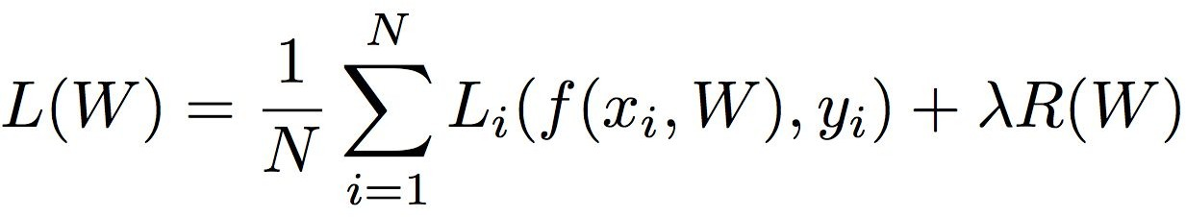
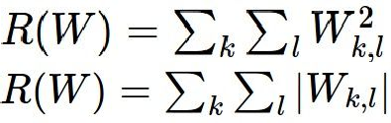

Weight Regularization
= regularization strength (hyperparameter)
Data loss: Model predictions should match training data
Regularization: Prevent the model from doing too well on training data
Simple examples L2 regularization: L1 regularization:
Elastic net (L1 + L2):
More complex:
Dropout
Batch normalization
Stochastic depth / pooling, etc
Why regularize?
Express preferences over weights
Make the model simple so it works on test data
Adapted from Fei-Fei, Johnson, Yeung

Slide 35





Weight Regularization
Expressing preferences
L2 Regularization
L2 regularization likes to “spread out” the weights
Slide from Fei-Fei, Johnson, Yeung

Slide 36
Weight Regularization
Preferring simple models
f₁
f₂
y
x
Regularization pushes against fitting the data
too well so we don’t fit noise in the data

Slide 37



Another loss: Cross-entropy
scores = unnormalized log probabilities of the classes
cat car frog
3.2
5.1
-1.7
Want to maximize the log likelihood, or (for a loss function) to minimize the negative log likelihood of the correct class:
Adapted from Andrej Karpathy

Slide 38

Another loss: Cross-entropy
Probabilities must be >= 0
Probabilities must sum to 1
cat car frog
3.2 5.1 -1.7 | exp
0.13
0.87
0.00
24.5
164.0
0.18
L_i = -log(0.13)
= 0.89
normalize
unnormalized log probabilities
probabilities
unnormalized probabilities
Aside:
- This is multinomial logistic regression
- Choose weights to maximize the likelihood of the observed x/y data (Maximum Likelihood Estimation)
Adapted from Fei-Fei, Johnson, Yeung

Slide 39

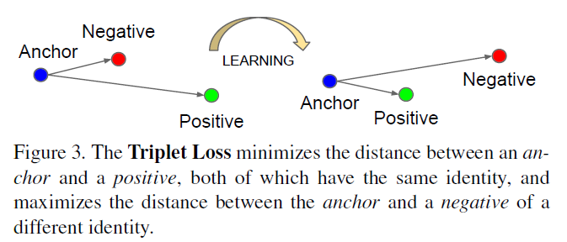
Other losses
Triplet loss (Schroff, FaceNet, CVPR 2015)
Anything you want! (almost)
a denotes anchor
p denotes positive
n denotes negative

Slide 40
Training

Slide 41


To minimize loss, use gradient descent
Andrej Karpathy

Slide 42

How to minimize the loss function?
In 1-dimension, the derivative of a function:
In multiple dimensions, the gradient is the vector of (partial derivatives).
Andrej Karpathy

Slide 43

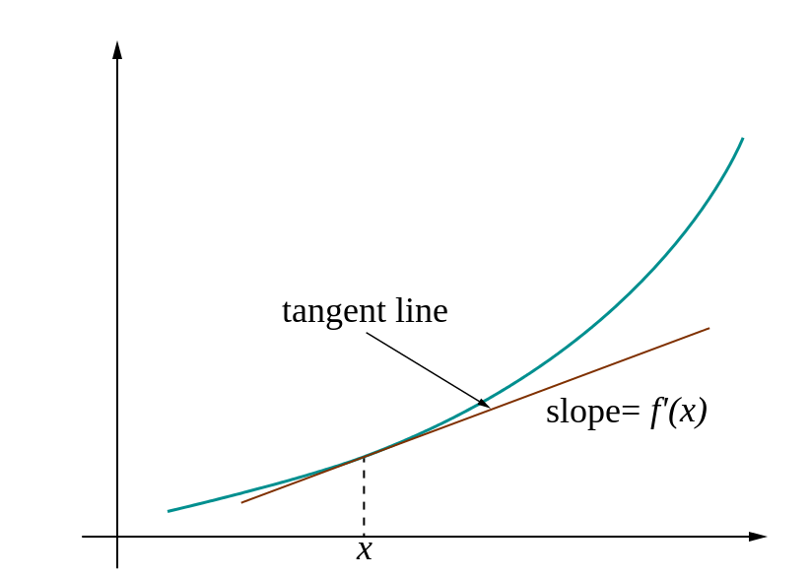
Loss gradients
Denoted as (diff notations):
i.e. how does the loss change as a function of the weights
We want to change the weights in such a way that makes the loss decrease as fast as possible

Slide 44
current W:
gradient dW:
[0.34,
-1.11,
0.78,
0.12,
0.55,
2.81,
-3.1,
-1.5,
0.33,…]
loss 1.25347
[?,
?,
?,
?,
?,
?,
?,
?,
?,…]
Andrej Karpathy

Slide 45
current W:
W + h (first dim):
gradient dW:
[0.34,
-1.11,
0.78,
0.12,
0.55,
2.81,
-3.1,
-1.5,
0.33,…]
loss 1.25347
[0.34 + 0.0001,
-1.11,
0.78,
0.12,
0.55,
2.81,
-3.1,
-1.5,
0.33,…]
loss 1.25322
[?,
?,
?,
?,
?,
?,
?,
?,
?,…]
Andrej Karpathy

Slide 46
current W:
W + h (first dim):
gradient dW:
[0.34,
-1.11,
0.78,
0.12,
0.55,
2.81,
-3.1,
-1.5,
0.33,…]
loss 1.25347
[0.34 + 0.0001,
-1.11,
0.78,
0.12,
0.55,
2.81,
-3.1,
-1.5,
0.33,…]
loss 1.25322
[-2.5,
?,
?,
?,
?,
?,
?,
(1.25322 - 1.25347)/0.0001
= -2.5
?,
?,…]
Andrej Karpathy

Slide 47
current W:
W + h (second dim):
gradient dW:
[0.34,
-1.11,
0.78,
0.12,
0.55,
2.81,
-3.1,
-1.5,
0.33,…]
loss 1.25347
[0.34,
-1.11 + 0.0001,
0.78,
0.12,
0.55,
2.81,
-3.1,
-1.5,
0.33,…]
loss 1.25353
[-2.5,
?,
?,
?,
?,
?,
?,
?,
?,…]
Andrej Karpathy

Slide 48
current W:
W + h (second dim):
gradient dW:
[0.34,
-1.11,
0.78,
0.12,
0.55,
2.81,
-3.1,
-1.5,
0.33,…]
loss 1.25347
[0.34,
-1.11 + 0.0001,
0.78,
0.12,
0.55,
2.81,
-3.1,
-1.5,
0.33,…]
loss 1.25353
[-2.5,
0.6,
?,
?,
?,
?,
?,
?,
(1.25353 - 1.25347)/0.0001
= 0.6
?,…]
Andrej Karpathy

Slide 49
current W:
W + h (third dim):
gradient dW:
[0.34,
-1.11,
0.78,
0.12,
0.55,
2.81,
-3.1,
-1.5,
0.33,…]
loss 1.25347
[0.34,
-1.11,
0.78 + 0.0001,
0.12,
0.55,
2.81,
-3.1,
-1.5,
0.33,…]
loss 1.25347
[-2.5,
0.6,
?,
?,
?,
?,
?,
?,
?,…]
Andrej Karpathy

Slide 50



This is silly. The loss is just a function of W:
want
Calculus
= ...
Andrej Karpathy

Slide 51
current W:
gradient dW:
[0.34,
-1.11,
0.78,
0.12,
0.55,
2.81,
-3.1,
-1.5,
0.33,…]
loss 1.25347
[-2.5,
0.6,
0,
0.2,
0.7,
-0.5,
1.1,
1.3,
-2.1,…]
dW = ...
(some function data and W)
Andrej Karpathy

Slide 52
Gradient descent
We’ll update weights
Move in direction opposite to gradient:
L
Time
Learning rate
Figure from Andrej Karpathy

Slide 53
Gradient descent
Iteratively subtract the gradient with respect to the model parameters (w)
I.e., we’re moving in a direction opposite to the gradient of the loss
I.e., we’re moving towards smaller loss

Slide 54
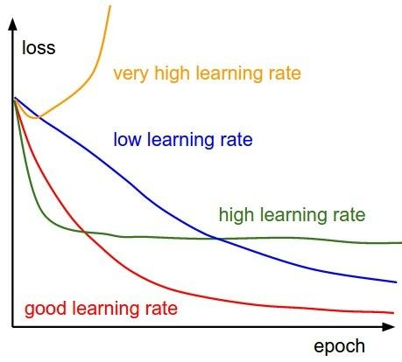
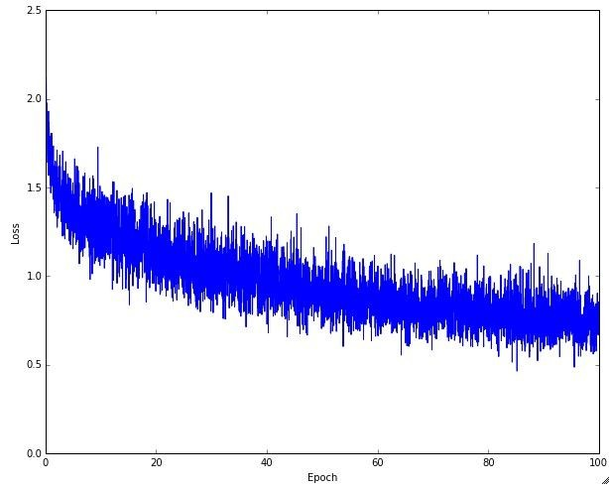
Learning rate selection
The effects of step size (or “learning rate”)
Andrej Karpathy

Slide 55
Comments on training algorithm
Not guaranteed to converge to zero training error, may converge to local optima or oscillate indefinitely.
However, in practice, does converge to low error for many large networks on real data.
Local minima – not a huge problem in practice for deep networks.
Thousands of epochs (epoch = network sees all training data once) may be required, hours or days to train.
May be hard to set learning rate and to select number of hidden units and layers.
When in doubt, use validation set to decide on design/hyperparameters.
Neural networks had fallen out of fashion in 90s, early 2000s; now significantly improved performance (deep networks trained with dropout and lots of data).
Adapted from Ray Mooney, Carlos Guestrin, Dhruv Batra

Slide 56
Gradient descent in multi-layer nets
We’ll update weights
Move in direction opposite to gradient:
How to update the weights at all layers?
Answer: backpropagation of error from higher layers to lower layers

Slide 57
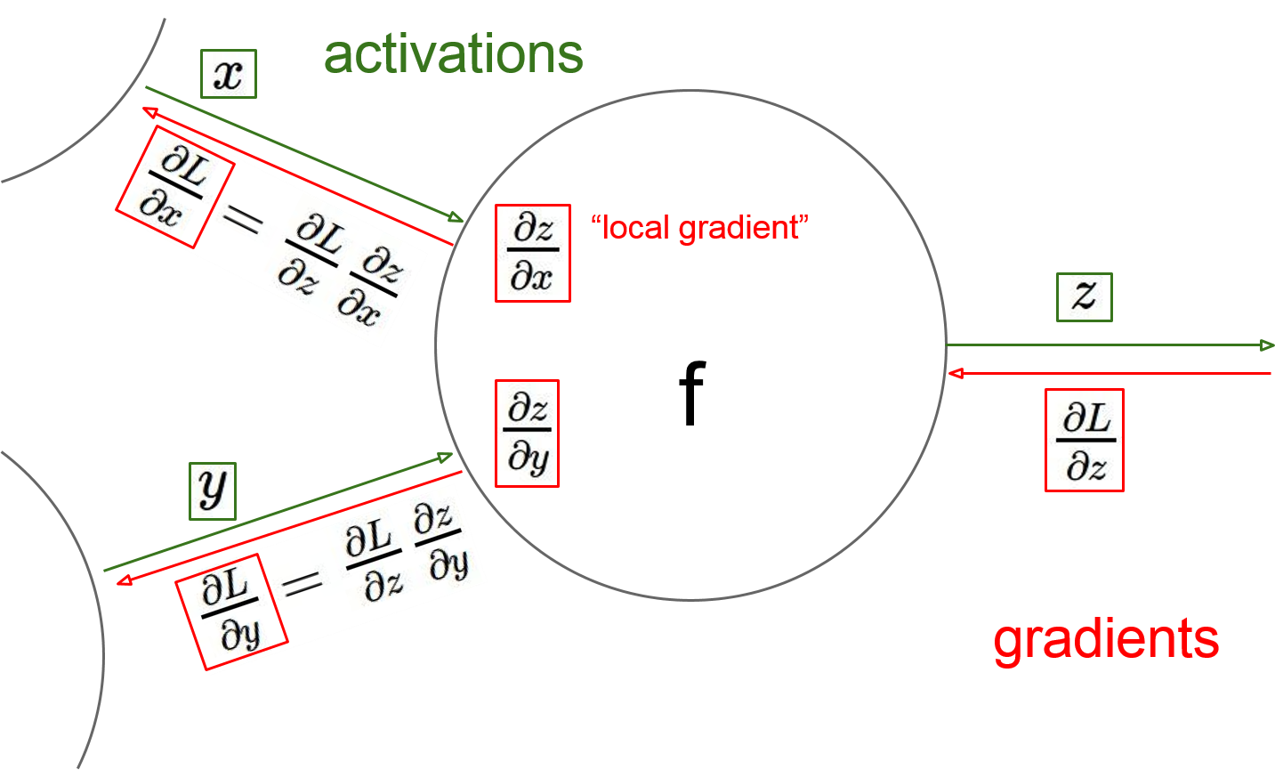
Gradient descent in multi-layer nets
How to update the weights at all layers?
Answer: backpropagation of error from higher layers to lower layers
Figure from Andrej Karpathy

Slide 58
Backpropagation: Graphic example
First calculate error of output units and use this to change the top layer of weights.
output
k
j
i
Update weights into j
(store diff, update @end)
w⁽²⁾
hidden
w⁽¹⁾
input
Adapted from Ray Mooney, equations from Chris Bishop

Slide 59
Backpropagation: Graphic example
Next calculate error for hidden units based on errors on the output units it feeds into.
output
k
j
i
hidden
input
Adapted from Ray Mooney, equations from Chris Bishop

Slide 60
Backpropagation: Graphic example
Finally update bottom layer of weights based on errors calculated for hidden units.
output
k
j
i
Update weights into i
hidden
input
Adapted from Ray Mooney, equations from Chris Bishop

Slide 61
Computing gradient for each weight
We need to move weights in direction opposite to gradient of loss wrt that weight:
w_{kj} = w_{kj} – η dL/dw_{kj} (output layer)
w_{ji} = w_{ji} – η dL/dw_{ji} (hidden layer)
Loss depends on weights in an indirect way, so we’ll use the chain rule and compute:
dL/dw_{kj} = dL/dy_{k} dy_{k}/da_{k} da_{k}/dw_{kj}
dL/dw_{ji} = dL/dz_{j} dz_{j}/da_{j} da_{j}/dw_{ji}

Slide 62
Gradient for output layer weights
Loss depends on weights in an indirect way, so we’ll use the chain rule and compute:
dL/dw_{kj} = dL/dy_{k} dy_{k}/da_{k} da_{k}/dw_{kj}
How to compute each of these?
dL/dy_{k} : need to know form of error function
  Example: if L = (y_{k} – y_{k}’)², where y_{k}’ is the ground-truth label, then dL/dy_{k} = 2(y_{k} – y_{k}’)
dy_{k}/da_{k} : need to know output layer activation
  If h(a_{k})=σ(a_{k}), then d h(a_{k})/d a_{k} = σ(a_{k})(1-σ(a_{k}))
da_{k}/dw_{kj} :
  z_{j} since a_{k} is a linear combination
  a_{k} = w_{k:}^{T} z = Σ_{j} w_{kj} z_{j}

Slide 63
Gradient for hidden layer weights
We’ll use the chain rule again and compute:
dL/dw_{ji} = dL/dz_{j} dz_{j}/da_{j} da_{j}/dw_{ji}
Unlike the previous case (weights for output layer), the error (dL/dz_{j}) is hard to compute (indirect, need chain rule again)

Slide 64
Another way of keeping track of error
Computation graphs
Accumulate upstream/downstream gradients at each node
One set flows from inputs to outputs and can be computed without evaluating loss
The other flows from outputs (loss) to inputs

Slide 65


activations
Generic example
f
Fei-Fei Li & Andrej Karpathy & Justin Johnson Lecture 4 - 13 Jan 2016
Lecture 4 - 22
Andrej Karpathy

Slide 66


activations
Generic example
“local gradient”
f
gradients
Fei-Fei Li & Andrej Karpathy & Justin Johnson Lecture 4 - 13 Jan 2016
Lecture 4 - 23
Andrej Karpathy

Slide 67

activations
Generic example
“local gradient”
f
gradients
Fei-Fei Li & Andrej Karpathy & Justin Johnson Lecture 4 - 13 Jan 2016
Lecture 4 - 24
Andrej Karpathy

Slide 68
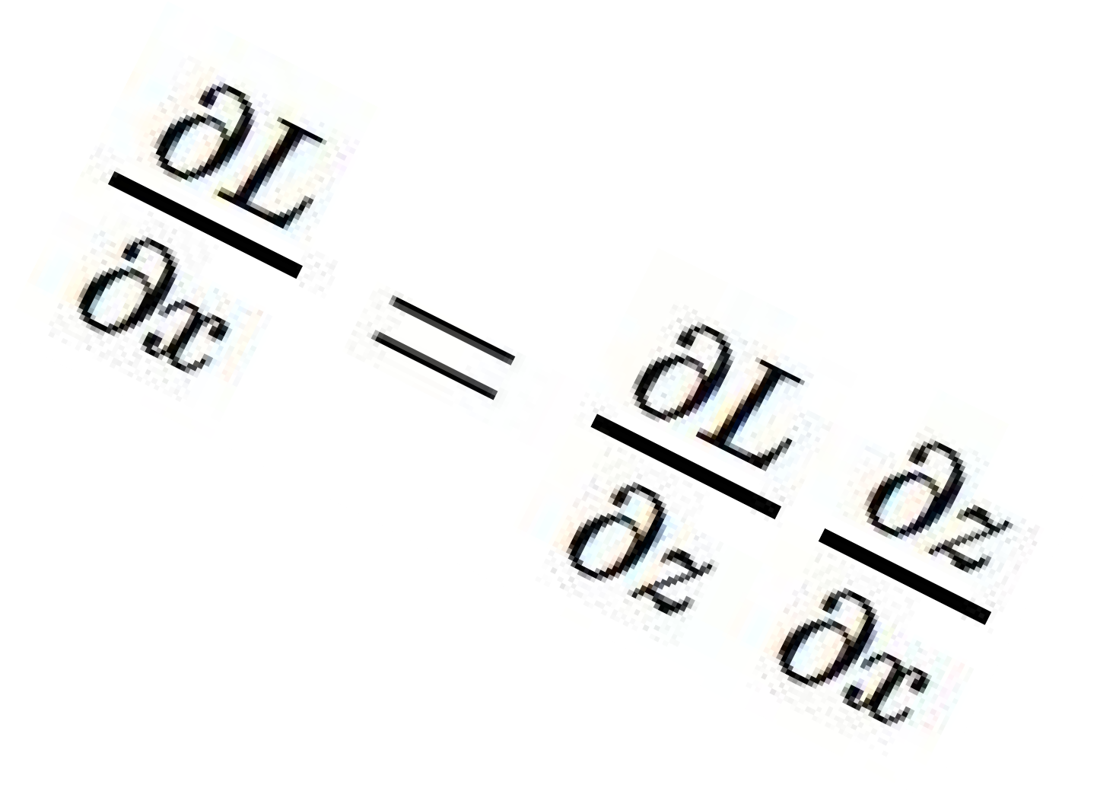
activations
Generic example
“local gradient”
f
gradients
Fei-Fei Li & Andrej Karpathy & Justin Johnson Lecture 4 - 13 Jan 2016
Lecture 4 - 25
Andrej Karpathy

Slide 69
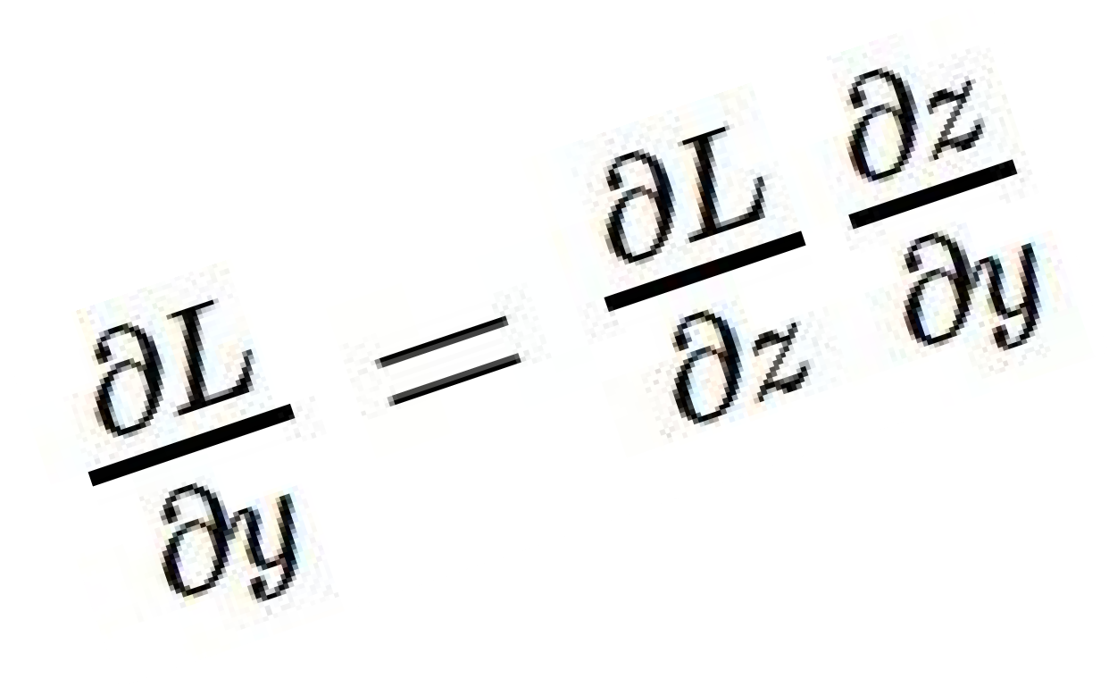
activations
Generic example
“local gradient”
f
gradients
Fei-Fei Li & Andrej Karpathy & Justin Johnson Lecture 4 - 13 Jan 2016
Lecture 4 - 26
Andrej Karpathy

Slide 70
activations
Generic example
“local gradient”
f
gradients
Fei-Fei Li & Andrej Karpathy & Justin Johnson Lecture 4 - 13 Jan 2016
Lecture 4 - 27
Andrej Karpathy

Slide 71
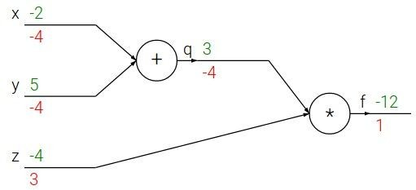

e.g. x = -2, y = 5, z = -4
Another generic example
Fei-Fei Li & Andrej Karpathy & Justin Johnson Lecture 4 - 13 Jan 2016
Lecture 4 - 10
Andrej Karpathy
Notes:
https://www.youtube.com/watch?v=QWfmCyLEQ8U&list=PL16j5WbGpaM0_Tj8CRmurZ8Kk1gEBc7fg&index=4

Slide 72





e.g. x = -2, y = 5, z = -4
Another generic example
Want:
Fei-Fei Li & Andrej Karpathy & Justin Johnson Lecture 4 - 13 Jan 2016
Lecture 4 - 11
Andrej Karpathy

Slide 73

e.g. x = -2, y = 5, z = -4
Another generic example
Want:
Fei-Fei Li & Andrej Karpathy & Justin Johnson Lecture 4 - 13 Jan 2016
Lecture 4 - 12
Andrej Karpathy

Slide 74
e.g. x = -2, y = 5, z = -4
Another generic example
Want:
Fei-Fei Li & Andrej Karpathy & Justin Johnson Lecture 4 - 13 Jan 2016
Lecture 4 - 13
Andrej Karpathy

Slide 75

e.g. x = -2, y = 5, z = -4
Another generic example
Want:
Fei-Fei Li & Andrej Karpathy & Justin Johnson Lecture 4 - 13 Jan 2016
Lecture 4 - 14
Andrej Karpathy

Slide 76
e.g. x = -2, y = 5, z = -4
Another generic example
Want:
Fei-Fei Li & Andrej Karpathy & Justin Johnson Lecture 4 - 13 Jan 2016
Lecture 4 - 15
Andrej Karpathy

Slide 77

e.g. x = -2, y = 5, z = -4
Another generic example
Want:
Fei-Fei Li & Andrej Karpathy & Justin Johnson Lecture 4 - 13 Jan 2016
Lecture 4 - 16
Andrej Karpathy

Slide 78
e.g. x = -2, y = 5, z = -4
Another generic example
Want:
Fei-Fei Li & Andrej Karpathy & Justin Johnson Lecture 4 - 13 Jan 2016
Lecture 4 - 17
Andrej Karpathy

Slide 79

e.g. x = -2, y = 5, z = -4
Another generic example
Want:
Fei-Fei Li & Andrej Karpathy & Justin Johnson Lecture 4 - 13 Jan 2016
Lecture 4 - 18
Andrej Karpathy

Slide 80


e.g. x = -2, y = 5, z = -4
Another generic example
Chain rule:
Want:
Fei-Fei Li & Andrej Karpathy & Justin Johnson Lecture 4 - 13 Jan 2016
Lecture 4 - 19
Andrej Karpathy

Slide 81

e.g. x = -2, y = 5, z = -4
Another generic example
Want:
Fei-Fei Li & Andrej Karpathy & Justin Johnson Lecture 4 - 13 Jan 2016
Lecture 4 - 20
Andrej Karpathy

Slide 82
e.g. x = -2, y = 5, z = -4
Another generic example
Chain rule:
Want:
Fei-Fei Li & Andrej Karpathy & Justin Johnson Lecture 4 - 13 Jan 2016
Lecture 4 - 21
Andrej Karpathy

Slide 83
Summary
Feed-forward network architecture
Training deep neural nets
  We need an objective function that measures and guides us towards good performance
  We need a way to minimize the loss function: gradient descent
  We need backpropagation to propagate error towards all layers and change weights at those layers
Next: Practices for preventing overfitting, training with little data, examining conditions for success, alternative optimization strategies

